Slide 1
Celebrating 10 years of…
WGCapD
WGCapD-10 Regional Exchange: AMERICAS
Session moderator:
Albert DeGarmo, National Oceanic and Atmospheric Administration

Slide 2
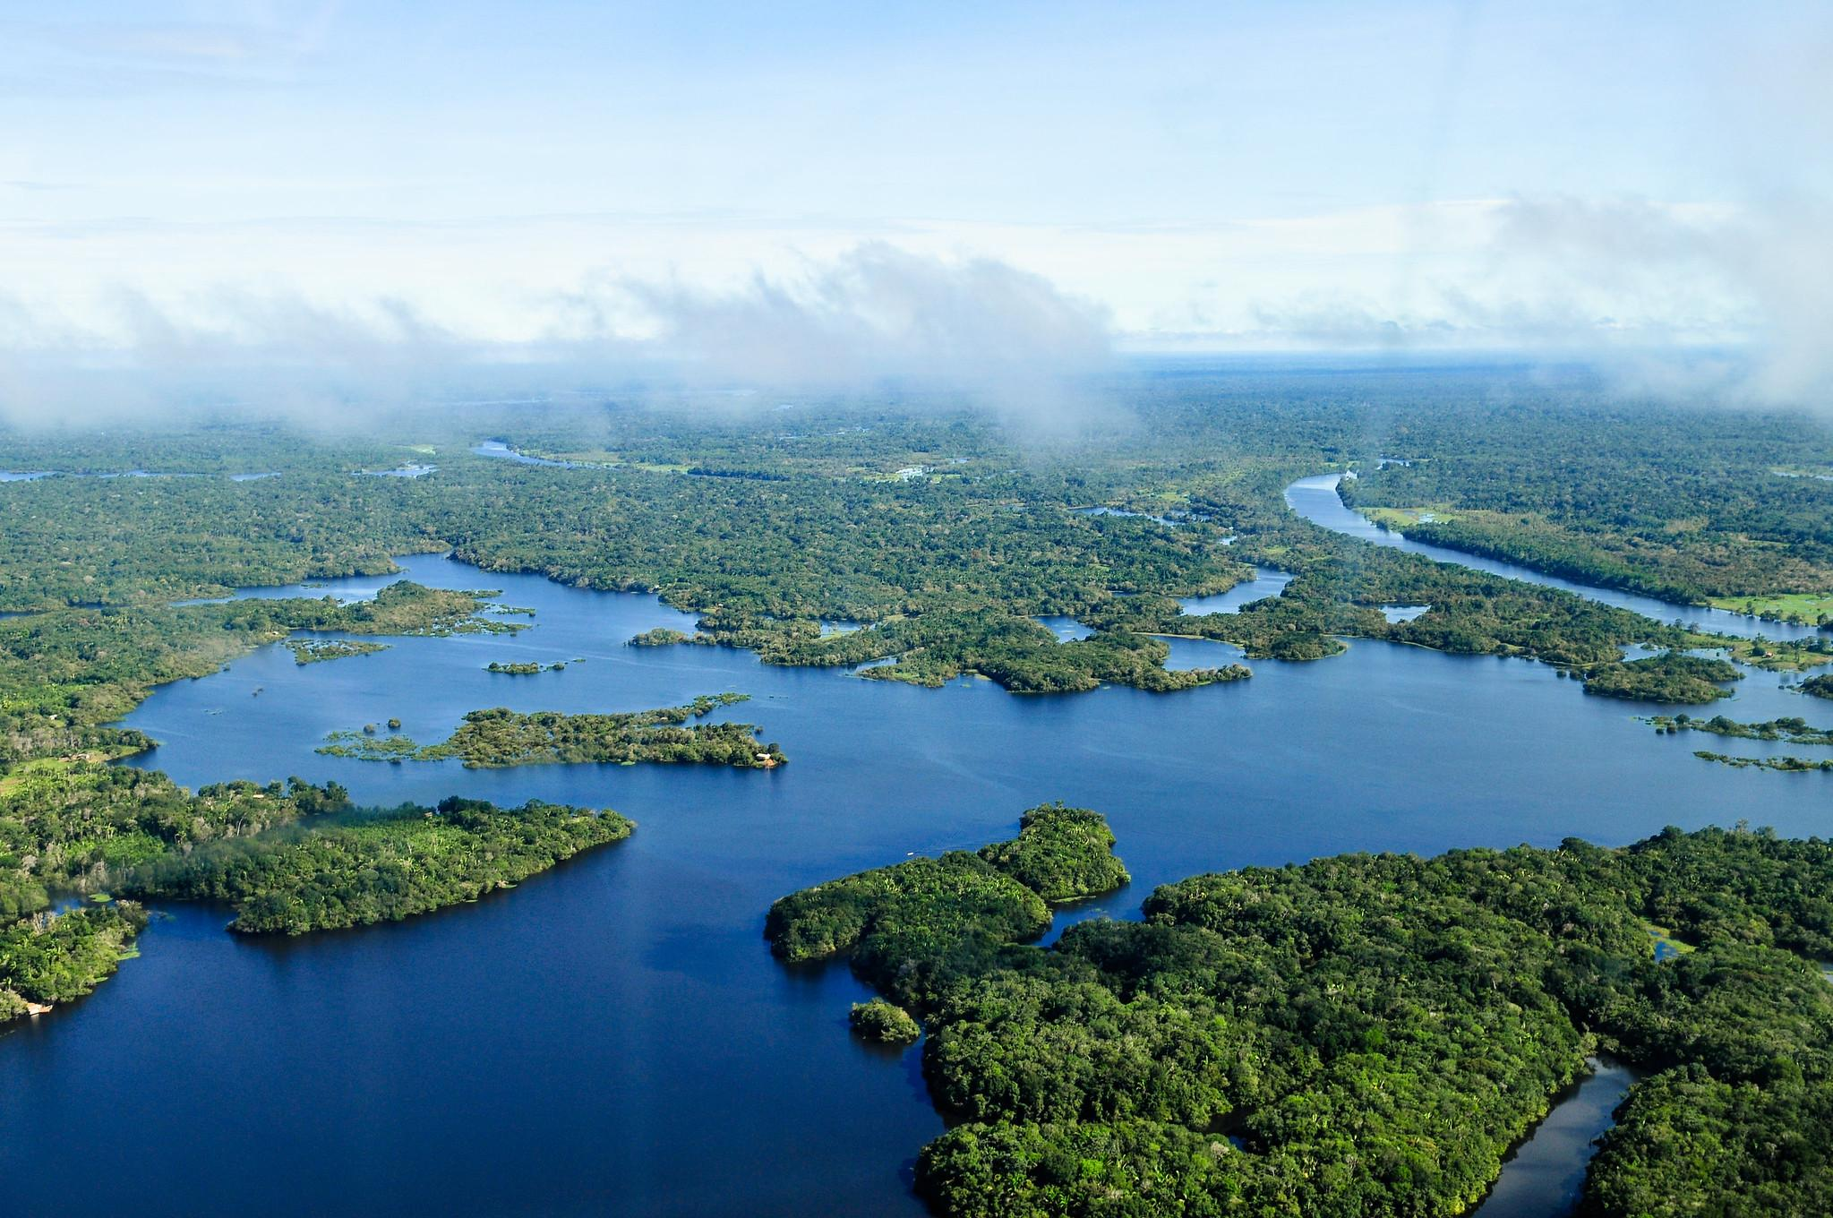
Goals for this session
Share information on WGCapD and its priorities
Explore experience in the region on capacity building efforts related to flood resilience
Identify practical next steps for WGCapD regarding flood resilience

Slide 3
Celebrating 10 years of…
WGCapD
WGCapD background
Regional Exchange: AMERICAS
Presenter: Nancy Searby, WGCapD Secretariat

Slide 4
First off, what is CEOS?
CEOS ensures international coordination of civil space-based Earth observation programs and promotes exchange of data to optimize societal benefit and inform decision making for securing a prosperous and sustainable future for humankind.
Established in 1984
61 agencies operating 172 satellites
Coordinates and harmonizes EO to make it easier for the user community to access and use data
Focused on validated requirements levied by external organizations
Works closely with other satellite coordinating bodies (e.g. the Coordination Group for Meteorological Satellites, CGMS)

Slide 5
What is the CEOS Working Group on Capacity Building and Data Democracy?
Pursues a variety of activities based on the pillars of the Data Democracy Initiative Mission and aims to unify CEOS efforts toward:
  Enhancing access to Earth observation data
  Increasing the sharing of software tools
  Expanding data dissemination capabilities and transferring relevant technologies to end users
  Providing intensive capacity building, education, and training for enabling end users
Website & Resources: https://ceos.org/ourwork/workinggroups/wgcapd/
Mission
Increase the capacity of
institutions in less
developed countries for
effective use of Earth
observation data for the
benefit of society and to
achieve sustainable
development.
WGCapD Chair
Dr. Nancy Searby (NASA)
nancy.d.searby@nasa.gov
WGCapD Vice Chair
Dr. Pham Thy (VNSC)
ptmthy@vnsc.org.vn

Slide 6

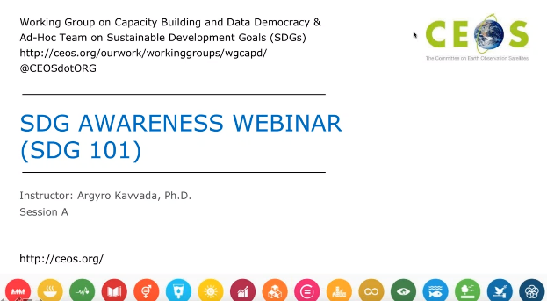
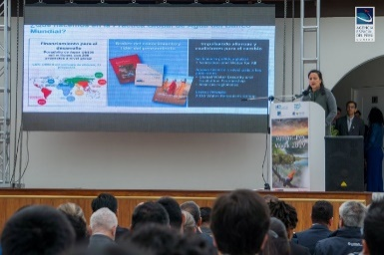
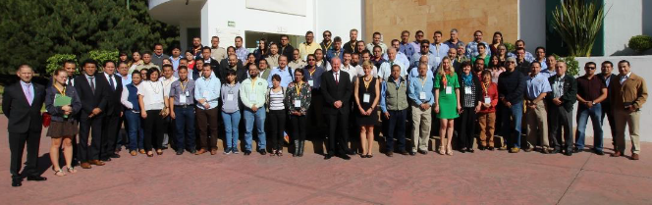
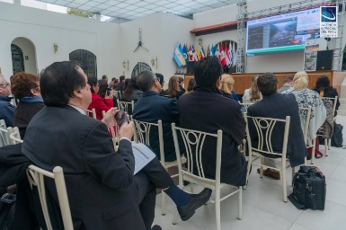
WGCapD Activities
Virtual Trainings
Organize free E-Learning courses and webinars for participants around the globe
Webinars:
MOOCs:
In-Person Workshops
Organize free training workshops for participants around the globe
EO Training Workshops: ex. SAR Trainings
Thematic Training Workshops: ex. Forest Monitoring, Land Cover Land Use Change, Flooding
Regional Workshops: ex. GEO – AmeriGEO & AfriGEO, Southeast Asia
  Awareness Webinars
  Webinar Series
  Echoes in Space: Introduction to Radar Remote Sensing
Training Calendar
https://training.ceos.org/
Good Practices & Toolkits
Share best practice documentation & building a CEOS Webinar Toolkit with tips and templates

Slide 7
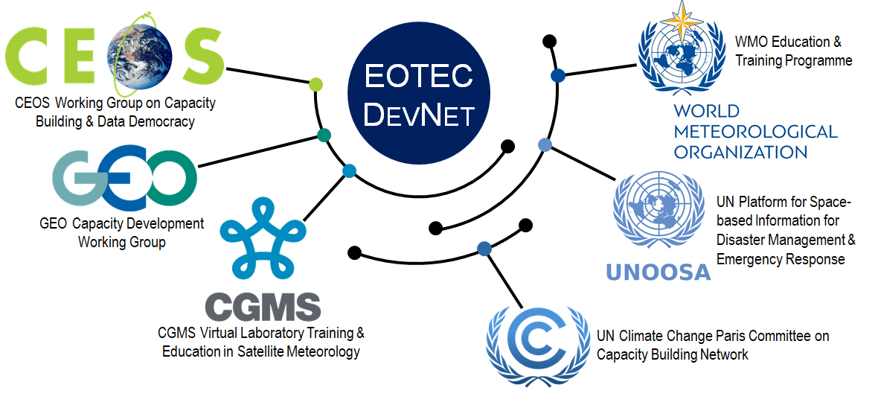

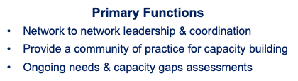
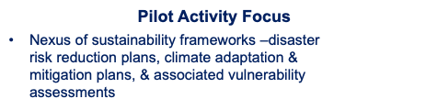
Key priority: Earth Observation Training, Education, and Capacity Development Network

Slide 8
How this meeting fits into WGCapD-10
10th annual meeting: Building a vision for the next decade
Global perspective
  Big picture from keynote
  Diverse perspectives from those not involved in CEOS
  CEOS member panel on floods as a use case to understand the landscape
Regional perspective
Reflection and next steps > work plans and vision for the upcoming decade

Slide 9
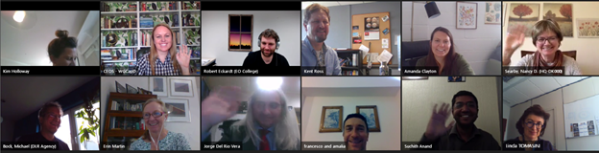
The conversation will continue...
Follow-up meeting planned for June

Slide 10
Today’s discussion: aims of WGCapD-10 focus on floods
Gathering information on ongoing flood-specific capacity building efforts, including frameworks, leading models/tools/approaches
Identifying gaps and opportunities that WGCapD might help address
Strategizing on improved cooperation and coordination across groups providing capacity building
Brainstorming next steps for WGCapD

Slide 11
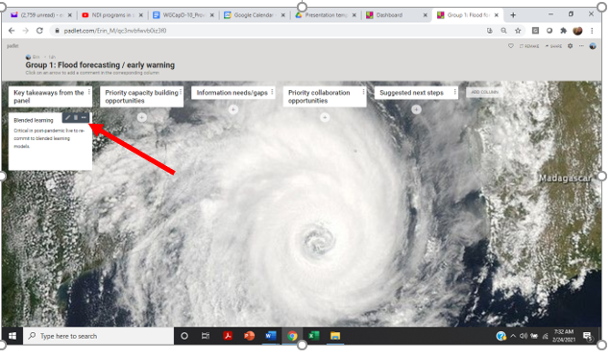
Using Padlet
Find the padlet link in the agenda or in the chat.
If you want your name to appear with comments, please sign in.
The page is divided into columns. Each column represents a discussion topic.
To add a comment, click on the arrow at the bottom of corresponding column.
Add a comment to any column at any time – you do not have to wait for the discussion.
You can add a title and a comment. Click anywhere else on the screen to post the comment.
If you like someone else’s comment, hit the
After posting a comment, click on the dots on the top right corner to edit, delete and change the color of the note.

Slide 12
Today’s discussion: key questions
In your current activities, what flood regimes (physical and temporal) do you focus on, and why?
What major gaps or needs do you see?
What models, tools, processes and datasets are you using?
What collaboration opportunities do you see?
What success stories, lessons and/or best practices have emerged from your work?

