Slide 1
WGCapD-6 Annual Meeting
DLR Oberpfaffenhofen
March 27-29, 2017
Status: 30th January, 2017

Slide 2
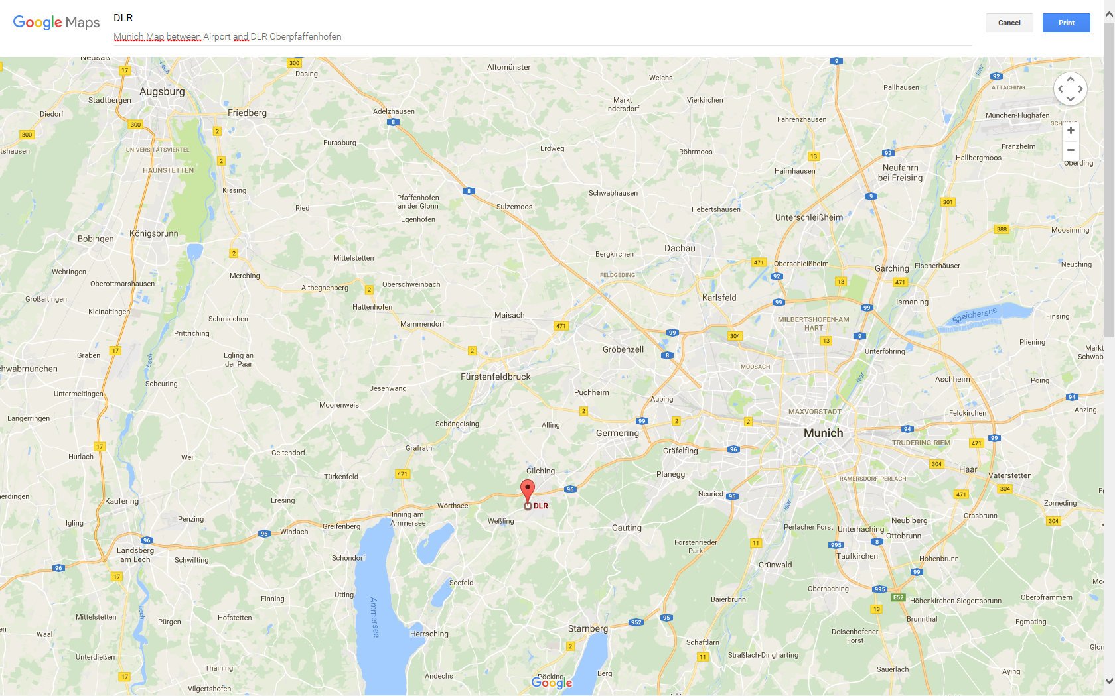
AIRPORT MUC
Hofbräuhaus
DLR
Deutsches Museum
Hotel Seehof
Dinner

Slide 3
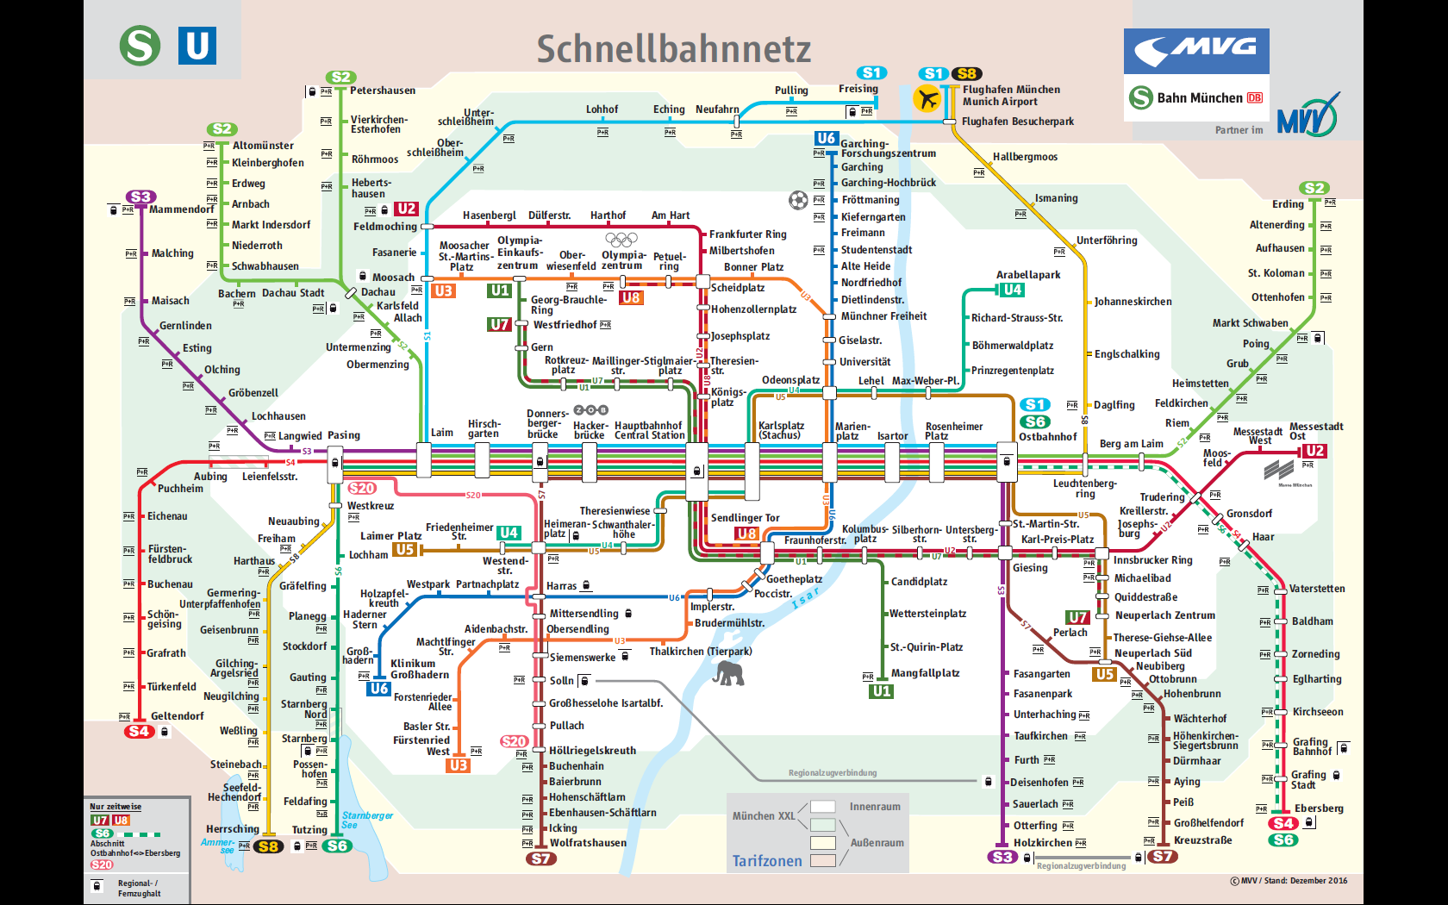

Slide 4
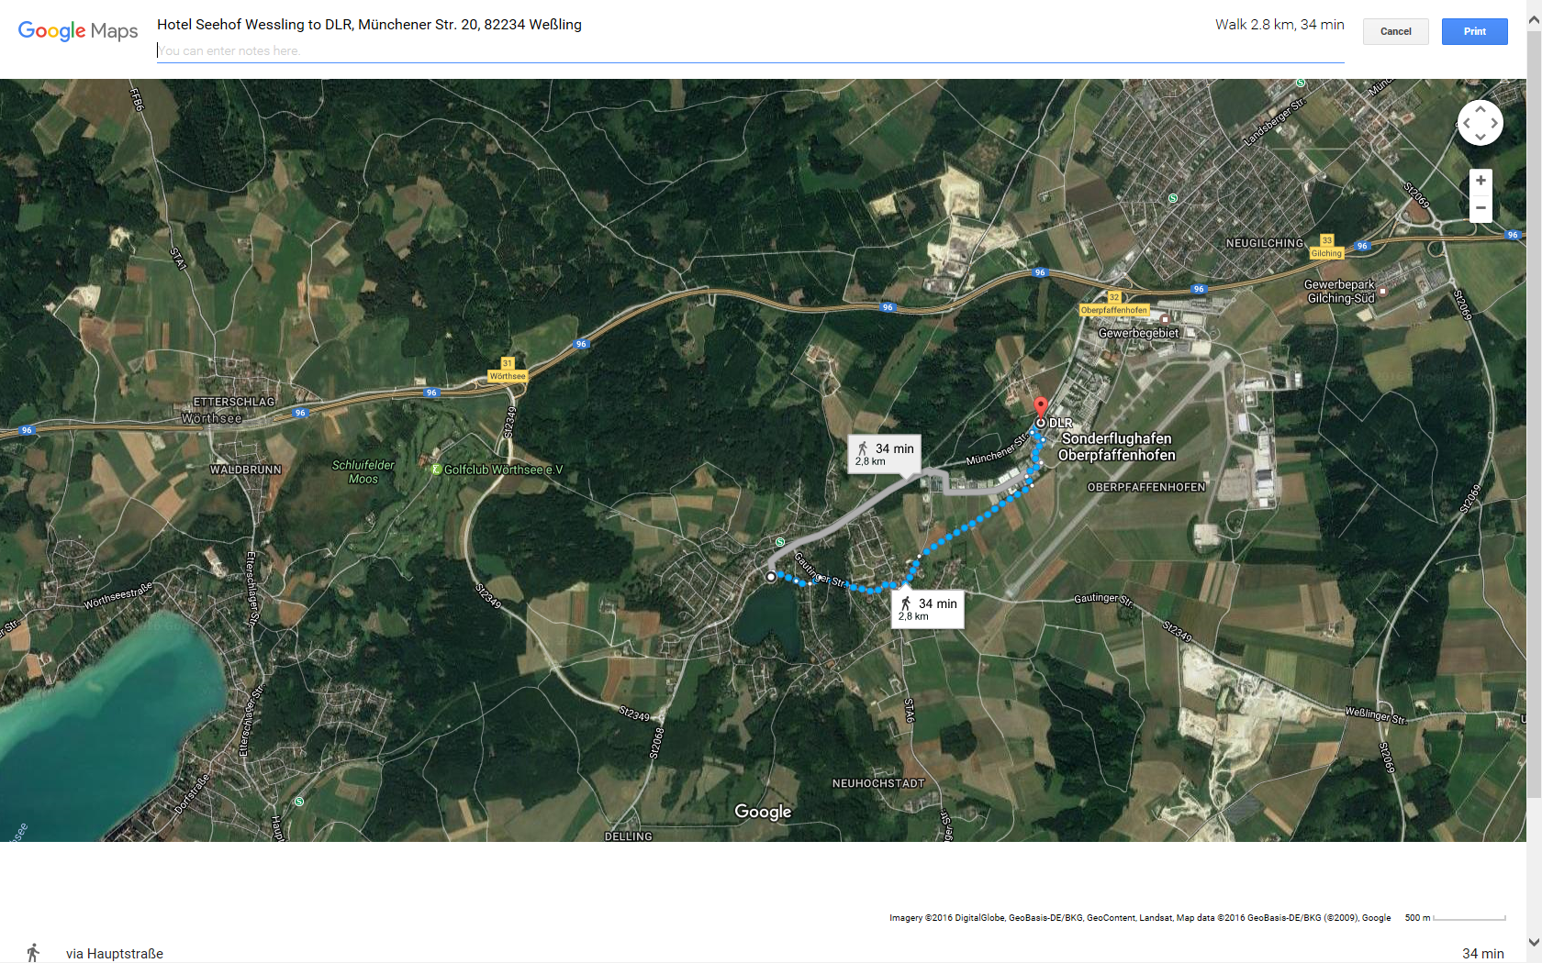

Slide 5
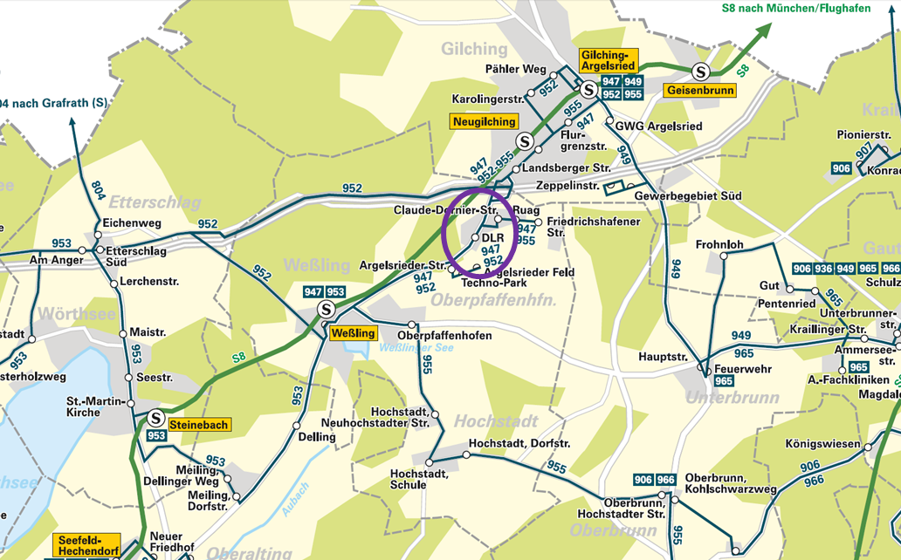
DLR Oberpfaffenhofen - Local Bus System

Slide 6
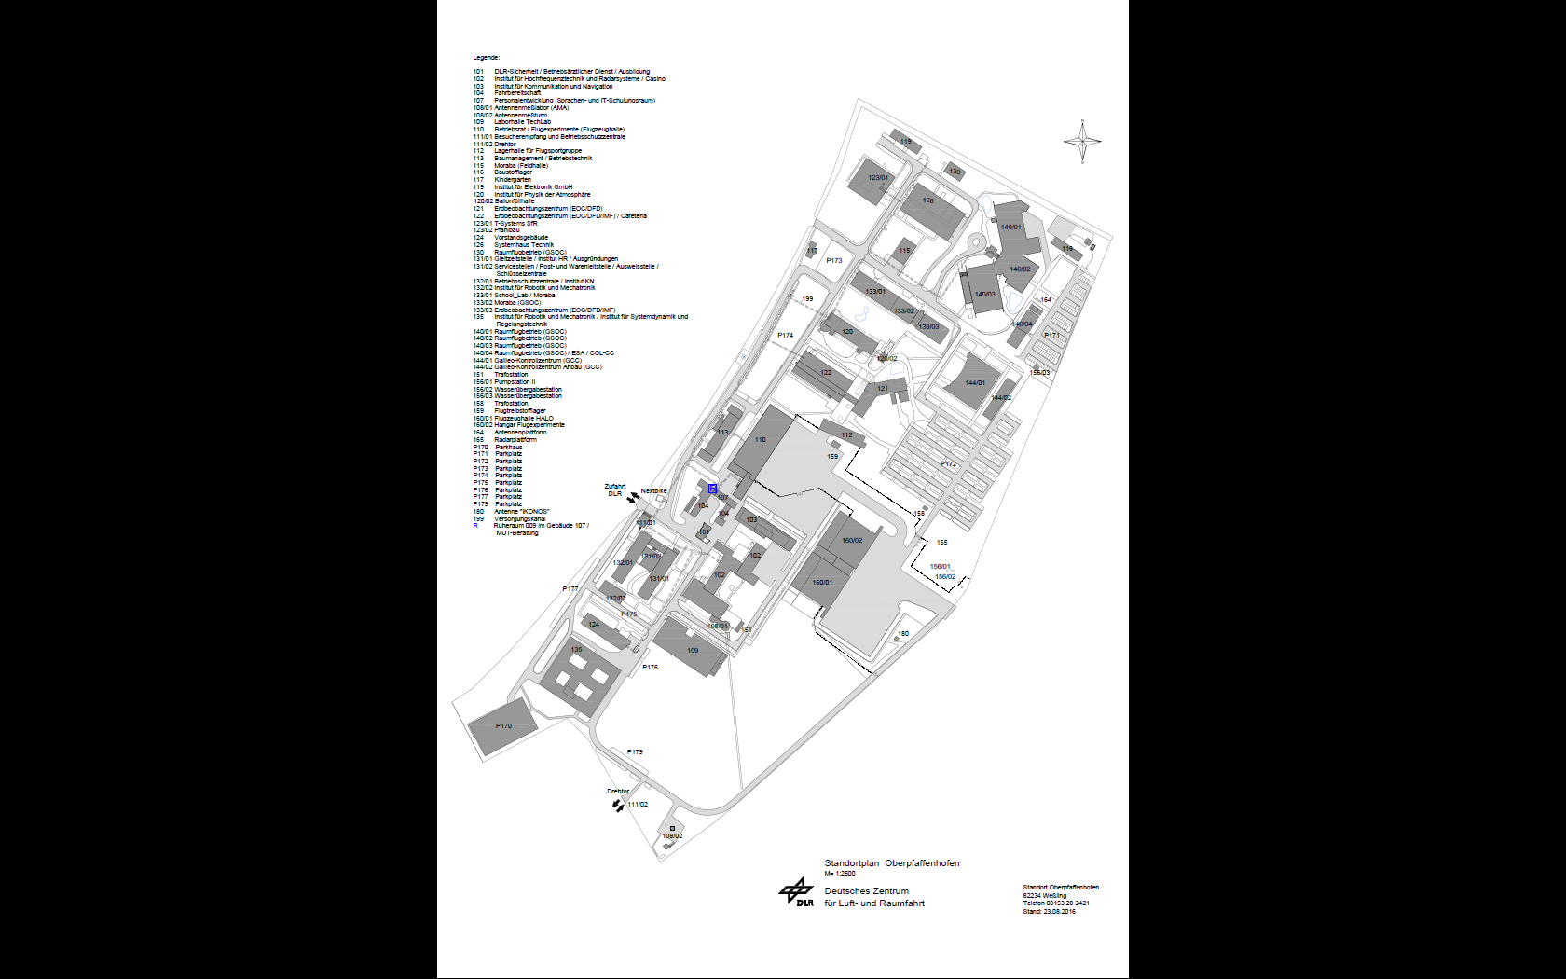
VENUE

Slide 7
WGCapD-6 Important Links
Munich: http://www.muenchen.de/int/en.html
Public Transport: http://www.mvv-muenchen.de/en/journey-planner/mobile-services/mvv-app/index.html
Bus Stop: „DLR Oberpfaffenhofen“
DLR Oberpfaffenhofen: http://www.dlr.de/dlr/en/ and
http://www.dlr.de/dlr/en/desktopdefault.aspx/tabid-10261
Hotel Seehof Wessling: http://www.hotelseehof.com/
Restaurant Seehof Herrsching (Invited Dinner on Monday): http://www.seehof-ammersee.de/en/restaurant.html
Hofbräuhaus München (Dinner on Tuesday): http://www.hofbraeuhaus.de/en/index_en.html
Deutsches Museum: http://www.deutsches-museum.de/en/information/

Slide 8
Hotel Seehof Wessling
Reservation Period: March 26 – 30, 2017
Reservation Deadline February 15, 2017
Room Rate Includes Breakfast
15 Standard Single Room: 90 Euro per night
5 King Size Rooms: 100 Euro per night
S-Bahn Train Station („WESSLING“, Line S8, Direction Herrsching) in Waking Distance
Distance to DLR 2 km, Shuttle Bus planned
Many Accommodation Alternatives in Munich

Slide 9
WGCapD-6 Meeting Schedule
Mon, March 27: Opening Session
Status of Main Projects
…
Tue, March 28: DLR Oberpfaffenhofen
Other Agency Presentations
CEOS – GEO – Other Organizations
…
Wed, March 29: WGCapD Work Plan & Strategy
Final Discussions/Decisions/Summary
Visit to Deutsches Museum

Slide 10
DLR Oberpfaffenhofen POCs
Dieter Hausamann
mobile: +49-171-8597800
e-mail: dieter.hausamann@dlr.de
Stefani Krznaric
phone: +49-8153-281071
fax: +49-8153-281070
mobile: +49-151-12751967
e-mail: stefani.krznaric@dlr.de

