Slide 1
Capacity Building for WGCV
Committee on Earth Observation Satellites
Senthil Kumar (ISRO)
Agenda Item #22B
CEOS 6th Working Group for Capacity Building and Data Democracy (WGCapD)-6 Annual Meeting
DLR Oberpfaffenhofen, Germany
27th-29th March, 2017

Slide 2
Rationale for Capacity Building for WGCV
Cal-Val efforts are highly challenging and expensive and call for high skills
Many more developing countries joining CEOS need to develop trained scientists / engineers to understand Cal-Val concepts
Better utilization of CEOS data assets needs user acceptability of methodology in calibration (involving standardized measurement protocols, instrumentation, and processing)
Imparting knowledge to user community on
Best practices for Cal-Val, QA4EO, LANDNET, Supersite,..

Slide 3
Rationale for Capacity Building for WGCV
User communities increasingly rely on information products from multiple satellite sensors – this includes Data Cube, GSO-LEO combined services, Disasters (Int.Char), ECVs
Future global monitoring systems, using increasingly complex constellations of satellites with multiple sensors, such as the Global Earth Observation System of Systems (GEOSS), will amplify the need for this initiative to provide GEO societal benefits

Slide 4
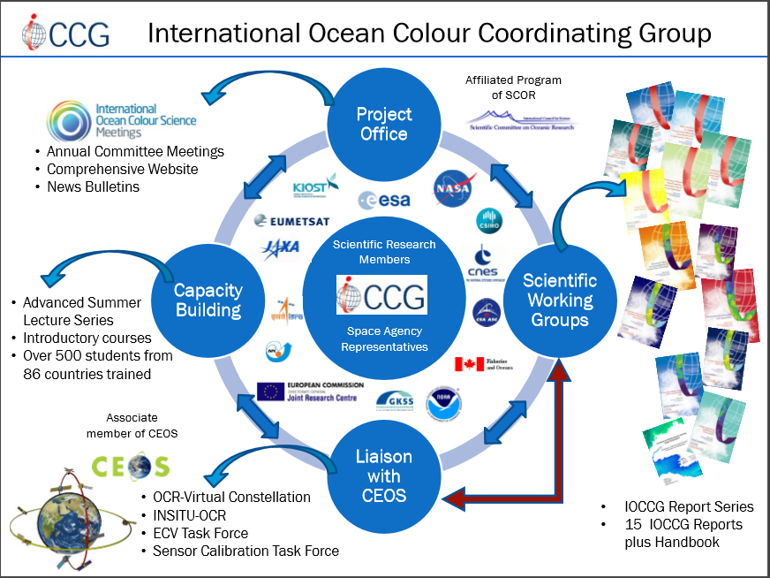
Capacity Building in Cal-Val

Slide 5
Rationale for CB for Cal-Val activities

Slide 6
Areas of Common Interest between WGCapD and WGCV

Slide 7
Subgroups

Slide 8
Imagery Calibration Types

Slide 9
What CapD can take the role of :
Promoting basic concepts and best practices of Cal Val for optical, microwave, thermal sensors by conducting webinars, training workshops
Coordinating with WGCV in conducting their training programs through sharing best practices for conducting training
We can provide short videos on success stories for new agencies who may join CEOS about the need of CV and how they can join campaigns
Bring out details on supersites and instrumentation needs for more such site developers

Slide 10
Capacity Building on Data Policy

Slide 11
QA4EO References :
QA4EO-CEOS-GEN-CEK-001 | A guide to procedure and document management
QA4EO-CEOS-GEN-DQK-001 | A guide to establishing a quality indicator on a satellite sensor derived data product
QA4EO-CEOS-GEN-DQK-002 | A guide to content of a documentary procedure to meet the Quality Assurance (QA) requirements of CEOS
QA4EO-CEOS-GEN-DQK-003 | A guide to “Reference Standards” in support of Quality assurance requirements of QA4EO
QA4EO-CEOS-GEN-DQK-004 | A guide to comparison – Organisation, operation and analysis to establish measurement equivalence to underpin the quality Assurance of QA4EO
QA4EO-CEOS-GEN-DQK-005 | A guide to establishing validated software, algorithm and models to underpin the Quality assurance requirements of QA4EO
QA4EO-CEOS-GEN-DQK-006 | A guide to expression of uncertainty of measurements
QA4EO-CEOS-GEN-DQK-007 | A guide to establishing quantitative evidence of Traceability to underpin the quality assurance requirements of QA4EO

Slide 12
Thank you for attention Q & A
Committee on Earth Observation Satellites

