Slide 1

Data Cube Initiatives
Agenda #22a
Brian Killough
CEOS Systems Engineering Office (SEO)
NASA Langley Research Center
CEOS 6th Working Group for
Capacity Building and Data Democracy
(WGCapD) Annual Meeting
DLR Oberpfaffenhofen, Germany
27th-29th March, 2017

Slide 2


Why Data Cubes?
The primary user problems are data access,
data preparation, and efficient analyses
Users want to minimize the time and knowledge
required to obtain and prepare satellite data
Users want free and open source solutions.
Users want to perform time series analyses
Users want to use multiple datasets together
Users want to use common GIS tools
Users want to “own” the data and keep it locally
Users want customer service and help
Our goal is NOT to sell a product or give out a tool …
Our goal is to provide a SOLUTION that has VALUE and
increases the IMPACT of satellite data.

Slide 3
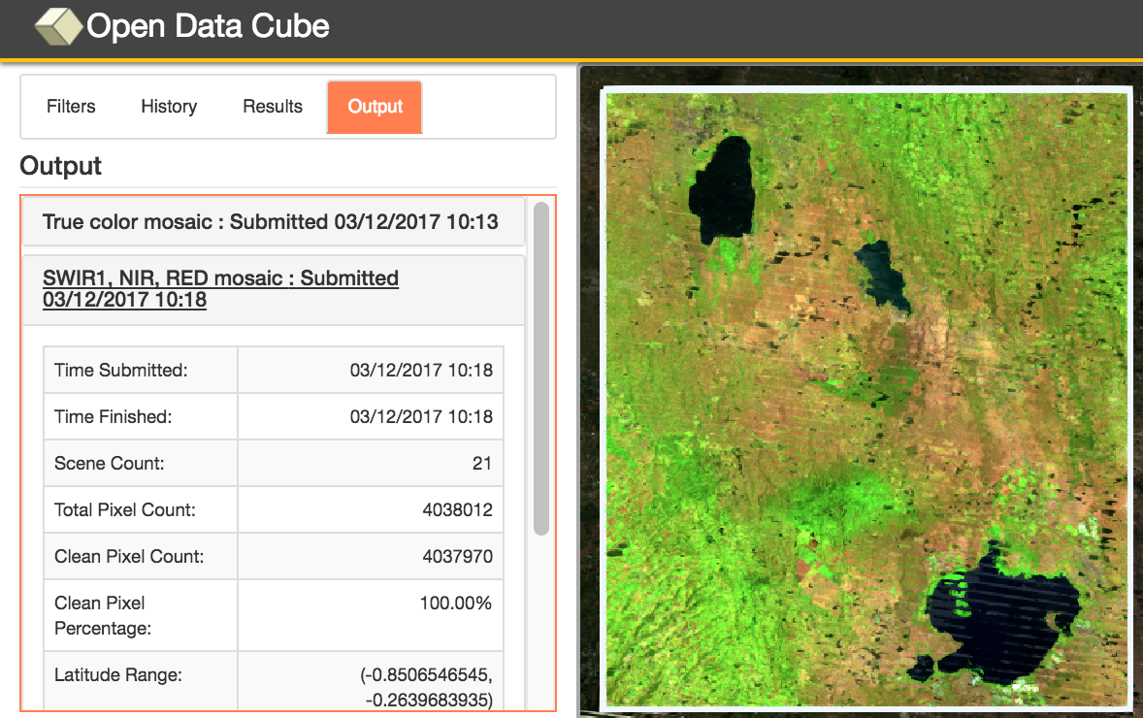

Amazon Cloud (AWS)
Data Cube Demonstration Portal
Data Cubes
14 cubes with 10+ years each.
Kenya, Cameroon (Lake Chad), Togo (coastal Africa), Colombia, Tonga (Pacific Islands), Vietnam, Australia (Menindee Lakes), Bangladesh.
User Interface Features
User-selected spatial region and time
7 applications: custom cloud-free mosaics, fractional cover, NDVI anomaly, water detection, water quality (Total Suspended Matter), landslides (SLIP) and coastal change.
Outputs in GeoTIFF and GIF animation.
Free and open!
This is the first “hands-on” global demo of the Data Cube to show its potential for rapid time series analysis and diverse applications
http://tinyurl.com/datacubeui

Slide 4
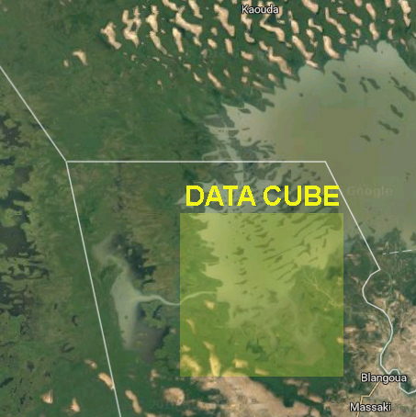
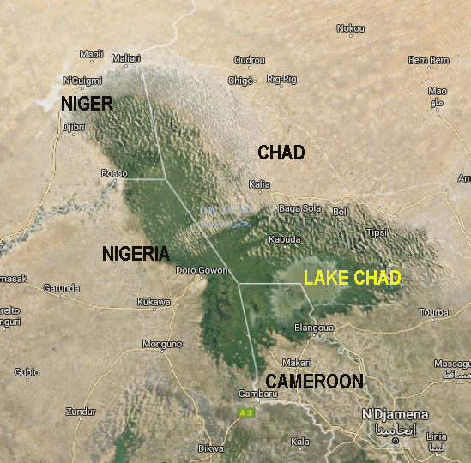
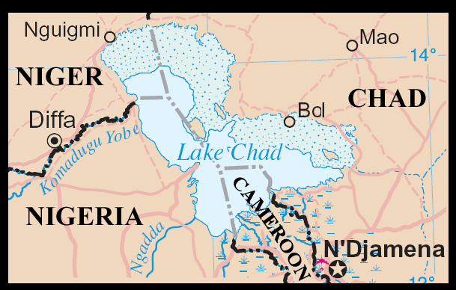
Lake Chad, Africa
Water Detection Demonstration
Historically large and shallow lake has shrunk by 95% from 1963 to 1998 due to increased population demand (reference United Nations). Provides water to 68 million people in 4 bordering countries.
Annual rainy season (May-June) gives rise to floods (Aug-Sept) which fill the lake (Oct-Jan) before evaporation during the dry season
(Feb-Mar).

Slide 5


Lake Chad, Cameroon, Africa
Time Series Water Detection
The product shows the percent of observations detected as water over the 17-year time series (water observations / clear observations).
Purple/Blue:
Frequent or permanent water
Red/Yellow:
Infrequent water and/or flood events

Slide 6
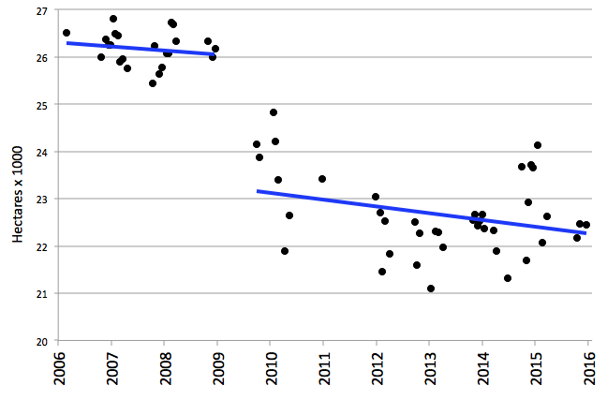
Lake Chad, Cameroon, Africa
10-year Time Series Results
The severe drought in 2008 is evident in the Lake Chad time series results. The overall 10-year trend is a loss of 1.4 hectares per day for this analysis region
Notes:
Lake Chad is a source of livelihood to 30 million people. The shrinking lake has had a substantial impact on the local populations, as entire communities have switched from a fishing-lifestyle to one of farming and agriculture. Local communities that once ringed the shores of the lake are now isolated villages — miles from water — and these populations have literally begun farming the now-dry lake bottom. As of 2015, there are plans are in the works to divert water from the Congo River to the River Chari, which flows into Lake Chad, and revitalize the lake.

Slide 7


Potential WGCapD Involvement
The CEOS Open Data Cube initiative plans a number of capacity building activities that could involve WGCapD
These include a Data Cube Learning Center and a potential GEO Data Cube Project.
Data Cube Learning Center – Customer service is our goal! We plan to have training materials, videos, and users forums. Some key items of need … language translation (Spanish, French).
GEO Data Cube Project – Considering a project linked to a GEO region of interest (e.g Ameri-GEOSS), use of data cubes and CEOS satellite data, focus on an UN-SDG indicator (e.g. 6.6.1 – Water Extent) and possible engagement of students. Some key items of need ... GEO region contacts and engagement, student programs, Python programmers. Recent discussions with Nancy Searby.

