Slide 1

CB-20: Provide CB Support to Regional and Thematic GEO Initiatives
Committee on Earth Observation Satellites
GEO Secretariat, NASA and INPE
Agenda Item # 37
CEOS 6th Working Group for Capacity Building and Data Democracy (WGCapD)-6 Annual Meeting
DLR Oberpfaffenhofen, Germany
27th-29th March, 2017

Slide 2
CEOS WGCapD 2017-2019 Work Plan: CB-20
CB-20 Provide CB support to regional and thematic GEO initiatives
Includes ongoing support to AfriGEOSS, additional support to AmeriGEOSS and engagement with Asia-Oceania (AO) GEOSS initiative. This would also include other GEO initiatives e.g. with WMO, CGMS, and WGClimate on essential climate variables (ECVs) and with the CEOS Ad Hoc Working Group on GEOGLAM.
Himalayan GEOSS

Slide 3
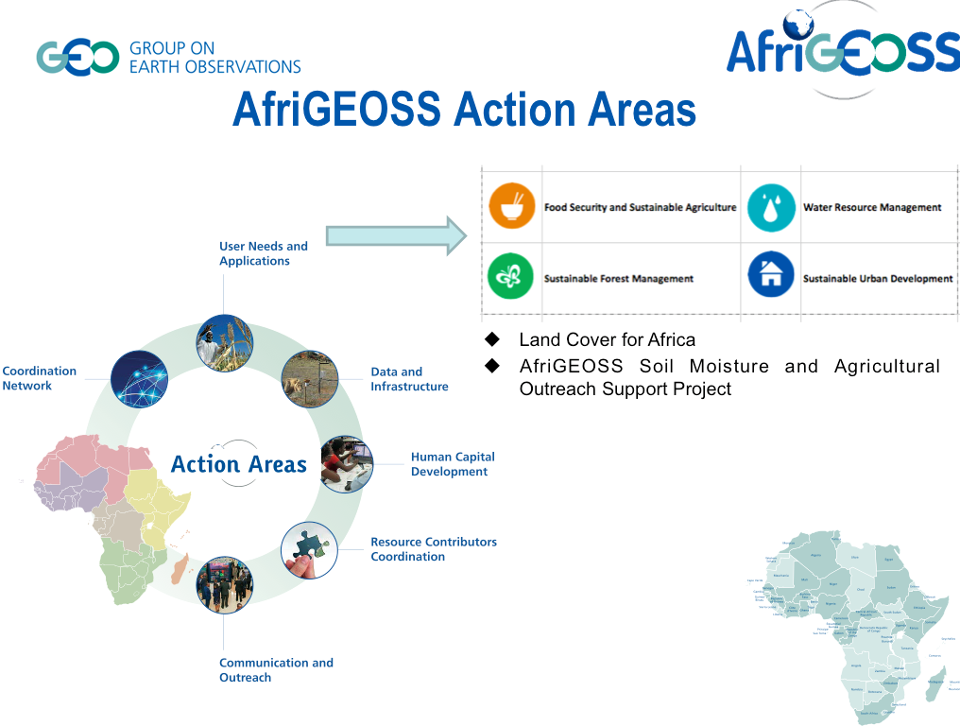

Slide 4
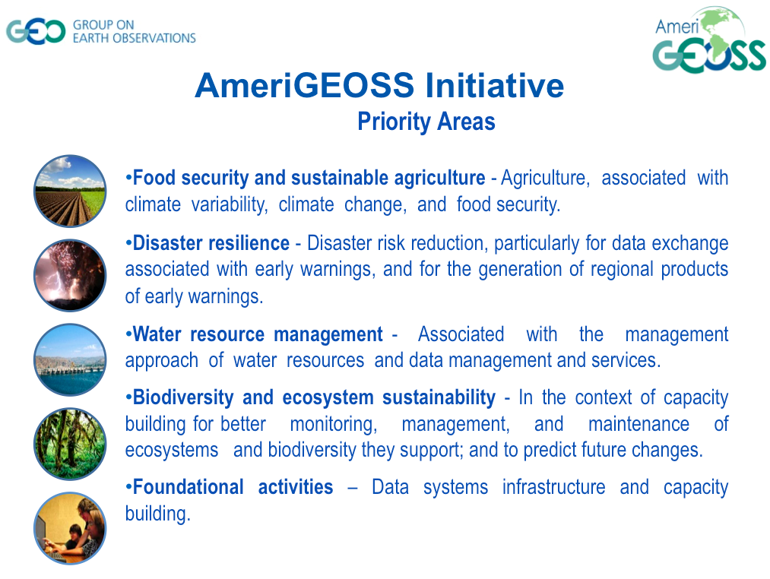

Slide 5
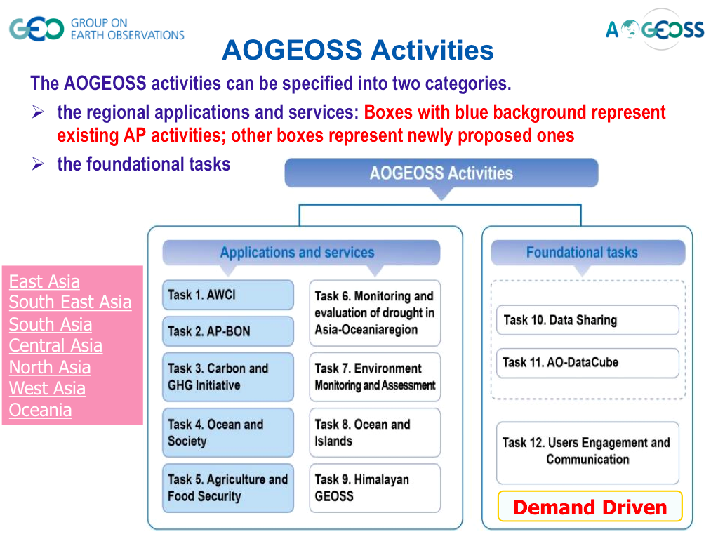

Slide 6
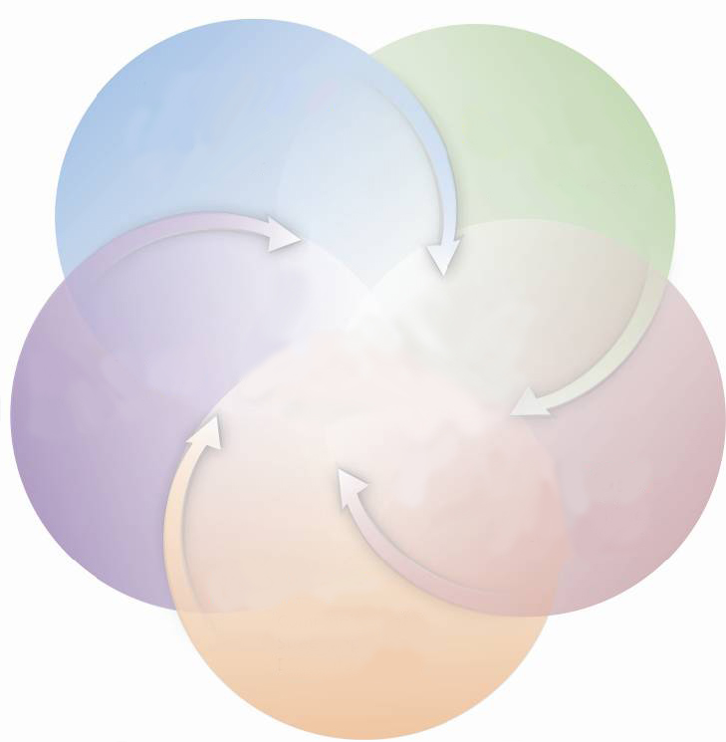
Addressing Mountain Development Challenges
Integrated Regional Database
Cryosphere & Atmosphere
Ecosystem and Biodiversity
EO applications and solutions
Himalayan
GEOSS
Capacity building and networking
Adaptation to Climate Change
Integrated water Resources Management
Fostering Regional Cooperation
Disasters Risk and Emergency Response
Promote
Himalayan SDI

Slide 7
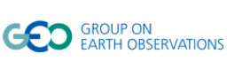

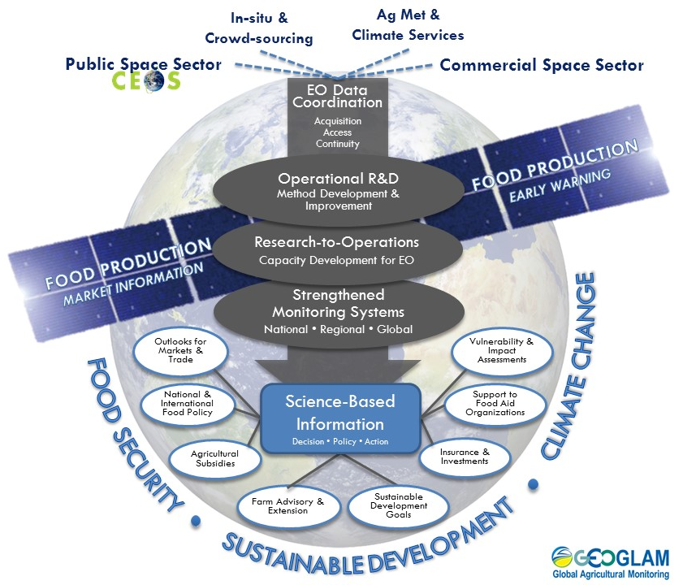
GEO-GLAM
Agricultural Mapping and Monitoring
GEOGLAM’S GOAL:
Strengthened operational monitoring systems which use EO to generate information that empowers science-based decision making, action taking, and policy in realms of food security and sustainable agriculture, in the context of climate change.

Slide 8
2017 Events:
Opportunity for Engagement
Breakaway sessions at GEO Work Programme Symposium, 12 – 13 May 2017, Pretoria, South Africa
2nd AfriGEOSS Symposium, 13 – 15 June 2017, Sunyani, Ghana
    Data & Software Carpentry Training Workshop, 8 – 12 June 2017
2017 AmeriGEOSS Week, 31 July – 4 August 2017, Costa Rica
  GEONETCast Training
  MBON training
  GEOGLAM ?? ; WGCapD track??
Asia-Pacific Symposium, September 2017, Vietnam
GEOGLAM
  GEOGLAM session at 37th ISRSE, Pretoria, South Africa
  RAPP, 15 – 17 May, Frascati, Italy
  GEOGLAM, GFOI, LSI-VC week before CEOS SIT

Slide 9
Recommendations for WGCapD Support
For effective engagement
Nominate WGCapD representatives to the identified GEO activities
Reflect WGCapD contribution in the GEO Work Programme
Potential areas for contribution
What is the support offer from WGCapD?
  Organize training responding to identified needs
  Contribute to training programs
  Participate at events e.g. annual Symposia / Week
  Advance CEOS data democracy activities - promote open access to space data

Slide 10
Thank you
Andiswa Mlisa, GEO Secretariat
Nancy Searby, NASA
Hilcea Ferreira, INPE

