Slide 1
Building Awareness: Partnership with WGCapD – Public Health Workshop
Committee on Earth Observation Satellites
Guy Aube, Canadian Space Agency
Agenda Item # 36 CB-11
CEOS 6th Working Group for Capacity Building & Data Democracy (WGCapD)-6 Annual Meeting
DLR Oberpfaffenhofen, Germany
27th-29th March, 2017

Slide 2
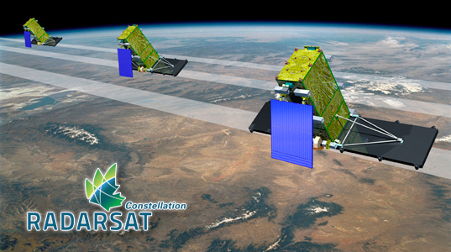
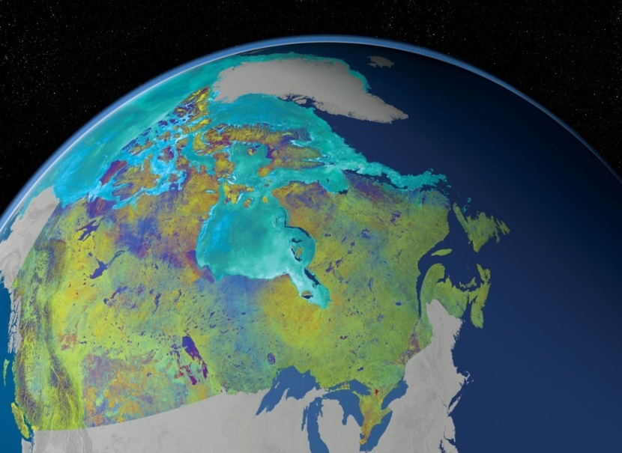
WGCapD-6 Annual Meeting 2017
DLR Oberpfaffenhofen, Germany 27th-29th March 2017
Canadian Space Agency: 2016-17 Summary
CSA’s Earth Observation (EO) capacity building activities with federal departments in Canada
Support to governement organizations, incl. Public Health Agency Canada (PHAC)
EO applications development program, with industry and government departments
Notes:
GRIP project: “Assessing the public health risks of microbial contamination in recreational waters by satellite imagery”: Objective: To assess the added value of using satellite imagery as part of monitoring and managing microbial risks associated with recreational waters in Canada. Methods: Satellite images were used to calculate five environmental indices that may affect the risk of contamination of recreational waters: agricultural land, urban areas (impervious surfaces), forest and wetlands. Statistical models including these indices were then compared with the average contamination level of beaches in southern Quebec, Canada. Various satellite sensors, including Radarsat-2, were compared against criteria of accuracy and performance. Outcomes: Satellite imagery classification performed well for the study area. Two of the variables were significantly associated with higher coliform levels: agricultural land and urban areas. In the context of this assessment, the Landsat-5 sensor offered the best cost-benefit ratio. Conclusion: Satellite imagery can be used to identify environmental factors associated with a higher risk of fecal contamination of recreational waters in Canada and may supplement current monitoring and risk assessment efforts.
International: see next slide for detail

Slide 3
WGCapD-6 Annual Meeting 2017
DLR Oberpfaffenhofen, Germany 27th-29th March 2017
Canadian Space Agency: 2016-17 Summary
Focus on WGCapD and related Health Theme – Past Activities
EO and Tele-epidemiology review for UN-Committee on the Peaceful Uses of Outer Space
Joint Project with Public Health Agency Canada (PHAC) on environmental health determinants
Living Planet Workshop in Prague “Tele-epidemiology & Public Health”
Notes:
UN-COPUOS and Space and Global Health:
A focused expert group on Space and Global Health under the leadership of Canada (PHAC and CSA) was established with the endorsement of the Scientific and Technical Subcommittee (STSC) of the UN-COPUOS. The focused expert group reviews and analyses current uses of space (technology, applications, practices and initiatives) in support of global health needs in order to: identify gaps; propose recommendations; and provide orientation for the future work of the STSC. The selected areas in which UN entities (WHO, international space agencies and other state members) focus on the use of space science and technology for public health are various (Tele-epidemiology, E-health, Tele-Health and Telemedicine) and the science is applied to many topics such as climate, air pollution, water quality and vector-borne diseases as well as pandemic, emergencies and health related to space. Space and Global health and the thematic of public health will be a pillar in the 2018 “UNISPACE+50” theme of the COPUOS.
CSA EOAU / GRIP & PHAC joint initiatives (2009-2017)
Since 2009, the CSA Government Related Initiatives Program (GRIP) team has been working in close partnership with the Public Health Agency of Canada’s (PHAC) Infectious Diseases Prevention and Control Branch medical geographers to foster the development and use of Earth Observation (EO) based solutions in support of PHAC mandates and Canadian public health benefits. Evidence-based knowledge is required for the management of key public health issues. However, obtaining the necessary data on environmental health determinants can constitute a major challenge due to the potentially large territory to cover. Critical information on population or environmental determinants of health may be derived from EO images, particularly in regard to the impact of natural or man-made ecosystem changes. Operationally, EO images have demonstrated their usefulness in the prevention and control of persistent and new diseases.
Tele-Epidemiology and Public Health” during the ESA Living Planet Symposium (May 9 2016, Prague): CSA (Space U.) have co-organizing, with Public Health Agency of Canada (PHAC), the Centre National d’Études Spatiales (CNES) and the European Space Agency (ESA) a thematic session called “Tele-Epidemiology and Public Health” during the ESA Living Planet Symposium (May 9 2016, Prague). The objective of this special session was to bring together Canadian and European leaders and experts in Earth Observation (EO) to present, discuss, establish and strengthen collaborations and partnerships on applications, products and services related to public health issues with a focus on infectious diseases. It will also be an opportunity for multiple organizations (e.g. CNES, IRD, PHAC) active in tele-epidemiology and public health to connect with space experts and existing EO networks (academia, industry, gov.). This event is directly aligned and in support of the Sustainable Development Goals (i.e. Targets 3: Ensure Healthy Lives and Promote Well-Being for All Ages) and to the GEO strategic objectives and Societal Benefit Areas (SBAs) related to public health. This event gave high visibility to PHAC and CSA EO programs, EO applications projects and supported missions (Radarsat-2, RCM, etc.) and highlights the CSA support in this emerging field of technology (i.e. tele-epidemiology, EO & health).

Slide 4
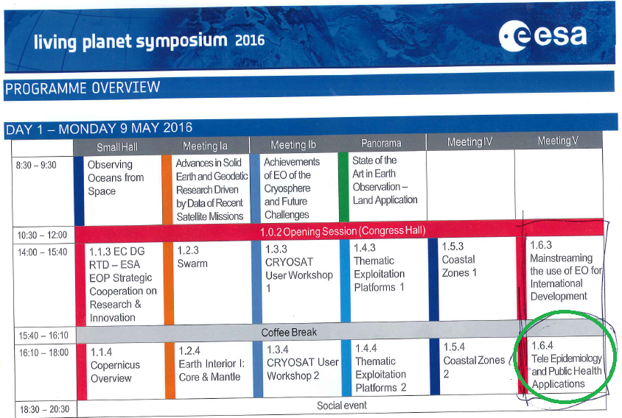
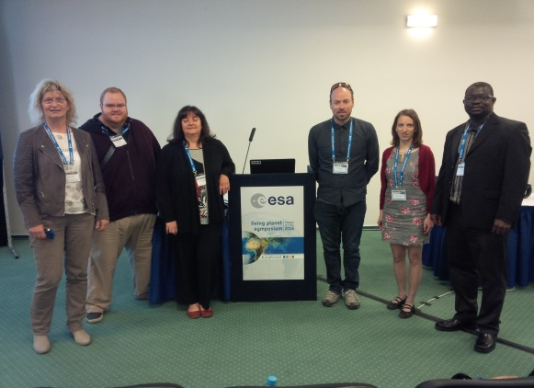
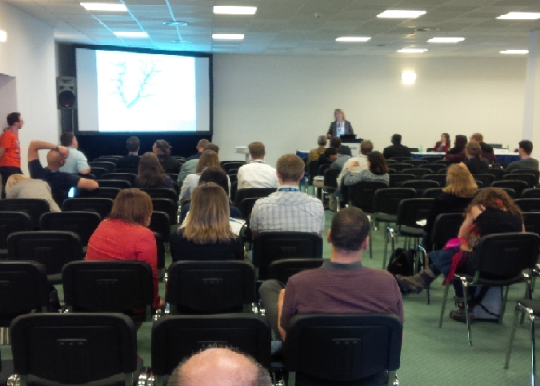
WGCapD-6 Annual Meeting 2017
DLR Oberpfaffenhofen, Germany 27th-29th March 2017
CSA / PHAC Tele-Epidemiology Session, Prague 2016:
First time a Health & EO theme was part of this symposium

Slide 5
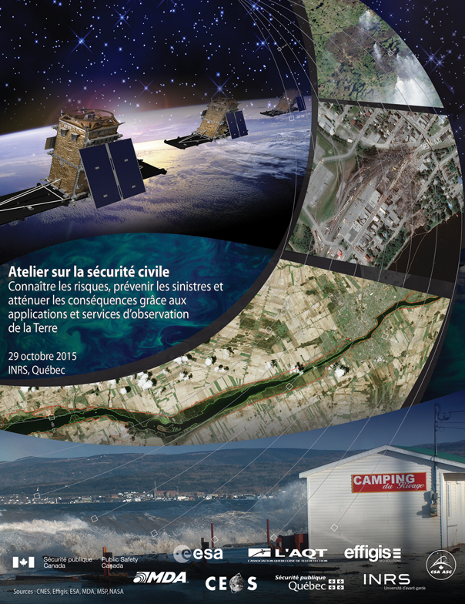
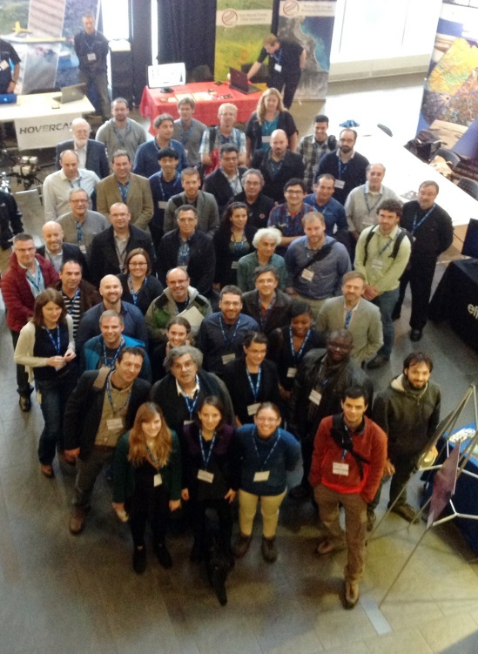
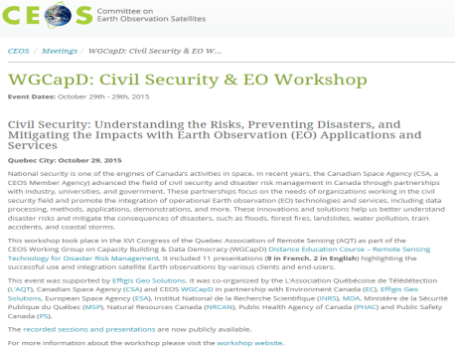
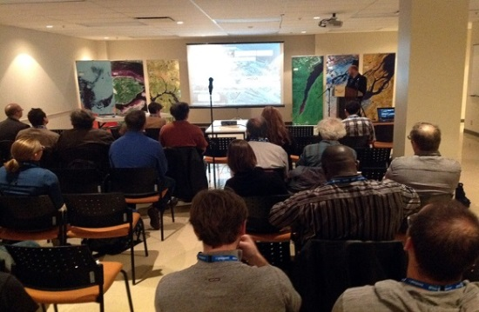
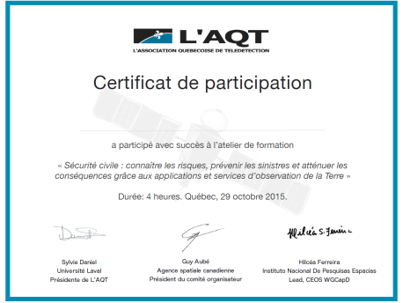
WGCapD-6 Annual Meeting 2017
DLR Oberpfaffenhofen, Germany 27th-29th March 2017
Canadian Space Agency: 2016 Activities
WGCapD Workshop in Quebec City (with int. partners): Civil Security & EO
Organizers and nine partner organizations
Scope: understand risks, prevent disasters and mitigate impacts with EO services
Virtual participation, *Open Education Resources (OER)
11 presentations, ~120 participants
Two sessions and discussion panels
Certificate of participation
http://ceos.org/meetings/civil-security-and-eo-workshop/
*http://wiki.obt.inpe.br/doku.php?id=workshop-quebec
Notes:
Hi Guy, I only received the pdf version.
The presentation is very good. I only missed reference to virtual participation and OER (Open Educational Resources) - making all presentations and recordings freely available on the internet (http://wiki.obt.inpe.br/doku.php?id=workshop-quebec). I believe it is worth to mention this.
My tickets to Germany were bought at 8pm last night!! I am finalizing packing to go to airport in a couple of hours.
Best
Hilcea

Slide 6
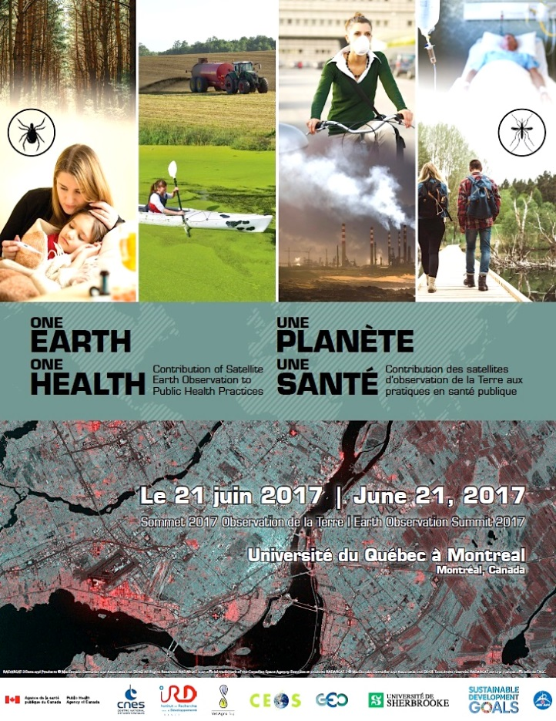
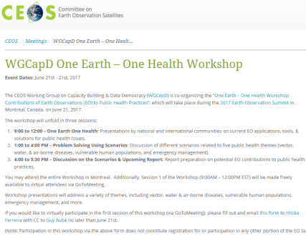
WGCapD-6 Annual Meeting 2017
DLR Oberpfaffenhofen, Germany 27th-29th March 2017
Canadian Space Agency: 2017 Activities
WGCapD workshop in Canada (with international experts)
One Earth – One Health: Contribution of Satellite Earth Observation to Public Health Practices
Expand on several scenarios of EO applications in public health, e.g. vector-borne diseases, vulnerable populations, health emergencies
Report & recommendations on EO-related strategies for Public Health Agency
http://ceos.org/meetings/wgcapd-one-earth-one-health-workshop/
Notes:
Workshop on Earth Observation and Public Health Applications (June 22 2017, Montréal): following the success of the Prague workshop in May 2016, PHAC, CSA and CNES are organizing a workshop with the Canadian health community as part of the 2017 EO Summit in Montreal. PHAC and CSA are presently developing the preliminary program.
PHAC User Need Assessment in Earth Observation (2016-2017)
PHAC and CSA GRIP teams are presently in discussion to conduct a user need assessment study. This will lead to the development of the 1st EO Strategy for PHAC.
DESCRIPTION
Infectious diseases and chronic conditions are issues of concern for public health. The development of evidence-based knowledge is essential for the management of these issues. Research needs to clarify the mechanisms at work and identify factors that foster the appearance, spread and persistence of diseases. These factors may be environmental, climatic, demographic, socio-economic or behavioral. In this context, integrated approaches focusing on One Health and EcoHealth concepts have to be developed to investigate the close and complex relations between the environment, ecosystems and etiological agents responsible for disease in human, animal and plant populations. Some drivers such as forest density, presence of wetlands, agricultural areas, climate and urban areas can be identified from space, but not without efficient methods and relevant partnerships to turn remote sensing into a tool suitable for the characterization, mapping and monitoring of risk factors.
This workshop is an invitation to the large remote sensing community to seek the potential contribution from EO to address public health issues with their own field of expertise (technology, applications, methods).The workshop will unfold in three parts. The first part will entail presentations by the national and international communities on current EO applications, tools & solutions for public health issues. The second part will allow participants to discuss different scenarios related to five public health themes (vector, water & air borne diseases, vulnerable human populations, and emergency management). An expert in the field will facilitate the discussion for each scenario and help the participants answer a list of pre-established questions. The third part will be a discussion that will help inform a report regarding the potential new contribution of space-based EO to public health.
The workshop will take place during the EO Summit 2017 in Montreal, Canada. This event is co-lead by the Canadian Space Agency and the Public Health Agency of Canada in partnership with the Centre National d’Études Spatiales (CNES, France), the CEOS Working Group on Capacity Building & Data Democracy (WGCapD), the department of Applied Geomatics from Université de Sherbrooke (Canada), the Institut de recherche pour le développement (IRD, France), and VetAgro Sup (France) with the participation of GEO (Group on Earth Observation) and UN-COPUOS Space and Global Health expert team. This event is directly aligned and in support of the Sustainable Development Goals (i.e. Goal 3: Ensure Healthy Lives and Promote Well-Being for All Ages) and to the GEO strategic objectives and Societal Benefit Areas (SBAs) related to public health.
OBJECTIVES
To better understand the links between environment, climate, society and public health in the Earth observation context.
To demonstrate the relevance of existing applications derived from satellite EO in the public health sector.
To identify existing or potential data, indicators, methods and technologies developed from EO that can support the public health sector.
To bring together leaders and experts in EO and public health to explore, discuss, establish or strengthen collaborations and partnerships on novel EO applications, products and services to support public health.

Slide 7
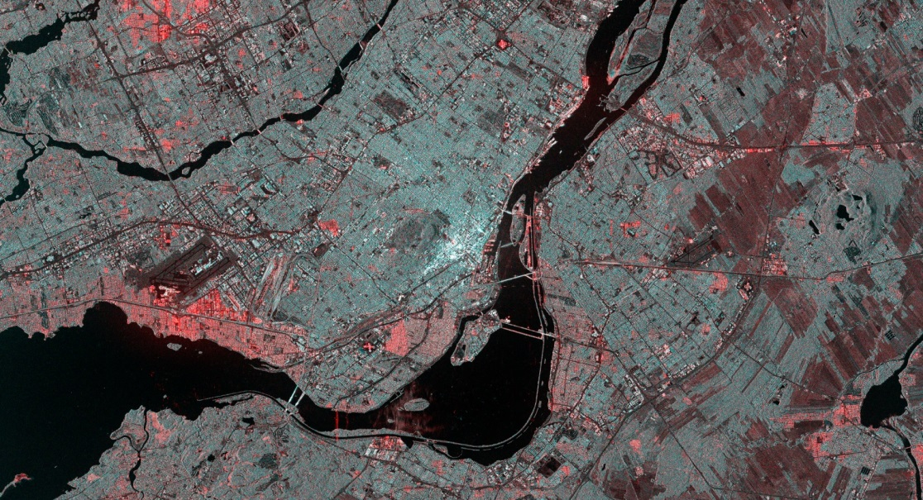
WGCapD-6 Annual Meeting 2017
DLR Oberpfaffenhofen, Germany 27th-29th March 2017
www.sommetot2017-eosummit2017.ca
Thank you!
Information:
Guy Aube, CSA
guy.aube@canada.ca
Hilcea Ferreira, INPE
hilcea@dpi.inpe.br
Montreal, Canada
Radarsat-2 data & products. MDA Ltd (2016). All rights reserved. Radarsat is an official trade mark of the CSA.

