Slide 1

CB-15: Best Practices
Committee on Earth Observation Satellites
INPE - Hilcéa Ferreira
NASA – Nancy Searby
Agenda Item 34
CEOS 6th Working Group for Capacity Building and Data Democracy (WGCapD)-6 Annual Meeting
DLR Oberpfaffenhofen, Germany
27th-29th March, 2017

Slide 2
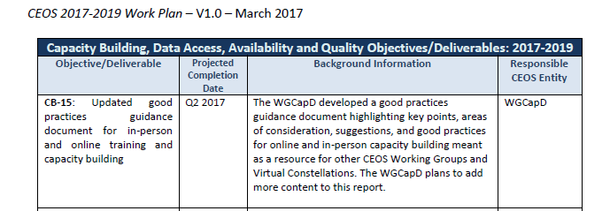
WGCapD-6 Annual Meeting 2017 - DLR Oberpfaffenhofen, Germany - 27th-29th March 2017
CEOS Work Plan – 2017-2019

Slide 3
WGCapD-6 Annual Meeting 2017 - DLR Oberpfaffenhofen, Germany - 27th-29th March 2017
Action Development
Background
Kick-of document - October 2016/January 2017
  Nancy/Ana Prados/Alyssa...
  CEOS WGCapD Training Good Practices
Version 2 – March 2016
  Kim Holloway
  WgCapD Training Best Practices
  CEOS standard format
Version 3 –under construction (April 10)
  Hilcea Ferreira
  WGCapD Training Methods and Best Practices

Slide 4
WGCapD-6 Annual Meeting 2017 - DLR Oberpfaffenhofen, Germany - 27th-29th March 2017
Action Development
Planning next steps
Document Improvement
  "Literature Review"
  Instructional Design and ADDIE Model
  Structure
    General Best Practices
    Related to Specific Areas: Geosciences, Meteorology
  Adding more delivery modes (offline, monitoring & evaluation and others)
Planning the review process
  Release within the group and ask for feedback (or to a group of key people?)
  Due date for finalize review
Public release
Marketing
Further steps – living document …

Slide 5
WGCapD-6 Annual Meeting 2017 - DLR Oberpfaffenhofen, Germany - 27th-29th March 2017
Literature Review
Stepehn Bojinski (WMO Space Programme)
Satellite Skills and Knowledge
Training Development Plan (Template)
VLab webinar – best practices
Remote Sensing Training: Methods & Best Practices. NASA’s Applied Remote Sensing Training Program (ARSET). 2016
Evaluation Reports
International e-learning course on Introduction to Remote Sensing Technology – 2013
Webinar Series - Remote Sensing Technology for Disaster Management Webinars on Disasters
Penn State World Campus - Faculty Development Courses
Research - TTool Model: ADDIE + Bloom´s Taxonomy + Competencies

Slide 6
WGCapD-6 Annual Meeting 2017 - DLR Oberpfaffenhofen, Germany - 27th-29th March 2017
Document Improvement
Instructional design or instructional systems design (ISD)
Practice of creating "instructional experiences which make the acquisition of knowledge and skill more efficient, effective, and appealing."[
Determining the state and needs of the learner, defining the end goal of instruction, and creating some "intervention" to assist in the transition. The outcome of this instruction may be directly observable and scientifically measured or completely hidden and assumed.
There are many instructional design models but many are based on the ADDIE model with the five phases:
  Analysis
  Design
  Development
  Implementation
  Evaluation

Slide 7
WGCapD-6 Annual Meeting 2017 - DLR Oberpfaffenhofen, Germany - 27th-29th March 2017
Document Improvement
ANALYSIS - more general
• Context
• Needs assessment
• Constrains and risks
After Analysis → Learning Solutions → DESIGN
Define model
• Short/Long Course
• Delivery mode (online, onsite)
• Practical (Hands-on)/Theoretical
Planning
• Milestones
• Deliverables
Competencies
Expected Outcomes
Assessment design

Slide 8
WGCapD-6 Annual Meeting 2017 - DLR Oberpfaffenhofen, Germany - 27th-29th March 2017
Document Improvement
DEVELOPMENT
IMPLEMENTATION
EVALUATION
  • Course evaluation (from students perspective, instructors, organizers)
  • Impact assessment

Slide 9
WGCapD-6 Annual Meeting 2017 - DLR Oberpfaffenhofen, Germany - 27th-29th March 2017
Document Improvement
THOUGHTS?
SUGESTIONS?
WHO WANTS TO JOIN THE TEAM?
Thanks
hilcea@dpi.inpe.br

