Slide 1

Webinars
Committee on Earth Observation Satellites
A.Senthil Kumar (ISRO0
Agenda Item 34 (CB-13)
CEOS 6th Working Group for Capacity Building and Data Democracy (WGCapD)-6 Annual Meeting
DLR Oberpfaffenhofen, Germany
27th-29th March, 2017

Slide 2

Webinar Series on SAR data
processing and applications
Recommended during 5th Annual Meet at Langley, USA
2 Special Telecons organized for finalizing the syllabus and faculty
Presented progress and plans during monthly Telecons

Slide 3
Webinar Series on SAR data processing and applications
Objective:
To provide an overview on SAR data availability, access, processing and its
applications in different thematic disciplines which include vegetation,
Geology, Cryosphere and floods
Target Participants:
Academicians, Scientists, Researchers and Professionals interested in SAR
Remote Sensing, data processing and applications.
Target Region
The course is open to participants from all countries.

Slide 4
Webinar Series on SAR data
processing and applications
Duration: April 17 – June 9, 2017
Schedule: Every Monday at 1300 UTC
Time for each webinar: 60 minutes lecture and 30 minutes Q&As

Slide 5
WS on SAR data processing and applications
April 17 – June 9, 2017
Methodology
This course is an online distance education (interactive) program that allows participants to fully engage with program content, their peers, and their instructors via live lectures, through discussion forums, online chat, question/answer session and feedback mechanisms.
The Learning Platform Moodle (Modular Object-Oriented Dynamic Learning Environment) will be used for the course administration, documentation, tracking, reporting and delivery system. It will be hosted at the Indian Space Research Organisation – ISRO LMS Platform
Citrix gotowebinar or ISRO’s A-view will be used for synchronous communication among teachers and students and live sessions.

Slide 6
WS on SAR data processing and applications
April 17 – June 9, 2017
Web. No./ (Date) | Topic | Organizations
W1(17-04-17) | Overview of SAR Remote Sensing | ISRO
W2(24-04-17) | SAR data Format, and Tools | ESA
W3(01-05-17) | SAR data processing | ISRO
W4(08-05-17) | Basics of SAR Polarimetry and Interferometry | ISRO
W5(15-05-17) | SAR Remote Sensing for Geological Applications | DLR and ISRO
W6(22-05-17) | SAR Remote Sensing for Forest, crop and soil moisture | Agriculture and Agrifood, Canada and ISRO
W7(29-05-17) | PolSAR and InSAR Applications in Snow and Glacier Studies | DLR and ISRO
W8(05-06-17) | SAR data for Flood Mapping | ESA and ARSET(NASA)

Slide 7
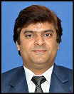
W1: Overview of SAR Remote Sensing
W1: Overview of SAR Remote Sensing (ISRO)
Principles of Microwave Remote Sensing (Imaging and Non imaging),
Microwave Bands,
Imaging Radar Geometry,
Basic Concept of Mono-, Bi-static & Multi-static SAR Sensors,
Synthetic Aperture Radar (SAR), SAR versus other Earth Observation Instruments,
SAR Polarisation, SAR Resolution Cell, Azimuth Resolution, Range Resolution, Complex SAR Image, Application of SAR Remote Sensing
Shashi Kumar
Senior Scientist, IIRS/ISRO
8 yrs. Teaching & Research
SAR remote sensing, SAR
data processing, Polarimetry
SAR, Interferometry
Delivering regular lectures in ISRO DLPs

Slide 8

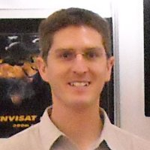
W2: SAR Data Format, SAR Missions
and data access
W2:SAR Data Format, SAR Missions and data access (ESA)
Different types of SAR system,
Imaging platforms and wavelength used in SAR remote sensing,
Active and Passive Microwave Sensors, Imaging Modes,
Spot-, Strip- & Scan-Mode,
SAR data format RAW SLC Multilook, Geocoded: Terrain Corrected Geo Coded Products,
Polarimetry Data, recent and historical SAR missions,
SAR data access
Magdalena Fitrzyk
Research Fellow, ESA
Ph.D (Geodesy and cartography,
spec. remote sensing)
10 years Experience
Chris Stewart
Scientific Consultant
(Remote sensing applications cons. Ltd c/o ESA)
12 years Experience

Slide 9
W3: SAR data processing
Shashi Kumar
Senior Scientist, IIRS/ISRO
8 yrs. Teaching & Research
SAR remote sensing, SAR
data processing, Polarimetry
SAR, Interferometry
Delivering regular lectures in ISRO DLPs
W3: SAR data processing by ISRO
Different Levels of SAR Data,
SAR Focusing- RAW Data Processing, Single Look Complex (SLC) Data,
Intensity Image Generation,
Slant Range Ambiguity & Slant to Ground Range Conversion,
Multi-look SAR Data,
Speckle Filtering,
Normalized Backscatter Cross Section.

Slide 10
W4: Basics of SAR Polarimetry and Interferometry
W4: Basics of SAR Polarimetry and Interferometry by ISRO/
Polarimetric SAR Remote Sensing,
Requirement and need of PolSAR data,
Stokes Vector, Polarimetric Scattering, Scattering Matrix and decomposition modeling.
Concept of Interference, Phase Information, SAR Interferometry, Baseline, Altitude of Ambiguity, Interferogram Generation, Coherence Generation, Phase Unwrapping,
Interpretation of SAR Backscatter, Coherence & Interferogram,
Height of the Effective Scattering Centre.
Mr. Shashi Kumar
Senior Scientist, IIRS/ISRO
8 yrs. Teaching & Research
SAR remote sensing, SAR
data processing, Polarimetry
SAR, Interferometry
Delivering regular lectures in ISRO DLPs

Slide 11
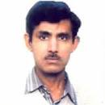
W5: SAR Remote Sensing for
Geological Applications
Dr. RS Chatterji
Senior Scientist, IIRS/ISRO
20 yrs. Teaching & Research
SAR applications in Geological applications
Worked on various SAR sensor data
Delivering regular lectures in ISRO DLPs
W5: SAR Remote Sensing for Geological Applications by ISRO/ DLR
Terrain Mapping and Analysis,
Differential Interferometry for
  Landslide Mapping
  Land Subsidence Monitoring

Slide 12
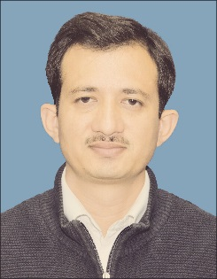
W6: SAR Remote Sensing for Forest, Crop and Soil moisture
W6: SAR Remote Sensing for Forest, crop and soil moisture By ISRO
Need & Requirement of SAR for Forest Biophysical Parameter Assessment,
Crop mapping and monitoring and
soil moisture estimation
Dr. Heather McNairn ( Agriculture and Agrifood, Canada) and
(bio-data not available)
Dr. Hitendra Padaliya
Senior Scientist, IIRS/ISRO
14 yrs. Teaching & Research
Forest monitoring and biophysical parameter retrieval using SAR
Worked on various SAR sensor data
Delivering regular lectures in ISRO DLPs

Slide 13
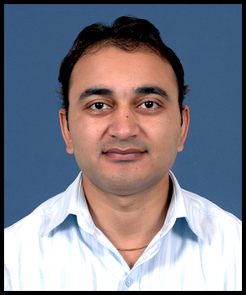
W7: PolSAR and InSAR Applications in Snow and Glacier Studies
Dr. Praveen K. Thakur
Senior Scientist, IIRS/ISRO
14 yrs. Teaching & Experience
SAR remote sensing for
Snow and Glaciar studies
Field experience of Himalayan glaciers and Antarctica
Delivering regular lectures in ISRO DLPs
W7: PolSAR and InSAR Applications in Snow and Glacier Studies by DLR / ISRO
SAR Data for Parameter Retrieval of
Snow Cover Area(SCA),
Snow Density (SD),
Snow Water Equivalent (SWE),and
Snow Wetness (SW)
D-InSAR for Glacial Movements

Slide 14
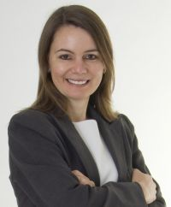
W8: SAR data for Flood Mapping
W8: SAR data for Flood Mapping by ESA/ ARSET(NASA)
  SAR Remote Sensing for flood inundation mapping and monitoring
Dr. Magdalena Fitrzyk
Research Fellow, ESA
Ph.D (Geodesy and cartography,
spec.remote sensing)
10 years Experience
Chris Stewart
Scientific Consultant
(Remote sensing applications
cons. Ltd c/o ESA)
12 years Experience
Erika Podest , ARSET (NASA)
Scientist with the Water and Carbon Cycles Group in JPL's Earth Science Division
Ph.D., Applied Physics Specializing in Remote Sensing & Image Processing
10+ years Experience

Slide 15
  Announcement
CEOS website: January 28, 2017
List of practitioners provided by ISRO and CEOS
Any other agency viz. GEOS, ARSET
Regional Centers for Space Science and Technology Education (affiliated with United Nations)
  Latin America and the Caribbean (Mexico and Brazil): CRECTEALC (Regional Center for Space Science and Technology Education for Latin America and the Caribbean)
  Asia and the Pacific (India): CSSTEAP (Centre for Space Science and Technology Education in Asia and the Pacific)
  Africa (Morocco): CRASTE-LF (African Regional Centre for Space Science and Technology Education in French Language)
  Africa (Nigeria): ARCSSTE-E (African Regional Centre for Space Science and Technology Education in English Language)
  Western Asia (Jordan): Regional Centre for Space Science and Technology Education for Western Asia
Regional Centers
  Regional Centre for Mapping Resource for Development (RCMRD) IN Nairobi, Kenya
  Regional Centre for Training in Aerospace Surveys (RECTAS) located within the campus of Obafemi Awolowo University, Ile-Ife, Nigeria.

Slide 16
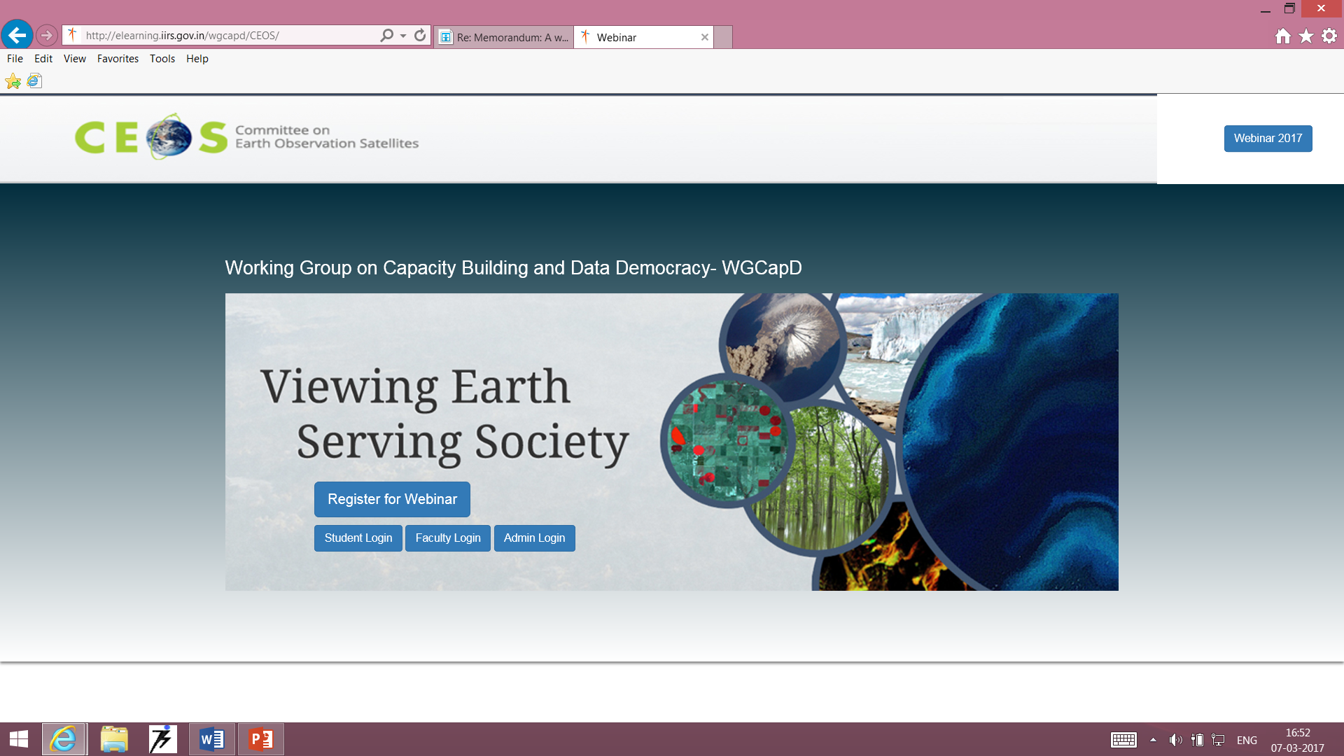
LMS for Webinar Series
http://elearning.iirs.gov.in/wgcapd/CEOS/

Slide 17
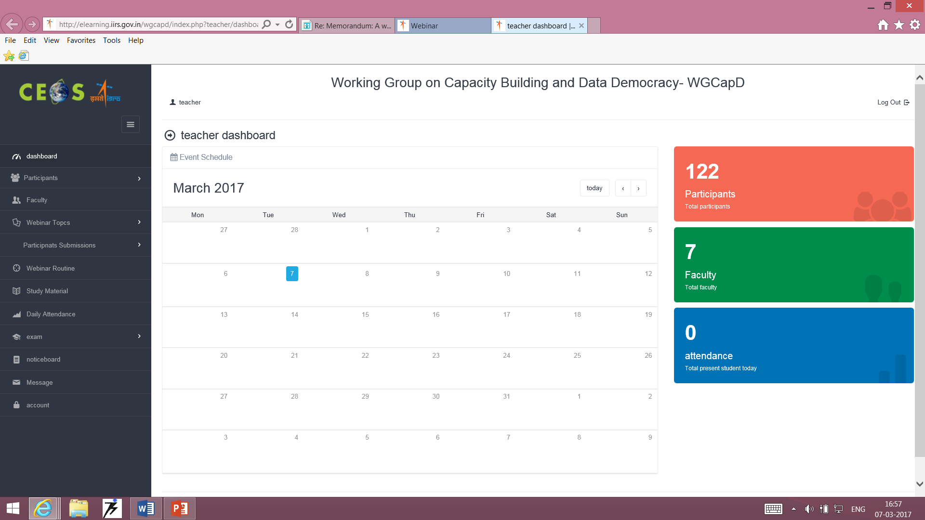
Faculty Account
Participants
Faculty
Webinar topics
Participants submissions
Webinar routine
Study material
Daily attendance
Exam
Notification
Messages
Account

Slide 18
  Need for Enhancing Attendance
2015 Webinar Participants Statistics:
  Total Applicants : 144
  Selected : 99
  Finally Completed
  (50% marks + 75% attendance) : 46
  Need to increase no. of participants …
  Request Agencies to please share their potential participants list to Kim

Slide 19
Thank you for attention
Q & A
Committee on Earth Observation Satellites

