Slide 1

WGCapD – Achievements of 2016
Committee on Earth Observation Satellites
A. Senthil Kumar, ISRO, Co-chair
Agenda Item: 26
CEOS 6th Working Group for Capacity Building and Data Democracy (WGCapD)-6 Annual Meeting
DLR Oberpfaffenhofen, Germany
27th-29th March, 2017

Slide 2
WGCapD-6 Annual Meeting 2017, DLR Oberpfaffenhofen, Germany, 27th-29th March 2017
Summary
SAR Training Workshops
  1st SAR Training Workshop Zambia October, 2016
  2nd SAR Training Workshop (Pretoria) January 2017
  3rd SAR Training Workshop (Gabon) February 2017
WGCapD participation in Geo-work Program Symposium Geneva May 2016
WGCapD in AmeriGEOSS Week on Disasters June 2016
SAR Webinar series: topic and content finalization
SRTM-2 Training Workshop Nepal September 2016

Slide 3

Zambia SAR Training Workshop 10-14 October: Objectives
Objectives
Contribute in bridging the skills gap of SAR technology in the region and to provide awareness on how and where to access freely available SAR data and processing software such as the Sentinel Application Platform, commonly known as SNAP.

Slide 4
Zambia SAR Training Workshop 10-14 October: Participants
Whom it was addressed?
The working group’s contribution to the “Training the Trainer” initiative, about 95% of the workshop participants were lecturers at universities. Such an approach ensures that the knowledge and material acquired can be shared with students.
Title | Name | Surname | Organization | Country | Responsibility
Mr | Phila | Sibandze | SANSA | South Africa | Course Coordinator
Prof | Christy | Hansen | Delft University of Technology | Netherlands | Course Coordinator
Prof | Chris | Schmullius | Friedrich-Schiller-University Jena | Germany | Course Coordinator
Prof | Chris | Stewart | European Space Agency | Italy | Course Coordinator
Prof | Mikhail | Urbazaev | Friedrich-Schiller-University Jena | Germany | Course Coordinator
Mrs | Joalane | Marunye | National University of Lesotho | Lesotho | Participant
Mr | Aniceto | Chauque | Universidade Eduardo Mondlane | Mozambique | Participant
Ms | Hilma | Nghiyalwa | University of Namibia | Namibia | Participant
Ms | Zodwa | Ndlela | University of Swaziland | Swaziland | Participant
Dr | Fadzai | Zengeya | University of Zimbabwe | Zimbabwe | Participant
Dr | Cosmo | Ngongondo | University of Malawi (UNIMA) | Malawi | Participant
Dr | Proches | Msigula | Sokoine University of Agriculture | Tanzania | Participant
Dr | George | Chirima | Agricultural Research Council | South Africa | Participant
Mr | Moses | Chisola | University of Zambia | Zambia | Participant
Dr | Douty | Chibamba | University of Zambia | Zambia | Participant
Mr | Michael | Phiri | National Remote Sensing Centre | Zambia | Participant
Ms | Phoebe | Odour | RCMRD | Kenya | Participant

Slide 5
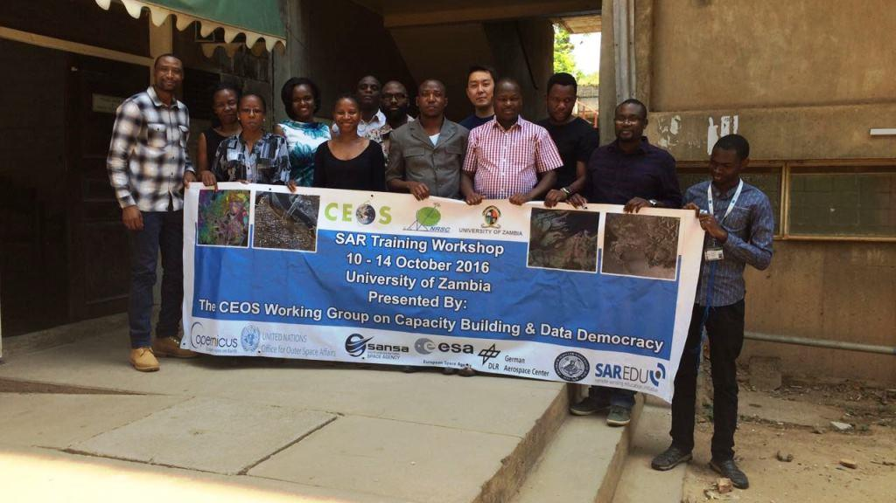
Zambia SAR Training Workshop
(10-14) October: Feedback
Future plan for these SAR Workshops
Collating all available SAR tutorials, tools and online courses and provide access to those that have participated in face-to- face SAR training workshops. (ESA, DLR , NASA and SANSA). WGISS– CEOS Data Discovery Webinar

Slide 6
CB-17 SAR Training @ Pretoria
Activity | Report
CB-17 :SAR Training Workshops Location: Pretoria, South Africa Hosted by: SANSA , supported by Japan International Cooperation Agency (JICA) Participants: 13 Southern African Development Community (SADC) region. | Objective: To build SAR capacity in the region. Rationale: Having noticed that most training and capacity building initiatives in Earth observation were addressing optical remote sensing, a gap that was identified by the Working Group and had to be filled in building capacity in SAR technology as well. What will be of benefit to the countries of Central Africa experiencing significant cloud cover is that SAR data is seen as more suitable in a range of specific applications, and not restricted by such frequent cloud cover.

Slide 7
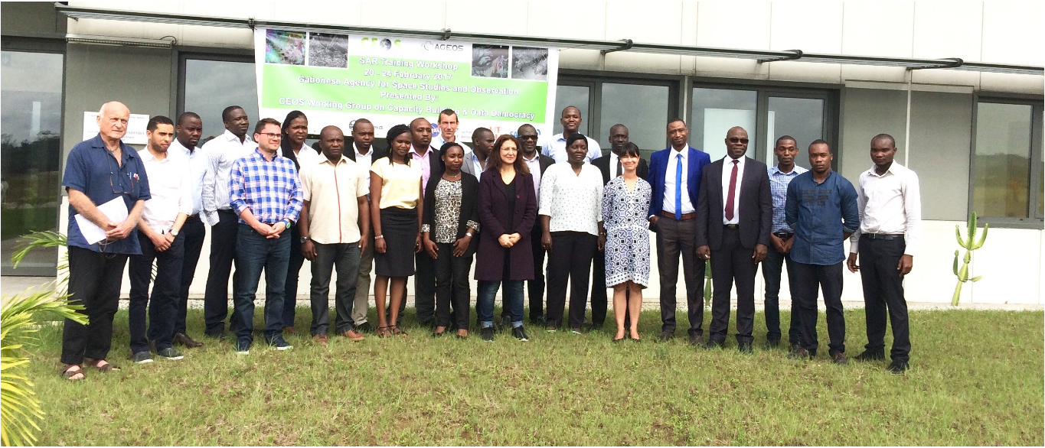
CB-17 SAR Training @ Gabon
Activity | Report
CB-17:SAR Training Workshops in Gabon 20-24 Feb. 2017 Location: AGEOS Ground Station Facility, Libreville, Gabon Libreville, Gabon Hosted by: Gabonese Space Agency (AGEOS), the United Nations Office for Outer Space Affairs (UNOOSA) and the European Space Agency (Copernicus programme) Participants: From Rwanda, Cote d'Ivoire, Senegal, Tunisia, Morocco, Kenya, Ghana, Nigeria and Gabon. | Objective: Same as Pretoria Workshop. The course focused on a number of SAR applications such as; crop monitoring, crop classification, biomass estimation, flood mapping, surface deformation, oil spill detection.

Slide 8
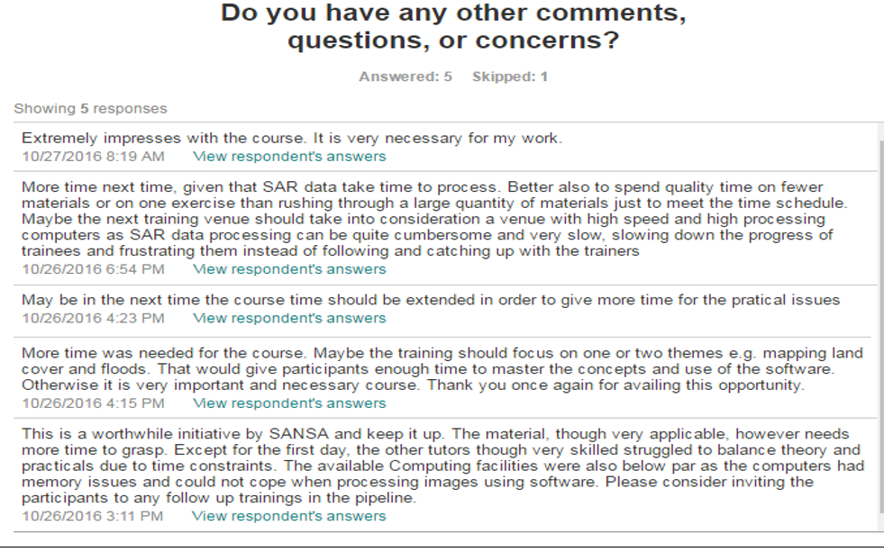
General Feedback on SAR Training workshops - Lessons

Slide 9
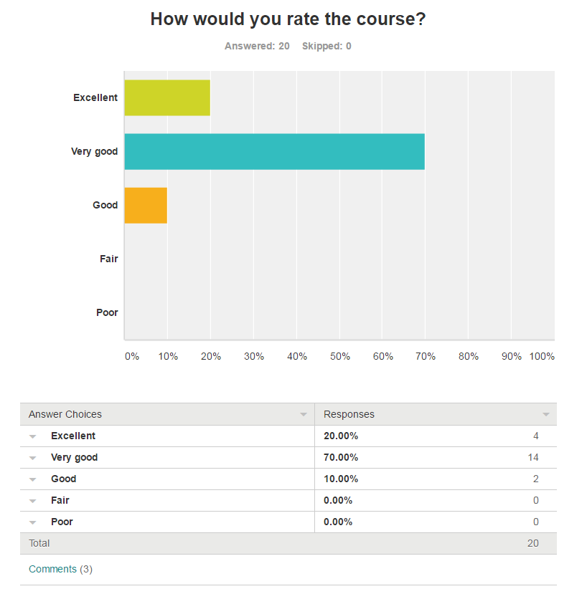
Feedback
The course is very interesting, but in my case English has been a limit, because some parts like explanations of tomography and practical work on biomass have escaped me.
Good plan but not well organized in terms of taking care of the trainees from abroad/ no enough fees to cover the basic needs like visa and super
I learnt a lot on SAR processing but I would more practice

Slide 10
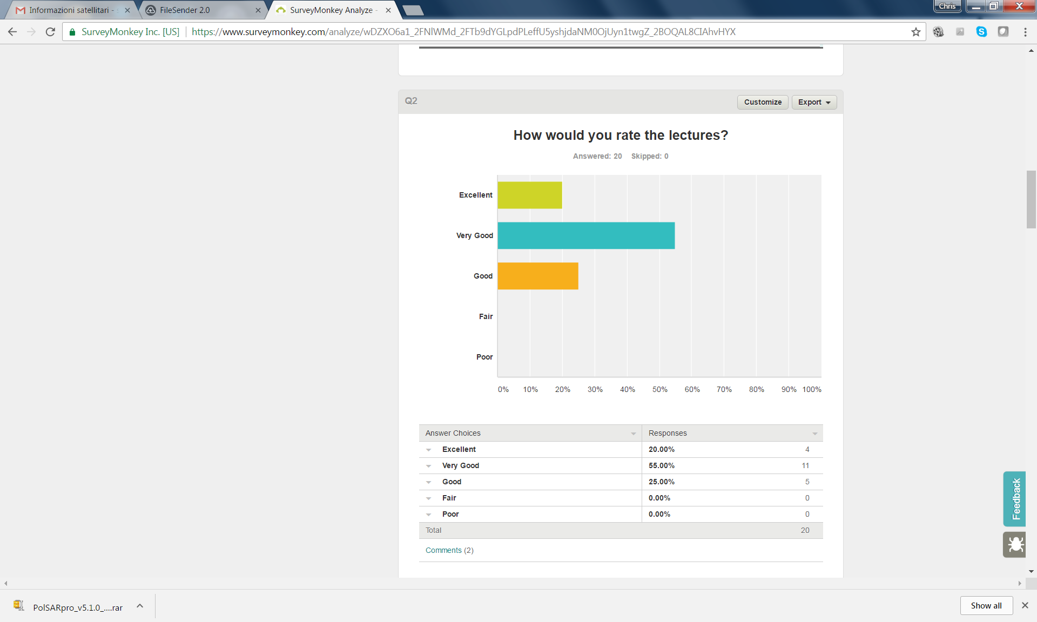
Course too technical with many mathematical calculations.
Good, very very good, some of them capture my focus but living in a French speaking country, I had problem to tilted between accent from different countries but before a few time, it was better

Slide 11
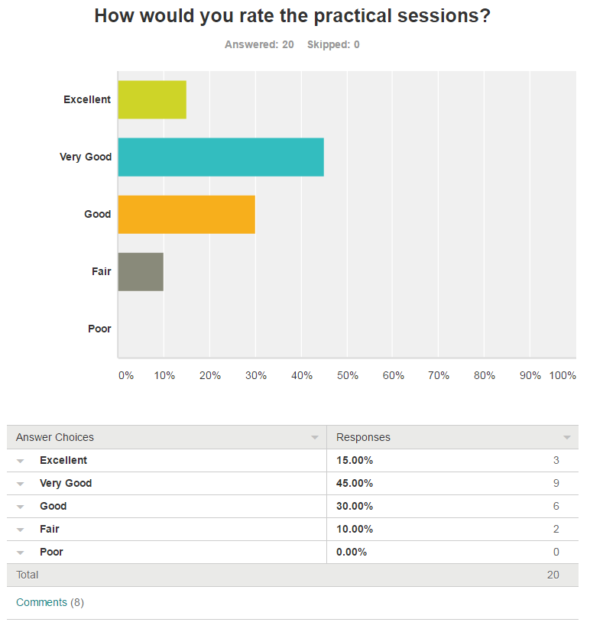
Feedback
Except for TD floods. The trainer was too fast
Much time should be allocated to practical's
But not that enough for practical It must be purely practical.
very good too but the time was too short to go deeper in software. I would like to learn more to produce data for applications like flood mapping or forestry
Insufficient time for too knowledges
I would have liked that practical sessions to be longer
Quick

Slide 12

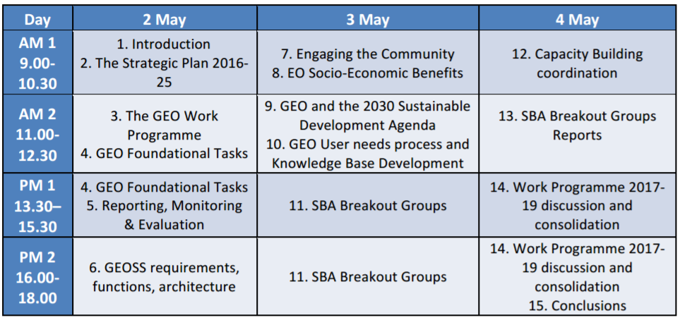
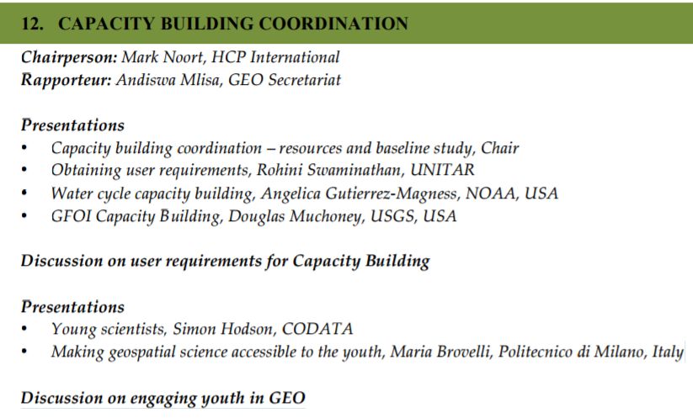
WGCapD participation in Geo-work Program Symposium -2016
Activity | Report
General Objectives: Reflect on the GE0 2016-2025 SP, on its targets and on the implications on the activities that GEO should put in place; Ensure a common understanding of the new arrangements defined by the Strategic Plan Strengthen the participation of the users to the GEO activities; Discuss the content of the GEO Work Programme 2017-2019 & provide clear inputs (technical and programmatic) for its development; Strengthen the involvement of current stakeholders and involve new ones identified in the GE0 2016- 2025 SP; Provide the opportunity to consolidate GEO activities at Global and/or Regional level and explore opportunities for new ones; Explore opportunities with the private sector;
✓

Slide 13
WGCapD participation in Geo-work Program Symposium -2017
Leads/Contributors (being populated)
2017 Deliverables:
GEO capacity building baseline assessment and annual review;
Maintain resource facility (GEOCAB Portal);
Two meetings of the CB Working Group;
Two meetings of the Capacity Building Forum (with participation of GEO Initiatives & Flagships Representatives);
GEO Capacity Building Symposium;
Capacity building database with resource providers, ongoing programmes & activities;
Calendar of training activities;
Brokered activities - match needs with capabilities; and
Annual report on capacity building needs and activities in GEO.
Role | Name | Member/PO | Implementing Entity
Lead (PoC) | Andiswa Mlisa | GEO Secretariat | GEO
Lead | Mark Noort | Netherlands | n/a
Lead | Freek Van Der Meer | ITC | n/a
Contributor | Hilcéa Ferreira | Brazil | n/a
Contributor | Jean-Christophe Desconnets | France | n/a
Contributor | Gregory Giuliani | Switzerland | University of Geneva
Contributor | Angelica Gutierrez-Magness | United States | NOAA
Contributor | Nancy Searby | United States | n/a
Contributor | Eric Wood | United States | USGS
Contributor | Simon Hodson | CODATA | n/a
Contributor | Lucia Lovison-Golob | OGC | n/a
Contributor | Sophie Seeyave | POGO | n/a
Contributor | Luca Delloro | UNITAR | n/a
Contributor | Joerg Szarzynski | UNU | n/a
Contributor | Rohini Swaminathan | WHO | n/a

Slide 14
CB-17 SAR Training @ Bogota
Activity | Report
CB-9 :SAR Training Workshops in Bogota (Columbia, South America) with GEOGLAM 6-9 June 2016 Location: National University of Colombia, Bogota, Colombia Hosted by: The government's Institute of Hydrology, Meteorology, and Environmental Studies (IDEAM) hosted the meeting on the campus of the National University of Colombia Participants in AmeriGEOSS Week 2016, including Americas Caucus members, Coordination Working Group members, and training participants. WGCapD member from ESA (Francisco Sarti) provided support for Dr. Jill Pearse from the Universidad de los Andes to provide SAR training. On behalf of WGcapD, instruction was provided on the application of SAR data for two days. Instruction for the remaining two days was provided by NASA. Other CEOS WGCapD members contributed significantly to the training,. These contributors include NOAA, USGS, and INPE. | Two of the four courses were SAR related (1) GEOGLAM, (50 students) Introduction to the use of aperture radar (SAR) data for monitoring agriculture - available systems, Pre-processing and general view of the application of SAR and its use in the monitoring of agriculture. The second session of SAR (25 students) focused on applications in the areas of seismology and volcanology. The training included an overview of SAR, an introduction to geohazards applications of InSAR, and the specific application to volcanic deformation and the seismic cycle. On the last day of the workshop, the participants were required to complete a survey of the course, with the following results: • More than 50% highly agreed or agreed objectives were clearly defined. • Less than 50% thought participation was promoted. • More than 50% found the topics relevant to their work • Over 50% thought the content was organized and easy to follow. • More than 75% found the material and presentations helpful. • More than 75% acquired knowledge useful to their work. Lessons learned from the instructors was the importance of teaching in Spanish for better uptake by the participants. Lessons learned by the organizers is the importance to be clear about responsibilities and attribution between the various contributors to the training.

Slide 15
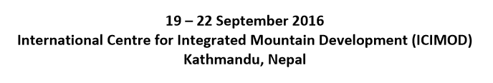
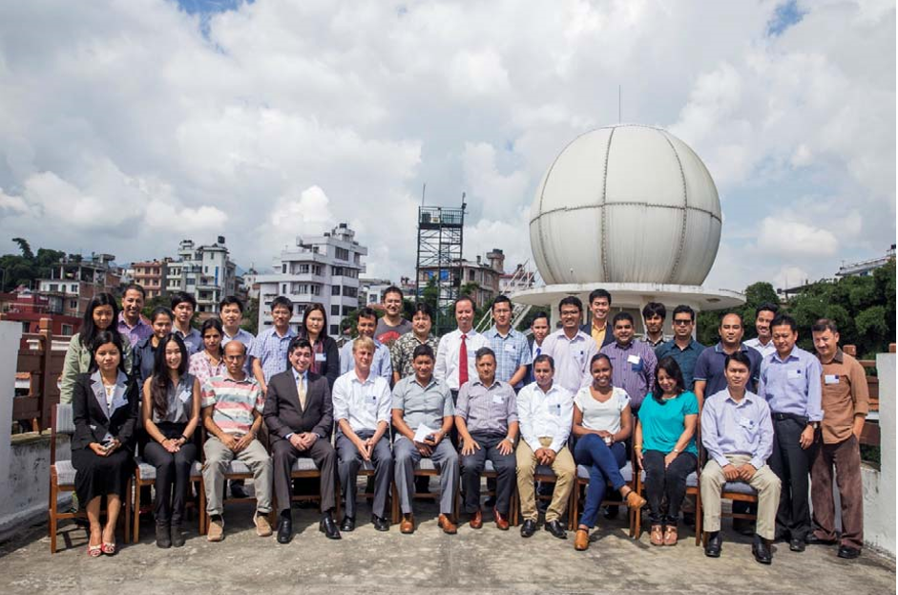
SRTM-2 Digital Elevation Model Applications Training Workshop
Objectives

Slide 16
SRTM-2 Digital Elevation Model Applications Training Workshop
Objectives
The training focused on use of freely and publicly available 30-meter elevation SRTM-2 datasets, for
  • Extracting terrain parameters
  • Modeling water flow for hydrology
  • Creation of relief maps
  • Rendering of 3D visualizations
  • Base mapping
  • Surface analysis
This Workshop was continued effort of NASA, USAID, NOAA and USGS to support the use and promotion of SRTM-2 data through Regional Workshops.
This was built on previous SRTM-2 workshops in Nairobi, Kenya (2013), Pretoria, South Africa (2015), and Puebla, Mexico (2015).

Slide 17
SRTM-2 Digital Elevation Model Applications Training Workshop
Training Focus
Ability to describe availability, applications, and limitations of Satellite DEMs at varying spatial scales, from submeter to 90 m. especially for
• Watershed delineation
• Landslide hazard zonation
• Height Above Nearest Drainage (HAND): Flood Inundation
• Identification of Priority Areas for Soil Erosion Management in the Koshi Basin
Ability to use DEM data for delineation of river basin;
Ability to use DEM data for flood modelling and inundation mapping
Understanding of accuracies of flood mas produced using DEMs at various spatial scales;
Ability to describe applications and accuracies of using DEMs in flood modeling and inundation maps.

Slide 18
SRTM-2 Digital Elevation Model Applications Training Workshop
Trainees and Trainers
A total of 22 participants, with 9 females, attended the training, comprising of representations from 18 different agencies.
Participants are from relevant Government Ministries and agencies in Hindu Kush Himalaya (HKH) and Mekong regional countries.
Training was facilitated by subject experts from SERVIR hubs based in ICIMOD, Regional Center for Mapping of Resources for Development (RCMRD) based in Nairobi, Kenya and the University of Washington, Seattle.

Slide 19
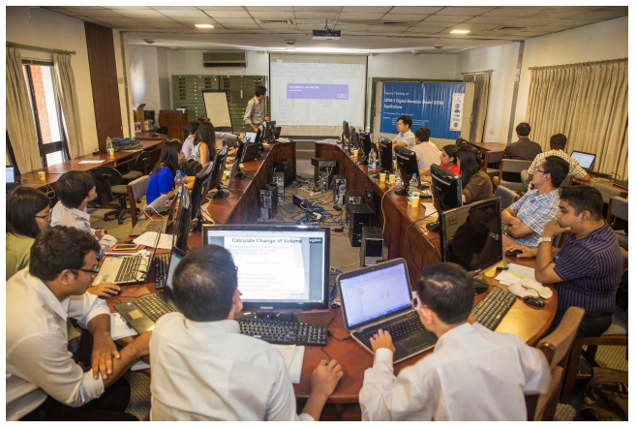
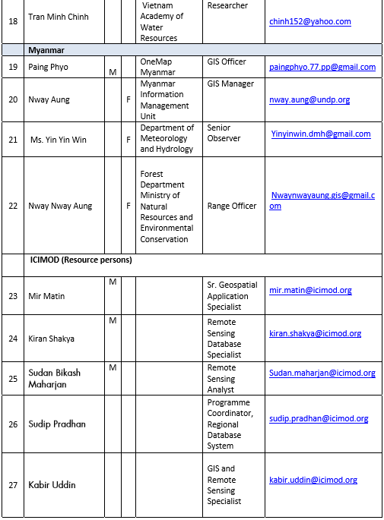
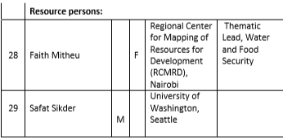
And the Trainers

Slide 20
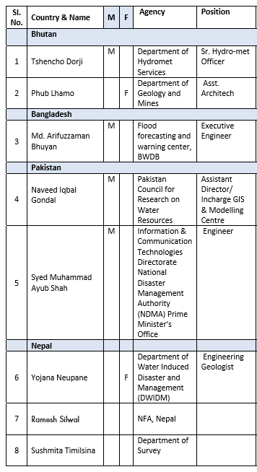
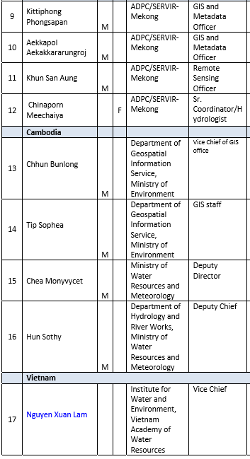
SRTM-2 Participants

Slide 21
CEOS: SAR Webinars
First proposal was made in last Annual Meet.
Discussed in all Telecons as Agenda point.
ISRO presented a proposal of SAR Webinars
It was decided to do it in 2017
Exclusive telecons were conducted for discussing and finalizing the topics and participating agencies.
Final version of the Webinars agreed by WG will be presented in Annual Meet (item# 32)

Slide 22
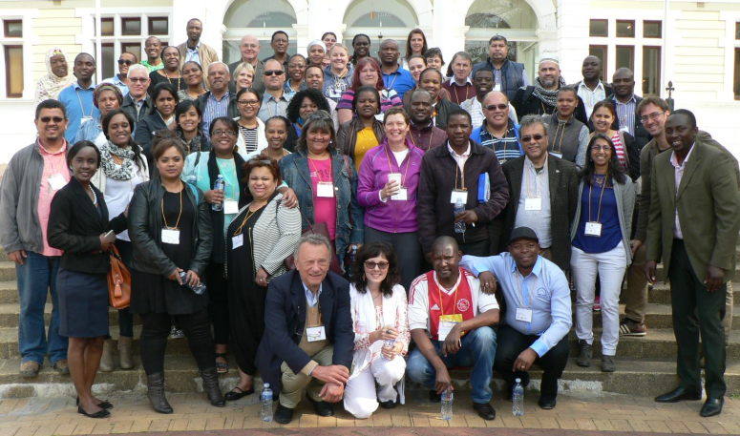
Gift Workshop for Teachers
Activity | Progress
Geosciences for Teachers (GIFT) Workshop in Cape Town, SA 27-28 August 2016, Location: Iziko Museum Organised: European Geoscience Union Workshop Theme: Mineral Resources and Natural Hazards. | WGCapD represented by ESA and SANSA Also distributed: ESA School Atlas, SANSA School Atlas, SANSA FUNDISA Disc and access to the its Portal

Slide 23
Committee on Earth Observation Satellites
Thank you for your support

Slide 24
SRTM- Training Workshops
19-22 Sept- 2016
A four-day Regional Training on Shuttle Radar Topography Mission (SRTM-2) took place from 19 – 22 September 2016 at the International Centre for Integrated Mountain Development (ICIMOD) Headquarters, Kathmandu, Nepal.
The training focused on the use of 30-meter elevation SRTM-2 datasets, which are freely and publicly available, and are extremely valuable for addressing critical issues impacted by the Earth’s topography, including water flow, heavy rainfall, river plain flooding, coastal storm surges, agricultural stresses; and public health challenges.
Participants were from relevant Government Ministries and agencies in Hindu Kush Himalaya (HKH) and Mekong regional countries, the training was facilitated by experts from NASA SERVIR hubs
Expected outcomes: The ability to describe the availability, applications, and limitations of satellite DEMs at varying spatial scales in different thematic areas
Ability to use DEM data for demarcation of river basins, flood inundation mapping, and hydrological modeling
Understanding of the accuracies of DEM derived products at various spatial scales.
The US Government (NASA, USAID, NOAA and USGS) and CEOS (WGCapD), and the Secure World Foundation (SWF) were partners and collaborators with ICIMOD to organize the training.

