Slide 1

AGEOS CB ACTIVITIES
Committee on Earth Observation Satellites
AGEOS
By Aboubakar Mambimba Ndjoungui
Agenda Item 23
CEOS 6th Working Group for Capacity Building and Data Democracy (WGCapD)-6 Annual Meeting
DLR Oberpfaffenhofen, Germany
27th-29th March, 2017

Slide 2
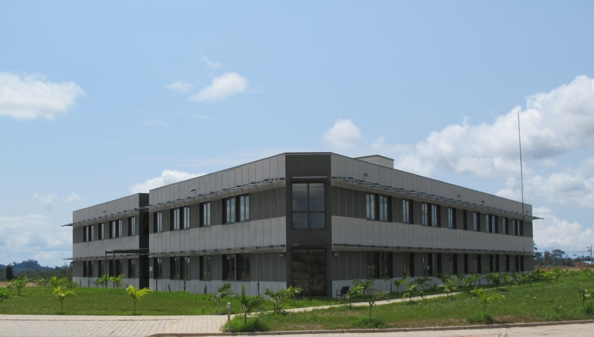
WGCapD-6 Annual Meeting 2017
DLR Oberpfaffenhofen, Germany
27th-29th March 2017
Agenda
AGEOS overview
2016 accomplishments
2017 accomplishments
2018-2019 plans

Slide 3
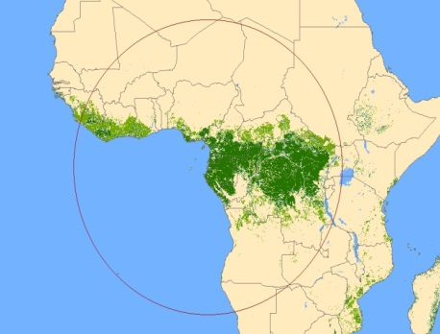
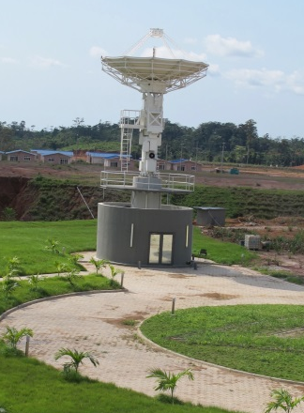
WGCapD-6 Annual Meeting 2017
DLR Oberpfaffenhofen, Germany
27th-29th March 2017
AGEOS overview 1/3
A public agency created in February 2010;
Has a ground station consisting of a 7.30 m antenna (SAR and optical) covering 24 countries (antenna plot about 2800 km at 5° elevation) and a competence center for processing, archiving and providing EO data to the end users;
Its mission are :
- to build a national space infrastructure;
- to support the capacity building in EO acquisition, processing
and use in the country and central Africa region;
- to lead the regional cooperation (research, innovation, thematic application, EO symposium, etc.) in the use of EO to face to the developing challenges;
- to provide EO data to public and private sectors for natural resources and land use monitoring for a sustainable development ;
- to assess the public policies using satellite images.

Slide 4
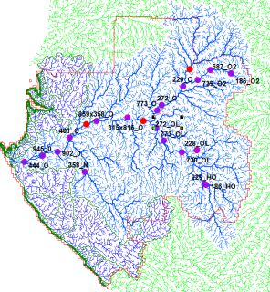
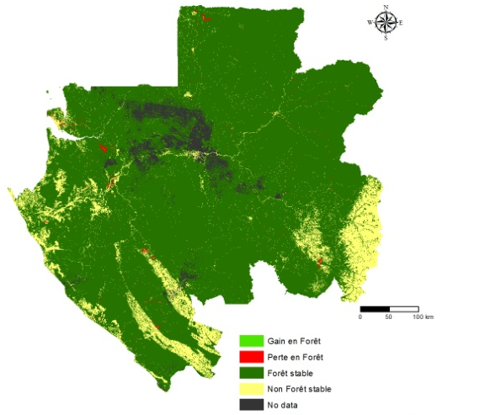
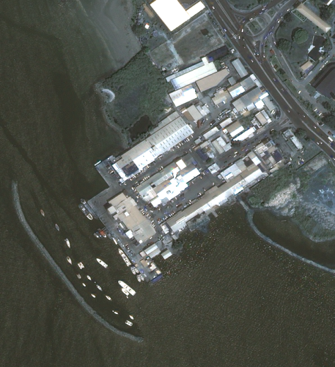
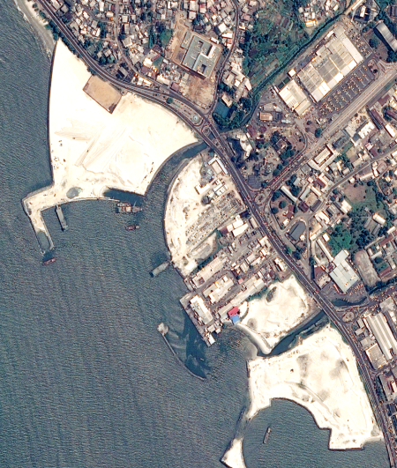
WGCapD-6 Annual Meeting 2017
DLR Oberpfaffenhofen, Germany
27th-29th March 2017
AGEOS overview 2/3
The Gabonese government has identified four themes
related to the country's development issues :
Forest,
Coastal Management (maritime surveillance, climate change impacts monitoring on the coastline, pollution, piracy, etc.)
Water Resources,
Urban growth monitoring.
337,26 km² (0,12%)
881,42 km² (0,33%)
225 882,14 km² (85,05%)
27 876,94 km² (10,5%)
10 256,934 km² (3,97%)
Forest cover mapping Y2015

Slide 5




WGCapD-6 Annual Meeting 2017
DLR Oberpfaffenhofen, Germany
27th-29th March 2017
AGEOS overview 3/3
International commitments
In order to ensure scientific and technical cooperation at the international level, AGEOS has signed several agreements to work with other international structures in the field of earth observation :
GEO,
CEOS,
USGS (US),
NASA (US),
ESA (EU),
CNES (FR),
IRD (FR),
IGNFI (FR)

Slide 6
WGCapD-6 Annual Meeting 2017
DLR Oberpfaffenhofen, Germany
27th-29th March 2017
2016 accomplishments
Web mapping tools training;
CB in forest monitoring with optical and SAR data;
CB in the use of ERDAS Pro software for EO processing ;
CB in the use of Google Earth Engine tool;

Slide 7
WGCapD-6 Annual Meeting 2017
DLR Oberpfaffenhofen, Germany
27th-29th March 2017
2017 accomplishments
Workshop on REDD+ tools in Abidjan 6-7 february organises by GFOI;
AfriSAR workshop in Libreville;
WGCapD SAR workshop in Libreville.

Slide 8
WGCapD-6 Annual Meeting 2017
DLR Oberpfaffenhofen, Germany
27th-29th March 2017
2018-2019 plans
CB in the assessing post-disaster needs using satellite imagery in libreville, May 2017;
CB in the use of MapBuilder for the web mapping, April to may 2017;
Lidar and SAR CB with the support of NASA at Goddard space centre;
Master in EO and remote sensing in French Marne-La-Vallée University for 10 people from AGEOS.
Thank you for your attention

