Slide 1

GEOGLAM
Committee on Earth Observation Satellites
Alyssa Whitcraft and Jan Dempewolf
on behalf of GEOGLAM Secretariat
(slides prepared by Alyssa Whitcraft)
Agenda Item # 22
CEOS 6th Working Group for Capacity Building and Data Democracy (WGCapD)-6 Annual Meeting
DLR Oberpfaffenhofen, Germany
27th-29th March, 2017

Slide 2
Some Context 1/3
GEOGLAM’S GOAL:
Strengthened operational monitoring systems which use EO to generate information that empowers science-based decision making, action taking, and policy in realms of food security and sustainable agriculture, in the context of climate change.
Critical to this is developing institutional capacity for using EO data – but it has to be driven by the end-user needs.

Slide 3
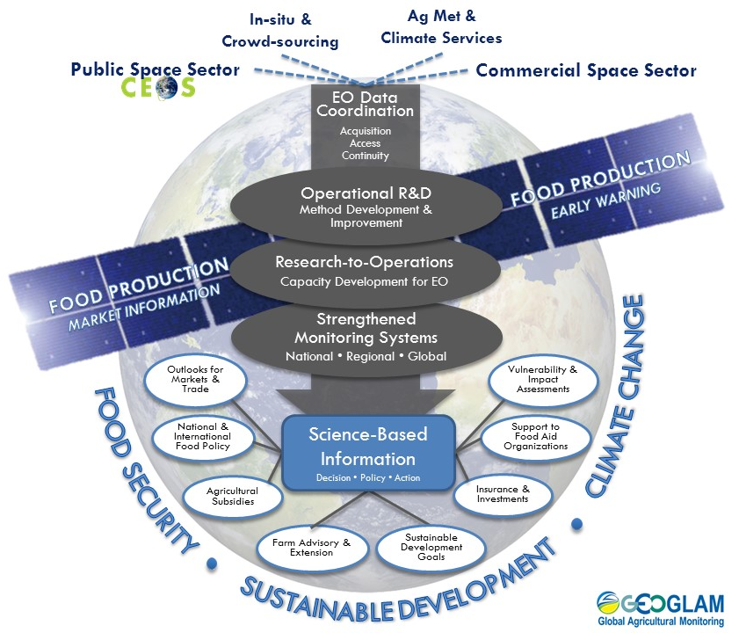
Some Context, 2/3
New Workflow Diagram for GEOGLAM
A flow from data through methods to information to decisions
BUT
The decisions at the bottom drive all information, methods, and data needs!
Capacity development is now positioned as CRITICAL step to operational monitoring [our goal]

Slide 4
Some Context 3/3
GEOGLAM’S GOAL:
Strengthened operational monitoring systems which use EO to generate information that empower science-based decision making, action taking, and policy.
Historically, GEOGLAM’s capacity development activities were an assemblage of existing efforts – no real coordination.
We never quite reached the point of having a comprehensive plan or vision for GEOGLAM Coordination of CapDev…
  …Based on end-user needs
  …For connecting the dots between countries, activities, needs
  …For ensuring carryover of results from one project to the next
  …For connecting with other WGs, leveraging resources
  …For facilitating/emphasizing South-South knowledge transfer
Starting in 2015, we recognized that regional networks would be our key to accomplishing this.
Further, we are seeking funding now to develop comprehensive capacity development plans for GEOGLAM.

Slide 5
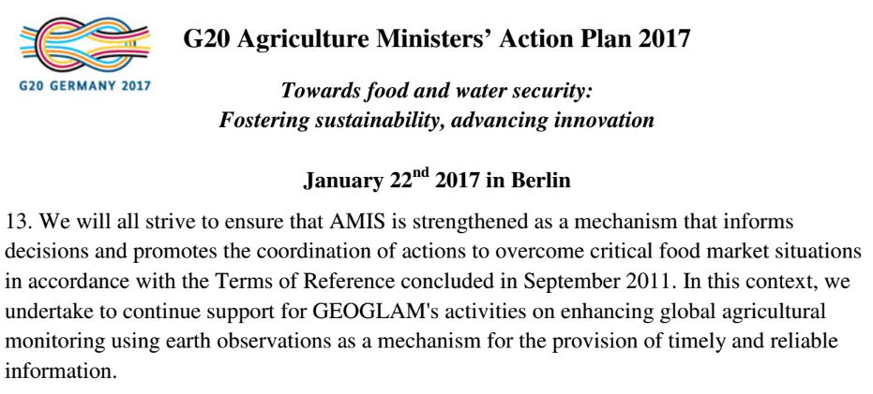
2016 Accomplishments
GEOGLAM-wide:
  Re-endorsement of GEOGLAM by G20 – Signaling greater support, strengthened political mandate
    EO for timely, reliable information
Regional Network Highlights:
  4-day GEOGLAM Training at AmeriGEOSS Week, Colombia, June 2016
    Coordination between GEOGLAM Latinoamerica and AmeriGEOSS
  Launch of AfriGAM – joint contribution to AfriGEOSS and GEOGLAM
    Full day workshop on needs, priorities, and objectives in Uganda, October 2016
  Asia-RiCE SARI/LCLUC Workshop, Vietnam October 2016
JRC, FAO, UMD, USAID/FEWS NET, and other partners continue to have strong bilateral/multilateral relationships and accomplishments

Slide 6
2017 Accomplishments & Plans
Activities [planned pending support]:
  Above all: secure funding for these activities; leverage existing funding for activities across GEOGLAM for better coordination around capacity development
  Build AmeriGEOSS alongside GEOGLAM Latinoamérica
  Develop bilateral and multilateral collaborations in regional networks in the context of GEO, GEOSS, & GEOGLAM
    e.g. R&D sites, training workshops (where desired), methods sharing, cal-val & intercomparison activities
  Coordinate with other international & national capacity development activities and groups (e.g. CEOS WG CapD; START; NASA SERVIR & DEVELOP; ESA LEARN EO)
  Develop a comprehensive capacity development plan to guide connectivity between efforts
Events:
  May 28-31, 2017: GEOGLAM Latinoamérica session at Brazilian Remote Sensing Symposium (inc. 1-day training, Argentine/Brazilian instruction)
  AmeriGEOSS Week (August 2017): provisional plans for agricultural monitoring training

Slide 7
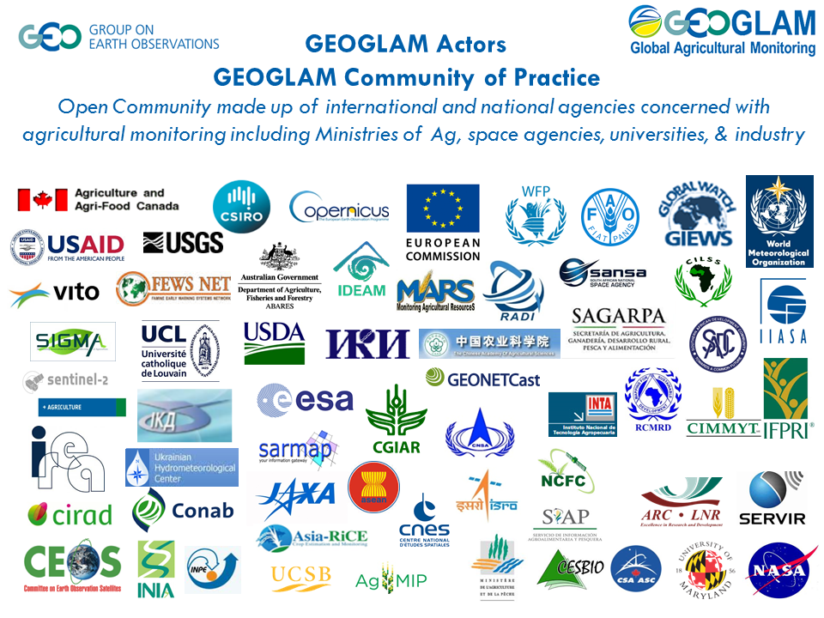
GEOGLAM Community of Practice

Slide 8
The Next Steps
GEOGLAM has less use for training events and webinars – these are great for outreach and community building and great for developing individual interest and capacity…
…but without institutional support, how can the outcomes be sustained? How can operational systems be built?
  Institutional support comes through those stakeholders owning and driving the process based on their information needs…
    Needs assessments are critical!
Perhaps the big plan for 2017-2018 should be on identifying a few case studies and piloting a user-driven WGCapD-GEO[GLAM] collaboration on capacity development
We (esp. Whitcraft, GEOGLAM Sec/NASA/UMD) would be very interested in working in a concerted way on this with WGCapD
  Initial discussions with Nancy Searby (NASA) and others

Slide 9
Thanks!
Contact
  Alyssa Whitcraft – akwhitcraft@geoglam.org
  Jan Dempewolf – dempewol@umd.edu

