Slide 1

Capacity Building GFOI SilvaCarbon
Committee on Earth Observation Satellites
Organization: USGS
Agenda Item #18
CEOS 6th Working Group for Capacity Building and Data Democracy (WGCapD)-6 Annual Meeting
DLR Oberpfaffenhofen, Germany
27th-29th March, 2017

Slide 2
WGCapD-6 Annual Meeting 2017
DLR Oberpfaffenhofen, Germany
27th-29th March 2017
Presenter Guidance
For the Agency, WG, GEO presentations (Agency numbers 6 – 22):
  Summarize 2016 accomplishments
    In capacity building for your agency
    In capacity building as a contribution to WGCapD
  Summarize 2017 accomplishments & plans
    In capacity building for your agency
    In capacity building as a contribution to WGCapD
    Please fill out schedule template also
  Summarize 2018-2019 plans (tentative schedules by quarter)
    In capacity building for your agency
    In capacity building as a contribution to WGCapD
    Please fill out schedule template also
Presentation materials should be sent to kim.e.holloway@nasa.gov no later than Monday 20th March for inclusion on the meeting website.

Slide 3

Global Forest Observation Initiative (GFOI)
There are many organisations supporting the implementation
of REDD+ (UNREDD, FAO, World Bank …)
GFOI’s unique features are
  its links to space agencies and their commitment to acquire data needed for annual forest monitoring
  Participation by many experts in Earth Observation, organisations involved in REDD+ and developing countries
GFOI has:
  Active support and involvement of 13 space agencies
  Active involvement of key REDD+ and GHG institutions: UNFCCC, FAO, WB, IPCC
  Explicit endorsement by 90 countries (GEO) and 67 international organisations
  Active involvement of developing country participants throughout FAO and Silvacarbon

Slide 4







USG SILVACARBON PARTNERS
U.S. Agency for International Development
U.S. State Department
U.S. Geological Survey
U.S. Forest Service
NASA
U.S. Environmental Protection Agency
Smithsonian Institution
As well as U.S. universities, NGOs, donors and industry

Slide 5
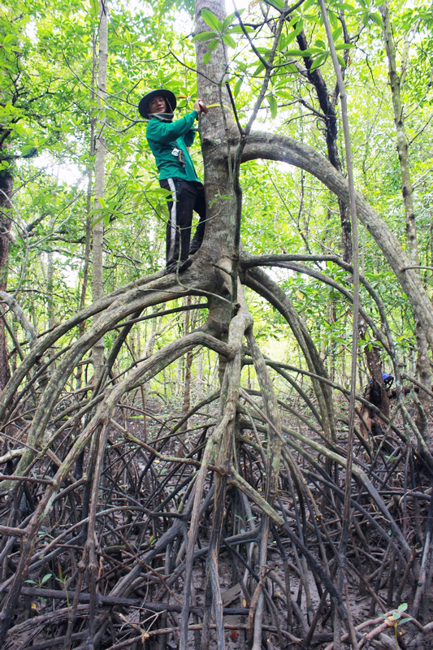
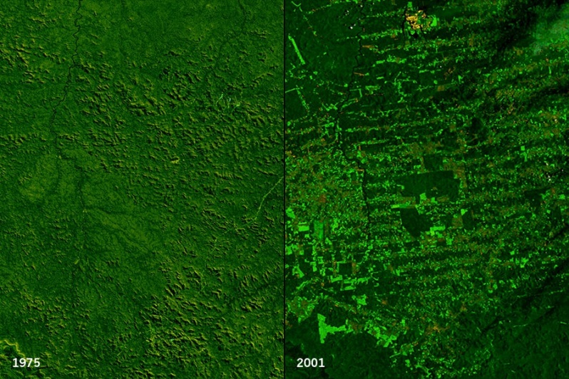
SILVACARBON OBJECTIVES
Improved Forest Inventories
Improved remote sensing
Integration of remotely sensed and ground data
GHG inventory and reporting (ALU tool)
Advancing research
Goddard Space Flight Center Scientific Visualization Studio/NASA. ondoña, Brazil – Human deforestation impact

Slide 6
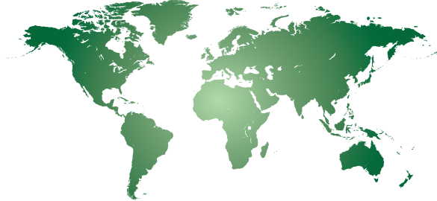
WGCapD-6 Annual Meeting 2017
DLR Oberpfaffenhofen, Germany
27th-29th March 2017
Americas
Belize
Brazil
Colombia
Costa Rica
Ecuador
El Salvador
Guatemala
Honduras
Mexico
Nicaragua
Panama
Peru
Asia
Bangladesh
Cambodia
Indonesia
Lao PDR
Nepal
Philippines
Thailand
Vietnam
z
z
z
z
z
z
z
z
z
z
z
z
z
z
z
z
Africa
Cameroon
DR of Congo
Gabon
R of Congo
Zambia
z
z
z
z
z
z
z
z
z

Slide 7
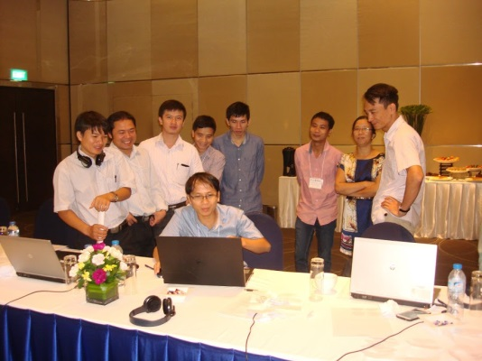
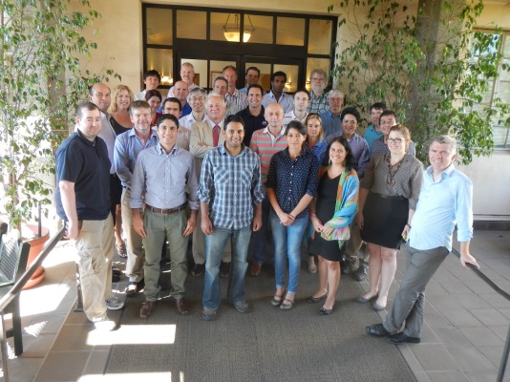
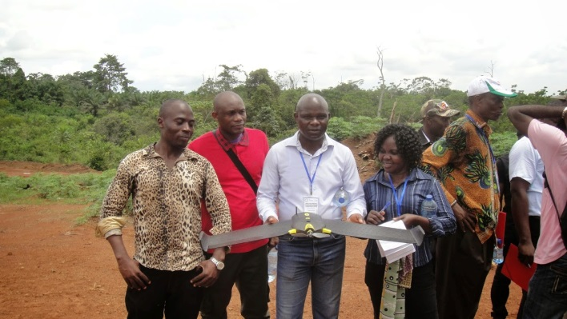
SILVACARBON REMOTE SENSING AREA
Does not developed tools, but support the development and testing of tools.
Present all GFOI capacity building efforts supporting forest cover mapping for reporting to REDD+
Support countries establish partnerships and implementing remote sensing methodologies
Promote research around EO for forest monitoring

Slide 8
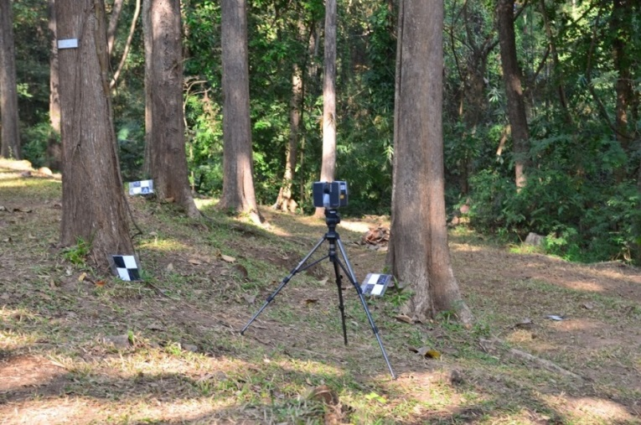
SILVACARBON ACTIVITIES
Regional GFOI Workshops
15 in Latin-America
https://sites.google.com/site/talleresgeofct/
6 in SE Asia
https://sites.google.com/site/gfoiseasiacapacitybuilding/
2 in Central Africa
https://sites.google.com/site/gfoiafricacapacitybuilding/home/first-gfoi-forest-monitoring-workshop
Objectives
Showcase operational methodologies for different aspects of forest monitoring
Provide and space for discuss new cutting edge research methodologies
Provide an space for testing and demonstration of field methods using new technologies

Slide 9
SilvaCarbon Key Accomplishments
USG Inter-agency coordination
International coordination in the REDD+ MRV arena
Leveraging funding
Contribute to building NFMS that are operational
Provision of data
Strengthening national science partnerships
Technical advisory role to nations and US policy

Slide 10

SilvaCarbon Looking Forward
FY17-19 strategy
    Geographic priorities
      Increase bilateral engagement
      Increase collaboration with other capacity building programs in support of land cover monitoring
    Key technical support areas
      Support Nationally Determined Contributions (NDCs)
      Development of baselines for REDD+ reference levels and NDCs
      Expanding beyond forests/REDD+ to the landscape scale
      Integration of subnational activities with national strategies
      Focusing on transparency

Slide 11

Sylvia Wilson – USGS
snwilson@usgs.gov
More information available at
www.SilvaCarbon.org

