Slide 1
SEO Capacity Building
Agenda #15
Brian Killough
CEOS Systems Engineering Office (SEO)
NASA Langley Research Center
CEOS 6th Working Group for Capacity Building and Data Democracy (WGCapD) Annual Meeting
DLR Oberpfaffenhofen, Germany
27th-29th March, 2017

Slide 2
SEO CB Activities 2016/2017
2016 CB Activities for the CEOS SEO
COVE Training at SilvaCarbon Workshops – May, Panama
Colombia Data Cube Training - Aug 2016, Bogota, Colombia
Global Open Data for Agriculture and Nutrition (GODAN) Conference, COVE and Data Cube exhibition booth, Sept 2016, New York, NY, USA
World Bank visits – April, July, September – Washington, D.C., USA
2017 CB Activities for the CEOS SEO
SERVIR Data Cube Training Workshop – Feb, Huntsville, AL, USA
World Bank visit – February – Washington, D.C., USA
Vietnam Data Cube Training – April, Hanoi, Vietnam
IGARSS Data Cube Workshop – July, Fort Worth, Texas, USA
GEO Plenary – CEOS exhibition booth – Oct, Washington, D.C., USA

Slide 3
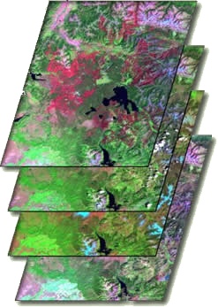
What are Data Cubes?
Data Cube = Time-series stack of spatially aligned pixels ready for analysis
Proven concept by Geoscience Australia (GA) and the Australian Space Agency (CSIRO) and planned for the future USGS Landsat archive.
Analysis Ready Data (ARD) ... Data which has been pre-processed and ready for analyses, thereby reducing the burden on users
Open source software approach allows free access, promotes expanded capabilities, and increases data usage.
Unique features: exploits time series, increases data interoperability, and supports many new applications.
TIME

Slide 4
Our 5-year Vision
A solution supporting CEOS objectives …
Build capability of users to apply CEOS satellite data
Supporting priority CEOS/GEO agendas (SDGs, Paris and Sendai)
CEOS Agencies wanting to participate …
Through provision of CEOS Analysis Ready Data (ARD) products
Contributing to development and uptake of solution
Customers feel that they are the focus …
Training materials and easy installation/maintenance
A CEOS “Open Data Cube” brand that people know and trust
Scalable solution …
Supporting Data Cubes in 20 countries by 2022
Key partners (e.g. FAO, World Bank) supporting data cube projects
An active Data Cube community …
Users helping each other and open source contributions

Slide 5
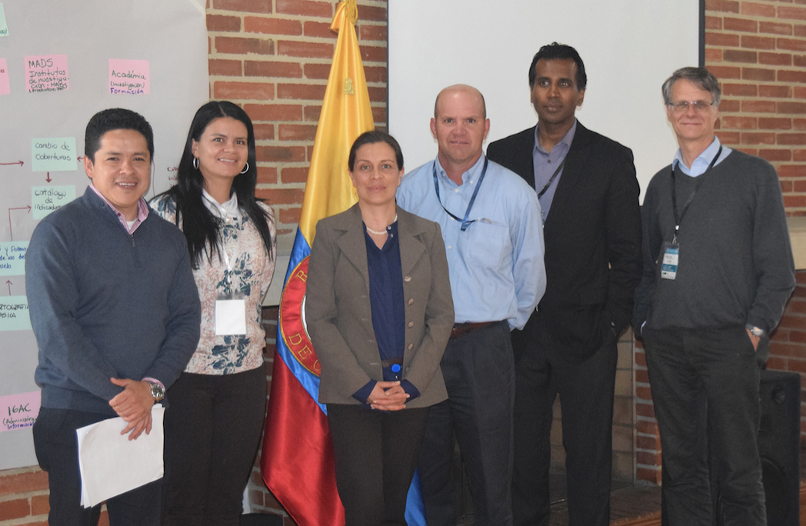
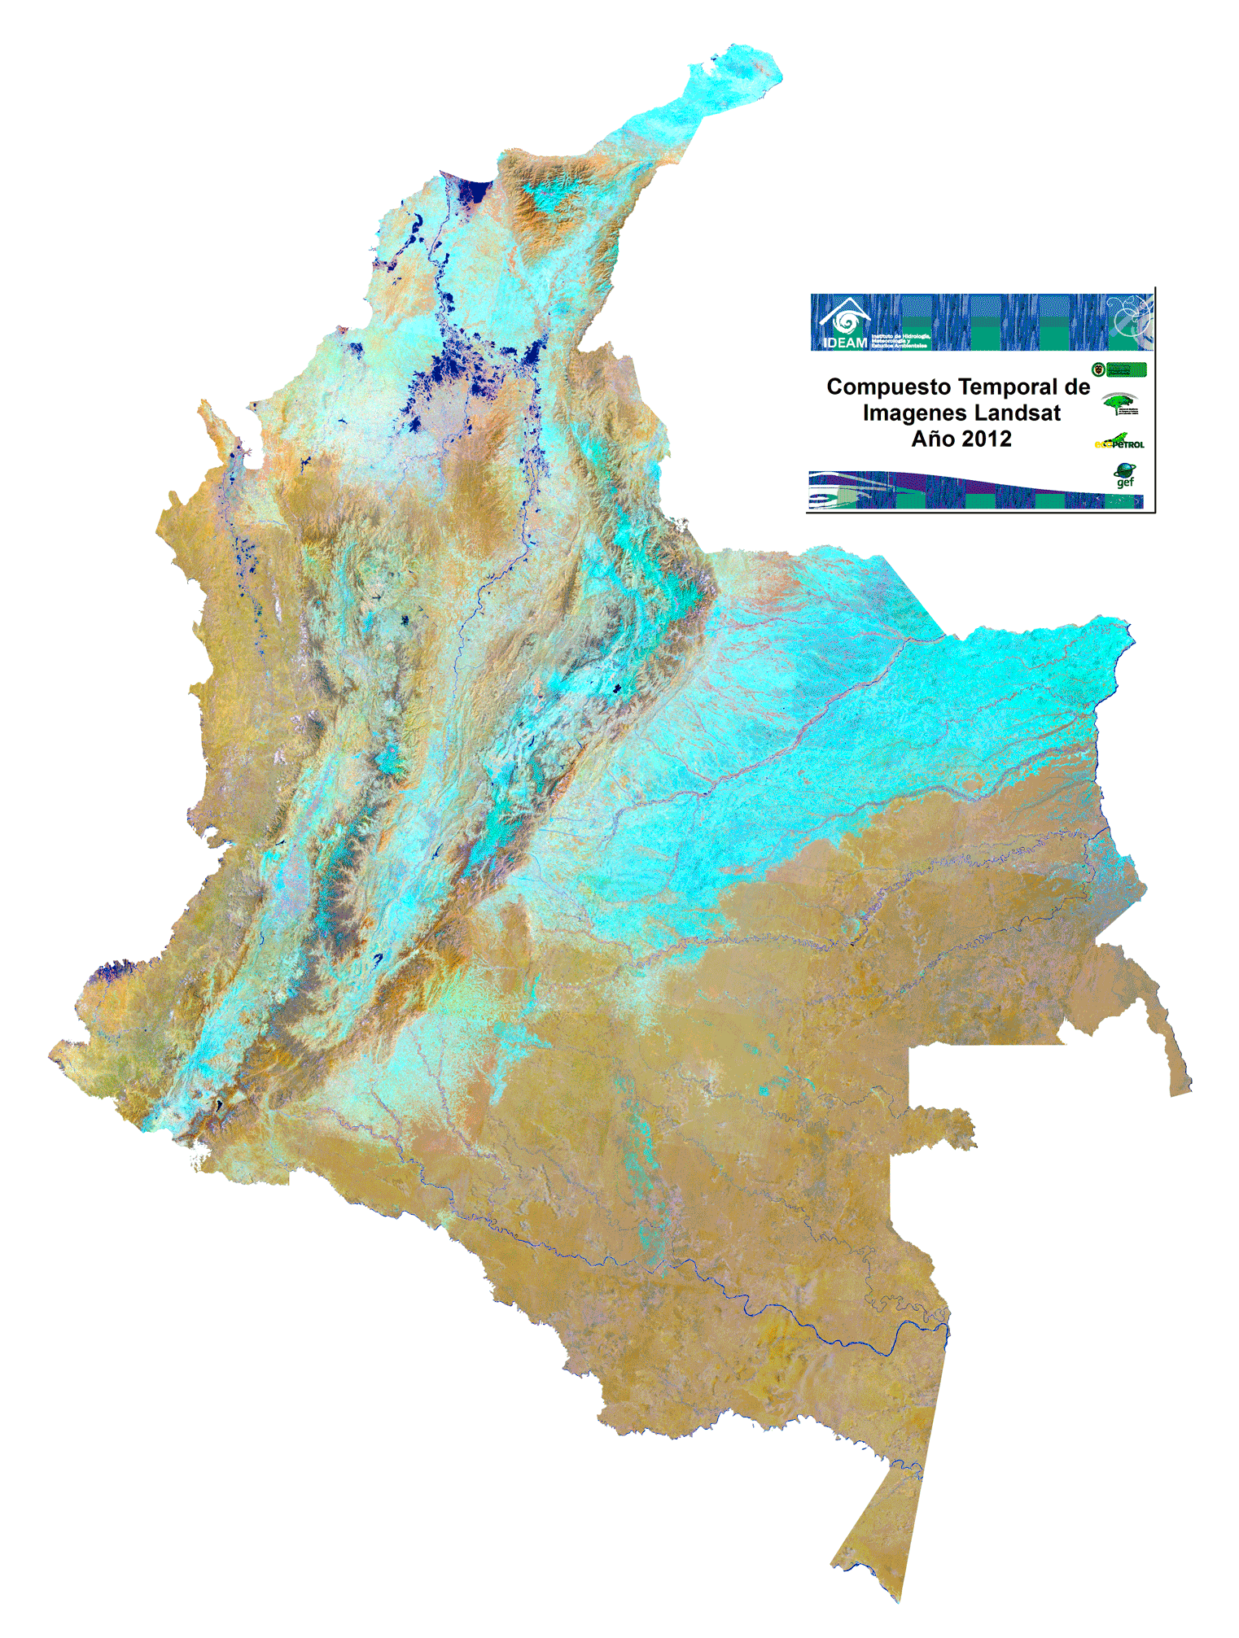
Colombia Prototype
The Government (IDEAM) and University (Andes) have made considerable progress in learning how to create and use Data Cubes!
A complete country-level Landsat Data Cube (25,000 scenes back to year 2000) was completed in Dec 2016.
Forest mapping and land change detection are the primary application needs.
Future plans to add more datasets and applications.
The SEO will continue to support IDEAM and the University of Andes in the coming year.

Slide 6
Switzerland Prototype
SEO was approached by UNEP GRID Geneva and the Univ. of Geneva to develop a Data Cube pilot project. Significant computing and programming resources exist, so little effort was needed to get them started.
SEO visited UNEP GRID Geneva on February 14 to discuss the progress of the project. The group has made excellent progress installing a small data cube within the country and attaching the application user interface.
The meeting resulted in 15 actions that the group will pursue in the coming year. These actions are focused on Landsat data, data cube creation, and application testing.

Slide 7
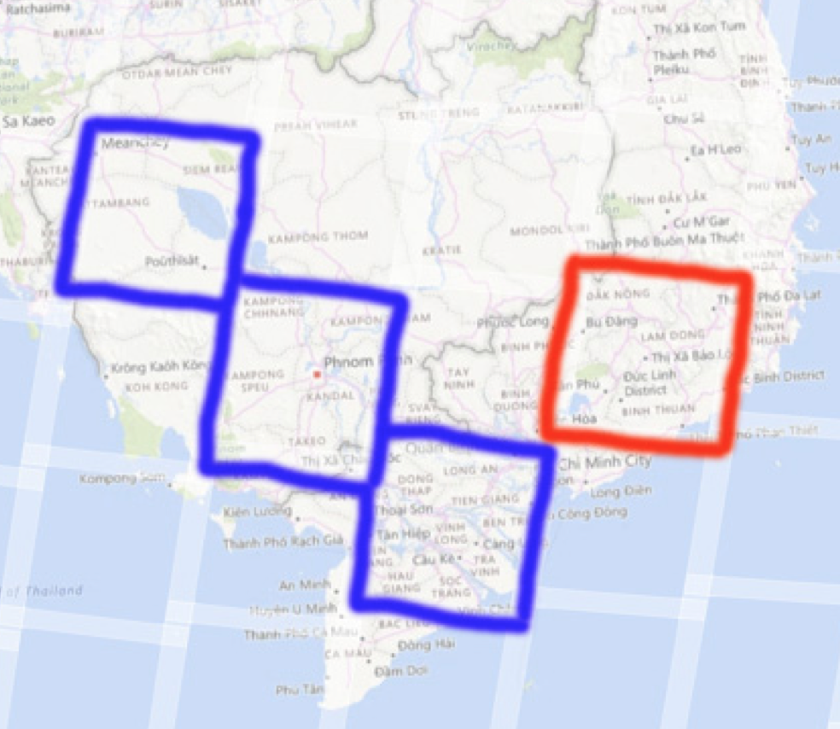
Vietnam Prototype
SEO and CSIRO developing plans for a Vietnam Data Cube. The primary applications are rice and water management.
Two sample data cubes are under development with links to SERVIR (blue) and GFOI (red).
BLUE: Mekong Basin cube for Cambodia and Vietnam for SERVIR testing.
RED: Vietnam cube to support initial deployment training and a data interoperability study.
Datasets include: Landsat-7 (2000-2016), Landsat-8 (2015-2016), Sentinel-1 (2015-2016), JERS mosaic (1996), ALOS mosaics (2007, 2008, 2009, 2010, 2015, 2016).

Slide 8
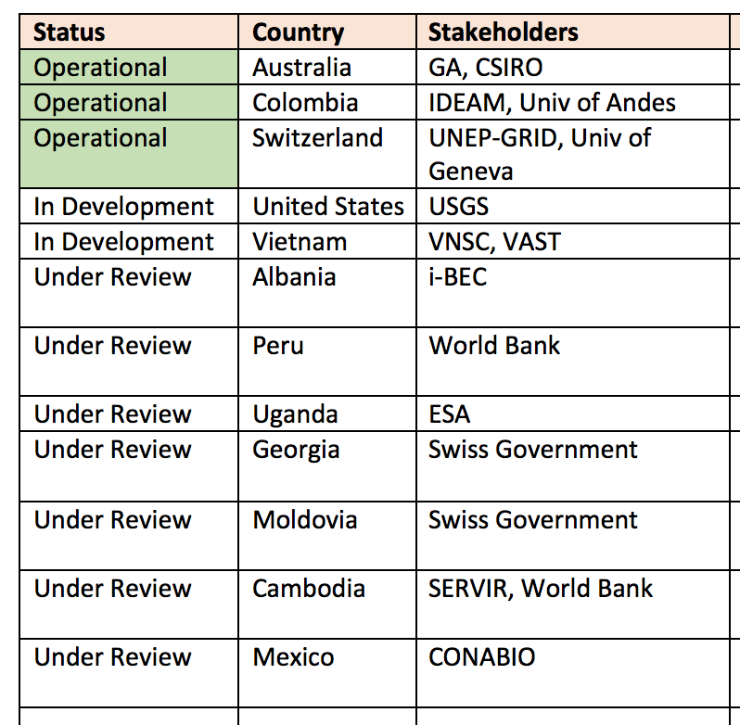
More countries …
The SEO continues to work on a number of possible country-level data cubes.
Australia (CSIRO) has just hired a new Python programmer to support data cube installations in the Asia region

Slide 9
SEO CB Activities 2018+
COVE Training at SilvaCarbon Workshops – TBD
Country-based Data Cube Training – TBD
IGARSS Conference – CEOS and Data Cube exhibition booth – TBD
Data Cube Training Workshops – TBD (likely linked to IGARSS)
World Bank visits – TBD
GEO Plenary – CEOS exhibition booth – TBD

