Slide 1
Capacity Building Activities in Earth Observation at CRECTEALC
Committee on Earth Observation Satellites
CRECTEALC
Agenda Item # 15
CEOS 6th Working Group for Capacity Building and Data Democracy (WGCapD)-6 Annual Meeting
DLR Oberpfaffenhofen, Germany
27th-29th March, 2017

Slide 2
WGCapD-6 Annual Meeting 2017
DLR Oberpfaffenhofen, Germany 27th-29th March 2017
Regional Centre for Space Science and Technology Education for Latin America and the Caribbean (CRECTEALC)
Mission: To Prepare highly qualified personnel from countries in Latin America and the Caribbean in:
Earth Observation (Remote Sensing, GIS, DTM*, Models*)
Satellite Communications
Satellite Meteorology
Basic Space Sciences
GNSS
Space Policy and Space Law
*Added in 2016

Slide 3
WGCapD-6 Annual Meeting 2017
DLR Oberpfaffenhofen, Germany 27th-29th March 2017
Regional Centre for Space Science and Technology Education for Latin America and the Caribbean (CRECTEALC)
EO capacity-building 2016 activities:
RS & GIS Course, September 2015 to August 2016 – Five EO final student projects on diverse applications
Workshops
Satellite image calibration in the production of vegetation maps using QGIS (June 2016)
Use of QGIS & field work exercises in the Sierra Gorda Biosphere Reserve (August 2016)
EO capacity-building 2016 activities contributing to WGCapD:
Regional Meeting of Experts on the use of EO in Early-warning Systems – Droughts, (July), Dominican Republic (UN-OOSA/AEM FOSAT-S project – follow-up to SRTM 2015 workshop)
Supervision of M.Sc. degree thesis on EO topic (on-going work).

Slide 4
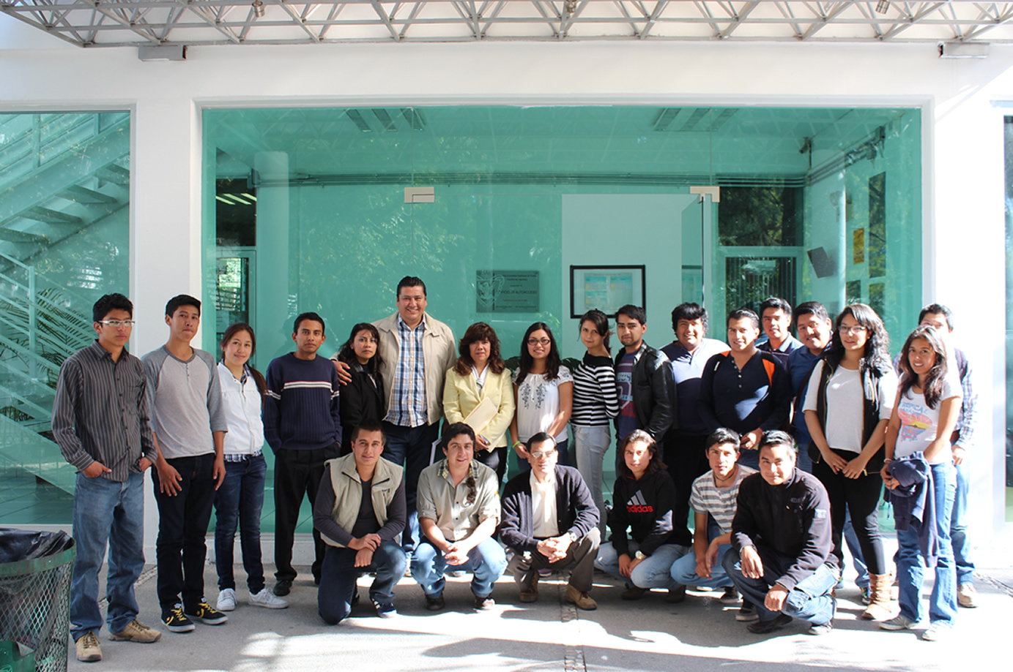
Ffj

Slide 5
WGCapD-6 Annual Meeting 2017
DLR Oberpfaffenhofen, Germany 27th-29th March 2017
Regional Centre for Space Science and Technology Education for Latin America and the Caribbean (CRECTEALC)
EO capacity-building 2017 activities:
RS & GIS Course, September 2016 to August 2017
Workshops
Using QGIS and DTMs for 3-D mapping of eruption scenarios around the Popocatepetl volcano (February 2017)
The use of maps/cartography and compass in EO applications (February, 2017)
EO capacity-building 2017 activities contributing to WGCapD:
Regional Meeting of Experts on the use of EO in Early-warning Systems – Droughts, (July) Mexico City (UN-OOSA/AEM FOSAT-S project – follow-up to SRTM 2015 workshop)
Master´s degree thesis, Flood modeling of the Orizaba River using EO data with the STRM-derived DTM-30, February 2017

Slide 6
WGCapD-6 Annual Meeting 2017
DLR Oberpfaffenhofen, Germany 27th-29th March 2017
Regional Centre for Space Science and Technology Education for Latin America and the Caribbean (CRECTEALC)
EO capacity-building 2018 - 2019 activities:
RS & GIS Course, September 2017 to August 2018
RS & GIS Course, September 2018 to August 2019
Workshops
Use of EO and ancillary tools in specific applications (tbd)
Use of EO ancillary tools (tbd)
EO capacity-building 2018-19 activities contributing to WGCapD:
Project proposal on the use of EO in Early-warning Systems – Droughts, for Mesoamerican and Caribbean countries (UN-OOSA/AEM FOSAT-S project – follow-up to SRTM 2015 workshop) – to be submitted to AMEXCID and INEGI

Slide 7
WGCapD-6 Annual Meeting 2017
DLR Oberpfaffenhofen, Germany 27th-29th March 2017
Regional Centre for Space Science and Technology Education for Latin America and the Caribbean (CRECTEALC)
EO capacity-building material in Spanish; 2016 activities:
Development of tutorials (2016, 2017 and beyond)
Tutorial on ILWIS
Tutorial on QGIS
Tutorial on TerraHidro
Other topics
Development of an e-learning platform for EO capacity-building (2016 and beyond)
M.Sc. and Ph. D. in EO (2017 and beyond)
M.Sc. & Ph.D. Courses
Supervision of M.Sc. & Ph.D. degree theses on EO topics

Slide 8
WGCapD-6 Annual Meeting 2017
DLR Oberpfaffenhofen, Germany 27th-29th March 2017
Regional Centre for Space Science and Technology Education for Latin America and the Caribbean (CRECTEALC)
EO capacity-building 2017 activities: Research Proposals
Development of a methodology for the use of multi-spectral and thermal IR imagery for water-stress evaluation of crops in arid and semi-arid climates – pilot assisted with a remotely-monitored sensor network – Submitted to CONACYT-INEGI
Development of a methodology for the use of multi-spectral imagery in crop phenology monitoring in the NW of Mexico - Submitted to CONACYT-INEGI
Use of EO in fog forest studies in the Sierra Gorda Biosphere Reserve - in colaboration with Comisión Nacional de Áreas Naturales Protegidas (CONAMP)
Development, visualization and updating of data bases of the seas and coastal areas of Mexico (proposal to be submitted in 2017 to CONACYT-INEGI)

