Slide 1
National and International Capacity Building Activities in Earth Observation at INPE
Committee on Earth Observation Satellites
INPE – Hilcéa Ferreira
Agenda Item 13
CEOS 6th Working Group for Capacity Building and Data Democracy (WGCapD)-6 Annual Meeting
DLR Oberpfaffenhofen, Germany
27th-29th March, 2017

Slide 2
WGCapD-6 Annual Meeting 2017 - DLR Oberpfaffenhofen, Germany - 27th-29th March 2017
CAPACITY BUILDING INITIATIVES
EARTH OBSERVATION GENERAL COORDINATION – OBT
AMAZON REGIONAL CENTER - CRA

Slide 3
WGCapD-6 Annual Meeting 2017 - DLR Oberpfaffenhofen, Germany - 27th-29th March 2017
INPE – National Institute for Space Research

Slide 4
WGCapD-6 Annual Meeting 2017 - DLR Oberpfaffenhofen, Germany - 27th-29th March 2017
Open Source Software
Geotechnology available as open source software with no use restrictions
Environmental Modelling System
General purpose GIS’s
Distributed Hidrological Modelling
Library to develop geographical applications
Data Mining System
Environmental Risks Monitoring, Analysis and Alert
Remote sensing imagery vector editor
Mapping land use land cover of the deforested areas of the Brazilian Legal Amazon

Slide 5
WGCapD-6 Annual Meeting 2017 - DLR Oberpfaffenhofen, Germany - 27th-29th March 2017
Remote Sensing Education at OBT
In Portuguese
Graduate Program in Remote Sensing (MsC and PhD)
500+ students
Short Courses in GIS and Remote Sensing (40 h)
4665 people trained (1999-2016)
Distance learning program in GIS and Remote Sensing
900 people trained (2004-2016)
Course for Teachers (Elementary School): Remote Sensing Technology applied to Environmental Studies
1200 teachers trained (1997 – 2016)
On-line material (books, presentations, video-classes) in English and Portuguese (inspired on Open Educacional Resources Initiative)
http://wiki.obt.inpe.br/doku.php

Slide 6
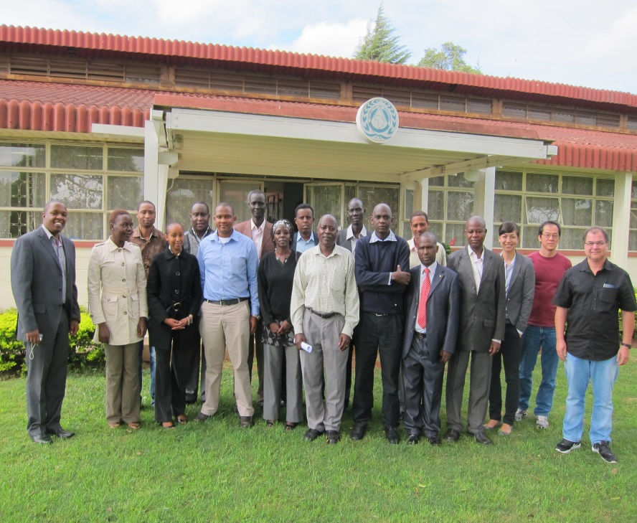
WGCapD-6 Annual Meeting 2017 - DLR Oberpfaffenhofen, Germany - 27th-29th March 2017
International Initiatives - CEOS
WORKSHOP: Improved access to global DEM developed on a country-by-country basis
May 6-10, 2013: I DEM Workshop held in Nairobi, Kenya, hosted by RCMRD
12 participants (Ethiopia, Somalia, Zambia, Kenya, South Sudan and Uganda).
Instructors were from SANSA, INPE, RCMRD/SERVIR, USGS (virtual), FEWSNET and SWF.
Unique CEOS workshop benefitting people at different levels with varying amounts of resources.
“Lessons-learned” Report available at WGCapD website, link “Documents”:
http://www.ceos.org/wgcapd

Slide 7
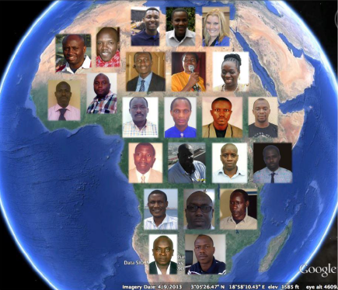
WGCapD-6 Annual Meeting 2017 - DLR Oberpfaffenhofen, Germany - 27th-29th March 2017
International Initiatives - CEOS
180 hour courses that target university lecturers in the sciences to teach them the benefits of incorporating EO into their classes (African Anglophone Countries)
Use of data sets that are normally restricted
Taught by consortium of CEOS agencies and partners
Coordinated by INPE in Brazil
July 2013: e-learning course was concluded and the final grades were compiled: from 30 students enrolled, 16 have successfully competed the course.

Slide 8
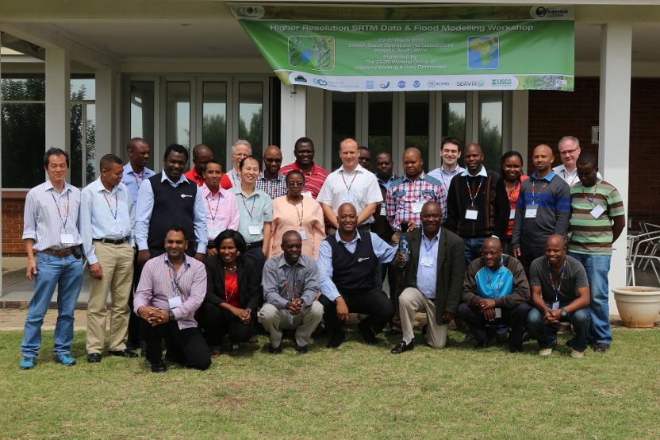
WGCapD-6 Annual Meeting 2017 - DLR Oberpfaffenhofen, Germany - 27th-29th March 2017
International Initiatives - CEOS
WORKSHOP: Higher Resolution SRTM Data & Flood Modeling Workshop
March 23rd - 27th, 2015 (Pretoria, South Africa, hosted by SANSA
Funded by: GEO, UNOOSA and SWF
25 participants (Botswana, Lesotho, Madagascar, South Africa, Swaziland, Zimbabwe).
Instructors were from INPE, NASA, NOAA, RCMRD, SERVIR, SANSA, USGS
Build capacity in utilization of satellite-derived digital elevation data, especially the Shuttle Radar Topography Mission (SRTM) 1-Arc Second data (a.k.a. SRTM 30m or SRTM-2).
“Lessons-learned” Report available at WGCapD website, link “Meetings”:
http://www.ceos.org/wgcapd

Slide 9
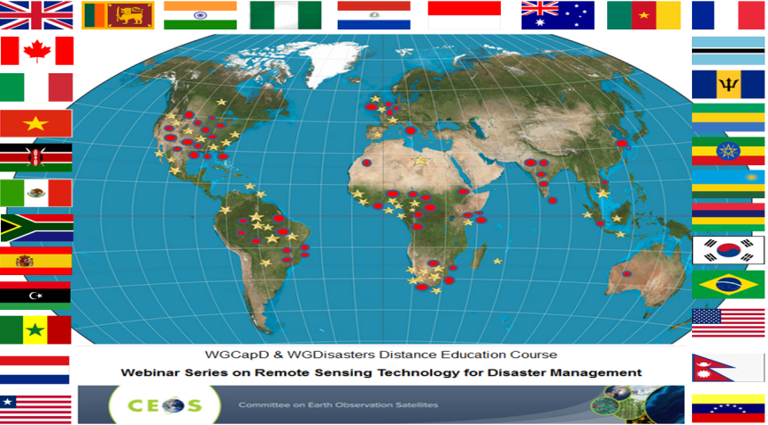
WGCapD-6 Annual Meeting 2017 - DLR Oberpfaffenhofen, Germany - 27th-29th March 2017
International Initiatives - CEOS
Webinar Series on Remote Sensing Technology for Disaster Management
April - May, 2015
144 participants from Africa (43), Central America and the Caribbean (2), North America (35), South America (19), Asia (33) and Australia (1)
Instructors were from INPE, ISRO, ESA, NOAA, USGS and NASA
Objectives:
Disseminating remote sensing technology among disaster risk management practitioners with an interest in geospatial technology
Providing wider and easier access to Earth observation data
Increasing the sharing of software tools such as open source software and open systems interfaces
Increasing data dissemination capabilities and transferring relevant technologies to disaster risk management practitioners

Slide 10
WGCapD-6 Annual Meeting 2017 - DLR Oberpfaffenhofen, Germany - 27th-29th March 2017
AMAZON REGIONAL CENTER - CRA

Slide 11
WGCapD-6 Annual Meeting 2017 - DLR Oberpfaffenhofen, Germany - 27th-29th March 2017
Umbrela Project for CB
TerraAmazon System
Basic concepts on remote sensing, digital image processing and geoprocessing
Tutorials and Instructors (Portuguese, English, French and Spanish)
Video-classes – YouTube – channel INPE-CRA
Site for online course (under development)
Presentations and hands-on activities
Pre and post students assessment
Online support after course
Discussion Forums
Publications

Slide 12
WGCapD-6 Annual Meeting 2017 - DLR Oberpfaffenhofen, Germany - 27th-29th March 2017
Multilateral Cooperation
ACTO (Amazon Cooperation Treaty Organization)
Countries: Bolivia, Brazil, Colombia, Ecuador, Guiana, Peru, Suriname, Venezuela
International Course: Monitoring Tropical Forests using the TerraAmazon System
2016 – Face-to-face
Languages: Spanish (2) and English (1)
Focus on TerraClass: map of land use land cover of the deforested areas of the Brazilian Legal Amazon
2017 – ONLINE
Languages: Spanish (1) and English (1)
Focus on TerraAmazon: A GIS tool for vector data using multi-temporal satellite images.

Slide 13
THANK YOU!
hilcea@dpi.inpe.br

