Slide 1
Viewing Earth
Serving Society
Capacity Building at GA
Jonathon Ross
Geoscience Australia CEOS Contact
DLR Oberpfaffenhofen
May 2017

Slide 2
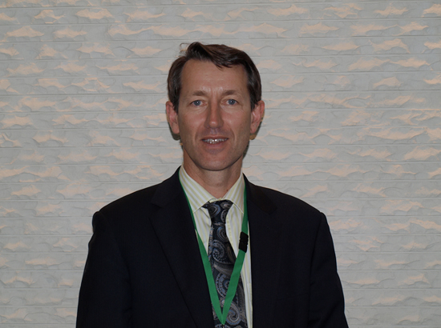
Hello from Adam!
Dr Adam Lewis
GA CEOS Principal

Slide 3
Agency Mandate
Domestic Focus
Support Australian Governments to benefit from geoscience data
Build national capacity to exploit geoscience data
International Focus
National representation on international fora (GA is Aus. GEO Principal)
Projects in other countries in support of Department of Foreign Affairs

Slide 4
Domestic
Australian Government agencies
Lowering technical barriers (e.g. Data Cube)
Training sessions on data and products
Support domain ‘centres of excellence’ (e.g. within Bureau of Statistics)
Acting as a contact/advice point
Broader community
Lowering technical barriers (e.g. Data Hub)
Participate in the Australian Earth Observation Community Coordination Group

Slide 5
International
Focus domains:
Disaster risk reduction (Community Safety Branch)
Mining for development (Resources Division)
Groundwater (Groundwater Branch)
Spatial data infrastructure (inc. geodesy, satellite data, etc)
Focus countries:
South-East Asia
South Pacific
Preference to work as part of broader agendas, e.g. World Bank where outcomes likely to be ‘embedded’
Project support for Dept of Foreign Affairs:
Papua New Guinea ‘drought monitoring’ capability improvement
DRR training with Indonesia
International fora: CEOS, GEO, Charter, Sentinel-Asia, APEC

Slide 6
CSIRO Data Cube Pilots
About capacity building but also gathering user feedback on:
Technology
Analysis Ready Data (CARD4L)
Colombia
Water
Environment
Engagement with IDEAM (Environment Agency)
Viet Nam
Lower Mekong Delta
Agriculture
Water
Forestry
Engagement with VNSC/VAST

Slide 7
Thank you!
Any questions?

