Slide 1

Capacity Building Activities at NASA
Committee on Earth Observation Satellites
NASA, Nancy D. Searby, Ph.D.
Agenda Item #10
CEOS 6th Working Group for Capacity Building and Data Democracy (WGCapD)-6 Annual Meeting
DLR Oberpfaffenhofen, Germany
27th-29th March, 2017

Slide 2



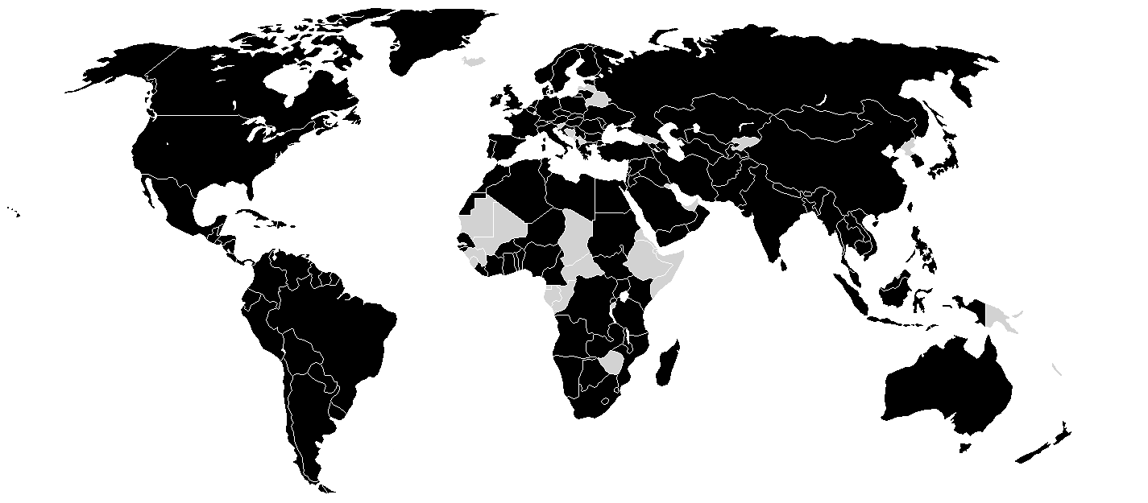




WGCapD-6 Annual Meeting 2017
DLR Oberpfaffenhofen, Germany
27th-29th March 2017
2016 NASA Capacity Building Accomplishments
2016 by the Numbers
2016 by the Map
4,259
Individuals Engaged
142
Countries Reached
1,684
Institutions Engaged
65
EO Assets Utilized
55
Trainings Provided
35
Multi-Year Projects
77
Feasibility Projects
Notes:
4,259: Individuals Engaged
1,684: Organizations Engaged
55: Trainings Given
77: Feasibility Studies Conducted
35: Multi-year Projects Conducted
65: Earth Observation Assets Applied
8: Application Areas Addressed
50: U.S. States Impacted
9: U.S. Territories & Holdings Impacted
142: Countries Impacted
23: Publications
103: Conferences & Meetings Attended

Slide 3
Capacity Building Program
SERVIR: Building international capacity with hubs in and serving Eastern & Southern Africa, Hindu Kush-Himalaya, Mekong, & West Africa
Applied Remote SEnsing Training (ARSET): Online and hands-on NASA remote sensing training
DEVELOP: Dual workforce/end user capacity building using collaborative feasibility projects
Participating in Interagency & Global Capacity Building Activities
https://www.servirglobal.net/
http://arset.gsfc.nasa.gov/
http://develop.larc.nasa.gov/
Applied Sciences Program| NASA
Capacity Building Program

Slide 4
WGCapD-6 Annual Meeting 2017
DLR Oberpfaffenhofen, Germany
27th-29th March 2017
2016 NASA Capacity Building Highlights of Interest to WGCapD
ARSET developed and offered a webinar series on remote sensing training: methods & best practices
  https://arset.gsfc.nasa.gov/all/webinars/best-practices-2016
Building on ongoing collaboration between SERVIR and SilvaCarbon, SERVIR hosted a coordination workshop in Huntsville with SilvaCarbon and other partners focused on the use of synthetic aperture radar (SAR) to monitor and measure terrestrial biomass.
Capacity Building Program members held a session at the American Geophysical Union (AGU) called “Building Sustained Capacity to Use Earth Observations to Enhance Environmental Management Decisions, Actions, and Policy”, followed by a lunchtime CB Community of Practice discussion
DEVELOP conducted a study highlighting the utility of including Earth observations into the required measuring for the SDG framework through specific case study indicators (i.e. air quality, forest cover, and mangroves).
Notes:
4,259: Individuals Engaged
1,684: Organizations Engaged
55: Trainings Given
77: Feasibility Studies Conducted
35: Multi-year Projects Conducted
65: Earth Observation Assets Applied
8: Application Areas Addressed
50: U.S. States Impacted
9: U.S. Territories & Holdings Impacted
142: Countries Impacted
23: Publications
103: Conferences & Meetings Attended

Slide 5
WGCapD-6 Annual Meeting 2017
DLR Oberpfaffenhofen, Germany
27th-29th March 2017
2016 NASA Capacity Building Contributions to WGCapD
SERVIR team member from SERVIR-E&SA hub and SERVIR-W Africa hub-consortium benefited from WGCapD Zambia and Gabon SAR trainings.
SERVIR-Himalaya hub located at the International Centre for Integrated Mountain Development (ICIMOD) in Kathmandu, Nepal hosted an Asian regional training on SRTM-2 Digital Elevation Model (DEM) applications from 19 – 22 September 2016.
  SERVIR-E&SA hub member trained on flood mapping.
  SERVIR-Mekong participated and sent stakeholders.
  SERVIR paid for the stakeholders travel.
Assembled WGCapD best practices from last year’s meeting.
Aided in report preparation for the 2017 AmeriGEOSS Week training track supported by WGCapD.
Notes:
4,259: Individuals Engaged
1,684: Organizations Engaged
55: Trainings Given
77: Feasibility Studies Conducted
35: Multi-year Projects Conducted
65: Earth Observation Assets Applied
8: Application Areas Addressed
50: U.S. States Impacted
9: U.S. Territories & Holdings Impacted
142: Countries Impacted
23: Publications
103: Conferences & Meetings Attended

Slide 6
WGCapD-6 Annual Meeting 2017
DLR Oberpfaffenhofen, Germany
27th-29th March 2017
2017 NASA Capacity Building Accomplishments & Plans
2017 Targets:
  ARSET: engage 1,500+ participants & 500+ organizations, conduct 10+ trainings, impact 90+ countries & 40 US states
  DEVELOP: engage 200+ participants & 75+ organizations, conduct 60 projects, impact 35 US states
  SERVIR: engage 200+ participants & 25+ organizations, conduct 25+ projects, impact 35+ countries
Plans of interest to WGCapD:
  Sentinel-1 SAR data is being incorporated into ARSET trainings and SERVIR projects and trainings and services
  DEVELOP is exploiting Sentinel-2 data along with Landsat data, and JAXA AMSR-2 data in projects
  ARSET Air Quality Training “Advanced Training on Air Pollution in India” for May 2017, being developed in partnership with Indian Institute of Tropical Meteorology
  ARSET SDG-related trainings, e.g. AQ, and DEVELOP SDG-related projects
Notes:
Project Synopsis: Reliable data and spatial analysis are key to successful wetlands conservation and monitoring efforts. This project aims to utilize the Landsat series to classify wetland extent and change in Rwanda, as well as forecast the future extent of wetlands in the country. In collaboration with the University of Bonn’s DeMo-Wetlands project, this study would compare Landsat and Sentinel-derived mapping products and combine to provide a comprehensive approach for monitoring wetlands in response to the UN Sustainable Development Goals (SDGs). The team will explore the use of Google Earth Engine to create land cover classifications, along with the TerrSet Geospatial Monitoring System Land Change Modeler to forecast extent. Project partners will use this methodology for future assessment for SDG reporting and protection of Rwanda’s wetlands.

Slide 7
WGCapD-6 Annual Meeting 2017
DLR Oberpfaffenhofen, Germany
27th-29th March 2017
2017 NASA Capacity Building Accomplishments & Plans
Planned Contributions to WGCapD:
  Provided training support to Gabone SAR workshop in February 2017
  ARSET trainer will contribute to WGCapD SAR webinar series (Spring 2017)
  (Potential) - A Summer 2017 DEVELOP feasibility study in collaboration with a DLR-funded DeMo-Wetlands project at the University of Bonn’s Center for Remote Sensing of Land Surfaces and GEO-Wetlands Initiative: Rwanda Ecological Forecasting: Utilizing NASA Earth Observations to Classify Wetland Extent in Western Rwanda in Support of SDG Indicator Tracking
  Contribute to WGCapD actions
    Contribute to Capacity Building Portal (GEOCAB Portal)
    Explore future options for providing portal-based access to capacity building and training resources
    Update good practices guidance document
Notes:
Project Synopsis: Reliable data and spatial analysis are key to successful wetlands conservation and monitoring efforts. This project aims to utilize the Landsat series to classify wetland extent and change in Rwanda, as well as forecast the future extent of wetlands in the country. In collaboration with the University of Bonn’s DeMo-Wetlands project, this study would compare Landsat and Sentinel-derived mapping products and combine to provide a comprehensive approach for monitoring wetlands in response to the UN Sustainable Development Goals (SDGs). The team will explore the use of Google Earth Engine to create land cover classifications, along with the TerrSet Geospatial Monitoring System Land Change Modeler to forecast extent. Project partners will use this methodology for future assessment for SDG reporting and protection of Rwanda’s wetlands.

Slide 8
WGCapD-6 Annual Meeting 2017
DLR Oberpfaffenhofen, Germany
27th-29th March 2017
2018-2019 NASA Capacity Building Preliminary Plans
2018-2019 Targets: tentatively same as 2017
2018 Contributions to WGCapD:
  ARSET: contribute to a WGCapD organized webinar series in water or flood monitoring applications
  DEVELOP: Collaborate with a WGCapD member on a land use / land cover change feasibility study in northern Eurasia - Summer 2018
  Jointly host SRTM-30 m and/or SAR applications workshop in Amazonia once SERVIR-Amazonia hub is launched
  Leverage SERVIR’s investments in GEOGLAM in Tanzania and Uganda aimed at increasing use of a GEOGLAM Crop Monitor system and localized data collection methods
2019 Contributions to WGCapD:
  ARSET: contribute to a WGCapD organized webinar series in water or flood monitoring applications
  DEVELOP: Collaborate with a WGCapD member(s) on a TBD theme and location feasibility study - Summer 2019
  SERVIR: disseminate SERVIR’s best practices for capacity building

Slide 9
WGCapD-6 Annual Meeting 2017
DLR Oberpfaffenhofen, Germany
27th-29th March 2017
WGCapD Capacity Building Needs Assessment
To provide high quality trainings, we need:
  Clear end user need
  Funds for travel support and/or commitment from end user to fund their participants
  Clarity around purpose of training & WGCapD’s niche
    Thus far:
      Hands on: SRTM-30 m & SAR data applications trainings
      Webinar: disaster overview series
  Planning sufficiently in advance to offer quality trainings to the right participants
Role of doing vs helping others build capacity, e.g. best practices?
Role of doing vs pointing participants to each other’s trainings?
Role of enabling infrastructure, e.g. events calendar, training mailing list management, training resource collection and provision systems?

