Slide 1

Capacity Building Activities in Earth Observation at ISRO
Committee on Earth Observation Satellites
Dr. A. Senthil Kumar
IIRS/ ISRO
Dehradun, INDIA
CEOS 6th Working Group for Capacity Building and Data Democracy (WGCapD)-6 Annual Meeting
DLR Oberpfaffenhofen, Germany
March 27 -29, 2017

Slide 2
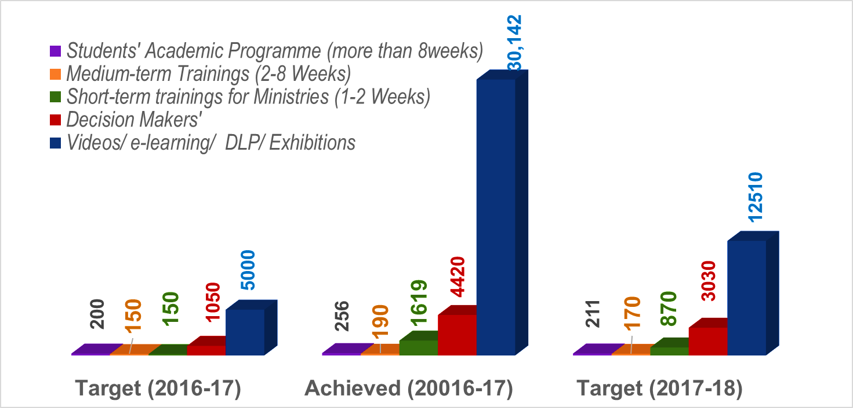
Overall Summary for 2016-17
Targeted CB Programs:
Individual CB: Education, training, employment and Mentoring ….. for future Professionals
Organizational CB: Structured Training Programs (in-house)
Train the Trainers (K12-, UG-teachers)
Tailor-made Training Programs (Govt. & Industries)
Active Learning & Offline Outreach Programs
Interactive Workshops
Training & Education
Masters,
PG Diploma,
Certificate &
Tailor-made
Courses
Beneficiaries
Capacity Building
&
Professional
Excellence
Research
Projects
EDUSAT-DLP,
Support to
External Students
& Researchers, etc.
Research Projects
Research
Outreach

Slide 3
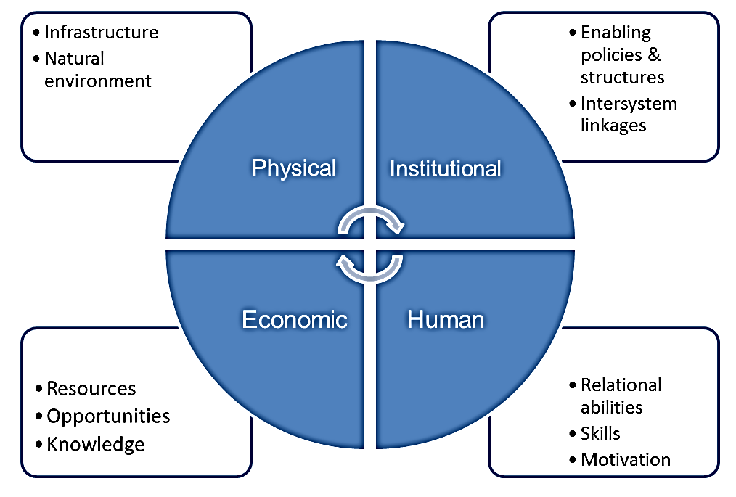
Capacity Building @ ISRO
ISRO Institutions for Capacity Building
Indian Institute of Remote Sensing (IIRS)
Indian Institute of Space Science & Technology (IIST)
National Remote Sensing Centre (NRSC)
Space Application Centre (SAC)
IIRS
SAC
NRSC & RCs
State RS Centre
RCs
Other DOS/ISRO Centres
IIST
ISRO’s Capitals to achieve programs

Slide 4
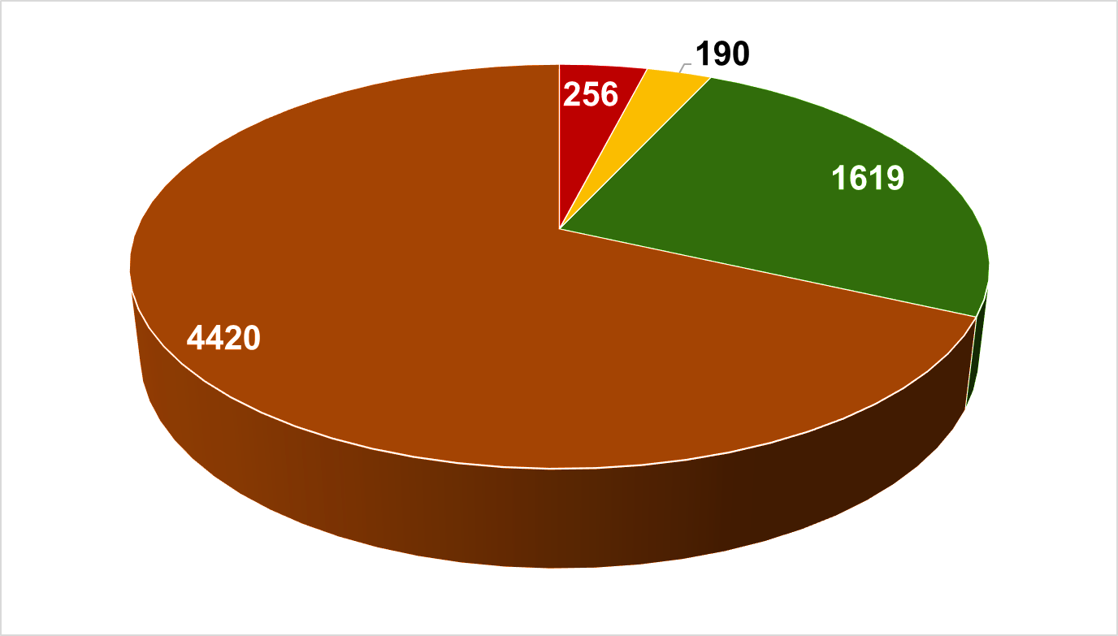
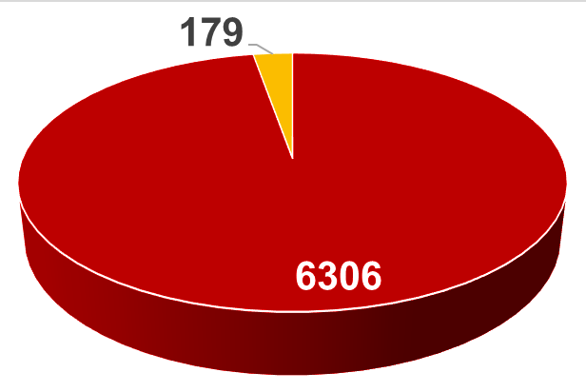
Face-to-Face Stakeholders 2016-17
Face-to-Face Capacity Building @ ISRO (6485)
Defense
(14)
Academia
(78)
Govt. Officials#
(6229)
International Trainees
(179)
Students*
(256)
Decision Makers
(4420)
Long-term [Students]
(more than 8-weeks)
Medium-term
(2-8 weeks)
Short-term
(1-2 Weeks)
Short-term
(1-2 weeks)
Decision Makers’
Duration wise
International beneficiaries
National beneficiaries
*international students incl.
# Govt. Officials are
inclusive of DM, Others
Gamut of
beneficiaries

Slide 5
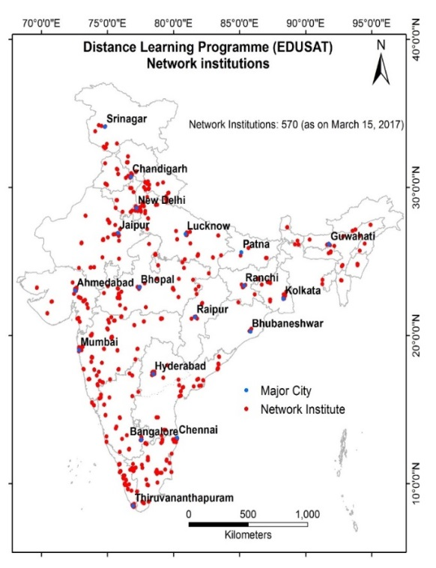
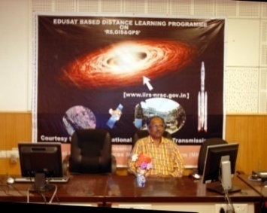
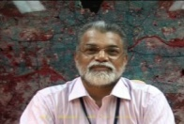
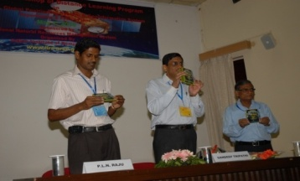
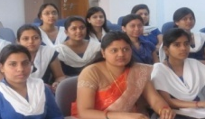
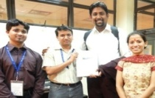
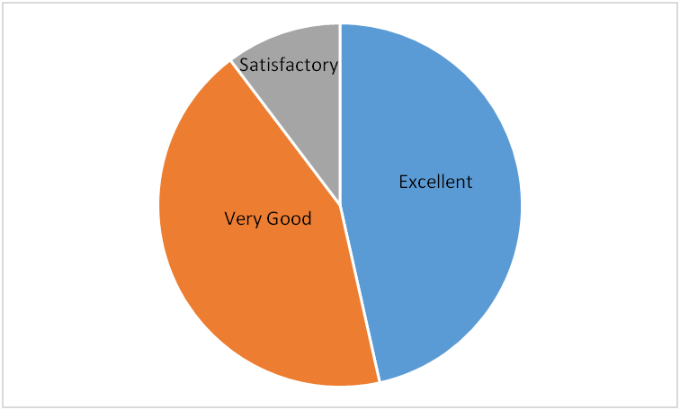
Virtual Training:
Distance Learning Program
(Satellite based interactive & internet based e_learning Initiatives)
Initiated in 2007 to complement educational programs of Indian universities
About 38,300 students from 550 Indian Universities/Institutions benefited so far
Who Can Participate?
UG & PG students/ Researchers/ Faculty
Individuals with good internet facility (>2Mbps)
Users under CEC-UGC / CIET networks
Institutions on high-speed National Knowledge Network (NKN)
Courses Offered
Basic Course on RS, GIS & GPS (12 Weeks)
Advanced and Thematic Courses (1-3 Weeks)
MOOC Initiative
certificate course of 4 months
Rich e-learning content is being developed with high quality animations / flash interactions and easy understanding modules
Focus on e-learning theme is Principles of Remote Sensing, GIS and GPS
Indians: 3515; Foreign: 210
University Network with IIRS/ISRO
User Feedback
Interactive Course Highlights
Complete Digital Learning Management System
Live Streaming server setup at IIRS

Slide 6
Capacity Building @ IIRS, Dehradun
“Promote capacity building through Quality Training an Education in the field of Remote Sensing and Geoinformatics to comply with Requirements and Continuously Improve the Effectiveness of Quality Management System” – QUALITY POLICY
An ISO 9001-2008 Institute
Educational Programmes
  M.Tech. in RS & GIS (24 months)
  Affiliated to Andhra University, Visakhapatnam
  M.Sc. in Geo-informatics (18 months)
Special courses & Support to
National Projects
C
A
P
A
C
I
T
Y
Training
&
Education
UAV Remote Sensing
Geospatial Tech for Smart City Planning
NCERT Teachers (Central Boards)
Dept. of Youth Affairs
National Institute of Electronics and IT / DeiTy
ISTM/ Dept. of Personal Training
LBSNAA/ DoPT
Ministry of Ayush (Health)
Geological Survey of India
Ministry of Environ Forestry & Clim Change
Research
As Joint Educational Program with ITC (Twente University)
Training Programmes on RS&GIS
  PGD, Certificate (Sponsored by ITEC, MEA)
  Course for Univ. Faculty (NNRMS Sponsored)
  Decision Makers Course (4 days)
  User -Specific /Tailor made courses(1-8 weeks)
  UN-CSSTEAP Programmes (IIRS, SAC, PRL & ISAC)
B U I L D I N G
Outreach
Measures (till March 2017)
Professionals trained in IIRS: 10, 614
Foreign professionals trained in IIRS: 1,003 from 95 Countries
Professionals trained in CSSTEAP- 1,726 from 34 countries in Asia-Pacific Region and 29 from 18 (outside AP) – Motivation is to empower them to take their countries’ demands through intensive training
M. Tech. students: 263 and M.Sc. Students:180 (since 2002)
Tailor Made Courses: 3,695 and Certificate 2,869
Distance Learning (EDUSAT based Program): >35,000 from 550 Institutes/ Colleges/Govt / Individuals.

Slide 7
Hands-on Short-term Programs @ IIRS
Capacity Building for Ministries & Departments (April, 2016 to Feb, 2017)
S.No. | Course Name (User Department ) | Duration | Professionals Trained
1 | Special course on Capacity Building Programme in GIS | 3 Weeks | 16
2 | Special Course on Image Interpretation and RS application (Indian Air Force Personnel/ MoD) | 2 months | 14
3 | Special course on GIS Based Utility Mapping of ISRO/DOS Campuses (ISRO/DOS) | 1 week | 33
4 | Special course on Orthorectification of Very High Resolution Satellite Data (FSI/ MoEF&CC) | 1 week | 11
5 | Refresher course for IFS officers on RS&GIS Application in Working Plan Preparation (MoFE&CC) | 1 week | 15
6 | RS&GIS with Special Emphasis on Medicinal Plants (Ministry of AYUSH) | 1 week | 10
7 | Special course for GSI officers on SAR Applications in Geosciences (GSI/ MoES) | 2 week | 12
8 | Orientation course for Range Forest Officers on Application of RS&GIS in forestry (MoFE&CC) | 1 week | 39
9 | Application of RS&GIS for NRM for ISS Officers (Ministry of Statistics and Programme Implementation) | 1 week | 18
10 | ISRO-sponsored NNRMS Course on Space Technology Applications in Governance and Development (MHRD) | 1 week | 23

Slide 8
Future Activities: IIRS DLP 2017 -18
S.No | Course | Tentative Slot | Starting date for online Registration | Duration | Tentative date for Examination
1 | Recent Trends in Remote Sensing and GIS Application in Carbon Forestry | February 16 – March 10, 2017 | 03/01/2017 | 3 weeks | March 10, 2017
2 | Microwave Radar Remote Sensing and its Applications | April 10-21, 2017 | 16/02/2017 | 2 Weeks | April 24, 2017
3 | RS & GIS Applications in Water Resource Management | May 08-26, 2017 | 01/04/2017 | 3 Weeks | May 29, 2017
4 | UAV Remote Sensing and Applications | June 12-16, 2017 | 01/05/2017 | 1 Week | Not Applicable
5 | Remote Sensing and Digital Image Analysis | August 21 -September 15, 2017 | 01/06/2017 | 4 Weeks | September 15, 2017
6 | Global Navigation Satellite System and Geographical Information System | September 18 - November 03, 2017 | 01/06/2017 | 6 Weeks | November 03, 2017
7 | RS & GIS Applications | November 06 – 24, 2017 | 01/06/2017 | 3 Weeks | November 24, 2017
8 | Basics of “Remote Sensing, Geographical Information System and Global Navigation Satellite System | August 21 – November 24, 2017 | 01/06/2017 | 13 Weeks | *
9 | Close Range Photogrammetry and Terrestrial Laser Scanning | December 11-15, 2017 | 01/11/2017 | 1 Week | Not Applicable
*Module wise examination as per scheduled in S.No. 5-7

Slide 9


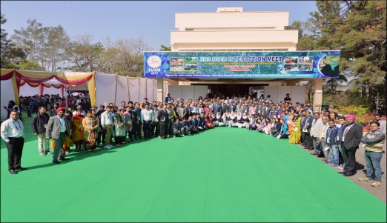
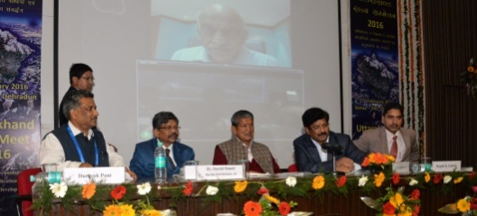
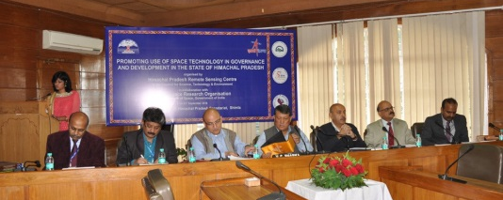
Other Major Events/ Activities at IIRS
Towards promoting space technology based tools & applications
in governance and development’
‘Fifth IIRS User Interaction Meet (IUIM-2017)’ on theme of ‘Academia-Industry Interface for Geospatial Applications’ was held on February 23, 2017 at IIRS. Besides faculty & staff from IIRS there were more than 340 registered participants from various academic institutions, industries, government departments, JRFs, Students & Distance Learning Program-users from all over India.
State meets:
      HP State Meet on September 23, 2016 in Shimla with > 300 participants.
      UK state meet on ‘Promoting Space Technology Based Tools & Applications in Governance and Development’ on February 27, 2016, with ~ 300 participants.
National Symposium on ‘Recent Advances in RS&GIS with Special Emphasis on Mountain Ecosystems & Annual Conventions’ was held in the institute from December 7 - 9, 2016 with 540 delegates from across country participated in the deliberations
Group photograph of participants with dignitaries in IUIM 2017
Hon. CM UK on Uttarakhand State-meet
Himachal State-meet

Slide 10
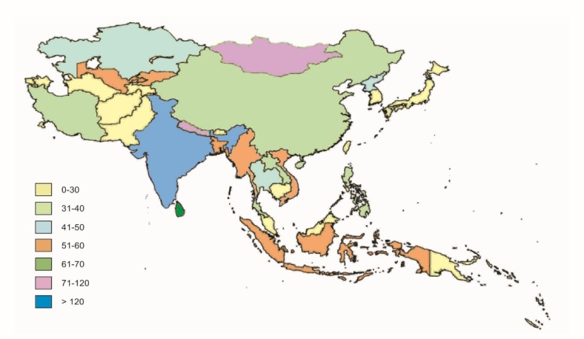
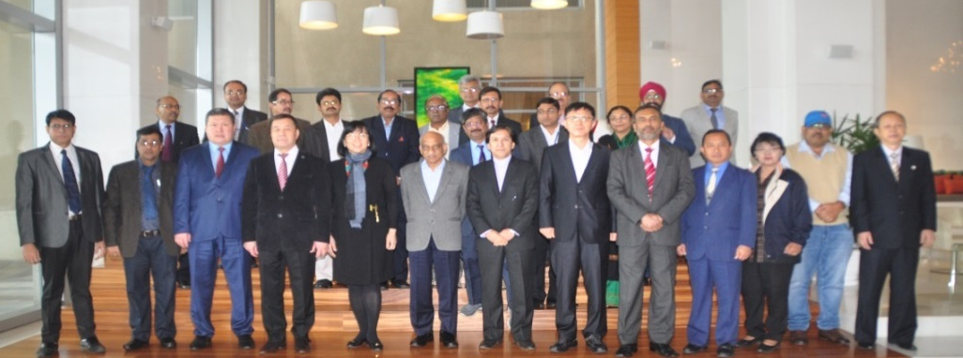
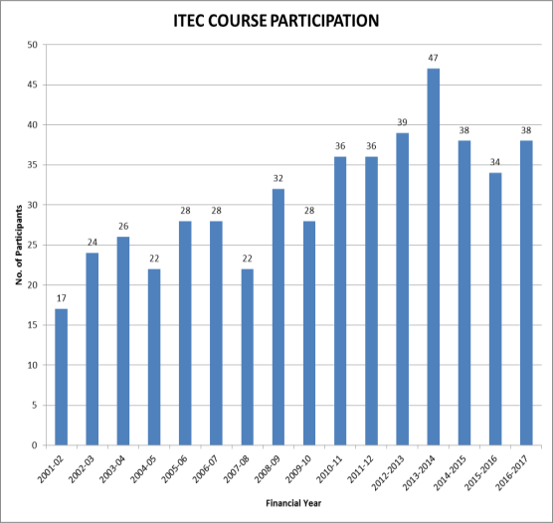
CB for International Participants
CSSTEAP* (UN affiliated) HQ: IIRS
  Host HQ of CSSTE-AP & Support to Director, CSSTE-AP
  PG-Diploma in RS/GIS (9 months) – 21 courses since 1996
  Short Course RS GIS in a thematic area
ITEC – Ministry of External Affairs (527 participants from 79 countries)
  Short Course in RS & Digital Image Processing (8 week)
  Short Course in Geoinformatics
Foreign Students In Regular Trainings
  Variable
IIRS & CTTEAP exhibited & participated in
Asia Pacific Remote Sensing (by SPIE)- 2016
April 4 – 7, 2016 at New Delhi
Around 1,726 participants benefitted in CSSTEAP from 35 countries
21st meeting of CSSTEAP GB on December 19, 2016
*Centre for Space Science and Technological Education in Asia and the Pacific – (1996)
ITEC - 527 Participants from 79 Countries

Slide 11
CSSTEAP Courses in 2016 - 2017
20th PG course in ‘RS & GIS’ at IIRS Dehradun (July 1, 2015 – March 31, 2016). (23 participants from 14 countries)
10th PG course on ‘Satellite Communications’ at SAC, Ahmedabad (August 1, 2015 – April 30, 2016)
(16 participants from 4 countries)
1st PG course on ‘Global Navigation Satellite Systems’ at SAC, Ahmedabad during August 1, 2015 – April 30, 2016
(9 participants from 4 countries).
NWP: Weather Forecasting using Numerical Prediction Models during April 18- May 17, 2016 (23 participants from 7 countries)
AFEA: Advances in Geospatial Tools in Forestry & Ecology Applications during May 23 - June 21, 2016
(20 participants from 9 countries)
SW: Short Course on Space Weather at PRL, Ahmedabad during May 9 - June 8, 2016 (13 participants from 6 countries)
DDLA: Disaster Damage and Loss Assessment in Natural Heritage and Cultural Sites using Geospatial Techniques, September 11 – October 2, 2016 (24 participants from 11 countries)
SSM: Short course on Small Satellite Missions jointly conducted by ISAC, Bengaluru & IIRS, Dehradun during November 21 – December 02, 2016. (25 from 09 countries). 12 participants from 07 Countries sponsored by ASEAN also attended the course
(37 from 14 countries)
Completed
21st PG course on ‘RS & GIS’ at IIRS, Dehradun (July 1, 2016 - Mar.31, 2017) (19 participants from 11 countries)
10th PG course in ‘Satellite Meteorology and Global Climate’ at SAC Ahmedabad (August 1, 2016 - April 30, 2017). [13 participants from 07 countries]
10th PG course in ‘Space and Atmospheric Sciences’ at PRL Ahmedabad (August 1, 2016 - April 30, 2017). [12 participants from 02 countries]
In progress
22nd Post Graduate course in RS&GIS at IIRS, Dehradun (July 1, 2017- March 31, 2018)
11th Post Graduate course in Satellite Communication at SAC, Ahmedabad (August 1, 2017 to April 30, 2018)
2nd Post Graduate course in Global Navigation Satellite Systems at SAC, Ahmedabad (August 1, 2017 to April 30, 2018)
Short course on UAV & its applications with special emphasis to DRR at IIRS, Dehradun (June-July, 2017)
  Short Course on LiDAR Remote Sensing and its Application at IIRS (May 15, 2017 to May 26, 2017)
6th Short course on Small Satellite Missions at IIRS, Dehradun and ISAC, Bengaluru (November-December, 2017)
Short Course on Weather Forecasting using NWP Models at SAC (July 03-14, 2017)
In Future

Slide 12
Challenges in multi-cultural /
multi-ethnic learning environment
Multi-cultural environment creates obstacles and opportunities for research and learning.
Students/trainees come from different higher education systems each with a unique mission, history, and societal context
Learning and teaching styles differ depending on cultural identity and heritage.
Question is how to bridge differences in culturally dependent learning and teaching styles related to cultural identity and heritage
This calls for specific feedback Questionnaire that helps to understand how the students feel about current courses offered.

Slide 13
Survey of International Participants
Questionnaire
A. Education/ Academic
  Are you able to follow the rigor in Mathematics w.r.t to your earlier education in your country?
  Are you able to follow the rigor in Physics w.r.t to your earlier education in your country?
  Do you feel this course is more technology or Application oriented?
  Do you feel that the field tours/ excursion were adequate?
  How do you rate the structure and organization of the course?
  How do you compare yourself in a classroom in your country vis-à-vis at IIRS?
  How do you rate your proficiency of English?
  Do you think knowledge of English was or could be an obstacle at IIRS?
  Were you able to apprehend the lectures taught in English?
  At any point of time did you feel the need of translator?
  Were you able to understand the pace of the lecturer?
  Do you think you were able to build a good rapport with your regular / guest faculty at IIRS?
  Would there be enough audience for a similar course in your country?
  Were the practical, case studies and exercises used, interesting and useful to your needs?
  The facilitator encouraged participation and questions.
  Do you think the Academic environment influences the quality of education at IIRS?
  What should be the ideal size of classroom (in terms of student strength) at IIRS?
  Whether refresher material was required before commencement of the course?
  Did you ever feel requirement of attending additional/ special session after regular classes?
Rating Scale: 4 Point
Agreement :
To a large extent : Score 4
To some extent : Score 3
Very little : Score 2
Not at all : Score 1

Slide 14
Questionnaire Contd..
  B. Benefit of the courses
  Have you acquired information and knowledge that is new to you?
  The content of this course matched announced objectives?
  Did you had opportunities to discuss issues of interest with other participants?
  Would you recommend this training to your colleagues ?
  Were there any unexpected areas of learning for you?
  After this course will you be able to handle RS and GIS projects?
  Do you think the training you got at IIRS will help in your current job?
  Do you think the training you got at IIRS will help you get a new / better job?
  C. General Ambience
  Was the class composition adequate and did not hinder the learning process? (Yes/No)
  Participants should be only from the same geographical region? (Yes/No)
  Multi-ethnic class composition does not affect the learning process ? (Yes/No)
  Educational background diversity does not affect the learning process? (Yes/No)
  How effective are your general working practices e.g. time management?
  What are your hobbies (apart from studies)?
  What is the approximate travel time from your country to IIRS?
  Do you think there is cultural bias in the field of education in your country?
  Do you think the long separation from your family and friends during your stay at IIRS, adversely impacts your ability to absorb the education imparted at IIRS?
  Do you think there is cultural bias in teaching at IIRS?
  Would you like to come to IIRS for another course?
  Any other comments/observations you wish to make about the course:
  Amenities / Infrastructure
  To what extent are you satisfied with the following?
    Residential Accommodation ,
    Food quality and service,
    Library facilities ,
    Computer facilities ,
    Recreation facilities ,
    Attitude of the staff ,
    Cleanliness ,
    Software Accessibility

Slide 15
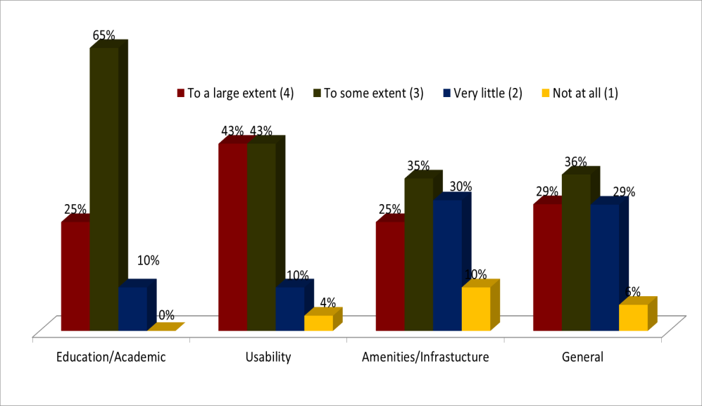
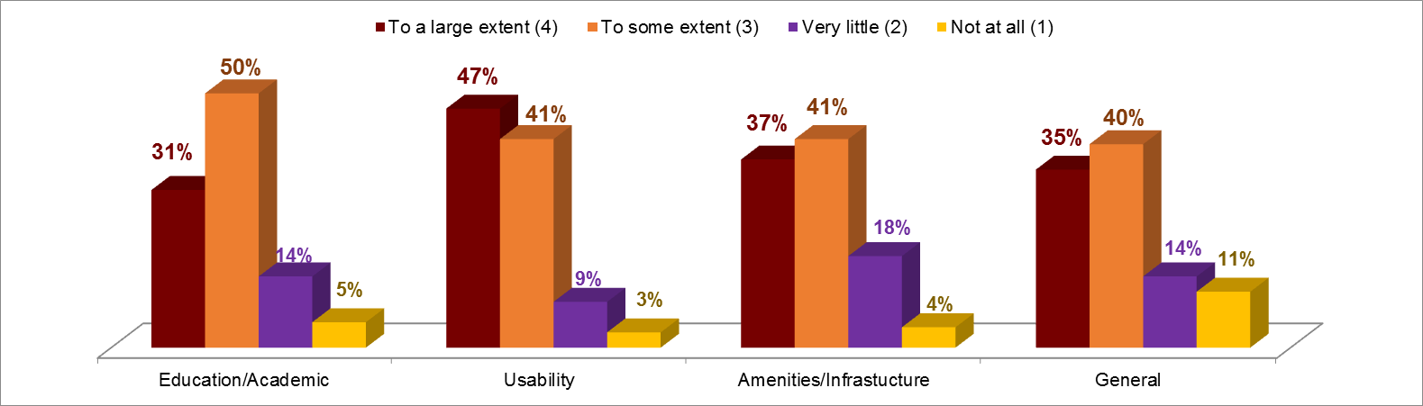
Survey analysis of International Participants
ITEC – Short Course ( 8 Weeks)
CSSTEAP - Long Course ( 9 months diploma)
Course Content of Short Course on Remote Sensing with special emphasis on Digital Image Processing (ITEC Sponsored) - eight weeks.
Aim - The primary aim of the course is to enhance the capacity of participants in understanding various dimensions of Geo-information science and technology for natural resource management and decision making.
Remote Sensing Basics (Weeks 1-3)
Digital Image Analysis (Week 4-6)
Project work (Week 7-8)
21st PG course on ‘Remote Sensing & Geographic Information System’ at IIRS
(July 1, 2016 – March 31, 2017)
Aim – Capacity building in Remote sensing and Geographic Information System and their application to citizen of Asia and the Pacific region countries
Remote Sensing and GIS Basics (Module 1A – 8 weeks)
Advances in RS&GIS technology & Environmental sciences (Module 1B- 4 weeks)
Specialization in electives (Module 2 – 12 weeks)
Pilot Project (Module 3 – 12 weeks )
20 International participants from 13 countries [Bhutan, Egypt, Ethiopia, Kenya(2) ,Mauritius (2) , Mozambique, Nigeria(5), Sri Lanka ,Syria(2), Tanzania, Thailand, Uzbekistan and Zambia]
19 participants from 11 countries [Kazakhstan (03), Sri Lanka (03), Nepal (01), Mongolia (02), India (02), Uzbekistan (02), Myanmar (02), Fiji (01), Tajikistan (01), Kyrgyzstan (01), Thailand (01)

Slide 16
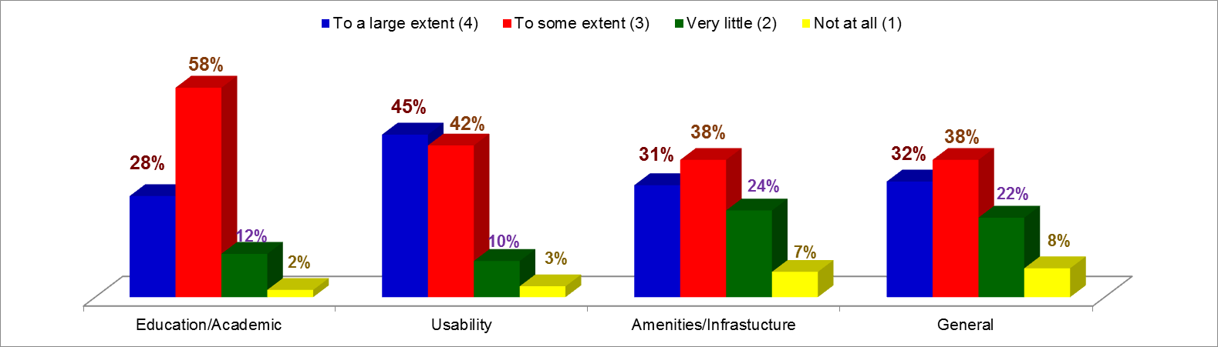
Survey analysis of International Participants
Trend
TREND

Slide 17
Hands-on Training Programs @ NRSC
Outreach Activities by NRSC, Remote Sensing Applications Area
Bhuvan IWMP & RKVY organised and Trained 327 State Officials
PD-NDEM organized “Familiarization on NDEM services for Disaster Management” for 22 Officials from state User Departments
Trained 700 people on Mobile Apps, trends in s/w development for Fiber crops such as Jute/Cotton and 505 officials Trained on different Mobile Apps for a) Geo tagging b) Bhuvan GHMC c) Telangana PWD, d) NTPC etc
5 officials from Spice Board UP were trained on “Mapping Inventory & Assessment of Mint Crops” and 15 Officials given Awareness cum Training Workshop on “Technology Utilization in the Crop Insurance”
programmes on Hydrology / RGNDWM were conducted and trained 212 officials
Programmes Organized by Regional Centres
100 officials of Cotton Corporation of India on Geospatial Applications in Agriculture & Mobile Apps on Geo-tagging in Agriculture Sector 20 officials from Archaeological Survey of India (ASI) were trained on SmartSMARAC and 72 officials from ASI were given on the job for SMARAC using high resolution data
12 State officials & NGOs were trained on “Empowering Panchayathi Raj Institutions Spatially” (EPRIS)
25 Postal officials were trained in “Geotagging of Delivery Zones” using BHUVAN
10 officers of the Amravati District Administration trained on Asset Mapping mobile Apps under SAGY
60 officials from IBM trained on “Space Technology Tools for Mineral & Mining Sector Applications” also 133 PGD students of Thermal Power Engineering participated in one Week training ”
30 officials of Social Forestry Department trained on Perspective Plan Generation for Extension Forestry using Geospatial Tools
1133 Officials participated in Awareness-cum-Training Workshops on (a) ISRO Geo-portals on Geospatial Technologies for Developmental Planning & e-governance b) Ground water potential zone mapping at village level, c) Wasteland Change Analysis & Land Degradation, d) EPRIS, e) SMARAC etc.

Slide 18
Capacity Building @ NRSC
Future Courses Planned in 2017-18
Sl. No | Course Type | Course Name | Duration
1 | Regular | Microwave Remote Sensing and Applications | 2 weeks
2 | Special | Remote Sensing Ground Segment Systems | 6 days
3 | Special | Open source GIS | 2 weeks
4 | Special | Advances in GIS | 2 weeks
5 | Special | Hyperspectral Remote Sensing | 1 week
6 | Regular | Geospatial Technologies & Applications | 12 weeks
7 | Special | Bhuvan Overview Training with Hands-on Practical | 2 days
8 | Special | Satellite Navigation | 2 days
 | Customized Courses | Organized in Specific Areas Based on Request from User Organizations
Sl. No | In House Training | Planned in
1 | ISRO-STP on “Space Technology Applications for Governance and Development” for ISRO Scientists | July, 2017

Slide 19
Hands-on Training Programs @ SAC
Training & Research in Earth Ecosystem (TREES) VEDAS Research Group, SAC
162 participants
Sr. | Event Name | Date | Participants | Institutes
1 | Satellite Calibration and Validation | June 13-17, 2016 | 04 | 02
2 | Remote Sensing & Geo-Informatics – Basics | August 30 –September 02, 2016 | 20 | 10
3 | Satellite based Hydrology and modelling | December 12–16, 2016 | 17 | 09
4 | Polari metric SAR data Processing and Analysis | December 20–21, 2016 | 21 | 12
5 | Hyperspectral remote sensing with AVIRIS-NG data over India. | January 4–6, 2017 | 50 | 25
6 | Handling of MARS Orbiter Mission (MOM) Data (MCC, MSM and TIS) | February 28 – March 01, 2017 | 29 | 24
7 | Training on Chandrayan-1 TMC and HySI data analysis | March 2-3, 2017 | 21 | 18
Satellite Meteorology & Oceanography Research and Training (SMART), MOSDAC, SAC
108 participants
No | Topic of Training | Date | Participants | Institute
1 | Introduction to Satellite Scatterometry with special emphasis on ScatSat-1 (Batch-1) | 19-21 October 2016 | 18 | 16
2 | Introduction to Satellite Scatterometry with special emphasis on ScatSat-1 (Batch-2) | 23-25 November 2016 | 18 | 15
3 | INSAT-3DR: Observations to Applications (Batch-1) | 14-17 February 2017 | 36 | 26
4 | INSAT-3DR: Observations to Applications (Batch-1) | 07-10 March 2017 | 36 | 19

Slide 20
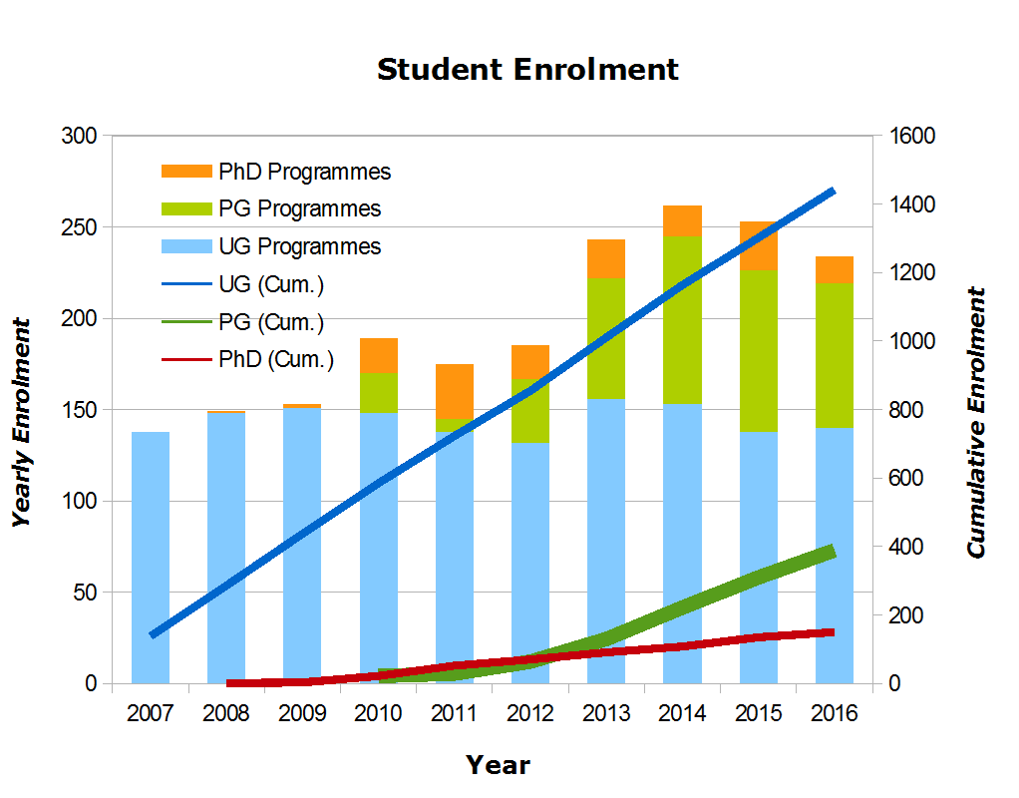
1. B.Tech in Aerospace Engineering
2. B.Tech in Avionics
3. B.Tech in Engineering Physics (started from the year 2014).
4. Five Year Dual Degree Programme (B.Tech-M.S/M.Tech).
Capacity Building @ IIST
Undergraduate level programmes
Three undergraduate programmes:
  B.Tech in Aerospace Engineering – 60 seats
  B.Tech in Avionics – 60 seats
  Dual degree (B.Tech & MS/MTech) – 20 seats
  All seats were duly filled.
Admissions to UG programme were based on
→National Competitive Examination
Yearly & Cumulative Student Enrolment
PhD Programme
Total Admitted: 165; (ISRO Staff: 40); Completed: 27
 |  | ADMISSION (Jan & July)
PhD : Full-Time | All Departments | UGC Norms
PhD : Part-time | All Departments | For ISRO/DOS Only - Interview-based
(PhD: IIST-ISRO) High Value |  | Closed (Total =11)

Slide 21
Positive takeaways of IIST
Is the only institute in the country offering UG, PG, doctoral and Post-doctoral programmes in space sciences and space technology
National character (UG students coming from 22 different states)
Total number of girl students and lady faculty accounting to 22 % and23 % of the total
Faculty members from 11 different states
All UG students of IIST are eligible for jobs at ISRO against vacancies provided they attain CGPA > 7.5 (2017 onwards)
  DOS provides complete assistanceship to all UG students of IIST which includes mess and lodging provided they continue to meet certain academic standards
Achievements & Accolades
IIST despite being the youngest and having been started only in the 21st century was awarded ′EIGHTH RANK′ among Engineering Universities by the First National Institutional Ranking Framework, MHRD in April 2016
The first student who completed MS programme in CalTech, USA in 2014 won ′Dr Abdul Kalam′ award instituted by CalTech for the best graduate student.

Slide 22





Hands-on Training Programs @ IIST
Academics and internship programmes abroad
(for B.Tech Students)
California Institute of Technology (CALTECH), U.S.A.
Universities Space Research Association (USRA), U.S.A.
Jet Propulsion Laboratory (JPL), U.S.A.
Lockheed Martin Undergraduate Student Visitation Program
Mitacs Globalink Foundation, Canada

Slide 23
Future Activities: 2017- 2018
Targeted capacity building Programs
Capacity Building @ IIST
Webinar/MOOCs (CEOS Program)
    Webinar Series on SAR data processing and applications (April 17, 2017 to June 9, 2017)
    E-Learning courses (TBD)
Conferences and Symposia
    ACRS: 2017 at New Delhi ‘Space Applications touching Human Lives’ (possibility of CEOS
    Sessions on selected themes) (October 23-27, 2017)
        ISPRS Mid term symposium at New Delhi, (November, 2018)
Myanmar course
    Post-disaster (earthquake) Rapid Damage assessment (March 28 to April 01, 2017 at Yangon)
ARSET (NASA) and IITM (MoES)
    Satellite Remote Sensing of Air Quality: Data, Tools and Applications (May 23-26, 2017)
ISRO - JAXA APRSAF-24
    Participation at Bengaluru (November, 2017 & four Co-chairs from ISRO)

Slide 24
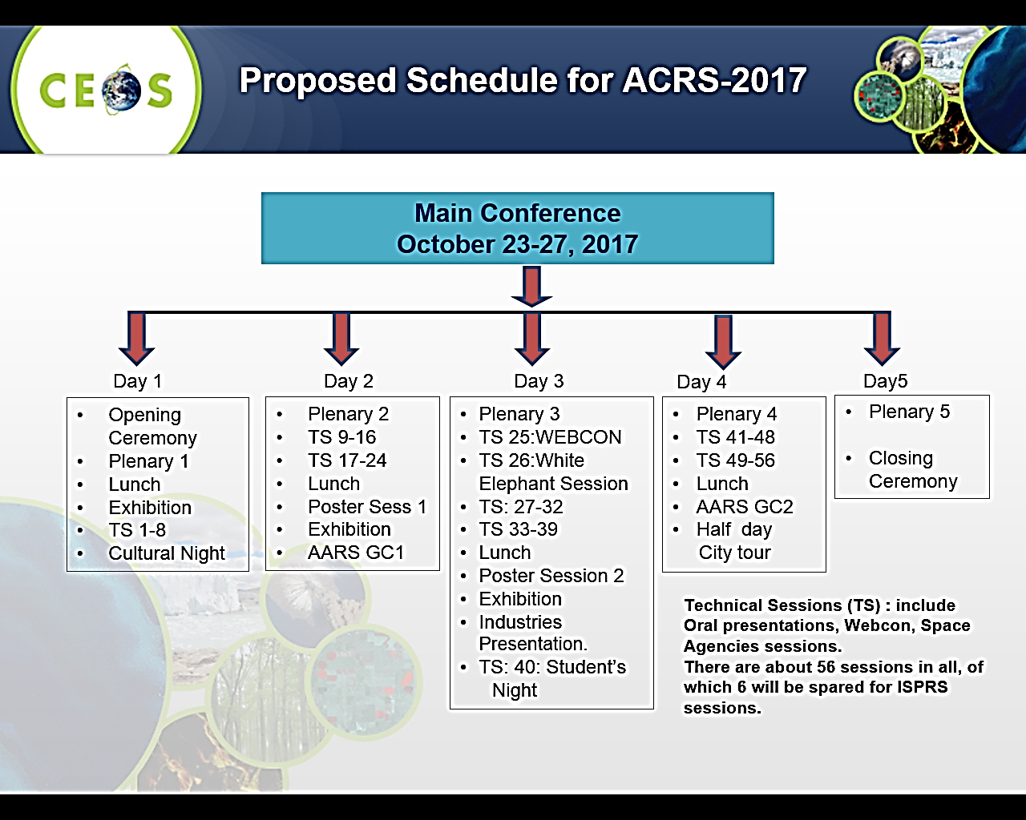
Future Activity under ACRS-2017
Space Applications – Touching Human Lives
Natural Resources Management
  Agriculture & Soils
  Forestry and Environment
  Geology and mineral resources
  Marine and coastal
  Water Resources and Cryosphere
Atmosphere, Ocean, Weather & Climate
  Atmospheric parameter retrieval and modelling
  Weather monitoring and modelling
  Ocean applications
  Climate change and its impact
Emerging trends in
  EO Sensors and data processing : Optical, Thermal and Microwave
  Data acquisition and Cloud computing
  UAS and Applications
  Mobile Apps, Crowd Sourcing and Citizen Science
  Big data analytics and information Science
  Cultural heritage monitoring
  Health GIS
  Information mapping from social media
  …
Disaster monitoring, damage assessment and risk reduction
  Hydro-meteorological
  Geological
  Environmental
Infrastructure and development planning
  Infrastructure mapping and development planning
  Urban and regional planning and Smart city planning
  Rural development planning
Education and outreach
  Needs and requirements in different countries
  Active Learning models
  Cross-border education through web-resources sharing
  Tools development for training and outreach
  ….
Important Dates
Conference Dates: October 23-27, 2017
Abstract submission started on: Feb 15, 2017
Abstract submission deadline: July 1, 2017
Notification of Acceptance: July 31, 2017
The deadline for submission of full paper: Sept. 10, 2017

Slide 25
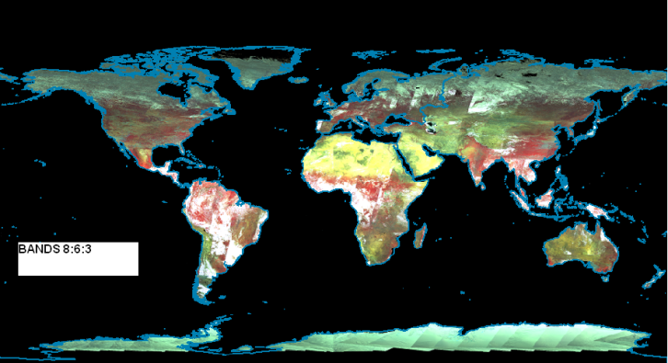
Data Sharing efforts from ISRO
Geophysical Products
Oceanographic products
  Chlorophyll-a map
  Total Suspended Sediment map
  Diffusion Attenuation Coefficient map
  Aerosol Optical Depth map
Land Products
  Vegetation products (NDVI, VF)
  Broad band albedo products
OSCAT wind vector products
  12 hourly/Daily Analyzed Ocean Winds
  Disaster purposes
  International Charter
  Sentinel Asia
  UN-SPIDER
  ASEAN countries (resource assessment)
  SAARC countries (severe thunderstorm predictions)
Global Products generated from ISRO
Land products from OCM sensor 5km
Ocean products from OCM at 5 km
Wind products from OSCAT at 25 km
Local Products within Indian Ground station visibility
Land geophysical products (≤ 1km)
Ocean geophysical products (1km)
Tropical products (+/- 20 deg Lat.) from Megha-Tropiques
Water vapor profile (10km res) from Saphir
Outgoing Long wave Radiation (OLR) (40km. res)-Scarab

Slide 26
Thank you for attention
Q & A
Committee on Earth Observation Satellites

