Slide 1

Activities @ DLR’s Remote Sensing Technology Institute
Committee on Earth Observation Satellites
Michael Eineder, DLR
Agenda Item #6
CEOS 6th Working Group for Capacity Building and Data Democracy (WGCapD)-6 Annual Meeting
DLR Oberpfaffenhofen, Germany
27th-29th March, 2017

Slide 2
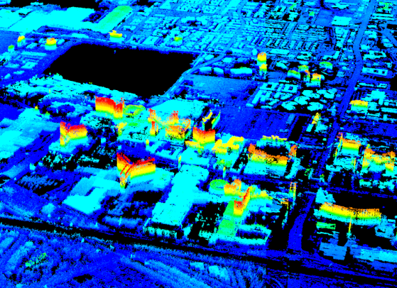
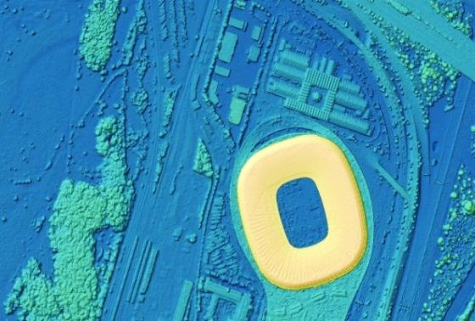
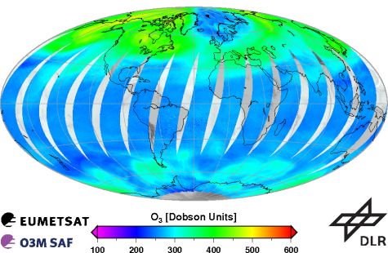
DLR Remote Sensing Technology
Institute (IMF) Competences
Synthetic Aperture Radar (SAR)
  Processors for TerraSAR-X, TanDEM-X, PAZ, Tandem-L, etc.
  Imaging geodesy
  4D imaging: PSI, SAR tomography et al.
  SAR oceanography, maritime security
Optical Imaging
  Processors for EnMAP and DESIS
  CATENA: generic processing chain for 15+ sensors
  3D: dense stereo matching and object reconstruction, computer vision
  Hyperspectral methods: retrieval, unmixing, classification, fusion
  Ocean color, water quality
  Calibration Home Base and airborne systems
Atmospheric Spectrometry and Lidar
  Processors for GOME-2, ADM, MERLIN, Sentinel 5p/4/5, etc.
  Spectrometry laboratory
  Scattering theory, radiative transfer, inversion methods

Slide 3
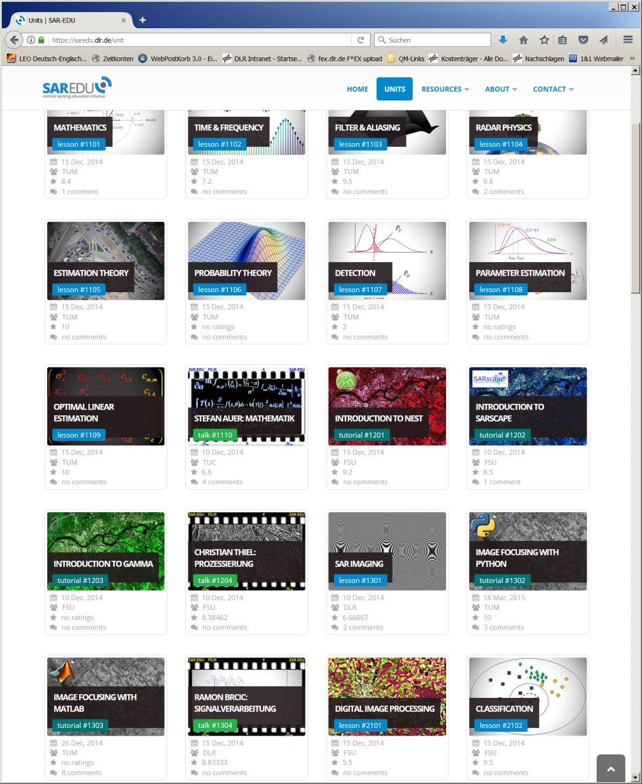
DLR IMF National Educ. Activities
Many contributions to German
SAR-EDU Remote Sensing
Initiative:
  Radar Physics
  SAR
  SAR Interferometry
  Estimation Theory
  …
Material and Videos available freely

Slide 4
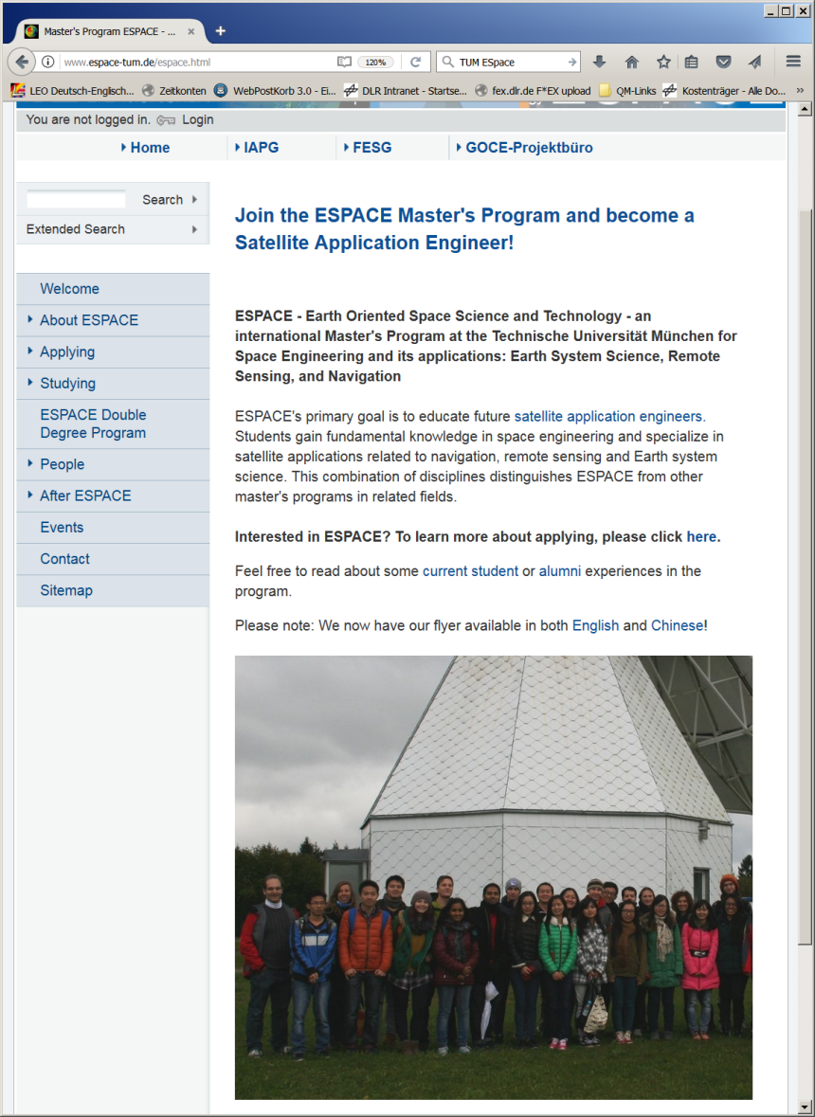
DLR IMF University Activities
International Earth Oriented Space Science and Technology (ESPACE) Master's Program @ Technical University of Munich
  ~10 IMF scientists teaching remote sensing technology
  No university tuition fees
  Double degree program with Wuhan University / CN
Other regular lectures @ Uni:
Bukarest, Alcala, Osnabrück, Hannover, Leipzig, München

Slide 5
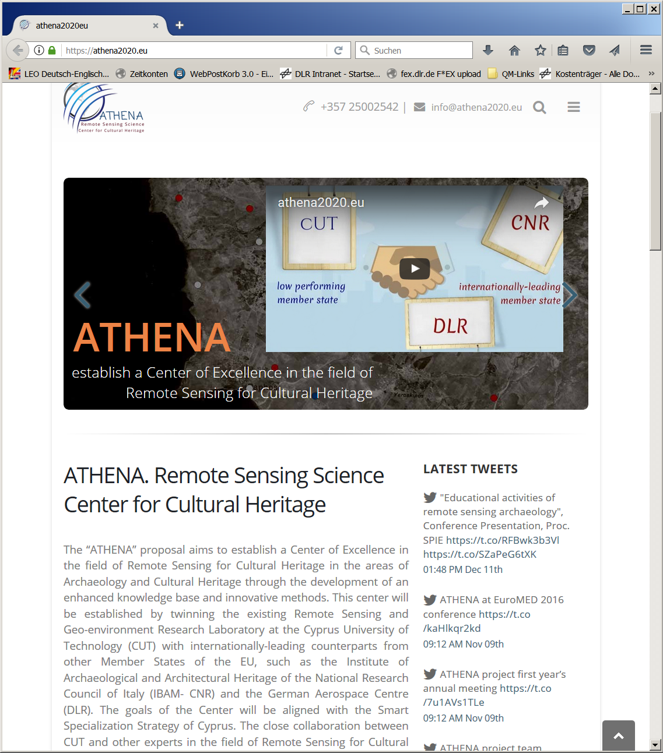
DLR IMF Non University Activities
Carl-Cranz-Gesellschaft e.V.
Tutorial ats conferences (IGARSS etc.)
EU FP2020 Project ATHENA: “… improve and expand the capabilities of collaboration between lowperforming and leading institutions, … with remote sensing technologies … related to Cultural Heritage protection, management and best practice”
DLR School lab: scientific advisory of student experiments

