Slide 1

The German EO Program & Tasks of the Space agency
Michael Bock, DLR Space Administration
Agenda Item 6.1
CEOS 6th Working Group for Capacity Building and Data Democracy (WGCapD)-6 Annual Meeting, DLR Oberpfaffenhofen, Germany, 27th-29th March, 2017
Capacity building activities
of DLR Space Agency

Slide 2

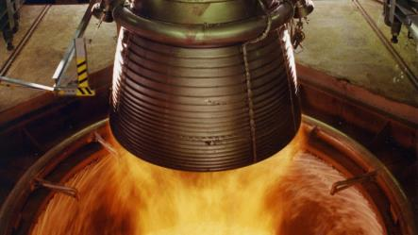

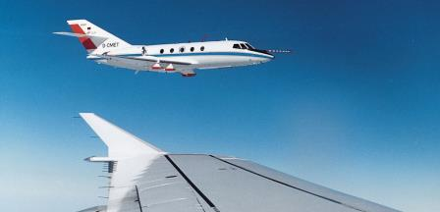
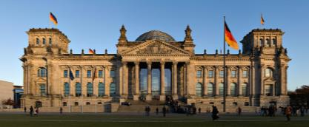
DLR – a dual capacity entity
DLR
Research & Technology
DLR
Space Administration

Slide 3
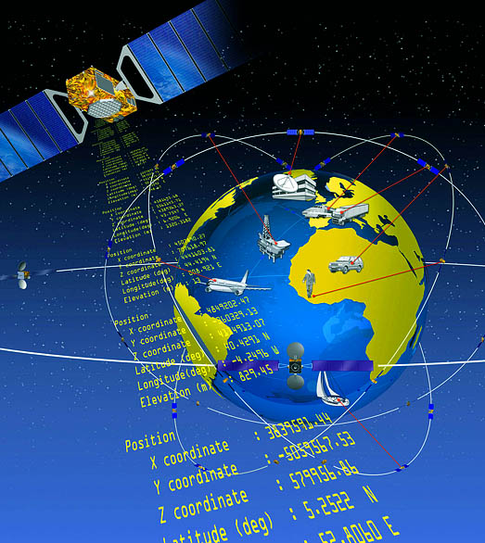
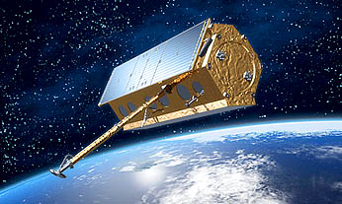
Tasks of the DLR Space Agency (1)
Defining German space planning on behalf of the federal government
Representing German space-related interests in the international arena, in particular in ESA
Contracts and grants for space projects in the National Programme for Space and Innovation - from consultancy to funding decision to technology transfer

Slide 4
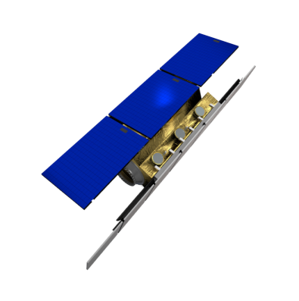


Tasks of the DLR Space Agency (2)
Defines and implements the national space programme, integrates national and European space activities:
  National Missions
  National User Support programmes (scientific use, methods, pilots, …)
  ESA Development and User programmes
  EU H2020 Space Activities
Monitors and influences the EU Copernicus Programm
  Copernicus Committee and User Forum
  Advisory function for Federal Ministries
Implements national Copernicus actions
  Support to national user coordination
  Technical projects for implementation and validation
  CODE-DE

Slide 5



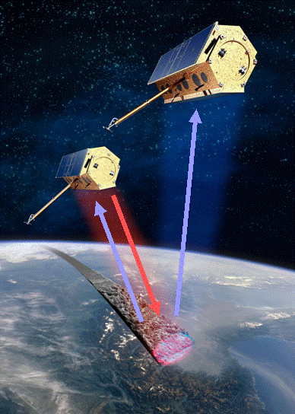

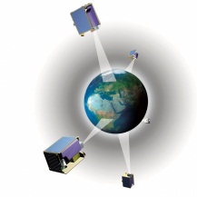

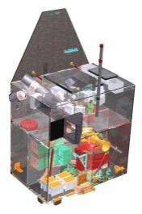
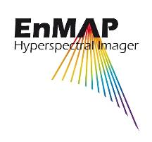
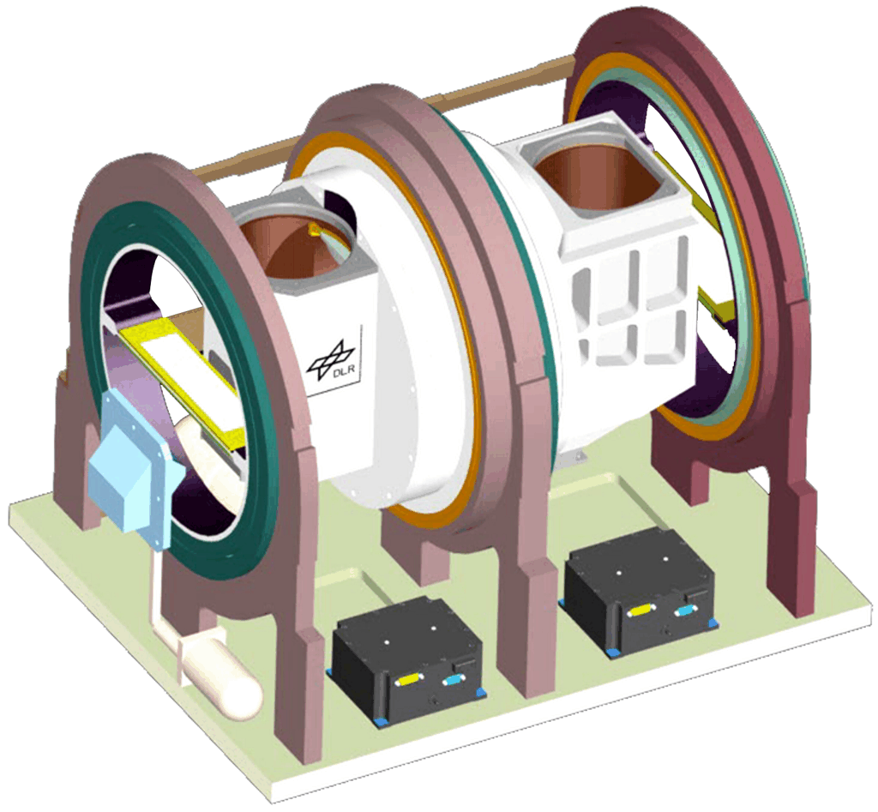

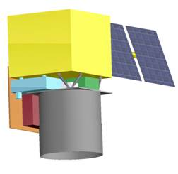

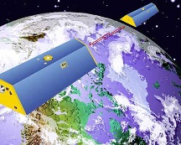

National EO-Missions
Radar
TerraSAR-X
  Launch: June 2007
TanDEM-X
  Launch: June 2010
  Formation flight with TerraSAR-X
RapidEye
  Launch: August 2008
EnMAP
  In Phase D
  Launch: end 2019
METimage
  In Phase C/D
  Launch: 2021
MERLIN
  In Phase C/D
  Launch: End 2021
GRACE
  Since 2002
GRACE-FO
  Launch 2018
Public-Private Partnership
Optic
Gravity

Slide 6


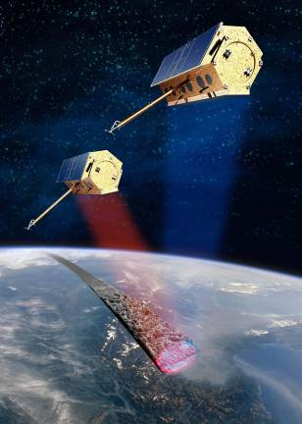
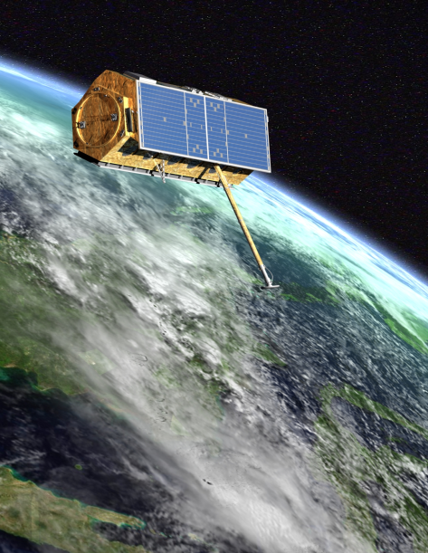

TanDEM-X… ein zweiter TerraSAR
TerraSAR-X
Nationale Radar-Mission
Wissensch. und kommerzielle Nutzung
Hochaufgelöste Radardaten der Erdoberfläche
Start: Juni 2007
Status: 10 Jahre im Orbit, weitere 3+ Jahre möglich
Nationale SAR Interferometrie Mission
Wissensch. und kommerzielle Nutzung
Primäres Missionsziel: hochaufgelöstes, globales Digitales Höhenmodell (DEM)
Start: Juni 2010
Status: globales DEM fertiggestellt
Anwendungen:
Land & Forstwirtschaft
Risikomanagement & Sicherheit
Kartografie & Planung
Bergbau & Exploration
Umwelt
Geologie
Weitere Missionsziele:
Meeresströmungen
Verkehrs- Monitoring
Gletscherabflüsse
Polarimetrisches InSAR
Super Resolution
Digital Beamforming

Slide 7
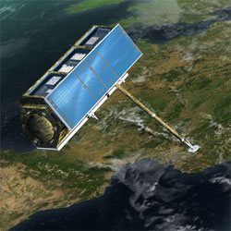
Public-Private Partnership
TerraSAR-X PPP: First large-scale national PPP Project, which became operational at the beginning of 2008.
Joint investment, but separate goals of
  DLR (scientific)
  Industry (commercial)
  No common enterprise.
No Co-investment of other ministries, therefore public authorities are customers of the commercial data provider (Airbus DS Geo).
Each PPP-Partner (DLR / Airbus DS) has a complete set of data
No (physical) sharing of the total amount of data. Partition starts with the rights to use the data (scientific / commercial)
Nevertheless, public customers have certain priorities in times of crisis:
DLR has granted the rights to supply TSX/TDX mission data to the charter

Slide 8
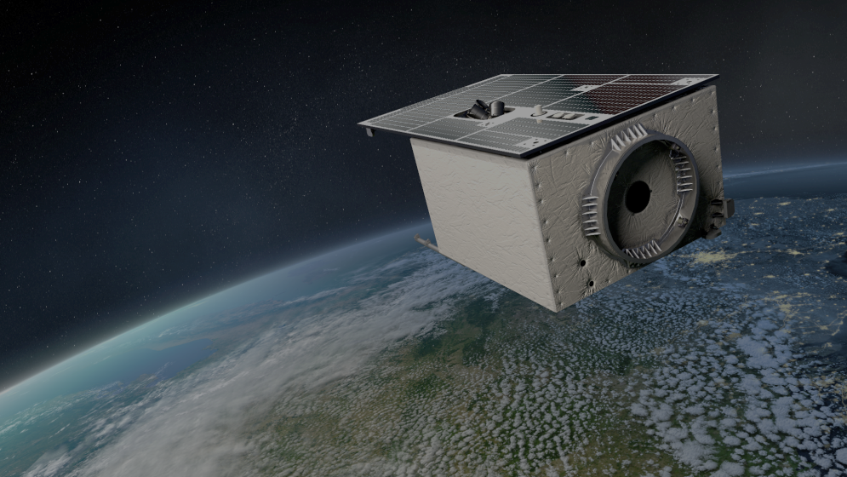
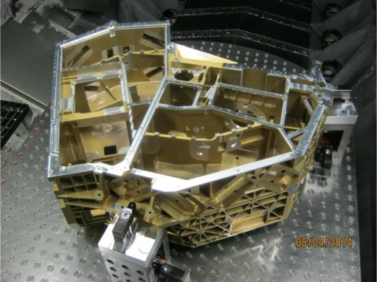



EnMAP Hyperspectral Imager
Objective
Hyperspectral instrument with over 200 channels
Mission goal: Investigate wide range of ecosystem parameters
Present Status: in Phase D
Launch end 2019
Outline (technical brief description)
Spectral range from
  420 nm to 1000 nm (VNIR) and
  900 nm to 2450 nm (SWIR)
High spectral resolution of 6.5 nm (VNIR) and 10 nm (SWIR);
~ 240 channels
Swath width 30 km
GSD 30 m nadir

Slide 9
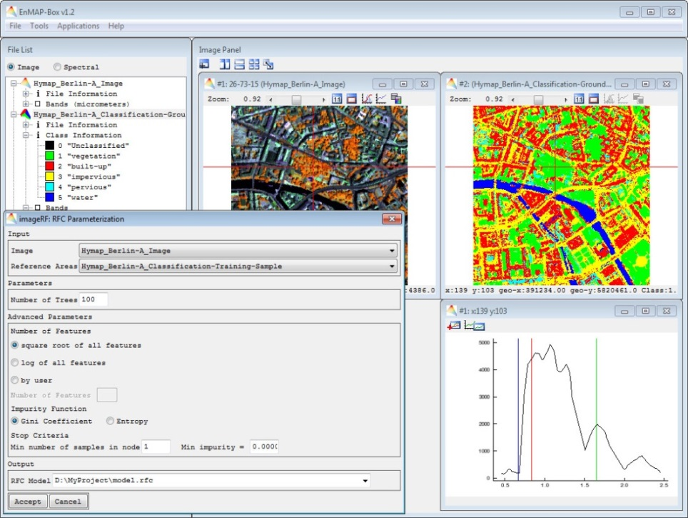
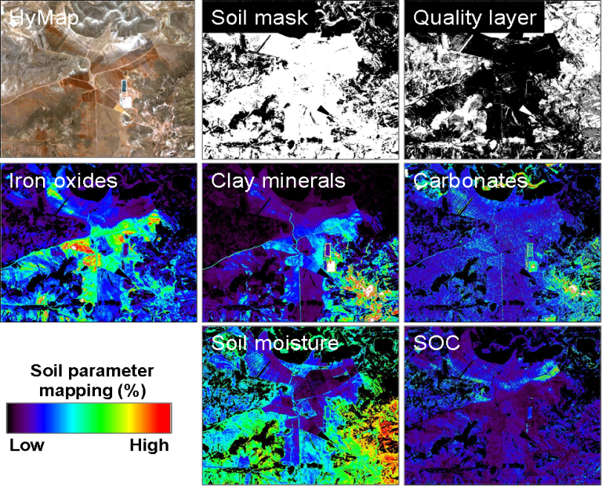
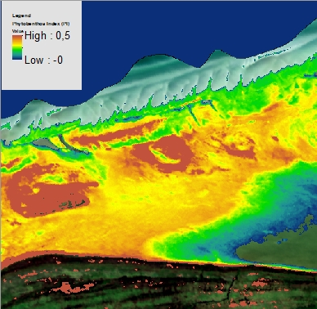
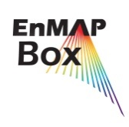



EnMAP e.g. soil &water mapping
http://www.enmap.org/
Map of Phytobenthos Distribution

Slide 10


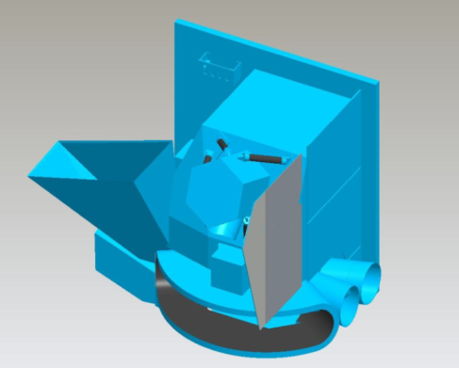

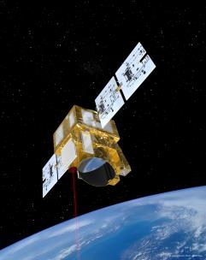
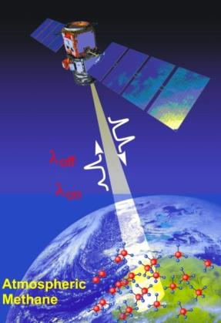
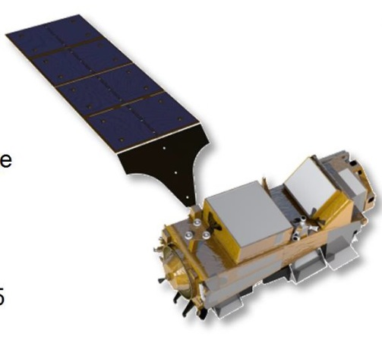

MERLIN
METimage
METimage imaging radiometer instrument for next EUMETSAT polar system
Measures physical parameters in atmosphere, sea & land surface for meteorological tasks
Present status: Phase C/D
Launch planned in 2021 on MetOp SG
French-German Climate Mission
Measurement of atmospheric methane using a Lidar (German Contribution) in cooperation with CNES
Present status: phase B
Launch planned end 2021

Slide 11

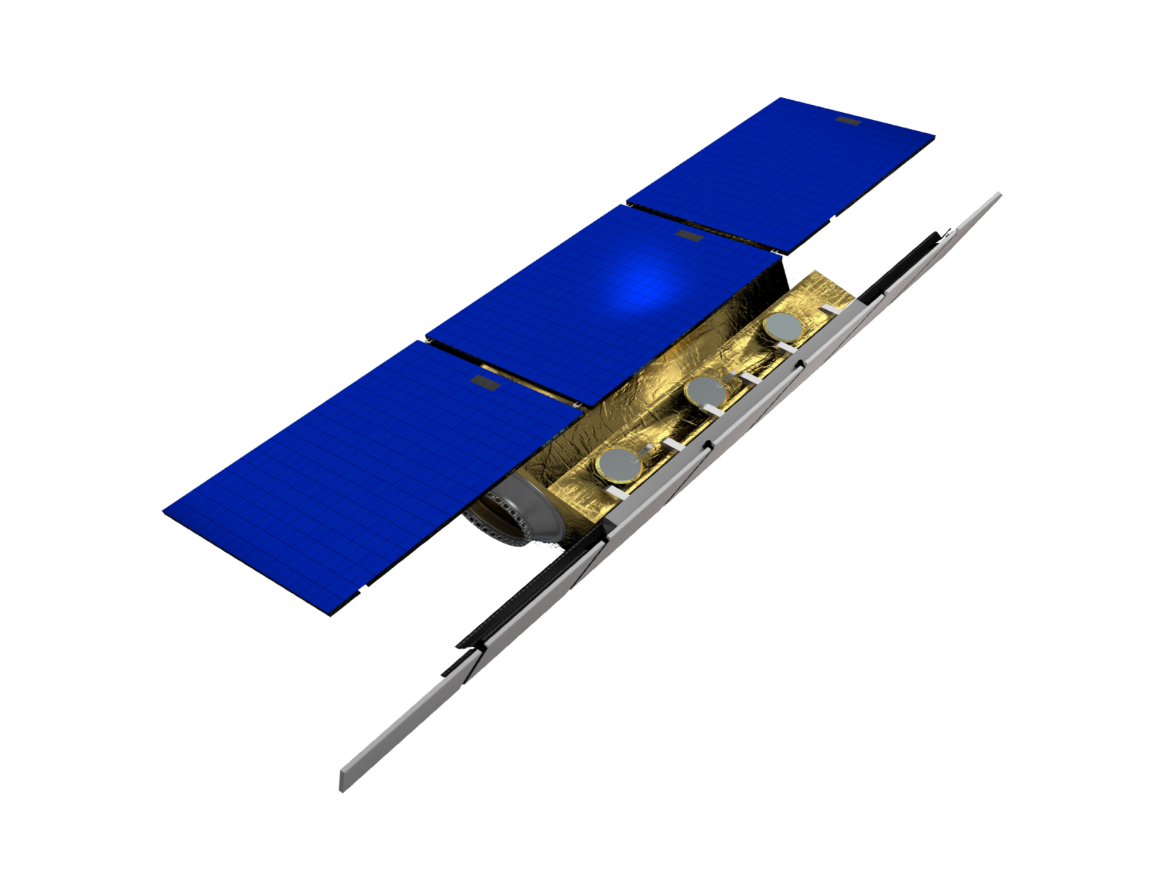
Next generation SAR
High Resolution Wide Swath with Digital Beamforming
Potential next X-band mission
Phase 0 study 2016

Slide 12



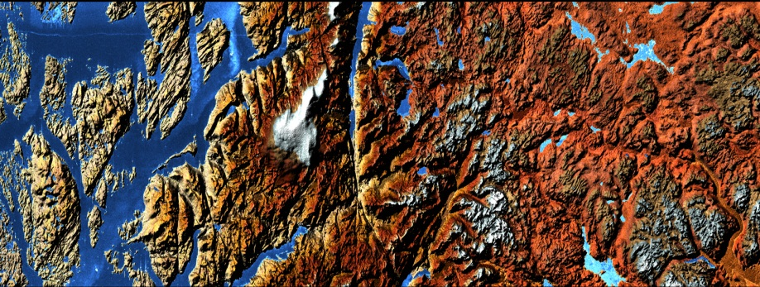

Conventional SAR-System
High Resolution Wide Swath
Stripmap
Moderate resolution and swath width
ScanSAR
HRWS
Low resolution
Continuous coverage
High resolution
High mapping performance
Spotlight
Small, discontinuous scenes

Slide 13
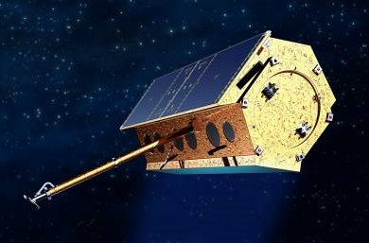
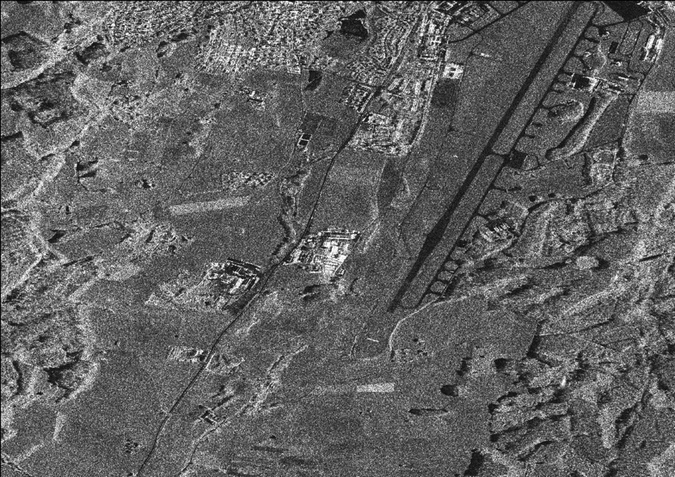
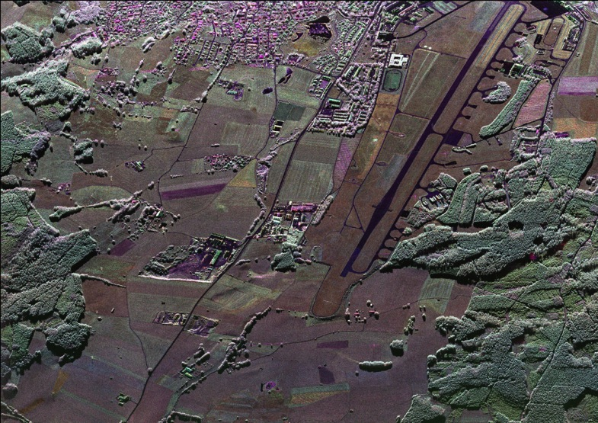
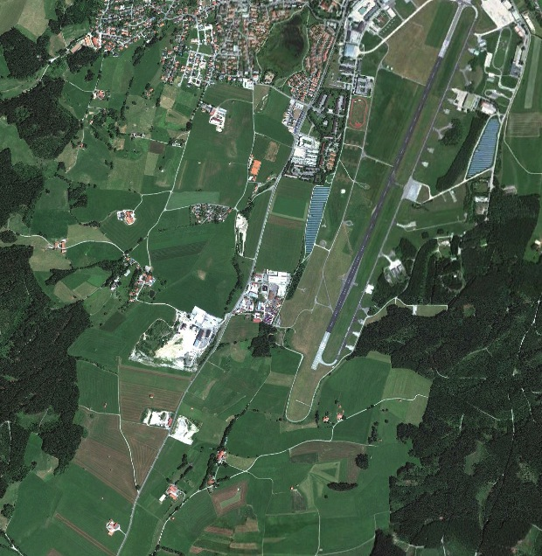
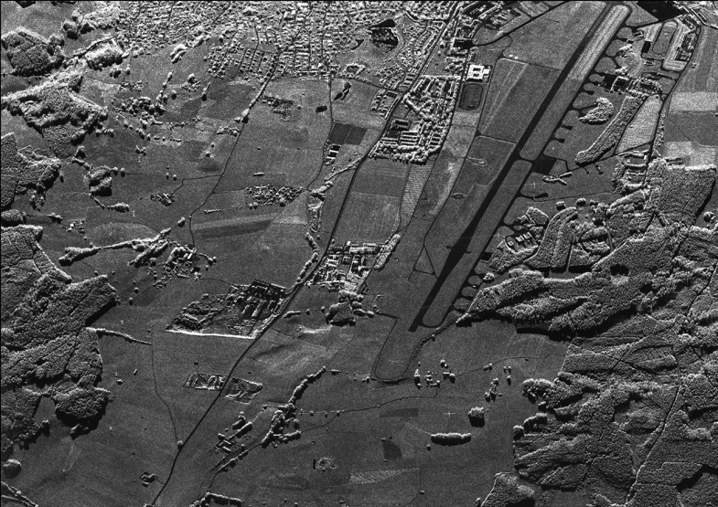
Evolving New Class of Capabilities
TerraSAR-X1 Image Quality
+ New Image Quality
High Geometric Resolution
High Radiometric Sensitivity
+ Polarimetry
+ New Image Quality
High Geometric Resoluion
High Radiometric Sensitivity

Slide 14
German EO-Program - current and planend Missions
2015 | 2016 | 2017 | 2018 | 2019 | 2020 | 2021 | 2022 | 2023 | 2024 | 2025 | 2026 | 2027 | 2028 | 2029
GRACE
GRACE-FO
RapidEye
TerraSAR-X
TanDEM-X
PAZ
HRWS-X
EnMAP
EnMAP-FO
MERLIN
METimage
FireBird
DESIS
Tandem-L

Slide 15




Data exploitation „End-to-End“
Maritime Economy
EnMap PHD
EO4Energie
SENSAT
TSX/TDX Science
EO4GEOSS
C/X Band
Method development
BIGDATA
Mission support / Algorithm development
Application development
Service Development for institutional needs
Technology oriented
(increase info detail and depth)
Application oriented
(multi-sensor, data integration)
User oriented
(integration into workflows,
decision supportt)
Requirements

Slide 16

Example: EO-Support for GEO Activities (EO4GEOSS)
Objectives
Expanding the contribution of national EO
missions and R&D to GEO Tasks
Strengthening international networking and
visibility of national capacities
Supporting access to global markets
Projects
Reference to priority GEO tasks and collaborations
(such as GFOI, GEOGLAM, GEOBON, GEO Water / IGWCO)
Collaborative projects from science and research-oriented industry
8 Projects started Q1- Q3 2016

Slide 17
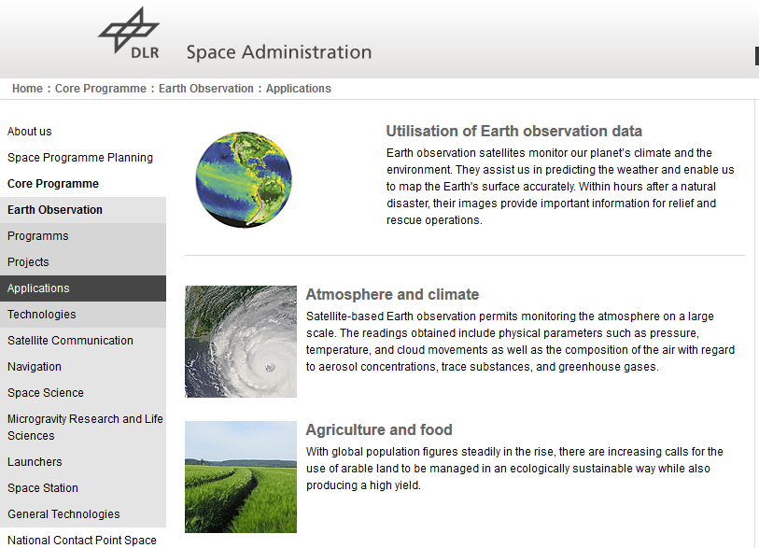
Thematic overview on German EO application programm
http://www.dlr.de/rd/en/desktopdefault.aspx/tabid-4285/6899_read-45463/

Slide 18
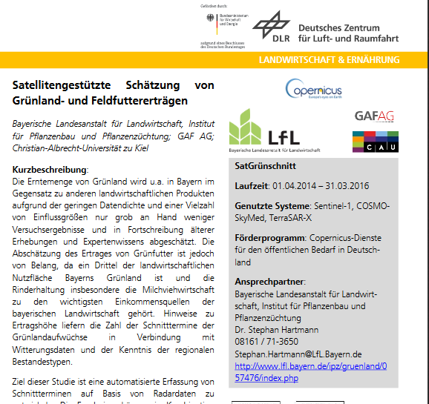
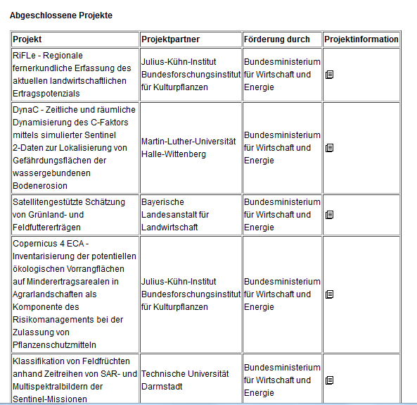
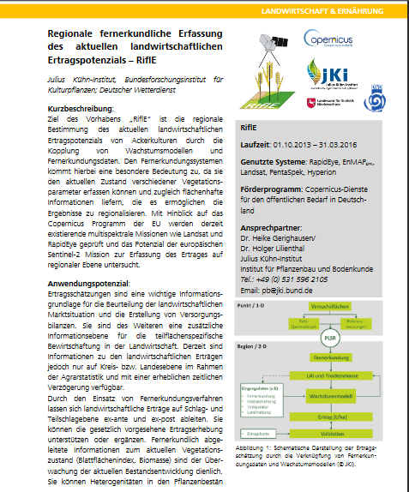
Detailed Information on projects (DE/EN)

Slide 19
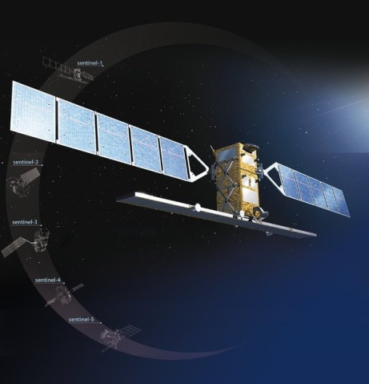
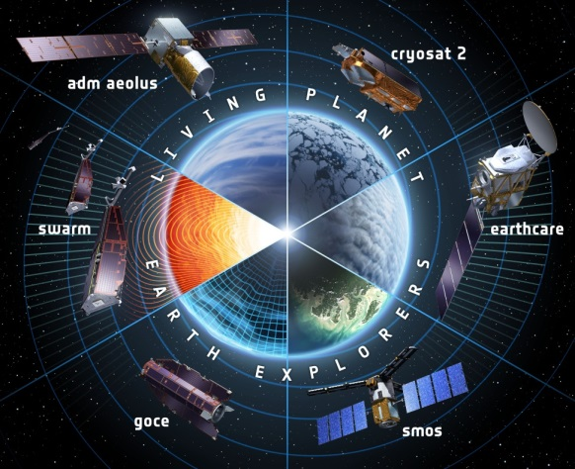



New challenge: „Big Data“
Development of innovative IT-technologies and of innovative applications
New Tender for contributions launched 4Q 2016 / first projects to start 3Q 2017

Slide 20
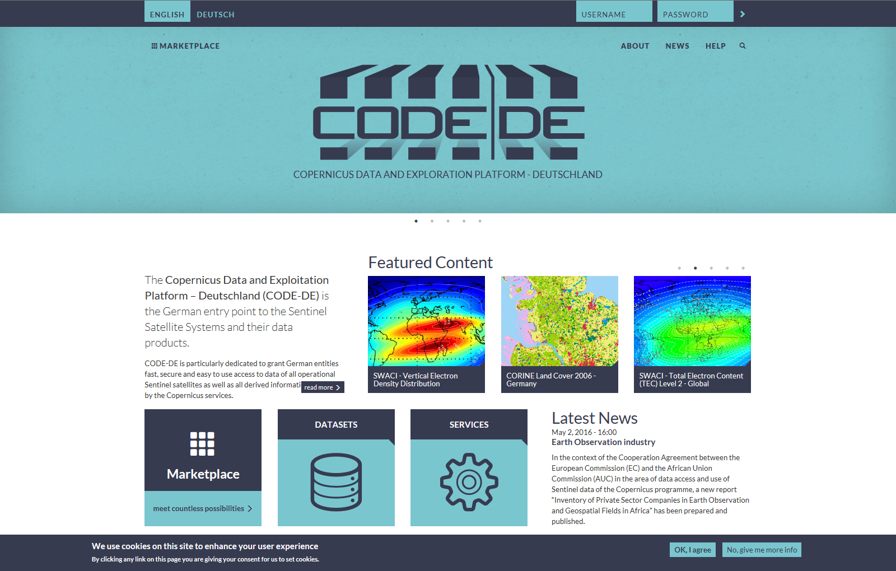


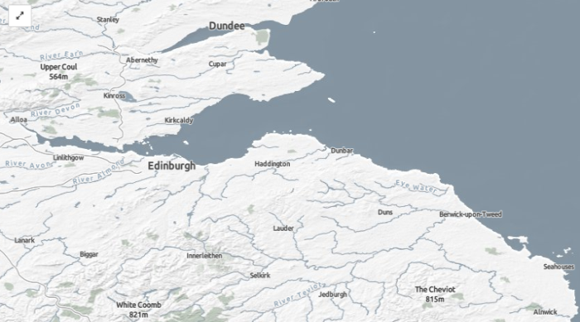
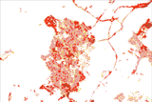
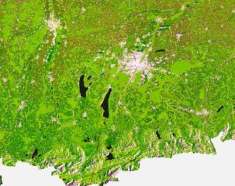
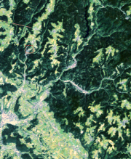
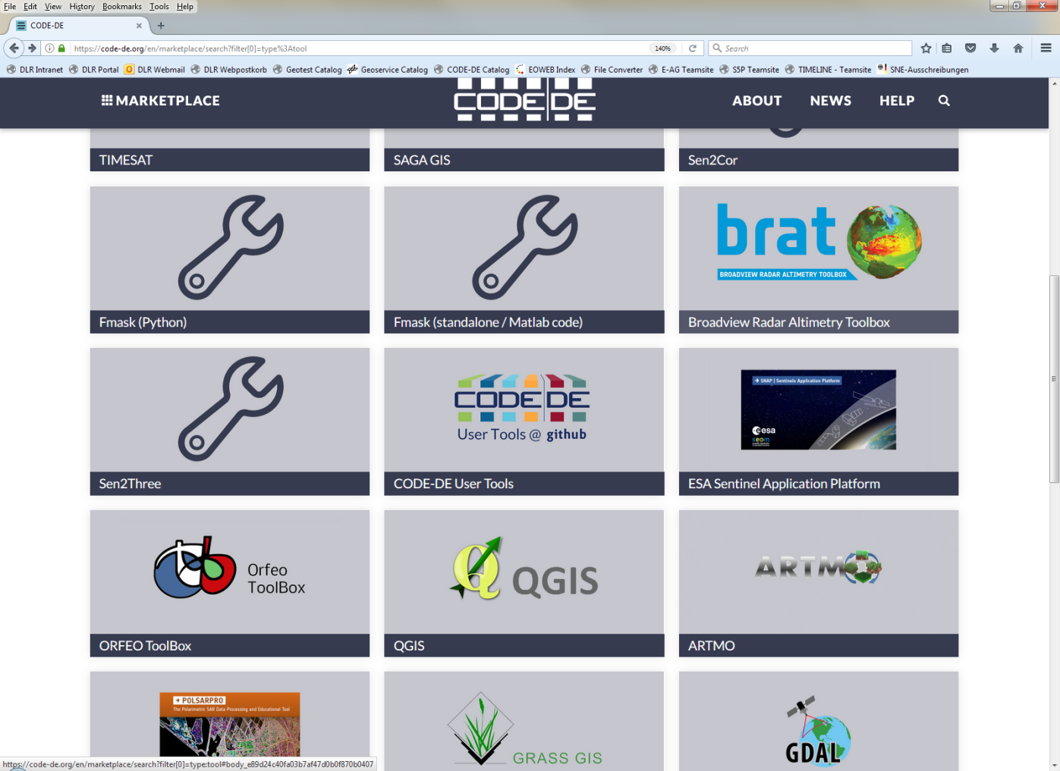
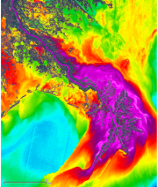
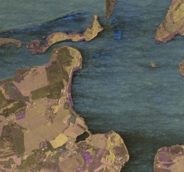

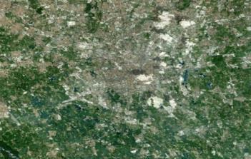
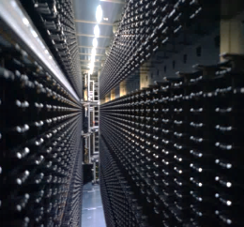
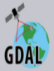



CODE-DE: Data access and Exploitation platform
Objectives & Functionalities
Efficient access to Copernicus Data and Services
for users in Germany
Provide value-added products for national use
Enable development of downstream services
Web Portal
Online Data Discovery and Access
Hosted Processing
CODE-DE
Value-added products
Core Service Products
Contributing Missions Data
code-de.org
online since 10.3.2017
Sentinel Data
D-SDA Data
Data and Products
Tools and Services

Slide 21
Capacity Building Activities at DLR Space Agency
Committee on Earth Observation Satellites
Michael Bock, DLR Space Administration
Agenda Item 6.1
CEOS 6th Working Group for Capacity Building and Data Democracy (WGCapD)-6 Annual Meeting
DLR Oberpfaffenhofen, Germany
27th-29th March, 2017

Slide 22
WGCapD-6 Annual Meeting 2017 DLR Oberpfaffenhofen, Germany 27th-29th March 2017
  CB 2016 accomplishments
Capacity Building related projects / activities funded by DLR SA
Funding to projects: “Remote sensing in schools” and
“Space for Geography” English Tutorial available !
5th SAREDU Summerschool Sept. 2016, Jena (Free for all audience)
5th EnMAP Summer School April 2016, Trier (For PHD and master thesis appl.)
Numerous support to PHD, Master and Bachelor through funded projects
Support to National Copernicus institutional training program
    Specific contribution to WGCapD
    Contract extension to the SAREDU project including financial support for SAR Training activities in Africa
    SAR Training ZAMBIA: Support with SAR EDU trainer and to organization of program and Trainers
    SAR Training GABON: Support to organization of program and trainers from DLR Technology Institute (HR)
.

Slide 23
WGCapD-6 Annual Meeting 2017 DLR Oberpfaffenhofen, Germany 27th-29th March 2017
  CB 2017 accomplishments & plans
Capacity Building related projects / activities funded by DLR SA
Successor project: “Remote sensing for schools” Start planned mid 2017
Launch of SAR-EDU E-learning portal
6th SAREDU Summerschool Sept. 2017, Jena (Free for all audience)
Continue support to PHD, Master and Bachelor through funded projects
Continue Support to National Copernicus institutional training program
    Specific contribution to WGCapD
    SAR Training ISRSE: Organization of WS together with SANSA and SAREDU team. Sponsoring of workshop catering.
    SAR EDU MINI MOOCs (early 2018) topics will be discussed with WGCAPD
.

Slide 24
WGCapD-6 Annual Meeting 2017 DLR Oberpfaffenhofen, Germany 27th-29th March 2017
  CB 2018 – 2019 plans
In General
Continue support to PHD, Master and Bachelor through funded projects
Continue support to CEOS WGCapD activities
Support to National Copernicus User Uptake
Objectives and Challenges
    Launch SAR EDU Mini Moocs
    Consolidate and Enhance SAR EDU E-Learning platform
      Involve other stakeholders (ESA, EU, Copernicus,
      Involve new partners to cooperate (exchange , translate, ..)
      Add other EO training modules (e.g Hyperspectral

Slide 25
WGCapD-6 Annual Meeting 2017 DLR Oberpfaffenhofen, Germany 27th-29th March 2017
  DLR Mission data support
Up to date TSX /TDX mission data support to CEOS Initiatives:
Via the CEOS Spatial data coordination group for GFOI
  Free data for GFOI R&D
  Background mission for R&D Groups
Via the GEO/CEOS Geohazard Supersites Server
  collaborative free data-pool and data sharing
Via CEOS Working Group Disasters (support to pilots)
  Volcano Pilot (several sides supported)
  Seismic Pilot (mainly Sentinel 1 )
  Landslide Pilot (TSX data requests expected)
Future challenges and objectives
  Ease and extend data provision for global science and society

Slide 26
Thank you for your attention
Michael Bock
DLR Space administration

