Slide 1

Viewing Earth
Serving Society
The Committee on Earth Observation Satellites (CEOS)
Activities and Priorities
Jonathon Ross
CEOS Executive Officer
c/o Geoscience Australia
WGCapD, Germany
March 2017

Slide 2
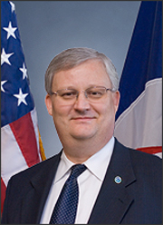
Hello from Frank!
Dr Frank Kelly
2017 CEOS Chair
USGS

Slide 3
Overview

Slide 4
Background
Established in 1984 under auspices of G-7 Economic Summit of Industrialized Nations
  Focal point for international coordination of space-related Earth Observation (EO) activities
  Optimize benefits through cooperation of members in mission planning and in development of compatible data products, formats, services, applications, and policies
Operates through best efforts via voluntary contributions
32 Members (Space Agencies) and 28 Associates
  Over 140 missions on orbit
  Welcome to the Vietnam National Space Center (VAST)!
The “space arm” of GEO: the intergovernmental Group on Earth Observations
Key activities delivered through:
  Virtual Constellations
  Working Groups

Slide 5
CEOS Virtual Constellations
Coordinate Member space and ground segment assets to meet a combined and common set of Earth observation requirements.
Focus dialogue from “all topics/all agencies” to small, specialized groups
Provide guidance for design and development of future systems to meet the broad spectrum of EO requirements
  Avoid duplication and overlap in EO efforts
  Close information gaps in support of societal benefit
  Establish and sustain global EO coverage and data availability
Ocean Surface Topography
Land Surface
Imaging
Atmospheric
Composition
Ocean Surface
Vector Winds
Sea Surface
Temperature
Precipitation
Ocean Colour
Radiometry
Co-Leads:
CNES, EUMETSAT
Co-Leads:
USGS, ESA, GA
Co-Leads:
NASA, ESA
Co-Leads:
NOAA, ISRO,
EUMETSAT
Co-Leads:
NOAA,
EUMETSAT
Co-Leads:
JAXA, NASA
Co-Leads:
ESA, NOAA,
NASA
Notes:
CEOS Virtual Constellations are a means to better address space-based Earth observation needs on a global basis – without eroding the independence of individual agencies.
CEOS Virtual Constellations harmonize and maximize efforts among space agencies to deploy Earth observation (EO) missions as part of GEOSS, address emerging data gaps, avoid overlap among observing systems, and make maximum use of existing assets. A Virtual Constellation consists of multiple satellites, ground systems, and related data delivery systems mobilized in a coordinated manner for greater efficiency.

Slide 6
CEOS Working Group Goals
Calibration and Validation (WGCV)
  Long-term confidence in the accuracy and quality of data & products
Information Systems and Services (WGISS)
  Coordinated development of systems and services which manage and supply the data and information from Member missions
Capacity Building & Data Democracy (WGCapD)
  Increased capacity of institutions in less developed countries for effective use of Earth observation data for development
Climate (WGClimate) [joint with CGMS]
  Facilitation of the use of Essential Climate Variable (ECV) time-series through coordination of Member Agencies’ activities
Disasters (WGDisasters)
  Strengthened contribution of Earth Observation satellite to the various disaster risk management phases
Notes:
Working Groups typically address topics such as calibration/validation, data portals, capacity building, and common data processing standards that area shared across a wide range of Earth observation domains. As a consequence, their activities are intimately connected with, and complementary to, the work of the Virtual Constellations and are often viewed as “cross-cutting” mechanisms within CEOS.

Slide 7
Supporting implementation of global agendas

Slide 8
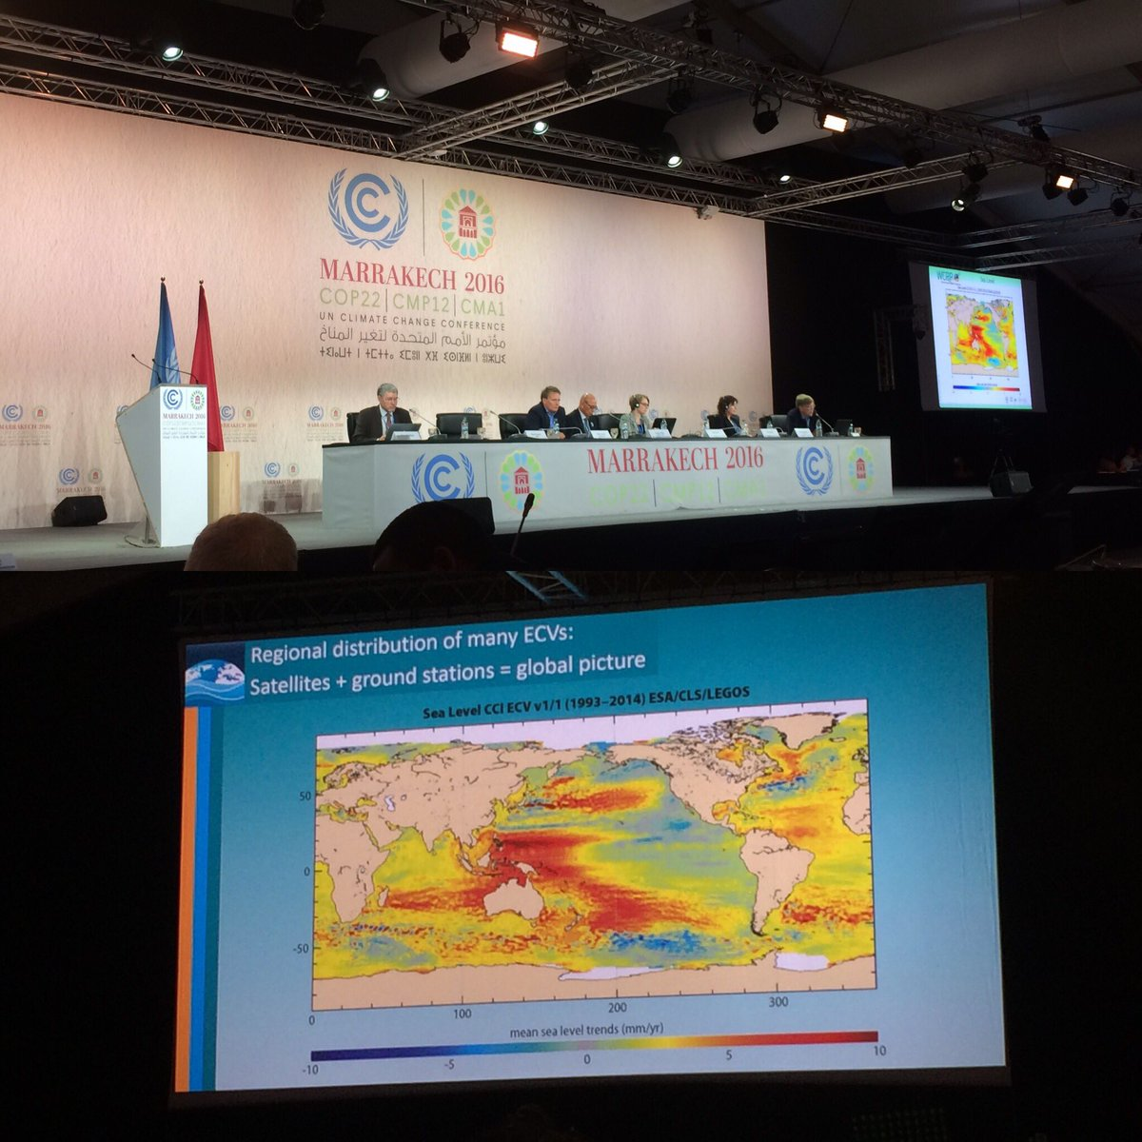
Climate
CEOS:
Ensures that requirements identified by the Global Climate Observing System (GCOS) are addressed through Agency planning processes
Provides regular updates on progress to UNFCCC SBSTA.
Contributes to the periodic updates of the GCOS Implementation Plan
  Response to the 2016 GCOS-IP now in progress!
Works with stakeholders to support implementation of the Paris Climate Agreement.

Slide 9
Disaster Risk Reduction
CEOS supports implementation of the Sendai Framework for Disaster Risk Reduction 2015-2030 by:
Coordinating provision of data in support of disaster risk reduction.
Engaging with relevant UN agencies and authorities to ensure the full societal benefit potential of the data is realized in all phases of disaster risk management.
Leading implementation of the strategic GEO Initiative on disaster risk reduction, GEO-DARMA (Data Access for Risk Management).
Supporting other initiatives like Geohazard Supersites and Natural Laboratories (GSNL) which connects cutting-edge science to those responsible for managing major hazards.
Advancing use of satellite data for disaster risk reduction applications through a dedicated Working Group on Disasters.

Slide 10
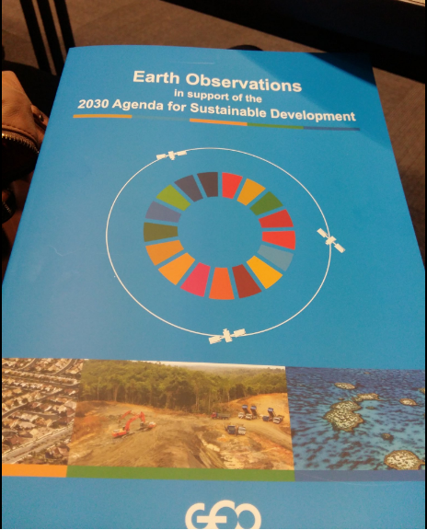
Agenda for Sustainable Development
CEOS:
Plays a leading role in the efforts of GEO and UN-GGIM to promote the use of Earth observation and spatial data in support of sustainable development.
Supports Agencies to work with their national statistical offices.
Monitors and promotes ways in which satellite applications can play a key role in monitoring progress, and achieving change.

Slide 11
Delivering on key challenges
CEOS is providing concrete support to initiatives tackling specific challenges in support of these bigger agendas.

Slide 12


Supporting GEO
GEO’s ‘convening power’ is unique – it is a key link in getting EO benefits realised.
CEOS is committed to the second decade of the intergovernmental Group on Earth Observation.
Increasing strategic and responsive focus that has been adopted is a big step forward!
CEOS more deeply engaged in GEO governance than before: Programme Board and ExCom.
Space
Arm
Of

Slide 13
2017 Chair Initiatives:
Unlocking the potential of ‘big space data’

Slide 14

2017 USGS CEOS Chair Initiatives
Future Data Architectures
Medium Resolution Sensor Interoperability

Slide 15
Future Data Architectures
  Context:
  Lack of data is no longer a limiting factor in many key domains.
  Traditional processing and data distribution methods are not scaling to capitalise on these opportunities.
  User expectations around ease of data access and use have changed due to internet/data ‘giants’.
  Collaborative environments where both data providers and users can work together are critical
  Opportunities are offered by new high-performance ICT infrastructure and architectures

Slide 16
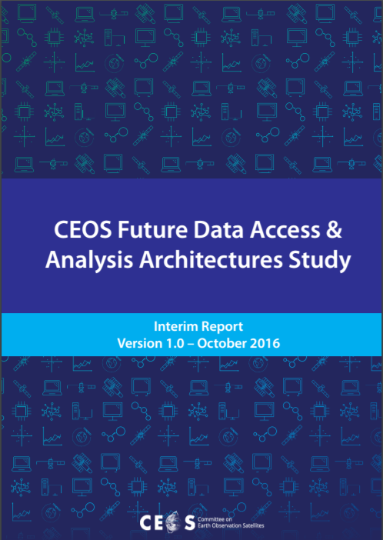
Future Data Architectures
  Initial Findings
  2016 Australian Chair Initiative delivered interim report.
  Key opportunities:
  Engage new user groups by lowering technical barriers – empower ‘domain’ experts.
  Leverage ability to “bring the user to the data”.
  New architectures depend on ‘analysis ready’ data if their potential is to be realized.
  Open source tools can support and complement proprietary efforts.

Slide 17
Future Data Architectures
Next Steps
  This is a focus area that will endure in CEOS over years to come.
  Interim report highlighted key opportunities.
  CEOS Agencies each at different stages:
  Challenge – need for a flexible strategy
  Opportunity – for Agencies to support each other
  Extended team is now considering what concrete actions should be taken forward:
  Where is it most critical (for impact on key agendas) for Agencies to work together in a coordinated way?
  Where should sharing of ‘best practice’ and ‘lessons learned’ be facilitated?
  Where would CEOS not add value?

Slide 18
Medium-Resolution Sensor Interoperability
  Interoperability:
  Easy to say
  Seems ‘easy’ to comprehend
  Difficult to pin down ☺
  Increasing demand for multi-mission products in land domain:
  Richer products
  Increased resilience to disruption
  Leverage complementary data types
  Landsat and Sentinel-2 being one example.

Slide 19
Medium-Resolution Sensor Interoperability
  Goals
  Framework for assessing the interoperability of two datasets
  Recommendations on ‘how to do interoperability if what you mean by interoperability is <x>’
  Looking at:
  Metadata interoperability
  Data interoperability
  Leverage complementary data types
  Landsat and Sentinel-2 will be a case study.

Slide 20
CARD4L
  CEOS Analysis Ready Data For Land (CARD4L)
  Framework for establishing ‘minimum requirements’ for products that:
  Are ready for ‘immediate analysis’
  Require minimal additional user effort to prepare
  Interoperable with other CARD4L datasets
  Intended to lower barriers and engage new communities of users …
  “Why didn’t you call it Top Of Atmosphere Sat?”
  … Without getting in to their ‘business’.
  Complementary to other product types.

Slide 21
CEOS Data Cube Initiative
Developing and applying Open Source tools
  Platform that can support countries to take up methodologies and products coming from initiatives such as GFOI and GEOGLAM.
  Key criteria:
  Users want to minimize the effort required to obtain and prepare satellite data
  Users want free and open source solutions.
  Users want to perform time series analyses and use multiple datasets together
  Users want to work in familiar environments
  Users want to “own” the data and products
  Working with countries including Viet Nam, Colombia, Kenya and Switzerland.
  Leveraging the Open Data Cube technology, an open source project that you can join today!

Slide 22
Resources

Slide 23
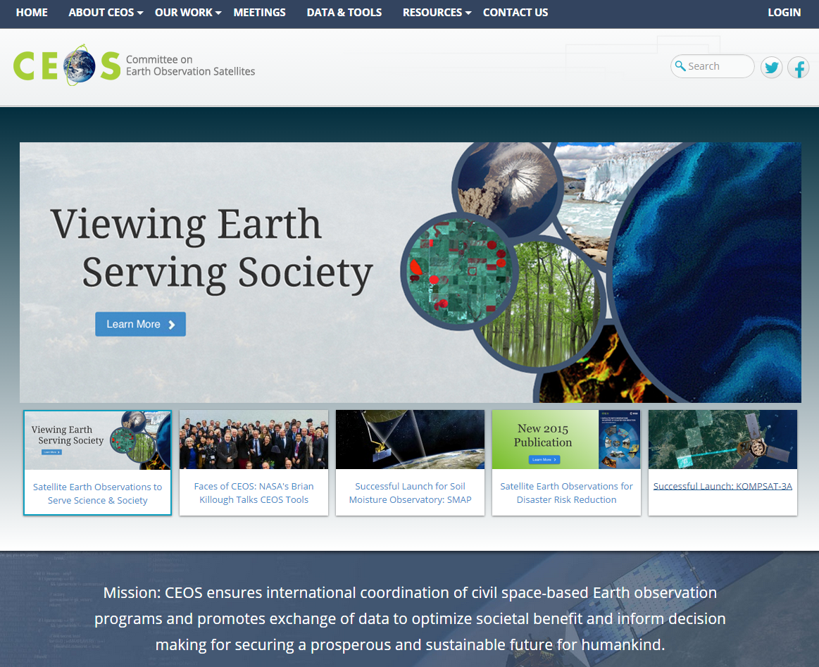
Our website – ceos.org
Access here

Slide 24
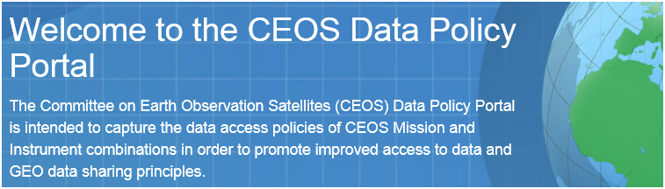
Other CEOS Tools & Resources
http://ceos.org/data-tools/

Slide 25
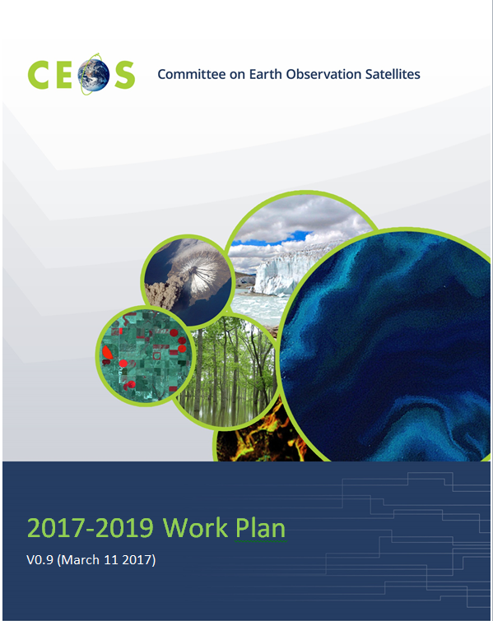
CEOS Work Plan 2017-2019
Thematic
  Climate – space agency response to GCOS IP 2016.
  Carbon – projects progressing the Carbon Strategy; support to GFOI.
  Agriculture – support the evolution of GEOGLAM as it scales up.
  Disasters – close out pilots and determine way forward; scale up GEO-DARMA.
  SDGs – dedicated ad-hoc team, working closely with GEO through PB.
  Water – see as GEO re-orients itself.
  Oceans and coasts – support BluePlanet.
  Polar and biodiversity – CEOS ‘experts’ act as coordination points.

Slide 26
Cross-cutting
  Data access – discoverability, preservation, and engagement in GEOSS Common Infrastructure evolution.
  Data quality – ongoing strong area of activity, e.g. through ‘ACIX’ and ‘RADCALNET’.
  VCs – re-emergence of LSI-VC, work on requirements consolidation and ‘CARD4L’.
  Outreach – attendance at major events, newsletter, website.

Slide 27
Our Team

Slide 28
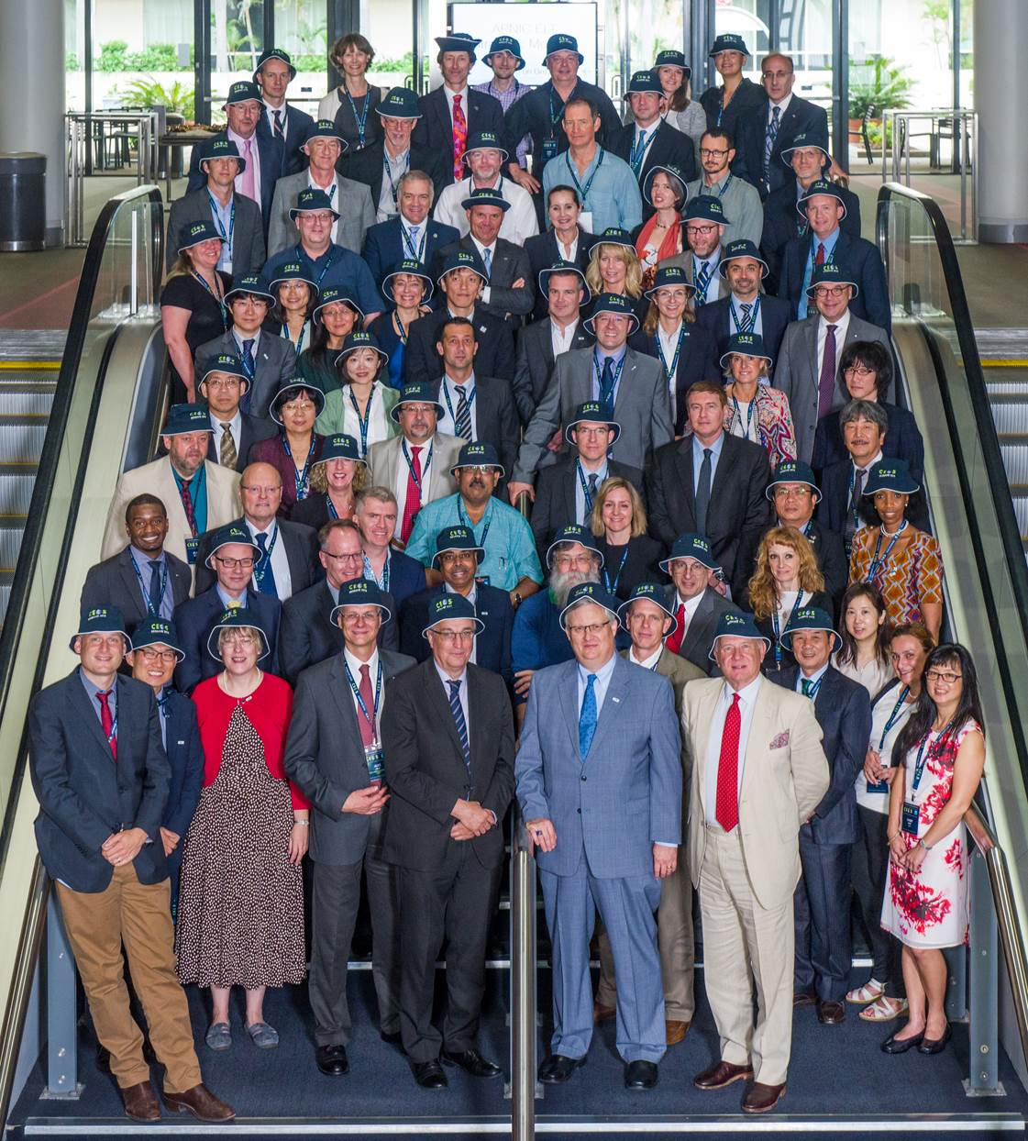
Chair
SIT Chair
EUMETSAT
2014
CNES
JAXA
2015
CSIRO
2016
ESA
USGS
2017
EC
2018
NOAA

Slide 29
CEOS Members & Associates
MEMBERS
Agenzia Spaziale Italiana (ASI)
Canadian Space Agency (CSA)
Centre National d’Etudes Spatiales (CNES), France
Centro para Desarrollo Tecnólogico Industrial (CDTI), Spain
China Center for Resources Satellite Data and Applications (CRESDA)
Chinese Academy of Space Technology (CAST)
Comisión Nacional de Actividades Espaciales (CONAE), Argentina
Commonwealth Scientific & Industrial Research Organisation (CSIRO),
Australia
Deutsches Zentrum fürLuft-und Raumfahrt (DLR), Germany
European Commission (EC)
European Organisation for the Exploitation of Meteorological Satellites
(EUMETSAT)
European Space Agency (ESA)
Geo-Informatics and Space Technology Development Agency (GISTDA),
Thailand
Indian Space Research Organisation (ISRO)
Instituto Nacional de Pesquisas Espaciais (INPE), Brazil
Japan Aerospace Exploration Agency/Ministry of Education, Culture, Sports,
Science, and Technology (JAXA/MEXT)
Korea Aerospace Research Institute (KARI)
National Aeronautics and Space Administration (NASA), USA
National Oceanic and Atmospheric Administration (NOAA), USA
National Remote Sensing Center of China (NRSCC)
National Satellite Meteorological Center/Chinese Meteorological Administration
(NSMC/CMA)
National Space Agency of Ukraine (NKAU)
National Space Research Agency of Nigeria (NASRDA)
Netherlands Space Office (NSO)
Russian Federal Space Agency (ROSCOSMOS)
Russian Federal Service for Hydrometeorology and Environmental Monitoring
(ROSHYDROMET)
South African National Space Agency (SANSA)
Scientific and Technological Research Council of Turkey (TÜBITAK)
United Kingdom Space Agency (UKSA)
United States Geological Survey (USGS)
Vietnam Academy of Science and Technology (VAST)
ASSOCIATES
Australian Bureau of Meteorology (BOM)
Belgian Federal Science Policy Office (BELSPO)
Canada Centre for Mapping & Earth Observation (CCMEO)
Crown Research Institute (CRI), New Zealand
Earth Systems Science Organisation (ESSO), India
South African Council for Scientific and Industrial Research
(CSIR)/Satellite Applications Centre (SAC)
Gabonese Agency for Space Studies and Observations (AGEOS)
Global Climate Observing System (GCOS)
Geoscience Australia (GA)
Global Geodetic Observing System (GGOS)
Global Ocean Observing System (GOOS)
Global Terrestrial Observing System (GTOS)
Intergovernmental Oceanographic Commission (IOC)
International Council for Science (ICSU)
International Geosphere-Biosphere Programme (IGBP)
International Ocean Colour Coordinating Group (IOCCG)
International Society of Photogrammetry and Remote Sensing
(ISPRS)
Malaysian National Space Agency (ANGKASA)
Mexican Space Agency (AEM)
Norwegian Space Centre (NSC)
Swedish National Space Board (SNSB)
United Nations Economic and Social Commission for Asia and the
Pacific (ESCAP)
United Nations Educational, Scientific and Cultural Organization
(UNESCO)
United Nations Environment Programme (UNEP)
United Nations Food and Agriculture Organization (FAO)
United Nations Office for Outer Space Affairs (UNOOSA)
World Climate Research Programme (WCRP)
World Meteorological Organization (WMO)

Slide 30
Thank you!
Any questions?

