Slide 1
German Aerospace Center (DLR) and DLR Oberpfaffenhofen
Dr. Reinhold Busen
Head of site management

Slide 2
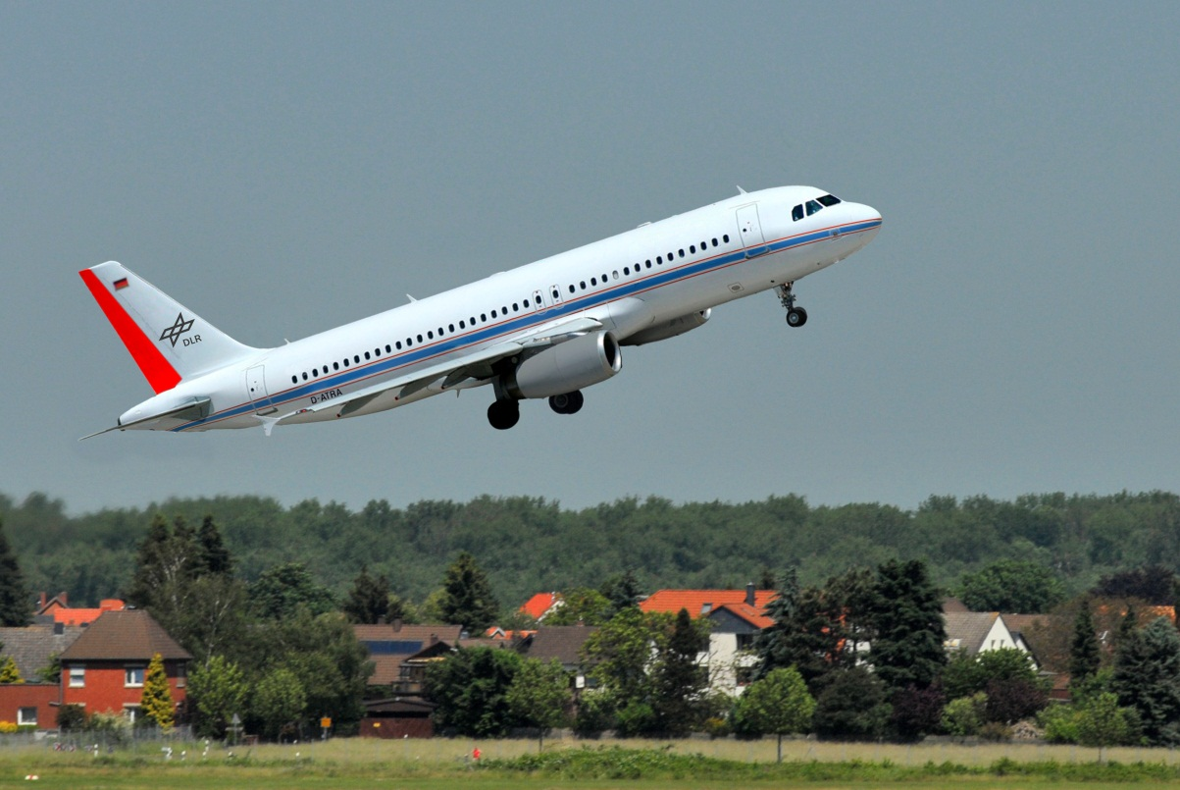
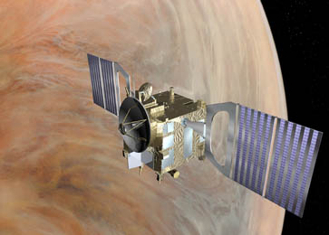

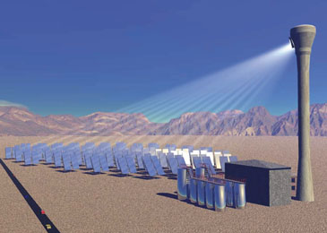
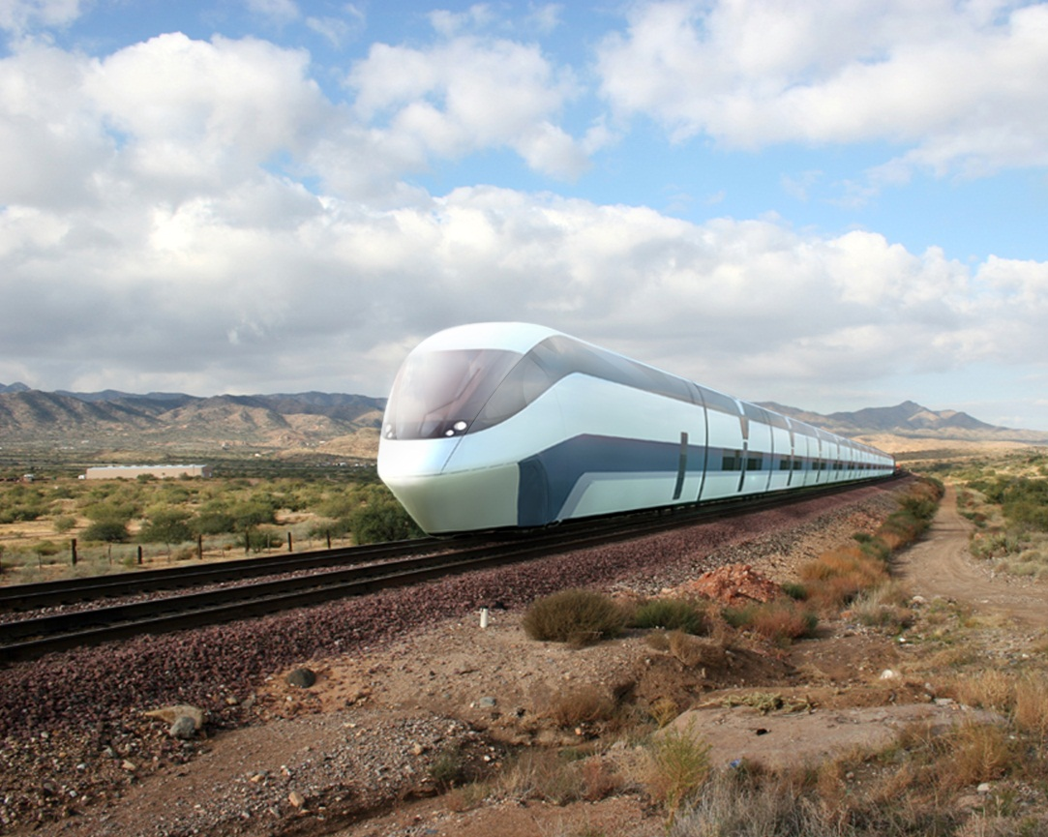
Notes:
The grapfic illustrates the research areas of DLR: Aeronautics; Space Research and Technology; Transport; Energy; Defence and Security
The globe symbolize the theme security. It is integrated in all other research areas.

Slide 3

Research Areas
Research Institution
  Aeronautics
  Space Research and Technology
  Transport
  Energy
  Defence and Security
Space Administration
Project Management Agency
Notes:
DLR's mission comprises the exploration of Earth and the Solar System and research for protecting the environment. This includes the development of environment-friendly technologies for energy supply and future mobility, as well as for communications and security.
DLR's research portfolio ranges from fundamental research to the development of products for tomorrow. In this way, DLR contributes the scientific and technical expertise that it has acquired to the enhancement of Germany as a location for industry and technology. DLR operates major research facilities for its own projects and as a service for clients and partners. It also fosters the development of the next generation of researchers, provides expert advisory services to government and is a driving force in the regions where its facilities are located.

Slide 4
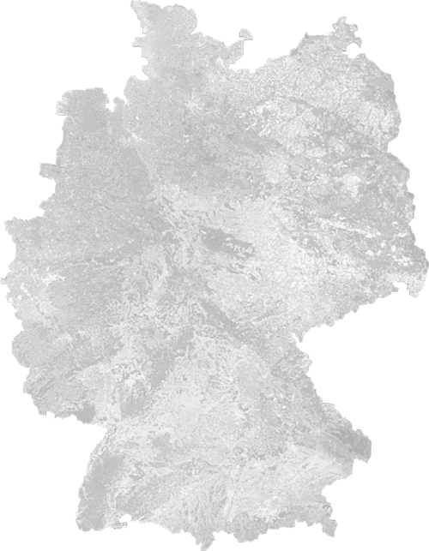
Locations and employees
Approx. 8000 employees across
33 institutes and facilities at
  16 sites.
Offices in Brussels, Paris,
Tokyo and Washington.
Near future:
39 institutes at 20 sites
Stade n
n Hamburg
n Neustrelitz
Bremen n
n Trauen
Berlin n
Braunschweig n
n Goettingen
Juelich n
n Cologne
n Bonn
Lampoldshausen n
Stuttgart n
Augsburg n
n Oberpfaffenhofen
Weilheim n
Notes:
DLR has approximately 8000 employees at 16 locations in Germany: Cologne (headquarters)
DLR has 33 institutes, test centres and operational facilities at 16 sites in Germany. The locations spread (out over) Germany.
The executive board is based in Cologne.
DLR also has international offices in Brussels, Paris, Tokyo and Washington D.C.

Slide 5
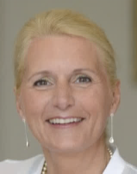
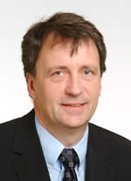
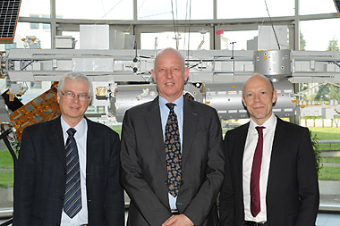
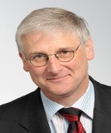
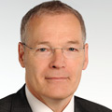
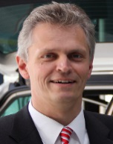
Executive Board
Prof. Dr. Pascale Ehrenfreund
Chair
Overall strategy and development
External relations
Corporate Communication
ESA Council
Klaus Hamacher
Vice Chair
Human Resources, Finance, Corporate Organisation
Quality Assurance and Infrastructure
Technology Marketing
Information technology
Project Management Agency
Dr. Gerd Gruppe
Space Administration
National/ESA program
Prof. Dr. Hansjörg Dittus
Space Research and Technology:
research, programs, projects, technology transfer
Prof. Rolf Henke
Aeronautics:
research, programs, projects, technology transfer
Approved Design Organisation
Prof. Dr. Karsten Lemmer
Transport and Energy:
research, programs, projects, technology transfer
Notes:
Here you see the managment (board) of DLR. Mrs. Prof. Ehrenfreund is since September 2015 the chair. Before it was Prof. Wörner, who is now the director of ESA.
She ist espacially responsible for the strategy, external relationship and Communication.
Mr Hamacher is the vice chair and responsible für the administration work at DLR.
Mr. Lemmer ist our new member of the management board. Before this job, he was a director of a DLR insitute for transport in Braunschweig.

Slide 6
Financing of DLR and research funding 2016
without settlement of cross-financing
Notes:
Here you see the diagram of DLR‘s budget planned for 2016.
DLR has a budget of approximately 900 million Euros, of which nearly 455 million Euros were third party funds obtained in competition in the market.

Slide 7

Human Resources Development and Development of Young Talents
Further development of human resources policy instruments for employee motivation
Systematic development and recruitment of young talent
Communicating the fascination of research and technology to the next generation
Representation in European organisations and promoting staff exchanges with industry and other national and international partners
Hamburg n
n Neustrelitz
Berlin n
Braunschweig n
n Dortmund
n Goettingen
n Cologne
Lampoldshausen n
Stuttgart n
n Oberpfaffenhofen
Notes:
DLR fosters and develops talented young scentists. There are many possibilities to profit: DLR_School_Lab; Talent_School, Graduate_Program;
In Oberpfaffenhofen is settled one of the School_Labs; about 30,000 pupils visit the facility. The kids get their experience in research work by conducting their own experiments.

Slide 8
DLR Sites
Oberpfaffenhofen
Weilheim
Augsburg

Slide 9
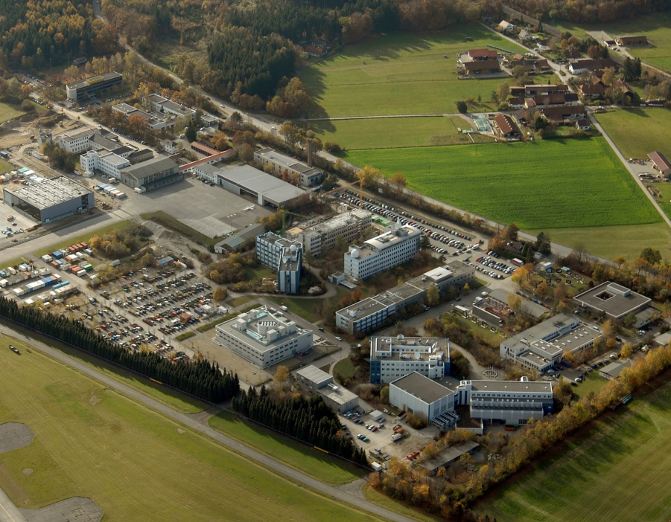
DLR Site
Oberpfaffenhofen
Employees: about 1.700
Size of site: 245 000 m²
Characteristics: connection to „Research airport“ / „pulser in the region“
Research institutes and facilities:
Microwaves and Radar Institute
Institute of Communications and Navigation
Institute of Atmospheric Physics
Remote Sensing Technology Institute
Institute of Robotics and Mechatronics
Institute of System Dynamics and Control
German Remote Sensing Data Centre
Research Group Complex Plasmas
Space Operations and Astronaut Training
Galileo Control Centre
Flight Experiments
Notes:
- Together with the site at Cologne, the DLR site at Oberpfaffenhofen is one of Germany's largest research centres.
the site is home to 10 scientific institutes and facilities and in addition a research group and currently employs approximately 1700 people.
The research centre's main fields of activity include participating in space missions, climate research, research and development in the field of earth observation, developing navigation systems and advanced robotics development.
- At the Oberpfaffenhofen site, DLR’s research activities are concentrated on aeronautics and space exploration. and is equipped with a powerful infrastructure to support research operations. DLR Oberpfaffenhofen works closely with universities and research institutes in Germany and abroad, with the European space agency ESA and the American space agency NASA.
DLR has been conducting research at Oberpfaffenhofen since 1937– initially under the name “Flugfunk Forschungsinstitut Oberpfaffenhofen (FFO)” “aircraft radio research institute”.
Research was halted at the outbreak of the Second World War; after the war, the buildings were used as barracks for military flight operations. Research operations resumed in 1955, mainly in the field of aircraft radio. Additional office buildings were erected in the mid- 1960s. In 1969, the institute in Oberpfaffenhofen was expanded to include a space operations center. In the 1970s, Oberpfaffenhofen carried out various satellite missions in cooperation with NASA. NASA provided carrier rockets and flight paths, while the data from the first satellites were monitored and controlled from Oberpfaffenhofen, enabling DLR to gain initial experience of unmanned space expeditions. Since 1989, the site’s official name has been “DLR Oberpfaffenhofen”. Further research institutions were added and the significance of Oberpfaffenhofen as a location for research has increased steadily.

Slide 10
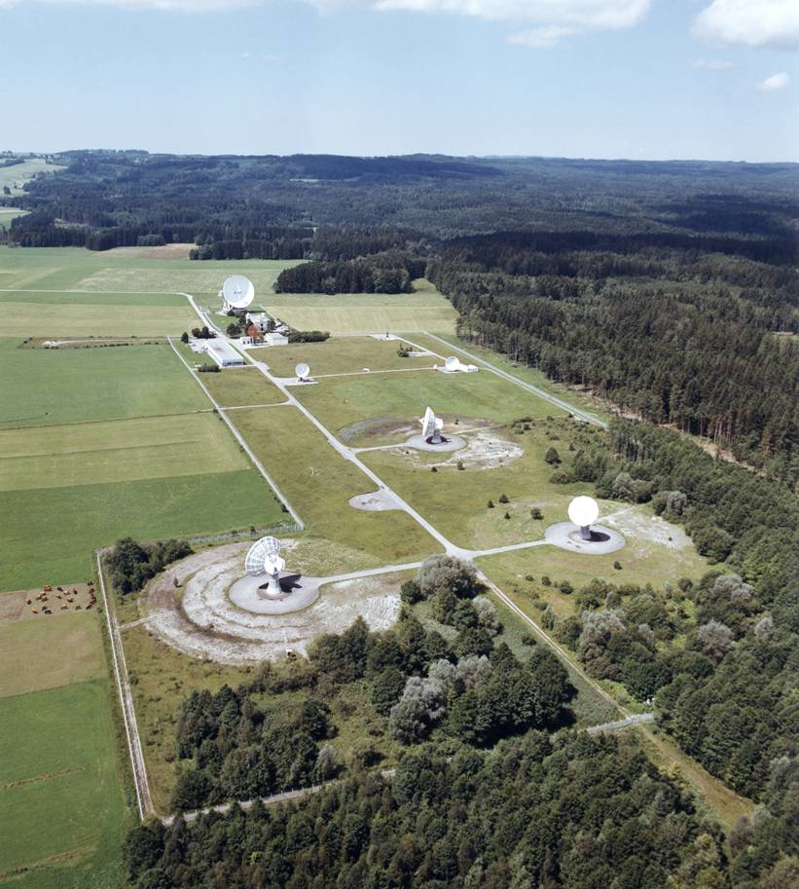
DLR Site
Weilheim
Employees: 40
Size of site: 356 000 m²
Characteristics:
Ground station with 12 antennas
established in 1968
communications link between Earth and satellites in orbit.
Facilities:
Space operations and astronaut training
Notes:
Weilheim has a stong connection to Oberpfaffenhofen, there work colleagues of the facility Space operations and astonaut training.

Slide 11
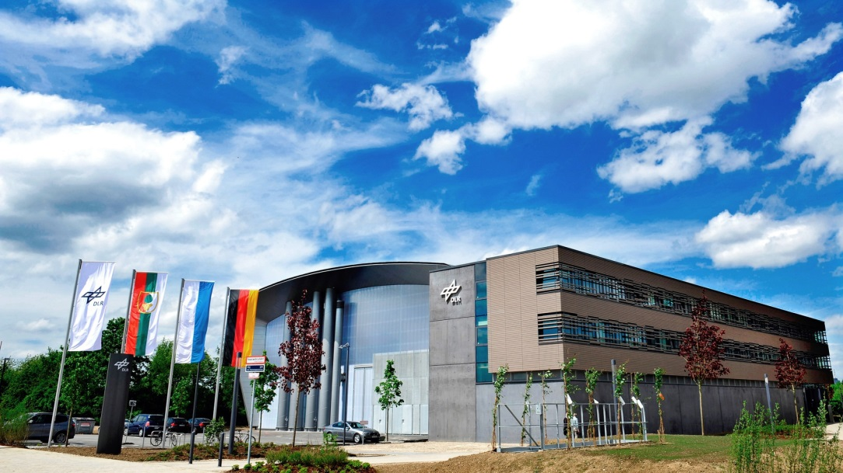
DLR Site
Augsburg
Employees: 48
Size of site: 750 m²
Characteristics:
Center for Lightweight Production Technology
Established in May 2011
Research institute:
Institute of Structures and Design
Institute of Composite Structures and Adaptive Systems
Institute of Robotics and Mechatronics
Notes:
Augsburg thus completes the process chain for the development and production of components made of carbon-fibre reinforced composites at DLR.

Slide 12
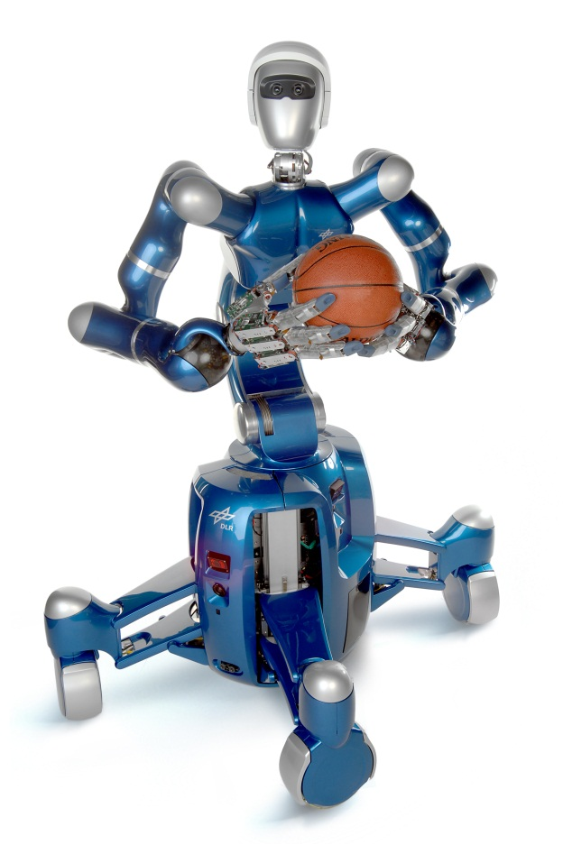
Thank you for your kind attention!

