Slide 1
Working Group on Calibration & Validation (WGCV) support to other initiatives
Philippe Goryl, ESA
Agenda Item 3.9
WGCV-54
16-17 October 2024
Sioux Falls, South Dakota, USA

Slide 2
Conclusion : Vision for WGCV (2)
WGCV Support Groups/Initiatives/Applications
Climate – GCOS IP:
- Better align the satellite FRM program to the reference tier of tiered networks and enhance/expand FRM to fill gaps in satellite cal/val.
- B5.1 Increase the number of in situ river level observations that are exchanged internationally and can be used to calibration satellite observations of water levels.
- D4. Create a facility to access co-located in situ cal/val observations and satellite data for quality assurance of satellite products.
- B 1. 5. Establish a long-term space-based reference calibration system to enhance the quality and traceability of earth observations 🡪 SITSat
GHG Tasks:
Contribution to the “ROADMAP FOR A COORDINATED IMPLEMENTATION OF CARBON DIOXIDE AND METHANE MONITORING FROM SPACE”
Participation and contribution to WMO 1st CIPM STG-CENV CIPM Sectorial Task Group on Climate Change
and Environment (CIPM-STG-CENV). 29 actions where WGCV contributes
(uncertainties tool, FRM assessment, support to network, SITSat…)
Support Biodiversity task: initial discussion. Discussion on FRM for Land Cover. To be Followed….
Coordination with WMO GSICS
Dialog/Cooperation with CEOS groups – WGISS, Interoperability….
Newspace support – Quality Standards, matchup radiometric database, GCP database

Slide 3
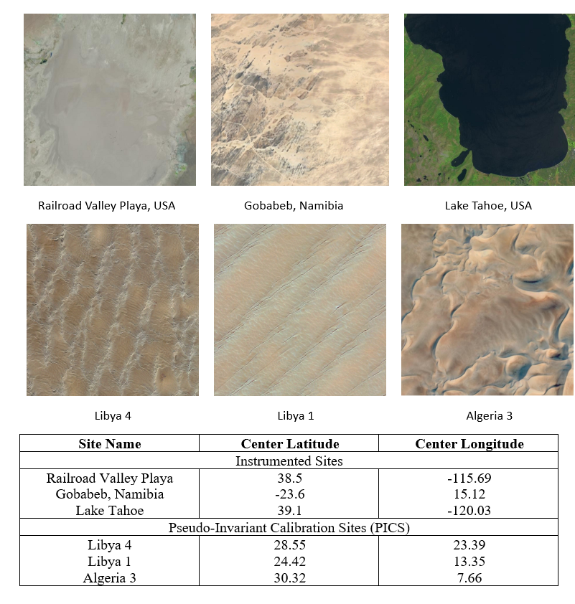
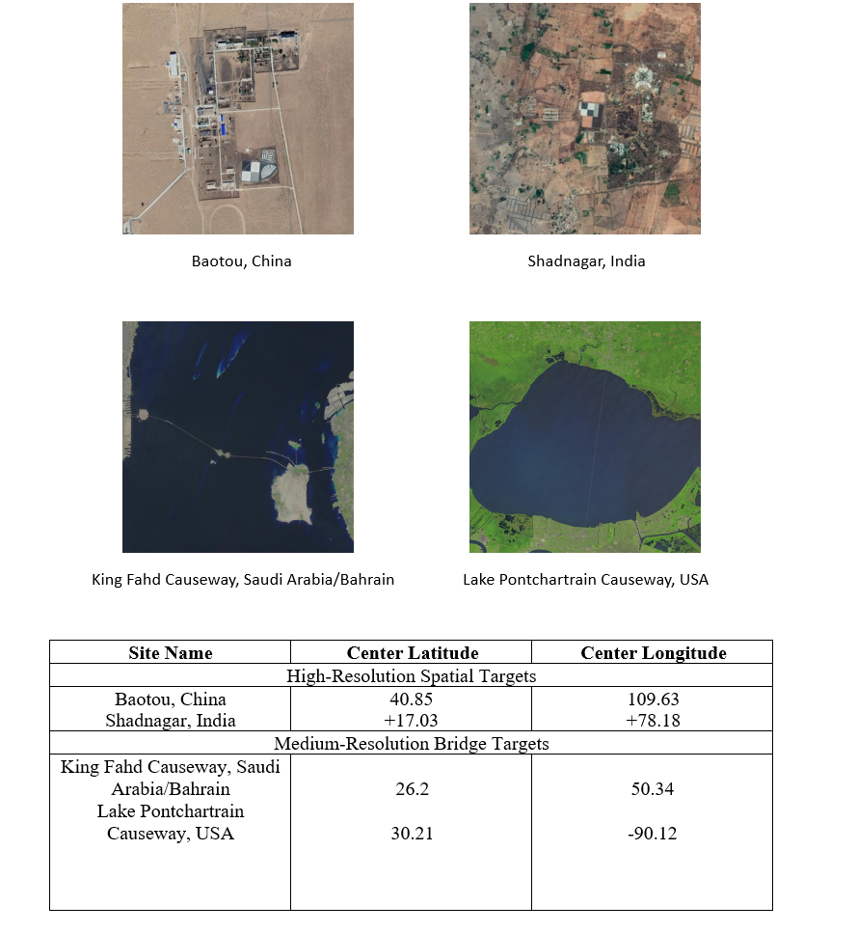
Recommendation
CEOS WGCV Recommendation: Facilitating interoperable global satellite imagery: agency & newspace
To
To facilitate a consistent understanding of the relative radiometric and geometric performance characteristics of passive optical satellite Level 1 imagery CEOS recommends that member agencies provide from their own missions and encourage/request any commercial data provider they can influence, to regularly (ideally every opportunity) collect and provide free access to imagery and associated metadata against a common ‘CEOS reference’. The imagery can be made available for collection by API or deposited to a dedicated CEOS archive (location to be confirmed). CEOS will provide feedback on relative performance for QA purposes for both satellite operators and data users via a tool/web app developed by NPL (UKSA).
The CEOS reference has been chosen to be derived from a minimal set of locations together with the minimal required metadata. The reference in practice consists of a few sites for solar refelective missions, Thermal infrared radiometry and geometric evaluation. Whilst collections over all appropriate sites listed in the CEOS reference are recommended to give the best representation and uncertainty (approximately three per category) a minimum of one from each category is required.

Slide 4
Comment on METROLOGY FOR CLIMATE ACTION report
T1-0.1 1A.1: 1.A2. 1A.5 | 1B.2 1B.8 1,B9 1B.10 1B.11 | 1C.1 1C.2L 1C4: 1C.6 1C.7 | 1D.1 1D2. 1D.5 1D.6 1D.7 1D.8 1D.9 | 1E.1 1E.2 1E.3 1E.4 1E.5 1E.7 | 2C.3 2D.1
Large number of recommendations/actions are relevant for CEOS WGCV
T1-0.1 :Coordination is fundamental and needed. Proper mechanism for coordination should be found. NMIs/WMO should be invited in WGCV.
1A.5/1B2, 1B10/11….Uncertainties (representation, tools (comet), GUM, FIDUCEO…etc…)
1B.8: FRM assessment process (FRM4SM, FRM4ALT, S3TART, FRM4SST, FRM4VEG…)
1D.8: ESA starts a project with ECMWF to assess the satellite uncertainties impact and handling in model (Dantex project).
1A2/4/5, 2C, 2D1…Atmosphere Domain – GHG. Number of CEOS activities (FRM4GHG, TTCON, Pandora, COCCON…etc….)
1A.1 Development of maturity Matrix – increase the confidence in data and fitness for purpose
1C.2L Support SITSat – CEOS WGCV SITSat task group

Slide 5
WGCV for WGClimate
CEOS WGCV in response to GCOS Implementation Plan
B1.3 Better align the satellite FRM program to the reference tier of tiered networks and enhance/expand FRM to fill gaps in satellite cal/val.
B5.1 Increase the number of in situ river level observations that are exchanged internationally and can be used to calibration satellite observations of water levels.
D4. Create a facility to access co-located in situ cal/val observations and satellite data for quality assurance of satellite products.
B 1. 5. Establish a long-term space-based reference calibration system to enhance the quality and traceability of earth observations. The following measurables are to be considered: high-resolution spectral radiances in the reflected solar (RS) and infrared (IR) wave bands, as well as GNSS radio occultations.
🡪 SITSats

Slide 6
Collaboration with WGCV on EBVs
From WGCV-53
Support the development of RS-enabled EBVs best practice workflows. (including multi sensor approaches)
For EBVs essentially on ecosystem traits (ecosystem function and structure)
Starting from the variables already addressed by WGCV (e.g., Biomass, fAPAR, LAI)
Development of data quality standards for EBV retrieval algorithms.
Development of scientifically sound validation frameworks (including EBV validation protocols, possibly algorithm intercomparisons)
Support to EBV Cal/Val with sharing/provision of in-situ measurements (fiducial reference measurements)
Support the integration of future CEOS missions in the EBV workflows (e.g. CHIME, SBG)
Initial Discussion
Individual elements are put place
Protocols for LAI, BIOMASS, fAPAR, Land Cover
Link with Network: ICOS, TERN, NEON 🡪 toward FRM
FRM4LC
Intercomparison fAPAR, GPP/NPP/ET
Need to continue and reinforce coordination

