Slide 1
WGISS/WGCV
Joint Meeting
SARCALNET update
Bruce Chapman
California Institute of Technology
Jet Propulsion Laboratory
Muriel Pinheiro, Antonio Valentino, Paolo Castracane
European Space Agency
& the SAR subgroup SARCALNET team
WGISS/WGCV Joint Meeting

Slide 2


SARCalNet
The www.SARCALNET.org website is online (currently requiring a password to enter) and contains
  Sample target sites
  Documents library including drafts of the
    SARCALNET Handbook
    Requirements documents
      On artificial targets
      On natural targets
      On image calibration analysis
    Submission templates
    Self assessments
  Links to resources such as software calibration tools, SAR data providers, etc.
Thanks to the hard work of Paolo Castracane, Muriel Pinheiro, Antonio Valentino and others at ESRIN!

Slide 3

SARCalNet Documentation
SARCalNet
Requirements for Artificial Targets
SARCalNet
Requirements for Natural Targets
SARCalNet
Requirements for Image Calibration Analysis
SARCalNet
Handbook
These documents are close to completion, but still need to be carefully reviewed and edited.
Pinheiro et al, 2024

Slide 4
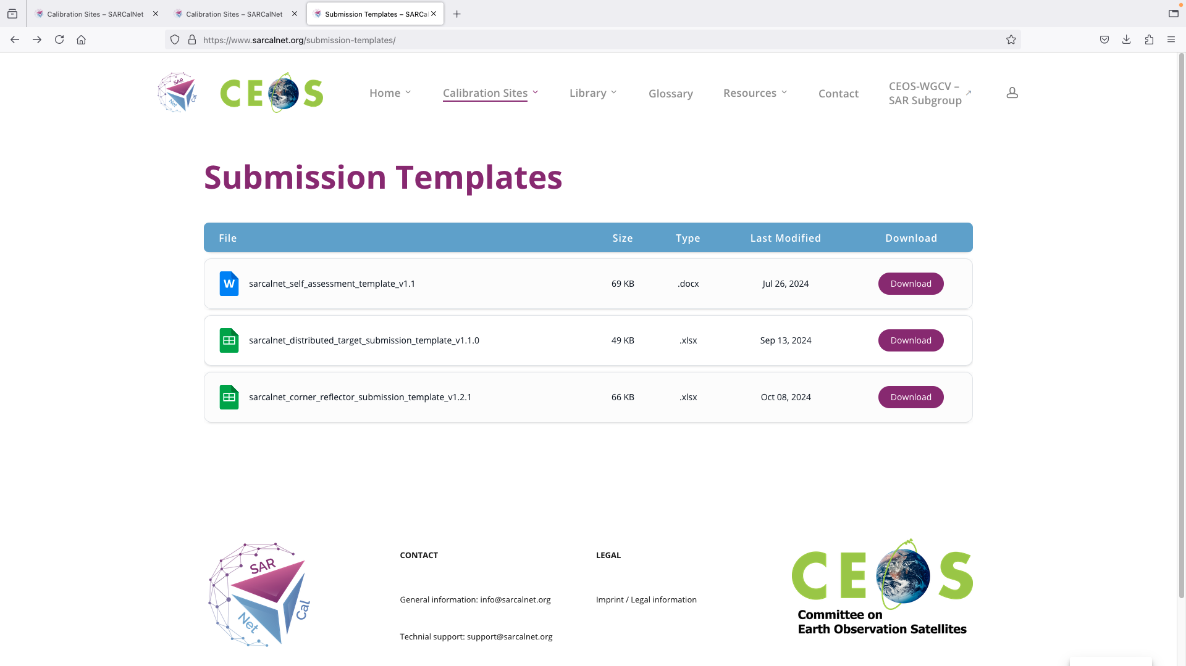
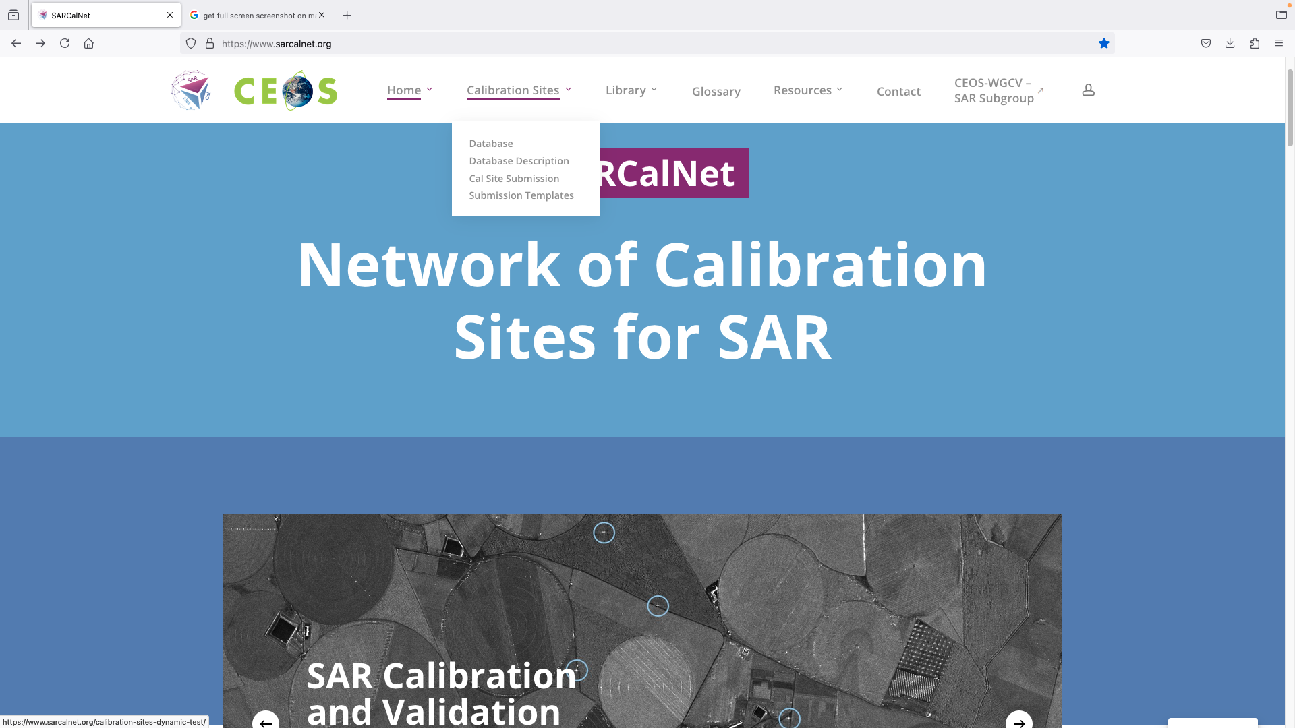
Templates and self-assessment form available for calibration site submission
Pinheiro et al, 2024

Slide 5
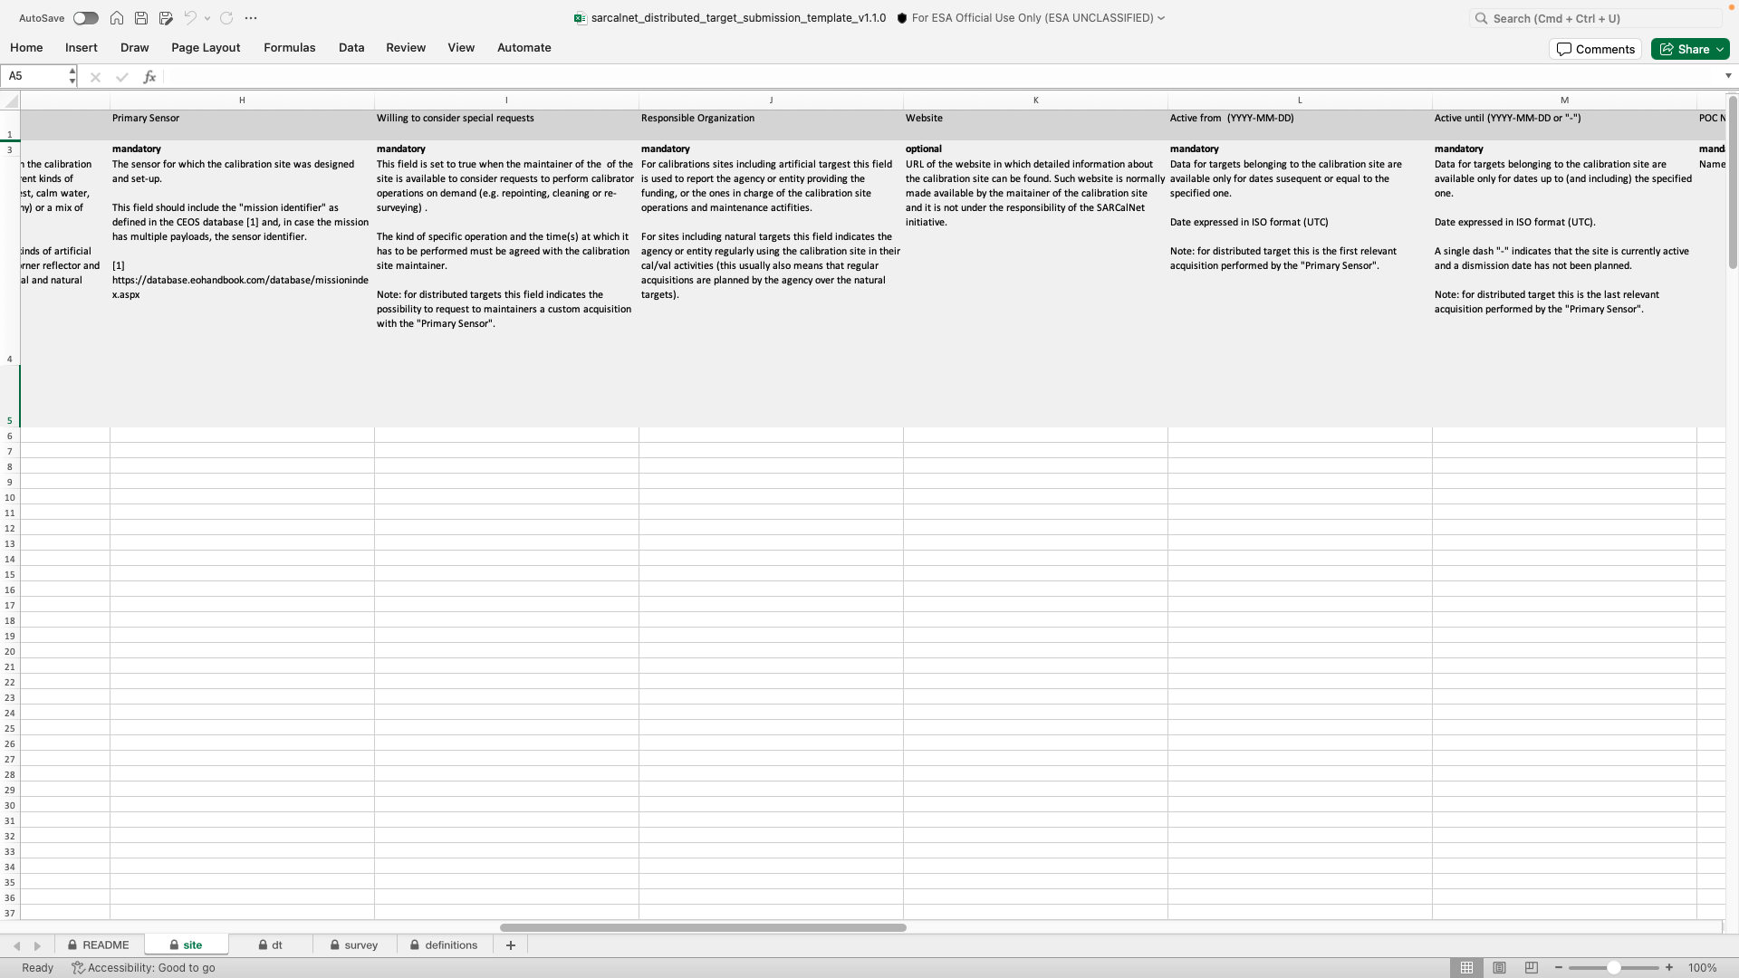
Templates with site, target and survey sheets as defined by the initiative
Pinheiro et al, 2024

Slide 6
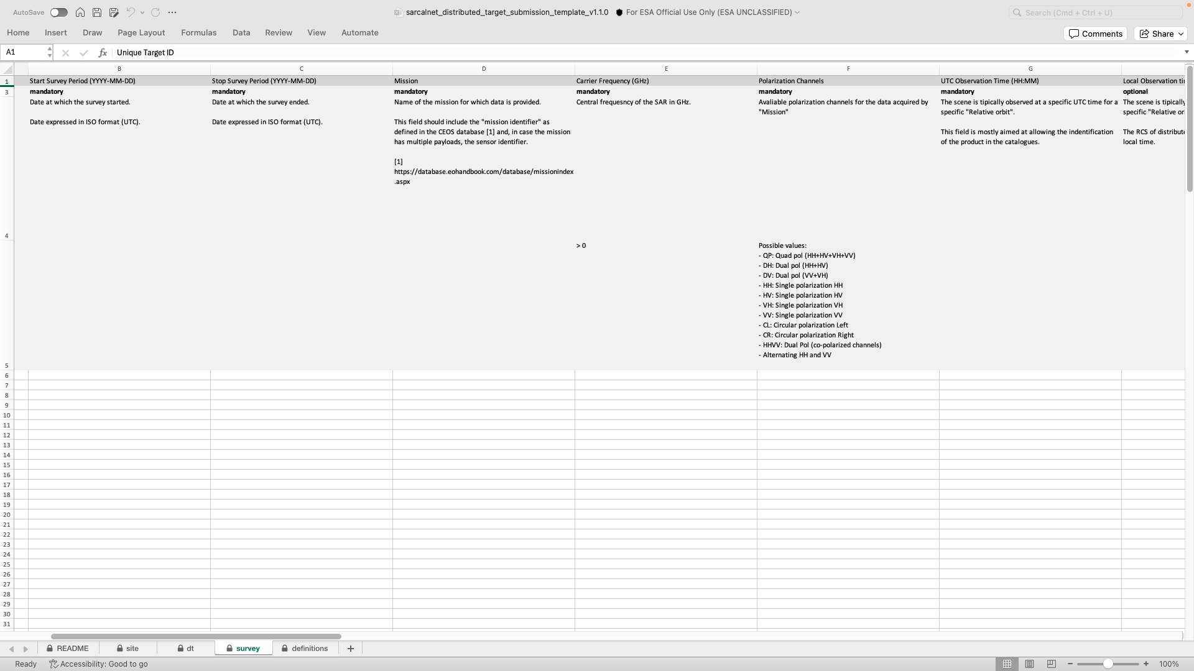
Each field has short description and, if relevant, pre-determined valid values
Pinheiro et al, 2024

Slide 7
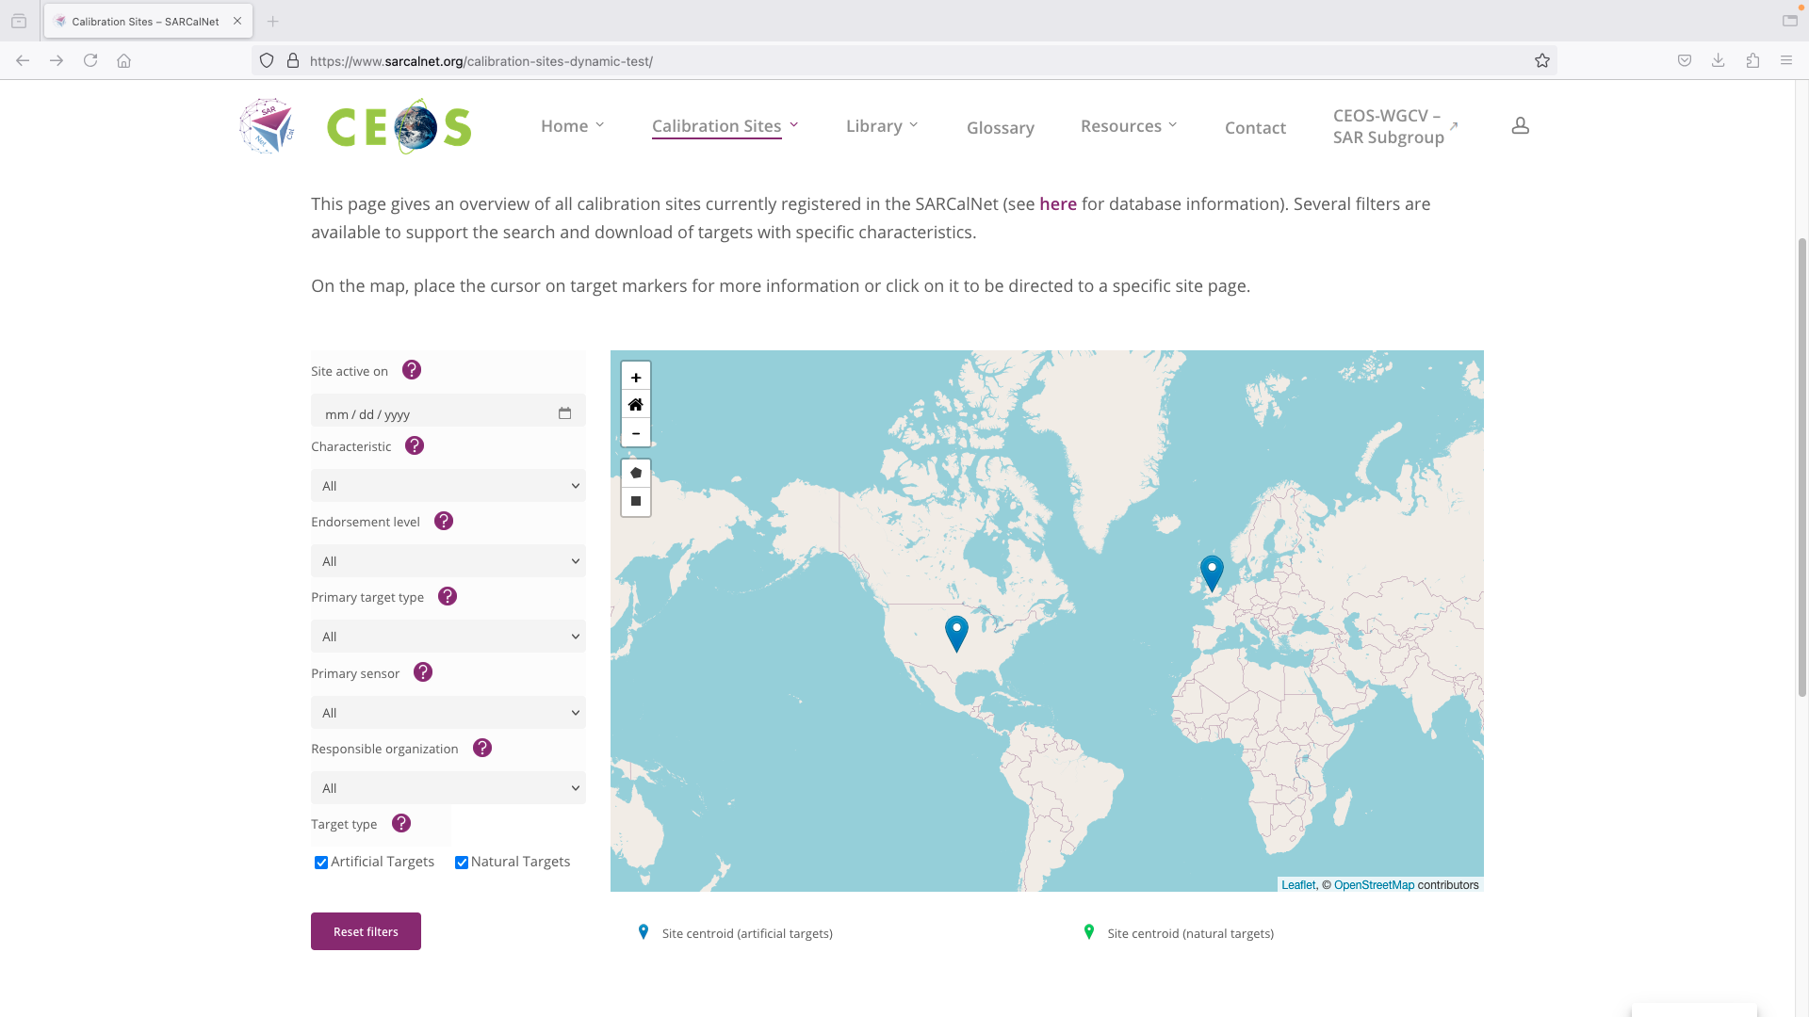
SARCALNET Website
The database with query fields
Currently JPL and BGS ingested and “Under Review”
CONAE, INTA (2x) and CSA submission being ingested
Pinheiro et al, 2024

Slide 8
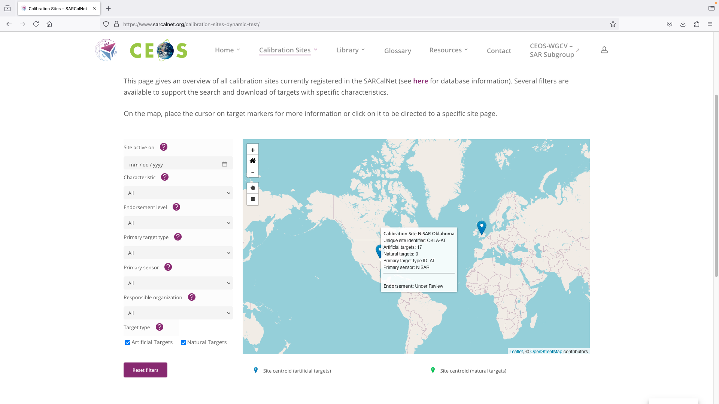
Each site and target receive a unique identifier to support resubmission and traceability
Pinheiro et al, 2024

Slide 9
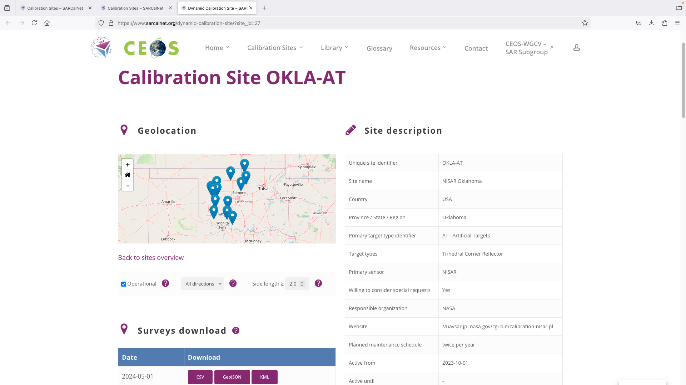
SARCALNET Website
Each site has its own page and standard content
Possible to filter by most relevant target characteristics
And to download complete surveys
Pinheiro et al, 2024

Slide 10
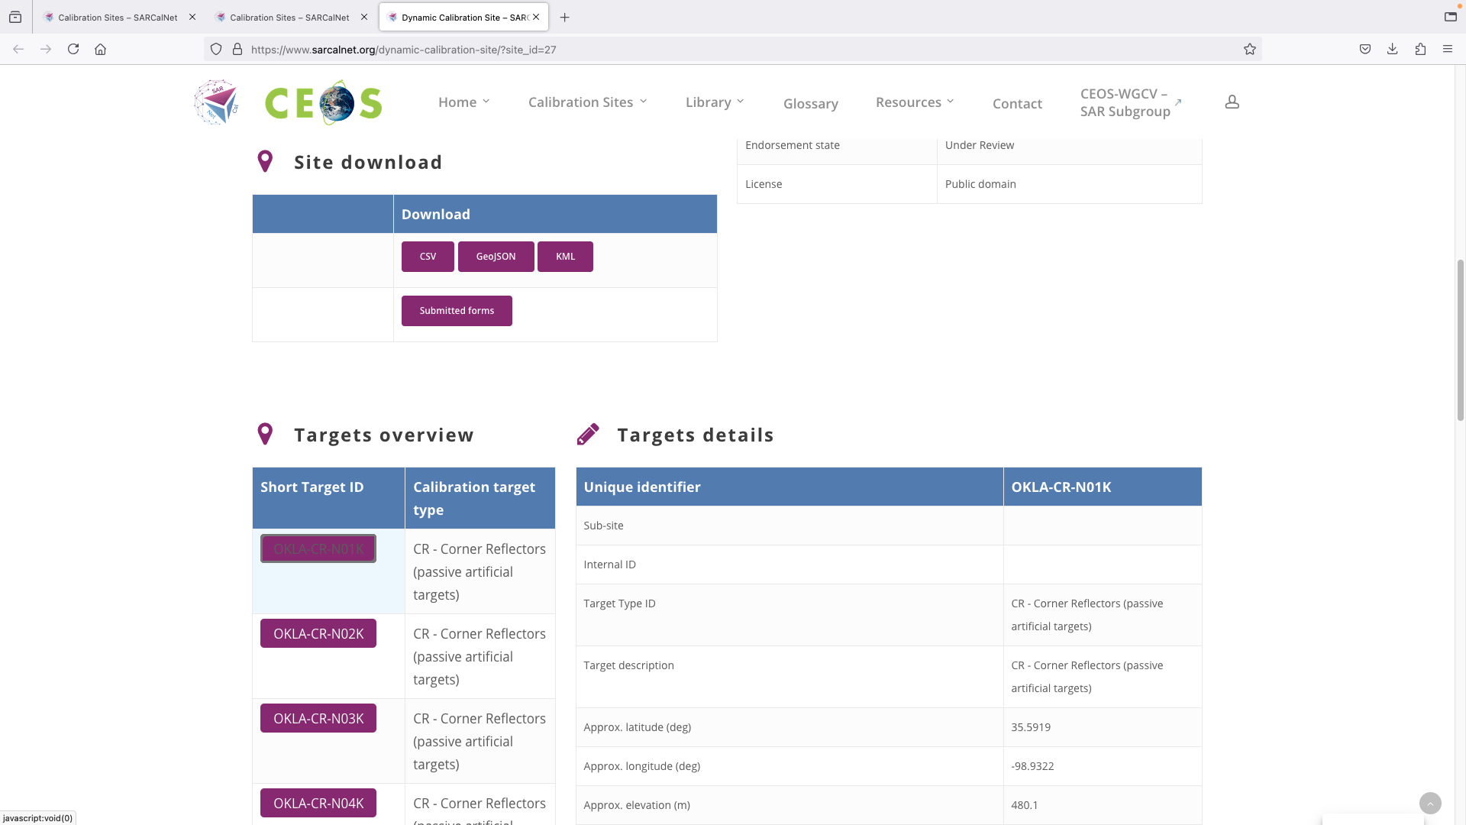
SARCALNET Website
Site info can be downloaded in different formats
Each target is presented in dedicated table
Pinheiro et al, 2024

Slide 11
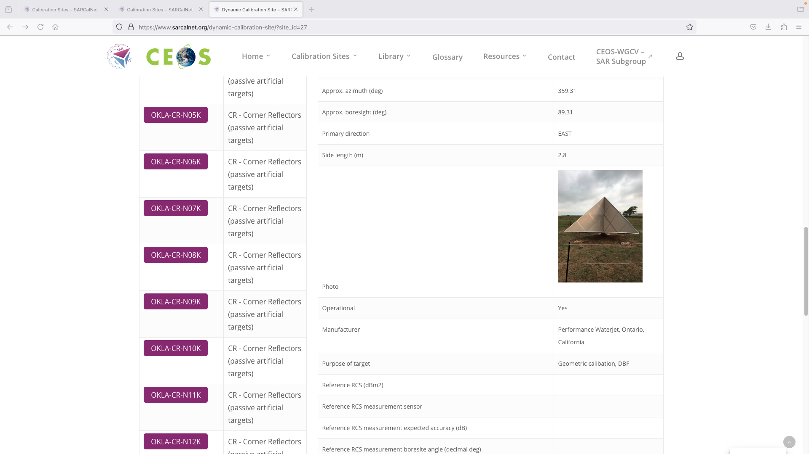
SARCALNET Website
Pinheiro et al, 2024

Slide 12
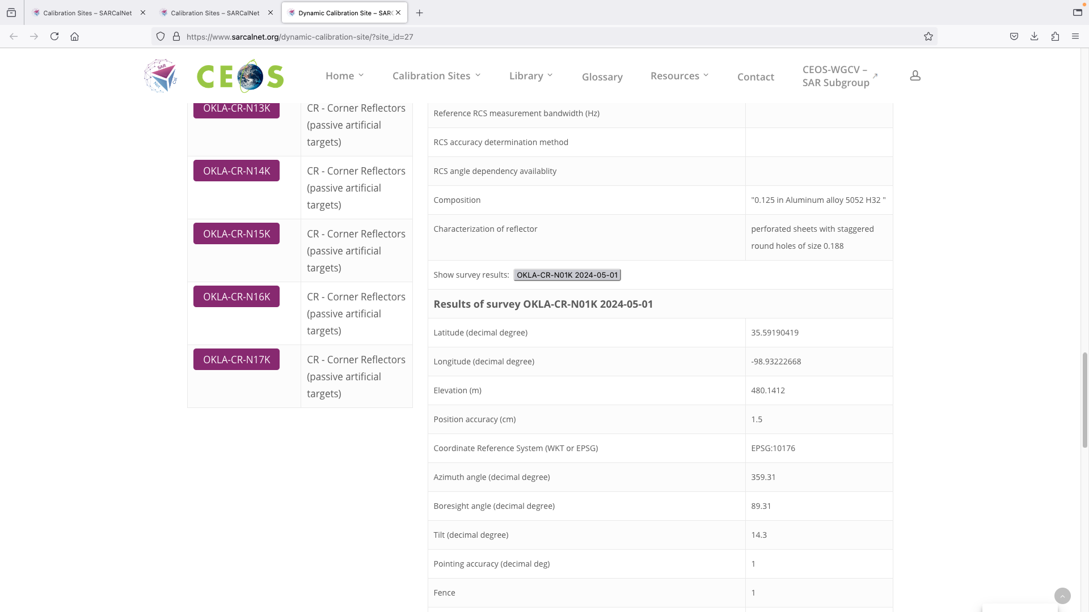
SARCALNET Website
Survey also visible when required/available
Pinheiro et al, 2024

Slide 13
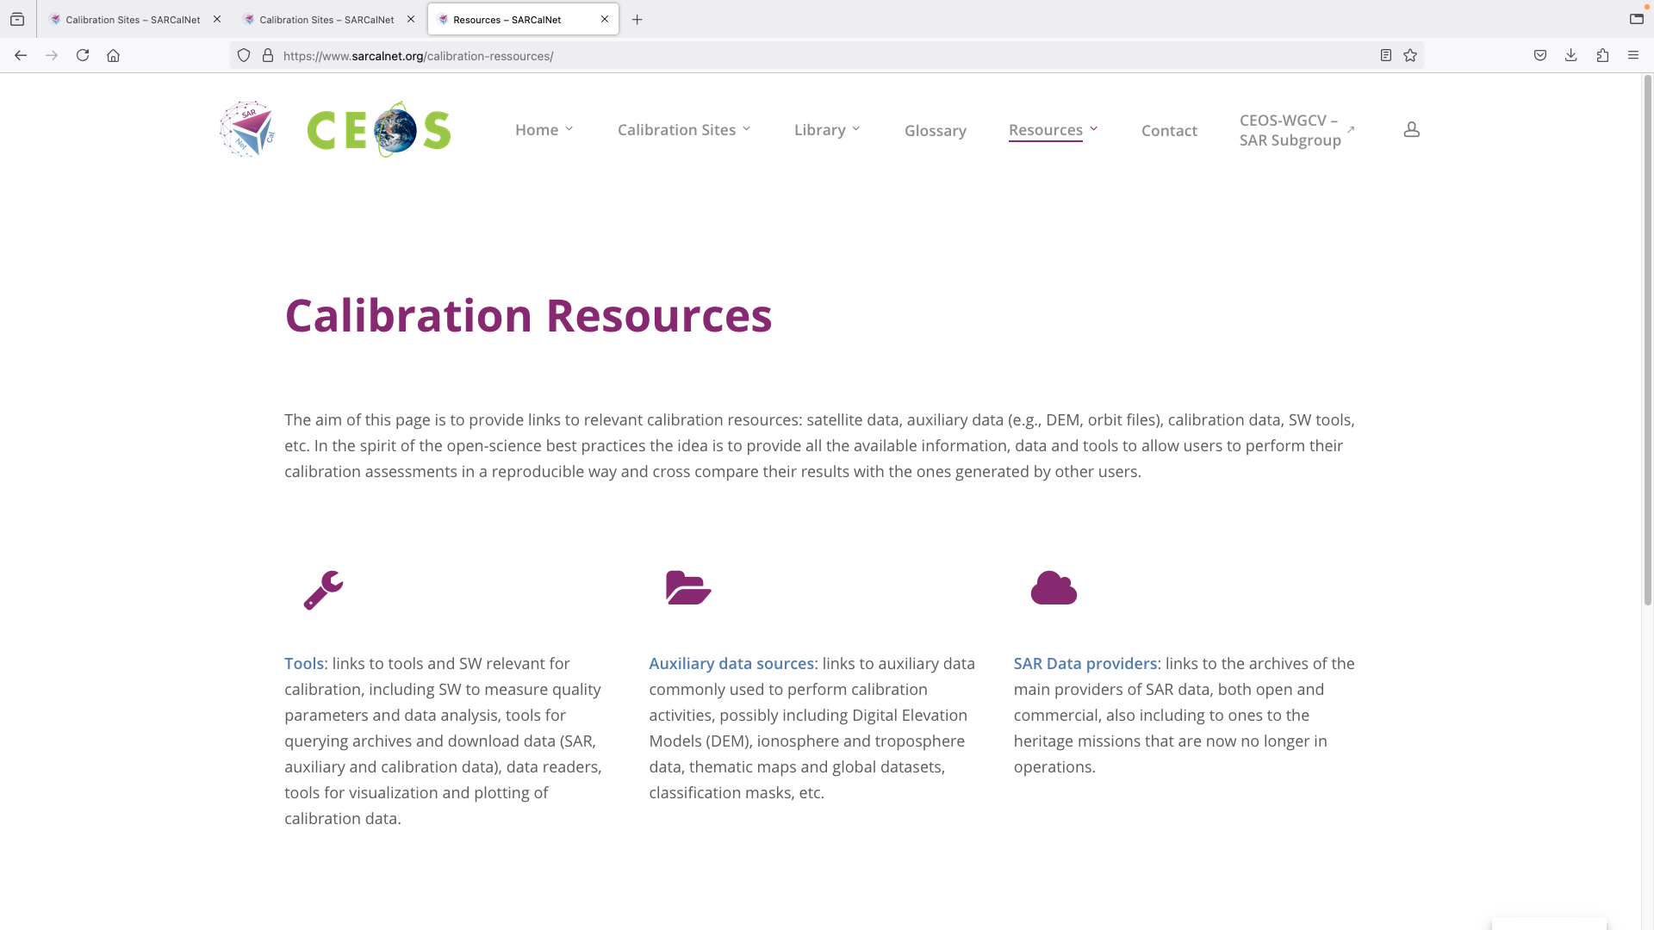
SARCALNET Website
The website also contains relevant cal/val resources
Pinheiro et al, 2024

Slide 14
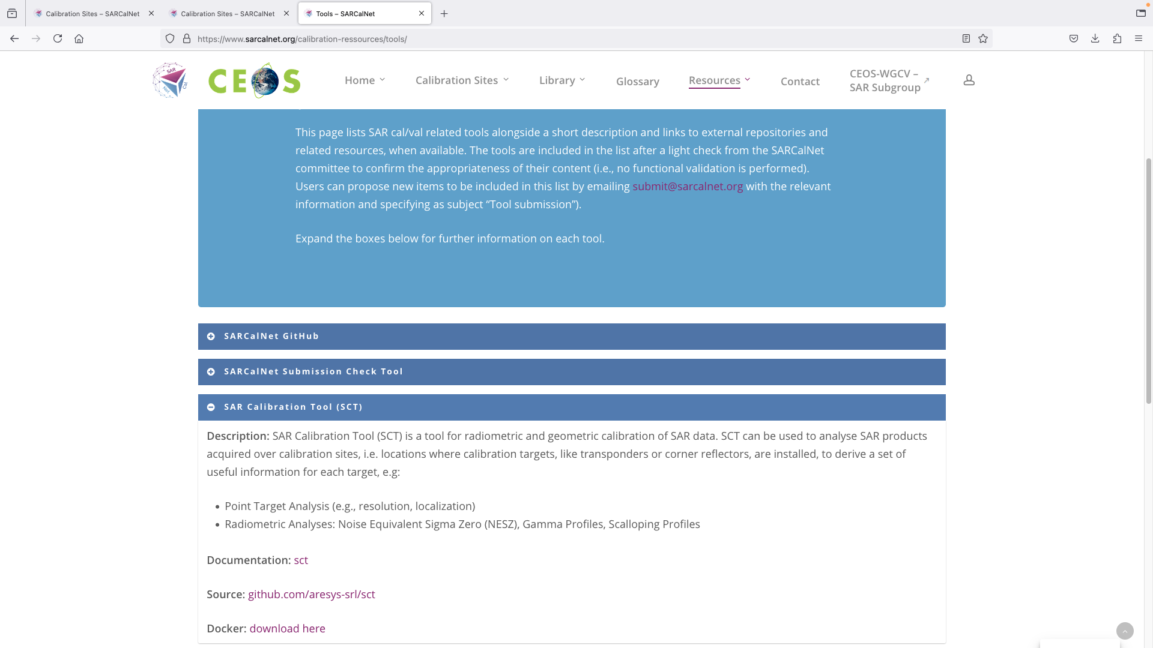
SARCALNET Website
Including general information on open cal/val tools
Pinheiro et al, 2024

Slide 15
Summary
The SARCalNet website has been implemented and tested, and is currently ingesting target data
We will review the first set of target submissions at the upcoming CEOS WGCV - SAR subgroup meeting in India this November.
Before the end of the year, we will complete the final edits of documentation and review them.
Make the website available to the general public in the next couple of months

