Slide 1
GSICS Collaboration Update
Paolo Castracane
(STARION for ESA)
and GSICS representatives
Agenda Item 3.6
WGCV-54
16-17 October 2024
Sioux Falls, South Dakota, USA

Slide 2
ToC
GSICS relevant Actions from Annual Meeting
The SITSat Task Team
Pre-flight Calibration and Characterisation Workshop
WGCV and GSICS area of cooperation

Slide 3
GSICS Annual meeting
GSICS Annual Meeting
11-15 March 2024, EUMETSAT HQ, Darmstadt, Germany
meeting page
Agenda: here
Meeting Minutes: here
Access to the actions: here

Slide 4
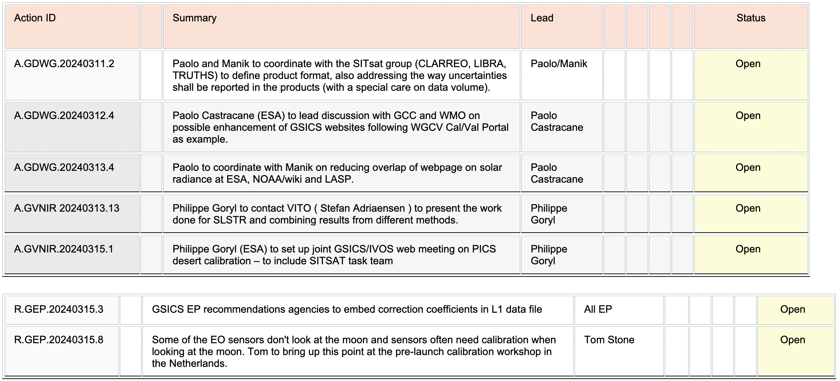
GSICS Actions 2024 (relevant for CEOS WGCV)

Slide 5
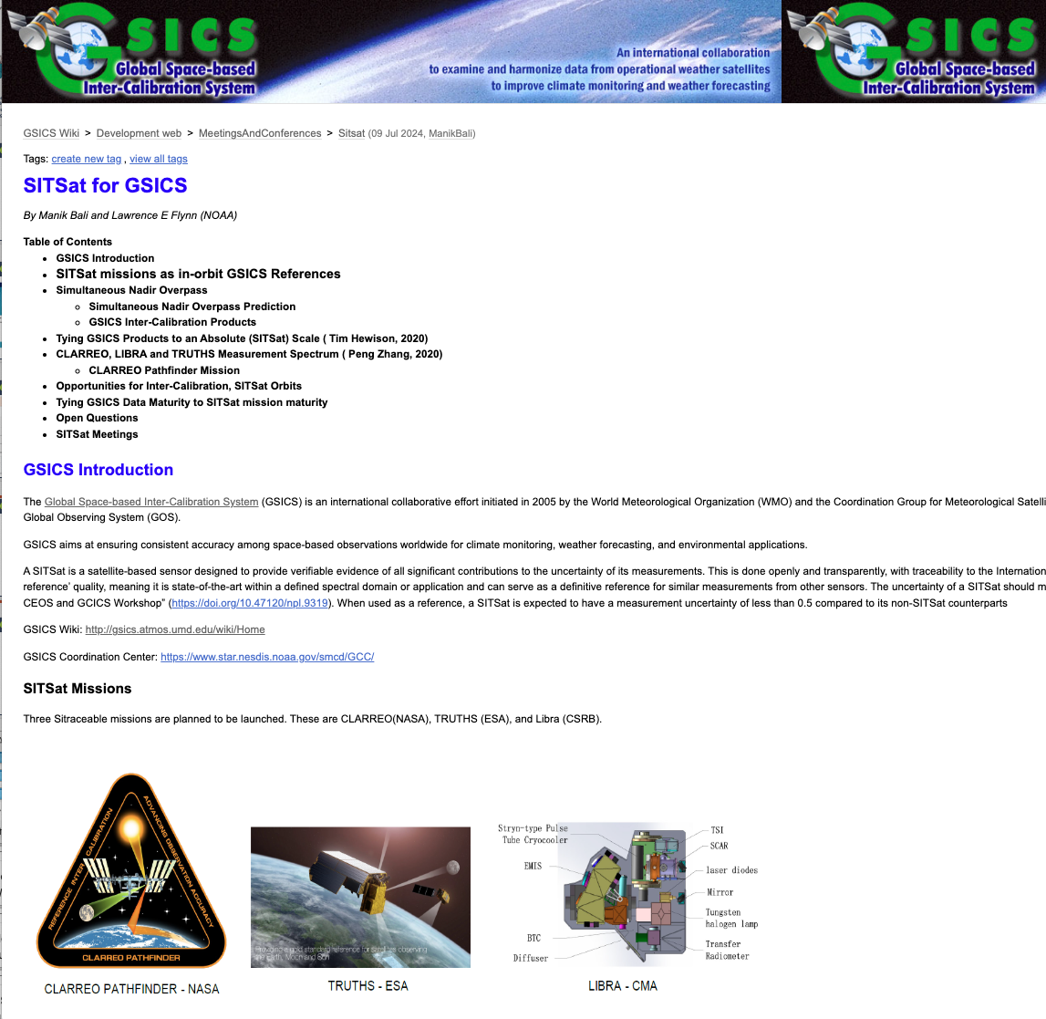
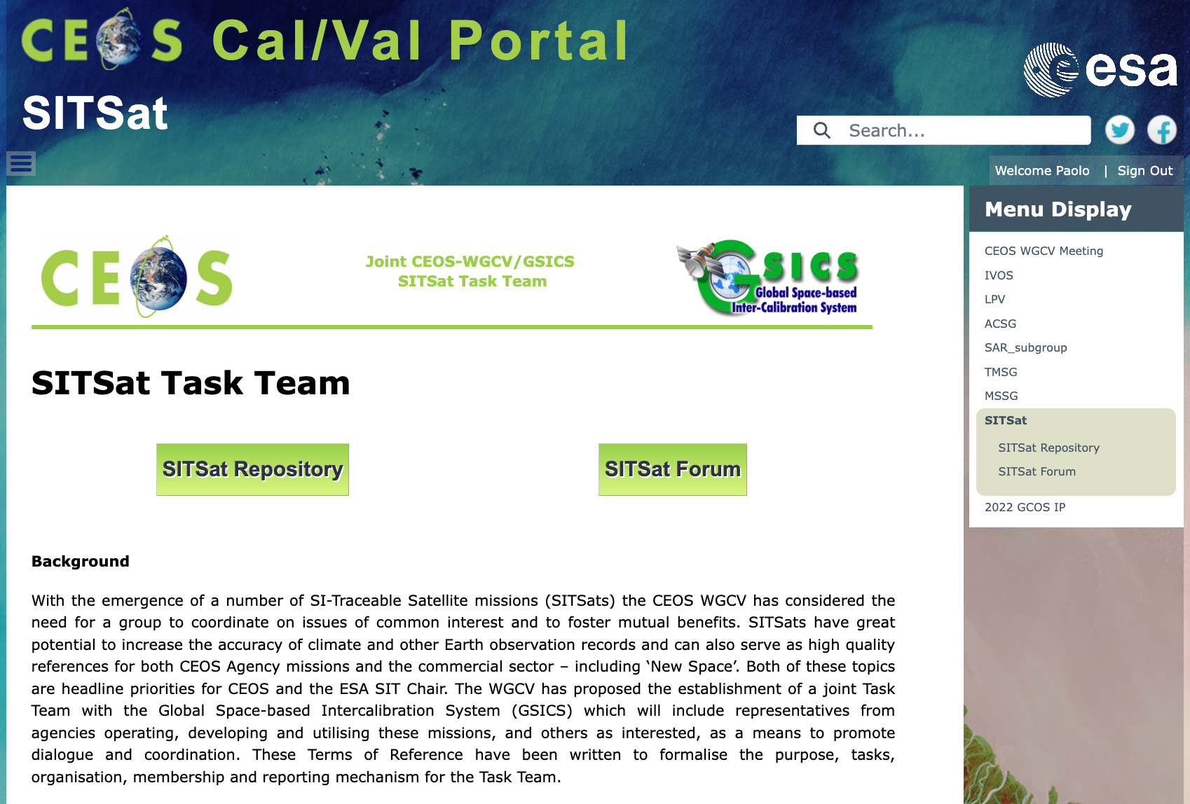
SITSat Task Team
The SITSat webpage has been proposed with
Public information: Background, Definition, Objectives; Organisation and reporting
Relevant links
SITSat Repository
SITSat Forum
Both Repository and Forum restricted to the SITSat members to share documents/materilas and discussions
https://calvalportal.ceos.org/sitsat
The SITSat for GSICS website offers an overview on the SITSat Missions, some key open questions and relevant links.
http://gsics.atmos.umd.edu/bin/view/Development/Sitsat

Slide 6
Pre-flight Calibration and Characterisation Workshop
GSICS and CEOS WGCV people in the Organising and Scientific Committee
Website https://atpi.eventsair.com/pre-flight-calibration-workshop/
Registration:
https://atpi.eventsair.com/pre-flight-calibration-workshop/registration/Site/Register
Programme released online

Slide 7
WGCV and GSICS area of cooperation
The collaboration between CEOS WGCV and GSICS is ever evolving. This collaboration occurs at multiple levels: GSICS Executive Panel Level and at Working group level.
Several areas of work between GSICS and WGCV are being actively pursued. These include methods, protocols, and organization of joint workshops (see e.g. Pre-flight Calibration and Characterization Workshop).
New Space topics: WGCV and GSICS participation at initiatives and workshops as
VH-RODA 2024 and JACIE 2025.

Slide 8
WGCV and GSICS area of cooperation
Maturity Matrix approach: to continue exchange of ideas, in different domines:
Maturity Matrix for products assessment (EDAP). ESA Earthnet is working closely with the NASA Commercial Smallsat Data Acquisition ( CSDA) program to design a Maturity Matrix that can apply maturity to Small Sat data sets.
WGISS Data Management and Stewardship Maturity Matrix (DMSMM) for dataset assessment and evolution
GSICS Procedure for Product Acceptance (GPPA) Workflow derived from QA4EO framework
Outreach: CEOS Cal/Va Portal shares GSICS Tools (colab notebooks), Conferences, Workshops and Projects. GSICS Newsletter (Via X @CEOS_WGCV). GSICS Wiki page – SITSat for GSICS page.

