Slide 1
CEOS-FRM Assessment Framework Updates
Paolo Castracane,
Starion for ESA
Nigel Fox, NPL
Jean-Christopher Lambert, BIRA
Akihiko Kuze, JAXA
Agenda Item 3.3
WGCV-54
16-17 October 2024
Sioux Falls, South Dakota, USA

Slide 2
ToC
Guidelines Updates
Maturity Matrix tool updates
New exercises
Discussion

Slide 3
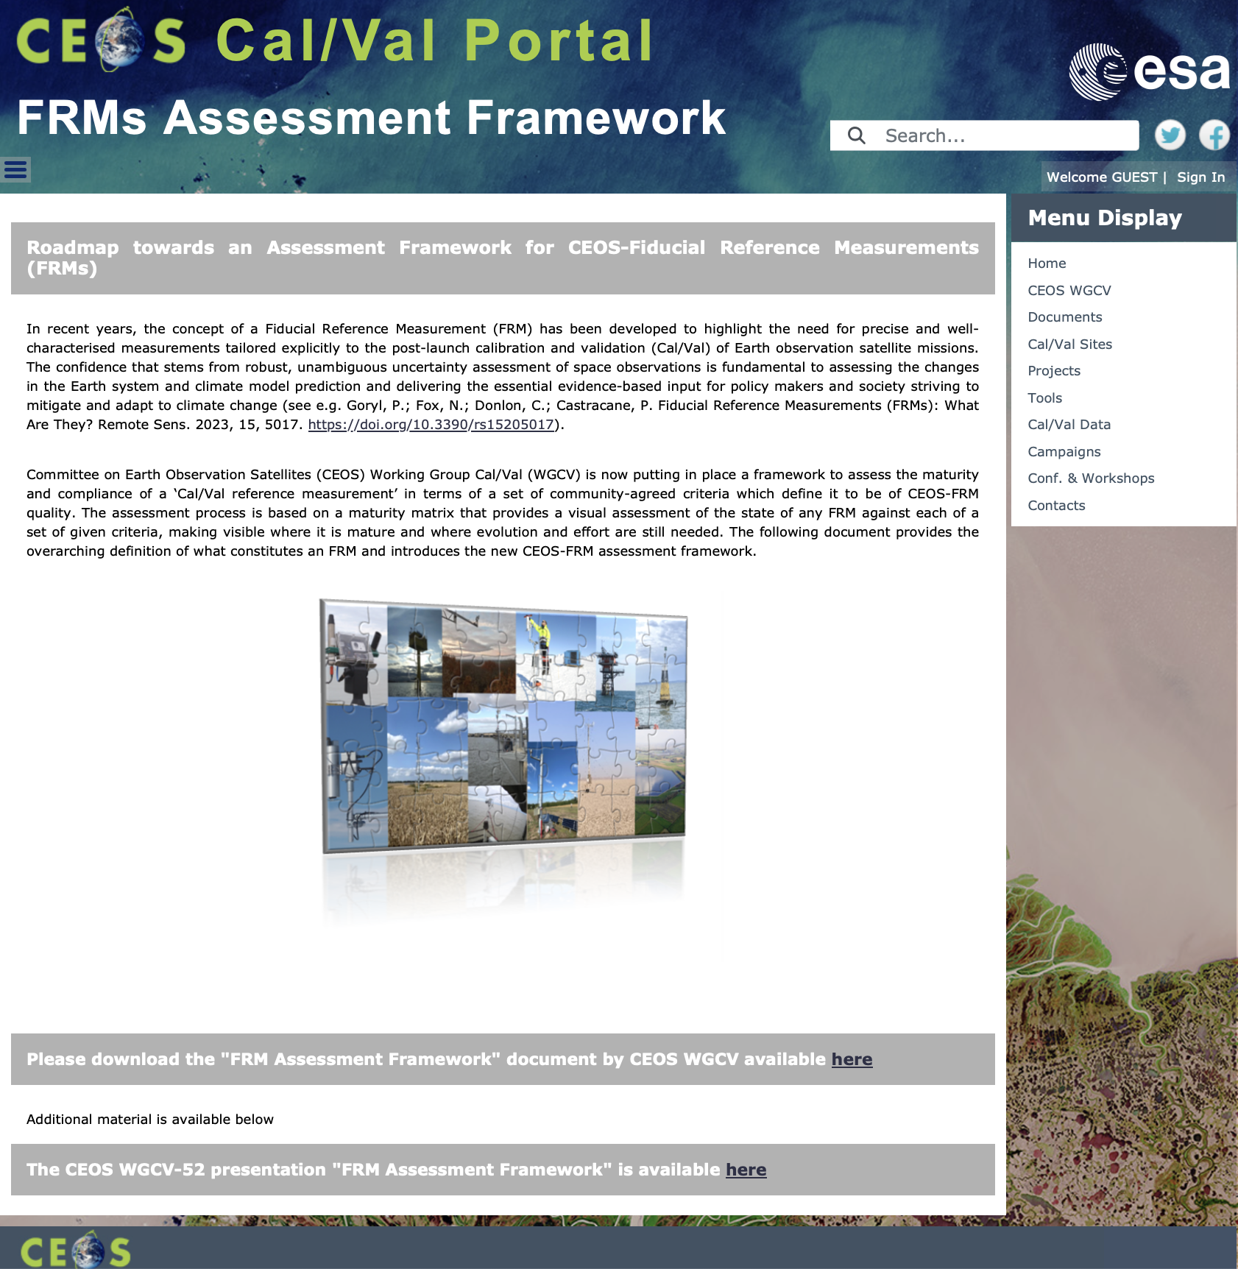
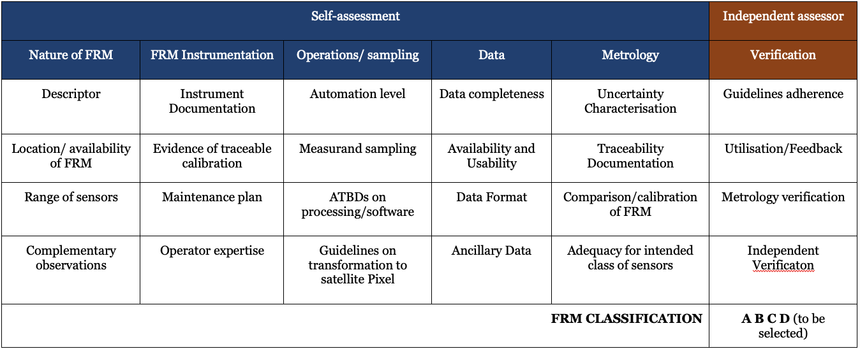
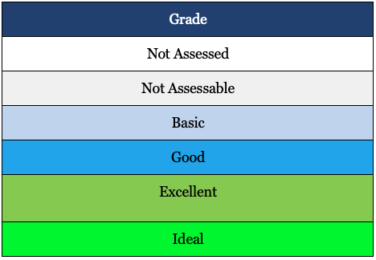
CEOS FRMs Assessment Framework
Roadmap towards an Assessment Framework for Fiducial Reference Measurements (FRM)
https://calvalportal.ceos.org/web/guest/frms-assessment-framework
The purpose of the document is to propose a roadmap towards an assessment framework to endorse a specific class of measurements as a Fiducial Reference Measurement (FRM).
Background and Objectives
FRM Definition and Principles
FRM Endorsement Process
FRM Maturity Matrix
FRM Overall Classification
Goryl, P.; Fox, N.; Donlon, C.; Castracane, P. Fiducial Reference Measurements (FRMs): What Are They? Remote Sens. 2023, 15, 5017. https://doi.org/10.3390/rs15205017.

Slide 4
Action form WGCV#53
ID | Description | Due Date | Status
WGCV-53-ACT-13 | Paolo and Nigel to make updates to the FRM Assessment Framework documentation to: Make clear that the assessment is relative to the intended purpose of the site. Remove subjectivity in parameters by incorporating clarifications present in the accompanying documentation, but which have to date been left out of the Matrix description. Clarify that verification should be undertaken by independent people from CEOS, not the person filling in the template (i.e., self-assessment followed by independent review). Make the Validation column a different colour. Consider inclusion of additional links to reference materials, mechanisms to allow assessors to provide feedback, etc. Aim to have an updated Version 2.0 by the May timeframe. This will align well with the next NDACC Steering Committee meeting. | May 2024 | In progress: Development has been triggered including all the collected feedback: Intro panel for each assessment Additional info for Configuration of Parameter (Question) and Answer Supporting Documents/References Verification (last column) for independent assessor Automatic CEOS FRM classification Assessment report
WGCV-53-ACT-14 | Paolo, Nigel and Kuze-san, to work with Jean-Christopher Lambert on the issues with the FRM Assessment Framework specifically for the atmospheric domain. Notes: May need some clarifications in the accompanying documentation regarding the situation / approach for Level 2 atmospheric data. | End April 2024 | In progress: Teleconf 2024/06/21 within working group: Paolo Castracane PC, Riza Singh RS, Akihiko Kuze AK, Jean-Christopher Lambert JCL, Harvey Jones HJ, Nigel Fox NF

Slide 5
Guidelines Updates
It was agreed that aspects such as sampling, representativeness, completeness and timeliness assume different meaning if related to the single instrument or to a network of instruments and these considerations bring to the following inputs needed to improve the CEOS FRM Assessment guidelines and the MM:
The intended purpose of the assessment (for a single instrument or for a network) shall be clearly specified in the intro panel. Important to provide greater clarity for the types of sensors and what ranges are needed to be considered adequate for validation.
FRM quality assessments involving contributors providing appropriate uncertainty and traceability data to ensure enough representativeness. Stick to the validation of satellite data. The criteria become generalised and broader for a network, but doesn’t diminish the traceability, uncertainty, and characteristics of individual stations.
An additional category (column) including network specific aspects shall be added to the guidelines and to the MM.
Since the FRM concept is more related to the quality of data itself, the aspects in this additional category dedicated to network characteristics will not be taken into account for FRM classification.
All agreed to maintain only one CEOS FRM Assessment Framework at the WGCV level.

Slide 6
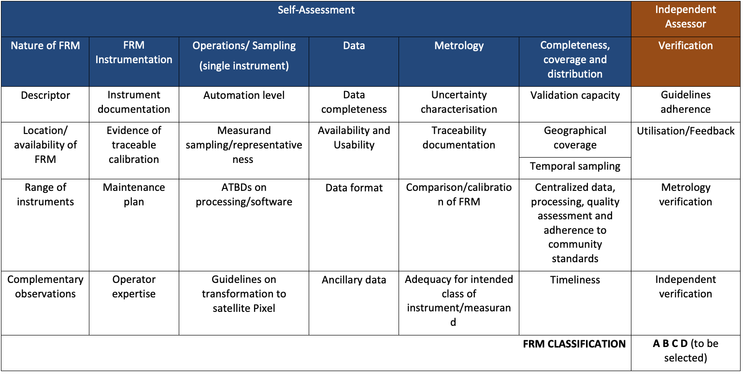
Proposed new category “Completeness, coverage and distribution”

Slide 7
“Completeness, coverage and distribution” aspects and assessment criteria
The “Completeness, coverage and distribution” category concerns criteria assessing the properties of the measuring system intended as a set of coordinated instruments deployed as network and/or in a context of a campaign. This new category includes the following aspects :
Validation Capacity
Geographical coverage
Temporal sampling
Centralized data, processing, quality assessment and adherence to community standards
Timeliness
For each aspects assessment framework grades are provided

Slide 8
Maturity Matrix Tool Updates
ID Title | Description | Status
1) Intro panel for each assessment | It has been requested to have, before of the first question, an introductive text panel where the assessor can specify and describe the intended purpose of the assessment | Done
2) Additional info for Configuration of Parameter (Question) and Answer | In order to better explain the possible answers, especially for data providers, which are not familiar with uncertainty tree diagrams and other metrological concepts. It could be useful have the possibility to add, links, or documentation during configuration of both parameters (Questions) and answers. | Done
3) Supporting Documents/References | We should find ways to encourage the assessor to provide evidence of his assessment, it could be reference papers, links, reports, sample data. Otherwise we cannot verify the FRM assessment. When compiling the matrix, for each question, under the “Comments” textbox, it could be added an item called “Supporting documents/references” allowing to attach documents/materials. | Done
4) Verification (last column) for independent assessor | The last column named “Verification” of the FRM MM (but it is also valid for EDAP MM) shall be compiled by an independent assessor (i.e. different from the ones who filled the first part of the MM). In order to highlight this difference (currently Verification columns has the same color of the other columns), it has been requested to change the color of the column | In progress
5) Automatic CEOS FRM classification | The idea is to provide the resulting CEOS-FRM overall classification directly from the tool. The classification: Class A, B, C or D is based on score of matrix cells according to the criteria defined in the reference document.The result should be included in the MM | In progress
6) Assessment report | It would be useful to generate an assessment report in pdf at the end of the process, collecting the maturity matrix together with the detailed answers to all questions and eventually links to supporting material provided. | In progress

Slide 9
CEOS FRM Assessment: Exercise Reports
CEOS FRM MM - Brewer Spectrometer - NO2 Vertical Column Densities (VCDs) Measurements - Henri Diémoz (ARPA Valle d’Aosta) – BAQUNIN project
CEOS FRM MM – FRM4GHG 2.0 project –COCCON (EM27/SUN) XCO₂, XCH₄, and XCO data. – Mahesh Kumar Sha (BIRA) - FRM4GHG team*.
CEOS FRM MM - Tropical Centre for reactive trace gas remote sensing (CREGARS) in ACTRIS – Martine De Mazière (BIRA) – in progress (waiting the V2 of the Guidelines/MM Tool)
*Sha, M.K.; De Mazière, M.; Notholt, J.; Blumenstock, T.; Bogaert, P.; Cardoen, P.; Chen, H.; Desmet, F.; García, O.; Griffith, D.W.T.; et al. Fiducial Reference Measurement for Greenhouse Gases (FRM4GHG). Remote Sens. 2024, 16, 3525. https://doi.org/10.3390/rs16183525
Maturity Matrix Tool
https://mmt.skytek.dev
Support provided by Jarek Dobrzanski (Skytek, Ireland https://skytek.com/)
Dedicated credentials provided for all the selected users

Slide 10
Exercise Report: Brewer for NO2
CEOS FRM
Class D
The maturity matrix shows promising results but still includes some gaps and cannot yet be considered ideal. However, it should be noted that NO2 retrievals with Brewer spectrophotometers are still experimental and are currently only performed at two stations: Rome Sapienza (BAQUNIN urban site) and Aosta (Alpine valley site). Further efforts to improve documentation, traceability, and the treatment of uncertainty will be made in the future, also based on this maturity matrix.

Slide 11
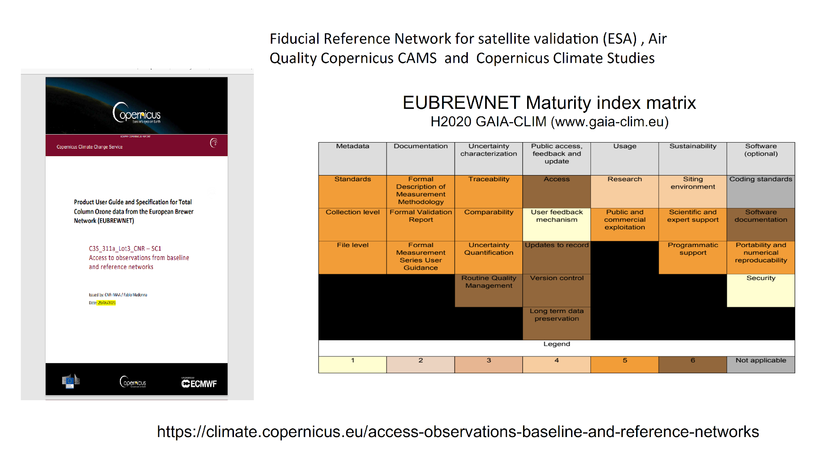
EUBREWNET
EUBREWNET Maturity index for ozone retrievals with the Brewer spectrophotometer,H2020 GAIA-CLIM (https://www.gaia-clim.eu/) compiled within the framework of the European Brewer Network (EUBREWNET).

Slide 12
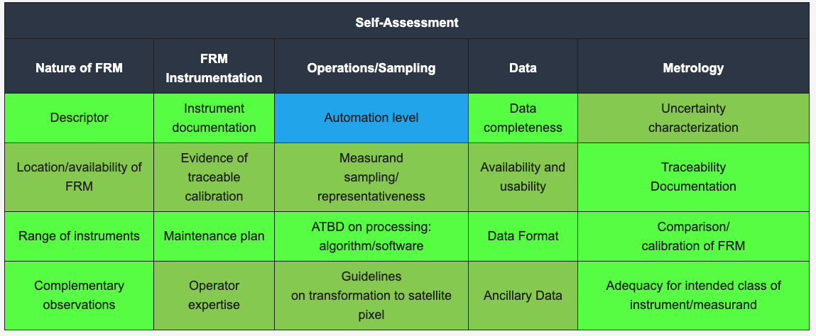
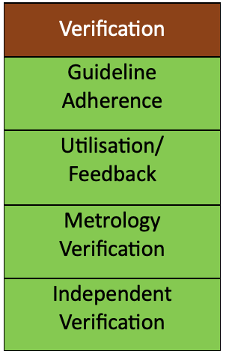
FRM4GHG (EM27/SUN) measurements (XCO₂, XCH₄, and XCO)
CEOS FRM
Class B
COCCON falls under class B according to the definition of the CEOS-FRM overall classification guidelines. COCCON meets many of the key criteria and has a path towards meeting the class A status in the future, where the condition to achieve a class of Ideal (class A) in the ‘guidance criteria’ in the ‘independent verification’ section of the MM and green (at least excellent) for all other verification categories where these have been carried out.

