Slide 1
WGCV-54
Land Product Validation Subgroup
Michael Cosh
Agenda Item 2.9
WGCV-54, USGS, Sioux Falls, SD USA
October 15-18, 2024

Slide 2
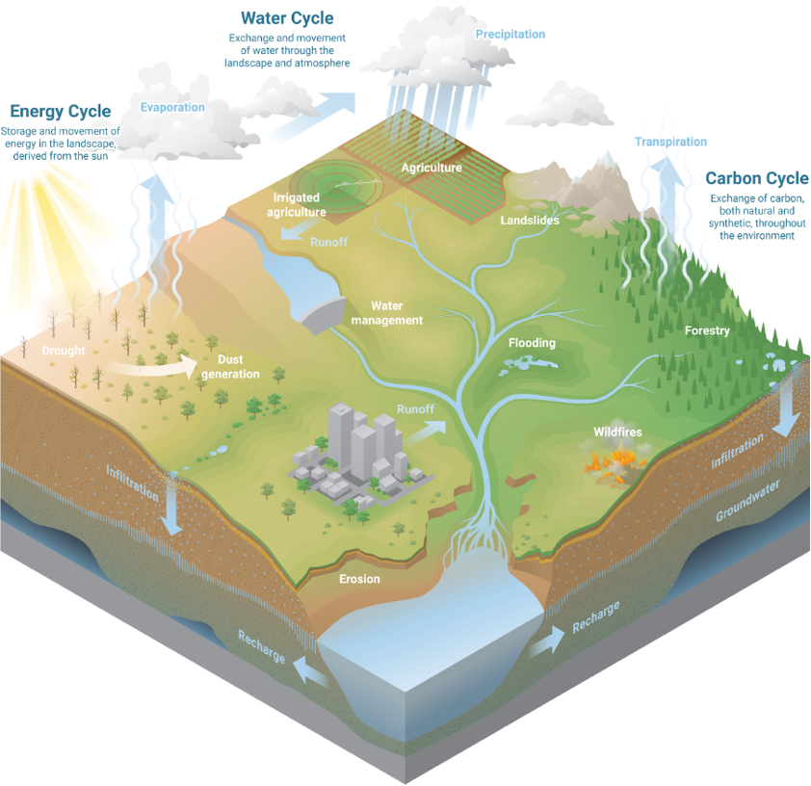
Focus Areas
Focus Area
Biophysical
Fire/Burn Area
Phenology
Vegetation Index
Land Cover
Snow Cover
Surface Radiation
Soil Moisture
LST and Emissivity
Aboveground Biomass
Evapotranspiration
GPP/NPP
12
Slide ‹#›

Slide 3
Focus Area Leads
 | First Name | Last Name | Institution | Institution | End of Term
Admin | Michael | Cosh | USDA | USA | Apr 2025
 | Fabrizio | Niro | ESA | Italy | Apr 2025 (promotion to Chair)
 | Jaime | Nickeson | GSFC | USA
Land Cover | Alexandra | Tyukavina | University of Maryland | USA | March 2027 (2nd term)
 | Nandika | Tsendbazar | Wageningen University | Netherlands | April 2027(1st term)
 | Sophie | Bontemps | Université Catholique de Louvain | Belgium | Ex-officio
Biophysical | Richard | Fernandes | Natural Resources Canada | Canada | Apr 2027 (last term)
 | Hao | Tang | University of Maryland | USA | April 2027 (1st term)
 | Luke | Brown | University of Salford | UK | Jan 2026 (1st term)
Fire/Burn Area | Louis | Giglio | University of Maryland | USA | Sep 2026 (2nd term)
 | Bernardo | Mota | National Physical Lab | UK | Jan 2026 (1st term)
Surface Rad | Zhuosen | Wang | UMass Boston | USA | ex-officio
 | Angela | Erb | UMass Boston | USA | Jan 2026 (1st term)
 | Jorge | Sanchez-Zapero | EOLab | Spain | Jan 2026 (1st term)
Soil Moisture | John | Bolten | NASA GSFC | USA | Apr 2026 (2nd term)
 | Alex | Gruber | TU Wien | Austria | Sept 2026 (1st term)
LST | Glynn | Hulley | NASA/JPL | USA | July 2024 (2nd term)
 | Lluis | Perez Planells | Karlsruhe Institute of Technology | Germany | Sept 2026 (1st term)
Phenology | Joshua | Gray | North Carolina State University | USA | Jan 2025 (2nd term)
 | Victor | Rodríguez-Galiano | University of Seville | Spain | Aug 2025 (2nd term)
Snow Cover | Carrie | Vuyovich | NASA GSFC | USA | Jan 2026 (1st term)
 | Juha | Lemmetyinen | FMI | Finland | Sept 2026 (1st term)
Veg Index | Simon | Kraatz | USDA | USA | Apr 2027 1st term
 | Tomoaki | Miura | University of Hawai'i | USA | Ex-officio
 | Else | Swinnen | VITO | Belgium | Apr 2023 (2nd term)
Biomass | Laura | Duncanson | UMD/GSFC | USA | ex-officio
 | Kim | Calders | Ghent University | Belgium | Feb 2026 (1st term)
 | Neha | Hunka | UMD | USA | Feb 2026 (1st term)
ET | Yun | Yang | Mississippi State | USA | ~Jan 2027 (1st term)
 | Carmelo | Cammalleri | Politecnico di Milano | Italy | ~Jan 2027 (1st term)
GPP/NPP | Arthur | Endsley | University of Montana | USA | Sept 2027 (1st term)
 | Alvaro | Moreno Martinez | University of Valencia | Spain | Oct 2027 (1st term)
Slide ‹#›

Slide 4
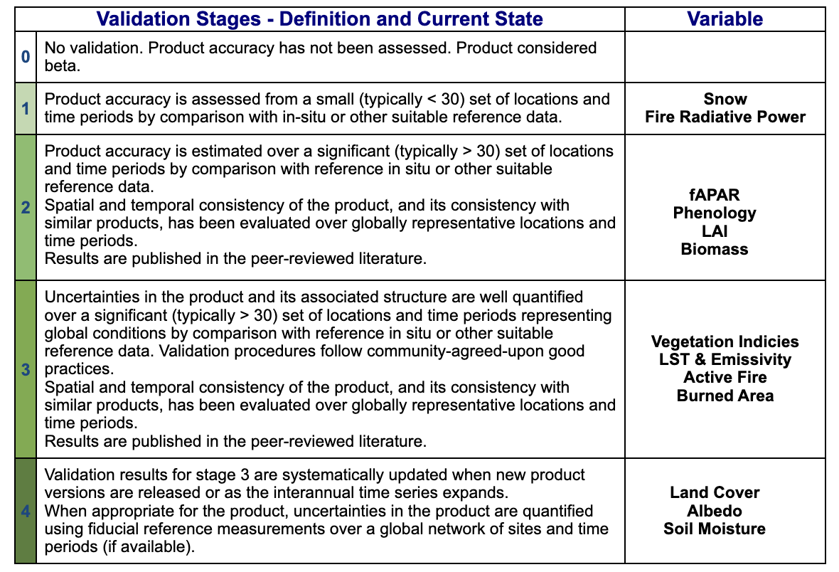
LPV Validation Stage Status
Slide ‹#›

Slide 5
Focus Area Protocols Update
Focus Area | Protocol
Biophysical | LAI(2014)
Fire/Burn Area | Burned Area Targeting 2025 Active Fire next
Phenology | Targeting end of 2024
Vegetation Index | Targeting end of 2024
Land Cover | Revision of first public comment -> WGCV 55
Snow Cover
Surface Radiation | Albedo(2019) Global Downward Radiation Product Validation Best
Soil Moisture | SM(2020)
LST and Emissivity | LST (2019)
Aboveground Biomass | AGWB(2021)
Evapotranspiration
GPP/NPP
Slide ‹#›

Slide 6
Biophysical
Definitions:
  3 Geomatics Canada Open Files (version controlled DOI labelled)
  Revised LAI, FAPAR to conform with current GCOS definitions.
  Added FCOVER corresponding to FAO definition.
  Added definition of “Related Quantities” to each definition to increase clarity in community.
Revised Product List
  Deleted 20 (mainly different resolutions of same products)
  Added new products: 6 LAI, 8 FAPAR, 8 FCOVER; including 7 <100m resolution continental products.
CEOS Validation Stage Assessment
  Assessed validation stage by continent.
  Geomatics Canada Open File summarizing findings
    A total of 22 LAI products, 17 fAPAR products and 8 fCOVER products were identified and evaluated in terms of continental scale CEOS validation stage.
    Stage 3 validated products are currently available for Europe and North America at >=250m resolution and for regions of North America above 40degrees at 20m resolution. Stage 2 validated >250m resolution products are also available for Africa and Asia and it is likely these will soon achieve Stage 3. Stage 1 validate products are available for South America and Australia/Oceania.
  Up to LPV to decide how to update product validation stage table – suggest it be uniform across variables.
Outline of new good practice document for medium resolution products including fCOVER.

Slide 7
Biophysical
Good Practices Update
Discussions on proposed new sections
  Revise Definitions
    inclusion of FAPAR, FCOVER
  Revise In Situ Reference Estimates
    include new sensor and tech development (e.g. terrestrial laser scanner)
  Add new section on high resolution data products
    high resolution vs. ESU
  Add new section on 3D data products
    lidar

Slide 8
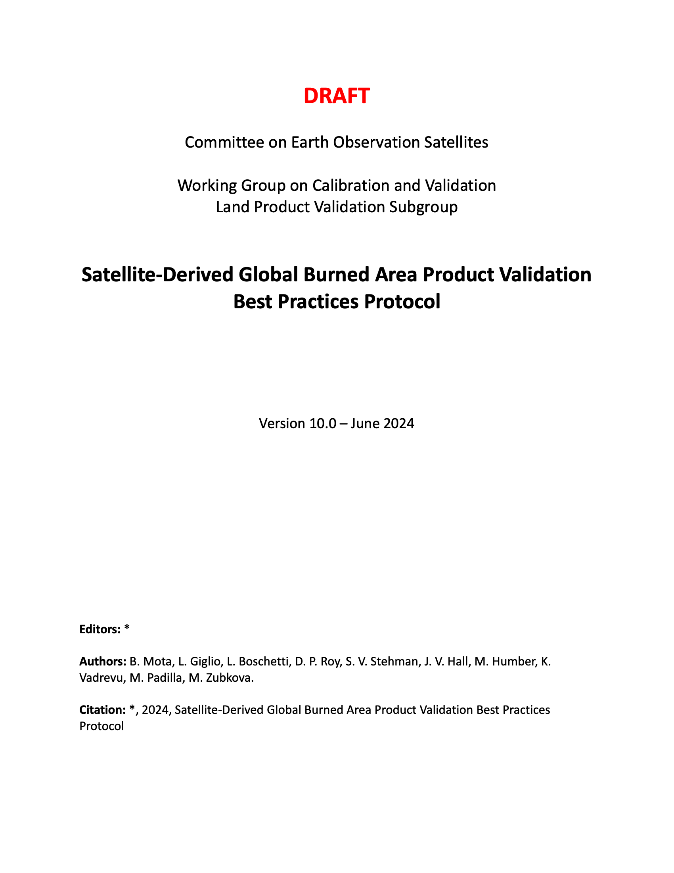
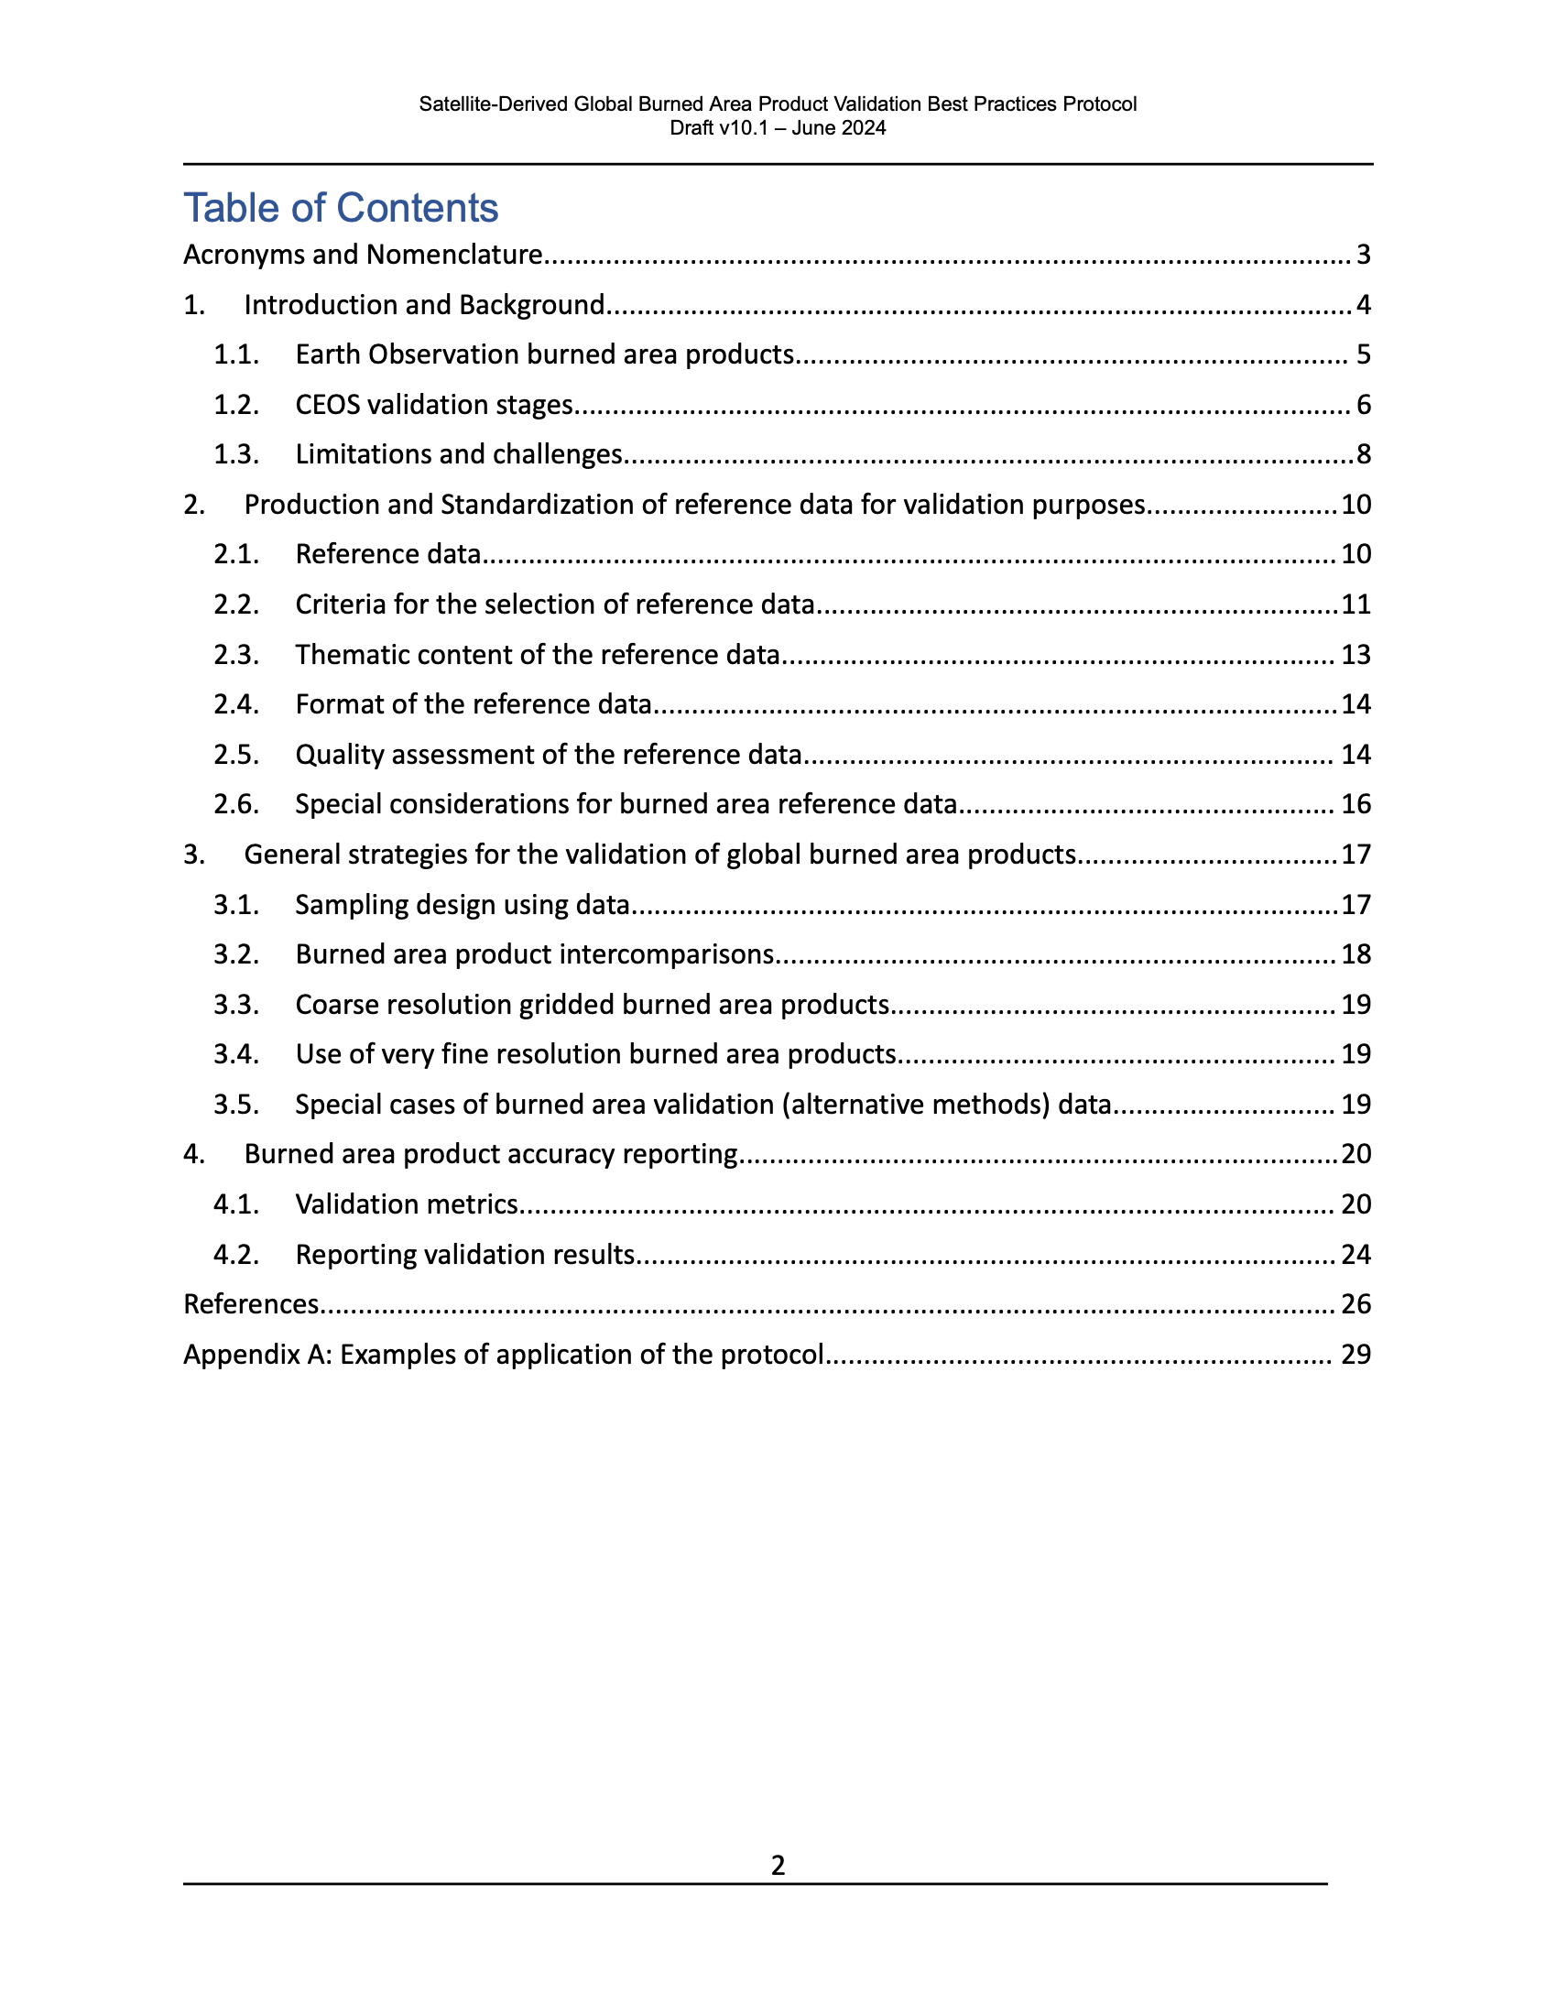
Fire/Burn Area
Validation Protocol Status
Update of 11-page 2010 draft burned area validation protocol ongoing
Currently 34 pages
Engaged additional section authors
Discussion-ready draft for GOFC Fire Implementation Team meeting (17-18 Sep.) and 13th EARSeL Workshop on Forest Fires (19-20 Sep.) in Milan
Active Fire protocol to follow
‹#›

Slide 9
Phenology
Copernicus Land Monitoring Service (CLMS) has signed a new contract for the continuation and evolution of the High-Resolution Vegetation Phenology and Productivity (HR-VPP) product suite:
  Consortium comprises VITO, in partnership with Lund University, Joanneum Research, and Space4Environment.
  Calibration report to be published in autumn 2025
Review paper: Gong et al. Satellite remote sensing of vegetation phenology: Progress, challenges, and opportunities. ISPRS J. Photo. Rem. Sens.
Special Issue in the journal “Forest”: Vegetation and Remote Sensing Phenology in Deciduous Forests.
  Deadline for manuscript submissions: 31 October 2025

Slide 10
Vegetation Indices
Protocol Development
Formed a small group of VI experts to review the outline (November 2022)
    Carolien Toté (VITO, Belgium)
    Kamel Didan (University of Arizona, USA)
    Molly Brown (University of Maryland, USA)
    Kazuhito Ichii (Chiba University, Japan)
Held a kick-off meeting with the expert group (December 15, 2022)
Held a 2nd meeting to the group’s review comments/suggestions (Jan 2023)
Revised the outline and shared the revised outline with them (March 2023)
Completed the first complete draft (December 3, 2023)
Had the group review one more time (December 2023 - January 2024)
Reviewed and updated the VI listserv list (May 2024)
Plan to send the draft protocol document for the community feedback (August 2024)

Slide 11

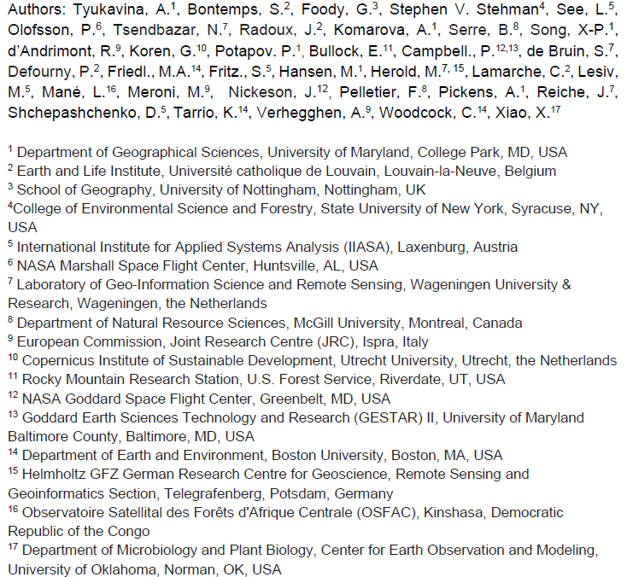
Land Cover
Guideline document update:
Version 0.1 is ready, sent out for community review on August 30th, 2024
Next steps:
Revisions due on October 1st, 2024
Expected completion of Version 1.0:
Winter 2024 – 2025
Editors and chapter leads will address reviewers’ comments
One round of revisions is planned
(no re-review)

Slide 12
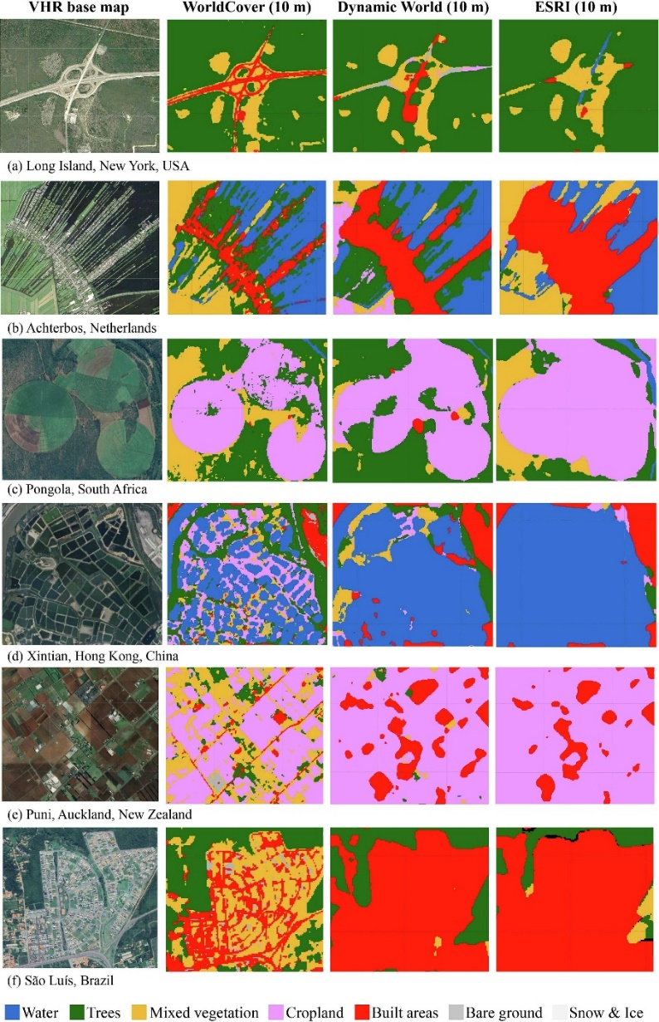
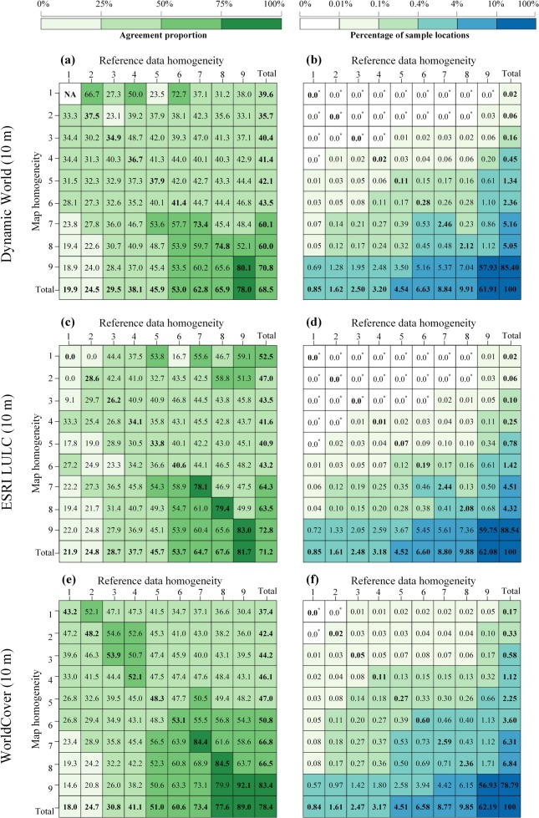
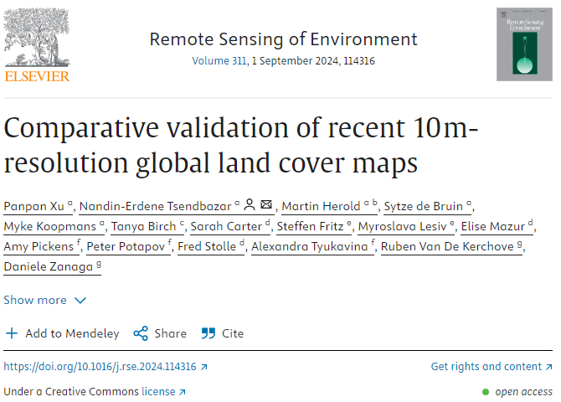
Land Cover
Comparative validation of recent high-resolution global land cover maps
Accuracy comparison – global, continental, and for 47 countries
Assessing spatial details
Integrating reference data uncertainty to map validation

Slide 13
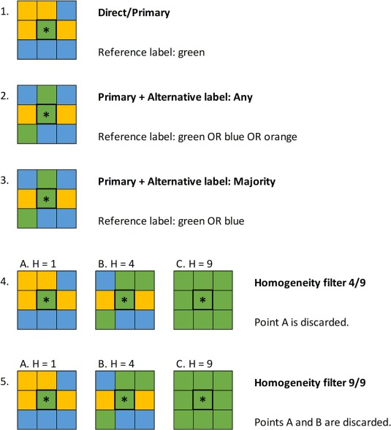
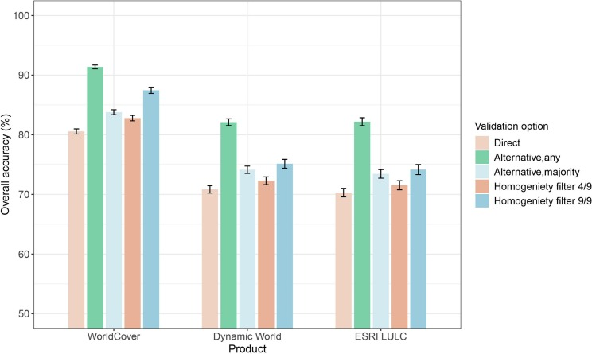
Land Cover
Validation data is error-free
Using landscape context to account for validation data error.
the more homogeneous the landscape, the less the validation data error
Comparative validation of recent high-resolution global land cover maps
Accuracy comparison – global, continental and for 47 countries
Assessing spatial details
Integrating reference data uncertainty to map validation

Slide 14
Snow
NASA Snow Community Meeting
August 14-15, 2024, Boulder, CO
Objective: To cohesively summarize existing and ongoing snowpack monitoring efforts and identify remaining knowledge gaps and next steps for the snow community, specifically through recognition of the completion of NASA SnowEx multi-year field experiment and recent Earth System Explorers satellite mission proposals
Toward consensus across snow community
Community building
Snow mission requirements
Science questions
Applications
Next steps
Summarize the current state of snow sensing, modeling, and technologies
Outline white paper concepts for the next decadal survey
Approximately 200 in-person and virtual attendees
Summary report in prep now

Slide 15
Snow Cover
Global Climate Observing System program (GCOS)
Current Essential Climate Variable (ECV) guidance for snow is being reviewed over the next ~6 months
These requirements mainly focused on data requirements that are not currently met by any satellite mission
The GCOS snow group has reached out to the snow community for input in the development of the requirements.
Update on process:
Meeting July 5 to discuss review:
  Plan to focus on the three existing snow ECV products (variables/quantities) – Area Covered by Snow, Snow Depth, Snow Water Equivalent.
  As this is a GCOS initiative, it will concentrate on the GCOS requirements which are intended for climate monitoring
Preliminary requirements drafted
Next meeting to discuss will be scheduled for late Sept/early Oct
We will work with this group to develop a validation protocol once the requirements are in place
In the meantime the CEOS LPV Snow will point to the protocols developed by the SnowPEx satellite snow product intercomparison and evaluation exercise which focuses on existing SCE and SWE products

Slide 16
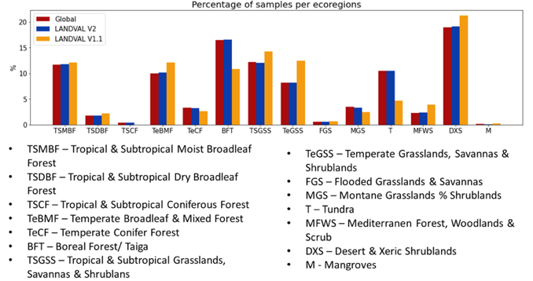
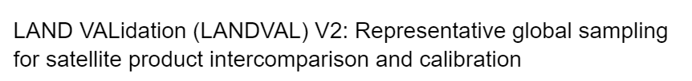
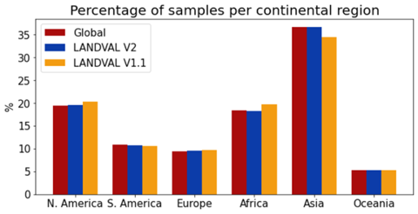

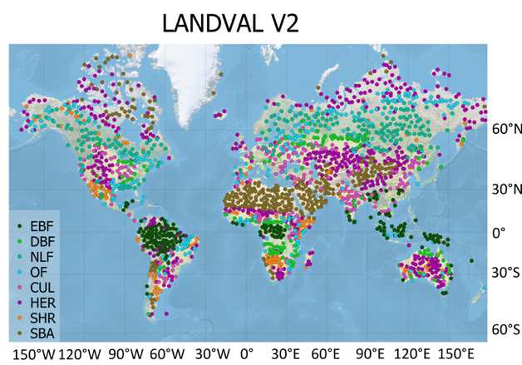
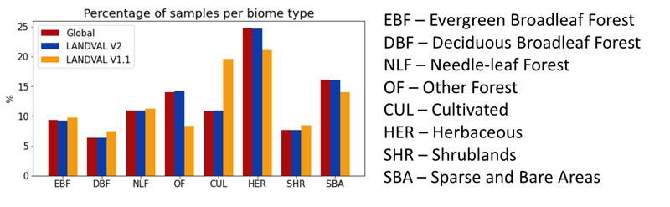
Surface Radiation
  SALVAL:
        2024 annual update has started (inclusion updated values for ground data and satellite products).
        New sampling LANDVAL-V2 for product intercomparison will be tested in the tool: from 720 to 2000 samples.
DOI 10.5281/zenodo.10559900
https://zenodo.org/records/10559901
‹#›

Slide 17
Surface Radiation
LP DAAC to Release Gap Filled MODIS Version 6.1 Albedo, BRDF, and NBAR Data Product
  Expected in Fall 2024
  The LP DAAC will announce the availability of the Terra+Aqua Combined MODIS Version 6.1 Bidirectional Reflectance Distribution Function and Albedo (BRDF/Albedo) Gap-Filled Snow-Free Daily L3 Global 30ArcSec Climate Modelling Grid (CMG) data product (MCD43GF).
  The data product includes Albedo, Bidirectional Reflectance Distribution Function (BRDF), and Nadir BRDF-Adjusted Reflectance (NBAR) data. Currently, the collection only contains data from 2013 through 2021. The remaining historic data will be added at a later date.
  The older MCD43GF Version 6 data product will remain available until the complete MCD43GF Version 6.1 data record is available.

Slide 18
Soil Moisture
Relevant projects:
Fiducial Reference Measurements for Soil Moisture (FRM4SM)
  Direct negotiations w. ESA for a Phase 2 (2025-2026)
  Dedicated budget to update the CEOS LPV validation good practice protocol
  Exchange w. Copernicus Evaluation and Quality Control (EQC) framework to integrate QA4SM activities
ESA Climate Change Initiative (CCI)
  New satellite-only root zone soil moisture products provided in the next release
  Proposal for new CCI AWU in preparation, important open questions regarding the validation of high-res soil moisture
  Proposal for new CCI ET in discussion, joint forces w. ESA CCI soil moisture team
  Potential of expanding QA4SM to validate other variables
EURAMET Green Deal Call 2024
  Proposal in development: “Metrology for ground-based reference measurements for satellite soil moisture validation”
  ~3 M€ project, led by the German National Metrology Institute (Miroslav Zboril)
  Focus: Development of soil moisture “super sites”, transferring SI-traceability from the lab into the field, aiming to get long-term funding for the operation via meteorological institutes, WMO, etc

Slide 19
Soil Moisture
Upcoming workshops:
BIPM-WMO Metrology for Climate Action Workshop 2024
  16-18 September @ BIPM headquarters, Sevres, France.
  Free online attendance possible: https://bipm-cenv2024.org/
EGU General Assembly 2025
  27 April-2 May, Vienna, Austria
  Several Cal/Val sessions proposed (incl. Soil Moisture)
ESA Living Planet Symposium 2025
  23-27 June, Vienna, Austria
  Several Cal/Val sessions proposed (incl. Soil Moisture)

Slide 20
LST and E
Upcoming Conferences
7th International Symposium on Recent Advances in Quantitative Remote Sensing (RAQRS'VII), Valencia, Sep 23-27
EUMETSAT Meteorological Satellite Conference 2024. Würzburg, Germany, 30 Sep – 4 Oct.
ECOSTRESS Science and Applications Team meeting, Pasadena, CA, 30 Sep – 2 Oct.
EARSeL Thermal Remote Sensing Workshop. 2-4 December 2024, Leicester, UK.
LST CCI 2024 User Workshop. 5-6 December 2024, Leicester, UK.
Project news
TIRCALNet preparation study, coordination meeting in June 2024.
Validation of ECOSTRESS Collection 2 LSTE products is underway.
Analyses of thermal camera in situ measurement intercomparison campaign available.
International science workshop on High resolution Thermal remote sensing expected in India during November 2024

Slide 21
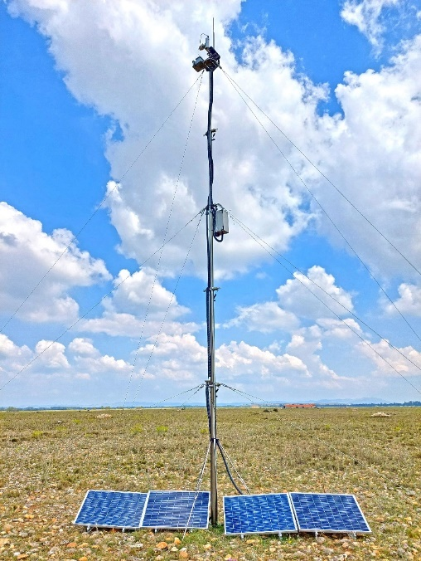
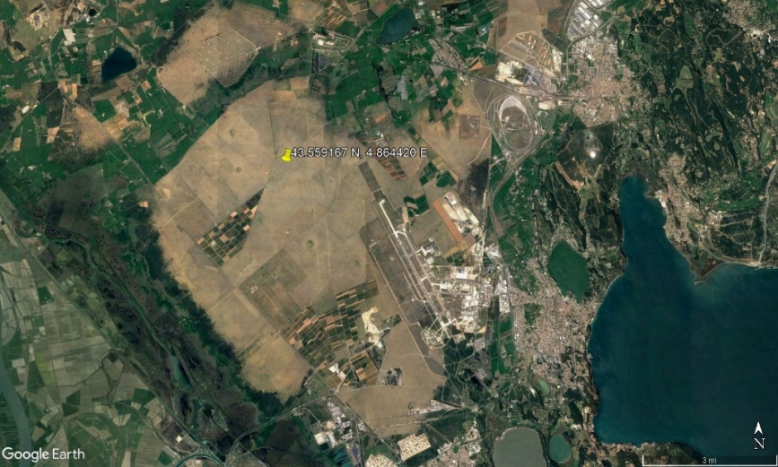
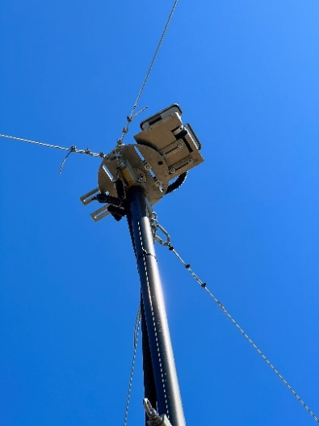
LST and E
TIRCalNet Preparation Study
Goal: Prepare the roadmap for the TIRCalNet operations.
Cooperation between TIRCalNet Preparation Study team (Uni. Leicester, KIT, RAL Space), CNES and JPL.
Study at La Crau site:
  Characterization of site uncertainties: Emissivity measurements + drone flights.
  Characterization of instruments uncertainties.
  Characterization of atmospheric propagation approach: common methodology.

Slide 22

Above Ground Biomass
Protocol Update Status
V2.0 is currently being drafted
Some authors have provided revisions to chapters.

Slide 23
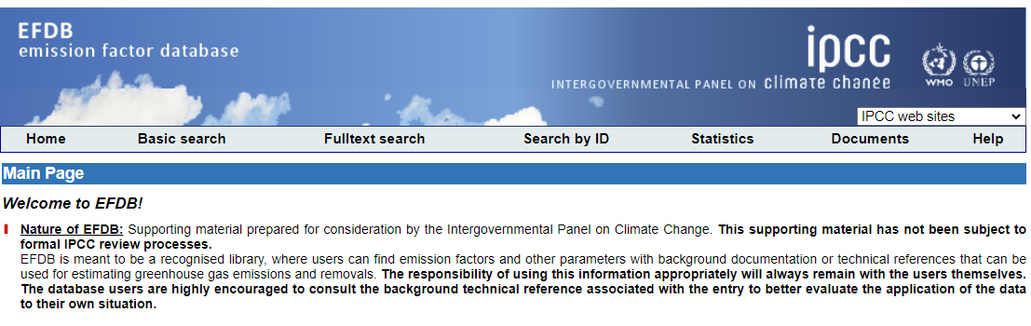

Above Ground Biomass
Two papers that use NASA GEDI and ESA CCI forest biomass estimates are currently in review
National Forest Biomass Assessments Enhanced with Earth Observation to Aid Climate Policy Needs
Hunka, Neha and May, Paul and Babcock, Chad and Armando Alanís de la Rosa, José and de los Ángeles Soriano-Luna, Maria and Mayorga Saucedo, Rafael and Armston, John and Santoro, Maurizio and Requena Suarez, Daniela and Herold, Martin and Málaga, Natalia and Healey, Sean P. and Kennedy, Robert and Hudak, Andrew and Duncanson, Laura. Available at SSRN: https://ssrn.com/abstract=4910141
Intergovernmental Panel on Climate Change (IPCC) Tier 1 forest biomass estimates from Earth Observation
Neha Hunka, Laura Duncanson, John Armston, et al. Authorea. March 04, 2024.
DOI: 10.22541/au.170958900.06861359/v1
Results to be submitted to the IPCC Emission Factors Database in October 2024

Slide 24
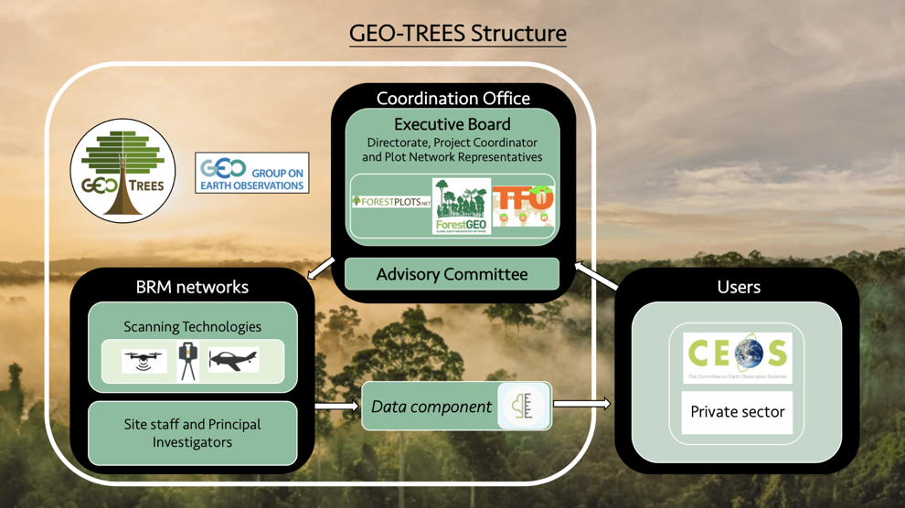
CARB-21-03
Forest Biomass Reference Network (GEO-TREES) (CARB-21-03)
In Progress…The project office is up and running via funding from the French government.
https://geo-trees.org and is actively soliciting funding, with various opportunities in the pipeline.
Nothing concrete as yet in terms of actual funding for data collection, but likely in the near future.

Slide 25
Evapotranspiration
Workshops:
AGU Chapman conference:
  The Energy Balance Closure Problem: Causes, Corrections, and Implications (Sep 14-19, 2025 Boulder)
  International Science Workshop on High-Resolution Thermal Earth Observation (Nov. 19-21, 2024 India, abstract and registration due 9/30)
  ECOSTRESS Science Team meeting (Sep 30-Oct 2, 2024 Pasadena, LA)
Publications (large regional or continental product):
Evapotranspiration and surface energy fluxes across Europe, Africa and Eastern South America throughout the operational life of the Meteosat second generation satellite (https://rmets.onlinelibrary.wiley.com/doi/full/10.1002/gdj3.235)
A brief history of the thermal IR-based Two-Source Energy Balance (TSEB) model – diagnosing evapotranspiration from plant to global scales (https://www.sciencedirect.com/science/article/pii/S0168192324000662)
Spatial-temporal patterns of land surface evapotranspiration from global products (https://www.sciencedirect.com/science/article/pii/S0034425724000774#f0060)

Slide 26
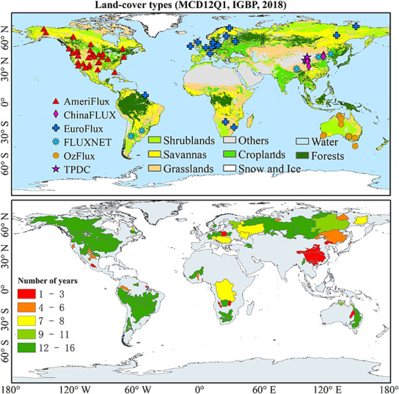
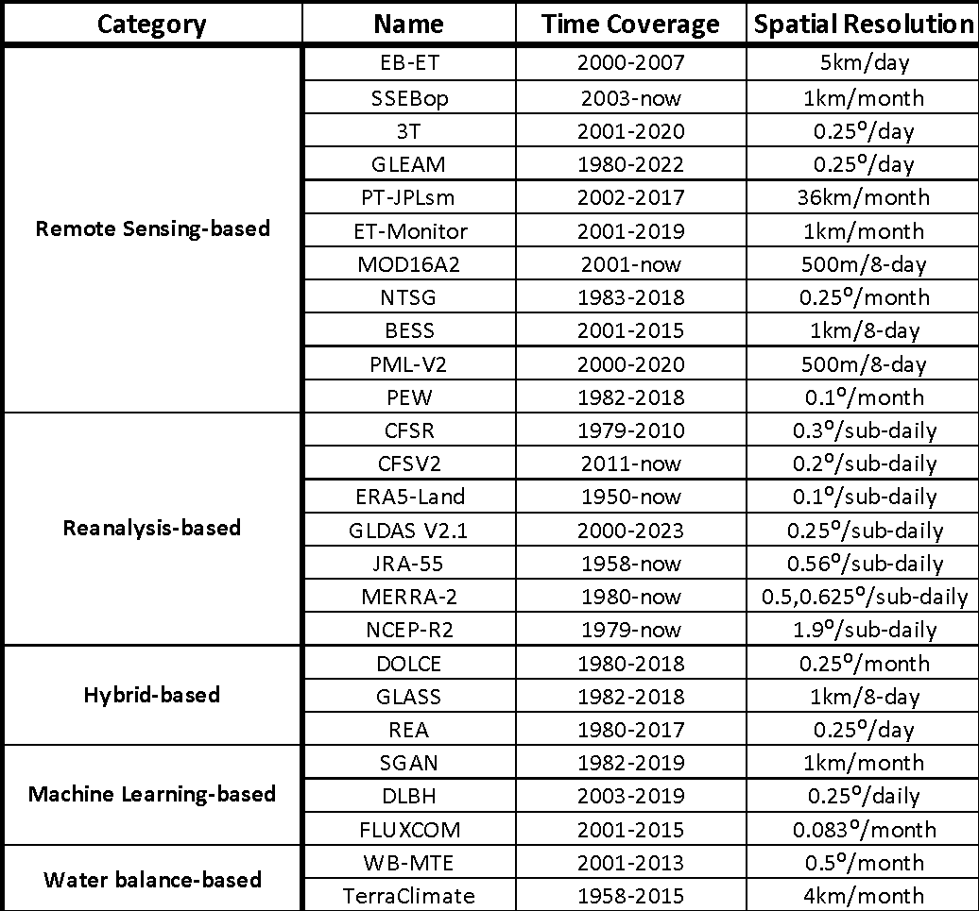
Evapotranspiration
Tang et al., 2024 RSE
https://www.sciencedirect.com/science/article/pii/S0034425724000774#f0010

Slide 27
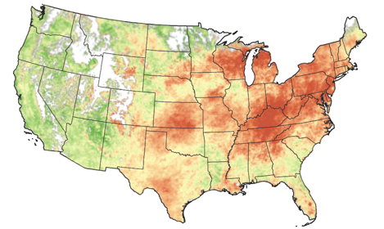
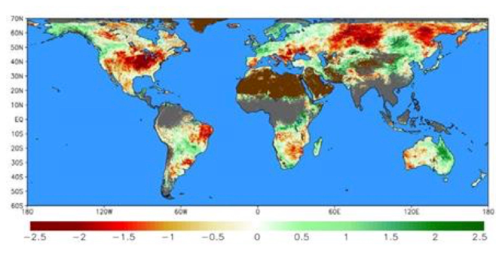
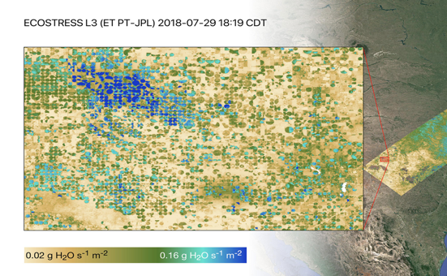
Evapotranspiration
Evaporative Stress Index
SERVIR Global ESI
ECOSTRESS

Slide 28
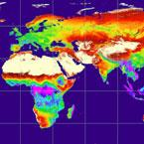
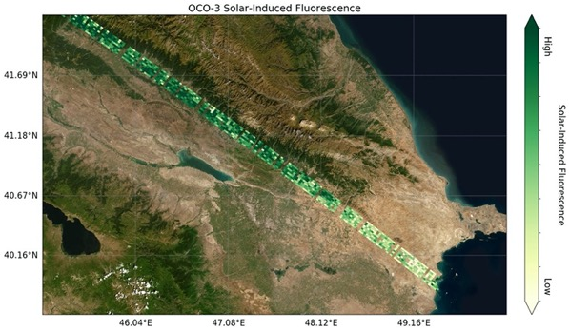
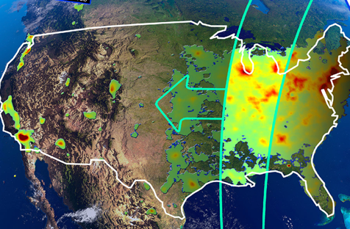
GPP/NPP
WGCV to consider potential for GPP/NPP land product Focus Area within LPV
MODIS GPP/NPP uses FPAR, Land Cover, modelled products (LST), etc.
New missions as well with GPP/NPP implications
MODIS GPP/NPP
OCO2 and OCO3
TEMPO
GPP/NPP - Gross Primary Production/Net Primary Production

Slide 29
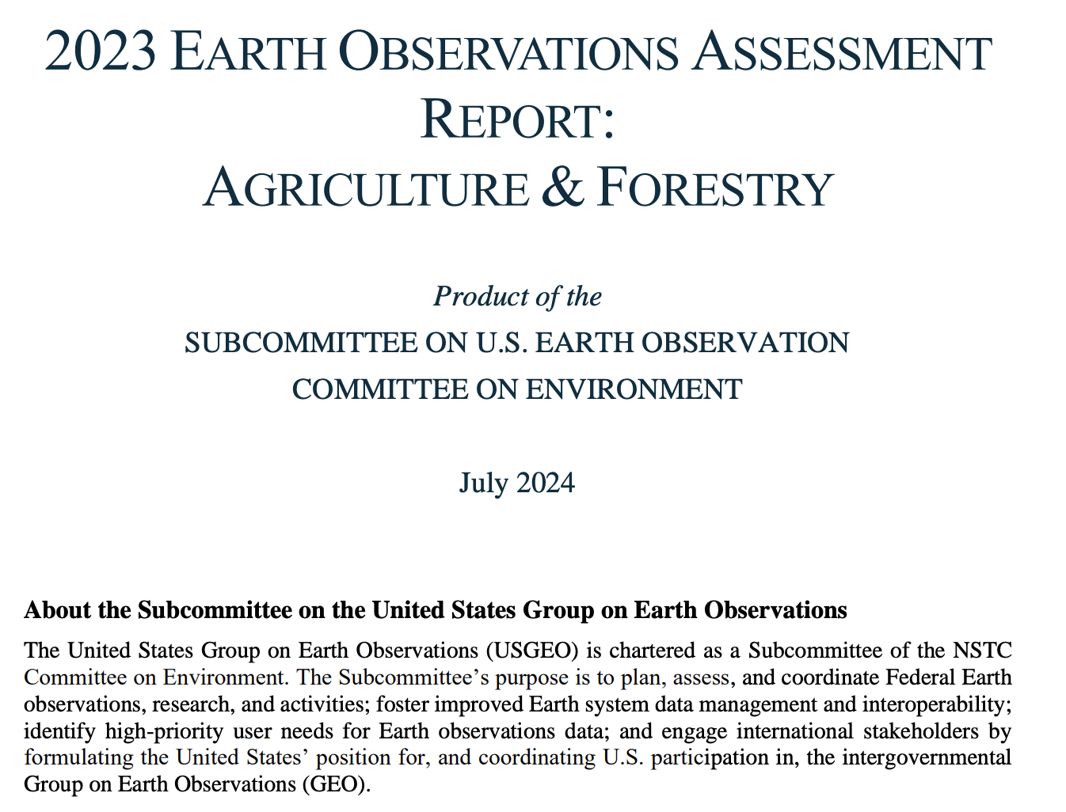
Earth Observation Assessment
2023: Agriculture and Forestry
Climate
2024: …
2025: …
2026: …
2027: …
2028: Agriculture and Forestry
Climate
2029: …

Slide 30
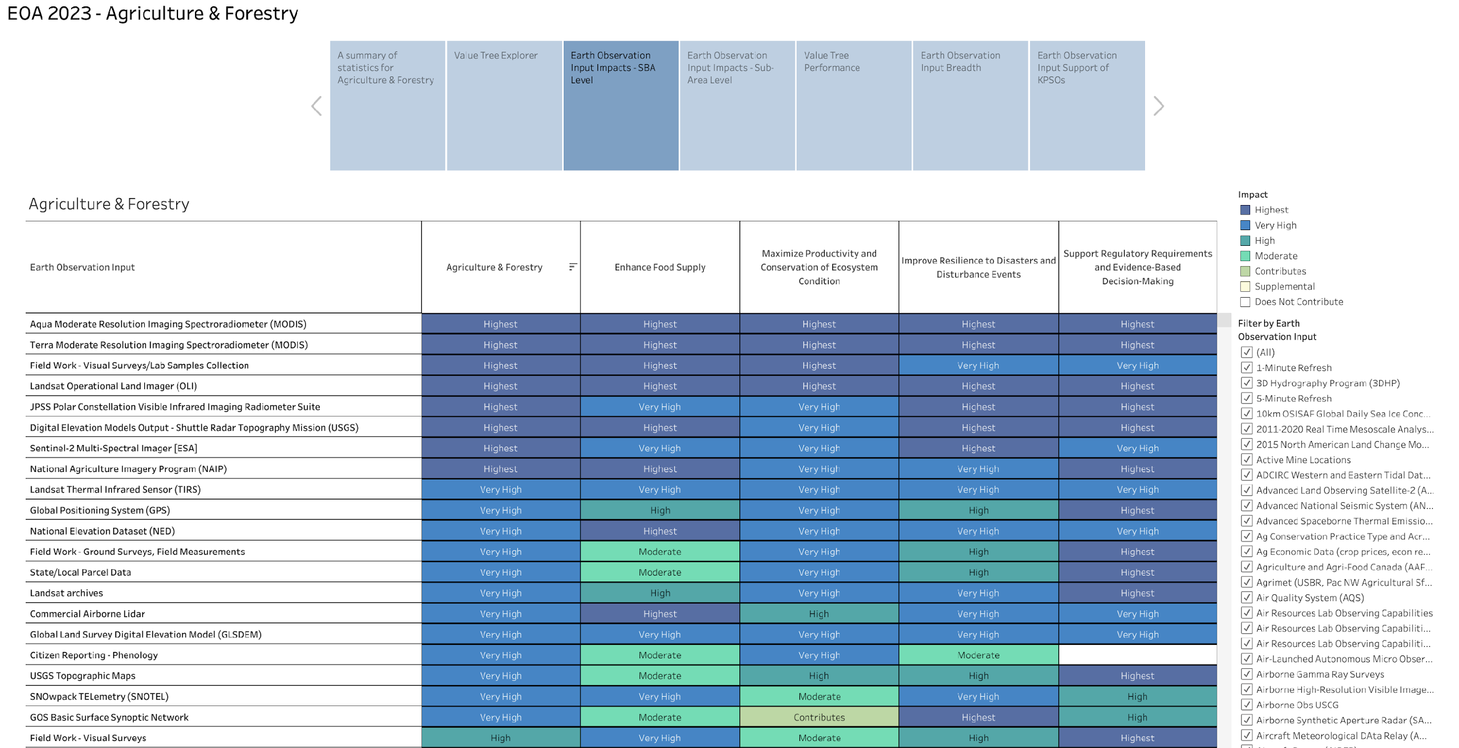
Earth Observation Assessment
https://usgeo.gov/eoa/

Slide 31
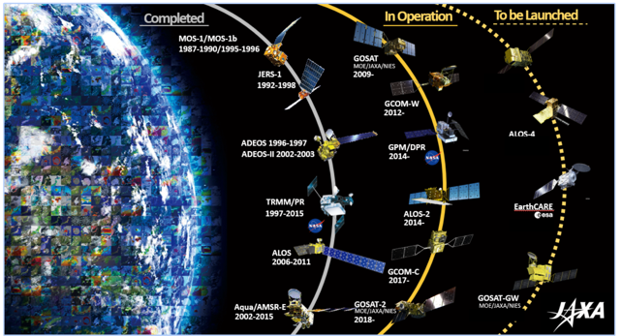
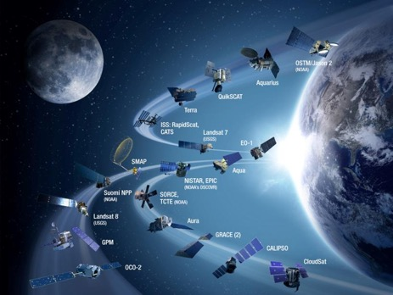
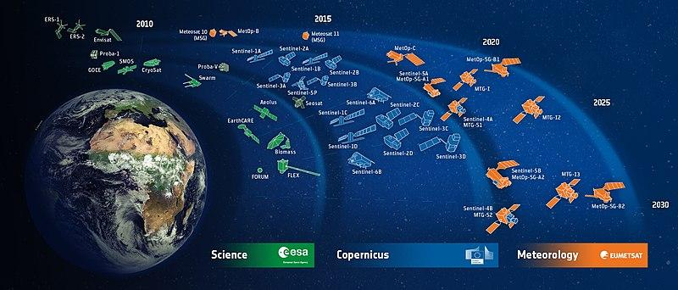
LPV Contributing Satellites Review
There is a need for a review on satellites which contribute to LPV development, not just in primary, but in ancillary datasets, both public and commercial
Challenges:
Moving Target: Aqua, Terra
Decommissioning cycles, GEDI, ECOSTRESS
Commercial transparency
Interdependencies of products on multiple satellites
Constellations

Slide 32
Discussions
Slide ‹#›

