Slide 1
WGCV-54
Atmospheric Composition Sub Group
Jean-Christopher Lambert, BIRA-IASB
Agenda Item 2.7
WGCV-54
15-18 October 2024
Sioux Falls, South Dakota, USA

Slide 2
Atmospheric Composition Updates
Aerosol, Cloud & Precipitation Profile
Aerosol, Cloud & Precipitation Profile Validation Protocol CV-22-01
EarthCARE validation campaign
Tropospheric ozone datasets harmonization and validation VC-20-01
GHG Cal/Val highlights
Air Quality Constellation validation VC-20-02/03/04
CINDI-3 campaign CV-24-01
CEOS-FRM – Atmospheric composition WGCV-53-ACT-14 / CV-23-01

Slide 4
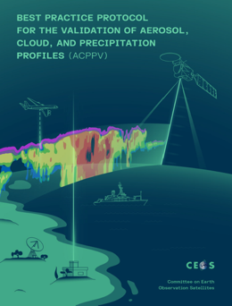
CV-22-01 Activity Status
February 2024: draft circulated within the EarthCARE validation team (250+ scientists)
Review feedback taken on board in an update which is considered the final version prior to CEOS review
This document was provided to J.-C. Lambert on 21 September 2024 and distributed to initiate CEOS review/endorsement process.
Authors and editors are on standby to take into account any CEOS feedback.
Intention for further updates based on EarthCARE lessons learned, in preparation for AOS, Aeolus-2, and further high-resolution profiling missions

Slide 5
CV-22-01 Activity Status
Content
Validation needs for space profilers
Survey of validation measurements
Correlative metadata and data format
Guidance for the validation of lidar and aerosol products
Guidance for the validation of Radar, cloud and precipitation products
Statistical validation
Near-real-time validation through monitoring in NWP data assimilation system
Gaps and challenges

Slide 7
1. ESA Validation-Related Activities
43 EarthCARE Cal/Val Projects
Knowledge transfer (algoritms, instruments)
Prepare observation planning & correlative data handling
Organise validation analysis
Foster interaction with funding sources
Facilitate interaction with algorithm teams, instrument experts, and peers through interactive validation portal
Organisation of pre-/post-launch campaigns
Securing collocated airborne datasets
Validation Data Centre for correlative data
ECVT
EarthCARE Validation team
Pre-/post-launch and correlative measurements
National
Agencies
Validation bi-laterals with several agencies to address funding
ESA-JAXA joint Scientific
Validation Implementation Plan
Collaboration
Coordination
ESA-NASA Joint Programme Planning Group (campaigns, best practices) and AOS, PACE etc.
Fiducial Reference Measurement developments for lidars (eVe, EMORAL) and radars (FRM4RADAR)
Development of suborbital to orbital signal converters for radar, lidar, imager
best practice convergence (collaboration of EarthCARE, CALIPSO, Cloudsat, Aeolus, and AOS scientists)
Pilot to support cal/val of Atmospheric satellite missions
Methods and
approaches
Various
Consultation with domains/communities to solicit further contributions

Slide 8
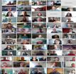
2. ESA validation preparations
Pre-Launch Validation Workshops
Adaptation and development of Supporting tools
and facilities for each element of the validation workflow
‘17
‘21
‘23
Planning
Studies, Community convergence
Supporting PIs
Reporting
Discussions
Q&A
Correlative Data handling
Rehearsal
Securing datasets and analyses
ATLID
Comparison
Analysis
EarthCARE data discovery & Download

Slide 9
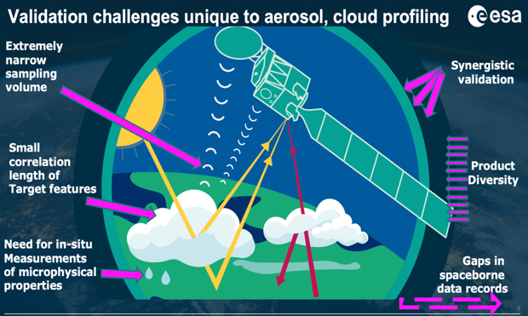
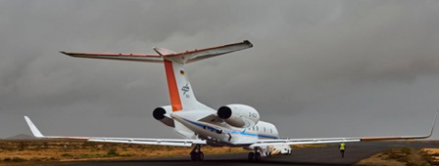
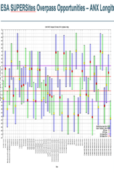
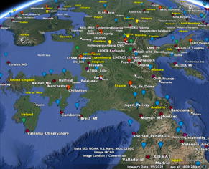
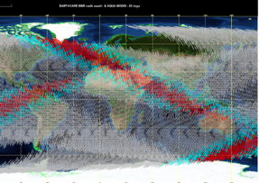
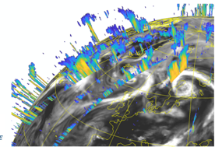
3. ESA Product Validation Approach
Airborne (Active,
Passive, In-situ)
Network
of
Networks
Plan is documented in EarthCARE Scientific Validation Implementation Plan
– Issue 2.0 Released 23 Sep 2024
NWP QC
SAT to SAT

Slide 10
4. Correlative measurements status
Ground-based, shipborne, and airborne measurements all underway
Correlative instruments for BBR and MSI related single sensor (L1, MSI L2) and BM-RAD synergy products are underway since 26 July (this includes also ground-based radars and lidars validating MSI cloud products)
Correlative measurements for CPR and ATLID (L1, and L2) and for the full synergy suite are underway since 9 and 10th of August respectively, including the first underflight on 11 August
Many of the network stations involved in EarthCARE validation have begun dedicated measurements, including CloudNet, Earlinet (example below), LALINET, ADNET, others have collected routine data (MPLNET, E-PROFILE)
ATMO ACCESS - EU project
53 Stations (mostly ACTRIS) participating, of which 28 are observing routinely. Includes EARLINET (lidar, most 355 and Depol) and CLOUDNET stations.
ATMO ACCESS project encompasses 2 prelaunch rehearsals, intercalibration with other networks/systems, bespoke data processing, and dedicated observation campaign during EarthCARE Commissioning Phase and until February 2025, with fast delivery. Intercalibration with MPLNET is ogoing, and will also be performed with eVe, EMORAL and BASTA

Slide 11
5. Airborne campaigns overview
Collaborations ongoing with large number (22 and counting) of airborne campaigns, often complemented with ground and/or ship-based instruments. National scientific institutions (mainly Europe and Canada) and NASA
Campaigns are a mix of dedicated validation campaigns and collaborative piggybacking campaigns
Strong synergies with NASA PACE mission: reciprocal EarthCARE and PACE underflights during ORCESTRA and PACE PAX campaigns, complemented by science projects with synergistic retrievals
41 underflights of 33 EarthCARE orbits have already been performed between 11 August and 10 October 2024 with many more to follow during the EarthCARE lifetime:
These underflights were performed by 7 Aircraft involved in 6 Campaigns, including tandem and triple underflights.
The airborne payloads included 5 lidars, 3 imagers, 1 polarimeter, 3 radars, and 4 different in-situ sampling suites, complemented by several ground-based and ship-borne instruments
https://blogs.esa.int/campaignearth/category/earthcare/

Slide 12
5. Airborne campaigns overview
2024 |  | 2025 |  | 2026
PERCUSION (ORCESTRA) | Cape Verde, Barbados, Germany | GLOVE | USA | PONEX | Canadian Arctic
MAESTRO (ORCESTRA) | Cape Verde | POST-Maestro | France | CELLO-Palau | Palau
CELLO(ORCESTRA) | Cape Verde | CELLO-ARCTIC | Norway/Romania
ARCSiX | Arctic
BAIVEC | France | Tentative:
PACE-PAX | USA | HALO South | New Zealand
ECALOT | Canada | CARINA | Australia | Tentative:
WhyMSIE | USA | Bermuda HSRL-2 | Bermuda | CoSENSE | Mediterranean
Tentative: |  | ARISTOTLE | Antarctica | NURTURE - | Canada
VERIFY | UK | Piper Seneca | Mediterranean | BACCOPA | Africa

Slide 13
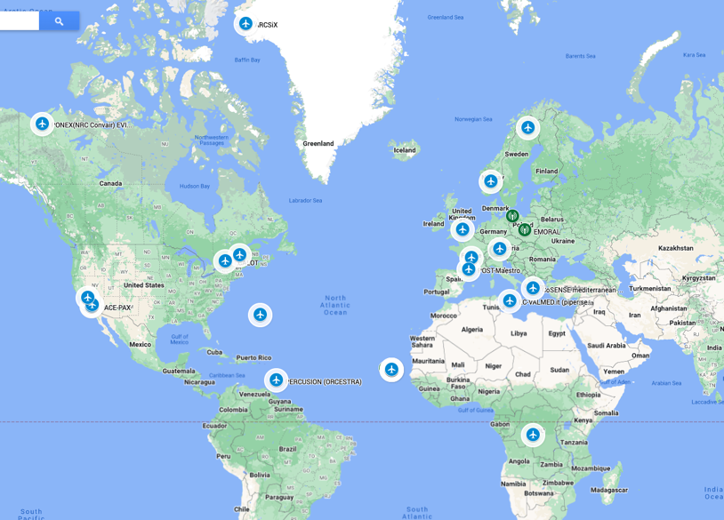
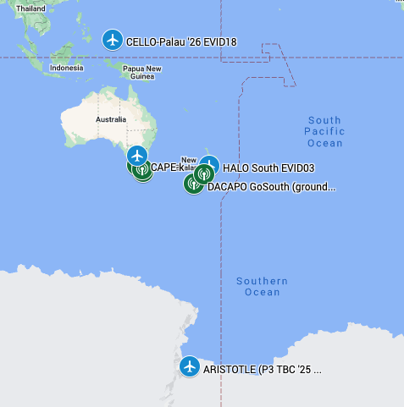
5. Airborne campaigns overview
X
Many airborne campaigns are combied with ground and or marine component

Slide 14
Outlook
Pre-operational Data release to validation teams
Level1 available
Level 2 staggered release between October ‘24 and February ‘25
Validation analysis (intercomparisons) reporting at workshops aligned with public release:
Operational data public release (for both ESA and JAXA products)
Level 1 by January 2025 (1st In-Orbit Validation Workshop, online)
Level 2a and 2-sensor L2B by March 2025 (2nd In-Orbit Validation Workshop, Frascati)
3- and 4-sensor L2B products by December 2025 (2025 Science and Validation Workshop, Tokyo)
Questions ? ⇨ Rob.Koopman@esa.int

Slide 15
Tropospheric Ozone Activity
VC-20-01
VC-20-01: Tropospheric ozone data validation and harmonization (Lead DLR, Co-Leads BIRA-IASB & NASA)
TOAR-II Community Special Issue in progress https://acp.copernicus.org/articles/special_issue1256.html
Community papers deadline November 30. 12 satellite-based papers/preprints so far, out of 28 in total
Summary papers come after, in 2025, including constellation wide assessment using cross-harmonized satellite data anchored to HEGIFTOM
Phase II

Slide 16
Tropospheric Ozone Datasets
VC-20-01
SATELLITE DATASETS
Optimal Estimation retrievals 🡪 vertical profile at pixel level or at pixel-cluster level
UV-VIS
TIR
Synergy UV-VIS+TIR
Residual techniques 🡪 partial column calculated as difference between total and pseudo-stratospheric columns, often gridded in time & space
Cloud-free TC minus above Convective Cloud TC
Nadir TC minus Limb PROF
Nadir TC minus Reanalysis PROF

Slide 17
Tropospheric Ozone Datasets
TOAR-II Focus Working Group: HEGIFTOM
Harmonization and
Evaluation of
Ground-based
Instruments for
Free
Tropospheric Ozone
Measurements
Major Deliverable:
Quality assessed ozone data sets from established ground-/air-based instruments, whereby each measurement gets also an uncertainty and a quality flag, with representativeness and instrumental drifts characterized and evaluated
Phase II
WG
HEGIFTOM
https://igacproject.org/hegiftom-focus-working-group
HEGIFTOM Core Group
Roeland Van Malderen (Co-Chair: roeland@meteo.be & Sondes),
Herman Smit ( Co-Chair: h.smit@fz-juelich.de & Sondes),
Romain Blot (IAGOS), Corinne Vigouroux & James Hannigan (FTIR),
Thierry Leblanc (LIDAR), Irina Petropavlovskikh (Brewer/Dobson Umkehr)
Michel Van Roozendael (MAX-DOAS), Alexander Cede & Thomas Hanisco (Pandora),
Owen Cooper, TOAR-II SSC-Liaison Member

Slide 18
Tropospheric Ozone Datasets
Ground-based Free Tropospheric Ozone Measuring Platforms
Instrument/Platform | Time period | Coverage/Network | Groups in HEGIFTOM
Ozonesondes | 1965 - present | > 50 Sites worldwide (GAW/WOUDC, NDACC, SHADOZ) | RMI (Belgium), FZJ (Germany), ECCC (Canada), NOAA (USA), NIWA (NZ), NASA (USA)
MOZAIC/IAGOS | 1994 - present | Cruise altitude (10-12 km) & Airports worldwide (100-250 Airports) | CNRS (France) & KIT (Germany
FTIR | 1995 - present | NDACC, 13-15 sites having more than 10 years of data | BIRA (Belgium), NCAR (USA), AEMET (Spain)
Lidar |  | NDACC, TOLNET (9-10 Sites) | NASA (USA), LATMOS (France), UAH (USA)
Umkehr (Dobson & Brewer) | 1956 - present | WOUDC (> Sites), NEUBrew, EUBrew (14 Sites) | NOAA (USA), MeteoSwiss (Switzerland), BoM (Australia), NIWA (New Zealand), OHP (France), AEMET (Spain), Univ. Thessaloniki (Greece)
MAX-DOAS | 2010-present | 5-10 sites NDACC and associated sites | BIRA (Belgium)
Pandora | 2012 - present | > 40 sites at 2020, Pandonia Global Network (PGN) | NASA (USA), VTU (USA), LuftBlick (Austria)
Phase II
WG
HEGIFTOM

Slide 19
GHG Cal/Val Highlights
Details: see WGCV-54 item 2.6 on GHG Val/Val (this morning)
L1 calibration
VICAL GHG Cal/Val website
Match-up database for SWIR and TIR sounders
L2 GHG networks:
Several actions in progress or in elaboration (see item 2.6)
EUMETSAT ITT for CO2M product validation methods, reference data provision and processing, incl. TCCON, COCCON and NDACC
EUMETSAT ITT for Pandora NIR development

Slide 20
GHG Cal/Val Highlights
Cal/Val updates in CEOS-CGMS Greenhouse Gas Roadmap v2
incl. WGCV related and coordination with AC-VC, Cal/Val networks role and challenges, Global Mapper/Facility Scale (New Space), emissions/fluxes validation challenges
Annexe C – Implementation Actions – Cal/Val as a living document
Facility scale L2/emissions/fluxes validation
JPL/ESA/NASA collaboration with commercial operators (GHGSat, CCMs…)
IMEO Cal/Val Testing WG
Continued work on ‘Common Practices for Quantifying, Reporting, Validating, and Assessing Facility Scale Methane Emissions Using Remote Sensing’ by Worden et al. and need for extension to area fluxes
GHG Cal/Val updates at AC-VC-20 (this week in College Park, MD)

Slide 21
Air Quality Constellation Validation
Cal/Val coordination (VC-20-02) & plans (VC-20-03)
L2 algorithms: Sentinel-4 L2 prototype testing on GEMS; NO₂ and HCHO algorithms round-robin studies
International collaboration on FRMs and other validation data: collaborative airborne campaigns, Pandonia Global Network & Pandora Asian Network, CINDI-3 MAX-DOAS community campaign with participation of other networks
Sentinel-5P MPC operational validation service (2017-2027) as pathfinder for:
ESA PEGASOS validation service for GEMS (2022-2024). PEGASOS to be continued and extended to TEMPO (2025-2026)
EUMETSAT operational validation system for Sentinel-4, Sentinel-5 and CO2M
EUMETSAT ITT (deadline 2024/10) scientific service for CO2M product (incl. NO₂) validation methods, reference data provision and processing

Slide 22
Air Quality Constellation Validation
Cal/Val Announcements of Opportunities (VC-20-04)
GEMS AO (L 2020/02) 🡪 ongoing Cal/Val activities with international participation; airborne campaigns, cross-validations
TEMPO (L 2023/04), Mission Validation Plan, joint NASA/NOAA science field campaigns contribute to validation
Joint ESA/EUMETSAT AO Call (closed October 11, 2024) for the Cal/Val of Sentinel-4 and -5 (first launches in 2025-2026)
Validation data analysis and reporting aligned with staggered release of L2 products
Proposed validation data must evaluate CEOS-FRM maturity level.
Synergies with Sentinel-5P, GEMS, TEMPO, OMPS and other validation efforts encouraged

Slide 23
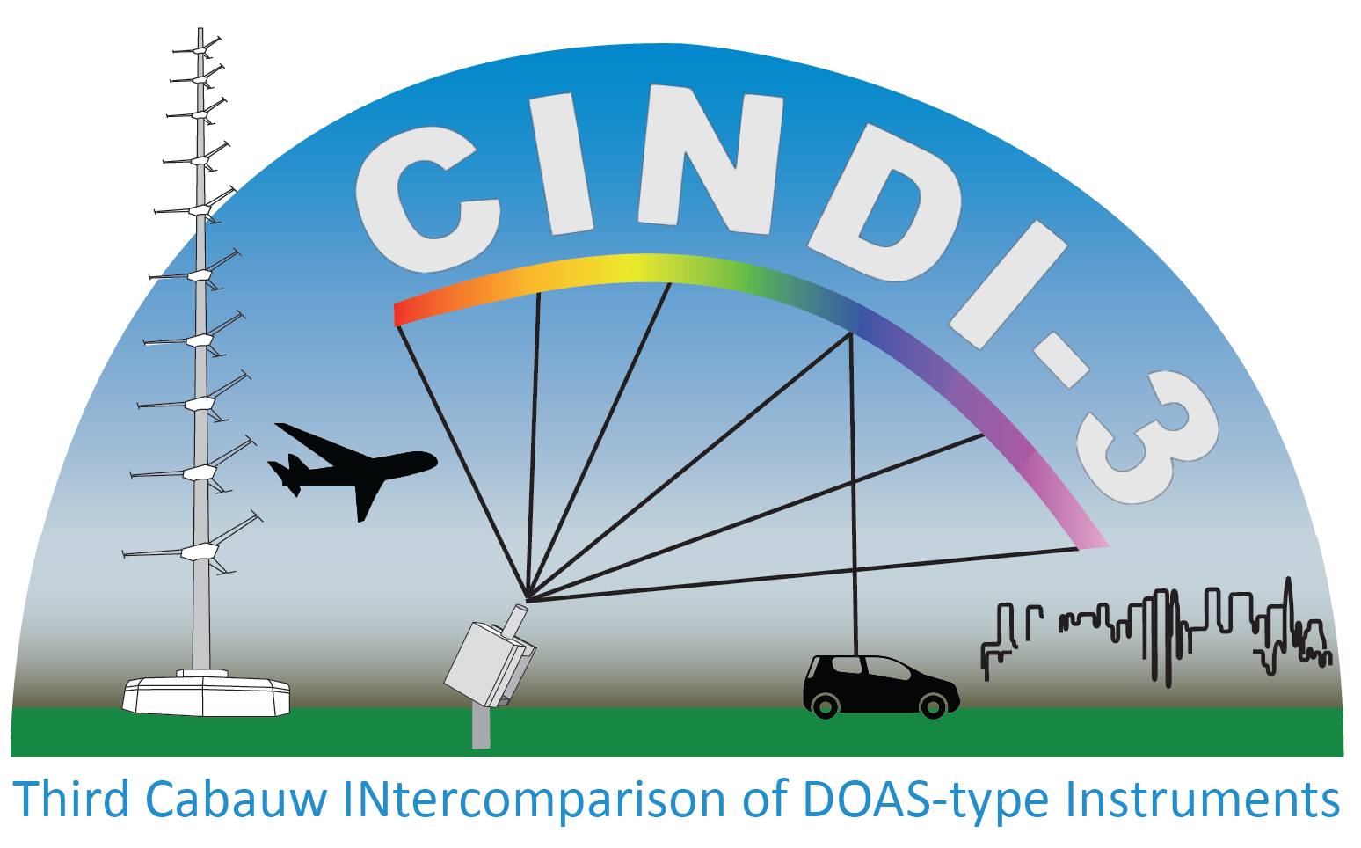
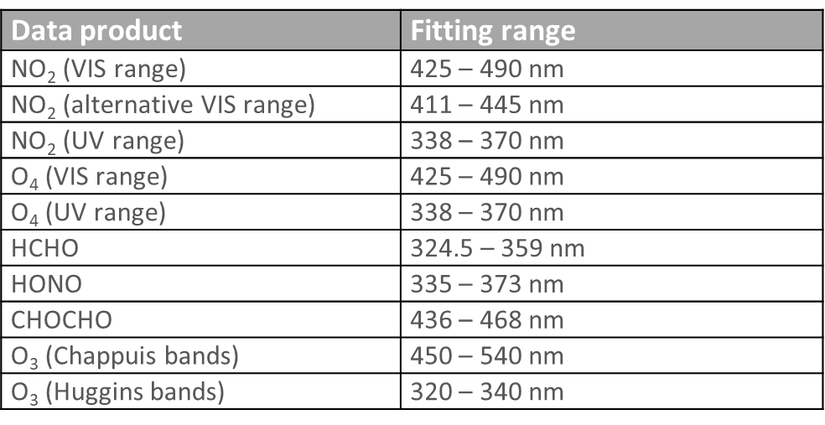
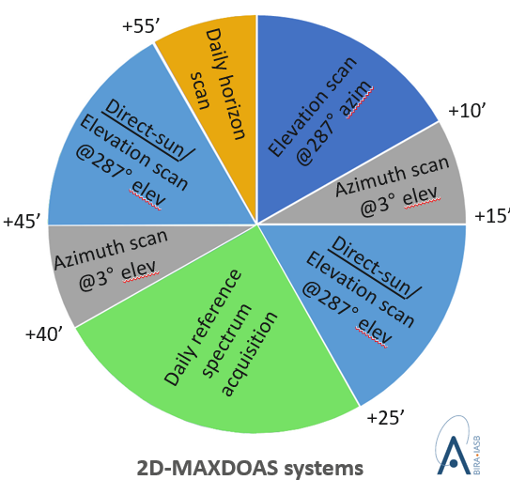
CINDI-3 (May 21 – June 21, 2024)
CV-24-01
The Third Cabauw INtercomparison of DOAS-like Instruments (CINDI-3)
Semi-blind intercalibration and intercomparison campaign with external referee
to intercalibrate instruments and assess mutual consistency of measurements
to get NDACC and ACTRIS-CREGARS certification for new instruments
to assess and improve FRM maturity for validation of CEOS Air Quality and Ozone satellite constellations
Observation protocol
Additional species: CHOCHO and HONO

Slide 24
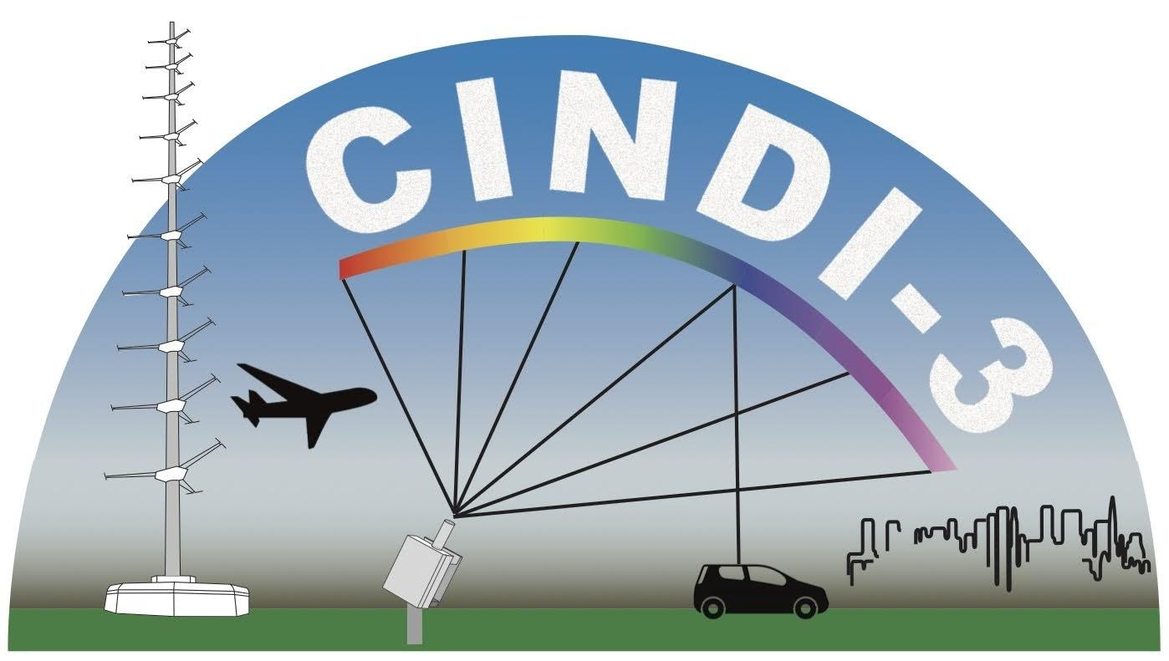
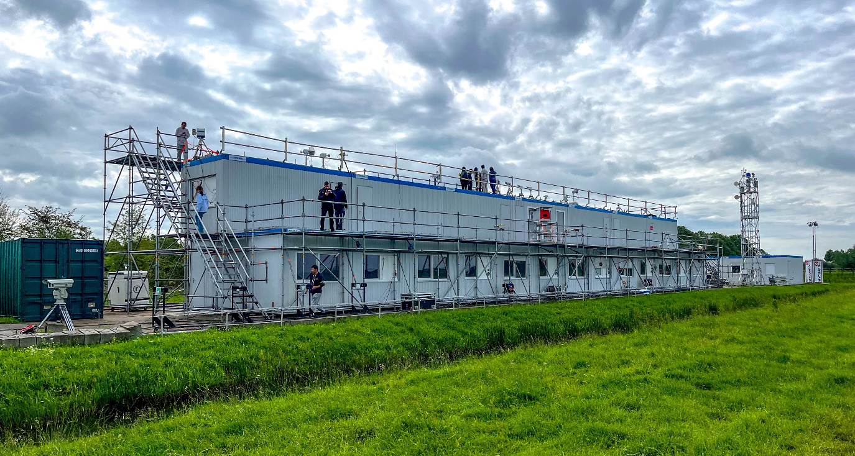
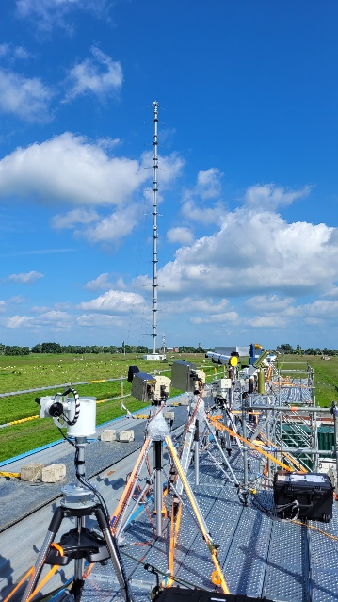
CINDI-3 (May 21 – June 21, 2024)
CV-24-01
Cabauw, The Netherlands
Overview
35+ UV-VIS MAX-DOAS instruments intercompared, from 16 countries
60+ instruments deployed
100+ participants
FRM4DOAS central processing applied to 50% of participating instruments
Airborne deployment for NO₂ mapping and profiling
Data analysis in progress
UV-Vis intercalibration campaign organized as part of NDACC and ACTRIS CREGARS topical center, with additional ESA support.

Slide 25
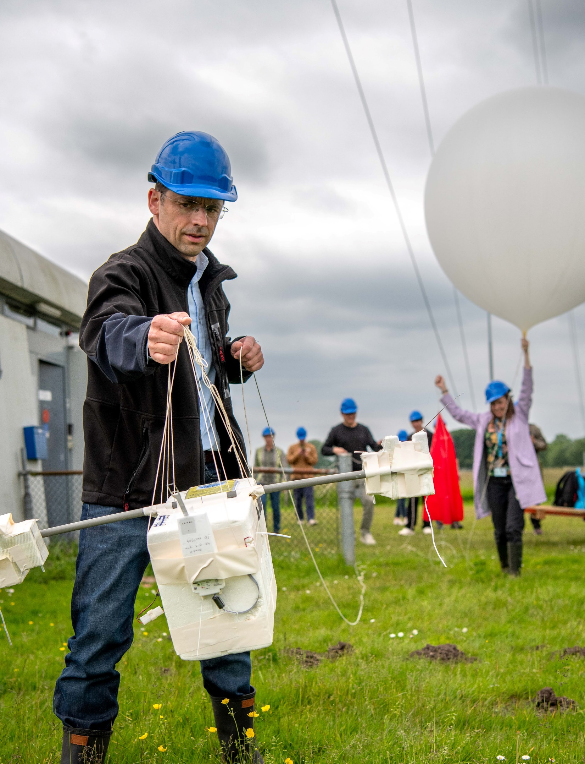
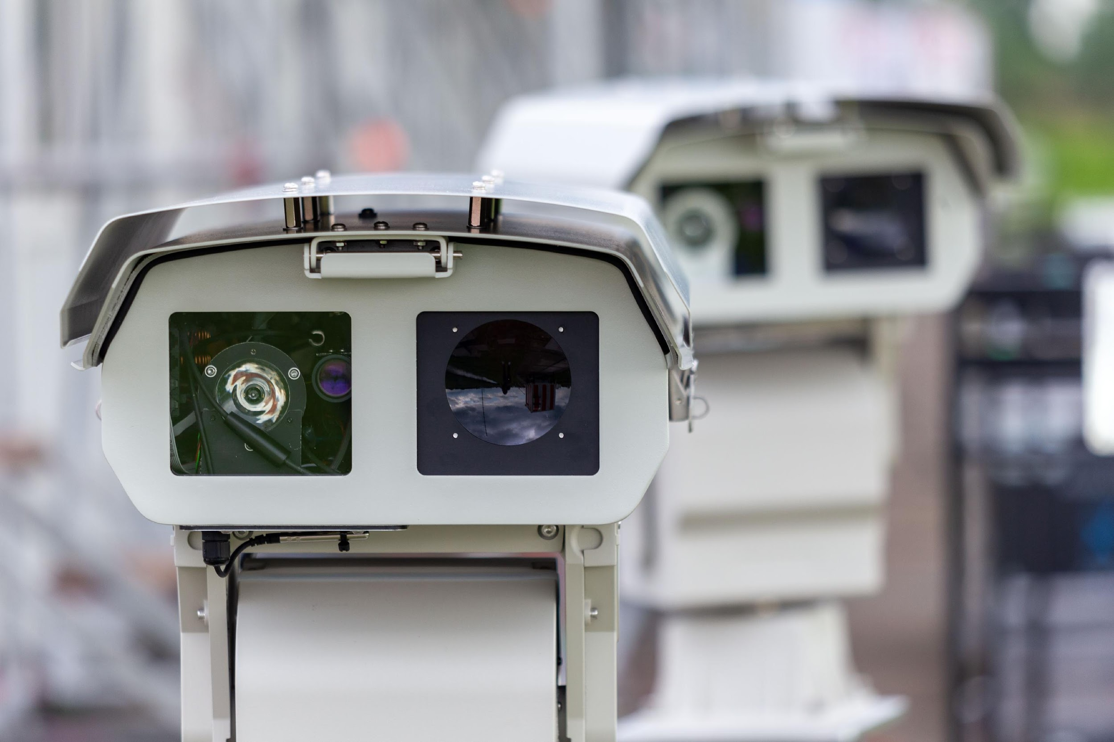
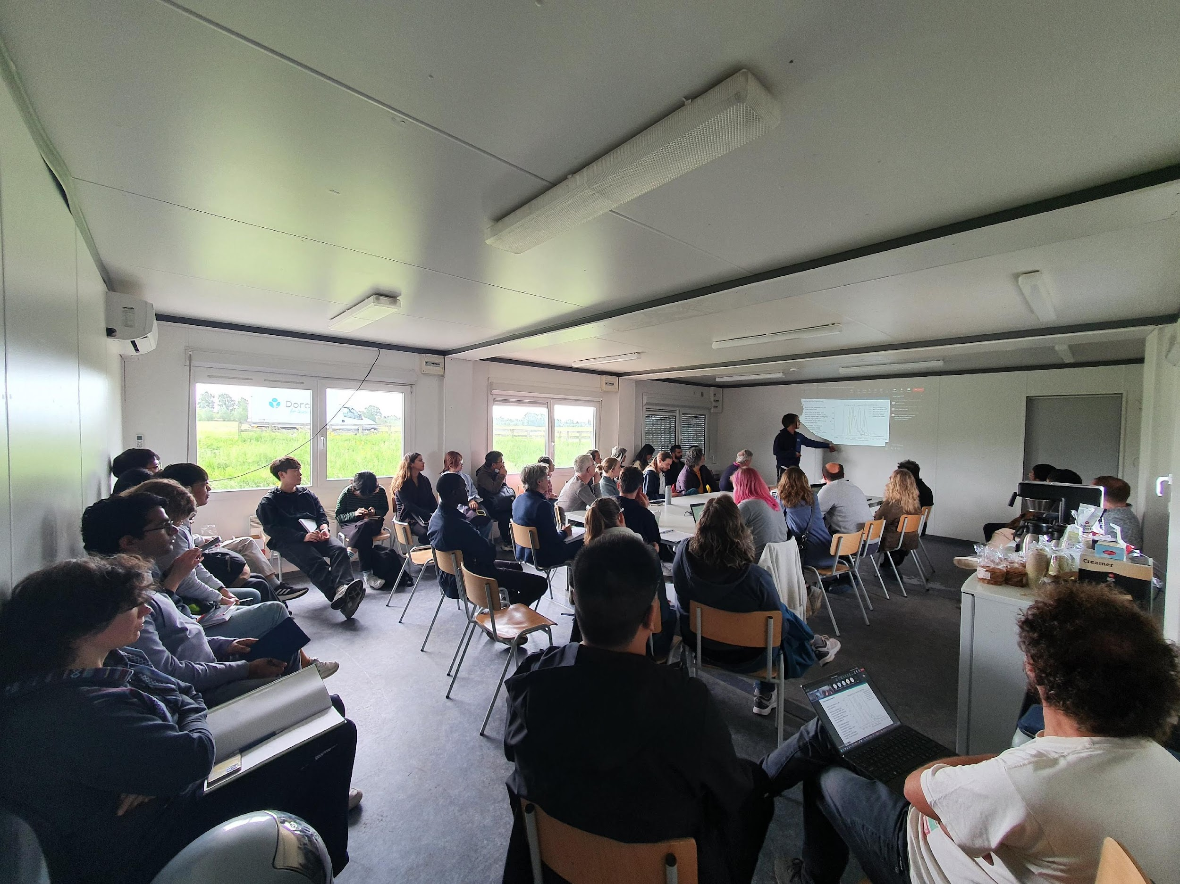
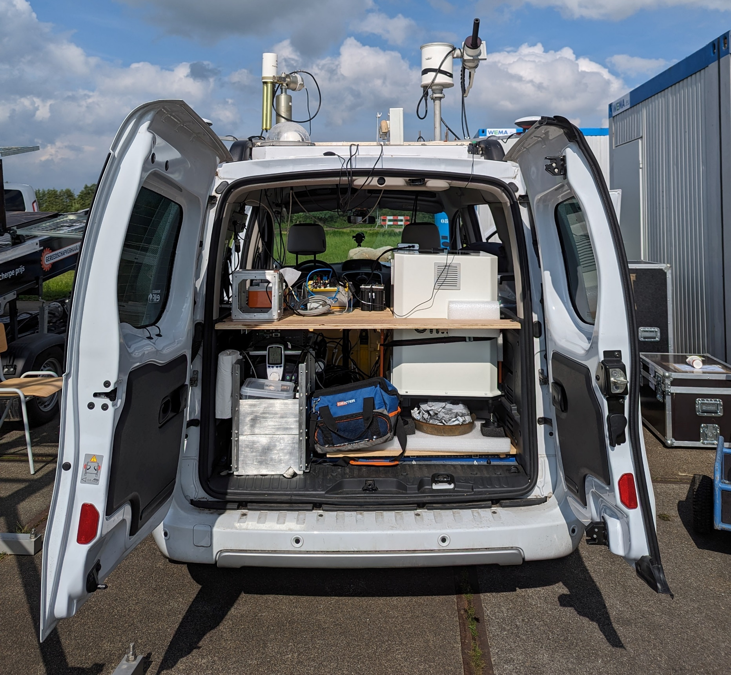
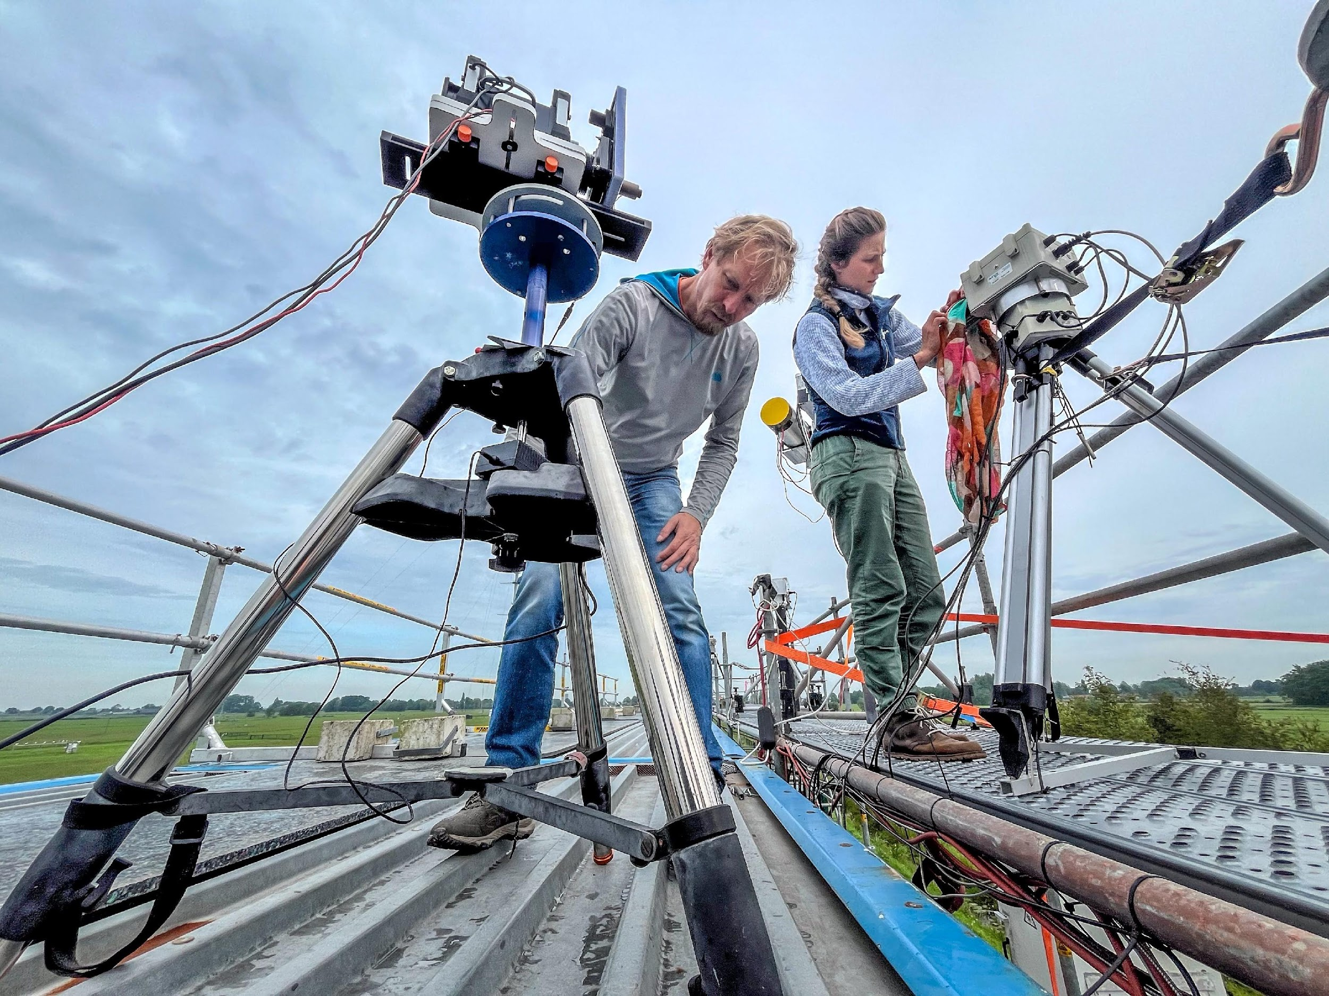
Highlights
35+ UV-Vis DOAS instruments of (MAX)DOAS, SAOZ and Pandora types intercompared for NO₂, HCHO, O₄, O₄, CHOCHO, HONO, BrO and O₃ slant column measurements
In-field calibration setup by Luftblick/NASA applied to all UV-Vis instruments
Interactive semi-blind data evaluation with daily briefs
Comprehensive set of ancillary measurements: aerosol and tropospheric O₃ lidars, Brewer and aerosol sunphotometers, NO₂ and O₃ sondes, in-situ instruments, long-path DOAS, etc.
Mobile measurement setup for NO₂ (carDOAS) and aerosols (MAMS)
Airborne mapping and vertical profiling of NO₂ in Cabauw and Rotterdam area using Belgian coast-guard research aircraft (operator RBINS)
Post-campaign data analysis in progress

Slide 26
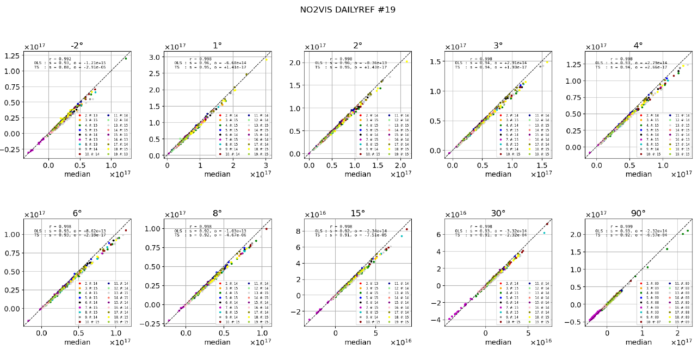
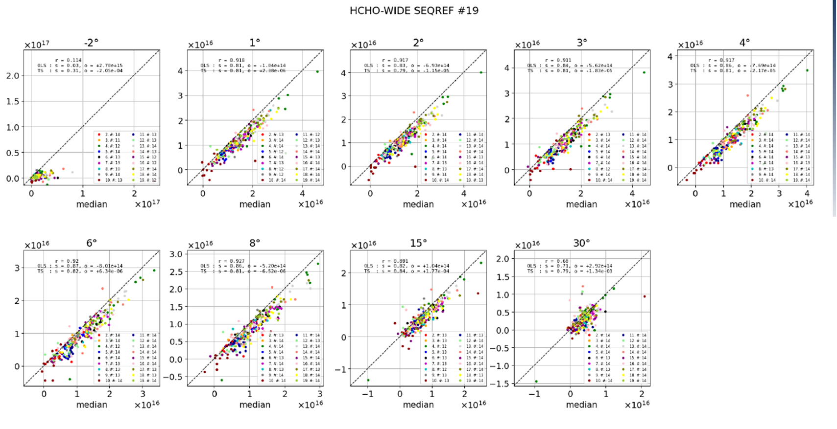
Data evaluation in progress
CINDI-3 (May 21 – June 21, 2024)
CV-24-01
Regression analysis against median values from all measurements

Slide 27
CEOS-FRM – Atmospheric composition
Current CEOS-FRM Version 1
2023/09: Substantial feedback on CEOS-FRM document provided by ACSG and NDACC Steering Committee
2024/02: FRM4DOAS and PGN test cases for CEOS-FRM tool (v1) reported at WGCV-53 ⇨ need to clarify guidelines and address CEOS-FRM v1 issues for atmospheric composition (WGCV-53-ACT-14)
BAQUNIN Brewer NO₂ self-assessment
2024/10: FRM4DOAS and FRM4GHG (EM27/SUN) self-assessments published in Remote Sensing special issue ‘Copernicus Sentinels Missions Calibration, Validation, FRM and Innovation Approaches in Satellite-Data Quality Assessment’ (SI closes 2024/11)

Slide 28
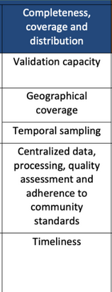
CEOS-FRM – Atmospheric composition
Future CEOS-FRM Version 2
WGCV-53-ACT-14 in progress: telecon 2024/06, iterations…, proposal for additional column:
v1 matrix applicable to a measurement ⇨ classification
additional column characterizing validation capacity achieved by network deployment, centralized processing and QA/QC, timeliness
Version 2 development in progress
Test cases volunteering for future v2: NDACC sub-networks (DOAS, FTIR, lidars, MWR, sondes), ACTRIS-CREGARS (topical Centre for Reactive Trace Gases Remote Sensing)

Slide 29
FRMs and Other Validation Data
Status, issues and challenges regarding FRM plans reported at QO3S (Boulder, CO, 2024/07) and AGU FM 2024 (Washington DC, 2024/12)
ESA Living Planet Symposium 2025 (Vienna, 2025/06): cross-EO domains session ‘Recent progress on uncertainty analysis for Earth Observation measurements’ open to FRM presentations
NDACC network strategy peer-reviewed paper in good progress, including satellite validation strategies for NDACC sub-networks and viewpoint of stakeholders (incl. ACSG and several space agencies)
NDACC Symposium 2025 Celebrating 35th Anniversary of the Network, Virginia Beach, VA, USA (2025/10)

