Slide 1
WGCV-54
GHG Cal/Val and Network Updates
WGCV Inputs to GHG Roadmap
GHG Match-up Dataset
Methane Best Practices
Akihiko KUZE,
Jean-Christopher LAMBERT,
John WORDEN
GHG task team
2.6 WGCV-54
16-17 October 2024
Sioux Falls, South Dakota, USA

Slide 2
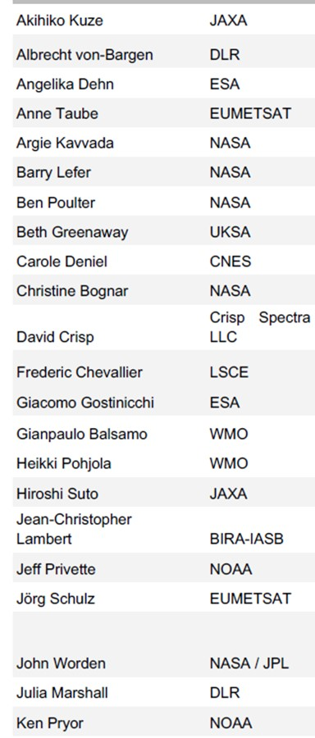
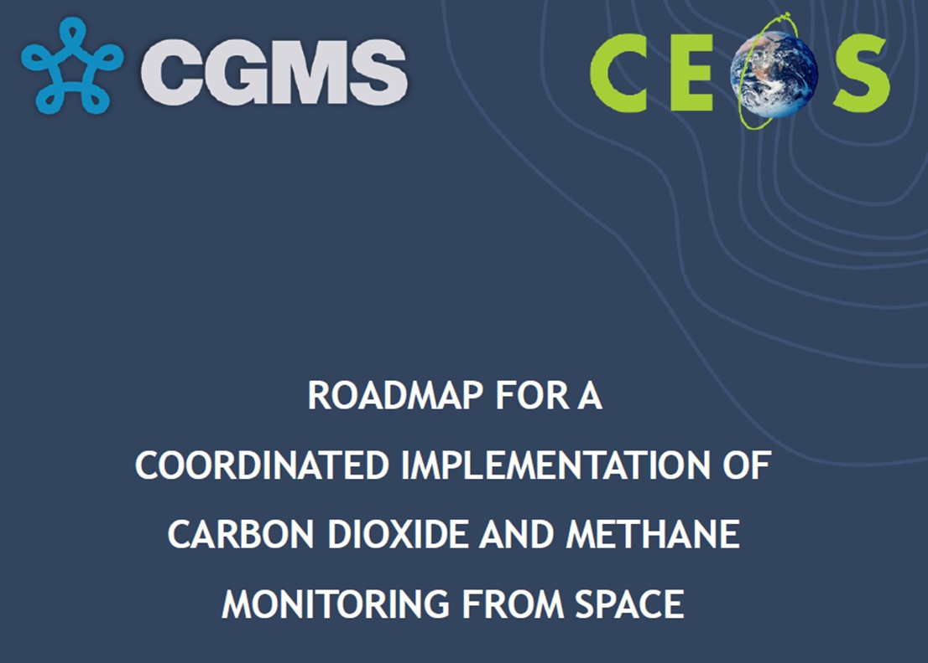
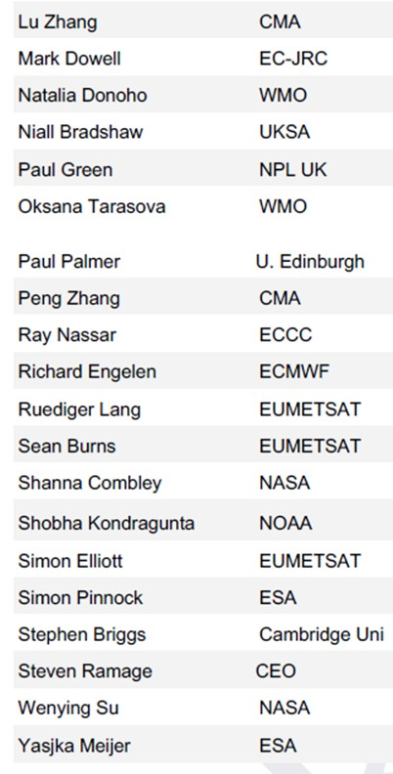
ROADMAP FOR A COORDINATED IMPLEMENTATION OF
CARBON DIOXIDE AND METHANE MONITORING FROM SPACE

Slide 3
ROADMAP FOR A COORDINATED IMPLEMENTATION OF
CARBON DIOXIDE AND METHANE MONITORING FROM SPACE
5c. Calibration and Level 1 Products
(1) Level 1 Product: time-ordered, geo-located, combined with radiometric, spectroscopic and geometric calibration data in geophysical units (e.g., W/m²/sr/um)
(2) Collected prior to launch referenced to commonly accepted reference standards and tracked throughout the mission lifetime by collecting dedicated calibration observations of radiometric transfer standards or other targets.
(3) Level 1(L1) generate the calibrated, geolocated products generated by these algorithms are called L1 products.
(4) Thermal radiances emitted from the Earth’s surface and atmosphere are calibrated frequently in space using onboard calibration standards to minimize the changes by thermal environments and expressed in Geophysical units (W/m²/sr/um) or radiance temperature (K).

Slide 4
ROADMAP FOR A COORDINATED IMPLEMENTATION OF
CARBON DIOXIDE AND METHANE MONITORING FROM SPACE
5c. Calibration and Level 1 Products
Traceability to commonly accepted reference standards, with known uncertainties quantified, I
multiple sensors to improve resolution or coverage or extend the data record beyond the operating lifetime of a single space-based sensor.
For public-sector missions, the pre-launch and on-orbit calibration methodology, standards, products and associated calibration algorithms ATBDs and refereed scientific publications.
Throughout its lifetime through active collaboration among the teams operating the first generation of dedicated GHG missions.
(1) Direct comparisons of radiometric standards and transfer standards used in pre-flight calibration experiments;
(2) Astronomical standards, including the Sun and Moon within the common spectra ranges for O₂, CO₂ and CH₄
(3) Near-simultaneous observations of vicarious calibration sights, such as Railroad Valley, Nevada
(4) Comparisons of near simultaneous observations of pseudo-invariant calibration sites (PICS)
(5) Exchange of reference solar spectra and gas absorption cross-section data .

Slide 5
ROADMAP FOR A COORDINATED IMPLEMENTATION OF
CARBON DIOXIDE AND METHANE MONITORING FROM SPACE
5c. Calibration and Level 1 Products
Initially, through bi-lateral then multilateral agreements among specific missions, More recently, key activities within the CEOS Working group on Calibration and Validation Atmospheric Composition Subgroup (WGCV/ACSG) and the WMO/CGMS Global Space-based Inter-Calibration System (GSICS) Visible and Near Infrared Subgroup (VIS/NIR) subgroup and tracked by the GHG-TT
Transitions from research to operations, interoperability of L1 products become important
(1) Identify and encourage sharing pre-launch radiometric, spectroscopic and geometric standards and methodology for their use in calibrating GHG sensors
(2) Spectrally dependent radiometric and spectro-polarimetric standards for the Moon
(3) Establish best practices for in-flight solar and lunar calibrations for GHG sensors
(4) Routine vicarious calibration campaigns
(5) Define common metadata requirements for L1 products to facilitate interoperability.

Slide 6

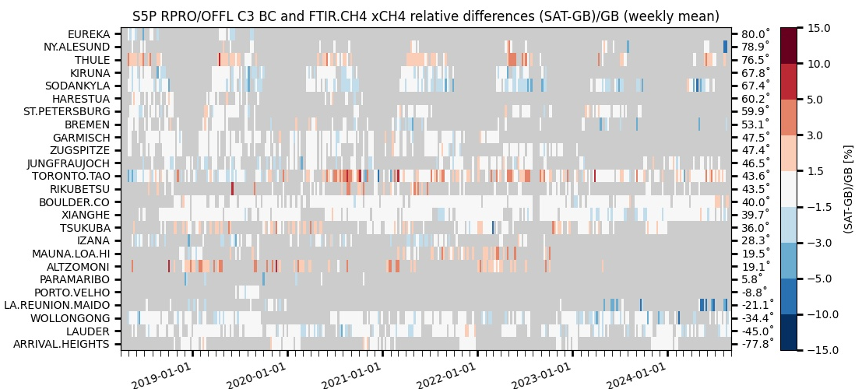


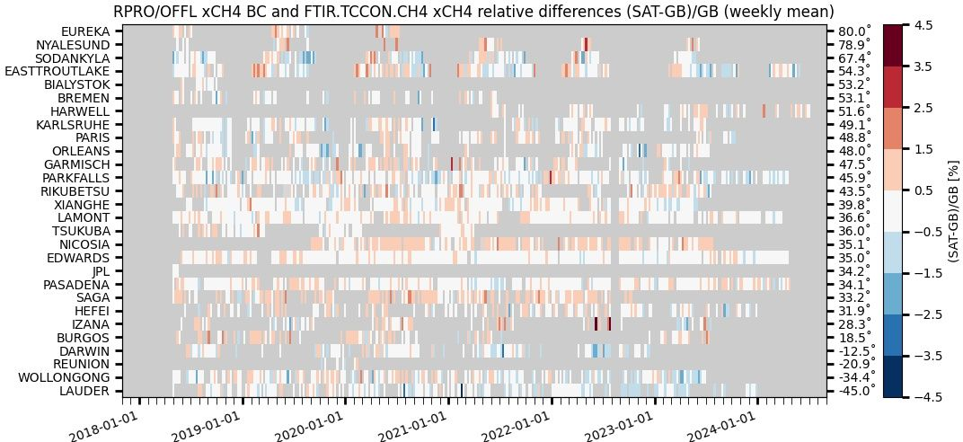

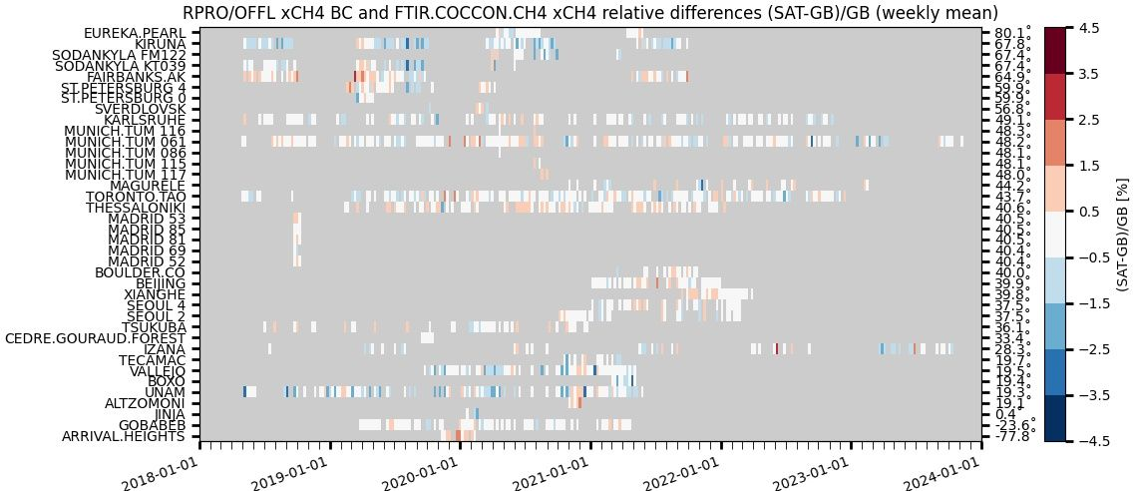





GHG Cal/Val Networks Updates
CO₂/CH₄ Roadmap CV-6: Operational reporting on the quality of space-borne GHG data
ESA/Copernicus ATM-MPC Sentinel-5P TROPOMI: Pathfinder for CH₄ and CO operational validation fed by the 3 GHG column/profile monitoring networks
    NDACC FTIR : automated validation channel in ATM-MPC Automated Validation Server (https://mpc-vdaf-server.tropomi.eu).
      Validation protocols based on published experience with HALOE, MOPITT, SCIAMACHY, MIPAS, ACE-FTS, IASI, GOSAT…
    TCCON FTIR : manual validation channel in ATM-MPC
    COCCON FTIR : manual validation channel in ATM-MPC, EVDC data collection and automation in progress (ESA contract 2023-2027)
S5P TROPOMI CH4 & CO validation updated permanently vs. NDACC FTIRs
and monthly – when and where data available – vs. TCCON & COCCON FTIRs.
Quarterly validation reports available on http://mpc-vdaf.tropomi.eu
CH₄ images courtesy M.K. Sha (BIRA-IASB)
ATM-MPC review October 2024
Automated collection of observations from 17
NDACC FTIR stations
through EVDC =>
automated production of S5P Quality Indicators
TCCON GGG2020 data
released 26 April 2022
No/limited data submitted
between early 2021 and the
release of new data version
GGG2020
Collection of permanent
and campaign based
observations

Slide 7
GHG Cal/Val Networks Updates
Cal/Val capabilities of TCCON/NDACC/COCCON networks and challenges updated in CEOS GHG constellation roadmap v2
Harmonized data processing and infrastructures
  Embedding of TCCON-Europe in Research Infrastructure ICOS will be discussed at ICOS Foresight Days in 2024/11
  New version of COCCON software released (PROFFAST2.4), reprocessing of all stations in progress
  Coordinated effort to validate GOSAT/OCO/S5P with COCCON v1 full network
  EUMETSAT CO2M Cal/Val ITT incl. COCCON, NDACC & TCCON processing
New Cal/Val planning and ground-based network design tool https://co2m.aeronomie.be/ in support to CO2M, extendable to related missions

Slide 8
GHG Cal/Val Networks Update
New stations / instrument deployments
  Canadian High Arctic Research Station (CHARS) operational since 2024/09; Porto Velho (Brazil) and Yucatán Peninsula have started measurements
  New planned sites: 2 new FTIR sites in India (2025-26) supported by BIRA-IASB and NIES; additional proposals in the make
  Number of (LR) spectrometers growing every year
  Permanent installations of LR spectrometers in array (by groups from: TUM - Germany, UoT + EC – Canada, French groups, AEMET – Spain, UK); EU H2020 deployment of three FTIRs in DRCongo and Republic of Congo
Campaigns
  ESA SVANTE: 4-year support for several IR and UV-Vis campaign dedicated to S5P validation

Slide 9
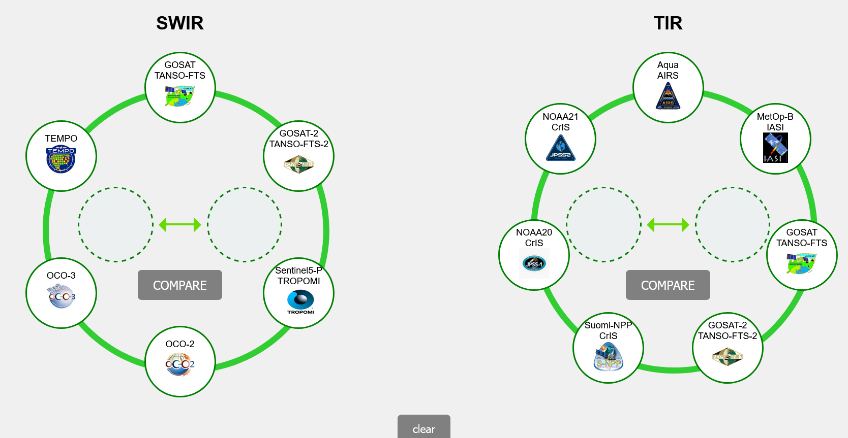
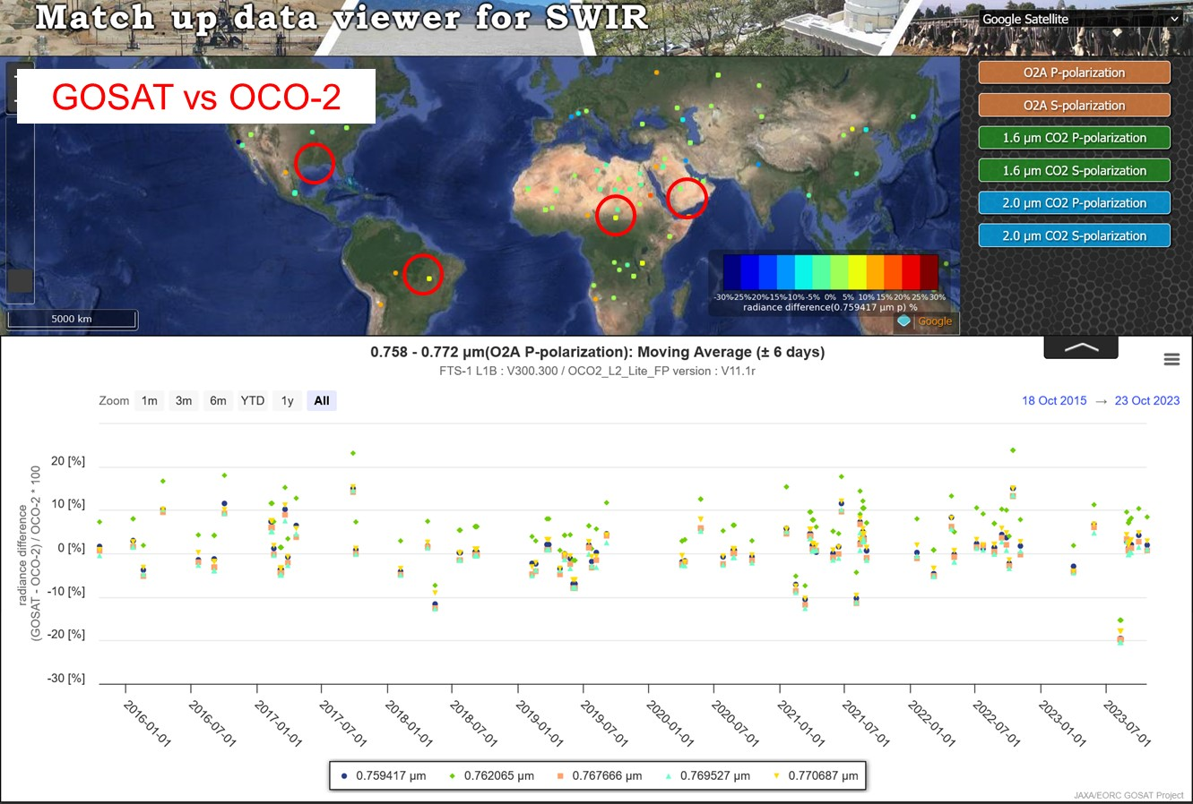
Matchup data set for SWIR TIR GHG sensors
Calibrated radiance and retrieval results
SWIR
Calibrated radiance
XCO2, XCH4, SIF, AOT
TIR
Calibrated radiance
Brightness temperature
GOSAT vs OCO-2 radiance spectra
Degradation corrected
Cloud screened (successful L2)
Most of the data agree within 10% for all three bans except for over forest.
Test website become available next month.

Slide 10
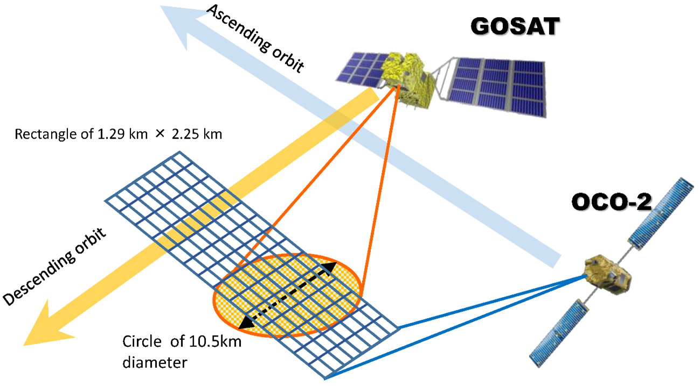
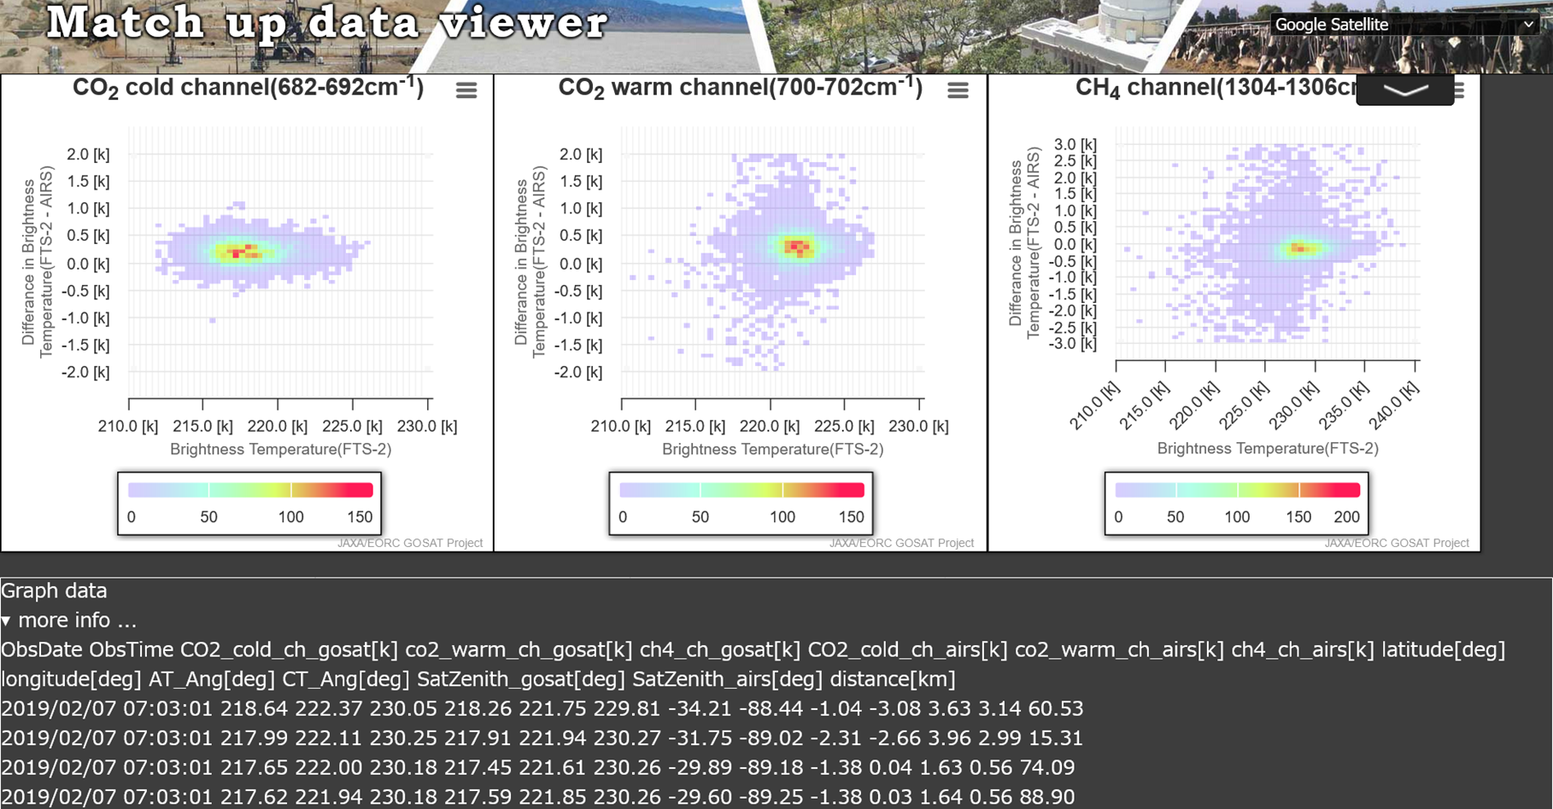
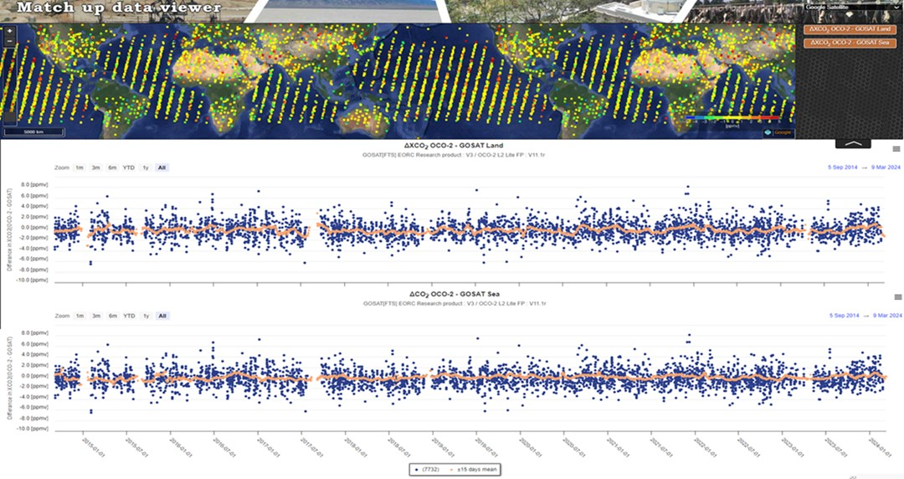
Match dataset
Example GOSAT-AIRS, GOSAT-OCO-2
Both SNO (nadir) and SONO (off-nadir GOSAT forward vs AIRS cross track)
GOSAT-OCO-2 XCO2 difference at match-up points: land and ocean

Slide 11
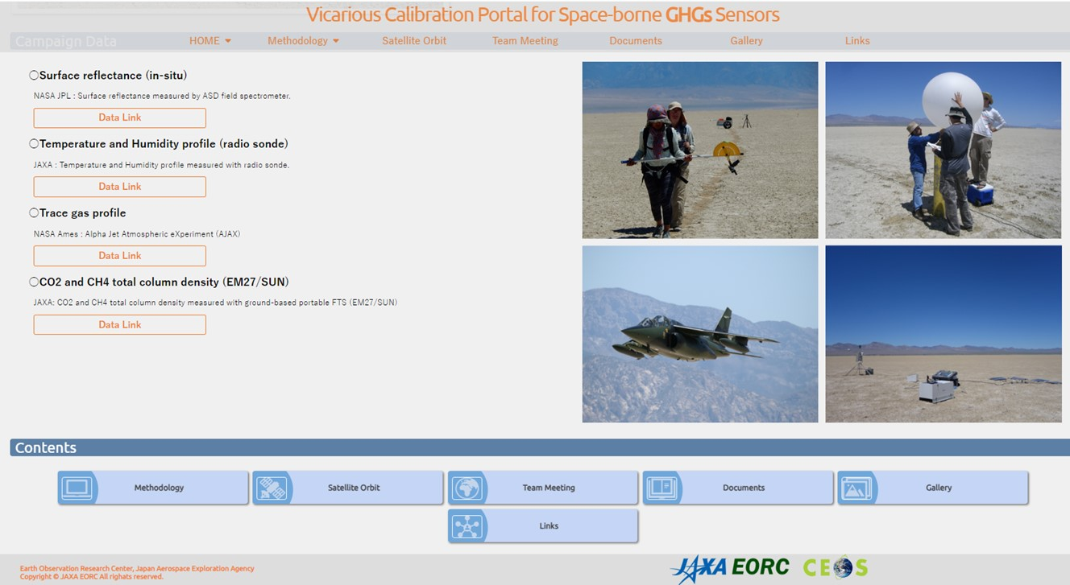
GHG Cal Val Site
Long term & high spectral resolution data will be available from GHG Cal site
All the CAL/VAL data of 16-year campaign are available from this portal.
Radiometric calibration results for 6 instruments: satellite measured vs. calculated radiance at TOA using campaign data
Recommendation: less polarized geometry tec.

Slide 12


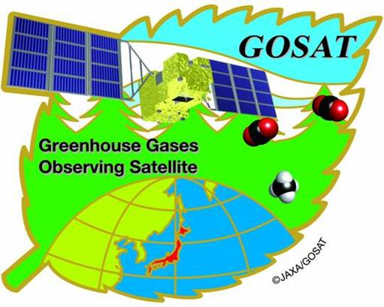


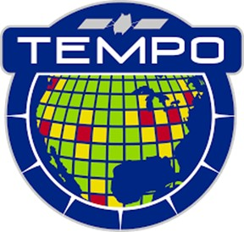
16-year multi-sensor VCAL results
Joint RRV summer campaign since 2009*
* All the surface, radiosonde, aircraft and EM27 data are available from VCAL portal
**IFOV-averaged and BRDF for smaller footprint instruments
Use center and surrounding area
*** Use common database: TSIS solar spectra, line parameters
****Select polarization in-sensitive geometry (PS<2%)
High sun In case of lower sun, select backward geometry
IFOV averaged and BRDF corrected surface albedo using MODIS data **
Common forward model (present LIDORT) ***
Forward TOA radiance vs in-orbit measured radiance using prelaunch calibration or degradation correction ****

Slide 13
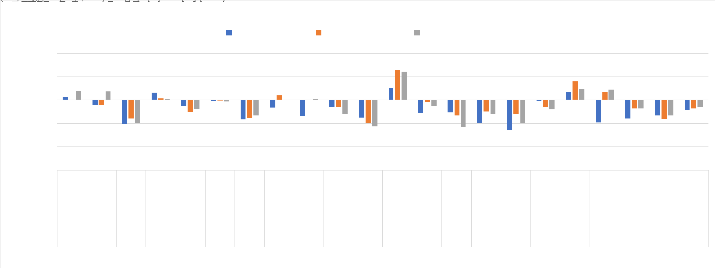
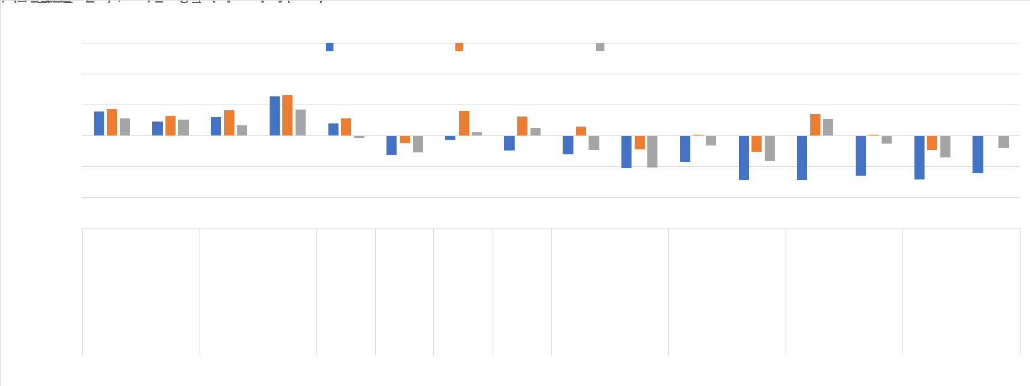
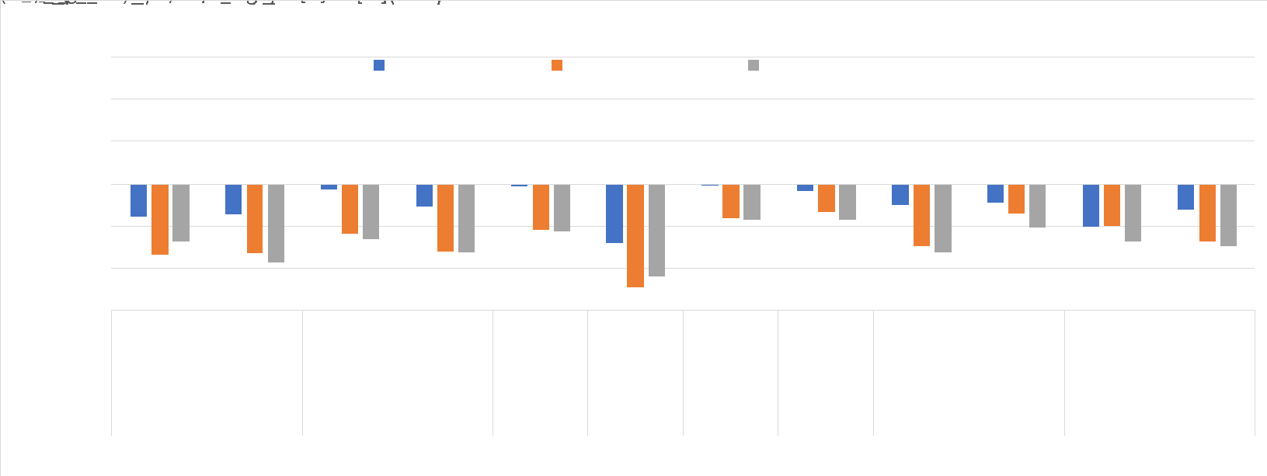
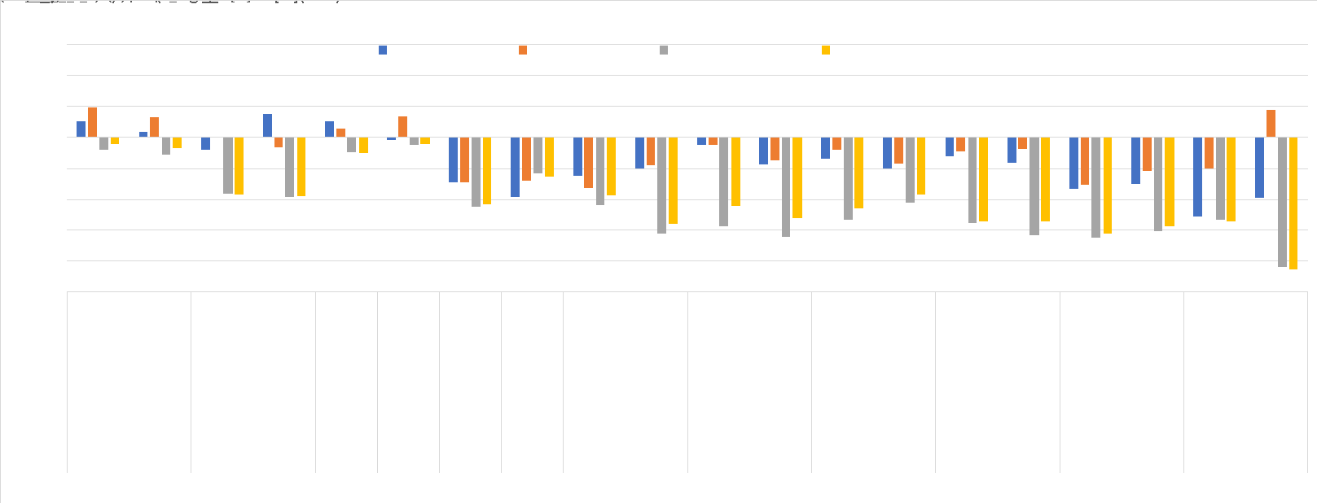
Forward Calculations for Multiple Sensors Using LIDORT Since 2019
The Percentage of LIDORT-L1B Residuals to the L1B Spectral Baseline
Smaller than +/- 7% (vicarious calibration requirement) and most of them are smaller than 5%
Apply long-term RRV campaign data to calibration of multiple sensors. Use the common forward model LIDORT
Use MODIS BRDF model(MCD43A1) for observation geometry and IFOV corrections.

Slide 14
Methane Best Practices – Summary
Emissions based on Public and New Space observations of CO2 and CH4 are increasingly being used for regulation (in addition to science) and are likely needed for a functioning reporting obligations and carbon market
We need a set of best practices for facility scale emissions so that producers of these data know what is expected by the community and (new) users know how the data should be generated and reported so that it can be trusted
Emissions estimates at both scales ideally are traceable to a calibration standard, are reproducible, and are well validated with ground truthing

Slide 15
Methane Best Practices – Next Steps
Continued support of effort to define best practices for quantifying and reporting emissions - Ideally this effort is handed off to an ”operational” focused organization after agreement between vested parties
Identified need to extend a Best Practices to Area Flux Mappers to better support the Global Stock Take and Global Methane Pledge as well as diffuse point sources and other sectors.

