Slide 1
SRIX4Veg & SR Validation Protocol with UAVs
Valentina Boccia (ESA), Cindy Ong (CSIRO)
& SRIX4Veg-I / –II Teams and Participants
CEOS-WGCV Plenary #54
16th October 2024

Slide 2




















Notes:
Plug for all the institutes involved

Slide 3

FRM4Veg – Fiducial Reference Measurements for Vegetation
FRM4Veg is an ESA-funded project to support the validation of key vegetation biophysical variables measured by satellites: surface reflectance (SR), fraction of absorbed PAR (fAPAR) and canopy chlorophyll content (CCC).
Fiducial Reference Measurements have the following qualities:
  Documented SI traceability (or conform to appropriate international community standards)
  Independent from the satellite geophysical retrieval process
  Accompanied by an uncertainty budget for all instruments and derived measurements
  Adhere to community-agreed, published and openly-available measurement protocols/ procedures and management practices
  Accessible to other researchers allowing independent verification of processing systems
Notes:
Context around where SRIX4Veg came from…

Slide 4
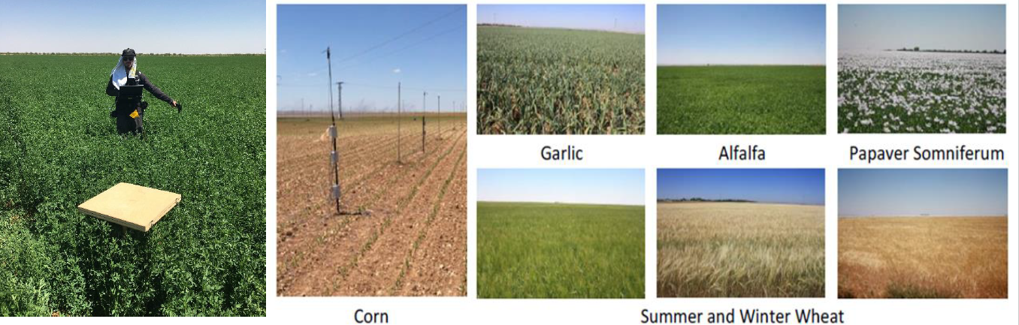

SRIX4Veg Premise: Why UAVs?
Surface Reflectance measurements have been traditionally made with hand-held instruments…
Combination of
field spectroscopy
with UAVs
UAV-mounted instruments are lighter, cheaper and easier to use
Growing interest in UAV-based hyperspectral systems
Advantages
Cover a greater area coincident with satellite overpass
Remove site disturbances
Measure inaccessible sites
Measurements at much greater height
Compliment permanent infrastructure
Significant interest in UAV-based hyperspectral instruments
Expected to grow as instruments get lighter, cheaper and easier to use
Notes:
The use of hand-held instruments for the same purpose has many limitations, such as: difficulty in collecting top-of-canopy spectral measurements over high forest trees or in areas that are difficult to access, inability to cover large spatial areas in a short time, disturbance of the field site (e.g. trampling) and limited sampling.
UAVs: the combination of field spectroscopy with UAVs can improve the understanding and analysis of different phenomena and upscaling from in-field to airborne and satellite measurements.
Advantages
Possibility to cover large spatial areas coincident with the satellite overpass
Limit errors in moving instruments between locations, as well as characterising the spatial distribution of the parameters in heterogeneous areas.
Allowing for measurements to be made at a much greater height meaning that small FOV can be used because they can sample a sufficient area
Angular filtering of the output image means that a single acquisition can yield a range of angular measurements.
Reflectance measured by the satellite is coming from a small FOV. UAV-mounted sensors offer a way of getting closer to the satellite estimate.
But important to recognise the complexities:
more complex than point spectrometer (uniformity, correlation when averaging, etc.)
limited by battery life
potentially not as good (due to weight limit leading to difficult design decisions)

Slide 5
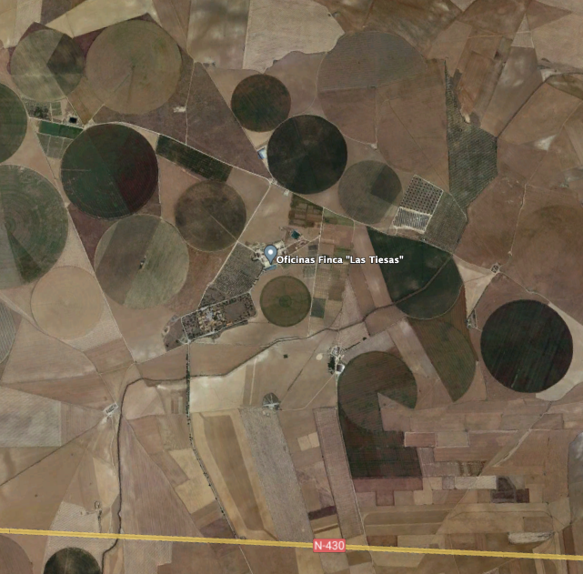
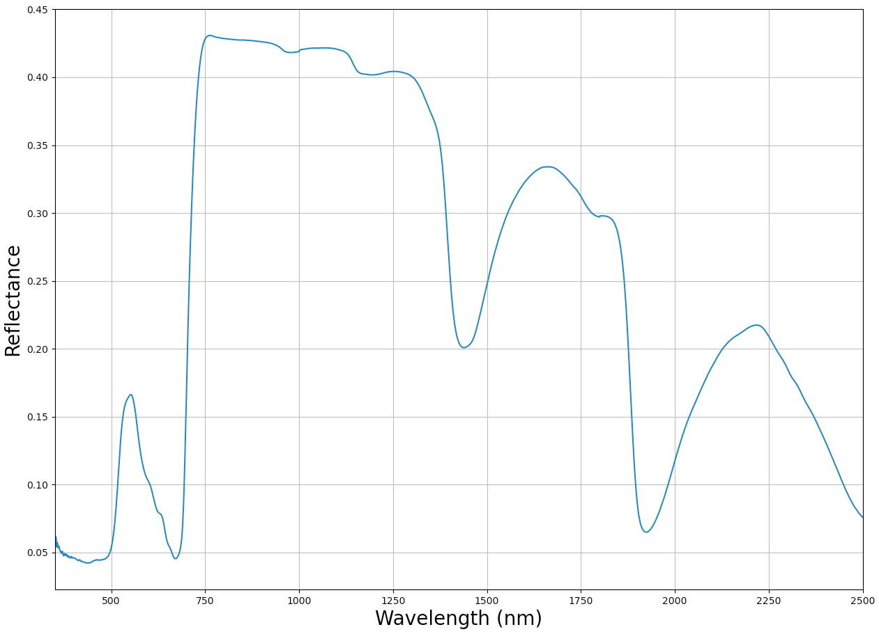
SRIX4Veg Premise: Why Surface Reflectance over Vegetation?
Dynamic in:
  Time
  Space
  Spectrally
  Angularly
Several biophysical satellite products derived for vegetation depend on SR
Notes:
Why it’s important to do over vegetated surfaces

Slide 6
SRIX4Veg Premise: How?
Protocols around this are yet to be developed and lots of people are developing different things (some more systematically than others).
The idea of SRIX4Veg was to assess the variability associated with different teams conducting the same validation work.
Then move towards a community-agreed Protocol to reduce this variability.
Two experiments:
SR validation data collected by participants following a pre-defined initial protocol (developed by the SRIX4Veg team, ESA, CSIRO, USGS, DLR, ASI and GA)
SR validation data collected as the participants would do it given some pre-defined information
Notes:
We gave the participants a flight plan for experiment 1

Slide 7
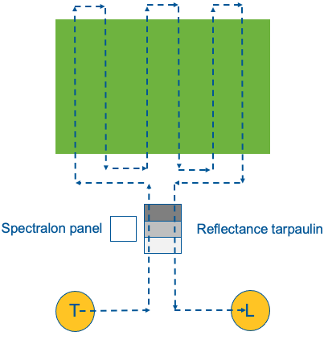
SRIX4Veg - Info and Flight Scheduling
Information given to participants about the mock satellite overpass:
Spatial resolution
Spectral bands and response function
Orbit inclination
Viewing geometry
Spatial location and extent of each of the satellite pixels on the ground
Reflectance quantity
Flight scheduling for comparability:
Each experiment will be a round-robin (everyone will do a flight back-to-back with everyone else) (57 flights completed)
Only the pairs will be compared
Only one UAV in the air at one time
Notes:
This is the information we gave to the participants about the mock satellite overpass – this was used by them to plan their response to experiment 2.
The analysis of the differences is only based on each pair that was made so that environmental (illumination, etc.) should be kept to a minimum.

Slide 8
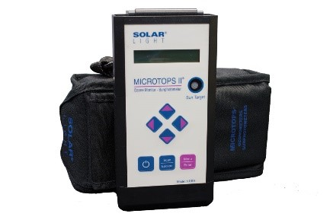
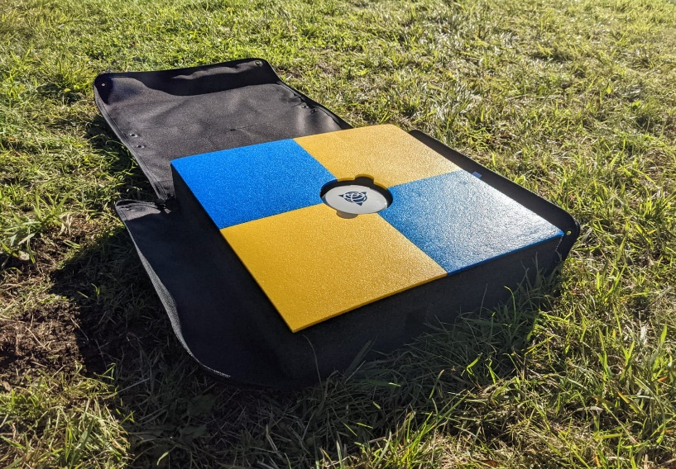
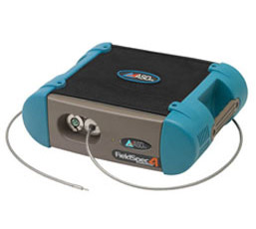
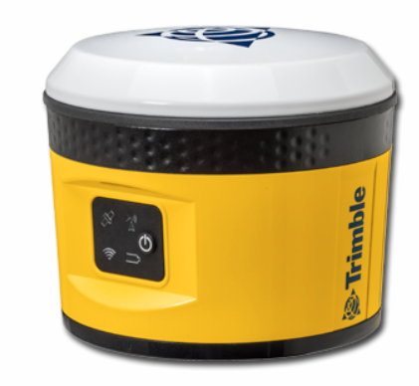
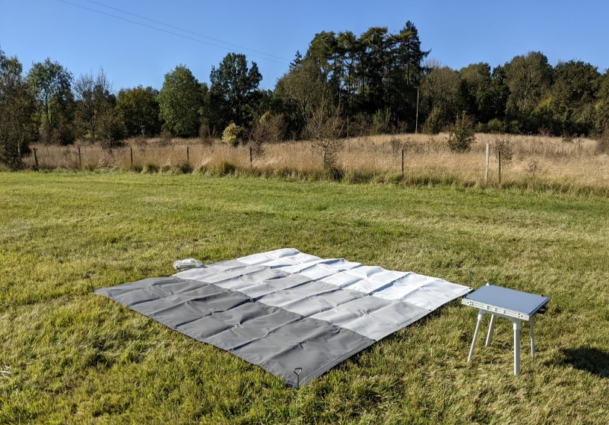
SRIX4Veg - On-ground Instruments & Measurements
Solar Light Company Microtops II
(measurement of AOT)
Trimble base station
(Differential GPS base station)
ASD FieldSpec 4
(measurements of spectralon panel)
Tarpaulin
+
Spectralon Panel
ASD measurements:
Spectralon > Light > Middle > Dark > Spectralon
5 spectrums per location @ 4 locations
Notes:
Basic setup with the instruments and calibration tarpaulins

Slide 9
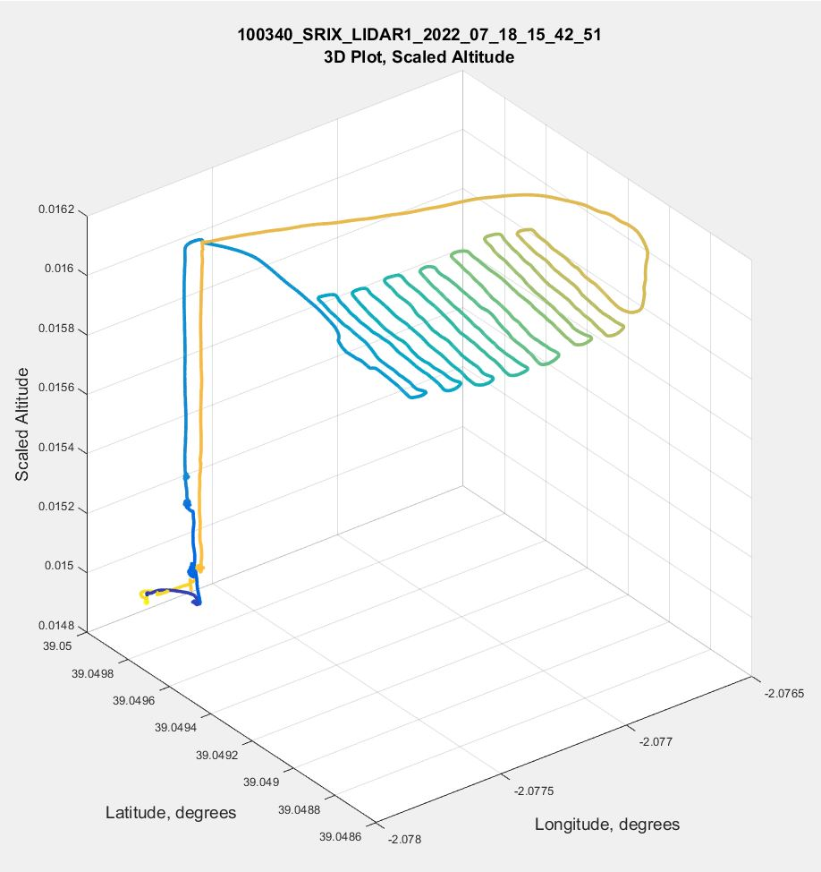
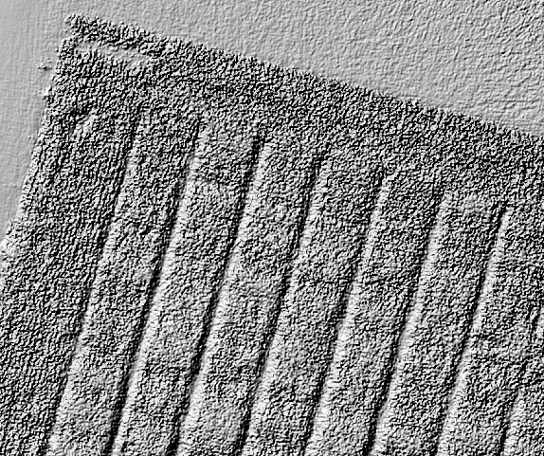
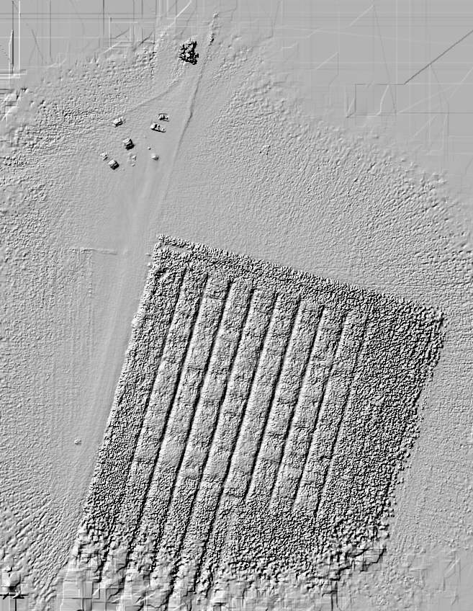
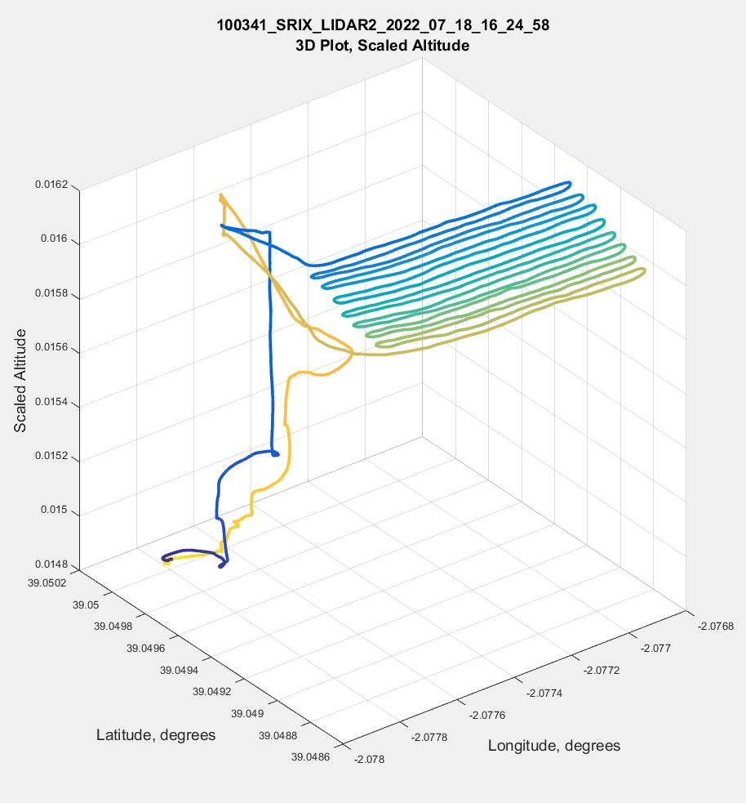
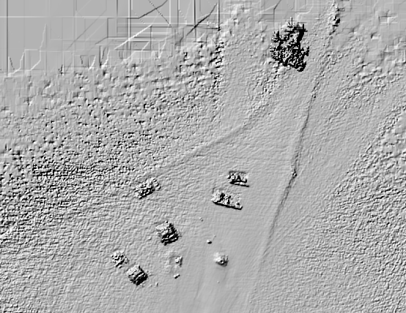
SRIX4Veg - Data processing (IMU/GPS and DEM)
GPS data for a fixed location was provided to all participants throughout the campaign along with a DEM – for consistency
Notes:
GPS data for a fixed location was provided to all participants throughout the campaign along with a DEM – for consistency

Slide 10
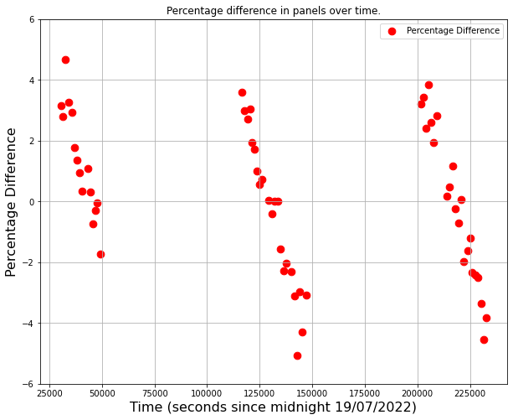
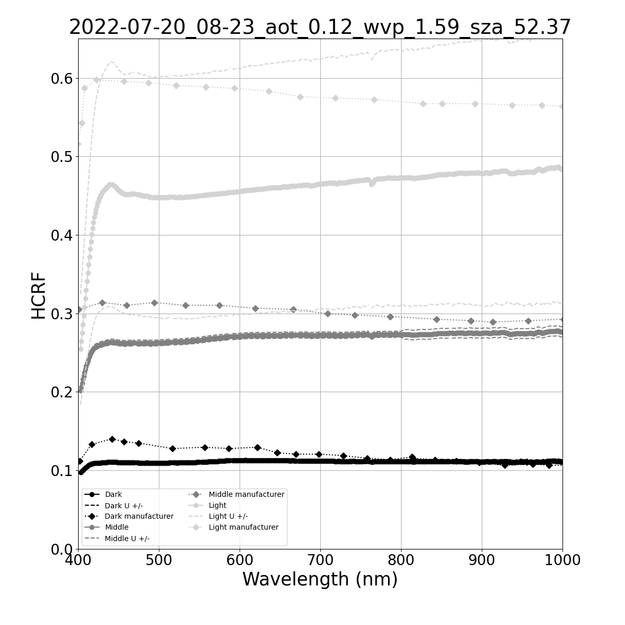
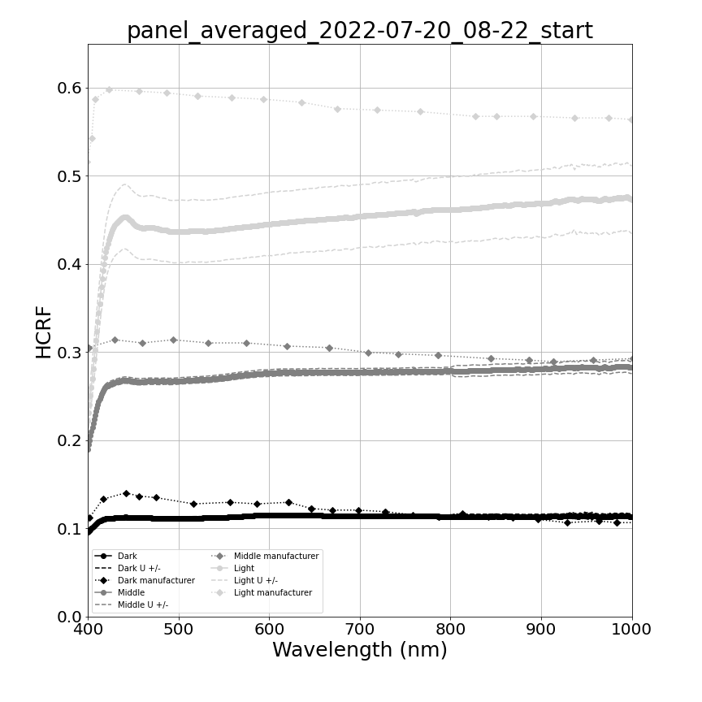
SRIX4Veg - Data processing (reflectance)
ASD measurements taken before and after each flight, so to allow averages and redundancy to be taken
  - Time difference of +/- 30 minutes roughly
Account for changes in illumination conditions
Notes:
Tarpaulin measurements were made before and after each flight which allowed for averages to be taken and redundancy (if needed)

Slide 11
SRIX4Veg - Comparison of Results (1/2)
Assess the impact of user decisions on the creation of surface reflectance validation datasets from UAVs
  Instrument type
  Flight design
  Post-processing
Determine if a common protocol improves consistency between users
Comparison Objective
Not all data received
Some was not useable
As a result, criteria for pairs was expanded to either side, e.g.
A B C D F G
A B C D F G
In total, 5 of 7 participants’ data is included in this analysis
Comparison Caveats:
Original
Expanded
Notes:
This meant that the maximum time difference was around 40 mins

Slide 12
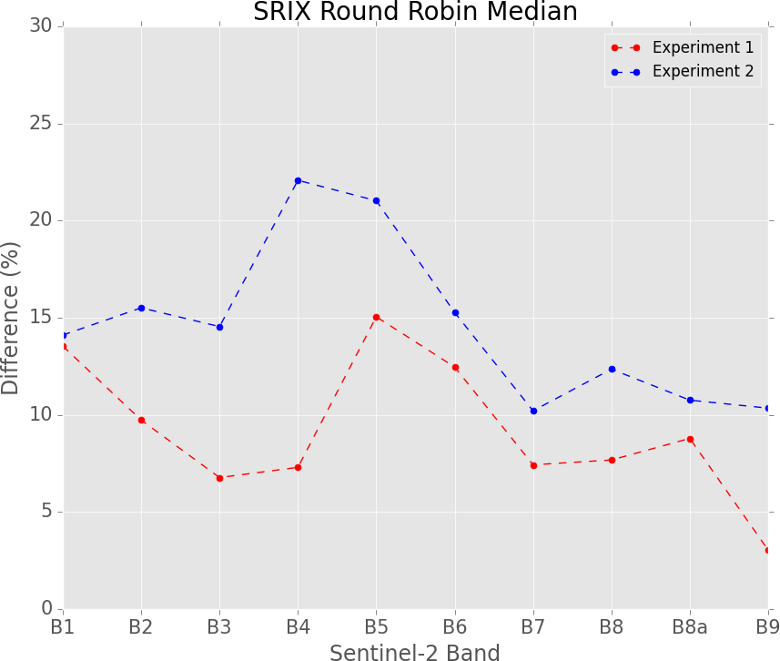
SRIX4Veg - Comparison of Results (2/2)
We looked at the absolute pairwise differences
Participant names are anonymised
Approximately 18/14 pairs in total (some variation based on spectral coverage)
Band-based assessment
Band-wise median differences for the whole exercise are shown, clearly showing that experiment 1 (defined protocol) had lower differences. No uncertainties present because none were provided back to us.
Notes:
Band wise median differences for the whole exercise are shown, clearly showing that experiment 1 (defined protocol) had lower differences. No uncertainties present because none were provided back to us.

Slide 13
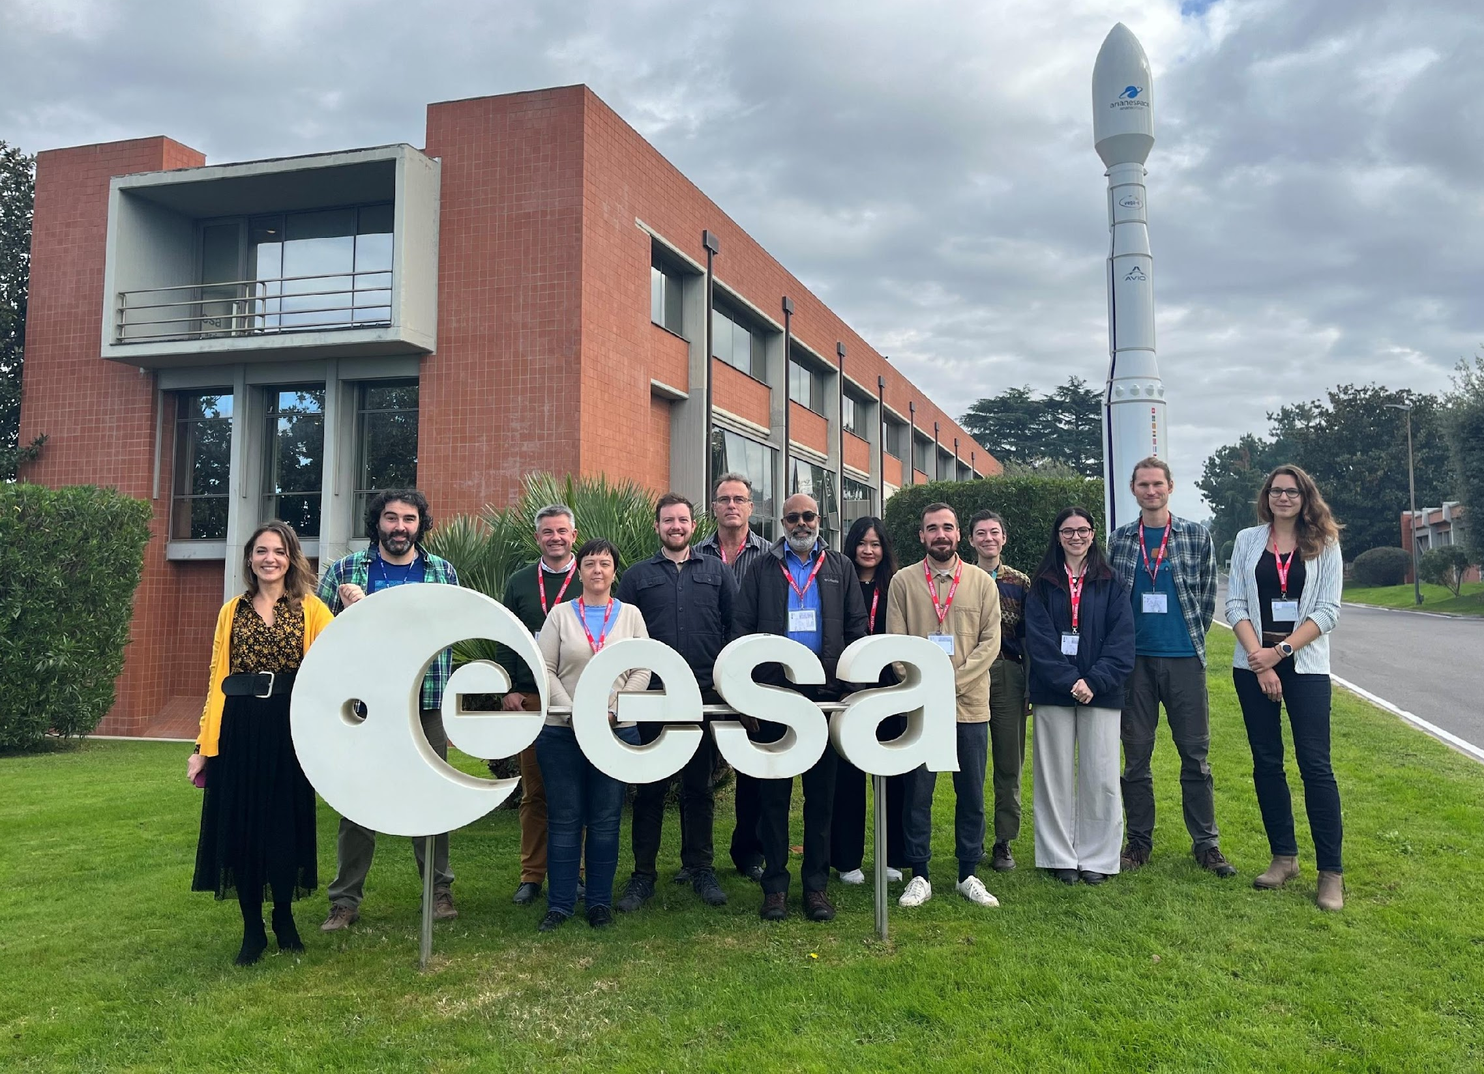
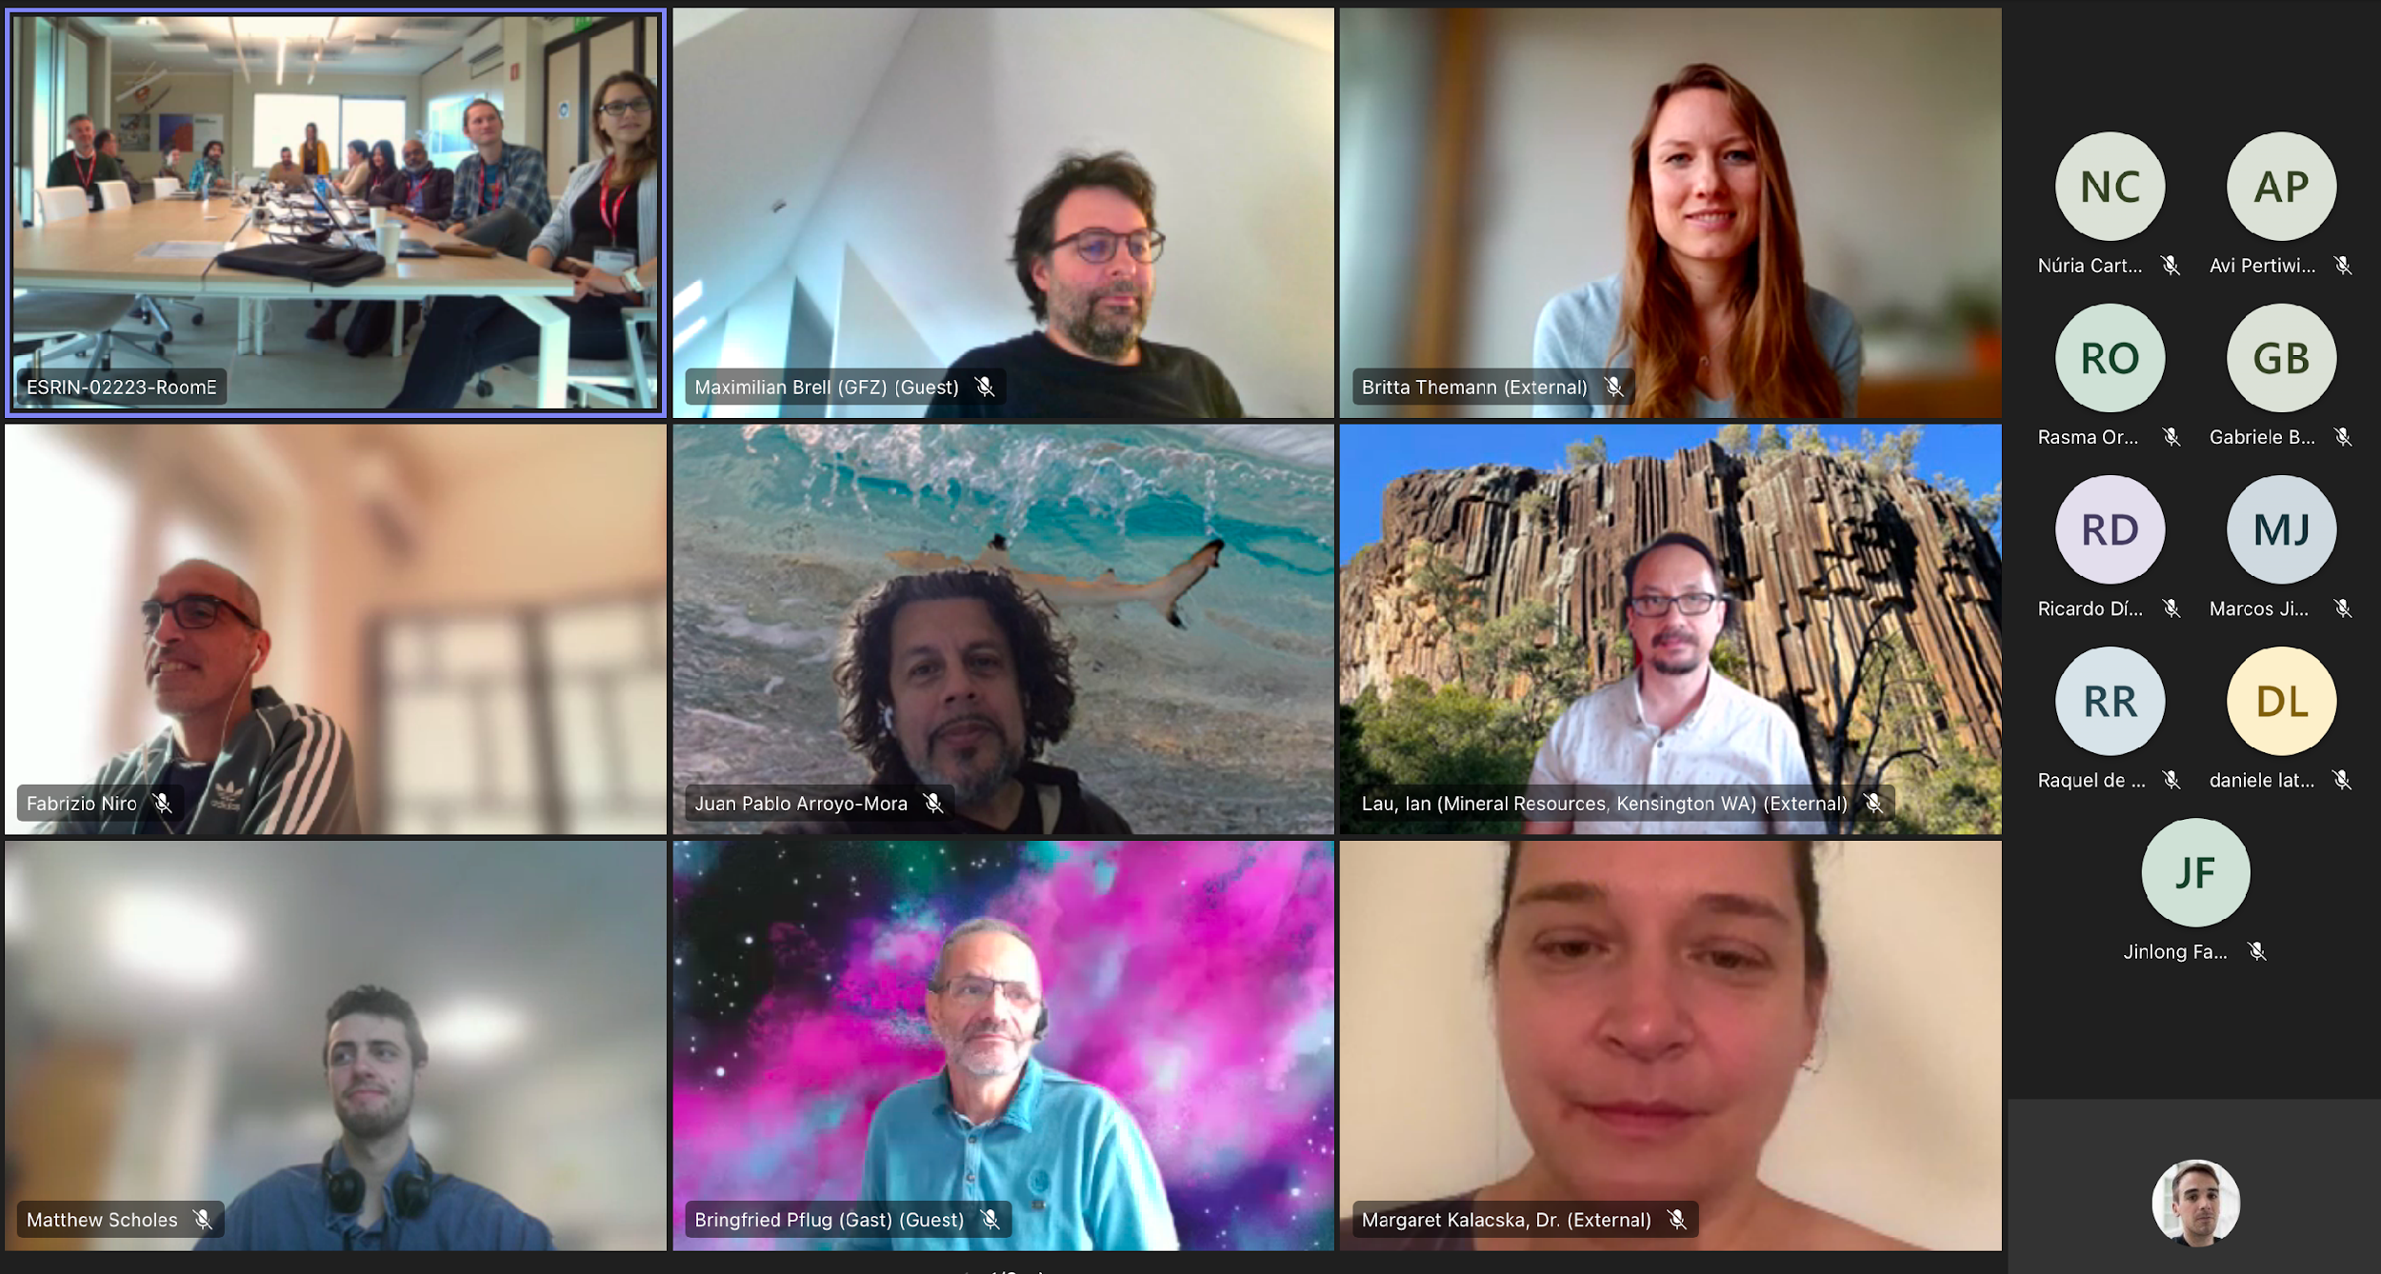
SRIX4Veg - Outcome
Results supported the need for a protocol
Reduction in median difference can be as high as 15%
Post-campaign workshop held at ESA-ESRIN (and hybrid) in November 2023
Participants attended to discuss results, challenges, successes, and to design and allocate protocol work. That helped to shape the contents and structure of the protocol.

Slide 14
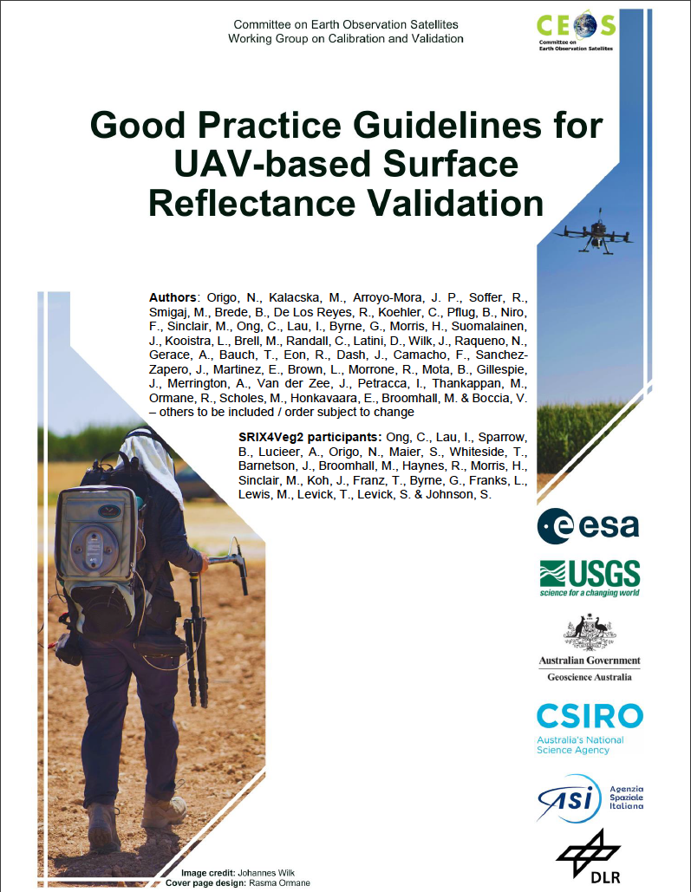
Protocol is here !
After successful field campaigns and multi-institution collaborative effort, a first draft of the protocol was presented.
A full Protocol review by CEOS was requested.

Slide 15
Protocol: Important Considerations
The Protocol is designed for surface reflectance validation datasets with UAVs (not general surface reflectance measurements).
Document is structured into a condensed version (i.e. quick reference; chapter 5) and long-version (chapter 6).
The recommendations are based on feedback from the November 2023 SRIX4Veg-I workshop and the two SRIX4Veg-I and -II campaigns.
Intention is that the Protocol is sensor-agnostic.
The Protocol aims to remain adaptable to future scientific improvements.
Synthesised set of recommendations pointing to more detailed explanation in other parts of the document.

Slide 16
Protocol: Requested Changes (1/2)
Grouping of recommendations by category (multiple)
Example of uncertainty budget (IVOS) and how to assess/reduce it (USGS)
Comment on straylight characterisation of imagers (IVOS)
Include more information on geo-correction (USGS)
More real-world examples (USGS)
Recommendations on UAV flight timing (LPV)
Prioritisation of recommendations (LPV)
Convert some recommendations to requirements when required to achieve CEOS-FRM (IVOS)

Slide 17
Protocol: Requested Changes (2/2)
Explanation of spectral data format recommendation (USGS)
More emphasis on trade-offs and regulation issues (USGS)
Changes to be completed by the 11th November 2024
To allow full author contribution to changes

Slide 18
Citations and Acknowledgements
Thanks to all the participants!
Arroyo-Mora, J. Pablo; Kalacska, Margaret; Soffer, Raymond; Lucanus, Oliver; Løke, Trond; Hernandez, Julio; Adamek, Dennis, 2023, "SRIX4VEG: Surface Reflectance Intercomparison Exercise for Vegetation - NRC, ARSL, NEO", https://doi.org/10.5683/SP3/WXLSK3, Borealis, V1

Slide 19
Thank
you
Notes:
Plug for all the institutes involved

Slide 20
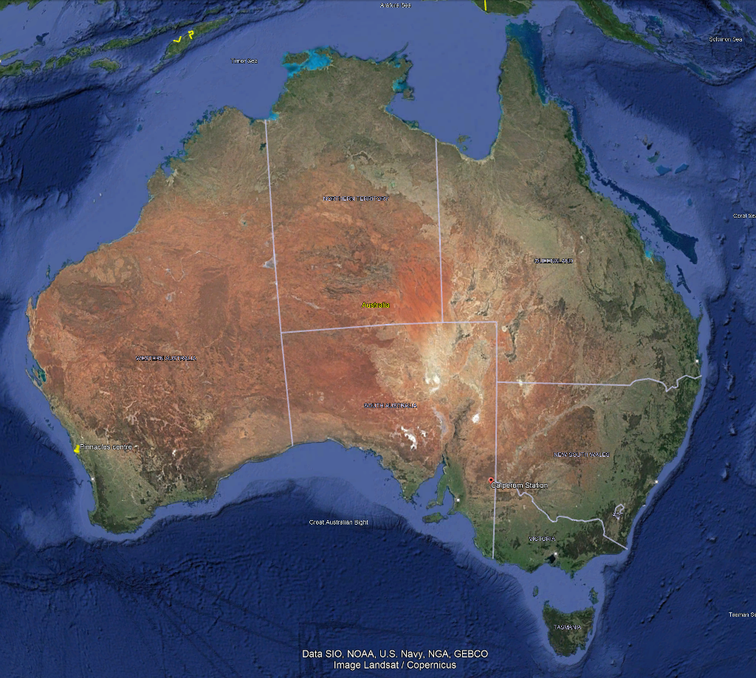
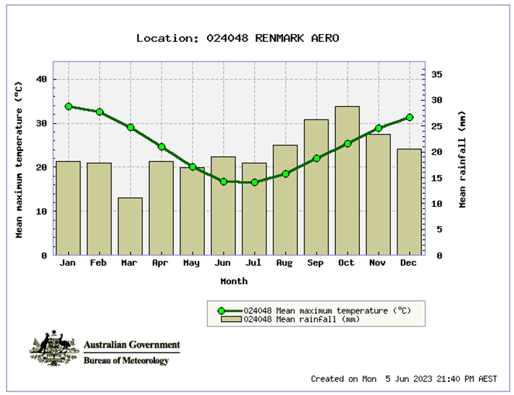
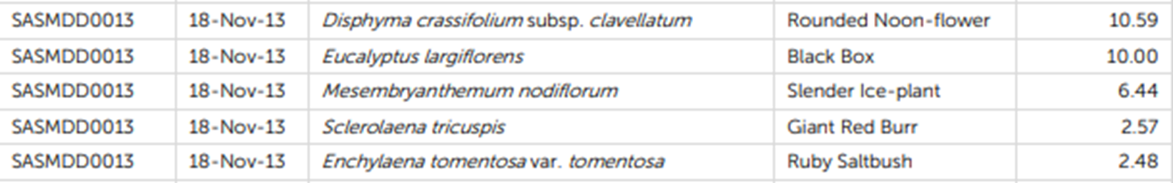

SRIX4Veg-II
Image credit: TERN
Site
TERN/LPV supersite Calperum (https://www.tern.org.au/tern-observatory/tern-ecosystem-processes/calperum-mallee-supersite/, https://www.tern.org.au/site-of-the-month-calperum-mallee-supersite/) across 9000 km² ~270 km E of Adelaide, close to Renmark;
13 years measuring fundamental carbon, water, energy and nutrient pools and fluxes;
                One eddy-covariance flux tower
                Soil water content, temperature and electrical conductivity probes
                Phenocams
                Groundwater bores with nested piezometers
                18 x 1 ha Surveillance monitoring plots
                Airborne LiDAR and hyperspectral imagery calibrated using SLATS star transects, leaf sampling, tree structure and LAI measurements
Mallee semi-arid ecosystem, fringing the River Murray floodplains on Calperum Station, South Australia;
Comprises undulating mallee woodlands and riverine vegetation alongside the river.
Calperum

Slide 21
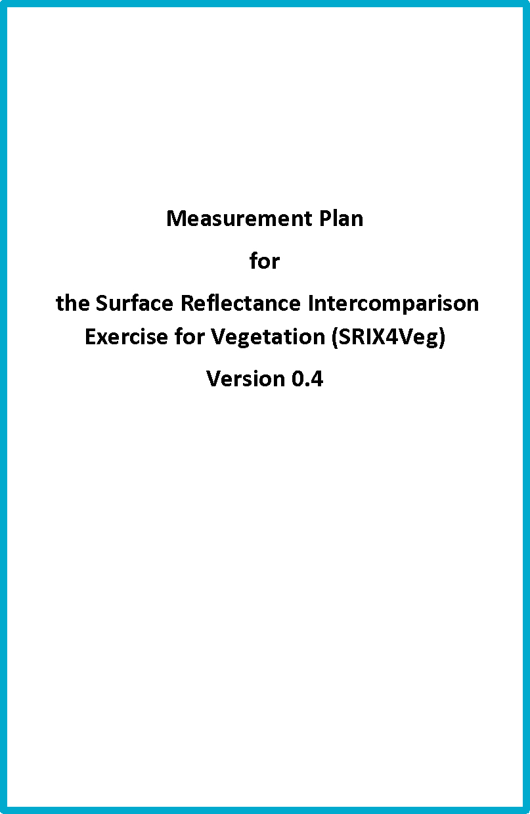
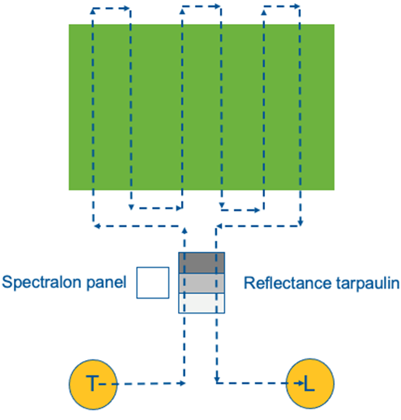
Intercomparison exercise
Followed similar template to SRIX4Veg-I
  Pre-fieldwork workshop for all participants
  Measurement plan provided
  Designed experiment based on a mock satellite (EnMAP) validation campaign

Slide 22
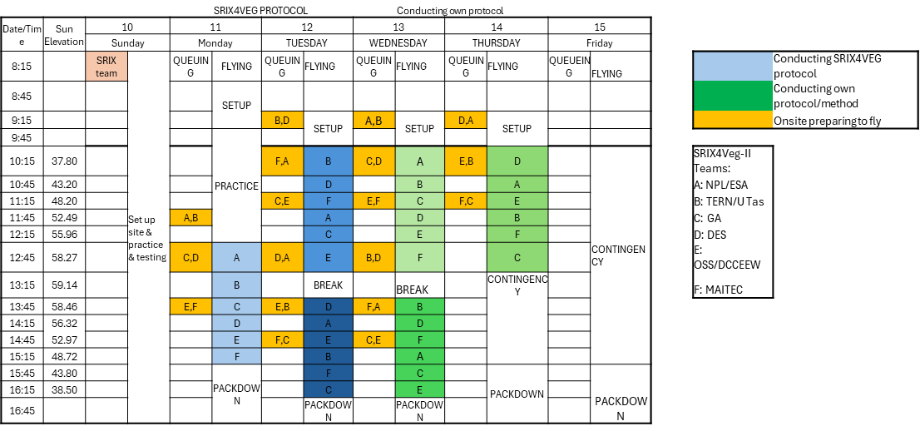
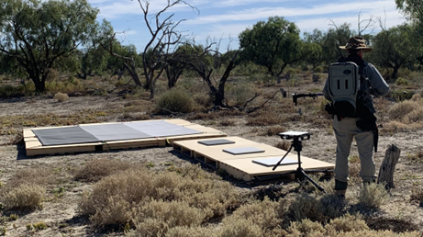
Inter-comparison exercise
Followed similar template to SRIX4Veg-I
  A standardised flight plan and schedule
  Supporting field instruments and measurements provided

Slide 23
Results
6 organisations
  Research institutes, universities, SME, local and state governments
Weather was less than ideal but 36 flights completed
Flight data and supporting field data are being systematically stored in TERN’s QRIS cloud (a large-scale cloud computing and data storage service)
Analysis of data are currently underway

Slide 24
Post field work workshop
Held at the Advancing Earth Observation Forum, 9 September 2024
Time | Agenda | Speaker
9:00-9:10 | Welcome and introductions | Cindy Ong
9:10-9:30 | Introduction, background, rationale for SRIX4Veg and experimental design | Niall Origo/Cindy Ong
9:30-9:50 | Background on the Calperum Research Station and remote sensing R&D conducted there | Ben Sparrow
9:50-10:00 | Ground Measurements | Ian Lau
Experiences and progress to date and future plans from participating teams
10:00-10:20 | Experiences and progress to date and future plans from participating teams from the TERN/UTAS team | Arko Lucieer
10:20-10:50 | MORNING TEA
10:50-11:10 | Experiences and progress to date and future plans from participating teams from the GA team | Mark Broomhall
11:10-11:30 | Experiences and progress to date and future plans from participating teams from the OSS team | Tim Whiteside
11:30-11:50 | Experiences and progress to date and future plans from participating teams from the MaiTec Team | Stefan Maier
11:50-12:10 | Experiences and progress to date and future plans from participating teams from the DES Team | Jason Barnetson
12:10-12:30 | Where to from here and wrap up | All

Slide 25
Post field work workshop
25+ attendees
Inter-comparison participants reported on progress
  Different levels depending on their foundational experience and resources
Future work and research areas
  Comparison of atmospheric correction parameters and techniques
  Comparison of irradiance measurements from various ground instrumentation
  Improved data extraction software (able to pull out time stamps/GPS time)
  SDK of ASD for improved data collection (variation of gains/offsets – triplets of varying values) (Labview?)
  Analyse effects of flight height for atmospheric absorption/parameters in atmospheric correction.
  Imagers vs profiler data comparison
  Determine best path for communication of results – reports? Data sharing?

Slide 26

Thank you

