Slide 1

WGCV54
Pre-flight workshop
Nigel Fox, UKSA/NPL
Xiaoxiong Xiong, NASA
Agenda Item:2.4
WGCV-54, USGS, Sioux Falls USA
15th - 18th Oct 2024

Slide 2
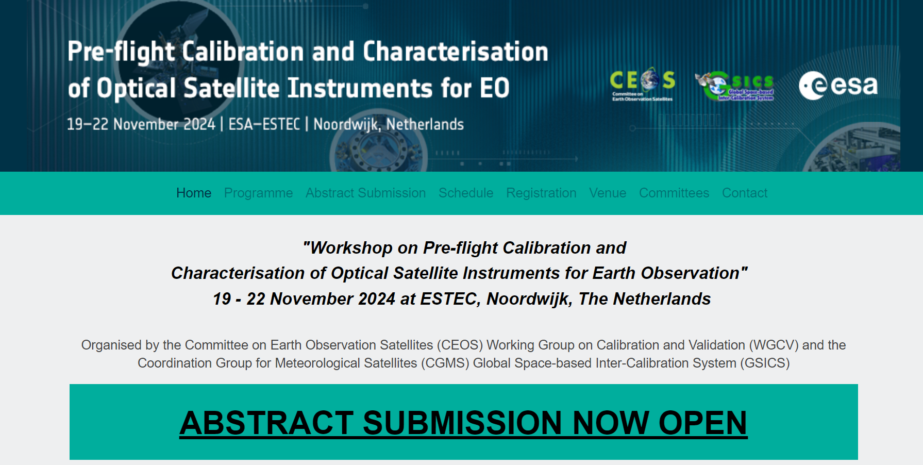
Pre-flight Cal Workshop
Pre-Flight Calibration Workshop (eventsair.com)

Slide 3
SCOPE
All passive optical sensors primarily solar reflective domain <~2500 nm (TIR on final day)
  Pre-flight satellite & On-board cal systems (pre-flight)
  Radiometric/Spectral Calibration and characterisation (not geometric)
    All aspects impacting measurment e.g. stray light, linearity. Gain…etc
  For whom?
    Engineers/scientists
    Science PI’s
    To some extent managers/funders
    Public/commercial all instruments scales inc ‘new-space’
  Format?
    Limited presentations in topic themes with time for facilitated discussion per theme
    Call for poster and oral (Spring 2024)
    3 days all plenary (solar reflective) additional day TIR
  Output
  Proceedings and Citeable guidance doc on good practises within a year

Slide 4
Organisation/Roles
Core CEOS/GSICS workshop implementation team
- Overall oversight of workshop
- link to CEOS/GSICS bodies & local ESA host
- Specific event implementation/logistics
- Selection of scientific committee
- Publication of Meeting Report
Scientific committee
- Domain (Optical sensor Calibration/characterisation) experts
- Representing globe- industry, agency, academia
- Define detailed program/session/ (critical topics/contributions)
- ‘Champions’ to encourage participation
- Review/selection of abstracts
- Core writing team of meeting conclusions & ‘good practises’
Nigel Fox | NPL/UKSA | United Kingdom
Philippe Goryl | ESA/ESRIN | Italy
Jean-Marc Laherrere | CNES | France
Mounir Lekouara | EUMETSAT | Germany
Albrecht von Bargen | DLR | Germany
Xiangqian Wu | NOAA | USA
Xiaoxiong Xiong | NASA | USA
Space Agencies/scientific committee
- Encourage participation of organisations they are funding
- Encourage transparency of information to community

Slide 5
Science committee
Pascal Blain CLS Belgium
JaeYoung Byon KMA Korea
Yong Chen NOAA USA
Hansford Cutlip Ball Aerospace USA
Camille Desjardins CNES France
Lei Ding SITP China
Gary Fowler EUMETSAT Germany
Nigel Fox NPL UK
Arnaud Heliere ESA Netherlands
Eric J Jacobson Raytheon USA
Glen Jaross NASA GSFC USA
Greg Kopp LASP USA
Toshi Kumura JAXA Japan
Stephen Maxwell NIST USA
Jean-Philippe Mur Thales France France
Jens Nieke ESA Netherlands
Thomas Pagano NASA JPL USA
Chengli Qi CMA China
Stefen Reidl Airbus Germany Germany
Dan Scharpf Labshere USA
Deron Scott SDL USA
Frank Schmülling DLR Germany
Ralph Snel TNO Netherlands
Dave Smith STFC UK UK
Christoph Straif EUMETSAT Germany
Dave Tobin Univ of Wisconsin USA
Sylvain Thomas Airbus France France
Richard Wachter OHB Germany Germany
Xiaoxiong Xiong NASA USA

Slide 6
TimeLine
April 2024 | Abstract Submission Deadline
July 2024 | Notifications to Authors
September 2024 | Preliminary Programme
Mid-October 2024 | Registration Deadline
19 - 22 November 2024 December 2025 | Workshop Publication of proceedings and good practises
~ 60 Abstracts
23 Oral selected
160 Registered attendees (todate)

Slide 7
Structure
Session 1: Introduction, objectives, drivers
Session 2 : Future needs
Session 3: Principles of Calibration/Characterisation/traceability/uncertainty
Session 4: Radiometric gain
Session 5: Spectral (response function/bandwidth/wavelength (UV-TIR))
Session 6: Stray light
Session 7: Next steps
Session 8: TIR (all topics)
Each session:
  Oral 25/30 mins
  Poster intro (3 min oral)
  Discussion ~90 mins
  Next Steps:
  Agree methods
  Plan and agree writing

Slide 8
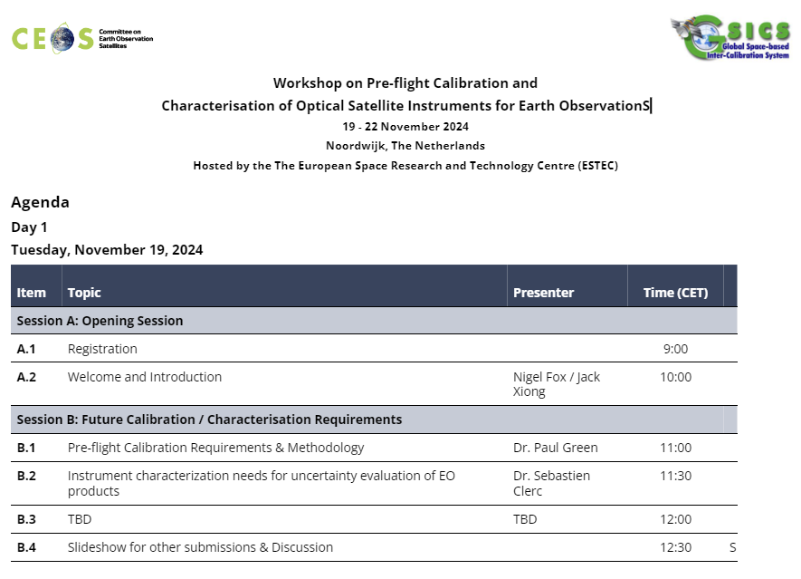
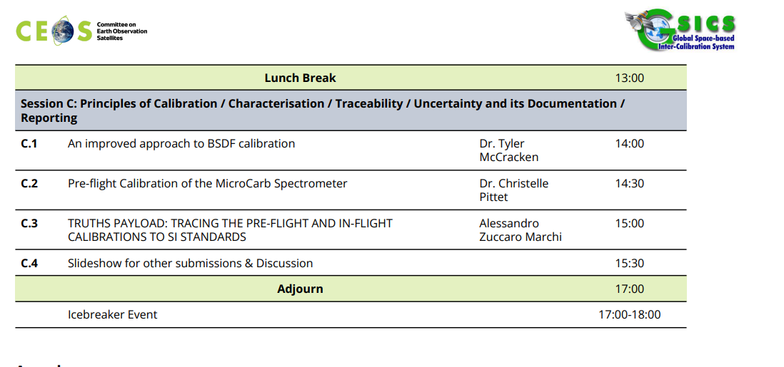

Slide 9
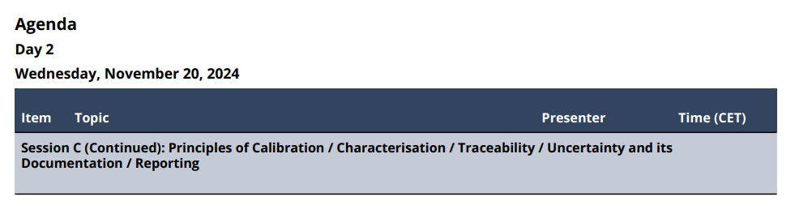
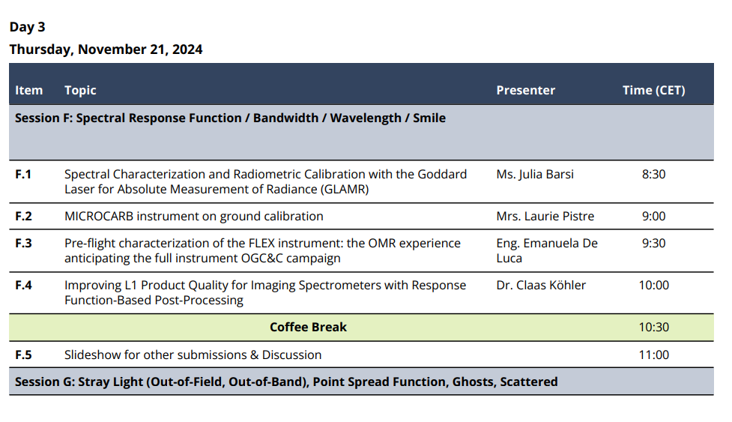
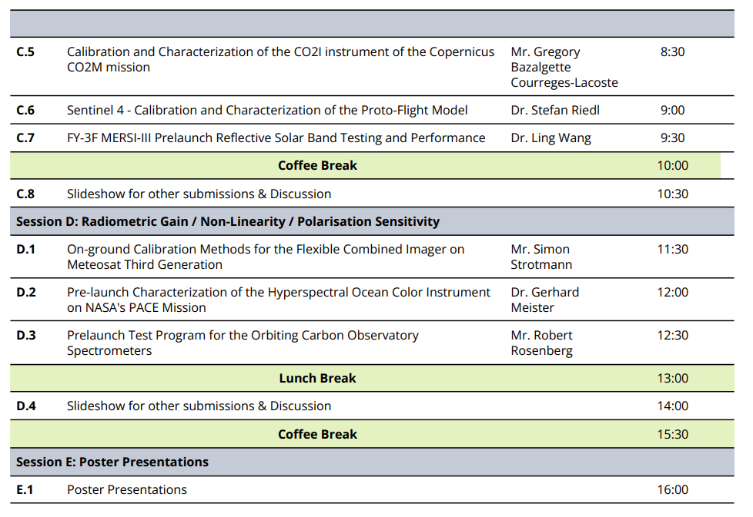
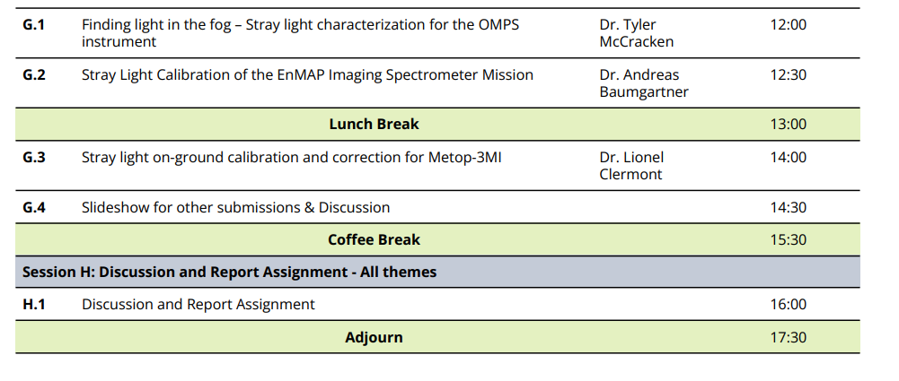

Slide 10
