Slide 1
WGCV-53
Plans for WGCV-54 Meeting
Cody Anderson, USGS
3.12
WGCV-53, Córdoba, Argentina
5th - 8th March 2024

Slide 2
WGCV-54
USGS Earth Observation Resources and Science (EROS) Center
Sioux Falls, SD, USA
Oct. 15-18, 2024
Joint WGCV and WGISS

Slide 3
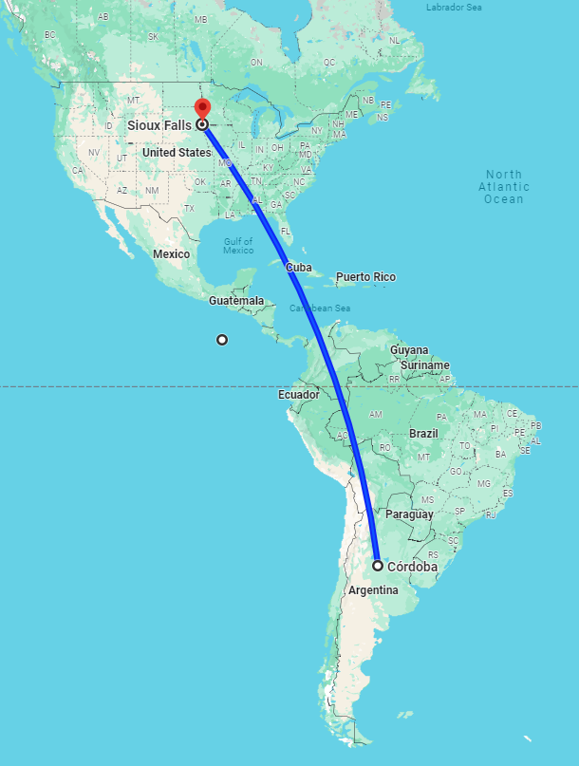
9,000km from
Córdoba, Argentina
to
Sioux Falls, SD, USA

Slide 4
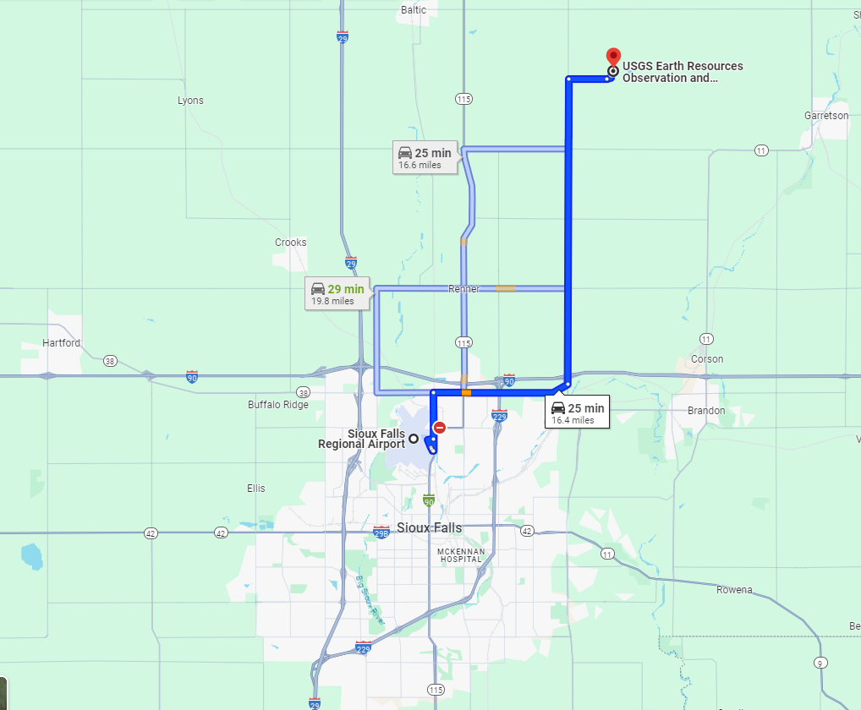
Sioux Falls Regional Airport (FSD)
USGS EROS
25 minutes
Northeast from
Sioux Falls, SD

Slide 5
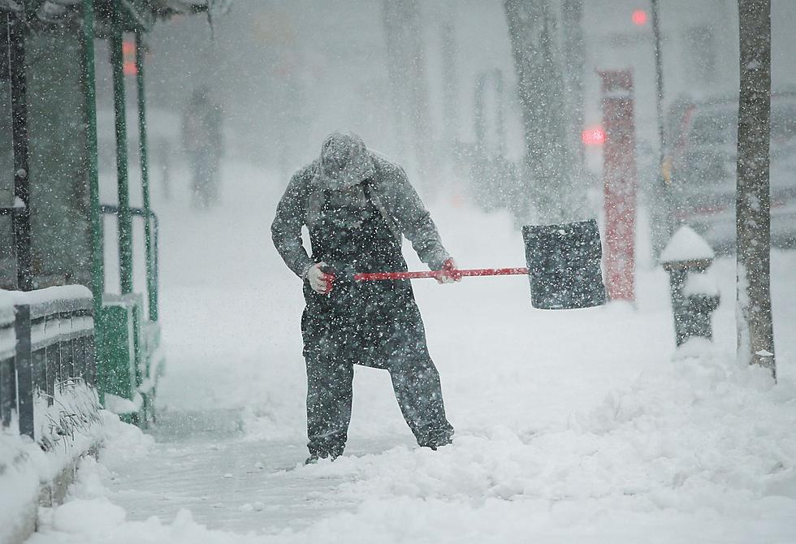
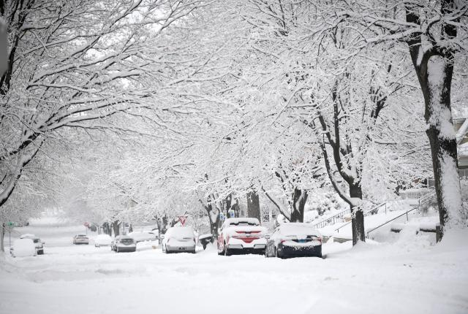
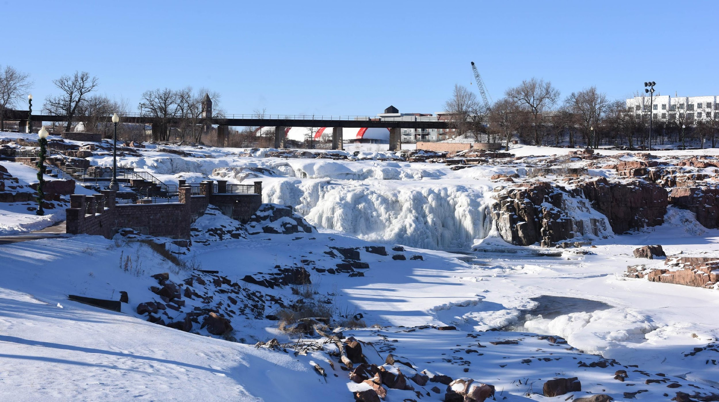
Sioux Falls, SD

Slide 6
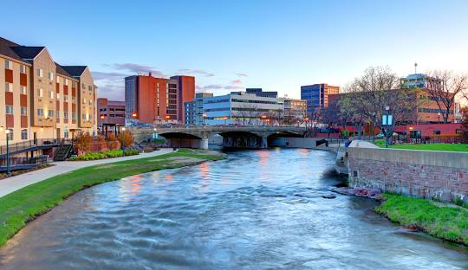
Sioux Falls, SD
Oct. Daily Mean Temperature: 16ºC(High) to 4ºC(Low)
Oct. Rainfall: 4 Days/Month
Oct. Daylight: 11 hours

