Slide 1
Geoscience Australia Cal / Val Update
Medhavy Thankappan
Geoscience Australia
Agenda Item # 3.10
WGCV 53 Plenary
Cordoba, 5-8 March 2024

Slide 2


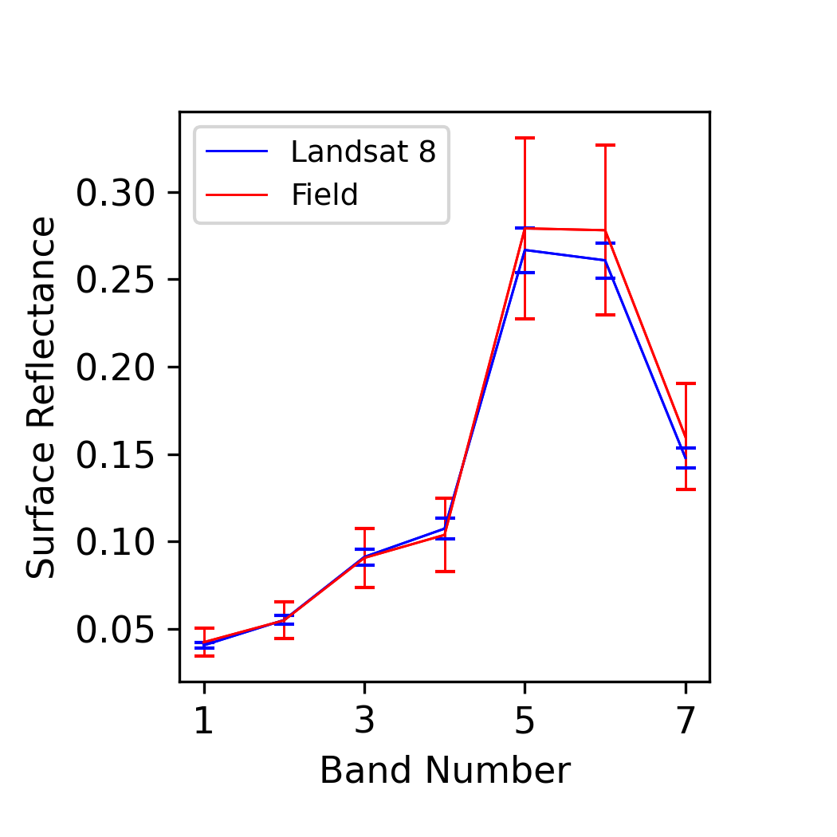
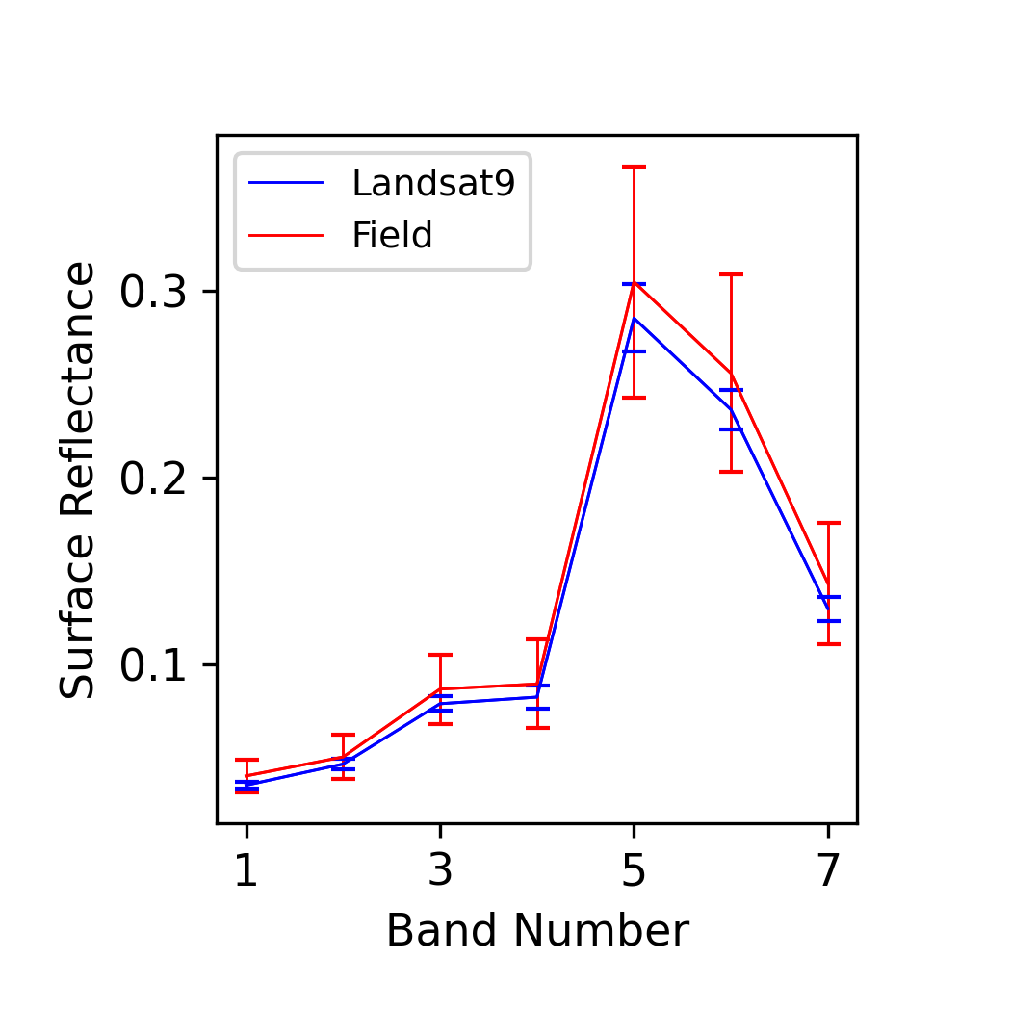
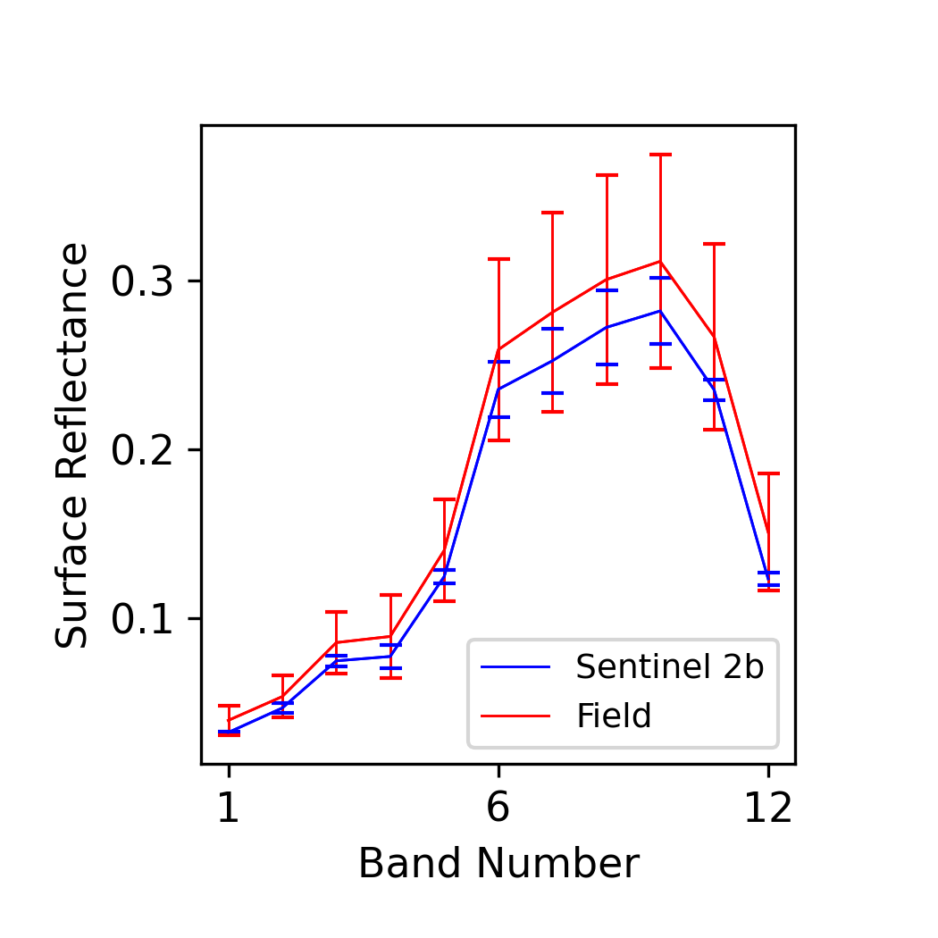
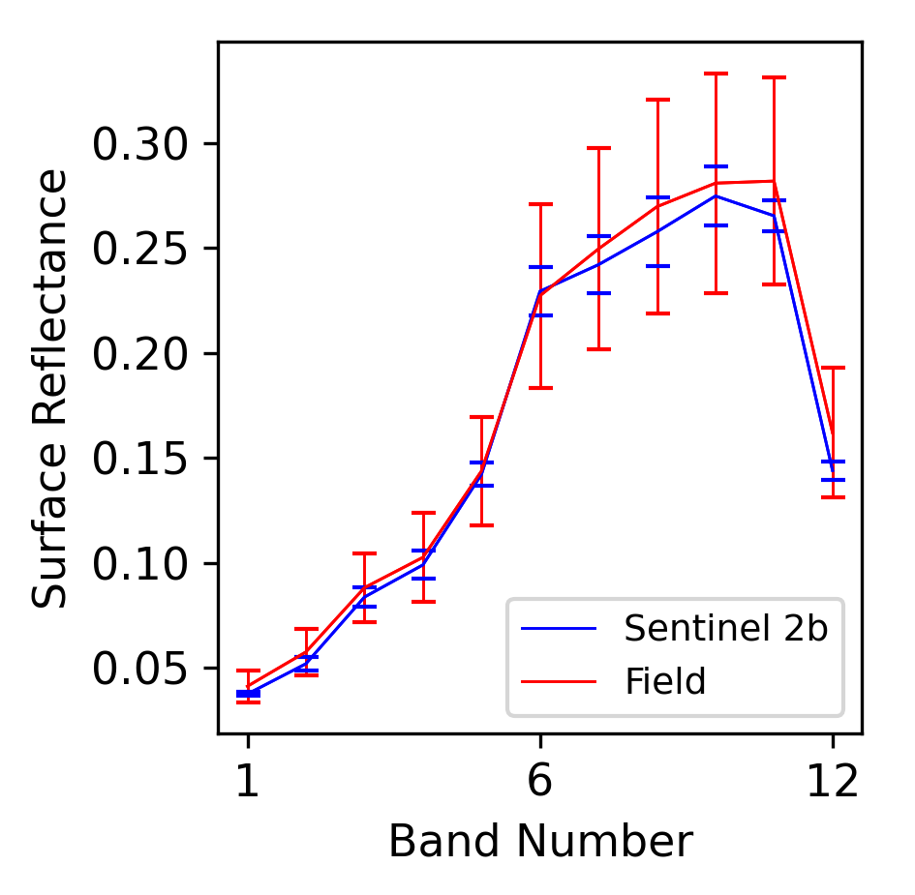
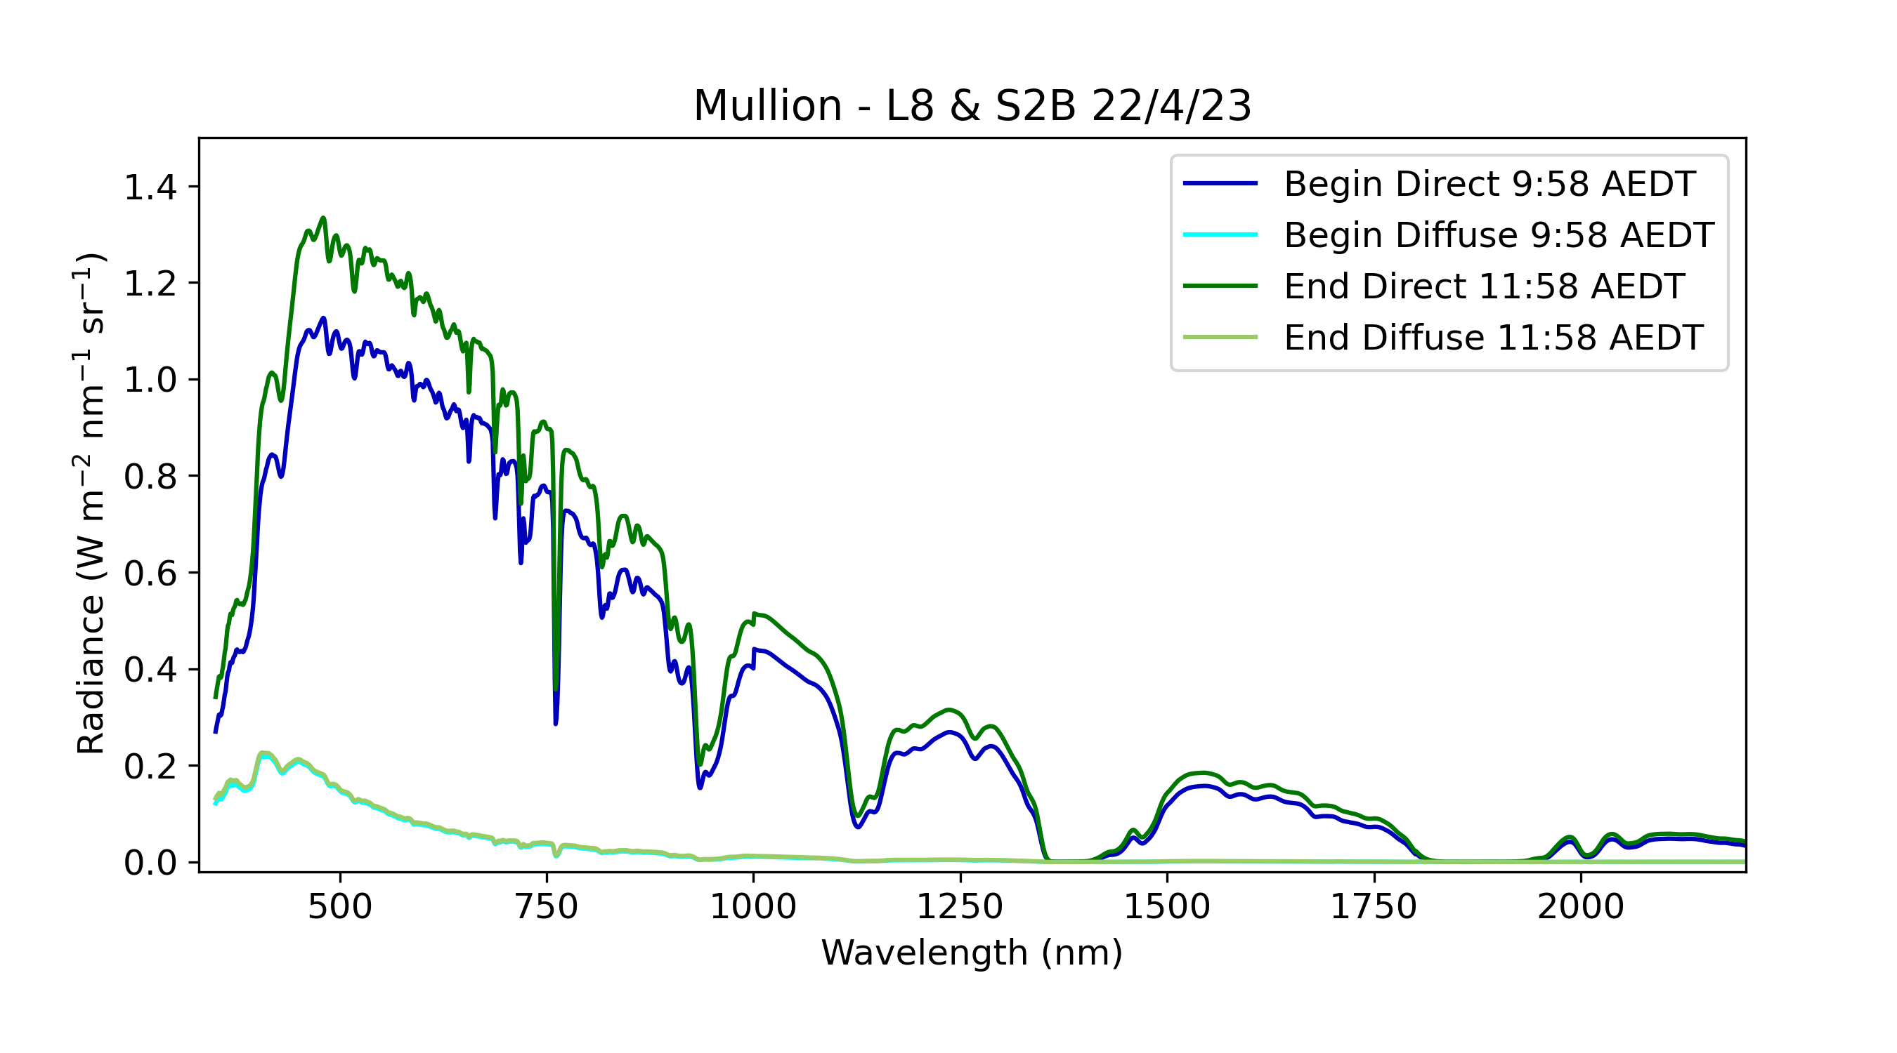
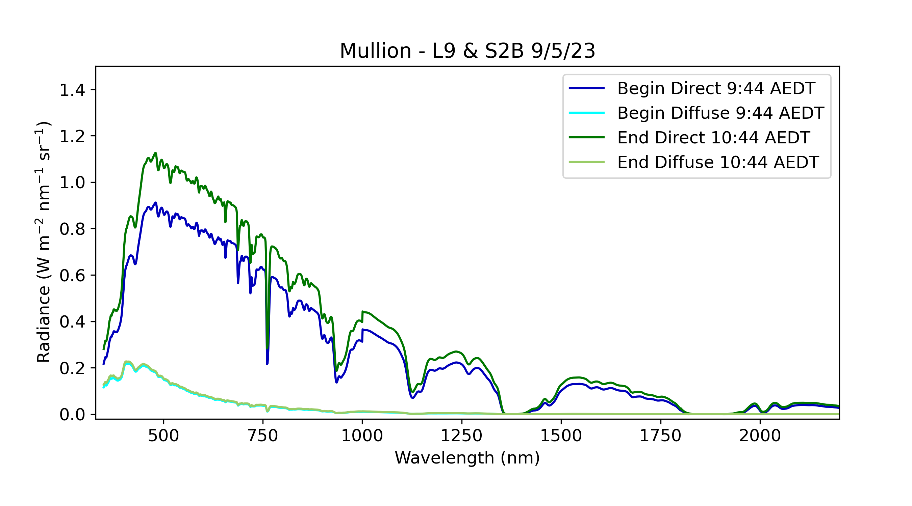
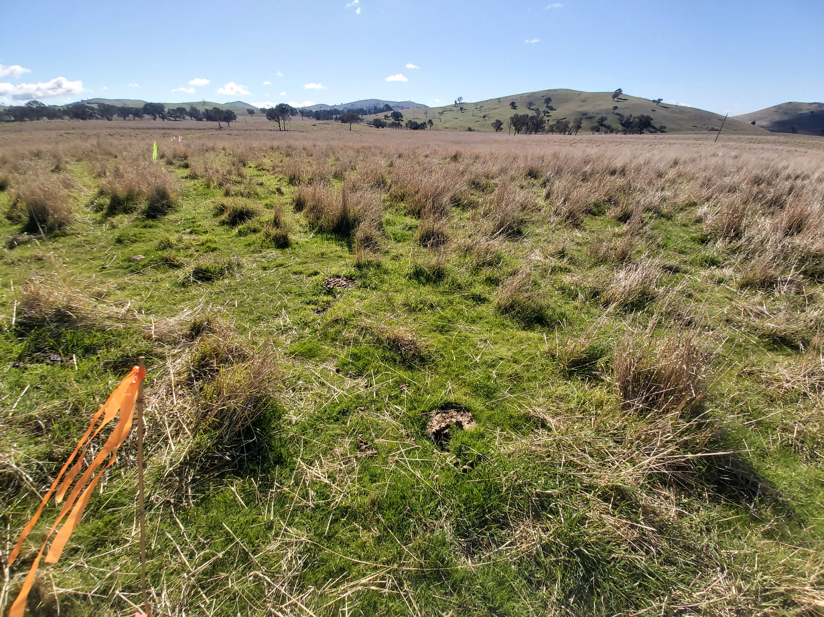
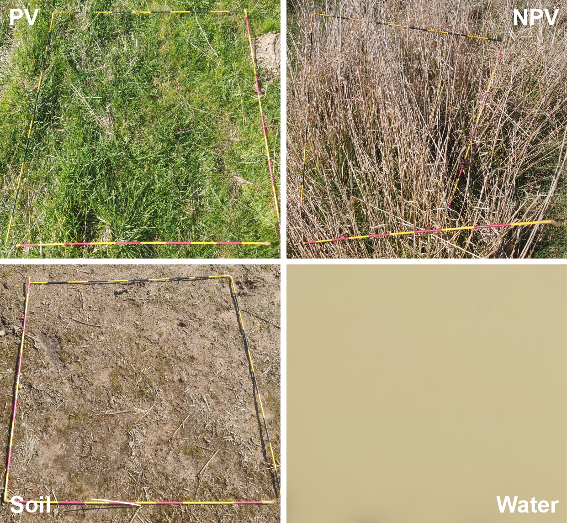
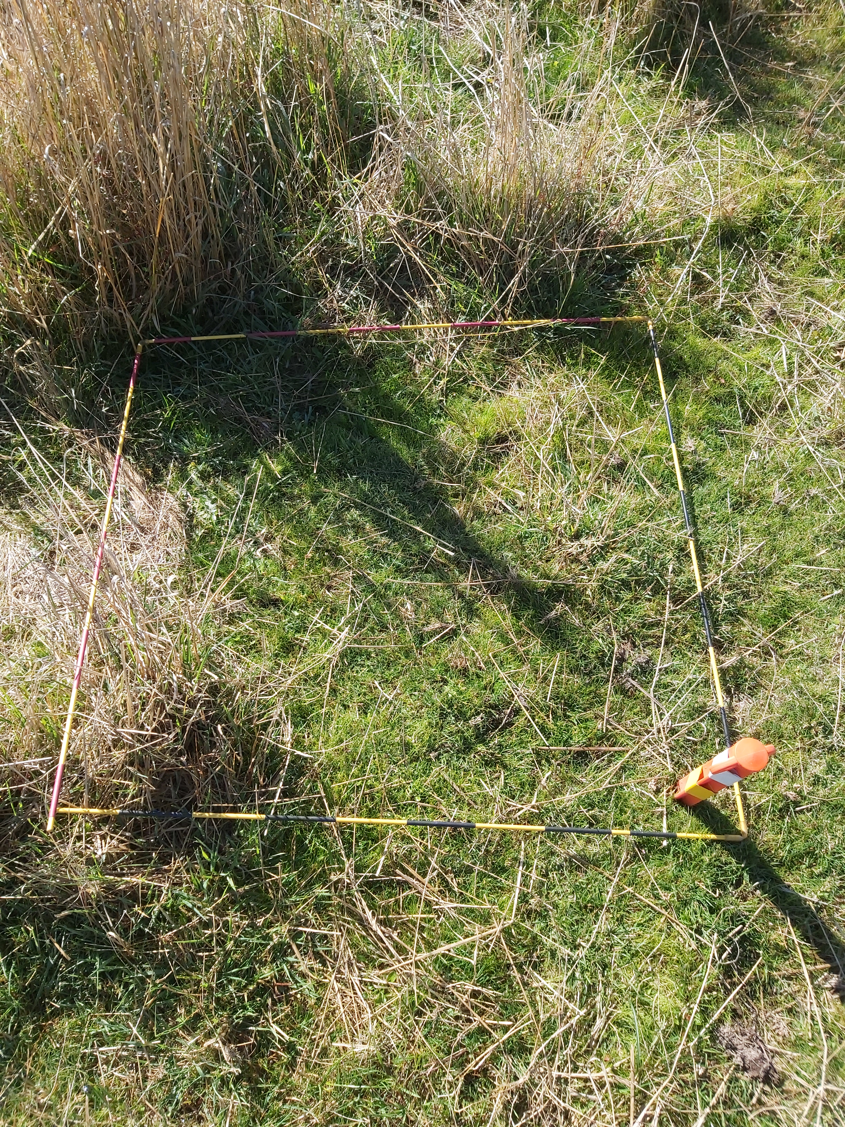
Surface Reflectance Validation Update
Ground based validation of satellite derived surface reflectance at GA
Mullion - L8 (15th April) & S2B 22nd April 2023
Mullion – L9 & S2B 9th May 2023
Atmosphere
Corner point
UAS RGB
Atmosphere
Site view
Cover end members

Slide 3
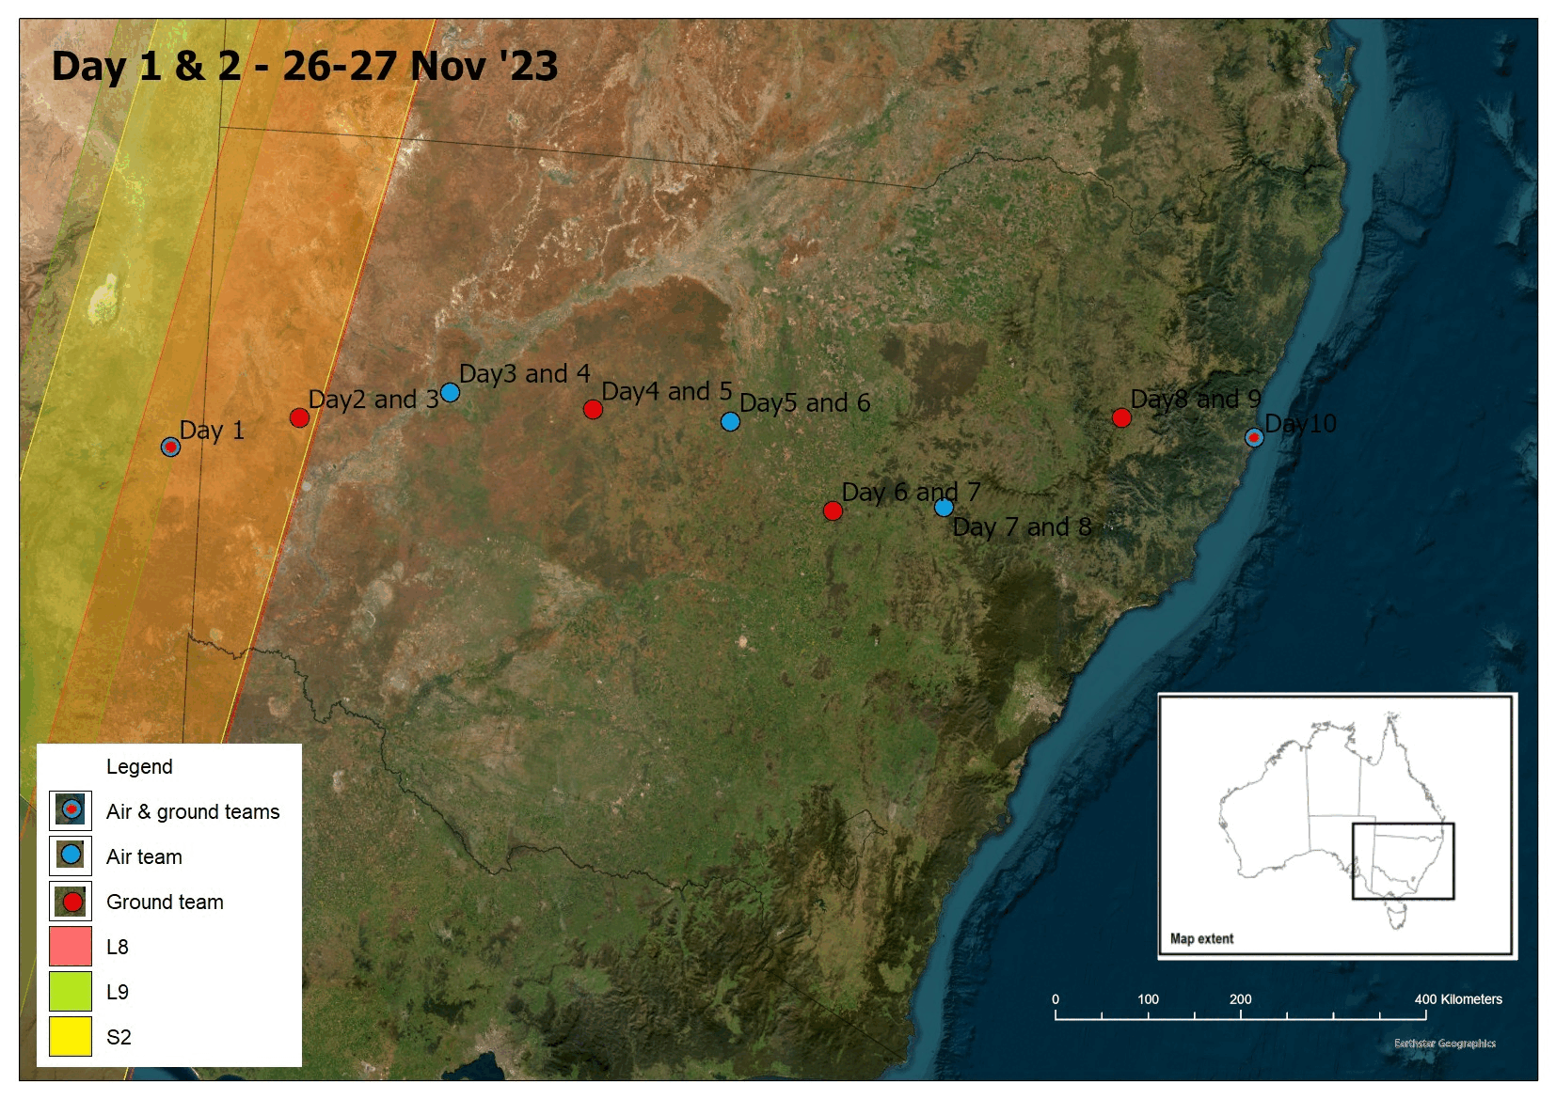
Targeted SR Validation Campaign
Targeted field validation campaign focussed on dual satellite overpasses (L8, L9, S2) in Nov 2023
4 dual overpasses. Additionally, DESIS, EMITS, EnMAP, PRISMA were tasked over the sites for cross-validation opportunities
Due to poor weather only two sites were visited, no UAV-based hyperspectral instruments were deployed. Next opportunity in April 2024

Slide 4
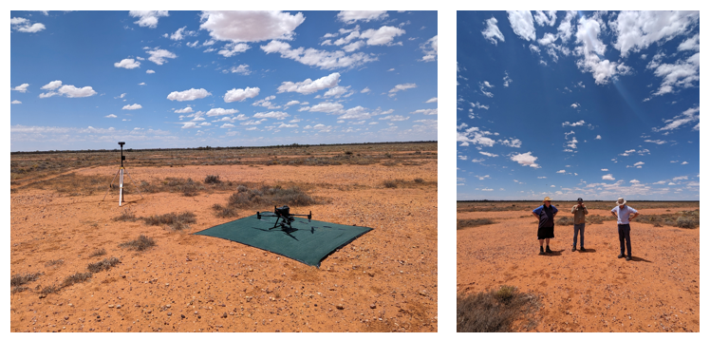
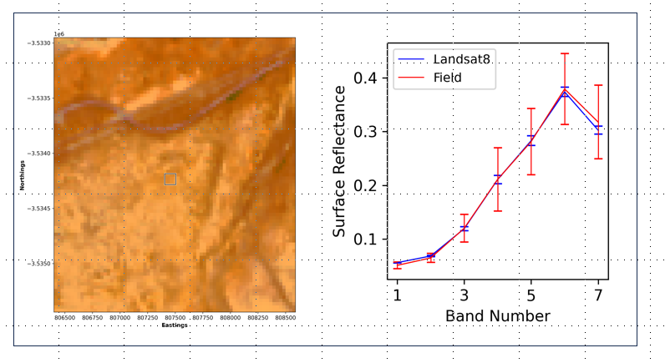
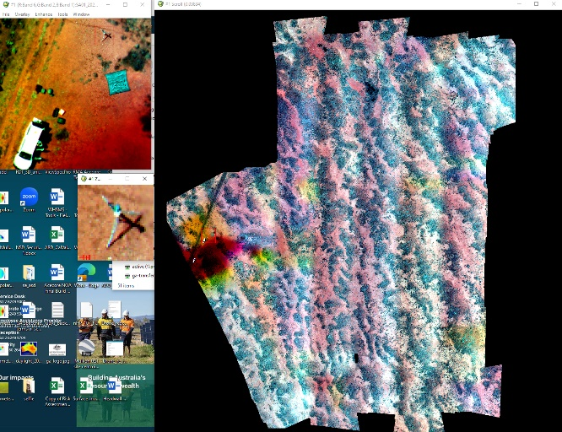
Site SA01
Field data matched up with Landsat 8 data (27/11/23)
M300 UAV with LiDAR and 10 band camera
Site was clear at the time of overpass on 26 Nov but cloud moved in while the spectrometry data were being captured (this takes around 40 min)
Careful sampling (while there were no cloud shadows on site), good data filtering techniques and conversion of temporally separated data being converted to NBAR means that a good matchup could still be made to the satellite data (top right)
LiDAR and 10-band Micasense data were captured the day before and the imagery shows the impact of cloud shadow
MicaSense 10-band camera imagery (26/11/2023)

Slide 5
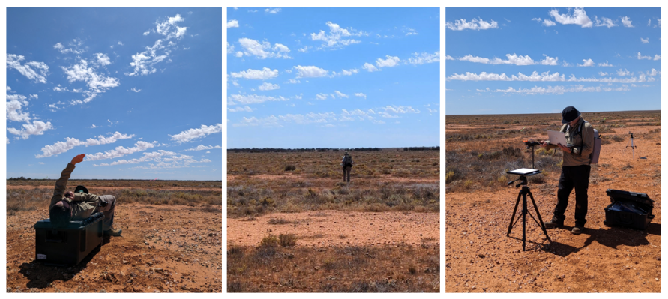
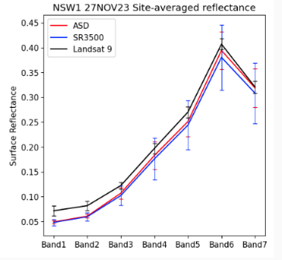
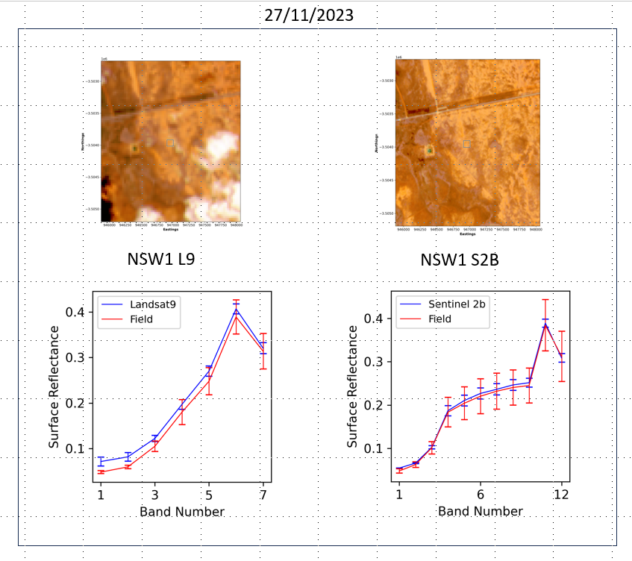
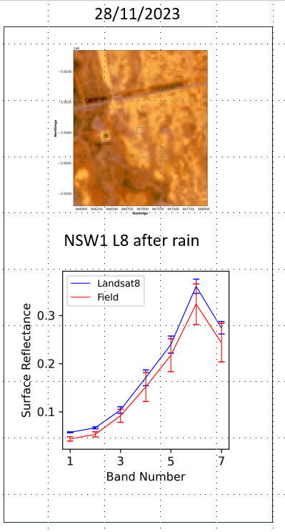
Site NSW01
Spectrometry data was captured on 27 Nov with both the ASD and SR3500 instruments
Only ASD data was captured on the 28 Nov
L9 and S2B overpass on 27 Nov, cloud at the site when L9 went over
The L9 matchup is not as good as the S2B due to the impact of the clouds, on 28 Nov after rain the site is noticeably darker
Compared the ASD spectrometer with the Spectral evolution spectrometer (typically flown on the drone)

Slide 6
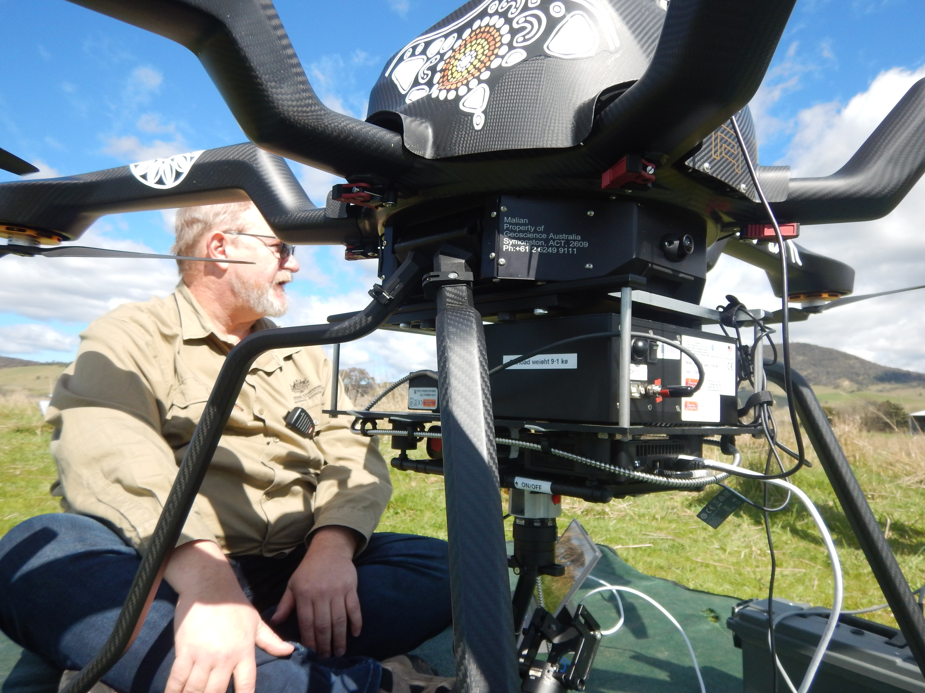
UAV Based SR Validation
Preparing for SRIX4VEG Campaign at Calperum, Australia in March 2024
SR3500 full-range spectrometer on the Noa-H6 heavy lift UAV
Nano-HP VNIR pushbroom hyperspectral imager on the M600 pro UAV

Slide 7
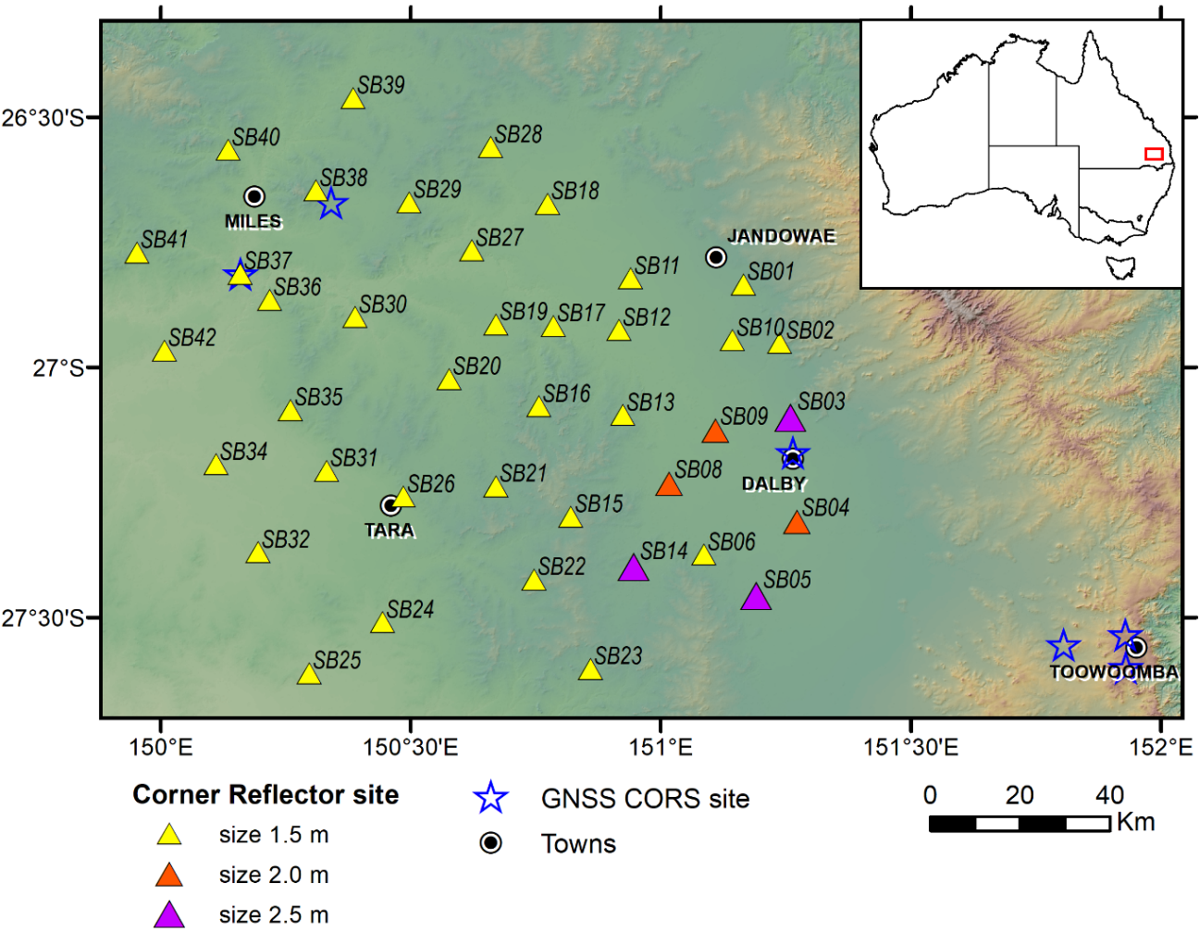
Queensland Corner Reflector Array
GA continues to maintain the QCRA of 40 CRs in Queensland
ESA leverages the QCRA for ongoing Sentinel-1 data quality assurance (https://sentinel.esa.int/web/sentinel/user-guides/sentinel-1-sar/document-library/-/asset_publisher/1dO7RF5fJMbd/content/id/4890957?_com_liferay_asset_publisher_web_portlet_AssetPublisherPortlet_INSTANCE_1dO7RF5fJMbd
AusCalVal (CSIRO) supported the maintenance of the QCRA site in May 2023, work underway to get QCRA admitted as part of SARCALNET

Slide 8
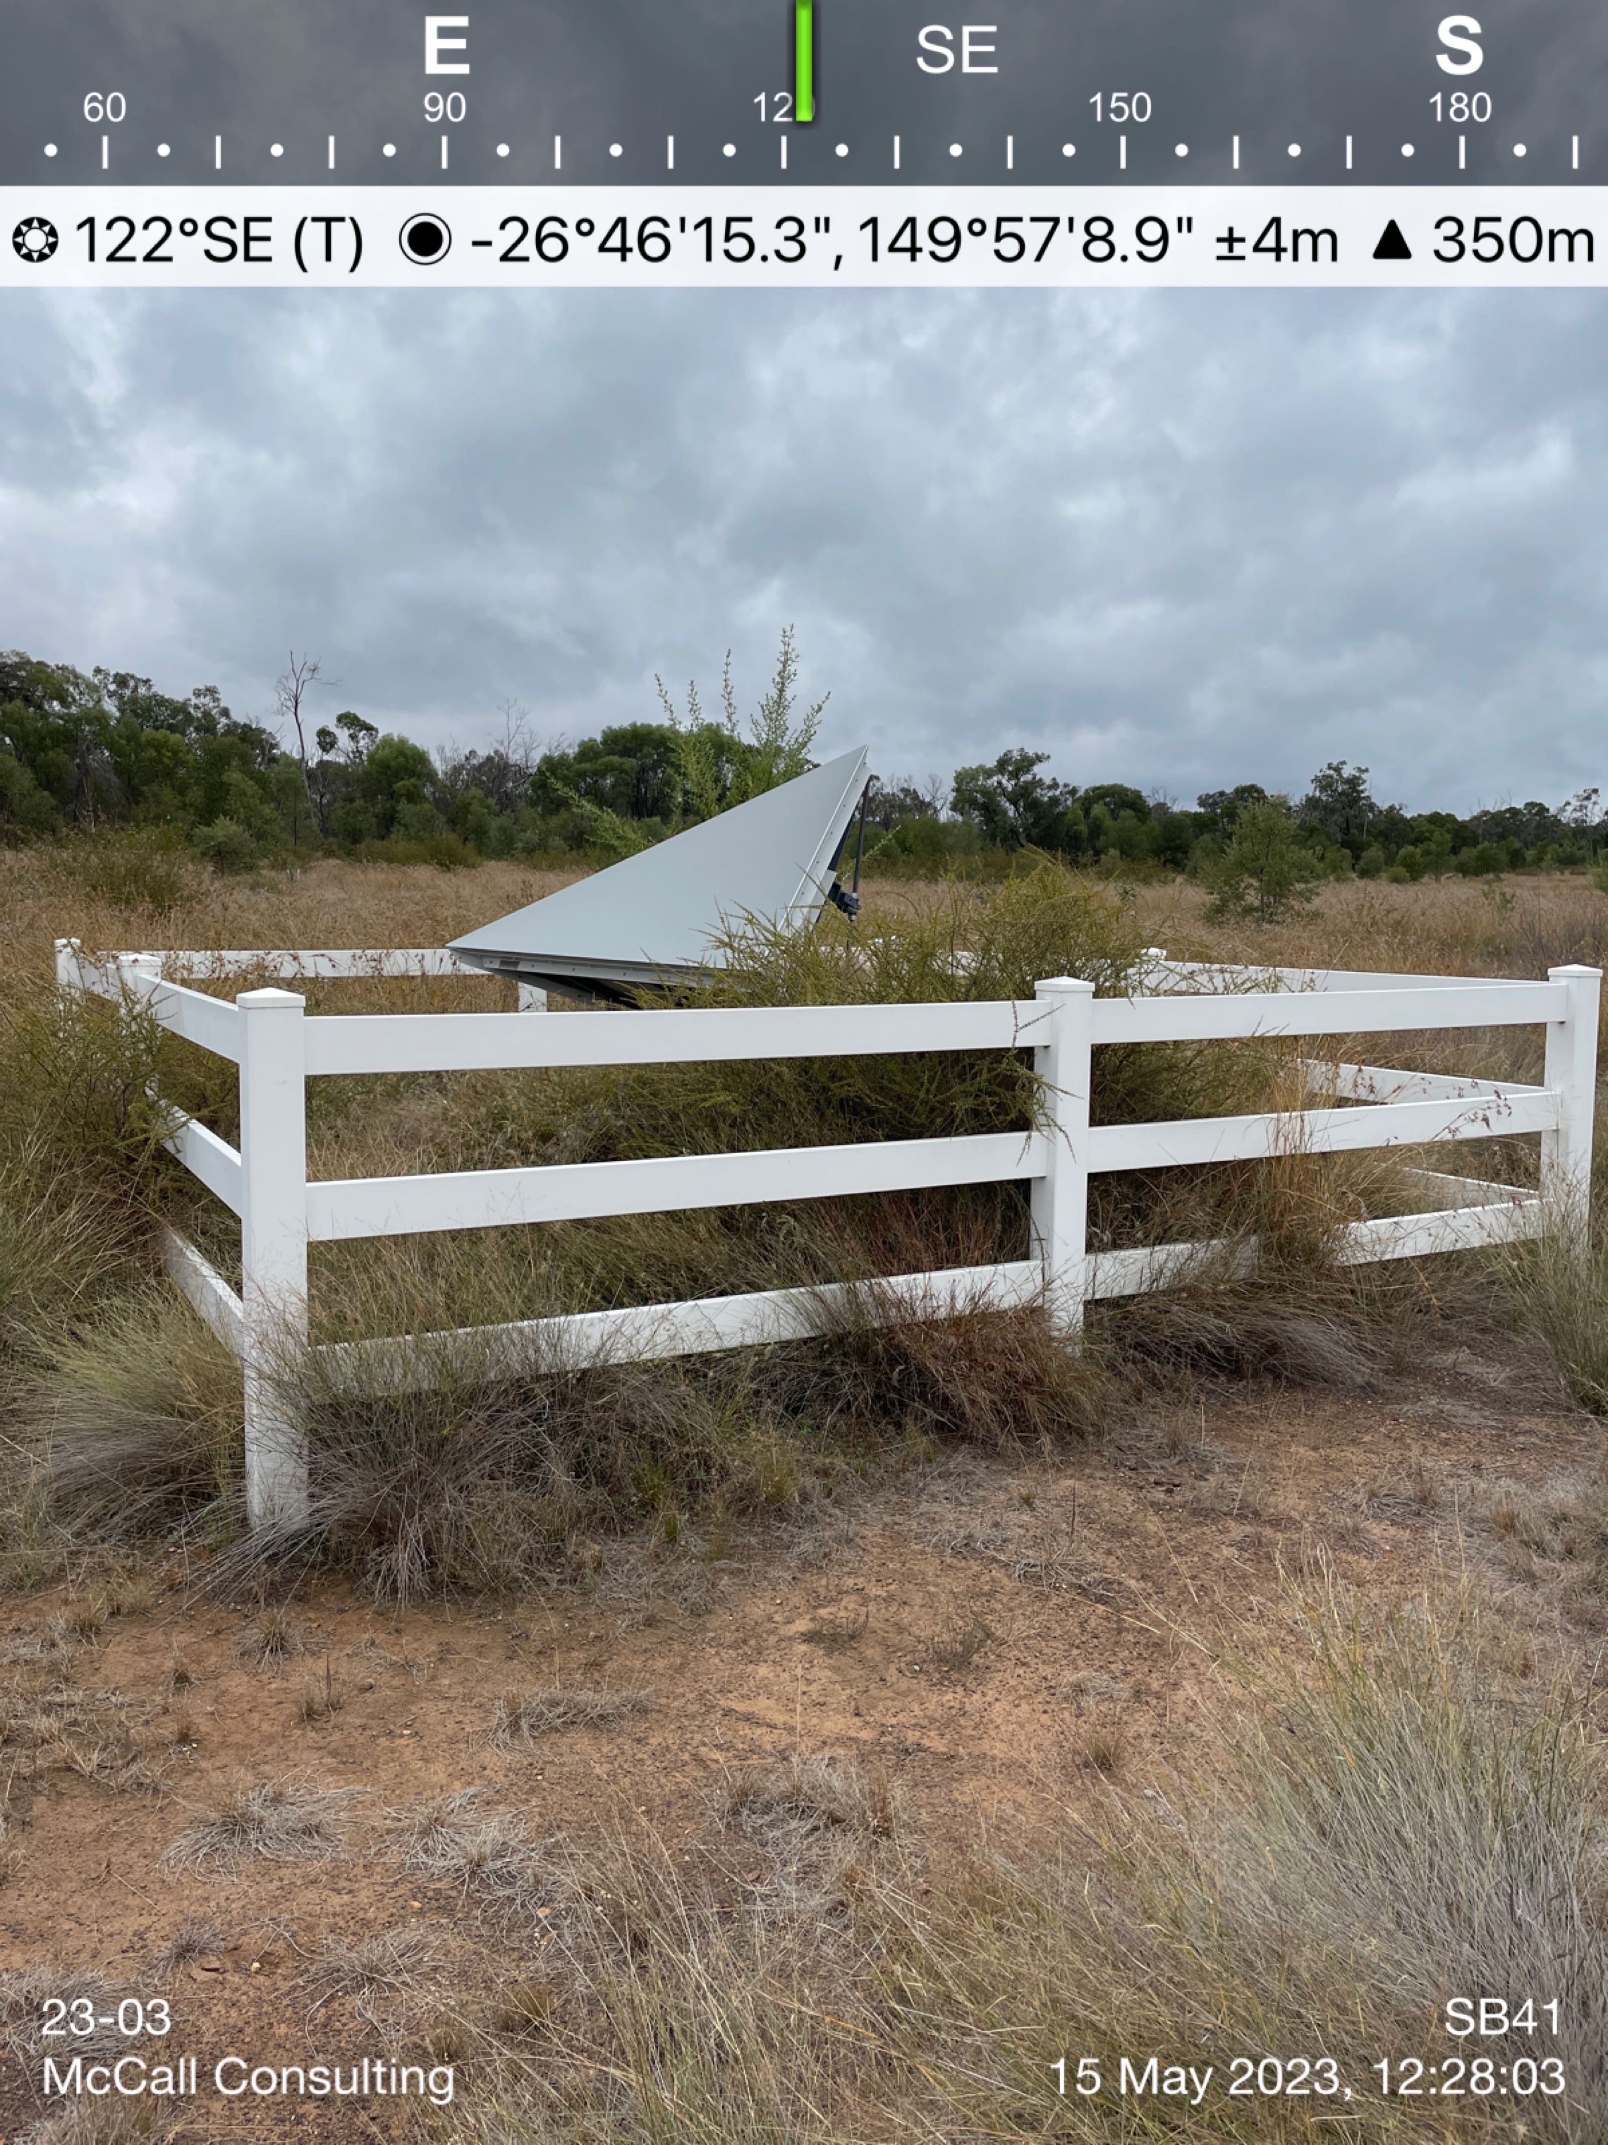
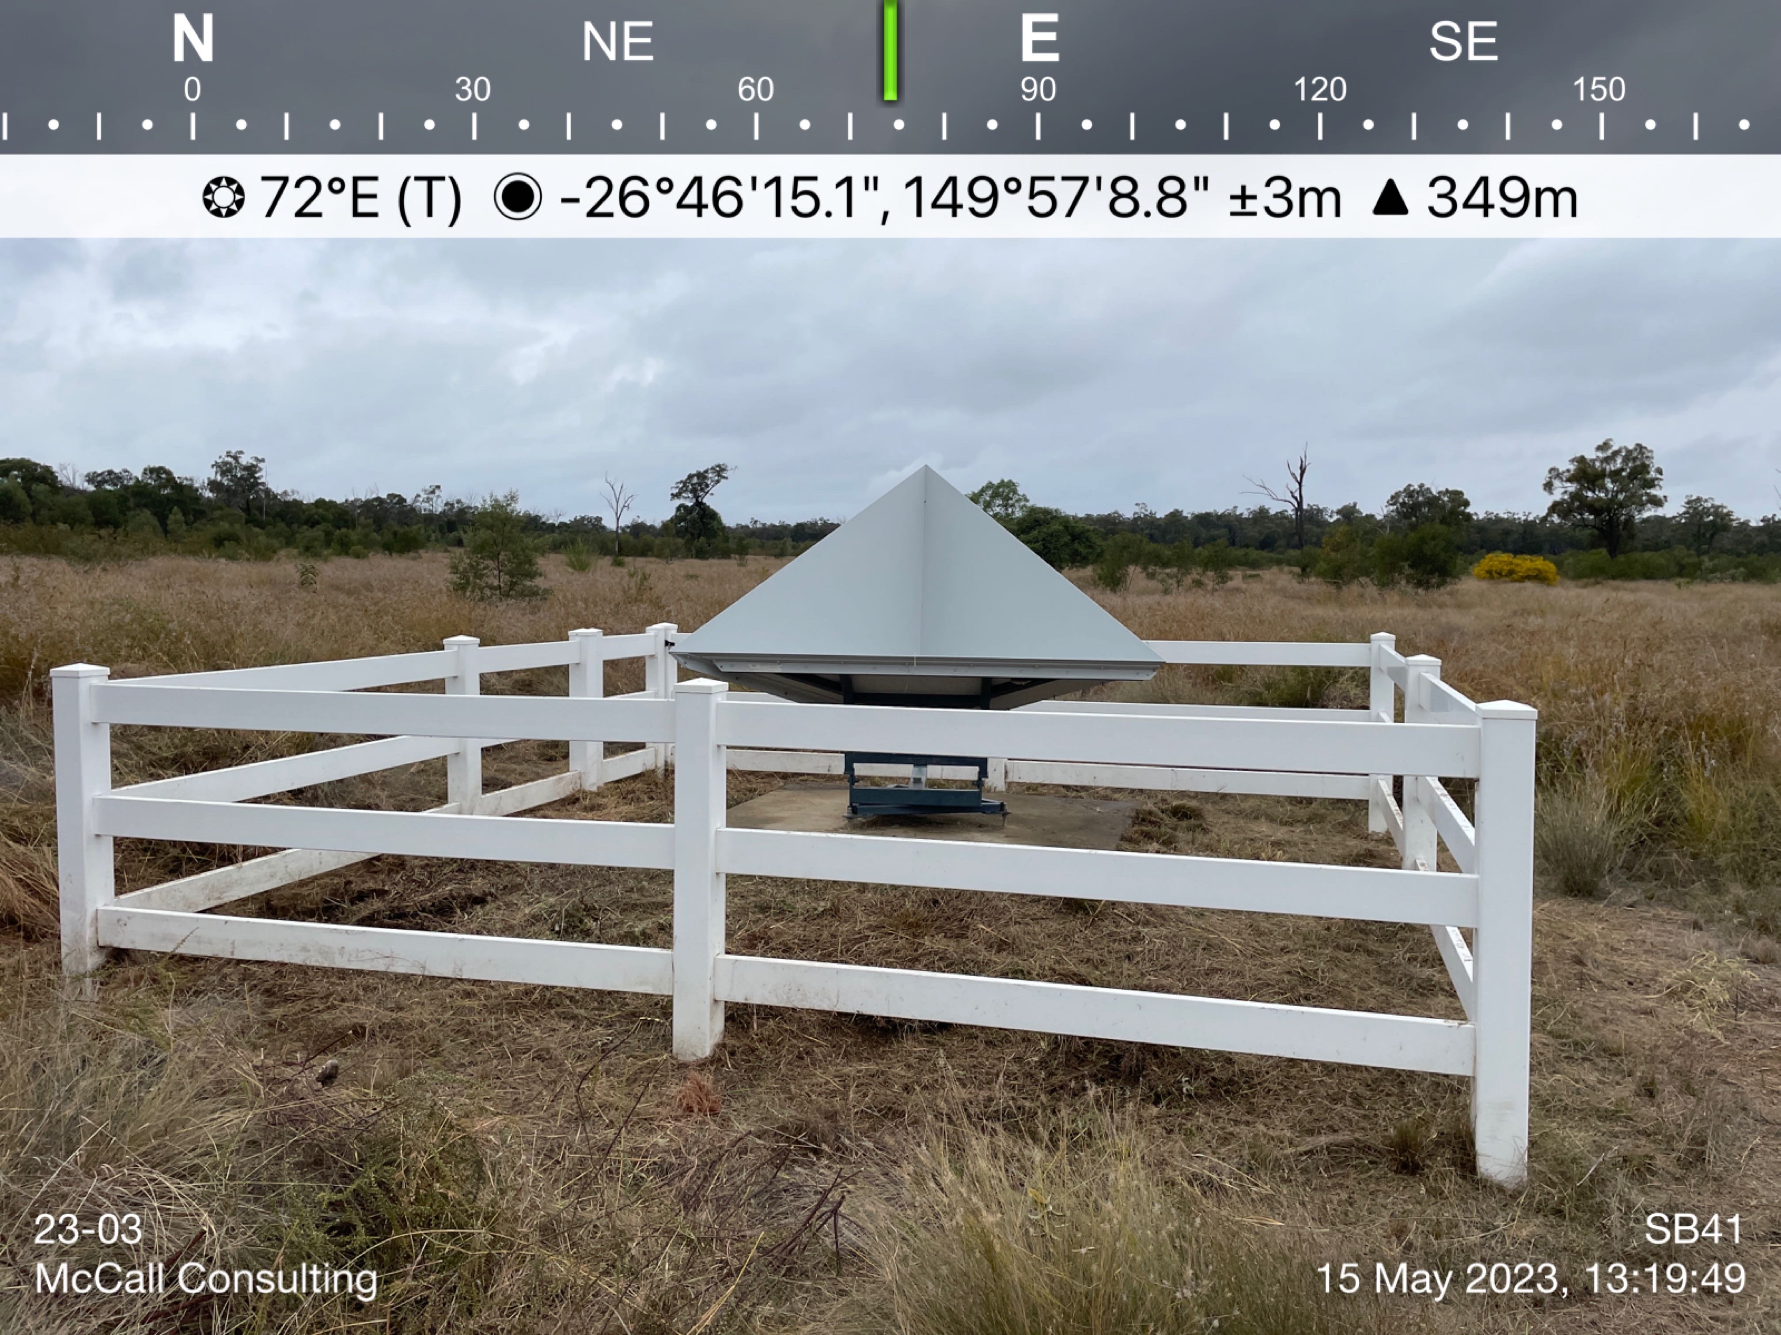
QCRA Maintenance
Before
After

Slide 9
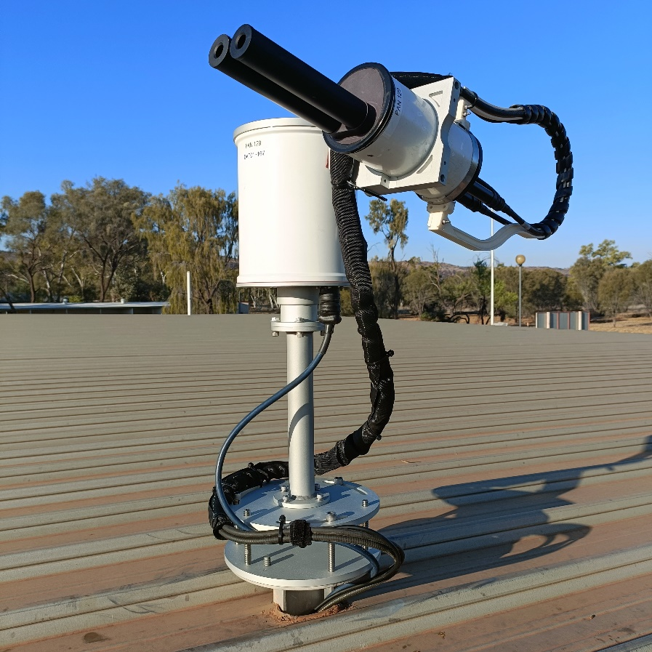
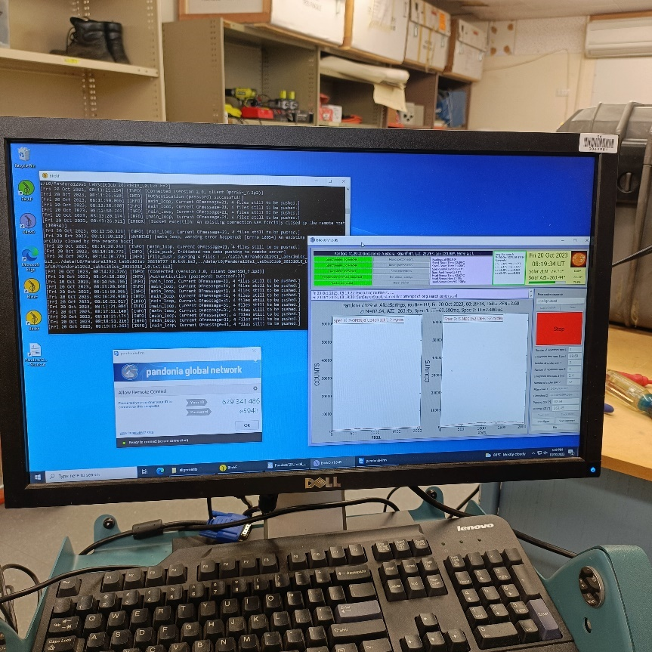
Pandora Instrument
The Pandora instrument has been successfully redeployed at GA’s Satellite Ground Station Facility in Alice Springs after re-calibration
The instrument continues to generate data as part of the global Pandonia network

Slide 10
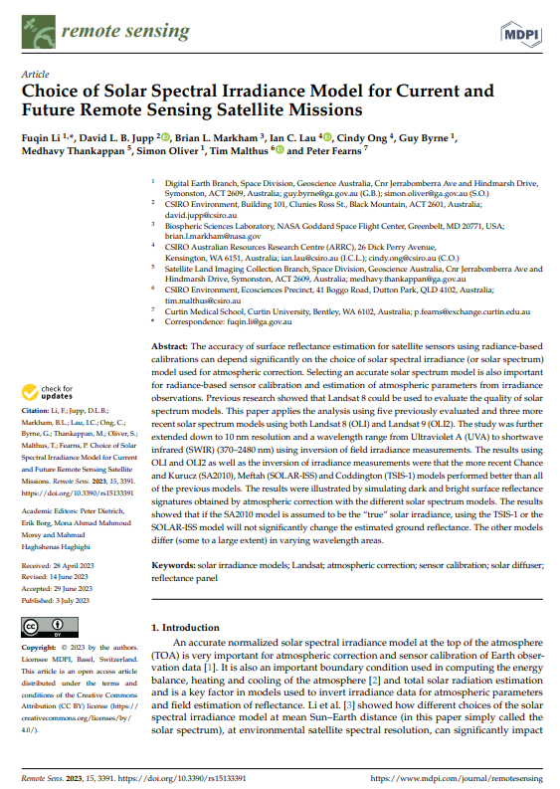
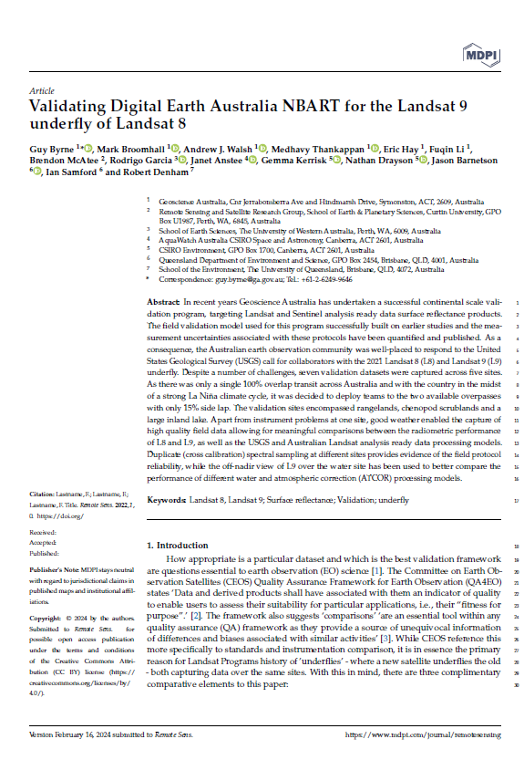
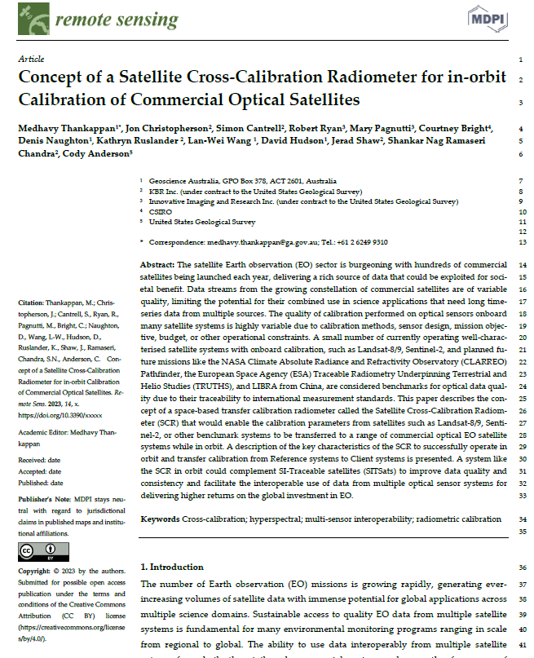
Publications
Submitted
Submitted

Slide 11
Thank you
medhavy.thankappan@ga.gov.au

