Slide 1
BELSPO Update
CEOS WGCV-53
Córdoba, 7 March 2024
Jean-Christophe Schyns

Slide 2

BELSPO
Belgian Science Policy Office (BELSPO)
10 federal scientific institutes: BIRA-IASB, RBINS, RMIB…
Funding of national research programmes
Management of national and international coordination
No Belgian Space Agency BELSPO Space Department

Slide 3
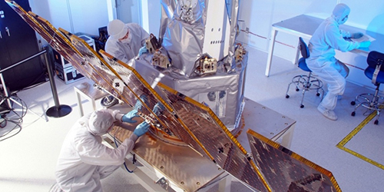
Belgian Space Strategy
Belgian participation in international organisations dealing with space:
ESA (BEL 5th largest contributor)
ECMWF, EUMETSAT, ESO
EU programmes (Copernicus, Galileo, Research Infrastructures…)
Bilateral cooperations: BEL/France + BEL/Argentina
National EO programmes: STEREO + TERRASCOPE https://terrascope.be/en

Slide 4

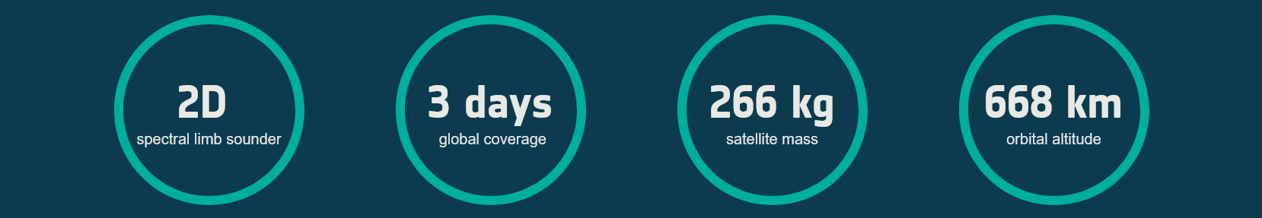
ALTIUS https://www.esa.int/Applications/Observing_the_Earth/Altius
ALTIUS = Atmospheric Limb Tracker for Investigation of the Upcoming Stratosphere
ESA Earth Watch mission, carries a high-resolution spectral imager and uses a limb-sounding technique to deliver profiles of ozone, other trace gases and aerosols in the middle and upper atmosphere
ESA mission financed by BEL with contributions from CAN, LUX, ROM
Upcoming AO Call for Cal/Val (ESA call for external contributions)

Slide 5
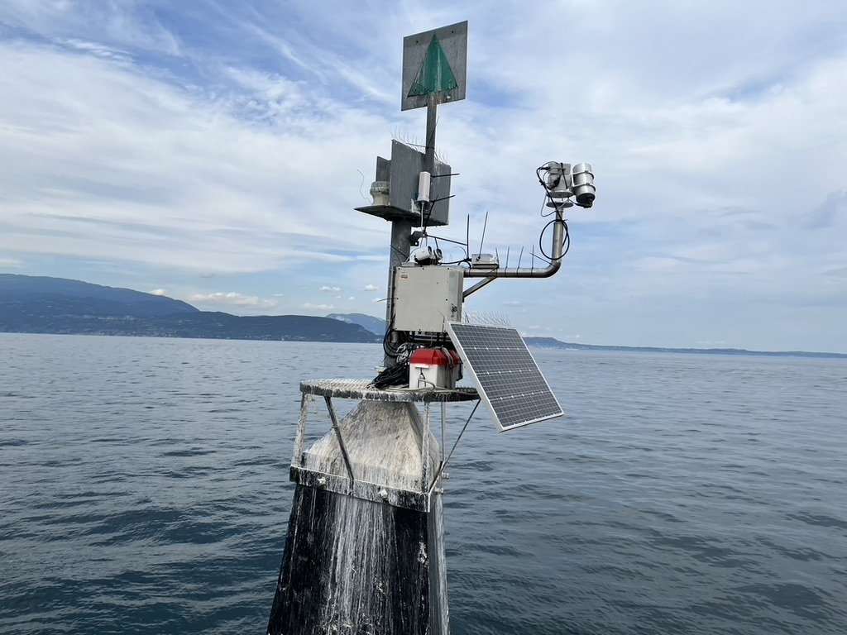
EO Cal/Val Activities in Belgium (1)
Belgium highly active in
Cal/Val activities
  Atmosphere
  Land
  Marine
BELSPO support to validation and calibration via:
  National STEREO Programme
  ESA (Future-EO, PRODEX)

Slide 6
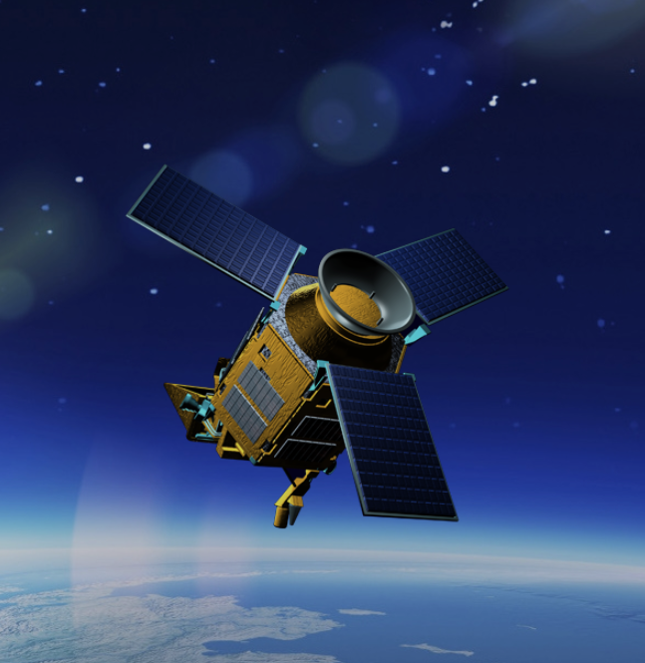
EO Cal/Val Activities in Belgium (2)
A few examples:
ALTIUS
Sentinel O-MPC
Sentinel-5P operational validation / ATM-MPC
FRM: Hypernets, NDACC, PGN, TCCON…
Harmonization VGT-1, VGT-2 PROBA-V and Sentinel-3
…

Slide 7


EO Cal/Val Activities in Belgium (3)
Federal Scientific Institutes under BELSPO authority
  Royal Belgian Institute for Space Aeronomy, BIRA-IASB
  Royal Institute of Natural Sciences of Belgium, RBINS
  Royal Meteorological Institute of Belgium, RMIB
  Royal Observatory of Belgium, ROB
  Belgian User Support and Operation Centre, B-USOC
Regional partners and SMEs
  Belgian Interregional Environment Agency, IRCEL-CELINE
  Centre spatial de Liège, CSL
  Rayference
  Université de Liège, ULiège
  Université libre de Bruxelles, ULB
  Universiteit Antwerpen, UA
  Vlaamse Instelling voor Technologisch Onderzoek, VITO

Slide 8
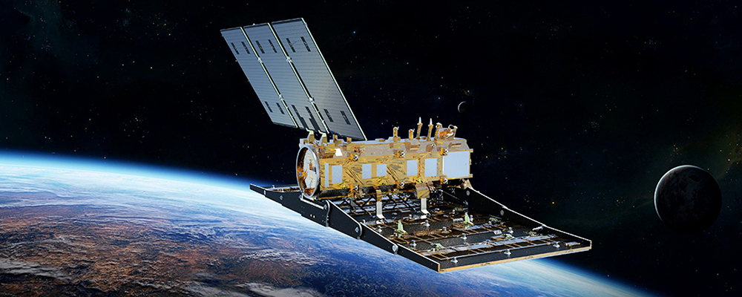
Bilateral agreement CONAE-BELSPO
SAOCOM mission providing L-Band radar data
Agreement ARG-BEL signed in 2000 and currently updated
BEL provided software
for data processing
ARG provides images to BEL users for non-commercial applications

