Slide 1
WGCV-53
JAXA Agency Report
Akihiko KUZE, JAXA
Kazuhisa TANADA, JAXA
Agenda Item #2.9 Agency Report
WGCV-53, Córdoba, Argentina
5th - 8th March 2024

Slide 2
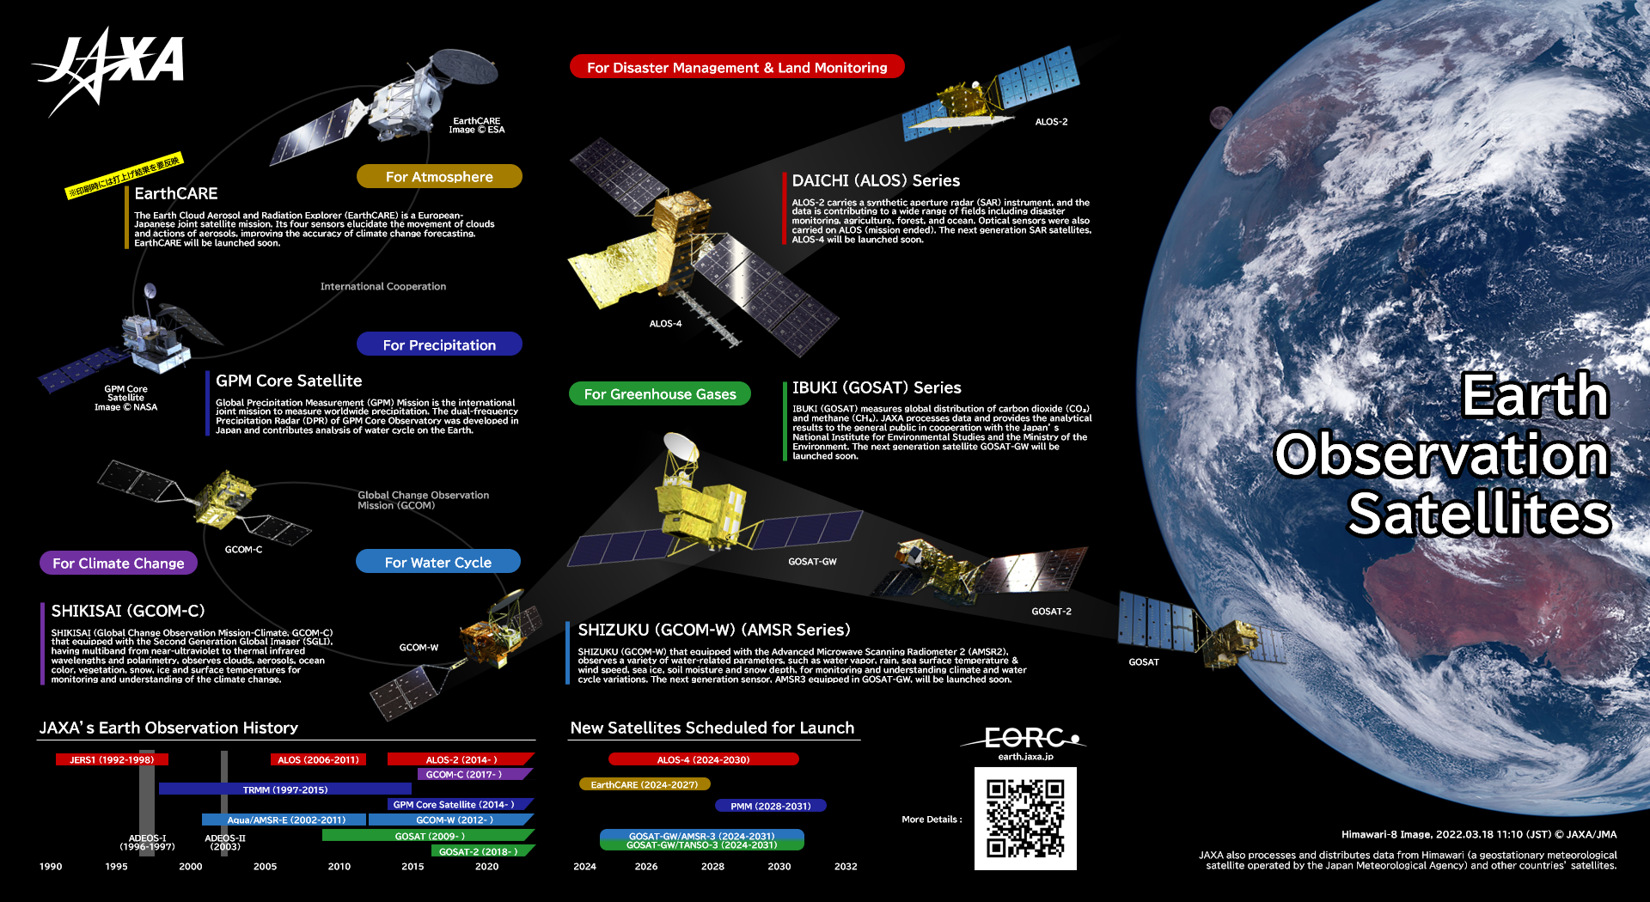

Slide 3
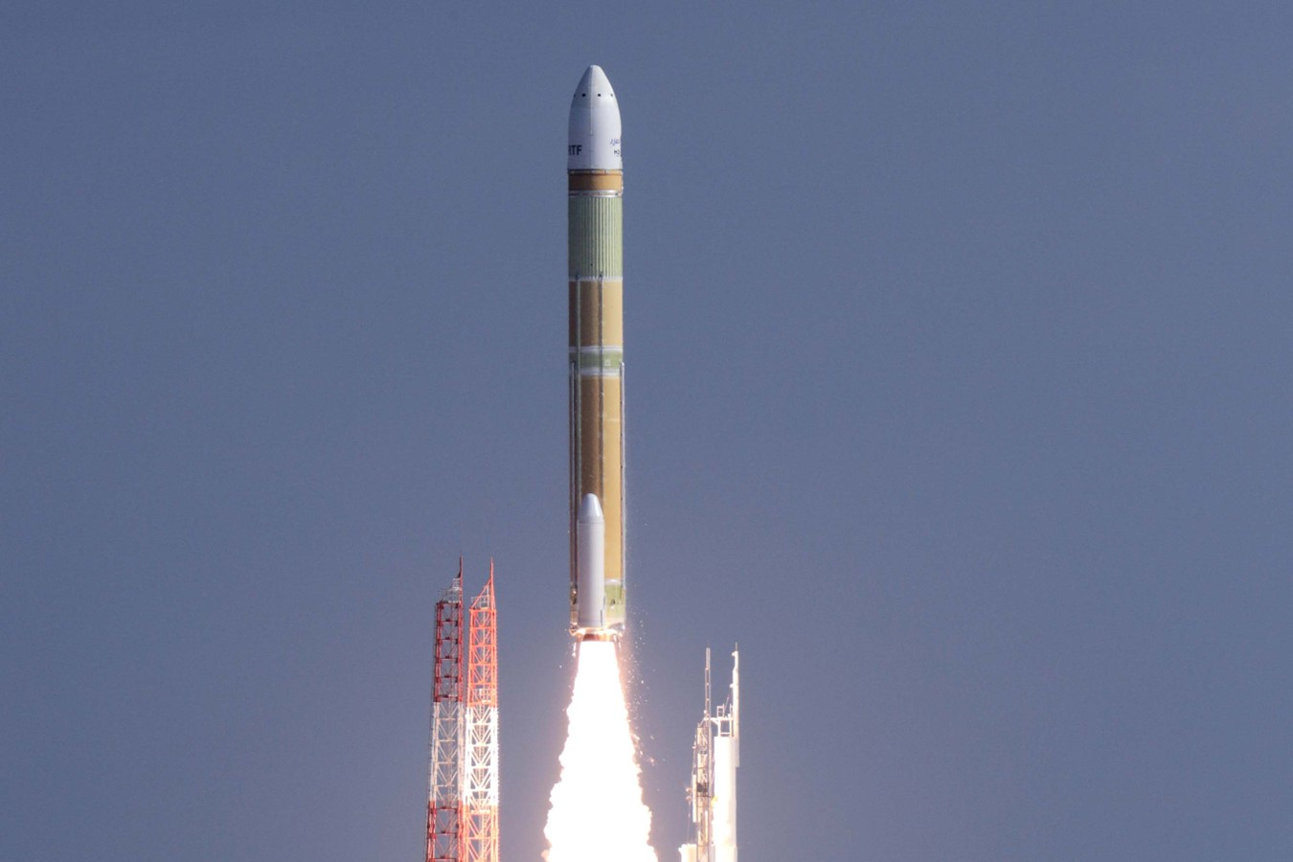
Successful Launch of H3
JAXA launched the second H3 Launch Vehicle (H3TF2) at 9:22:55 (JST) on February 17, 2024 from the Tanegashima Space Center.
6.5 tons or even more to geostationary transfer orbit (GTO) (ΔV=1500 m/s)

Slide 4
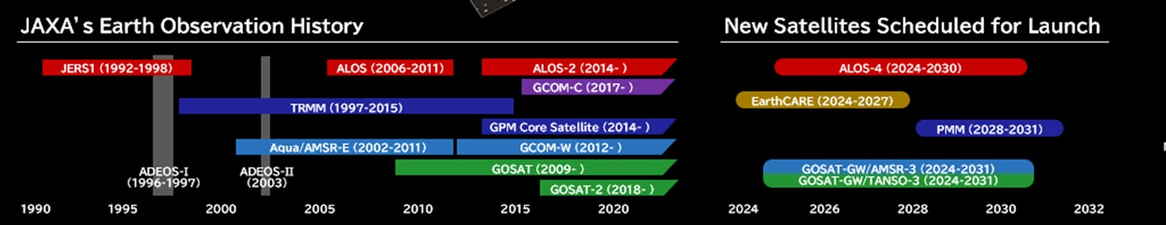
History and Launch Schedule
March 2023: ALOS-3 (Optical) was lost due to H3 Test Flight #1 (TF1) rocket failure
Feb 17, 2024: H3 TF2 rocket launch (successful)
May 2024: EarthCARE launched by Space X Falcon 9, JAXA provides Cloud Profiling Radar (CPR).
FY2024: GOSAT-GW (GHG spectrometers and microwave radiometer) launched by H-IIA
FY2024: ALOS-4 (SAR) by H-3 F3

Slide 5
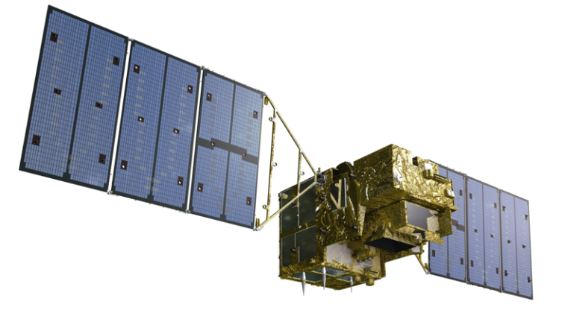
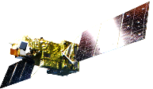
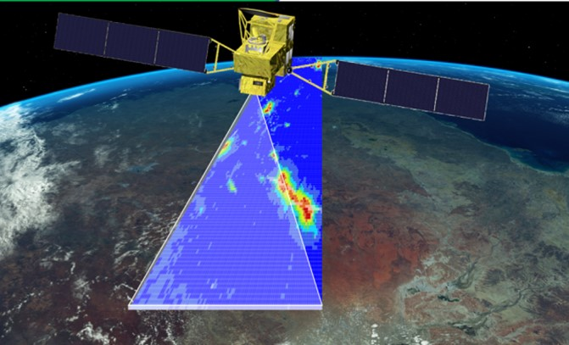
GOSAT Series CAL-VAL
GOSAT (2009-)
Long term (15-year Jan. 2024)
calibrated and validated dataset
Satellite Condition & Calibration
Enough fuel to operate for at least another 10-year
All four batteries are healthy
15-year solar irradiance calibration data set
Level 1 V300.300 (released in March 2023)
Best-estimate radiance spectra using TSIS-HSRS and long-term vicarious-calibration data.
JAXA Level 2 Partial Column product V3
GOSAT (14-year ) and GOSAT-2 (4-year)
Lite (csv format) and HDF with averaging kernels.
GOSAT-2 (2018-)
Intense target observations
using flexible and wider angle pointing
Calibration
The solar irradiance calibration has been suspended since Feb. 2021, Lunar calibration is normal. 5-year monthly lunar calibration data with lunar phase of 7 deg.
Level 1 V221 (released in March 2024)
GOSAT-GW (to be launched in FY2024)
Total Anthropogenic and Natural emissions mapping SpectrOmeter-3 (TANSO-3)
Adding NO₂ as an emission proxy for CO₂.
Imaging Spectrometers
+ Advanced Microwave Scanning
Radiometer 3 (AMSR-3)

Slide 6
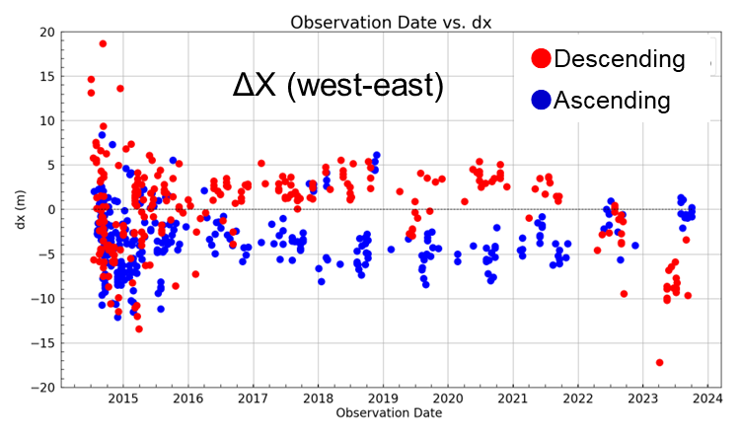
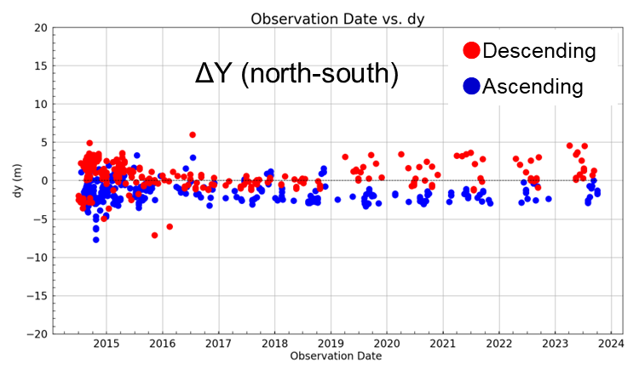
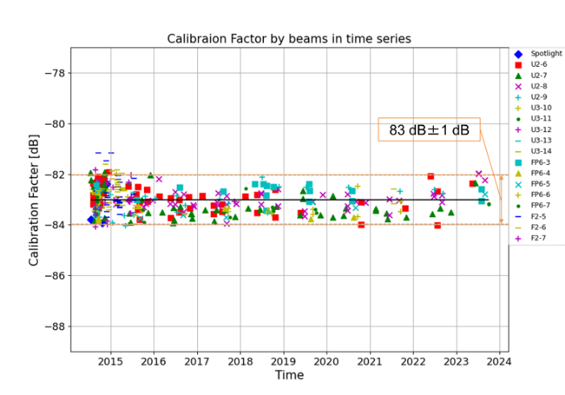
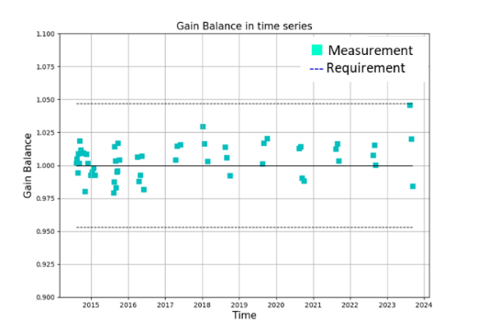
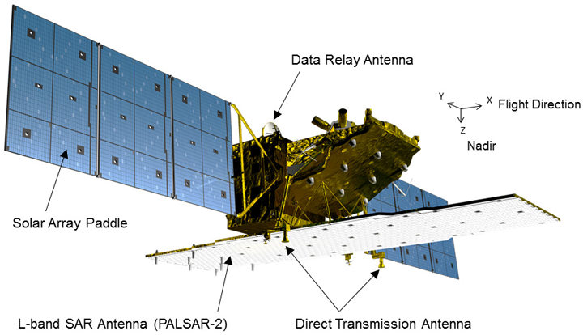
ALOS-2 CAL-VAL
The Advanced Land Observing Satellite-2 (ALOS-2, nicknamed “DAICHI-2”) is the follow-on mission of the ALOS/PALSAR and was launched in May 2014. ALOS-2 currently continues to operate smoothly by PALSAR-2, which is an L-band SAR and suitable for monitoring disasters, forest, agriculture, and infrastructures.
As the calibration activities, geometric accuracy, radiometric accuracy, and polarimetric accuracy of the standard product are regularly evaluated, and the resolution, sidelobe level, noise equivalent sigma zero (NESZ), ambiguity, etc. are measured as the image quality evaluation.
2014
10 years
2024
ALOS-2/PALSAR-2 geometric accuracy
2014
10 years
2024
(b) Time trend of the gain imbalance of VV/HH polarizations.
(a) Time trend of the radiometric accuracy.
ALOS-2/PALSAR-2 radiometric and polarimetric accuracies

Slide 7
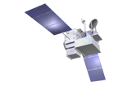
GPM CAL-VAL
The GPM Core Observatory (GPM-CO) satellite performed two orbit boost maneuvers on Nov. 7 and 8, 2023 that raised its altitude by 35km.
  The goal of these boosts is to restore the GPM-CO's lifespan closer to the original estimates of ending in the early 2030’s. Recent lifespan estimates have been getting shorter due to unexpectedly high solar activity, which causes additional atmospheric drag on the spacecraft.
  The primary goal of restoring GPM-CO’s lifespan is to allow the GPM mission to overlap with the satellites associated with the future Atmosphere Observing System (AOS) mission planned by NASA, JAXA, and other agencies, allowing for intercalibration of instruments between the GPM and AOS missions.
    https://gpm.nasa.gov/missions/gpm/orbit-boost
  NASA and JAXA started to provide the Dual-frequency Precipitation Radar (DPR) products, experimentally corresponding to the GPM Orbit Boost, on 16th January 2024, and are planning to resume the standard DPR products in March 2024.
    JAXA has been conducting calibration and validation of the DPR products corresponding to the GPM orbit boost.
442km
0.7°
407km
0.7°
5.0km
5.5km

Slide 8
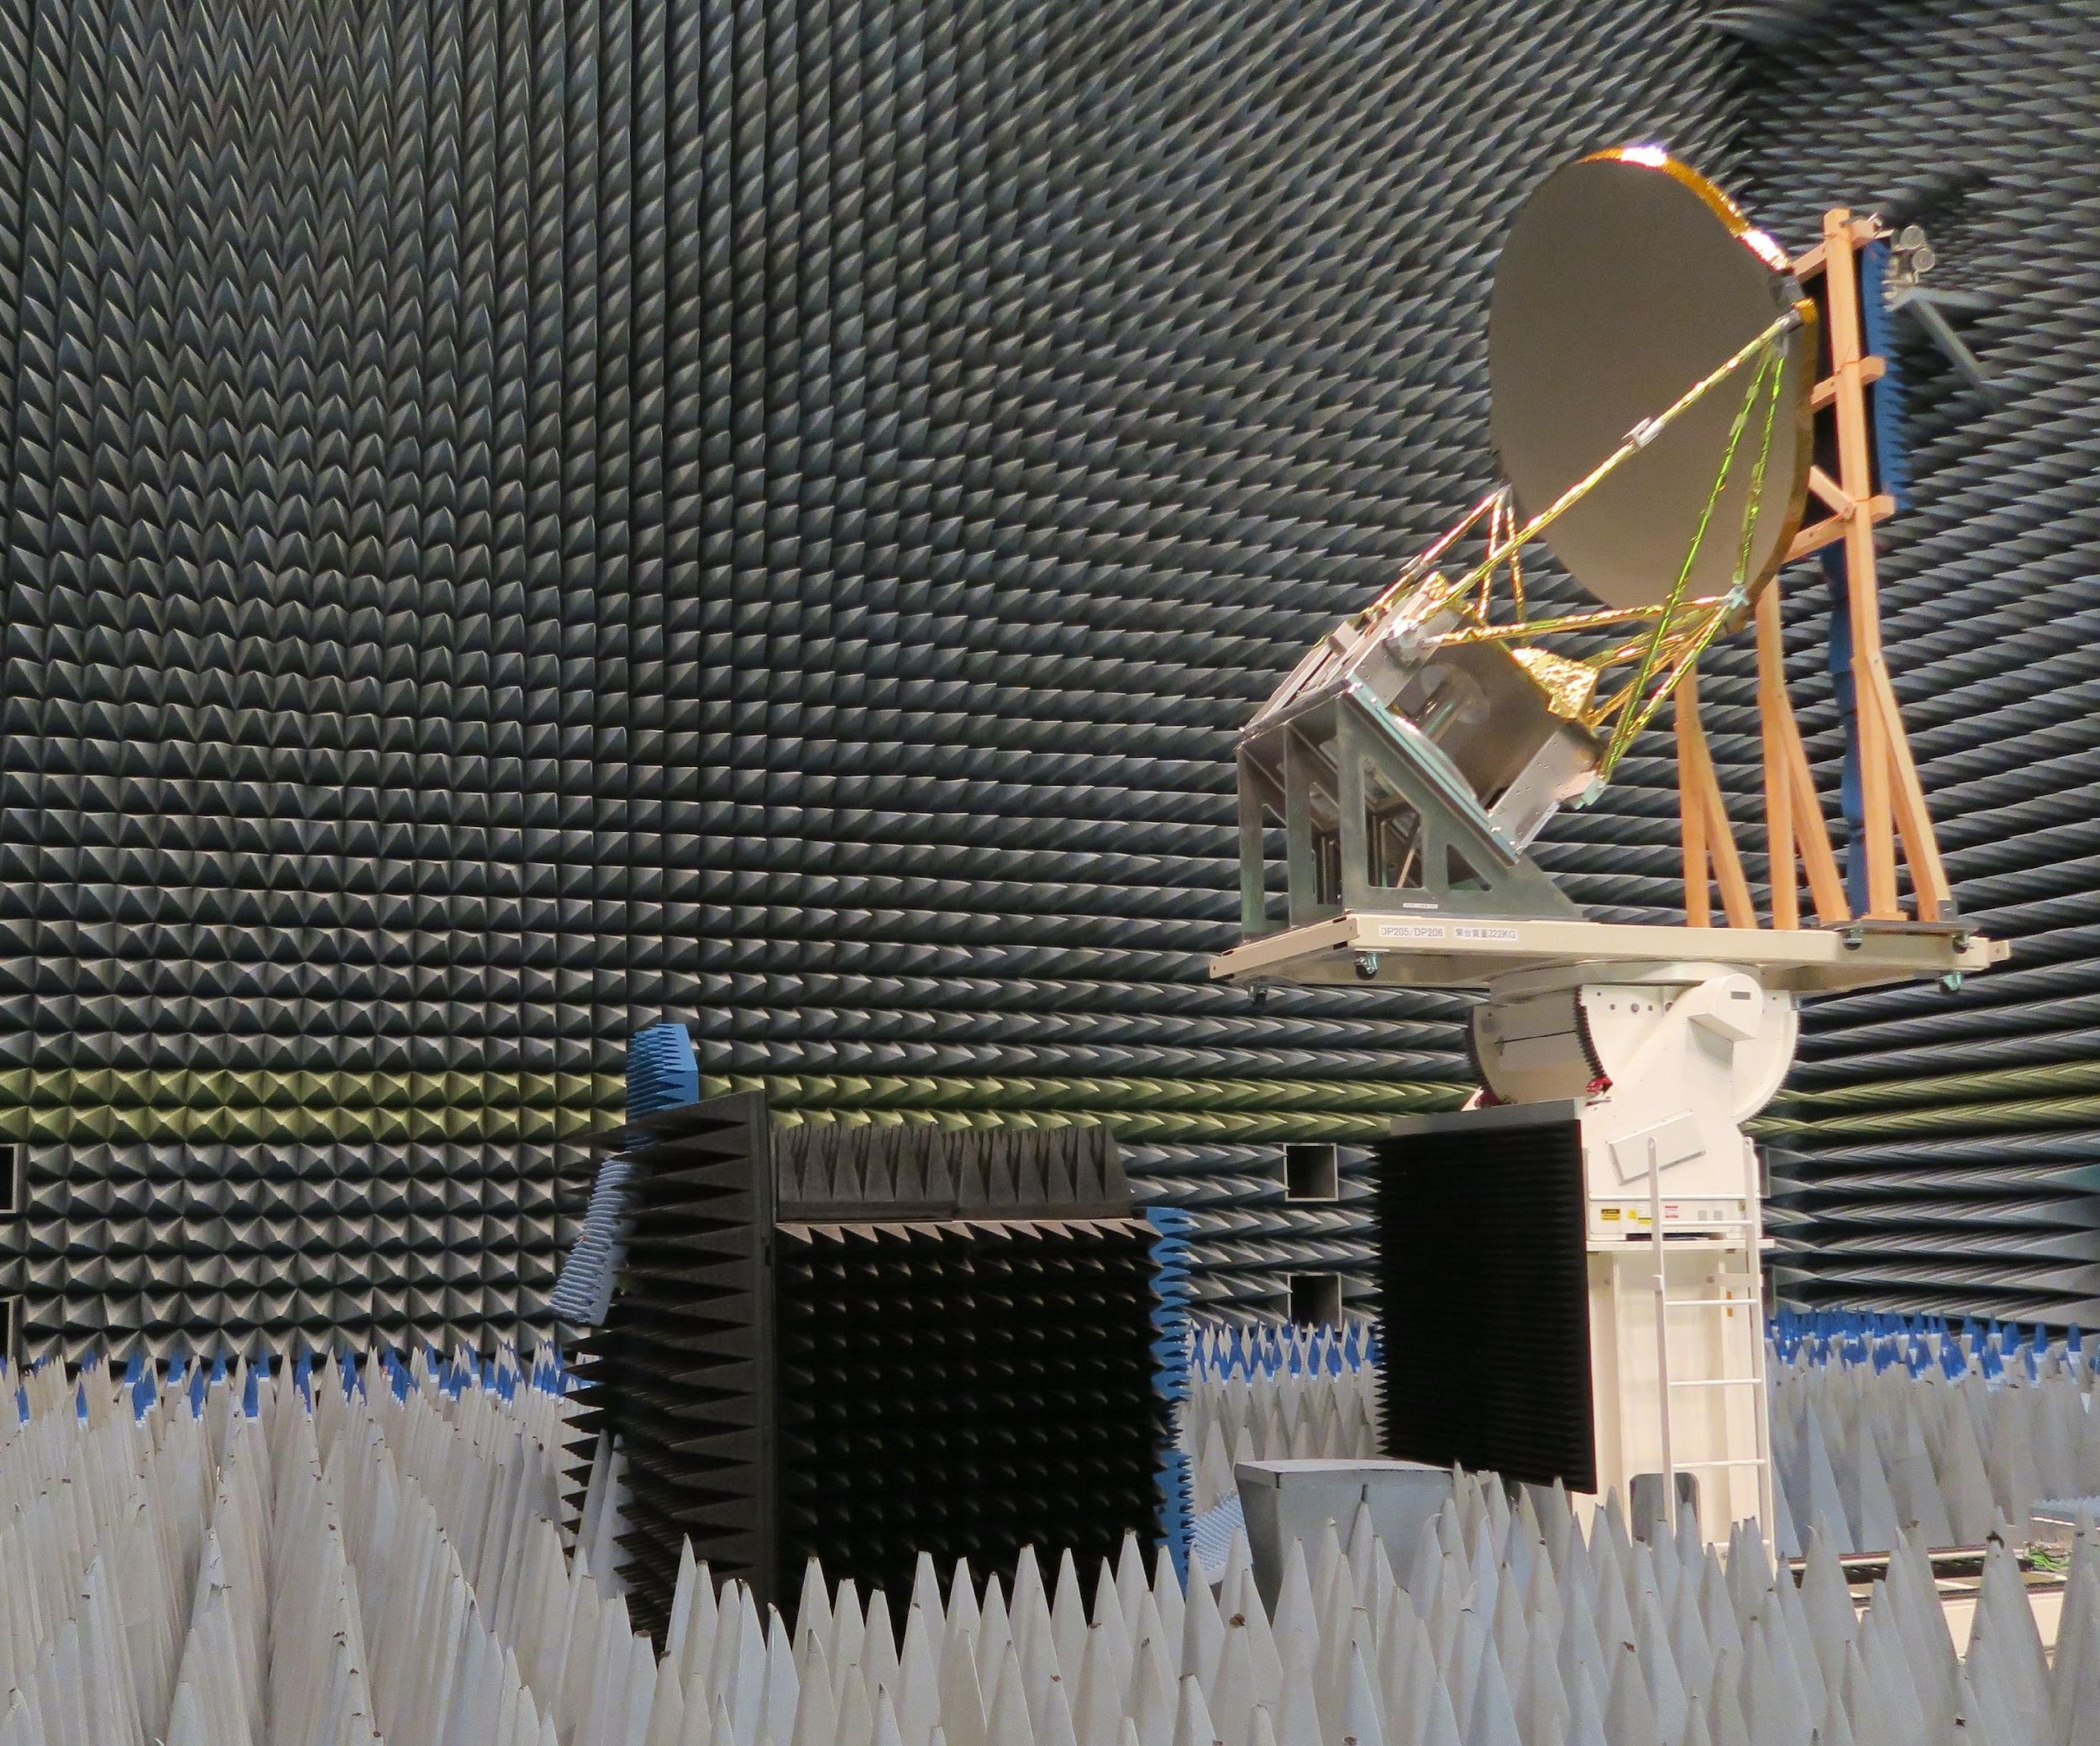
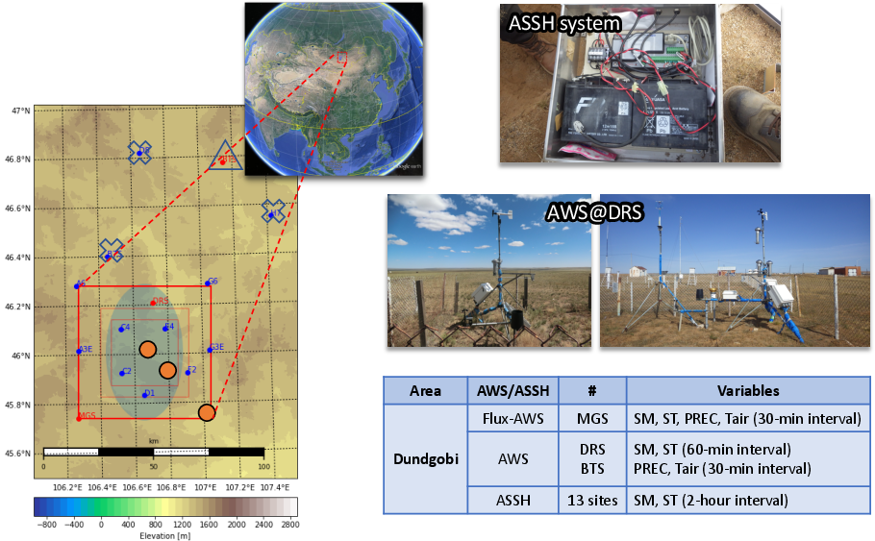
GCOM-W CAL-VAL
Global Change Observation Mission – Water (GCOM-W) “SHIZUKU” carrying the Advanced Microwave Scanning Radiometer 2 (AMSR2) has been operated since May 2012, and its successor, AMSR3, will be launched in JFY2024.
Calibration of AMSR2
  AMSR2 Level-1 sensor calibrations (radiometric, geometric)
  Cross-calibration with other MW sensors (GMI, TMI, AMSR-E)
  Monitoring of RFIs in C-band by using 6.9 & 7.3 GHz channels
Validation of AMSR
  Continue routine validation of AMSR2 basically by utilizing existing observation networks such as radiosonde, GPS, buoys, ground radar, other surface measurements by meteorological agencies, and satellite instruments
  Specific field sites for soil moisture observation are developed and operated in Mongolia and Australia under collaboration with universities
Preparation for future AMSR3
  Currently manufacturing flight models and conducting pre-launch tests, including antenna pattern test
  Development of calibration plan (pre-launch, post-launch, on-orbit, and cross-calibration) drawing upon AMSR2’s heritage. In addition, we plan to conduct cross-calibration of new high-frequency channels, comparing with GMI and SSMIS
  Development of RFI detection algorithm for X-band by using 10.65 & new 10.25 GHz channels is ongoing
  Renewal of Mongolian soil moisture validation sites, which have been in operation since 2000, is planned in May 2024 as preparation of AMSR3 launch.
AMSR3 pre-launch test
Antenna pattern measurement with MREF and Feed of AMSR3 flight model. Radiation characteristics for channels below 89-GHz were verified.
Mongolian soil moisture validation site since 2000
Provided by Profs. Asanuma & Hirose

Slide 9
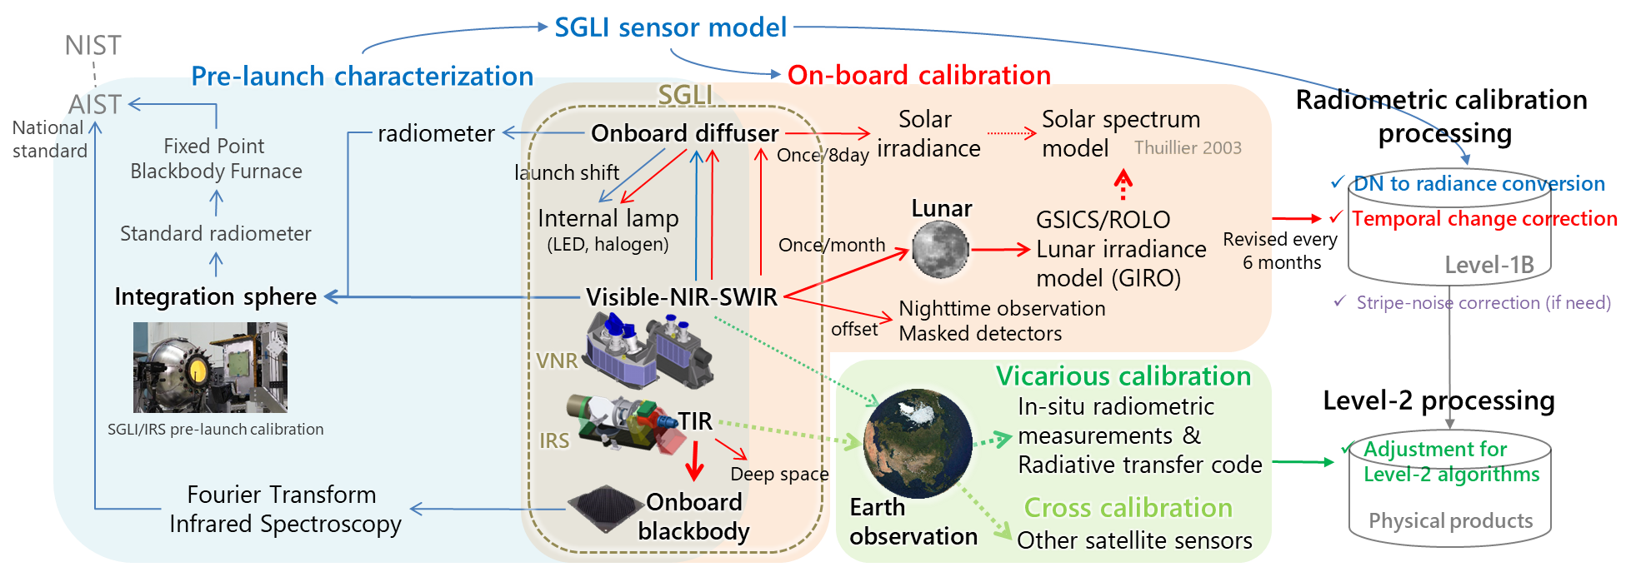
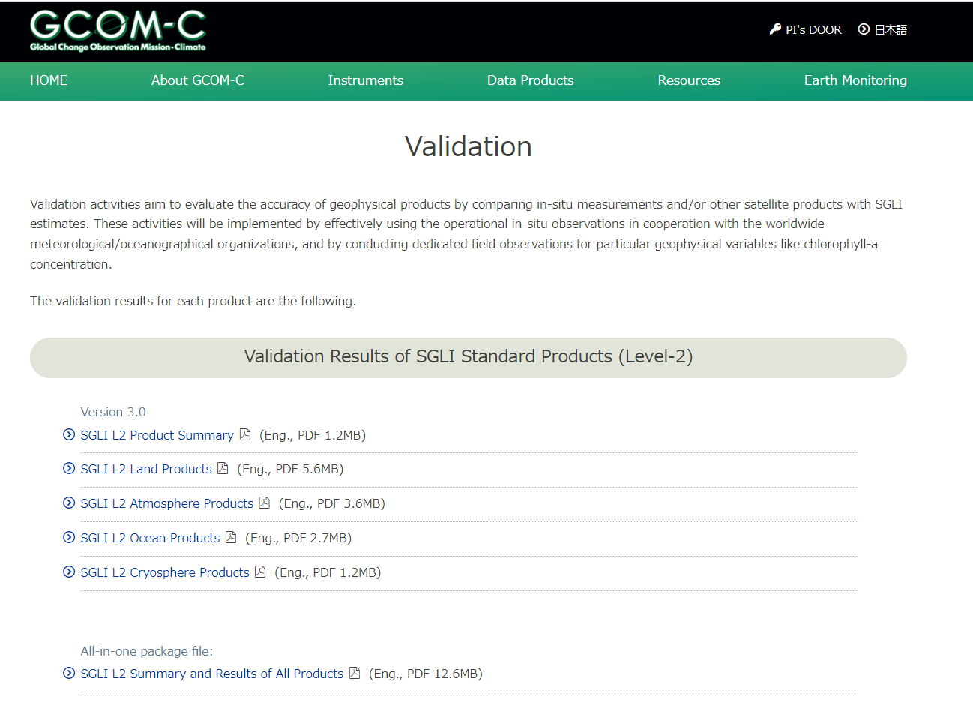
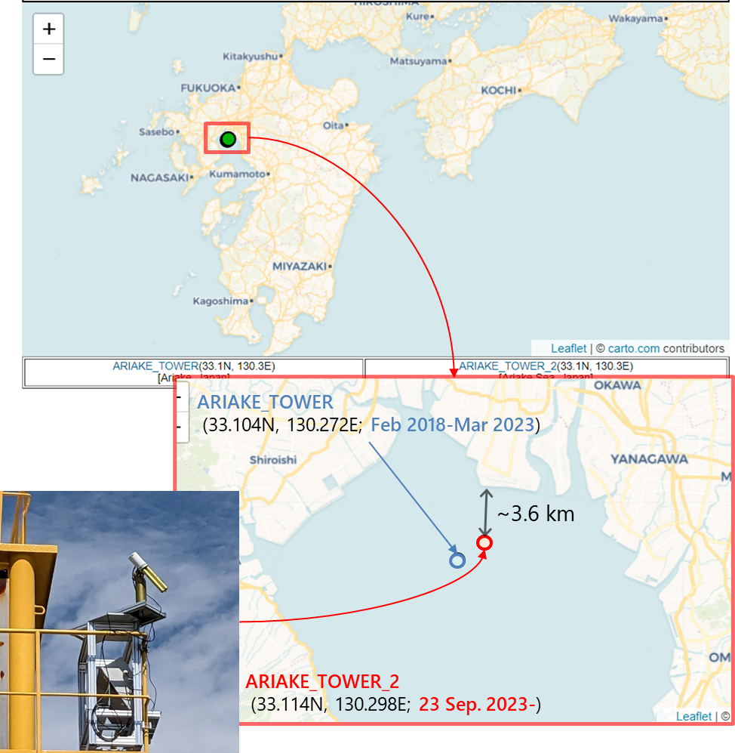
GCOM-C CAL-VAL
Global Change Observation Misson - Climate (GCOM-C) "SHIKISAI" carrying Second-generation GLobal Imager (SGLI) has been operated since Dec. 2017, and currently in the extension phase since 2023.
Calibration of SGLI on GCOM-C
SGLI Level-1 radiometric calibration is based on the sensor model constructed by the pre-launch characterization
Temporal change is corrected by the on-board calibration updated every 6 months in the L1 processing
Vicarious and cross calibration will be used for confirmation of the onboard calibration, and more accurate calibration (adjustment) required for the L2 algorithms
Validation of GCOM-C products
L2 products (the latest version: V3) are validated by in-situ data mainly provided by GCOM-C PIs and collaborated research institutes and agencies
Further evaluation focuses on the timeseries consistency to make long-term data records by the operation continuation
A topic in 2023: Due to the operation termination of the Saga Univ. Ariake observation tower mounting the Aeronet-OC, it has been moved to the Ariake Hayatsue-gawa tower of Saga Prefectural Ariake Fisheries Research and Development Center (ARIAKE_TOWER_2)
https://suzaku.eorc.jaxa.jp/GCOM_C/data/validation.html
ARIAKE_TOWER_2

Slide 10

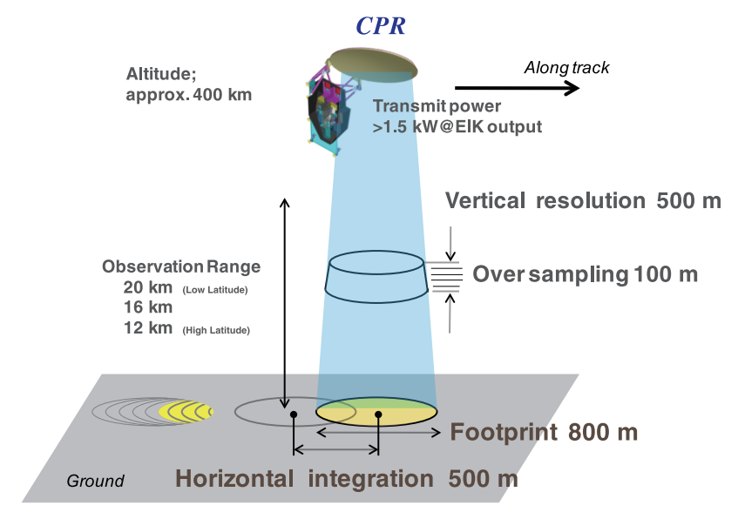

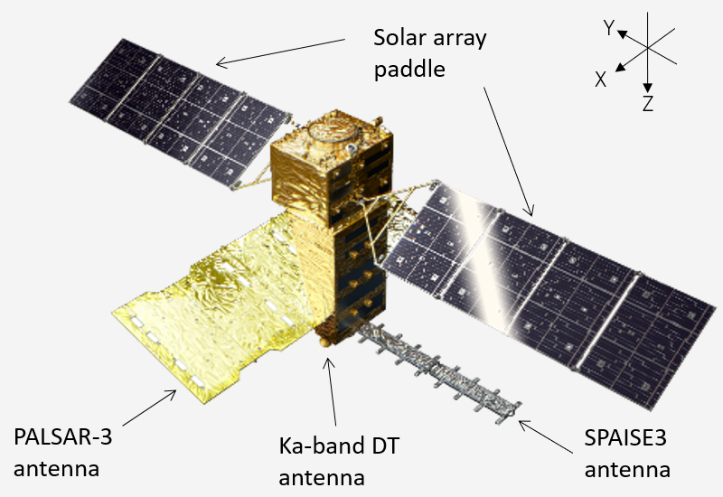
To be launched in FY2024
The Advanced Land Observing Satellite-4 (ALOS-4) is a successor of the SAR mission of ALOS and ALOS-2. ALOS-4 will be equipped with the phased array type L-band synthetic aperture radar (PALSAR-3).
The observation swath of ALOS-4 will be drastically increased from 50 km (ALOS-2) to 200 km while keeping the high resolution.
The Cloud Profiling Radar (CPR) will provide vertical profiles measurements of clouds and have the capability to observe vertical velocities of cloud particles through Doppler measurements. It will operate at 94GHz.

Slide 11
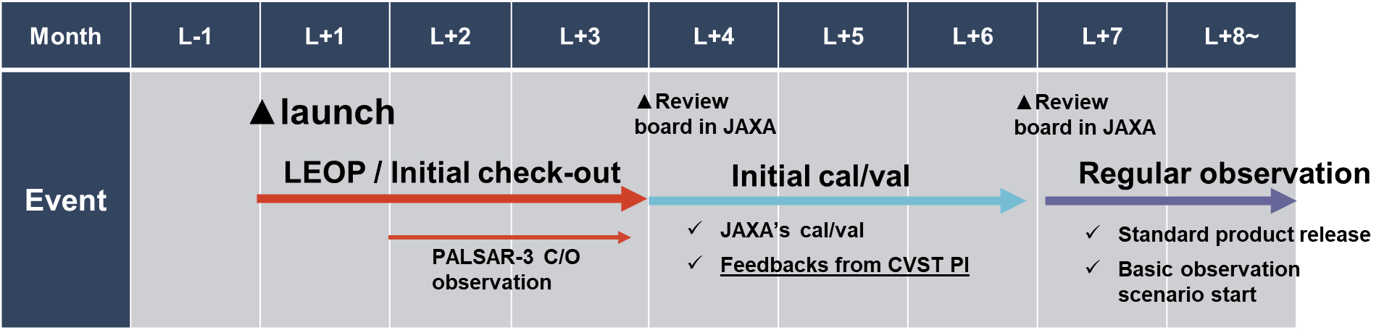
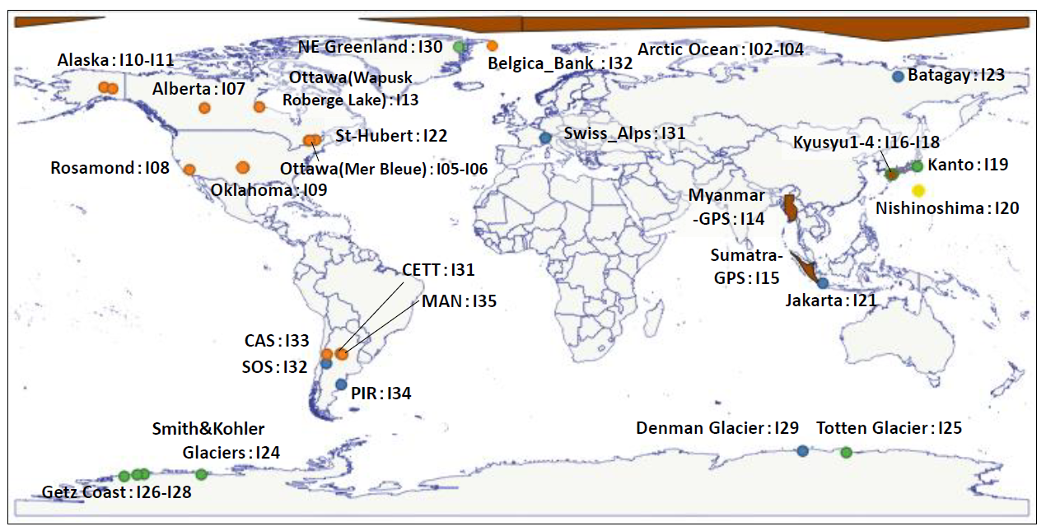
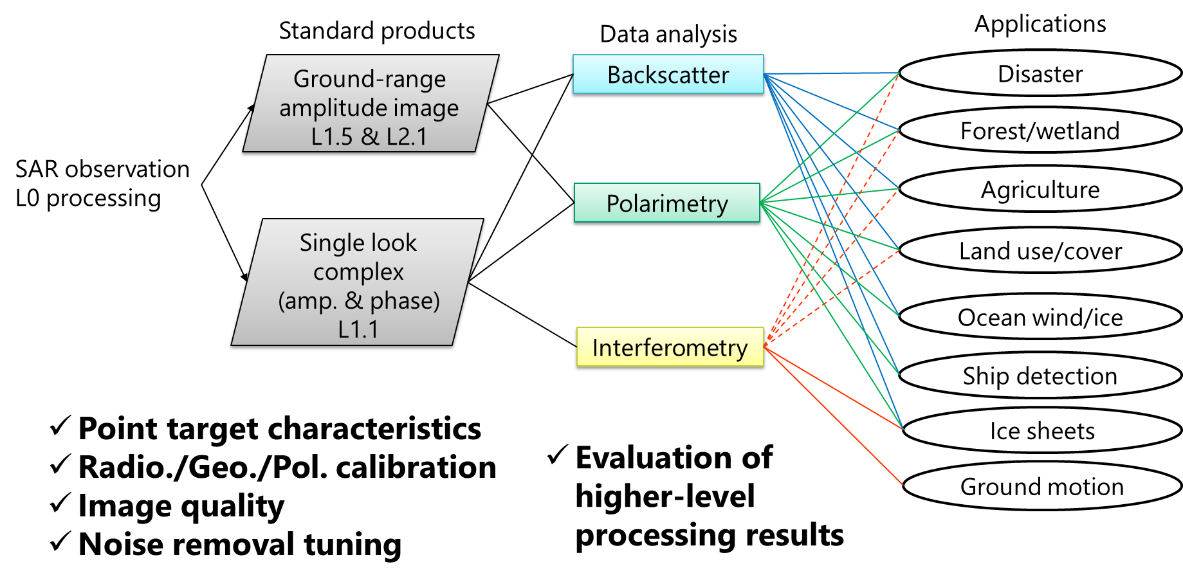
ALOS-4 CAL-VAL
The Advanced Land Observing Satellite-4 (ALOS-4, nicknamed “DAICHI-4”) is the follow-on mission of ALOS-2 and carrying on PALSAR-3.
The development completion review is currently underway, then ALOS-4 satellite will ship to Tanegashima Space Center, JAXA for preparing its launch by H3F3.
Initial operation plan of ALOS-4
Cal/Val sites in the ALOS-4 “Calibration, Validation and Science Team” (CVST)
Initial Cal/Val plan of ALOS-4

Slide 12
Presenter Guidelines 1
Presenters should name their file using the following convention:
  AgendaItemNumber_LastName_Subject_Version (e.g., 1.1_Goryl_WGCV-53_Welcome_v1)
Documents and presentations should be uploaded to the shared folder to allow for streamlined self service
  Shared Presentation Folder (default view only, ask for upload/edit permission as required)
  For support contact riza@symbioscomms.com or matthew@symbioscomms.com
  Documents for endorsement should be submitted by 20 Feb
  Documents (for information only) and Presentations should be submitted by 27 Feb
Reporting to engage discussion or decision is encouraged, but detailed reporting should be provided as pre-meeting reading material or in background slides.
Meeting website: https://ceos.org/meetings/wgcv-53/
Slide ‹#›

Slide 13
Presenter Guidelines 2
Please explicitly highlight the decisions, outcomes, or actions you are seeking. The more explicit you are, the better. i.e., feel free to provide text for a proposed action – it may be revised later, but this approach will help with the efficient preparation of the actions record.
Slide ‹#›

