Slide 1
WGCV-53
SARCALNET update
Bruce Chapman
California Institute of Technology
Jet Propulsion Laboratory
Dirk Geudtner
European Space Agency
Stéphane Côté
Canada Space Agency

Slide 2
SARCalNet
The www.SARCALNET.org website is online (currently requiring a password to enter) and contains
Sample target sites
Documents library including drafts of the
SARCALNET Handbook
Requirements documents
On artificial targets
On natural targets
On image calibration analysis
Submission template
Links to resources such as software calibration tools, SAR data providers, etc.
Thanks to the hard work of Paolo Castracane, Muriel Pinheiro, Antonio Valentino and others at ESRIN!

Slide 3
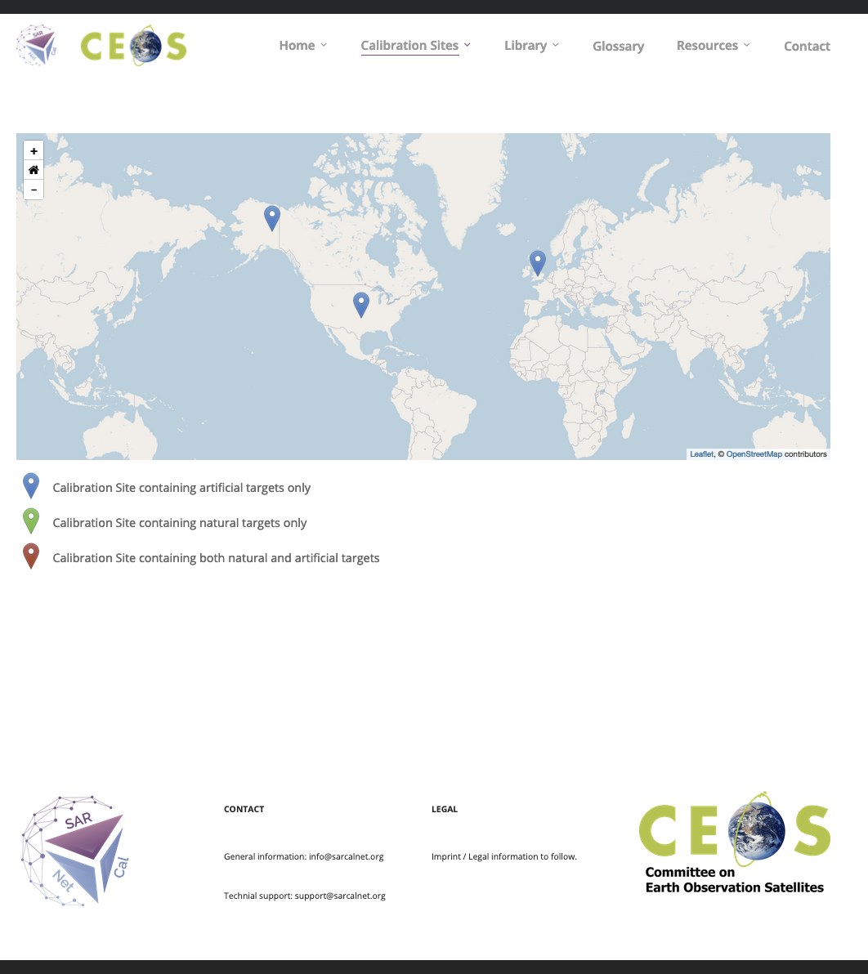
SARCalNet
Raising Awareness of SARCALNET
IGARSS 2023
“Opportunities for coordination of Cal/Val, data fusion and data assimilation for international spaceborne SAR missions”
CEOS WGCV SAR subgroup meeting 2023
Update on SARCalNet plus discussion topics
Discussed framework for Radcalnet sites (Medhavy T.)
EUSAR 2024
“The CEOS SAR Calibration Network – SARCalNet“

Slide 4
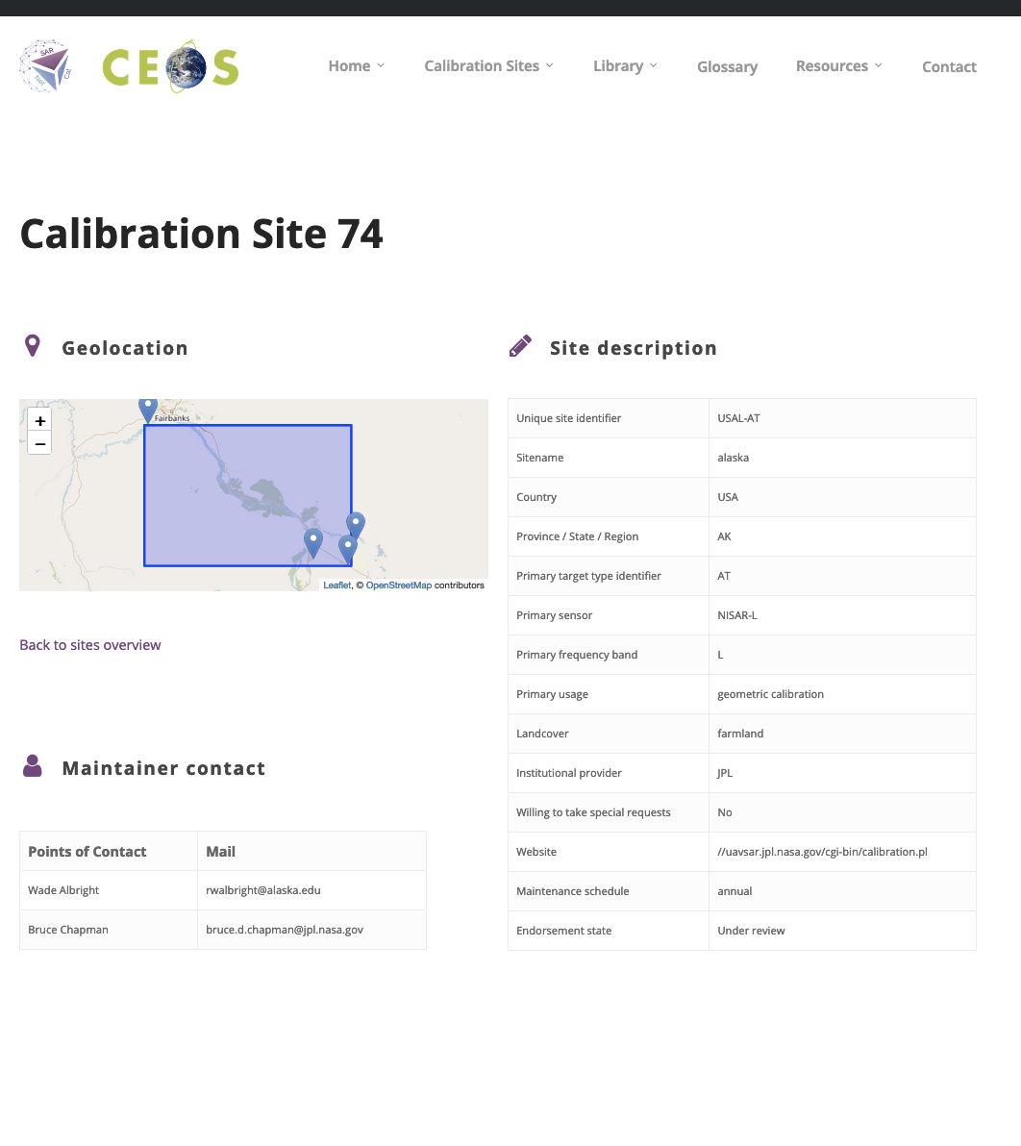
SARCalNet
Next steps
Refinement of website design
June 2024
Final drafts and reviews of documents
Sept 2024
Establish committee to review submissions
Process like CEOS ARD?
October 2024
Natural target selections and monitoring
January 2025

Slide 5
SARCalNet
Future enhancements
Enhanced software tools library
Hosting or linking to public repositories of SAR calibration imagery

