Slide 1
WGCV-53
Infrared Visible and Optical Sensors (IVOS) subgroup: #35
Nigel Fox, NPL/UKSA
Agenda Item 2-5
WGCV-53, Cordoba, Argentina
5th - 8th Mar 2024

Slide 2
Mission Statement
Mission
“To ensure high quality calibration and validation of infrared and visible optical data from Earth observation satellites and validation of higher level products”

Slide 3
Terms of Reference
Promote international and national collaboration in the calibration and validation of all IVOS member sensors, Level 1.
Address all sensors (ground based, airborne, and satellite) for which there is a direct link to the calibration and validation of satellite sensors;
Identify and agree on calibration and validation requirements and standard specifications for IVOS members;
Identify test sites and encourage continuing observations and inter-comparison of data from these sites;
Encourage the preservation, unencumbered and timely release of data relating to calibration and validation activities including details of pre-launch and in flight parameters.
In the context of calibration and validation encourage the full consideration of “traceability” in all activities involved in the end-to-end development of an EO product including appropriate models and algorithms.

Slide 4
IVOS: Vision
To facilitate the provision of ‘fit for purpose’ information through enabling data interoperability and performance assessment through an ‘operational’ CEOS coordinated & internationally harmonised Cal/Val infrastructure consistent with QA4EO principles.
Pre-flight characterisation & calibration
Test – sites
Comparisons
Agreed methodologies
Community Good Practises
Interchangeable/readable formats
Results/metadata - databases
Shared learning
Recommendations as appropriate
Key Infrastructure to be established and maintained independent of sensor specific projects and/or agencies

Slide 5
Work plan
Structured into themes and led by ‘champions’ (Plus specific projects)
Land surface reflectance - Czapler Myers (U of Arizona USA)
Ocean colour (link to IOCCG, VC-OCR etc) - Murakami (JAXA JPN)
Surface Temperature (link to VC-SST, GHRSST) - Corlett (Eumetsat)
Geo spatial image quality - Helder (SDSU, USA) & Viallefont (ONERA F)
NEED TO REPLACE + hold meeting to define scope
PROJECTS
PICSCAR P Henry (CNES)
RadCalNet M Bouvet (ESA)
SST & OC Comparisons N Fox (NPL)
Vocabulary E Woolliams (NPL)
Sensor pre-flight workshop N Fox (NPL)
Uncertainty/traceability S Hunt (NPL)

Slide 6
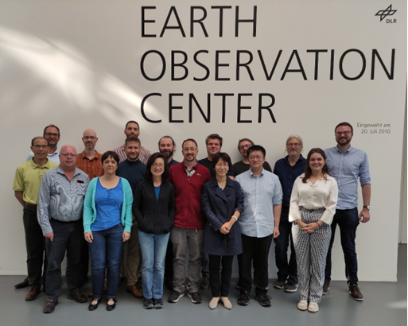
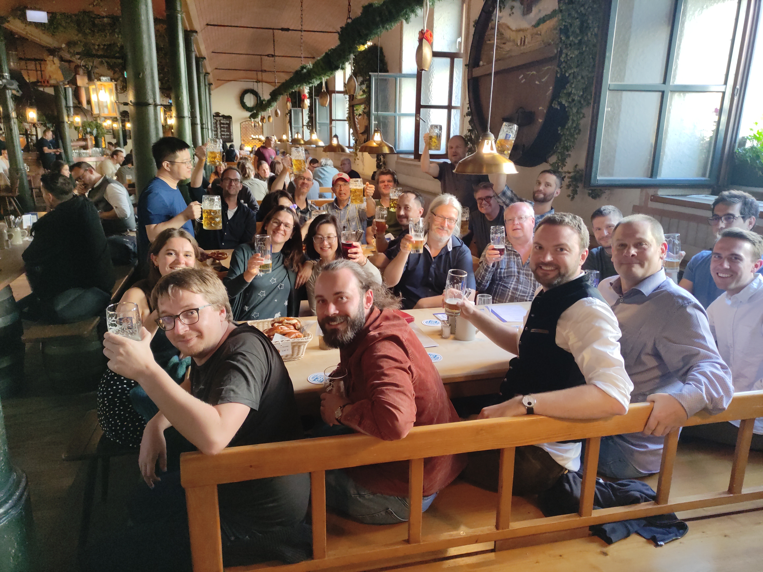
Summary of activities
IVOS 35 @ Oberpfaffenhofen, Germany
hosted by DLR Sep 2023
(next meeting AIST, Tokyo, Japan, Sep 9-14 2024)
28 agency/orgs represented
26 attendees + 36 on-line
Most themes and topics (work-plan
discussed or summarised)
  mett
Special Projects/Activities:
FRM4STS comparison results agreed papers reviewed and being published
VH-RHODA & JACIE interfaces
Pre-flight Cal workshop
Lunar workshop (GSICS Led)
Special Projects/Activities:
RadCalNet team met Sep 23
Regular telecons
Terminology task team linked with WGCV
FRM4Veg Comparison (LPV) SRIX

Slide 7
IVOS 35 Topics
Comparison tools
QA initiatives (VH-Rhoda & Jacie)
Cal/Val methods/Services (RadCalNet, Hypernets, RT-Code, STAR)
Impact of Solar Irradiance spectrum change
‘Test-sites’ + Moon
Sensor performance assessment and status (inc various new space)
Hyperspectral sensors (Inc DLR special session)
Uncertainty, Traceability, interoperability: what and how
CEOS WGCV projects/Actions:
- SST comparison, LST network, SITSats, FRM (QA), Pre-flight,
TIRCalNet
Communications

Slide 8
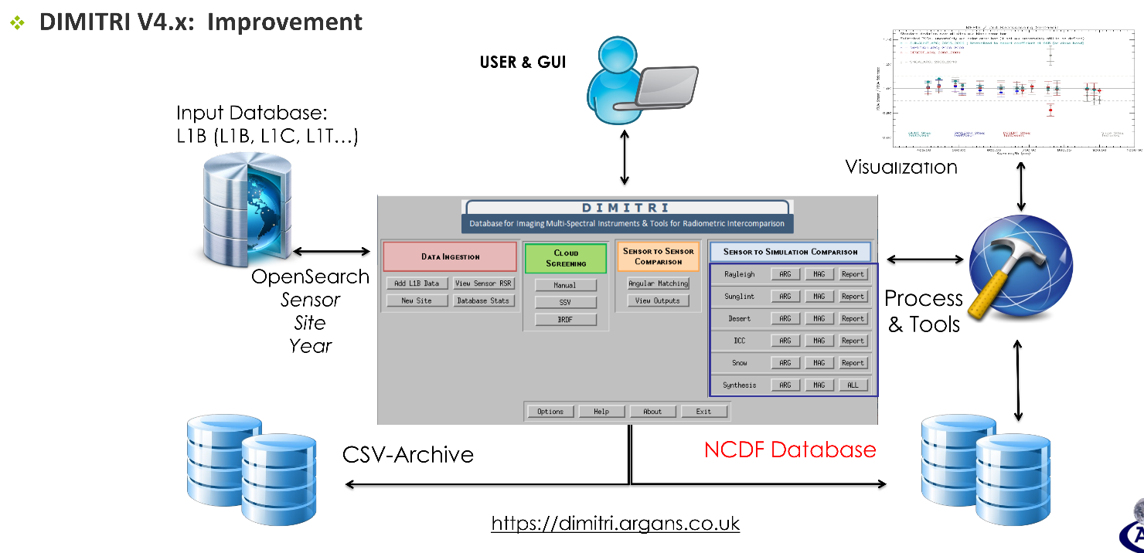
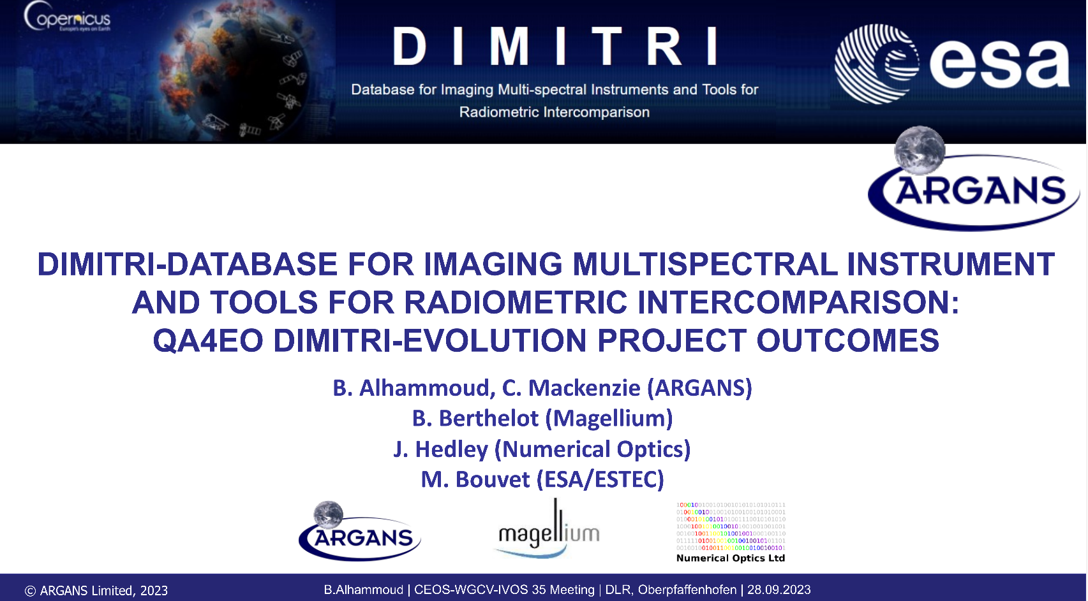
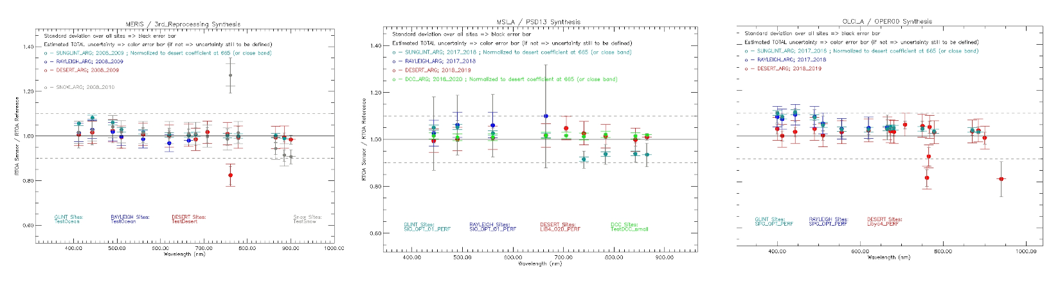
Comparison tools
Ongoing DIMITRI developments
MERIS 4th reprocessing reader
Improve PICS and snowy sites methodologies
  Use libradtran 2.0.5
  Use PICSAND for spectral interpolation
  Recompute hyperspectral BRDF models
  2 new mini sites (<~20 km size), e.g. Gobabeb
  extend PICS BRDF to SWIR
Adaption of DIMITRI to the FLEX mission
Create an on-line version VICALOPS

Slide 9
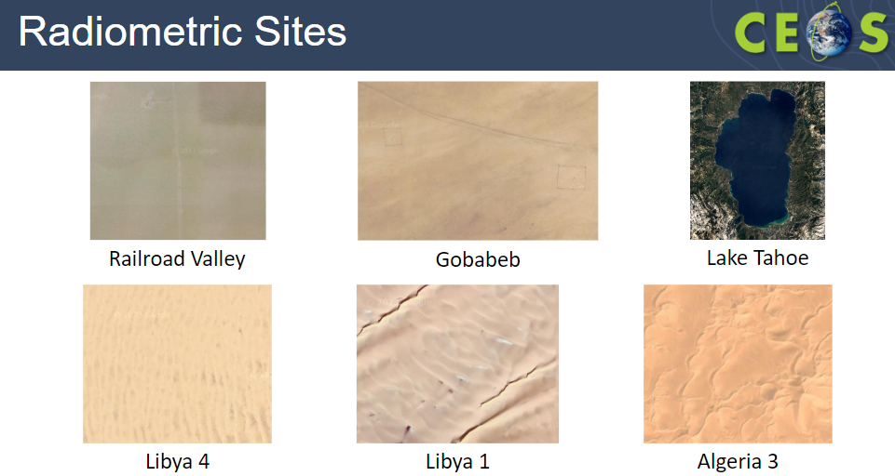
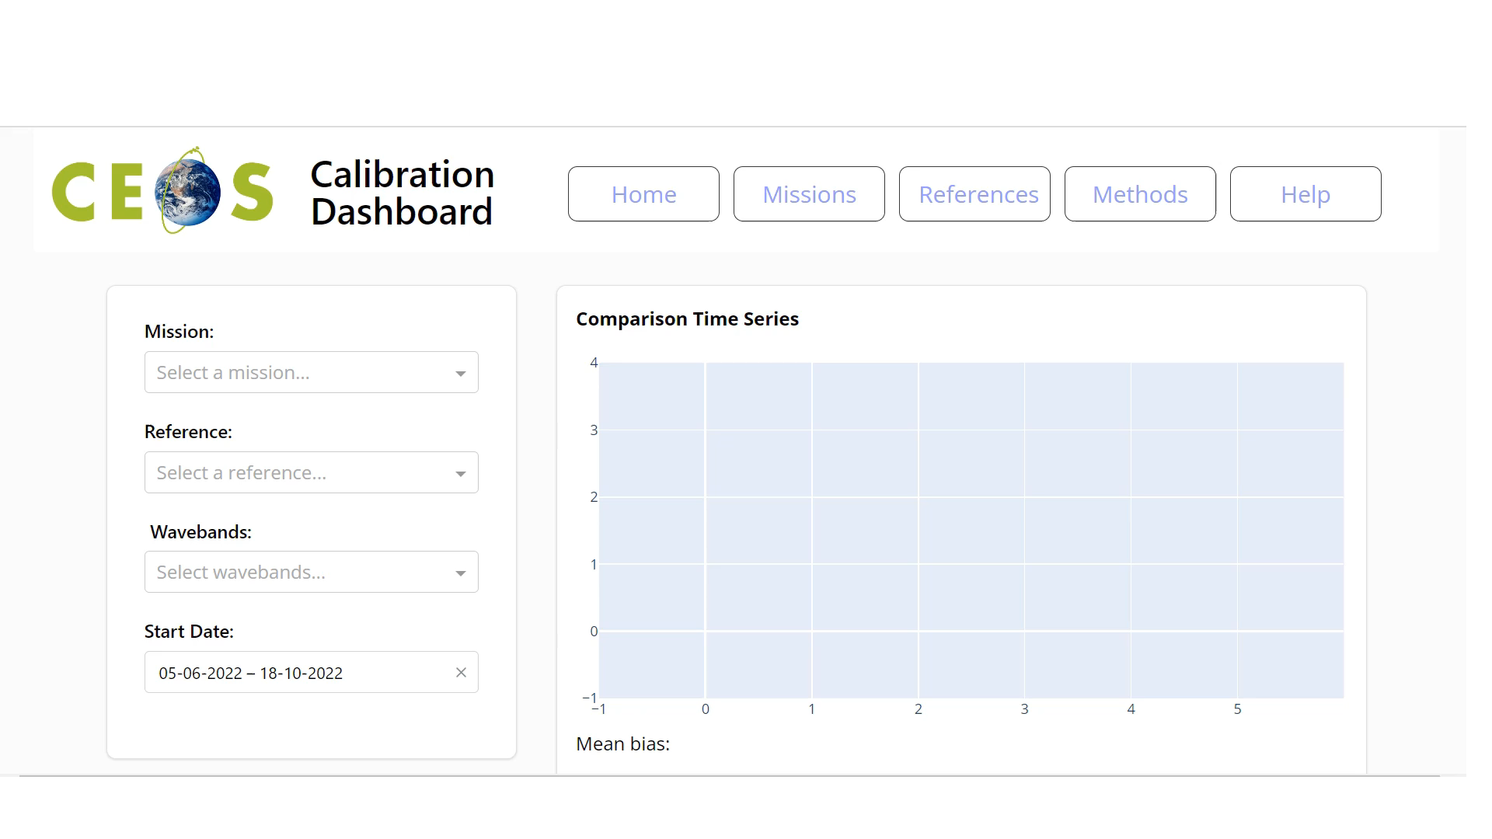
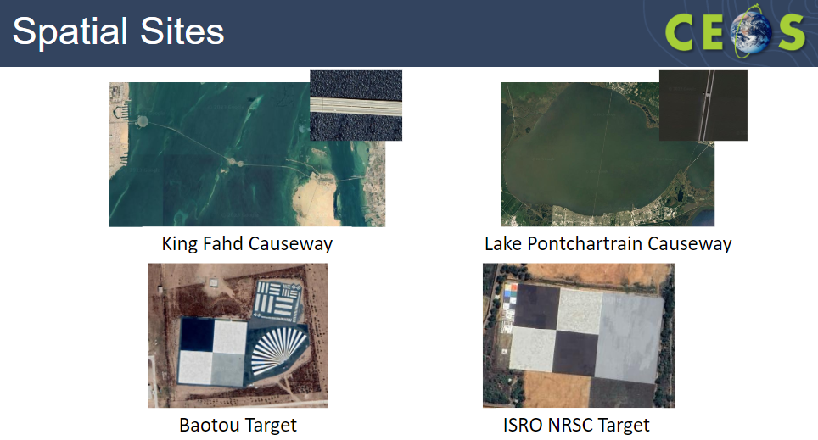
Comparison tools: Level 1 (newspace)
IVOS requests WGCV endorses identified subset of test-sites as a minimal set to request relevant satellite operators (particularly new space) to make regular aquisitions and provide data (imagery and radiometry to CEOS WGCV as a means of evidencing their capability in a consistent manner

Slide 10
Level 1 Cal/Val infrastructure
Nigel Fox
Sam Hunt
Samantha Malone

Slide 11
CEOS reviewed L1 Vicarious Cal/Val infrastructure
Post-launch Cal/Val essential element of satellite mission – particularly for IVOS sensors
Many methods and variations of methods
  Test-sites (RadCalNet, Hypernets, PICS, Campaigns)
  Moon
  Rayleigh
  DCC
  Flare
  ……
Community (Newspace, agencies) unclear as to what to use for what purpose?
  Absolute gain, stability, relative gain, land/ocean applications ….
Initiatives established to develop, coordinate, optimise and compare similar methods e.g. RadCalNet, PICSCAR
  But difficult to compare between and also for new methods to demonstrate credibility

Slide 12
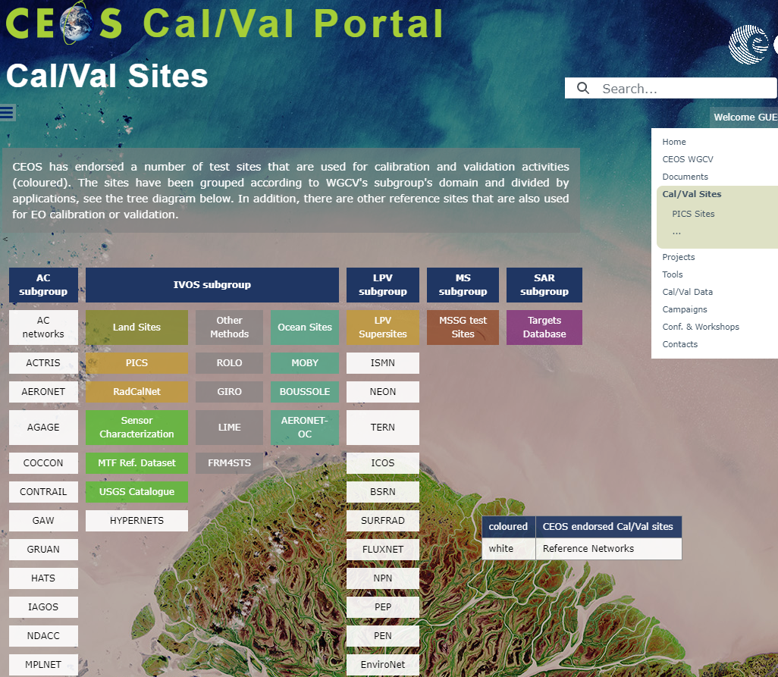
CalValPortal
Provides info on methods
Recommended Sites
But no real figure of merit
IVOS 34 discussion from Flare initiative led to request to establish means to evidence capabilities of a method
  Not necessarily ‘endorse’ but at least ‘reviewed’
  Commercial and public allowed
  Need process for fair but not onerous review
Action for ‘NPL’ to propose a process & template

Slide 13
CV 17-01
Establish means to achieve L1 radiometric interoperability – A community reference
Will create a template on Cal/Val portal (initially private) to record achievable uncertainties for different methods
IVOS team to populate template
Methods must be documented and be subject to peer review (IVOS team)
Evidence of results to specific sensors ideally to include Sensors such as S2, L8/9, S3, VIIRS
Any and all methods to be includable
Next step look to see how to combine results in most effective manner

Slide 14
Process/Template
Method owner to complete a simple web form as an entry to a searchable database
  Accessible through Cal/Val portal
Template to define in simple terms what the method does (Radiometric -gain, relative, stability, Potentially geometric etc)
  Initially at this stage focus only on Radiometric L1 ToA gain
  Type of sensor it is suitable for (GSD, spectral range)
What is it capable of achieving (uncertainty) and evidence to support the claim
Validation evidence of claim using a CEOS defined ‘reference sensor’
  Selected to cover spectral and spatial range and accessibility/acceptance
  Evidence to be visible (accessible URL, document uploaded to Cal/Val Portal)
Completed form to remain private until reviewed by CEOS IVOS members (defined time frame)
Following initial review entry becomes public and searchable
Subject to continuous review by feedback

Slide 15
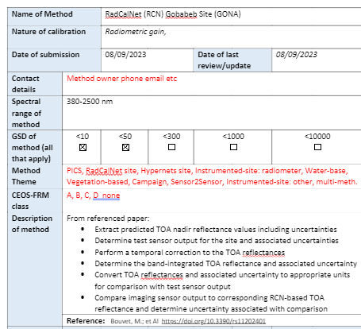

Slide 16
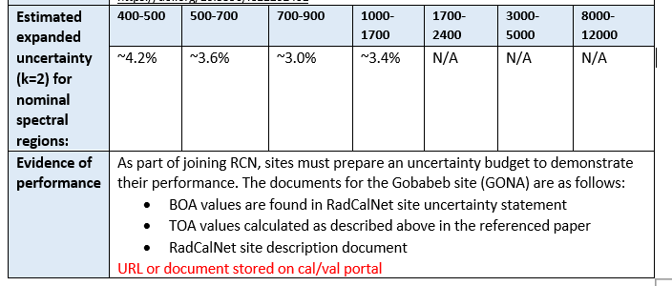
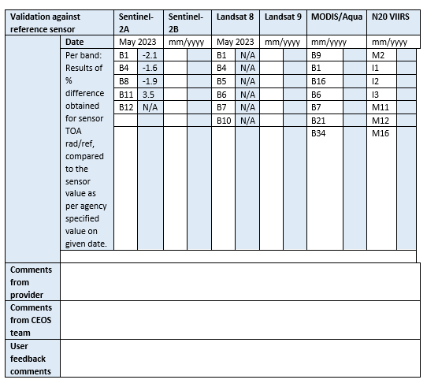
Ranges and sensor bands to be indicative not comprehensive
Could be other sensors?

Slide 17
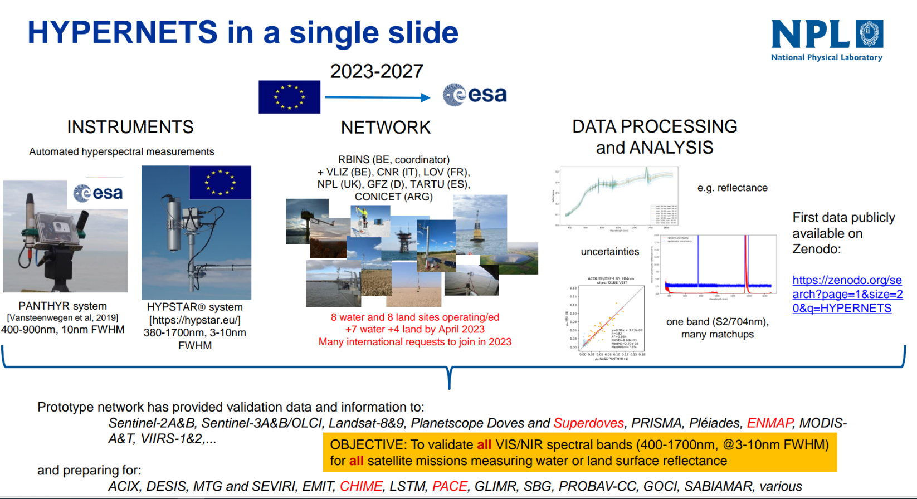



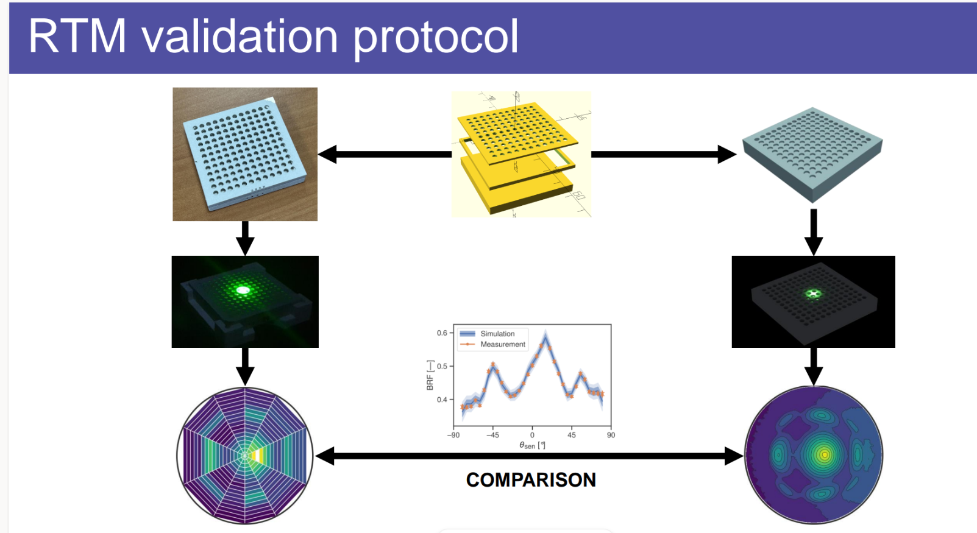
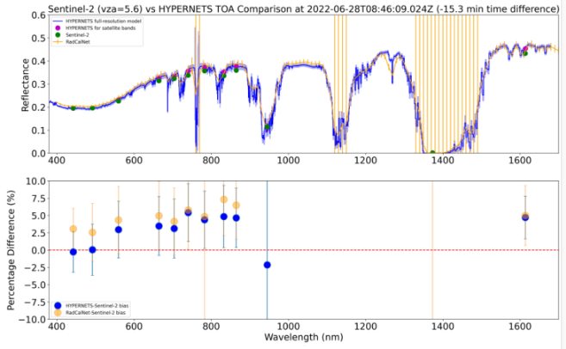
Cal/Val Methods: Pre and post launch
S2 vs RadCalNet & Hypernets at Gobabeb
700 m site difference
Rad is nadir Hyp nearest VZA
Diff RT codes
Equivalence <2% (k=2)

Slide 18
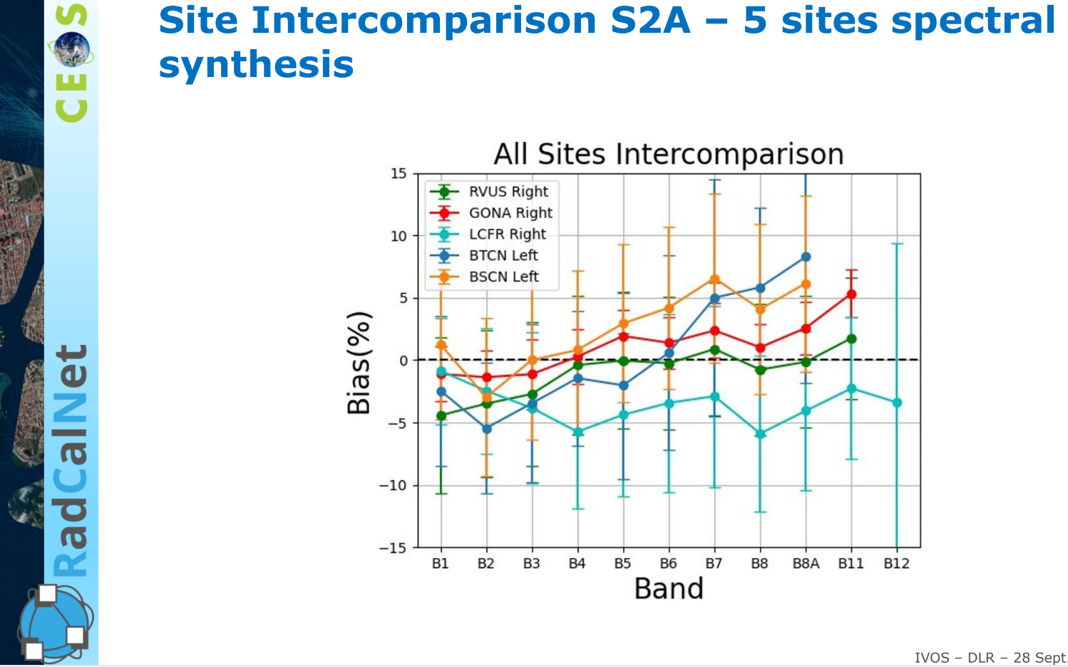
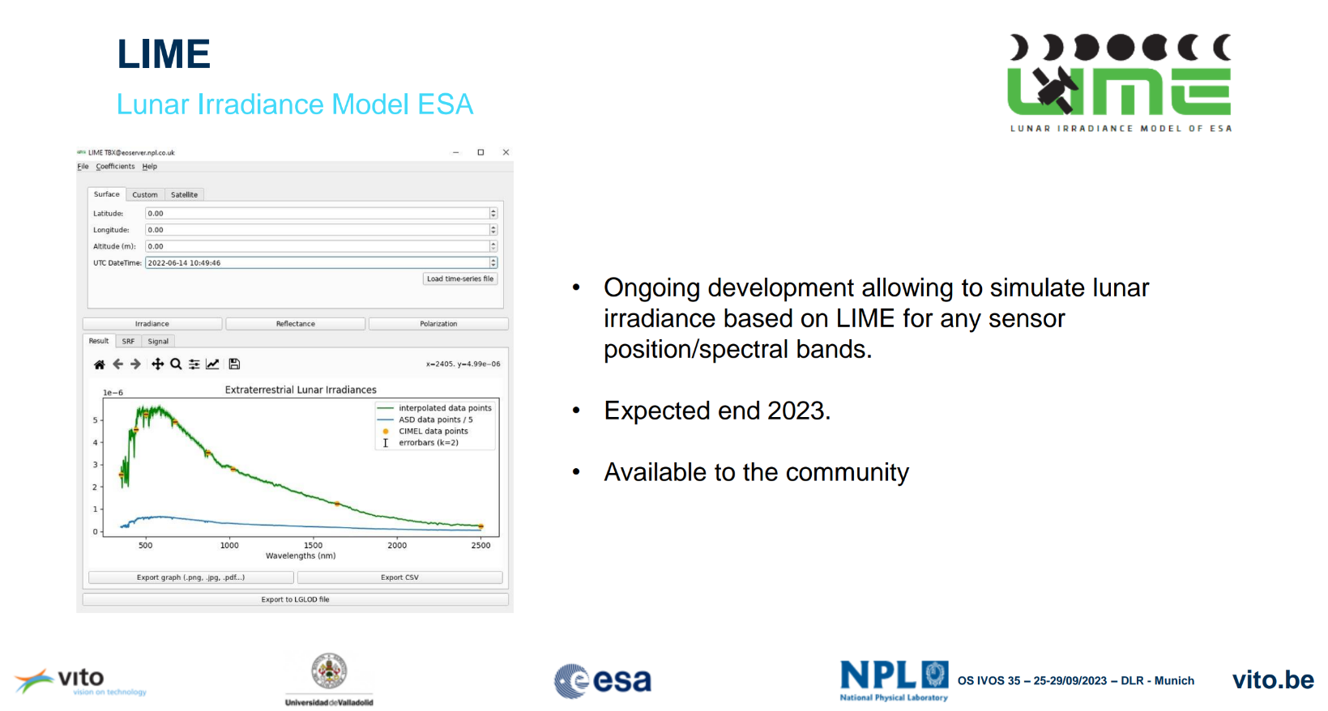
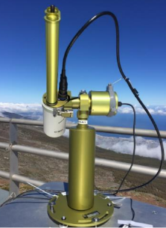
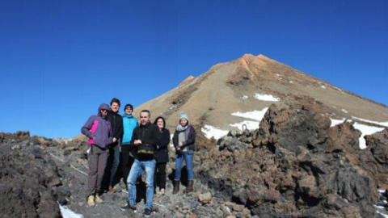
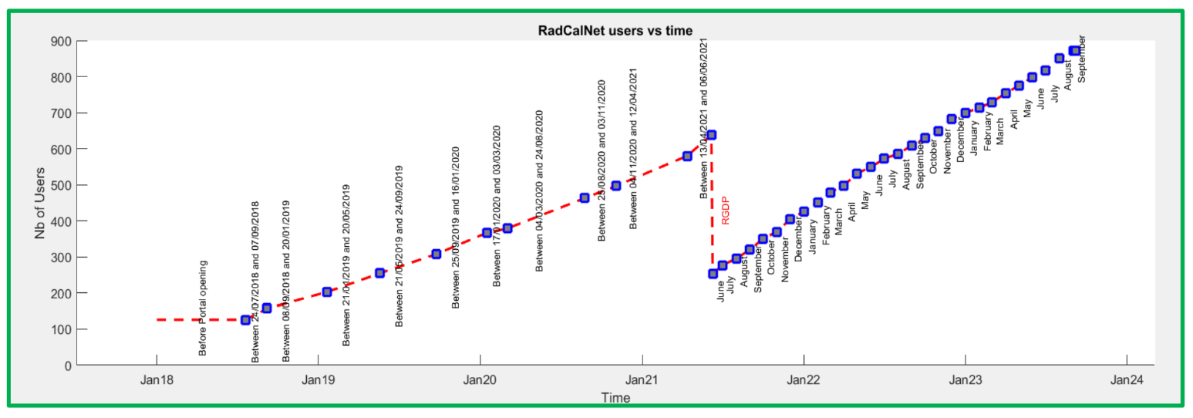
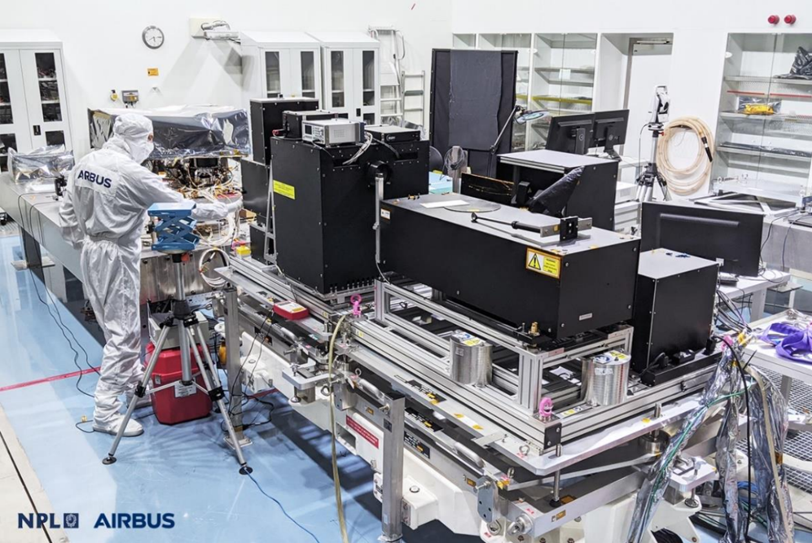
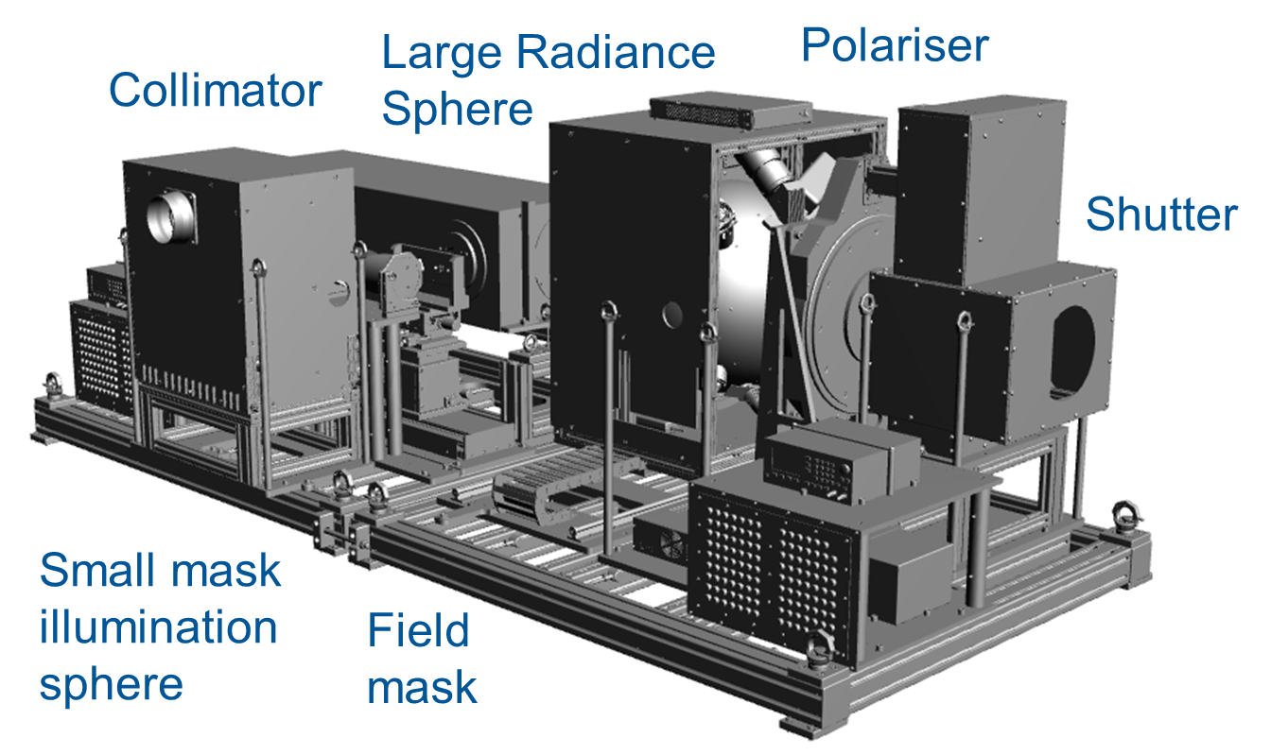
Cal/Val Methods: Pre and post launch
NPL: STAR facility for pre-flight calibration & characterisation

Slide 19
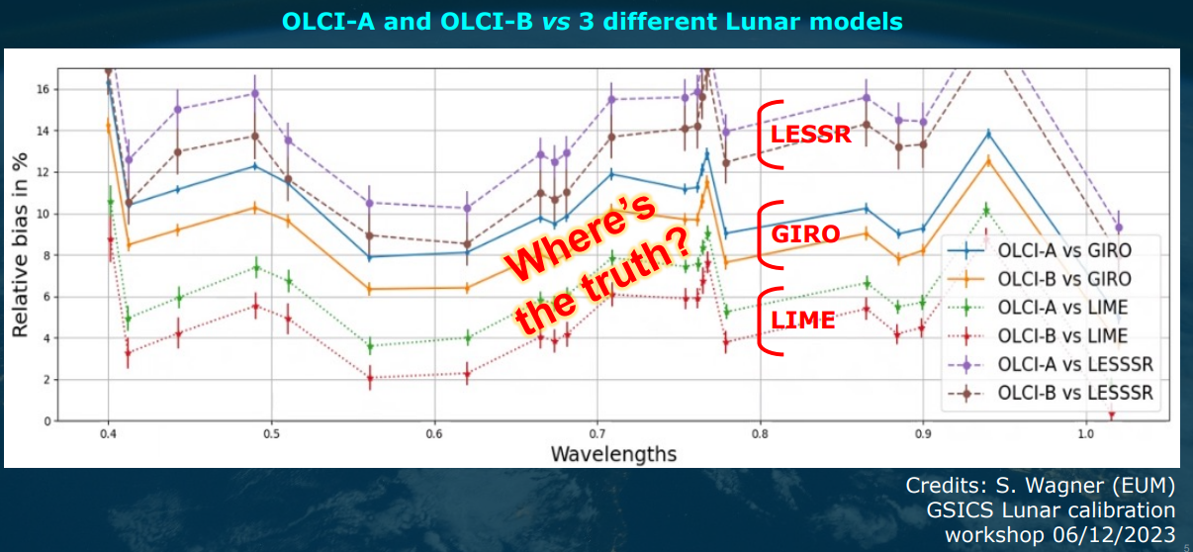
Cal/Val Methods: Pre and post launch

Slide 20
Endorsed TSIS spectrum
Noting difference in some satellite L1 Radiance products due to change in CEOS endorsed spectrum – Discussion held on impact and further actions for CEOS
CEOS spectrum and recommendation as to its use now on CalVal Portal
Examples of consequence of change presented
Difficulties for L2 when TSIS not in database of RT code and/or conversion if spectrum not publicly available
Noted that ESA are reprocessing S3-OLCI from Thuillier to TSIS

Slide 21
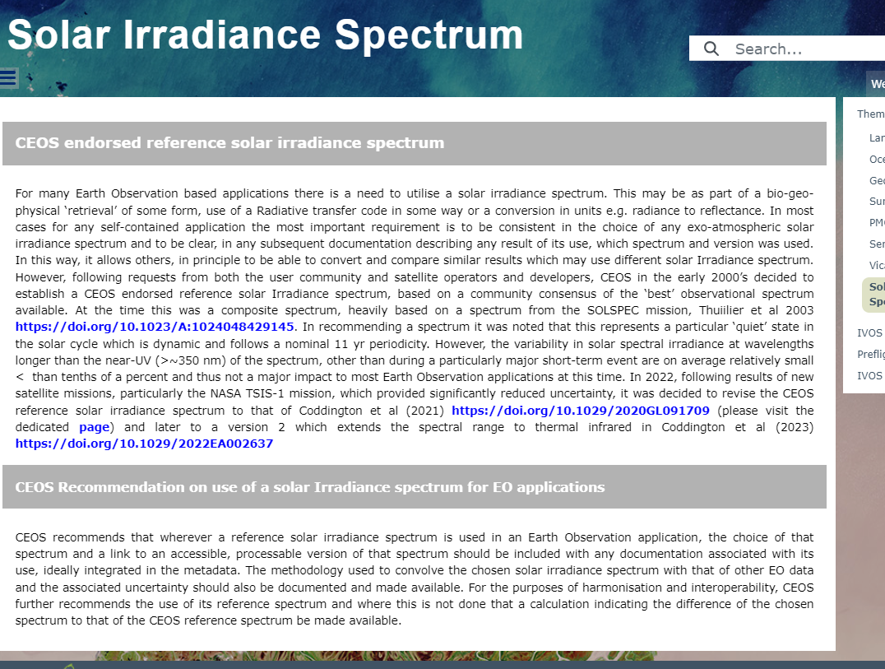
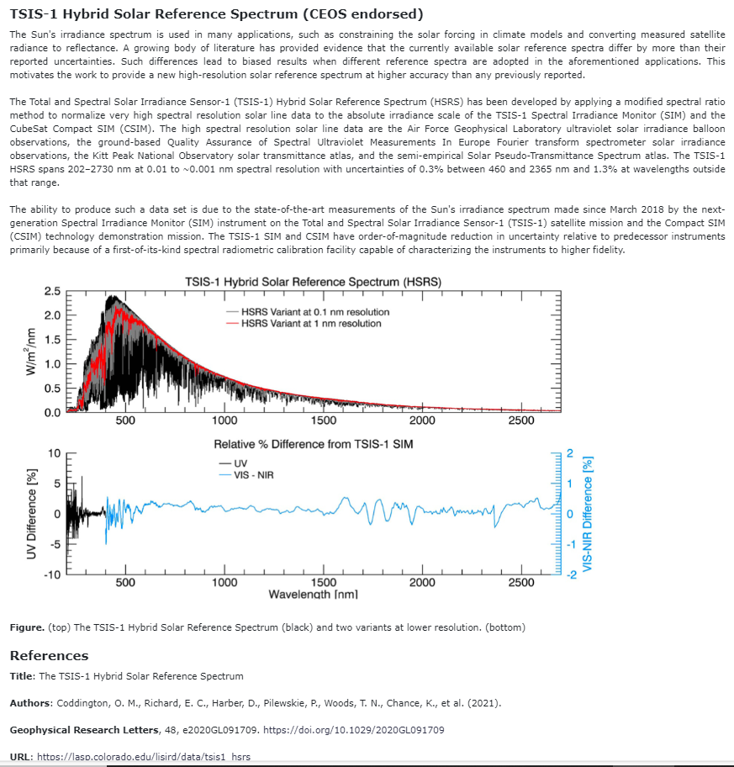
Endorsed TSIS spectrum

Slide 22
CEOS Reference solar Irradiance Spectrum
CEOS Recommendation on use of a solar Irradiance spectrum for EO applications
CEOS recommends that wherever a reference solar irradiance spectrum is used in an Earth Observation application, the choice of that spectrum and a link to an accessible, processable version of that spectrum should be included with any documentation associated with its use, ideally integrated in the metadata. The methodology used to convolve the chosen solar irradiance spectrum with that of other EO data and the associated uncertainty should also be documented and made available.
For the purposes of harmonisation and interoperability, CEOS further recommends the use of its reference spectrum and where this is not done that a calculation indicating the difference of the chosen spectrum to that of the CEOS reference spectrum be made available.

Slide 23
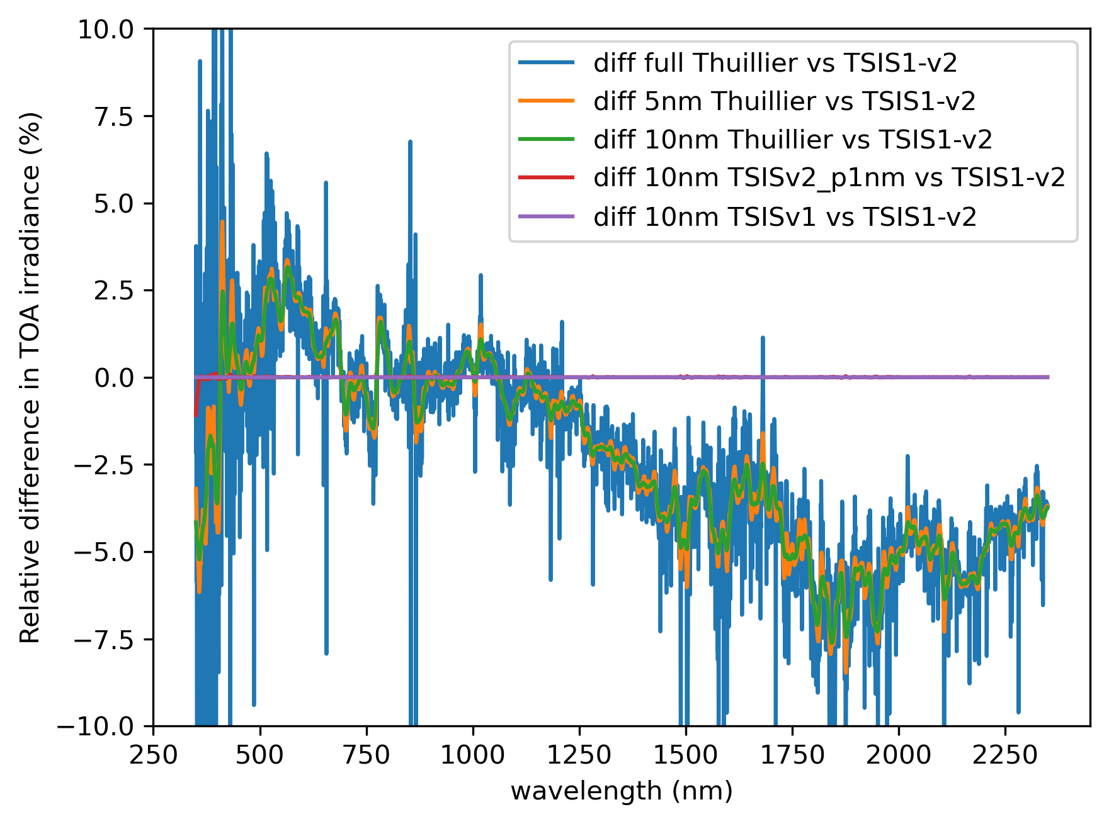
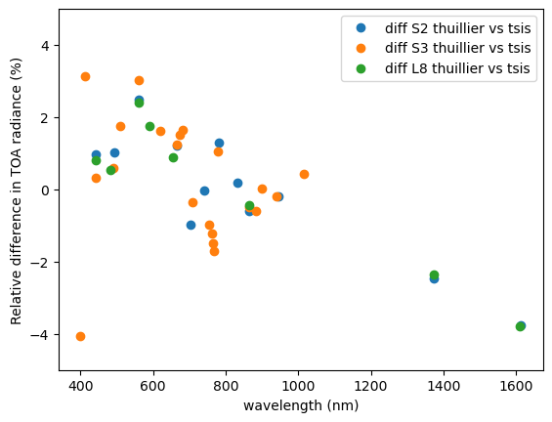
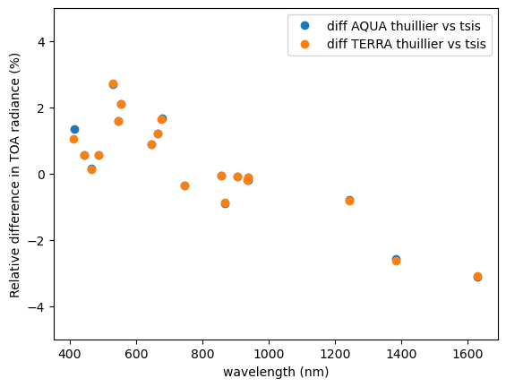
Solar spectral Irradiance
Conclusions/Actions
Make clear on Cal/val portal importance of stating reference
Make visible via CalVal portal examples potential biases with using for example Modtran base values
      - (Look to encourage Modtran team to include TSIS spectrum in database)
Hold discussion (IVOS 36) regarding recommendation on reporting in terms of reflectance if calibrated in reflectance
Promote CEOS spectrum and/or importance of making clear choice used - presentation at VH-RODA to new space
Emphasise benefit that use of TSIS reduces should reduce uncertainty if sun accounted for

Slide 24
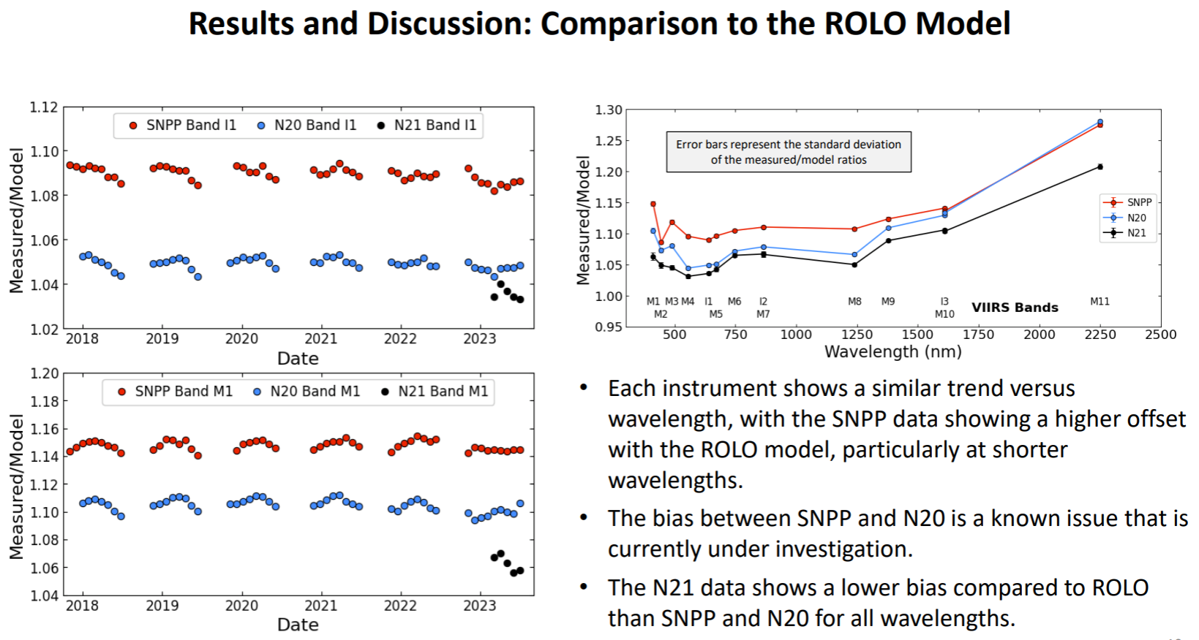
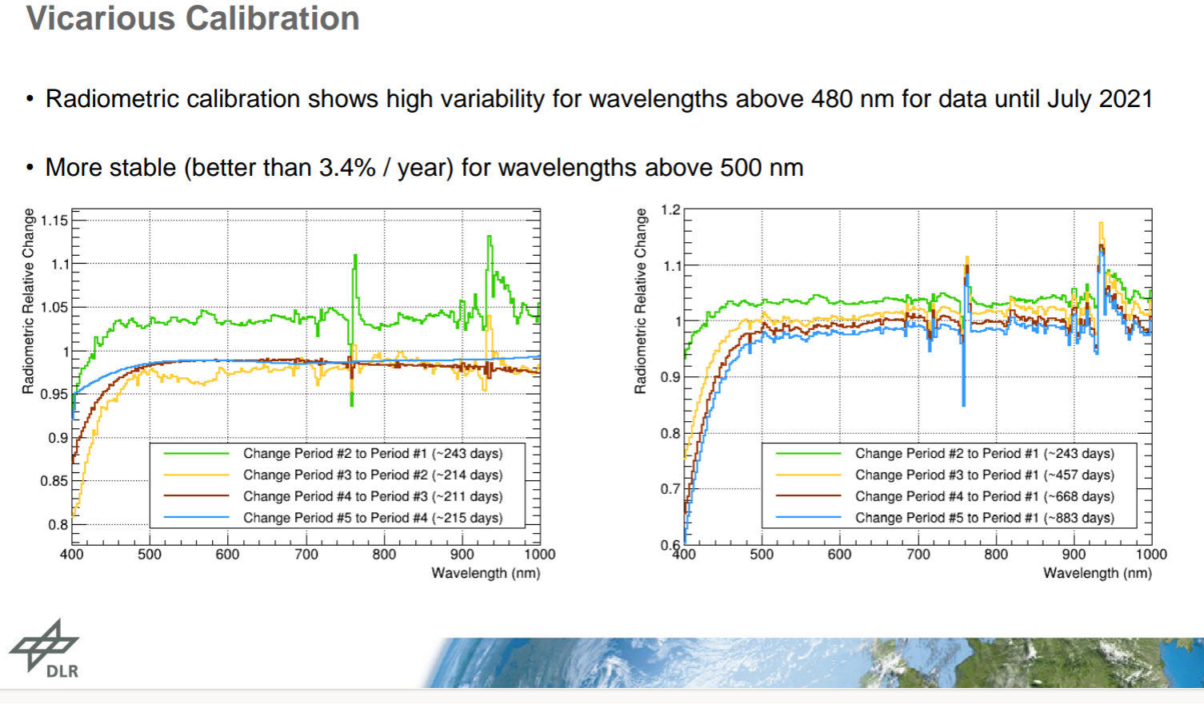
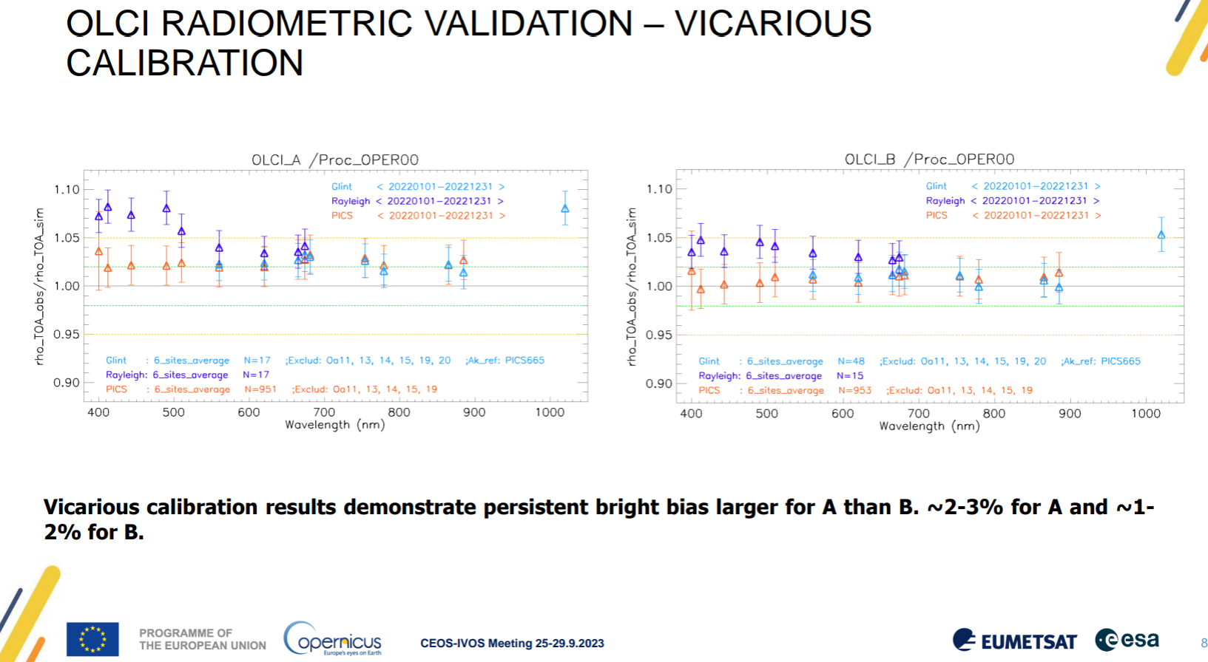

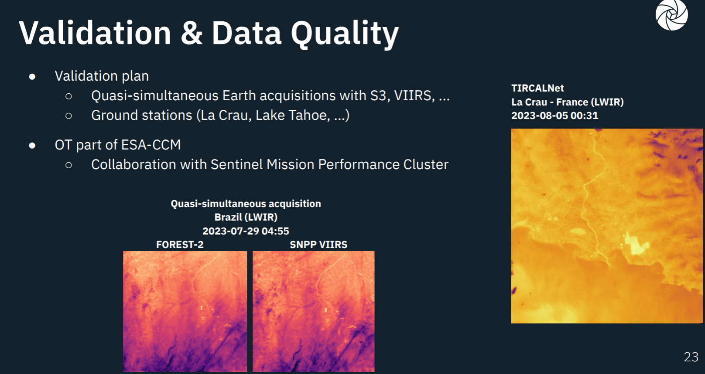

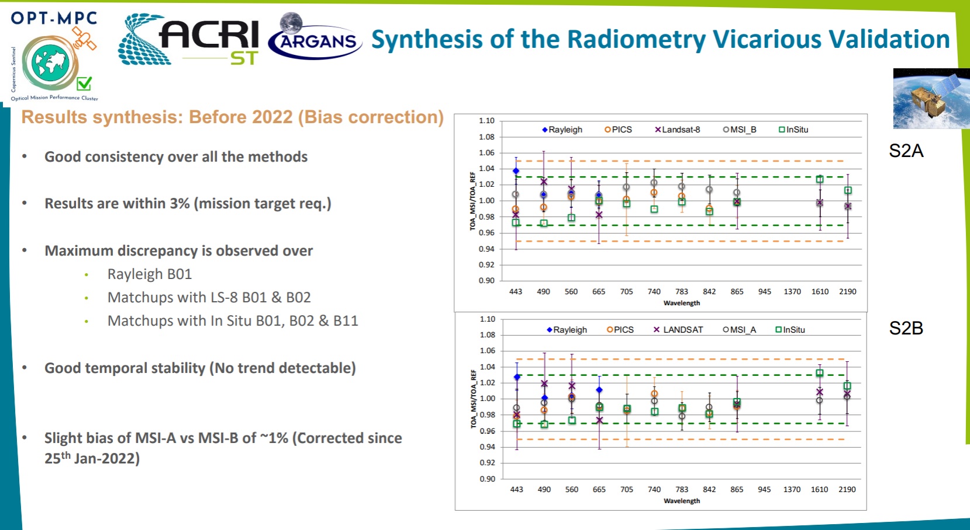
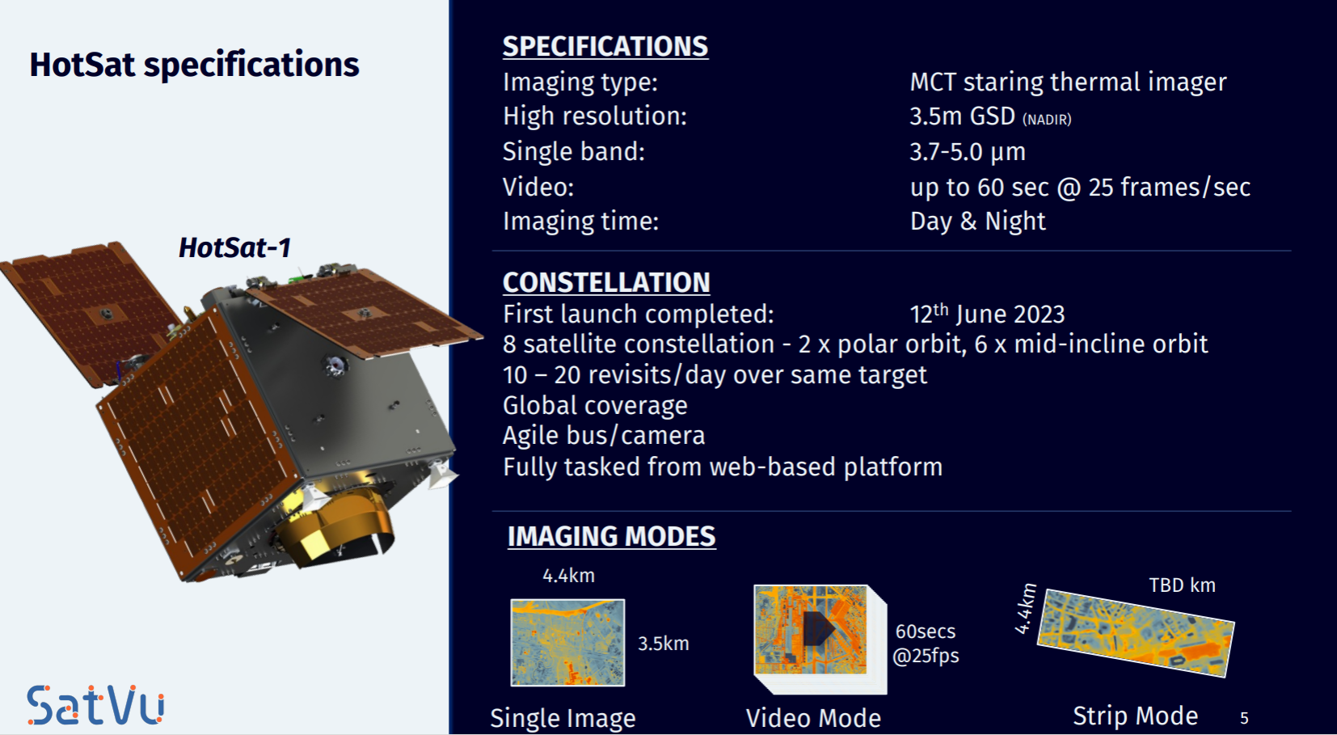
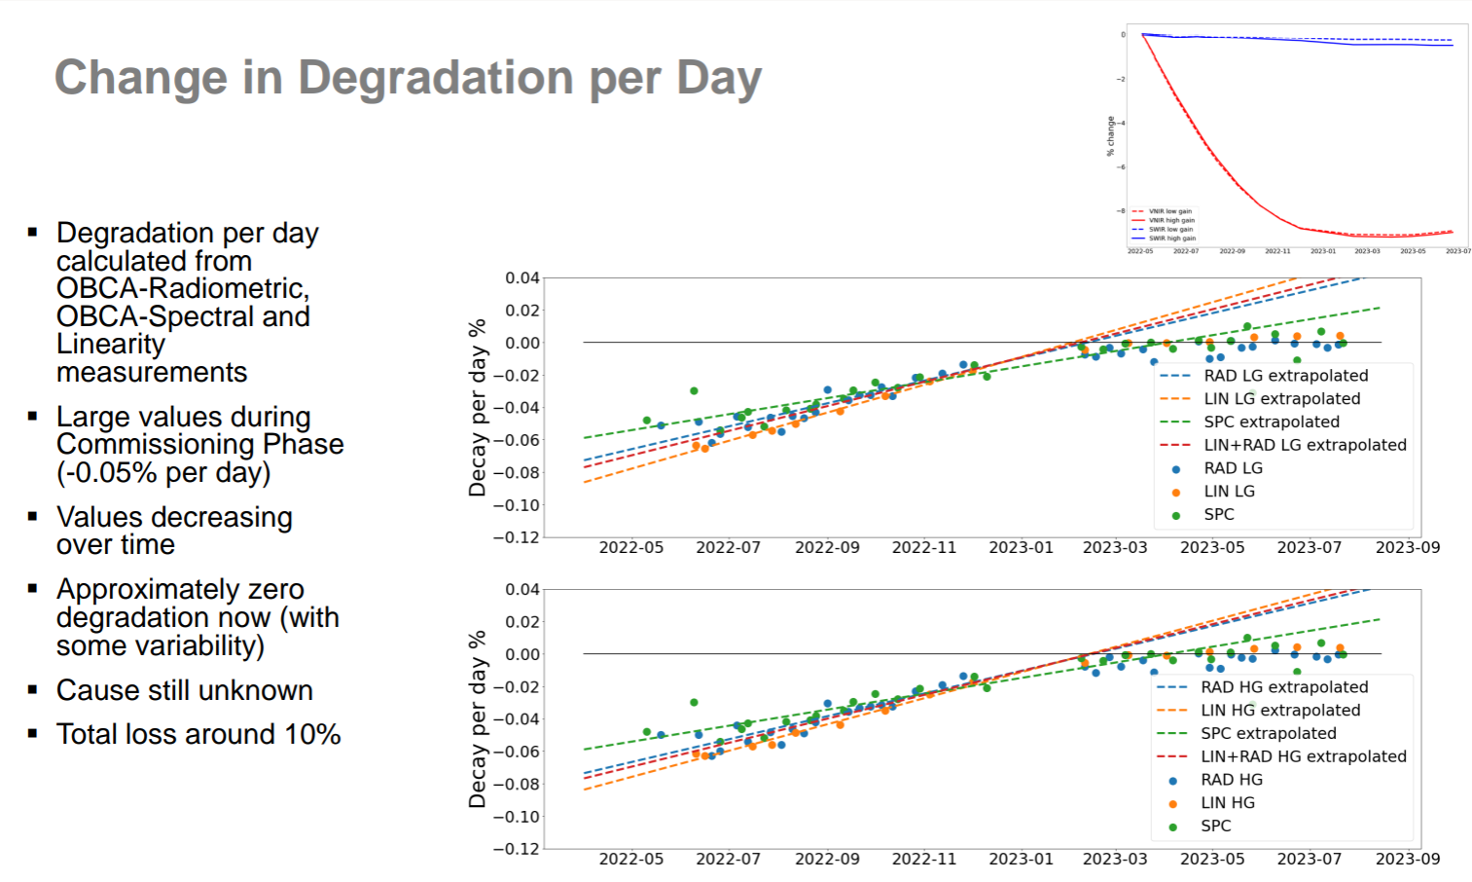
Sensor status and performance
VIIRS (SNPP vs N20
DESIS
EnMap

Slide 25
Hyperspectral/DLR session
Presentation | By | Filename
DESIS Spaceborne Hyperspectral Instrument Calibration | Emiliano Carmona | 15_DLR_DESIS.pdf
EnMAP Mission Overview: status, calibration and quality control | Miguel Pato, David Marshall, Raquel de los Reyes, and Martin Bachmann | 16_DLR_EnMAP.pdf
TIMELINE: ~40 years of NOAA/MetOp AVHRR reprocessing and harmonisation | Martin Bachmann | 17_Bachmann_AVHRR.pdf
Sensor Development & Cal/val Activities | Christian Fischer | 18_Fischer_FIREBIRD.pdf
Image transformation between imaging spectrometers | Andreas Baumgartner | 19_Baumgartner_HySpex.pdf
ENMAP Data Product Validation | Maximilian Brell | 20_Brell_EnVAL.pdf
Hyperspectral Cal/Val Resources | Cindy Ong | 21_Ong_CEOS_Hyperspectal.pdf
CNES Activities for Hyperspectral | Aimé Meygret | 22_Meygret_CNES_Hyperspectral.pdf

Slide 26
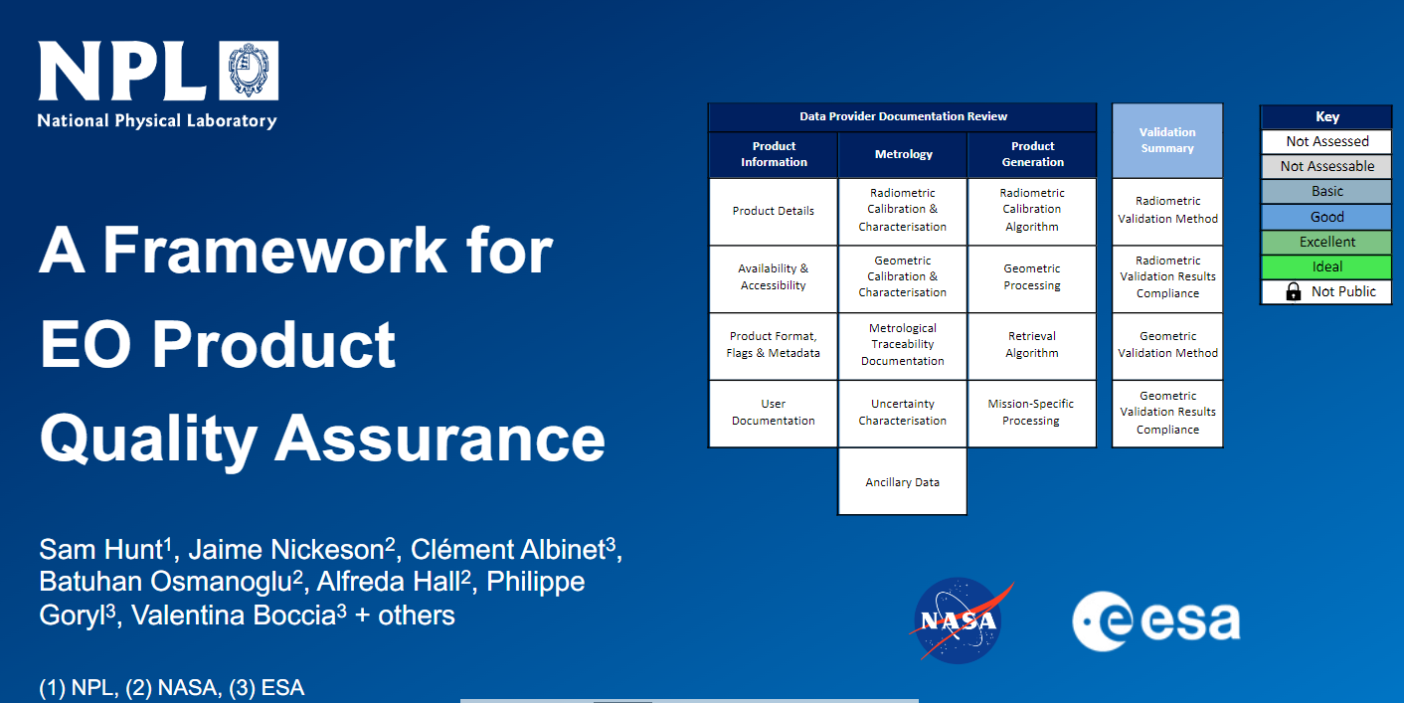
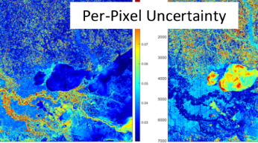
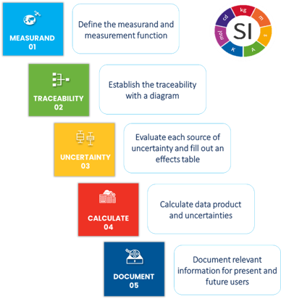
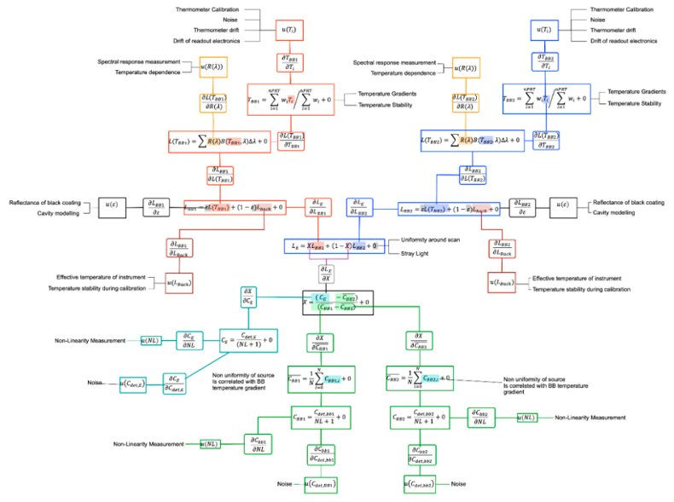
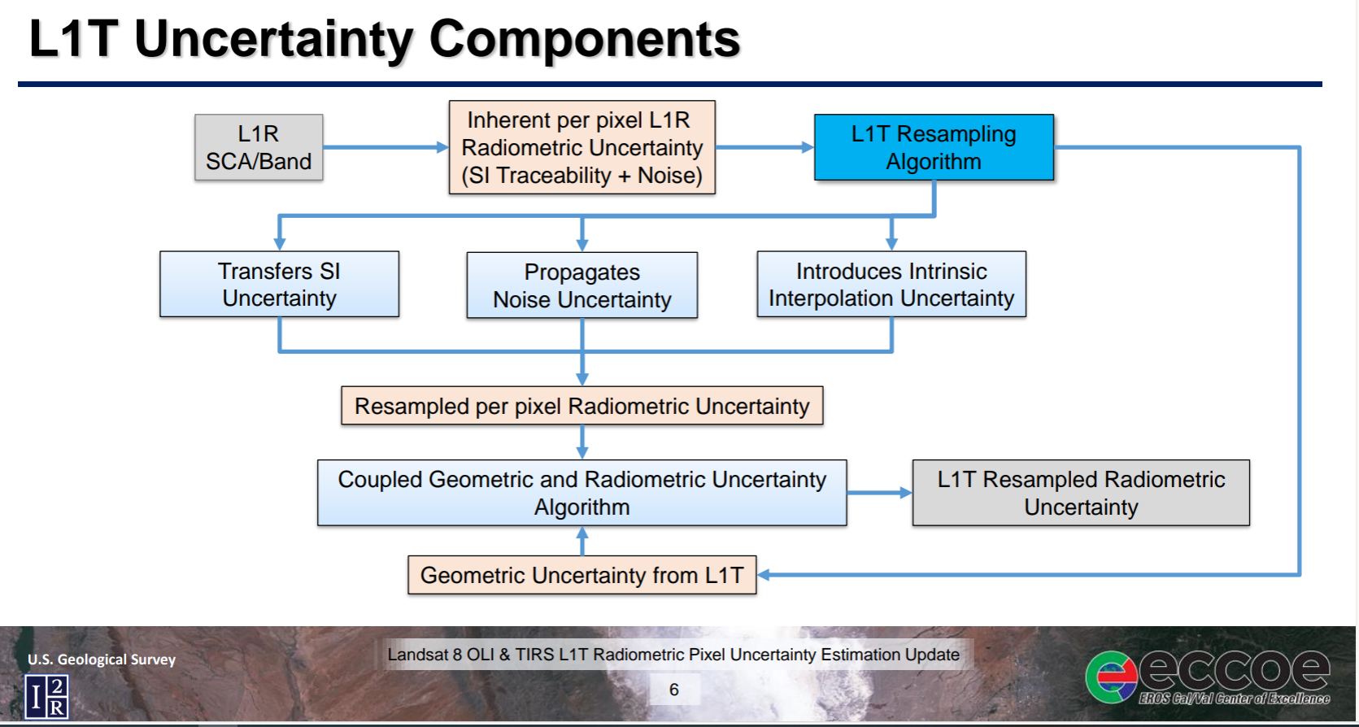
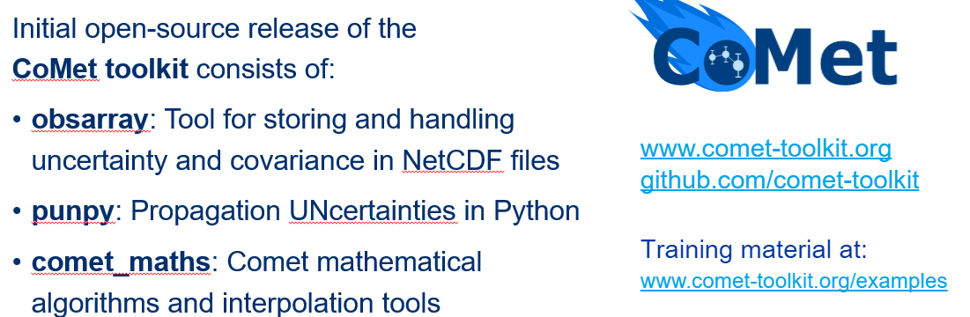
Uncertainty, Traceability and QA
Drivers: ARD, Per pixel Uc, Climate, New space -
What IS Traceability?
What do we have to evidence?
What is enough in terms of Uncertainty?
USGS/NASA initiative to derive per pixel Uc maps for Landsat 8 – comprehensive approach
On CalVal portal
With new QA4EO
Challenges – Next steps
Cannot quantify/assess all sources of uncertainty
Per pixel uncertainty is not easy
    – accounting for adjacent pixel interactions etc
Data volume increase can be dramatic
– How do we deal with this for user?
Level 1 – Level 2 etc
Follow-on workshop + interactions with WGISS on strategies for handling and reporting Uc

Slide 27
Uncertainty, Traceability and QA
Challenges – Next steps
Cannot quantify/assess all sources of uncertainty
Per pixel uncertainty is not easy
    – accounting for adjacent pixel interactions etc
Data volume increase can be dramatic
– How do we deal with this for user?
- Discussions with WGISS
Level 1 – Level 2 etc
Follow-on workshop (first at Jacie mid march) + interactions with WGISS on strategies for handling and reporting Uc

Slide 28
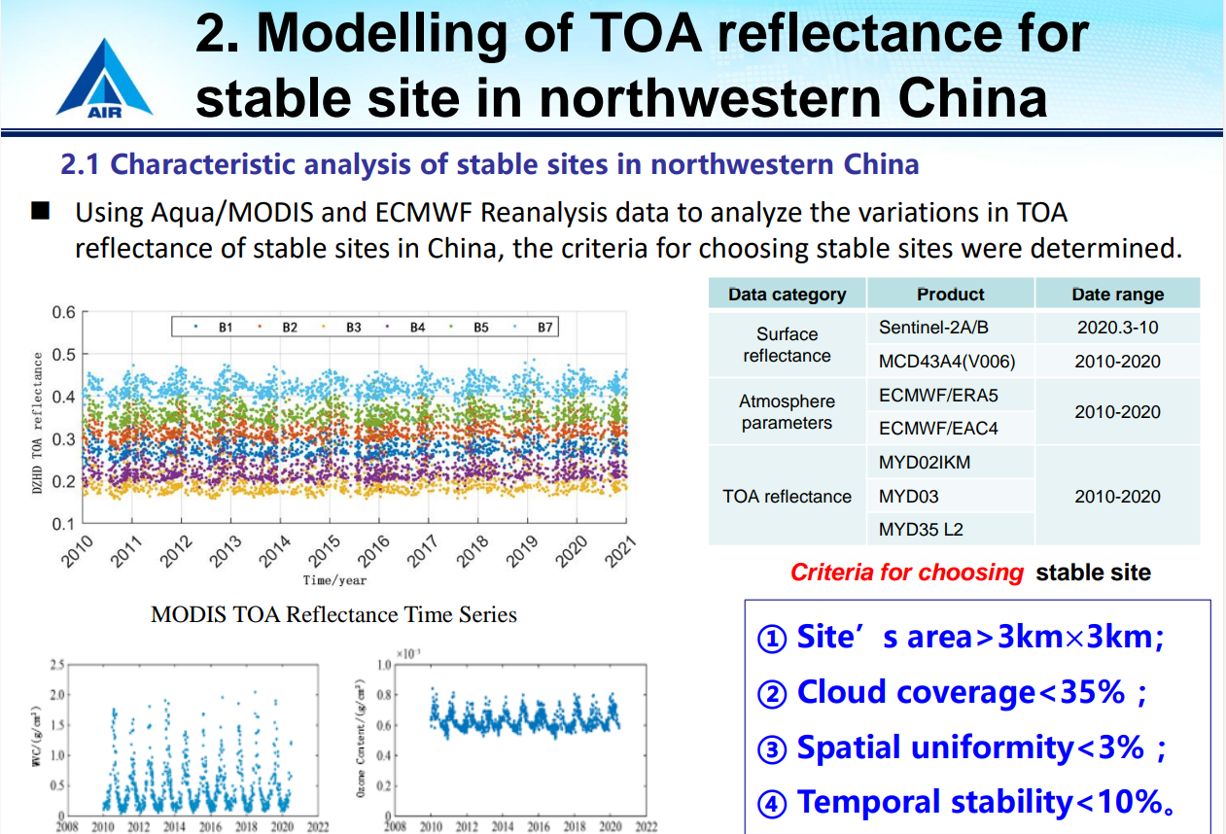
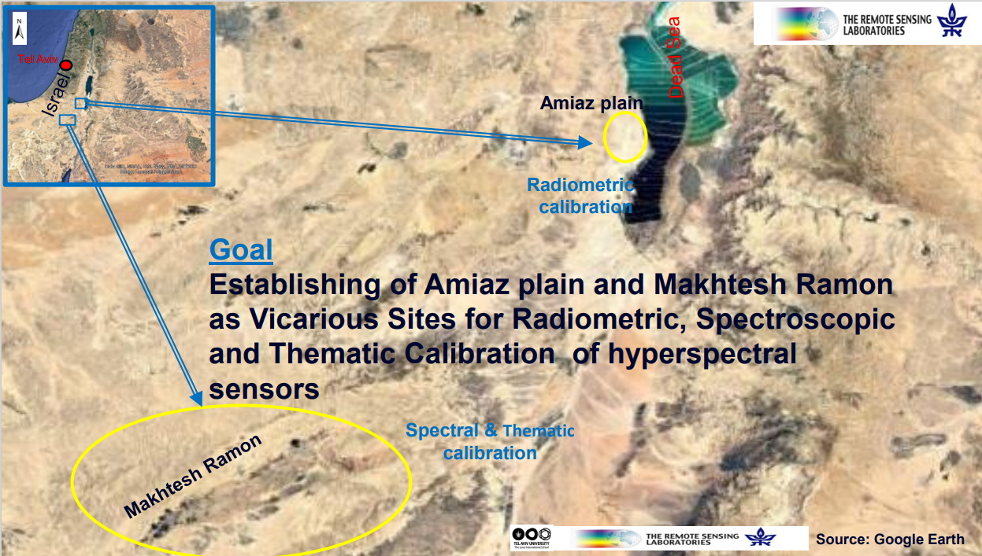
Test-Sites
Eyal Ben-Dor Tel Aviv university
Ling Ling Ma AIR

Slide 29
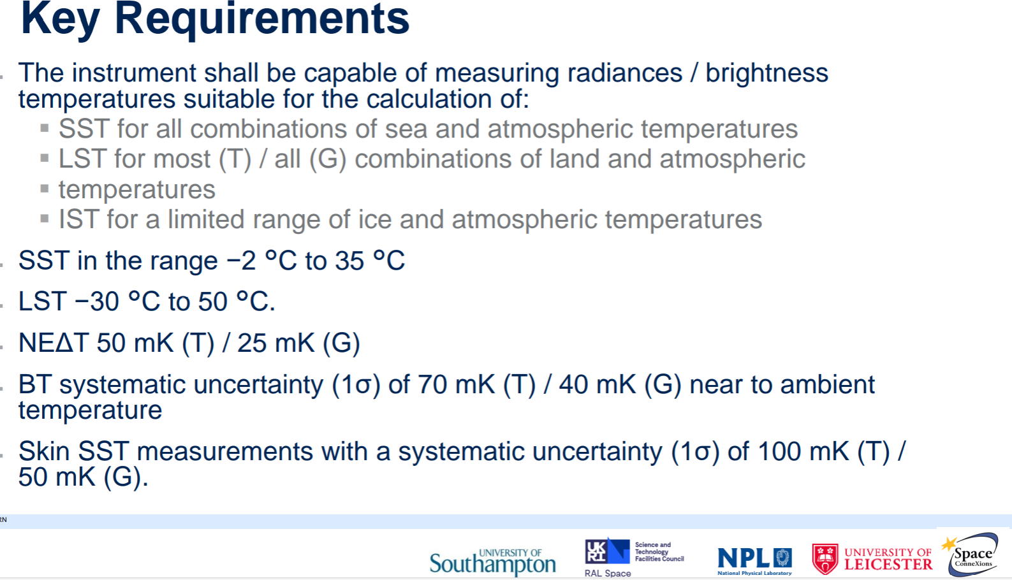
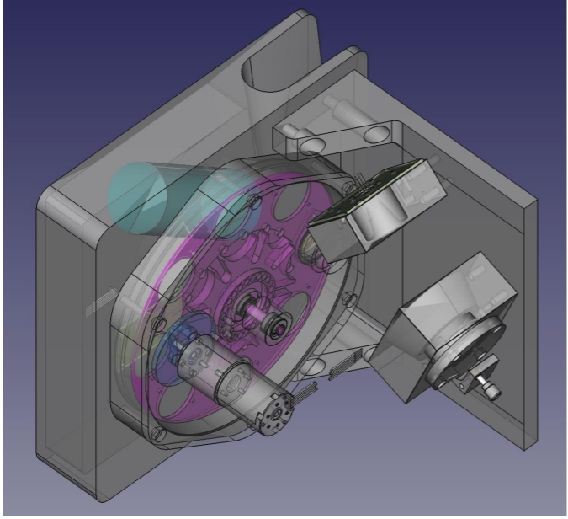
TIRCalNet/IR
Presentation | By | Filename
TIRCalNet Update | Steffen Dransfeld | 31_Dransfeld_TIRCalNet.pdf
Instrumented Site to TIR Cal/Val | Morgane Chapelier | 32_Chapelier_TIRCalVal.pdf
TIR Cal/Val at La Crau | Sebastien Marcq | 33_Marcq_La_Crau.pdf
Validation of Thermal Infrared Satellite Measurements Using Automated Validations Sites | Simon Hook | 34_Hook_JPL_TIRVal.pdf
ASTeRN – Advanced Surface Temperature Radiometer Network | Dave Smith | 36_Smith_ASTeRN.pdf
CEOS IR Radiometer Comparison | Yoshiro Yamada | 37_Yamada_IR_comparison.pdf
Realtime Thermal Data for Highly Dynamic Events | Marc Seifert | 38_Seifert_TIR.pdf
New space keen to have access to data particularly existing sites such as Lake Tahoe but hesitancy on sustainability

Slide 30
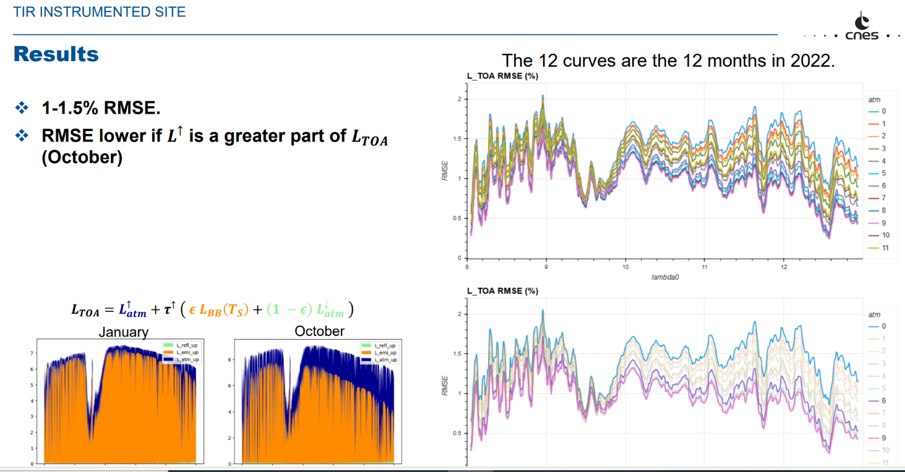
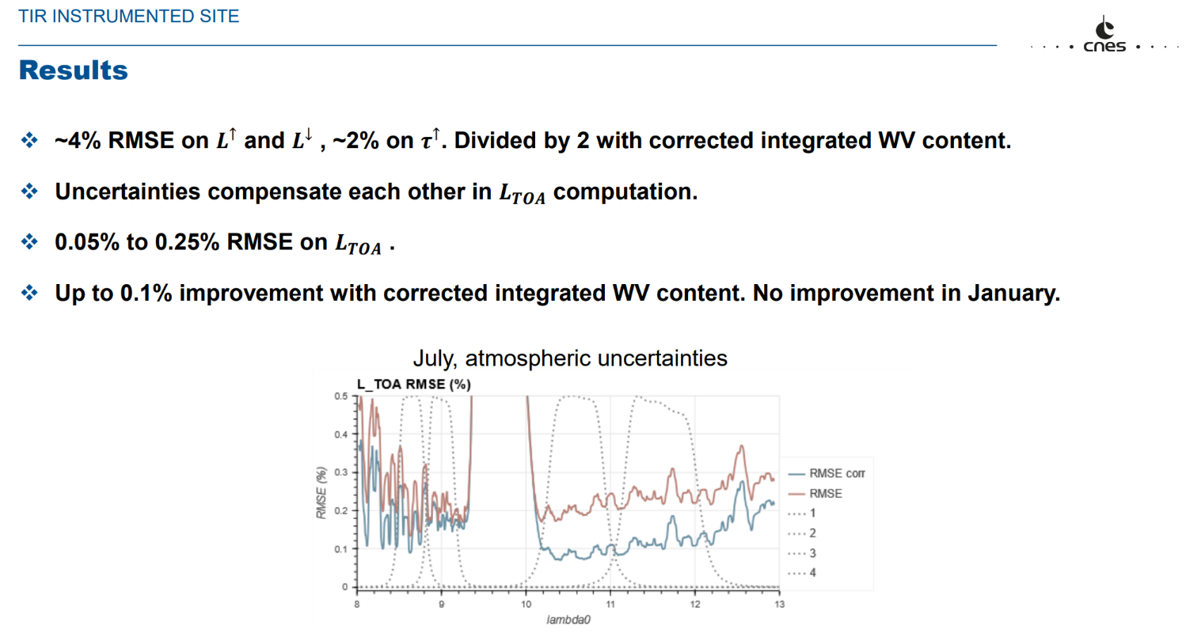
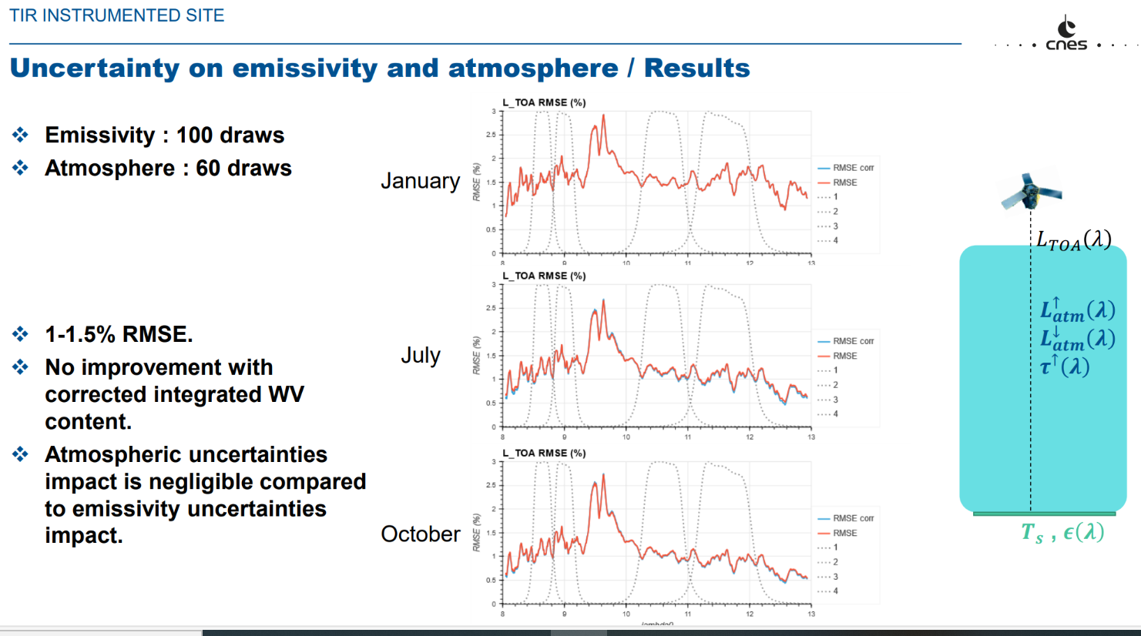
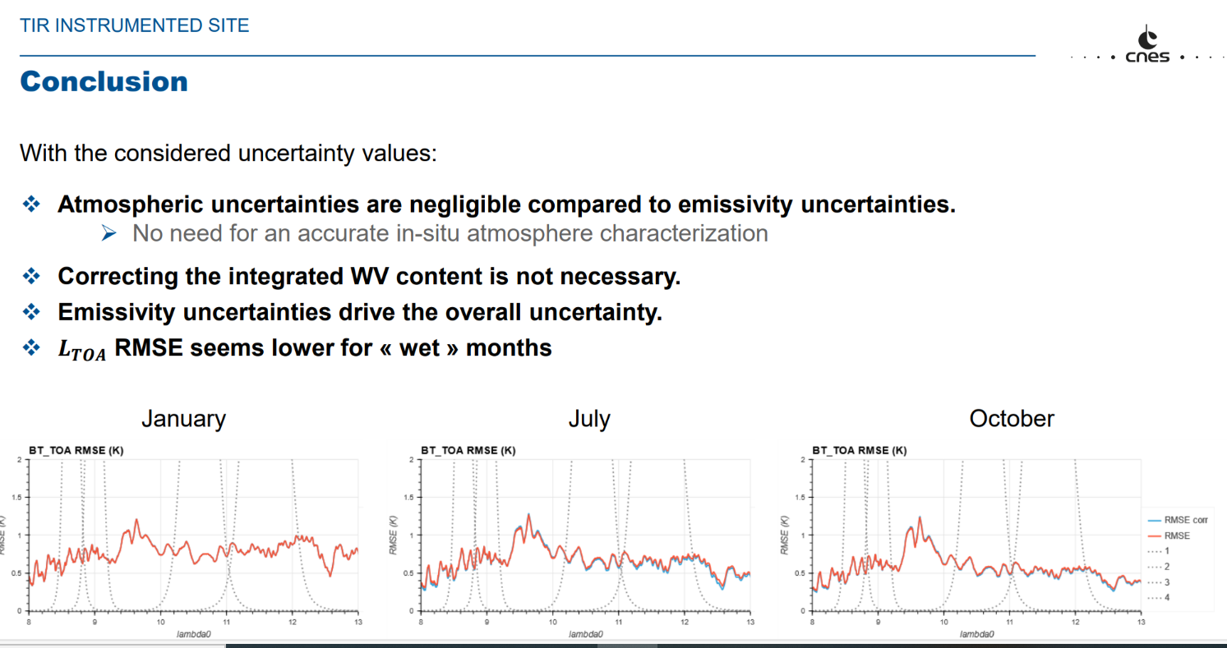
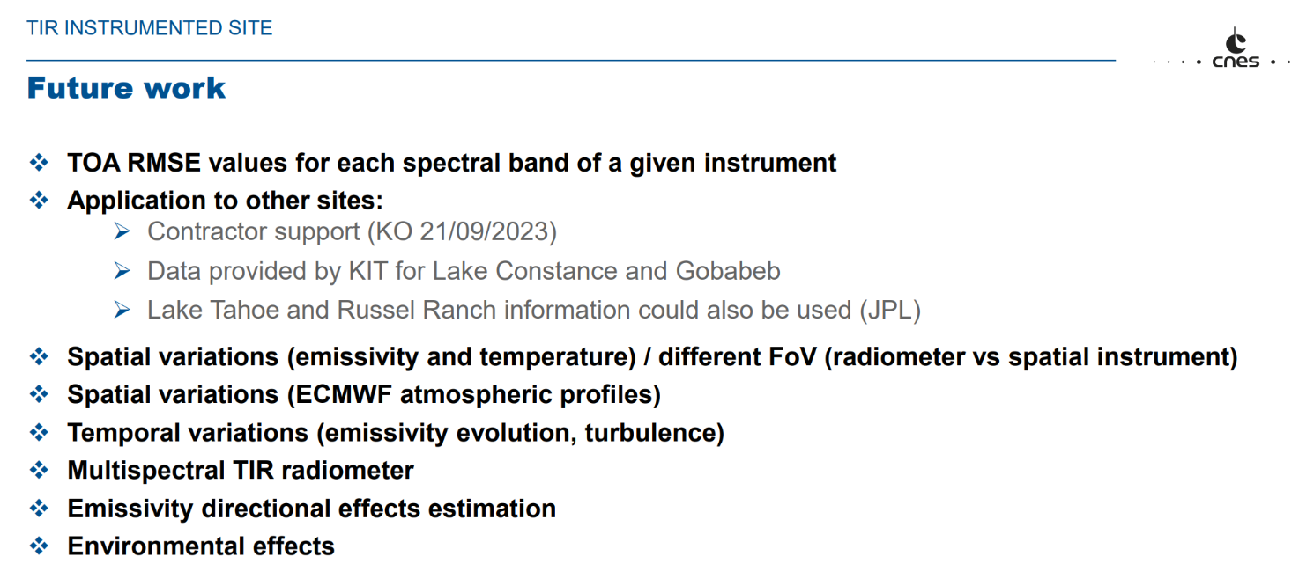
TIRCalNet site assessment protocol:
Morgane Chapellier et al CNES
Atmosphere correction

Slide 31





TIRCalNet: La Crau: Sebastien Marcq et al CNES

Slide 32



CEOS Projects
CEOS comparison (5) for Surface (water/land) brightness temperature
- 6 participants (water and land) (Covid limited)
- Results shortly
LST ToA brightness temperature (network) (TASK group started)
Discussion on requirements and strategy with LPV members
Agree on ToA brightness temperature per wavelength as a priority
Focus on higher resolution <100 m
Target of 0.5 K as ToA uncertainty (challenging! With land Water oK)
Project to start (see later)

Slide 33




CEOS IR validation comparison results

Slide 34

conclusions
Lab BB comparison
Landcal P80P BB uncertainties may be an overestimate.
Lab radiometer comparison
All radiometers underestimates uncertainties at and below 0 °C.
Possible systematic error in ISAR, increasing at lower temperature?
Field radiometer comparison
Two times larger temperature range of comparison,
two times improvement in agreement from 2016 comparison
(in terms of mean of the difference from reference value)
An abrupt shift in KIT measurement went unnoticed.
→ Internal reference BB (as in ISAR and SISTeR) is essential.
Results: FRM4SST Phase 2 (2021 - 2023) | www.shipborne-radiometer.org (ships4sst.org) Also two publications in Jtech
Basis to support TIRCalNet

Slide 35
Communications
Not getting maximal impact/awareness from WGCV/IVOS activities
Can we have a page on services to Newspace
Can we link agency pages on projects where cal/val is relevant and a short highlighter on cal/val portal but details on agency home page
News items/awareness e.g. forthcoming meetings – JACIE, VH-RHODA, calval workshop also potential campaigns

Slide 36
Summary
Looking for a volunteer (s) to take leadership of ‘image quality/geometric’ focus group
      - Early meeting to define scope and priorities geolocation? Partnership with TM subgroup
Volunteers to add to Vocabulary group
Interoperability (radiometric) L1
      - Sub-set of sites identified for ‘encouraged’ collect by Newspace and agencies For endorsement
      - Match-up platform to assess/report consistency with ‘CEOS reference’
– strategy to build a database for users to assess suitability for their application as first step
Uncertainties, Traceability – lot of interest further workshops include new space
      - Engage with WGISS on strategies for communicating / appending per pixel Uc
  LST ToA brightness temperature project (TIRCalNet) started with view to future operational network
  Solar Irradiance Spectrum
    – large potential impact on changing to TSIS spectrum How to communicate? (promote at VHRhoda)
    - Encourage Modtran to include TSIS as an embededed spectrum
    - Discussion on reporting (reflectance vs radiance)
    - Establish examples on impact to input to CalVal portal
    - follow-up with broader community e.g. operational services

