Slide 1
WGCV-53
Land Product Validation
Subgroup
Michael Cosh, USDA
Agenda Item #2.3
WGCV-53, Córdoba, Argentina
5th - 8th March 2024

Slide 2

Land Product Validation
Slide 2

Slide 3

Land Product Validation
Slide 3

Slide 4
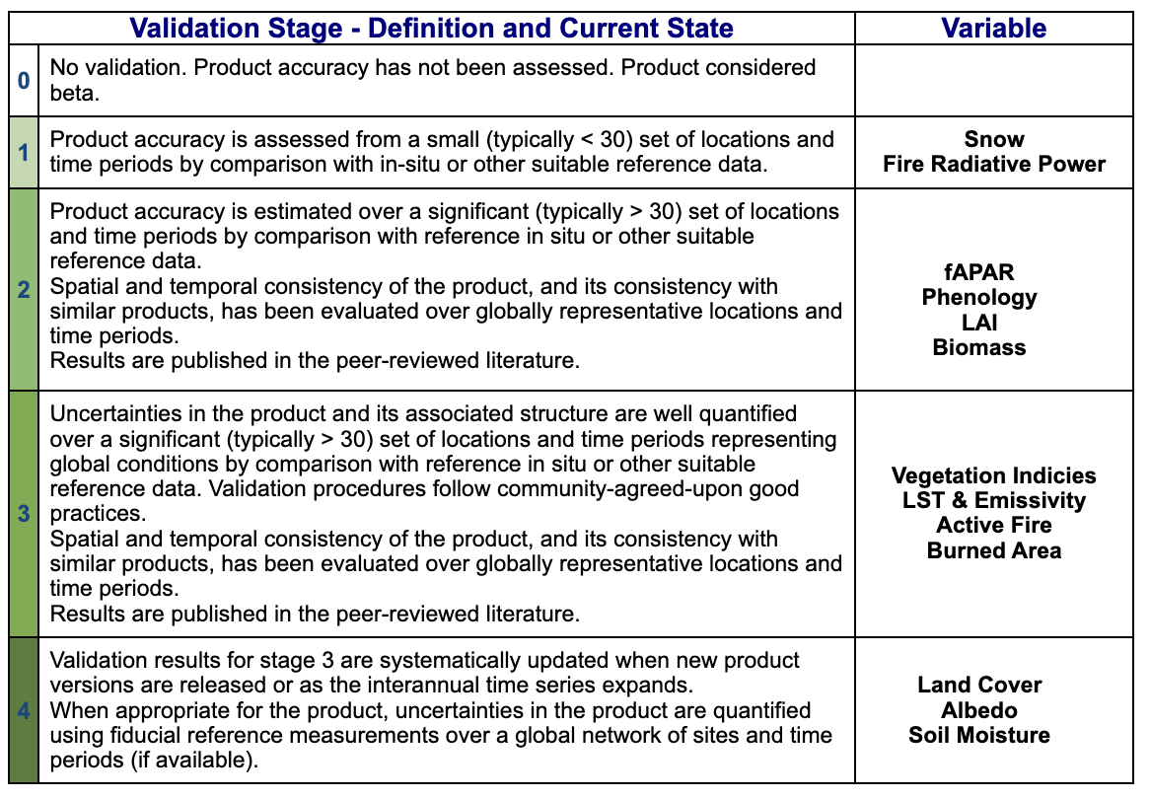
Land Product Validation
  Elevating Soil Moisture to Stage 4 with the release of FRM4SM
  Elevating Albedo to Stage 4
  Elevating Burned Area to Stage 3
Slide 4

Slide 5
Land Product Validation
 | First Name | Last Name | Institution | Institution | End of Term
Admin | Michael | Cosh | USDA | USA | Apr 2025
 | Fabrizio | Niro | ESA | Italy | Apr 2025 (promotion to Chair)
 | Jaime | Nickeson | GSFC | USA
Land Cover | Alexandra | Tyukavina | University of Maryland | USA | March 2024 (1st term)
 | Sophie | Bontemps | Université Catholique de Louvain | Belgium | Oct 2023 (2nd term)
Biophysical | Marie | Weiss | INRA | France | Sep 2023 (2nd term)
 | Sylvain | Leblanc | Natural Resources Canada | Canada | Sep 2023 (2nd term)
 | Luke | Brown | University of Salford | UK | Jan 2026 (1st term)
Fire/Burn Area | Louis | Giglio | University of Maryland | USA | Sep 2026 (2nd term)
 | Bernardo | Mota | National Physical Lab | UK | Jan 2026 (1st term)
Surface Rad | Zhuosen | Wang | UMass Boston | USA | ex-officio
 | Angela | Erb | UMass Boston | USA | Jan 2026 (1st term)
 | Jorge | Sanchez-Zapero | EOLab | Spain | Jan 2026 (1st term)
Soil Moisture | John | Bolten | NASA GSFC | USA | Apr 2026 (2nd term)
 | Alex | Gruber | TU Wien | Austria | Sept 2026 (1st term)
LST | Glynn | Hulley | NASA/JPL | USA | July 2024 (2nd term)
 | Lluis | Perez Planells | Karlsruhe Institute of Technology | Germany | Sept 2026 (1st term)
Phenology | Joshua | Gray | North Carolina State University | USA | Jan 2025 (2nd term)
 | Victor | Rodríguez-Galiano | University of Seville | Spain | Aug 2025 (2nd term)
Snow Cover | Carrie | Vuyovich | NASA GSFC | USA | Jan 2026 (1st term)
 | Juha | Lemmetyinen | FMI | Finland | Sept 2026 (1st term)
Veg Index | Tomoaki | Miura | University of Hawai'i | USA | Dec 2022 (2nd term)
 | Else | Swinnen | VITO | Belgium | Apr 2023 (2nd term)
Biomass | Laura | Duncanson | UMD/GSFC | USA | ex-officio
 | Kim | Calders | Ghent University | Belgium | Feb 2026 (1st term)
 | Neha | Hunka | UMD | USA | Feb 2026 (1st term)
ET | Yun | Yang | Mississippi State | USA | ~Jan 2027 (1st term)
 | Carmelo | Cammalleri | Politecnico di Milano | Italy | ~Jan 2027 (1st term)
GPP/NPP | TBD
 | TBD
Slide 5

Slide 6
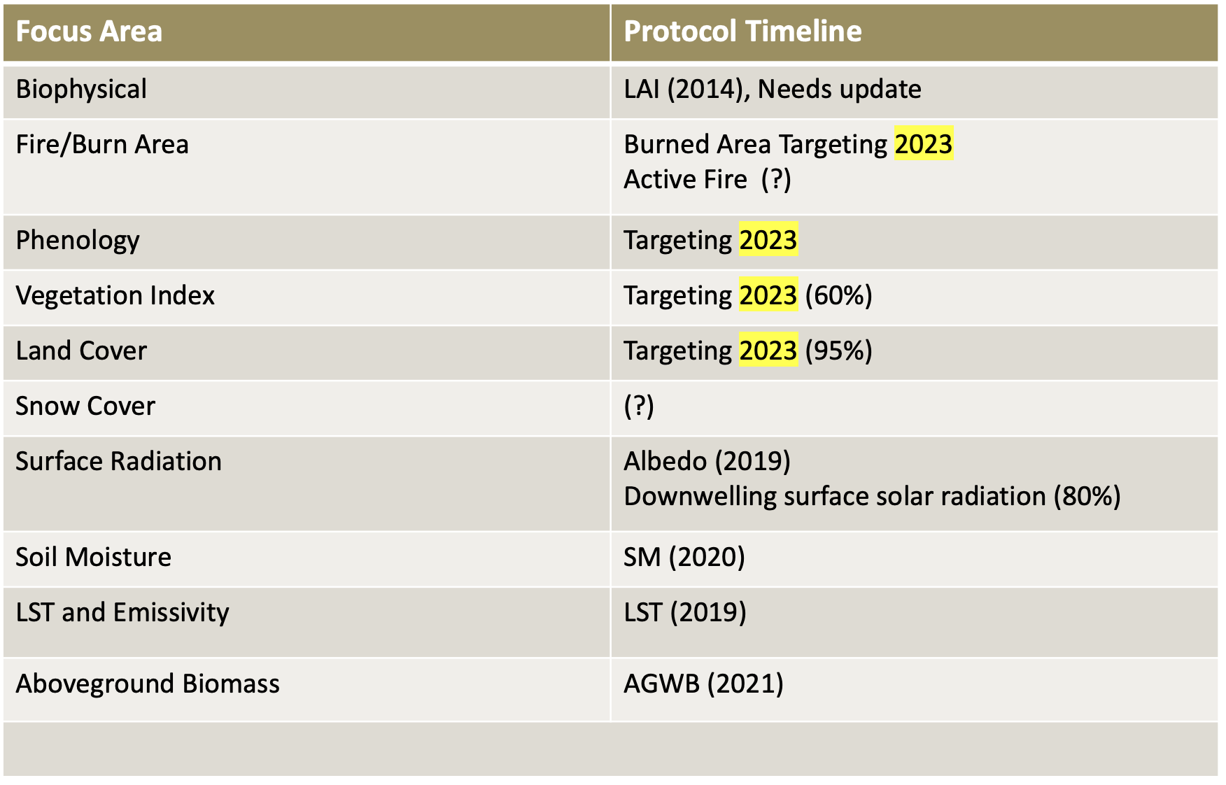
Land Product Validation
PROTOCOLS
Slide 6

Slide 7

Land Product Validation
ECV Requirements
Slide 7

Slide 8
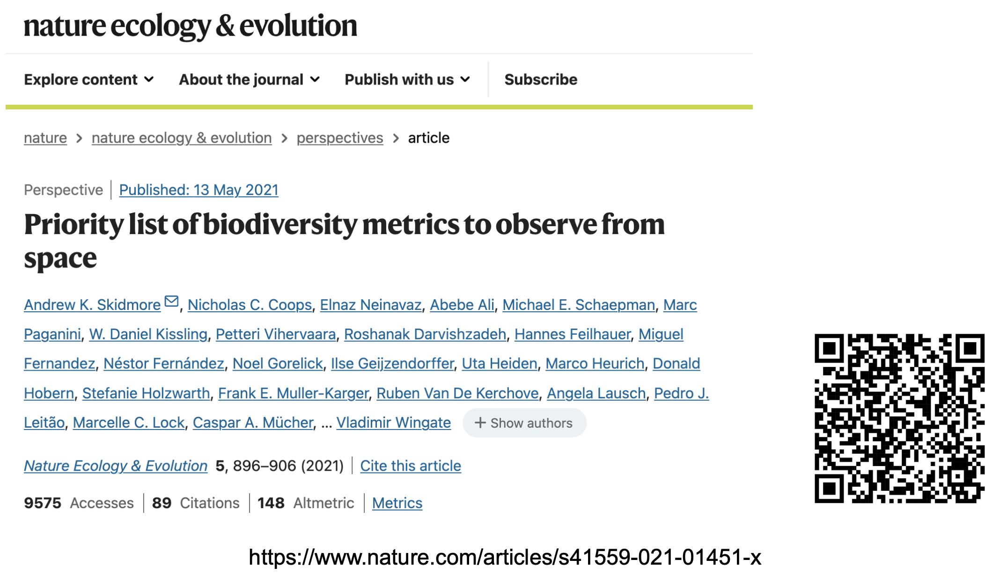
Land Product Validation
Biodiversity
Slide 8

Slide 9
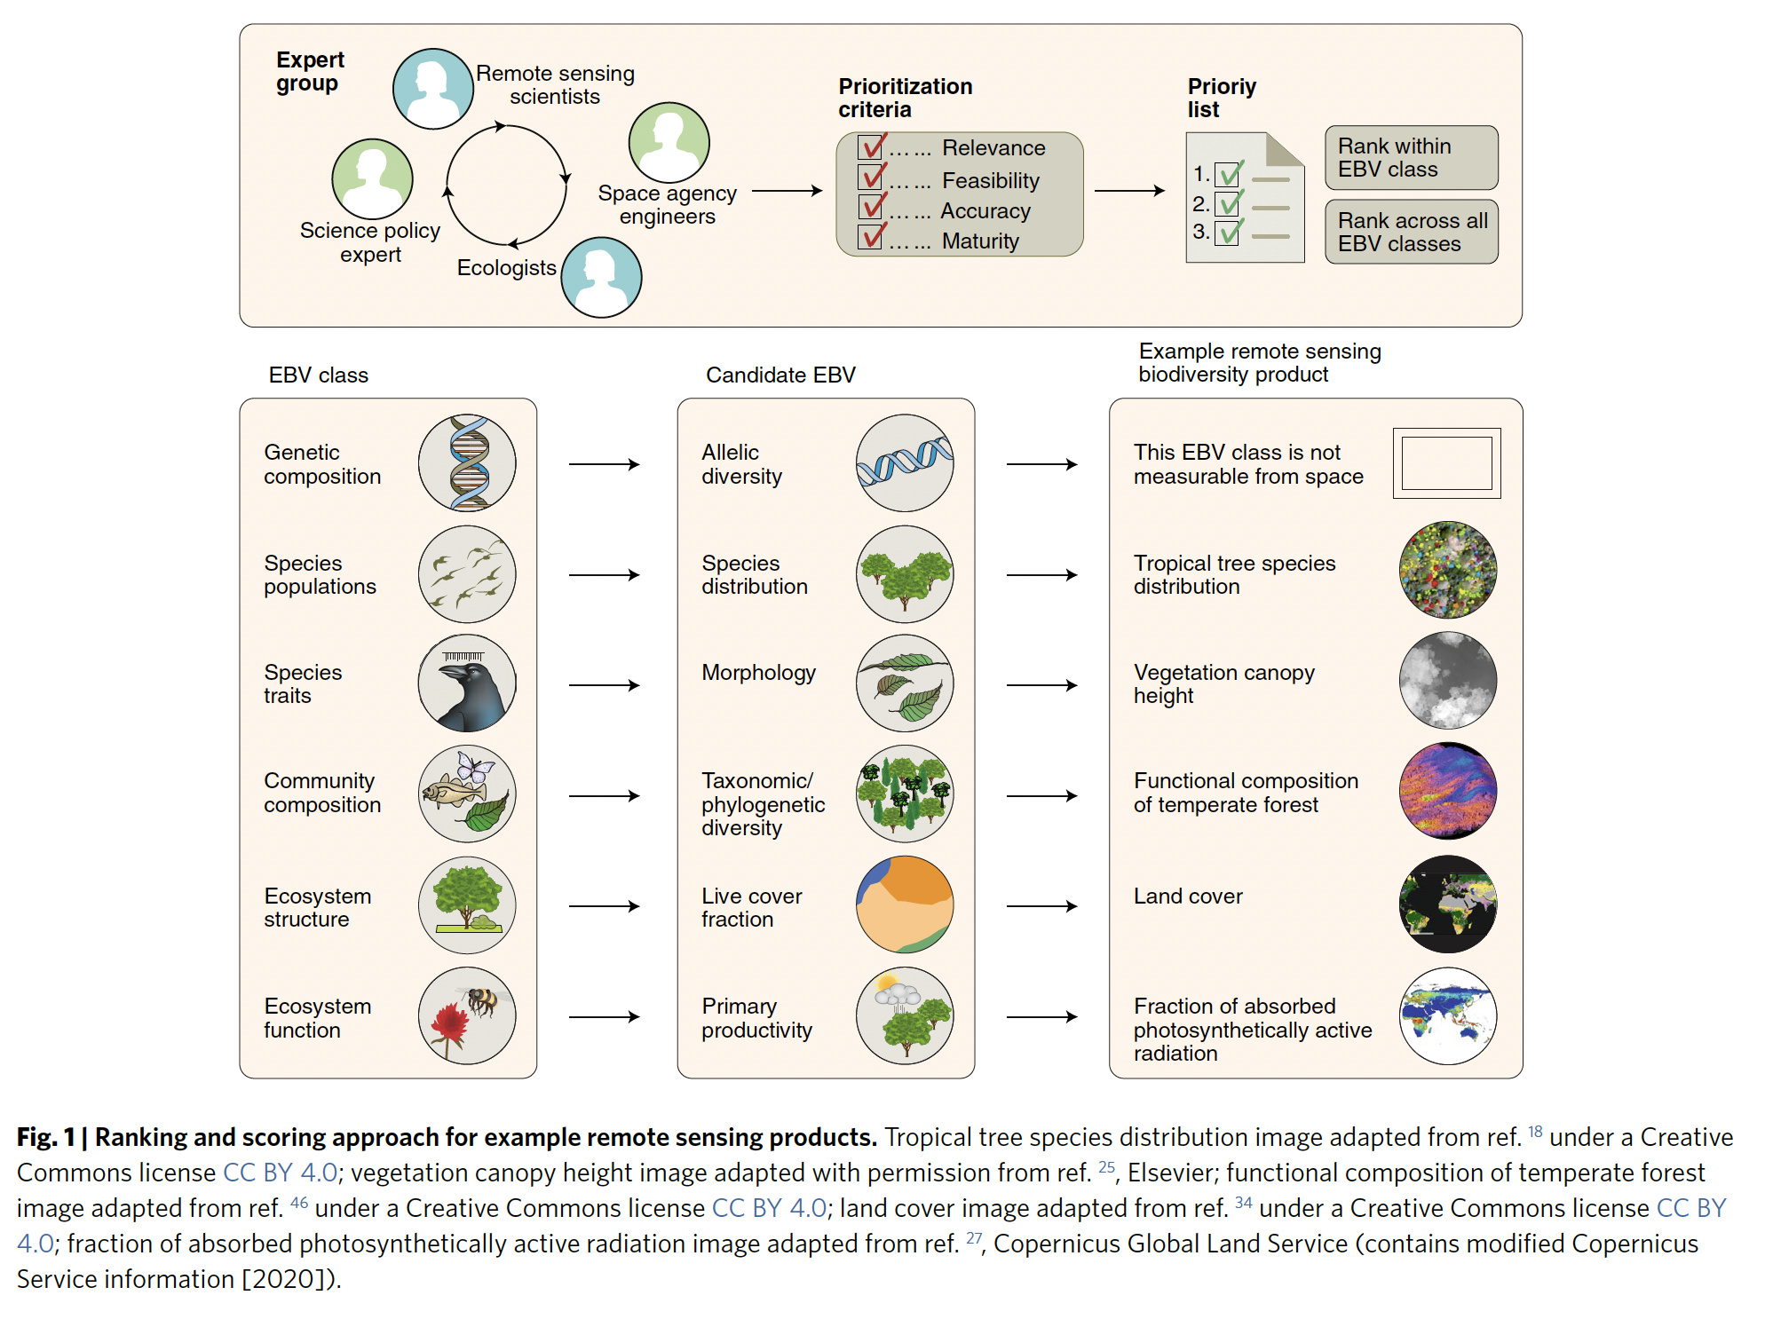
Land Product Validation
Biodiversity
Slide 9

Slide 10
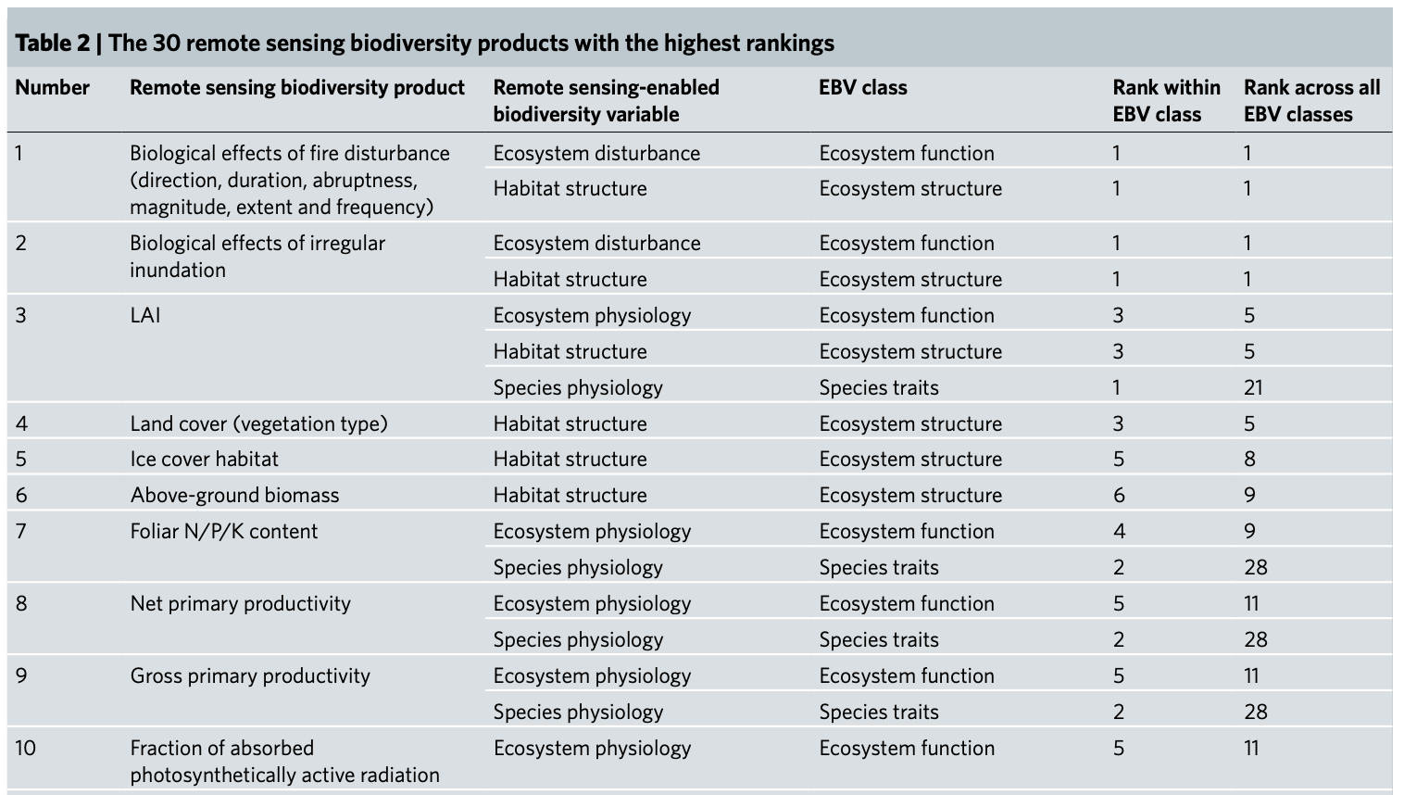
Land Product Validation
Biodiversity
Slide 10

Slide 11
Land Product Validation
Consideration of the potential for GPP/NPP land product Focus Area within LPV
Consideration of the potential for Evapotranspiration land product Focus Area within LPV
New Focus Areas

Slide 12
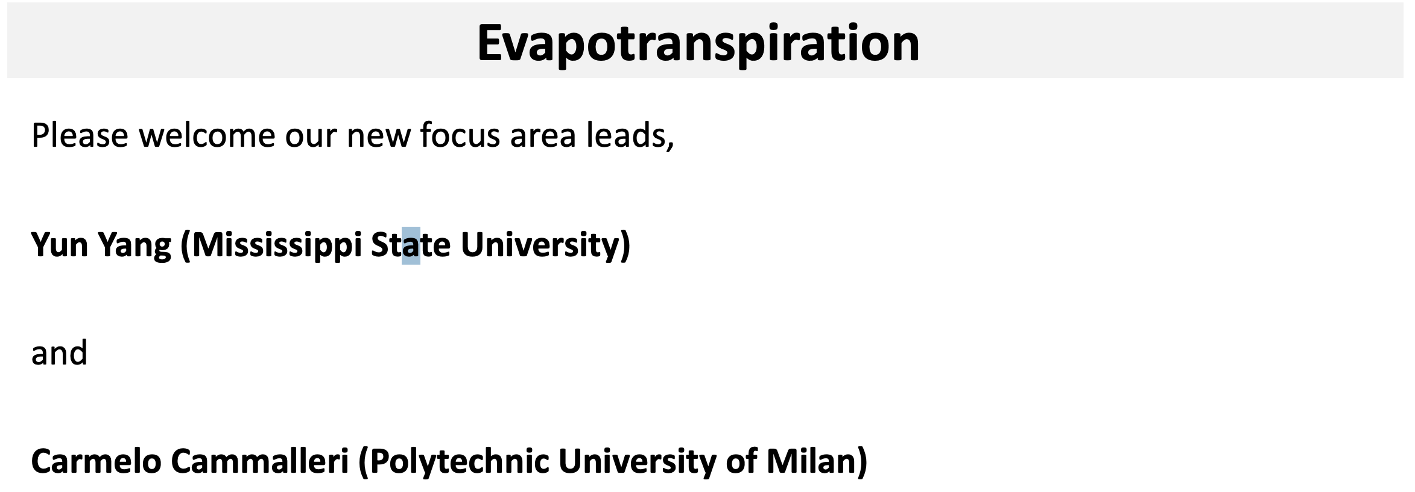
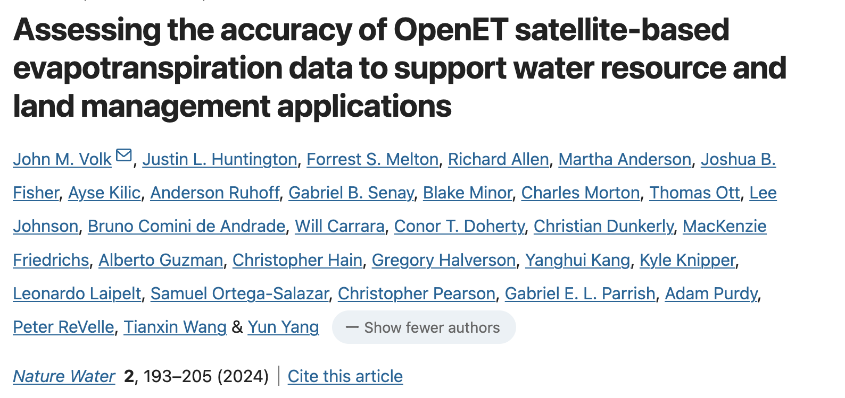
Land Product Validation
Evaporation
Slide 12

Slide 13
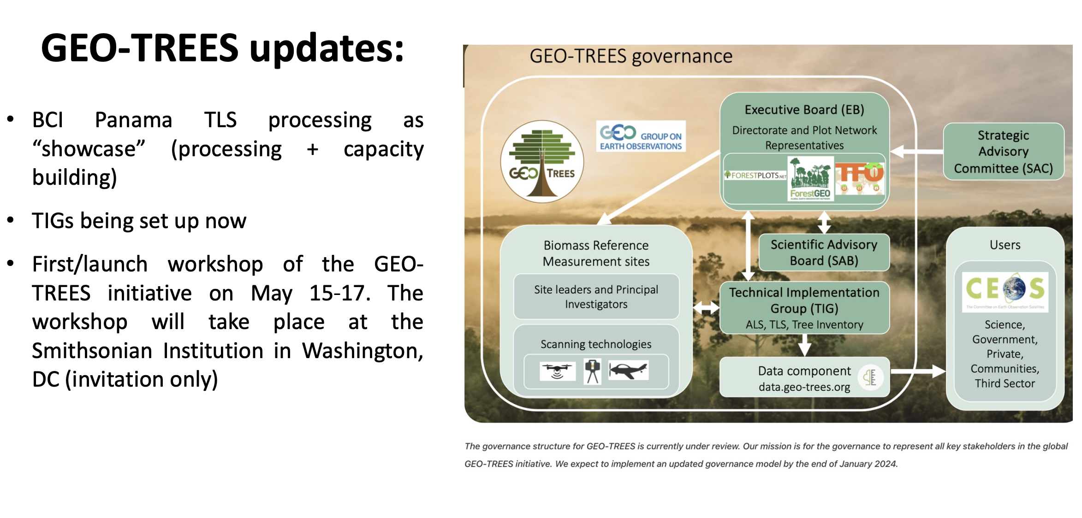
Land Product Validation
Biomass
Slide 13

Slide 14

Land Product Validation
Soil Moisture
Slide 14

Slide 15
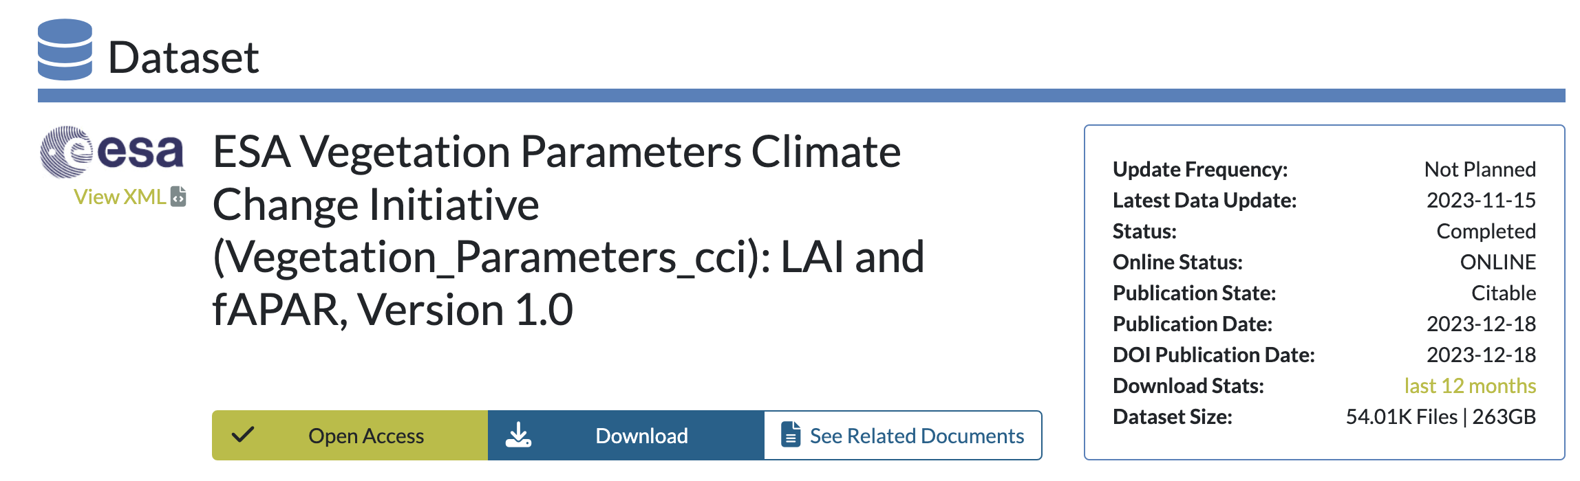
Land Product Validation
Biophyiscal
Slide 15

Slide 16
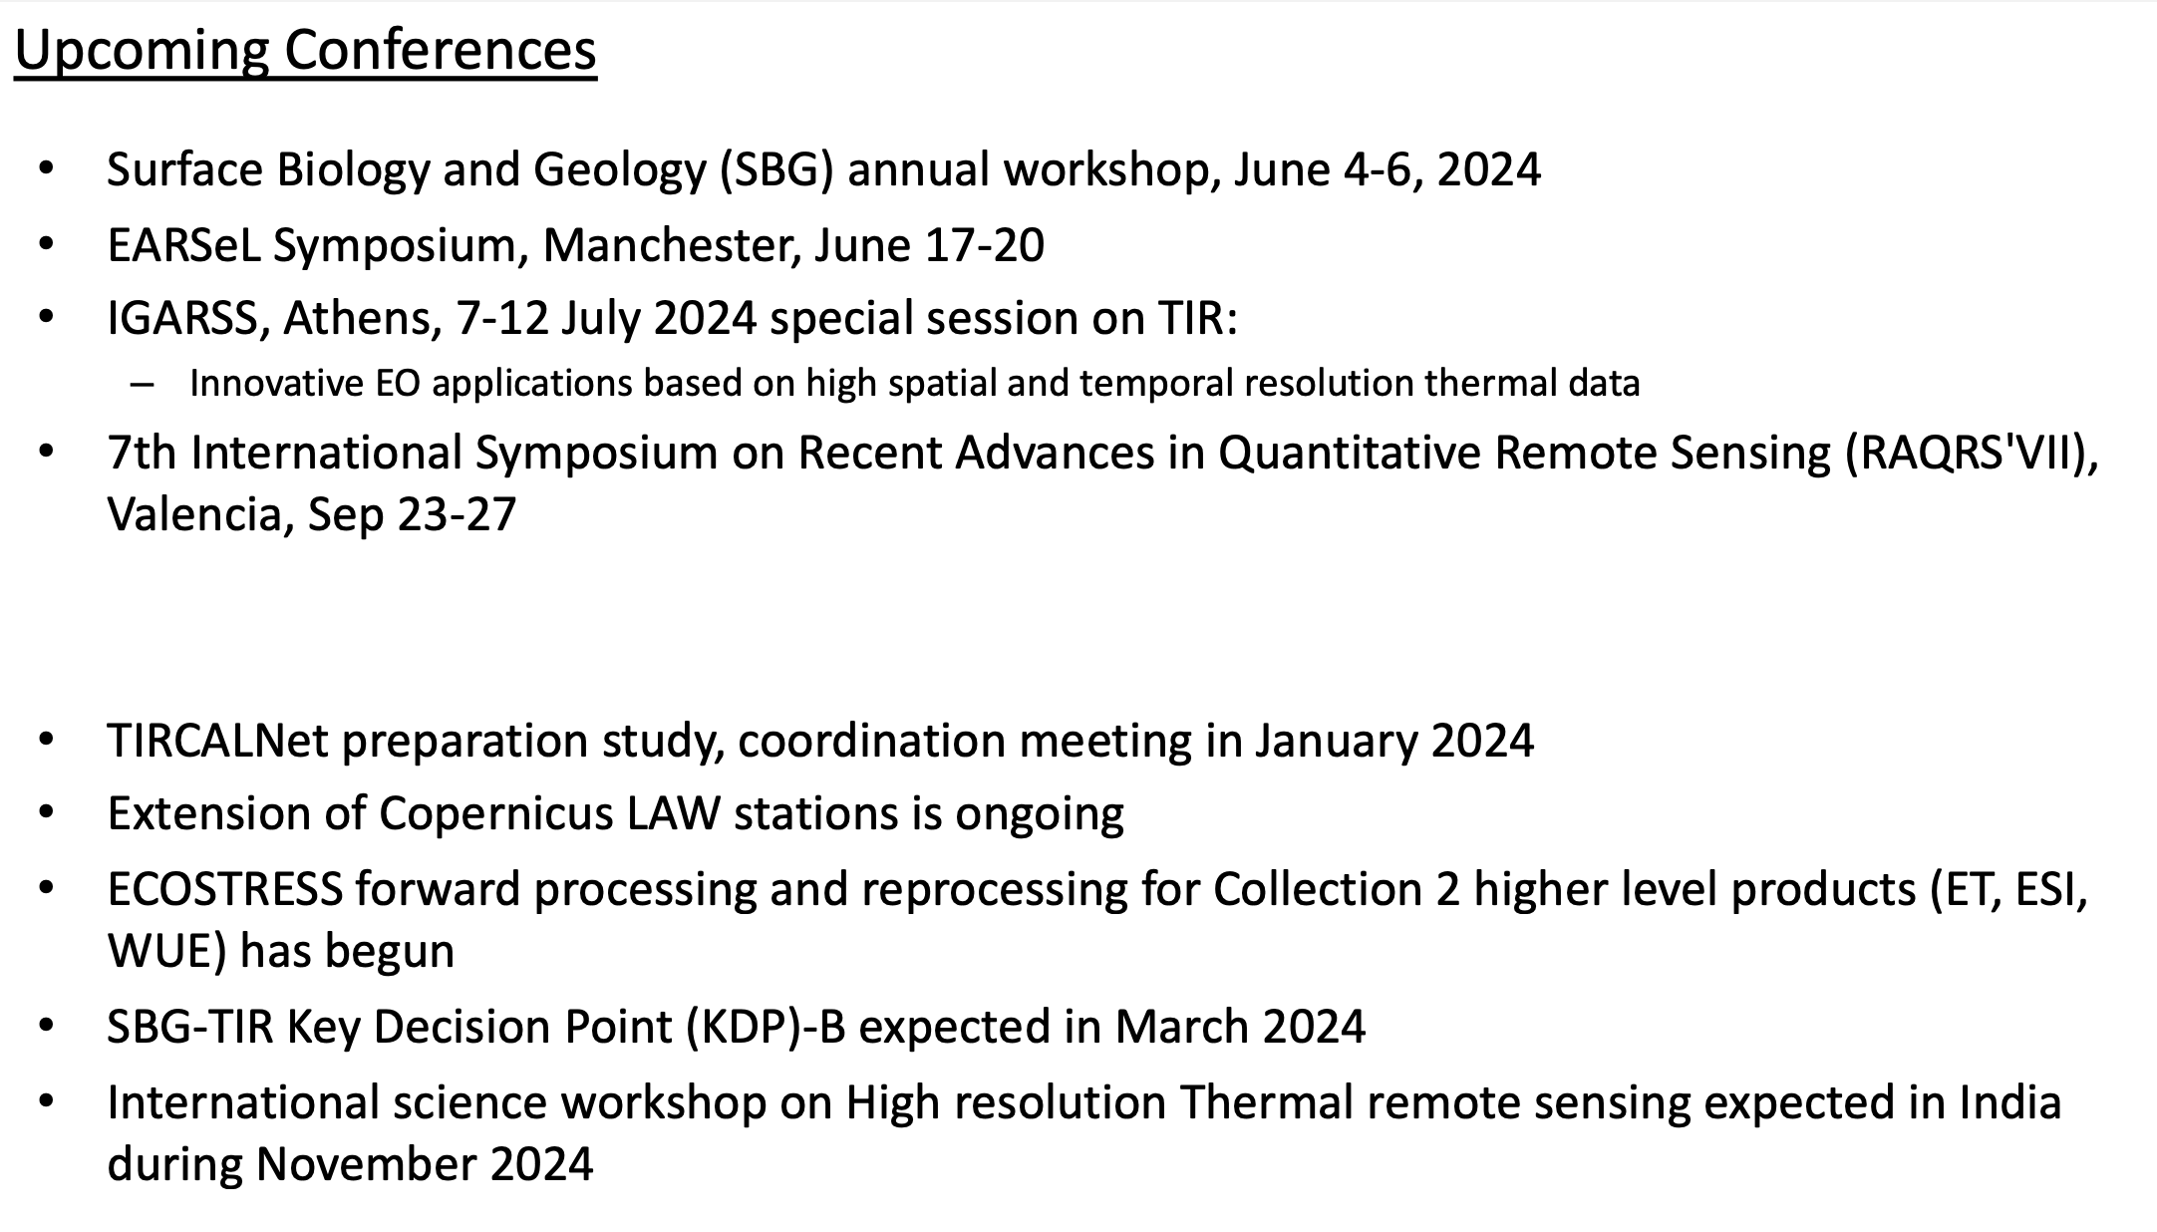
Land Product Validation
Biophysical
Slide 16

Slide 17
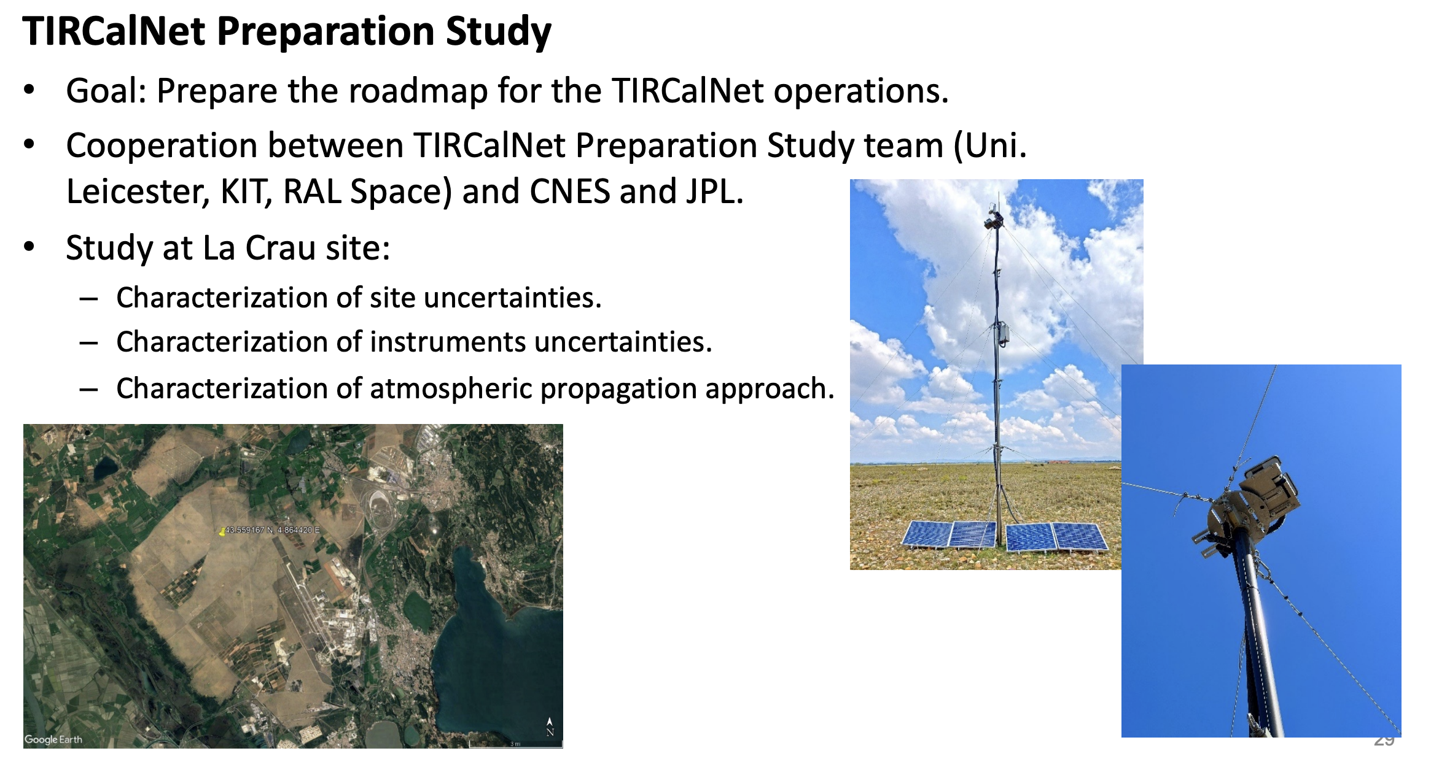
Land Product Validation
Biophysical
Slide 17

Slide 18
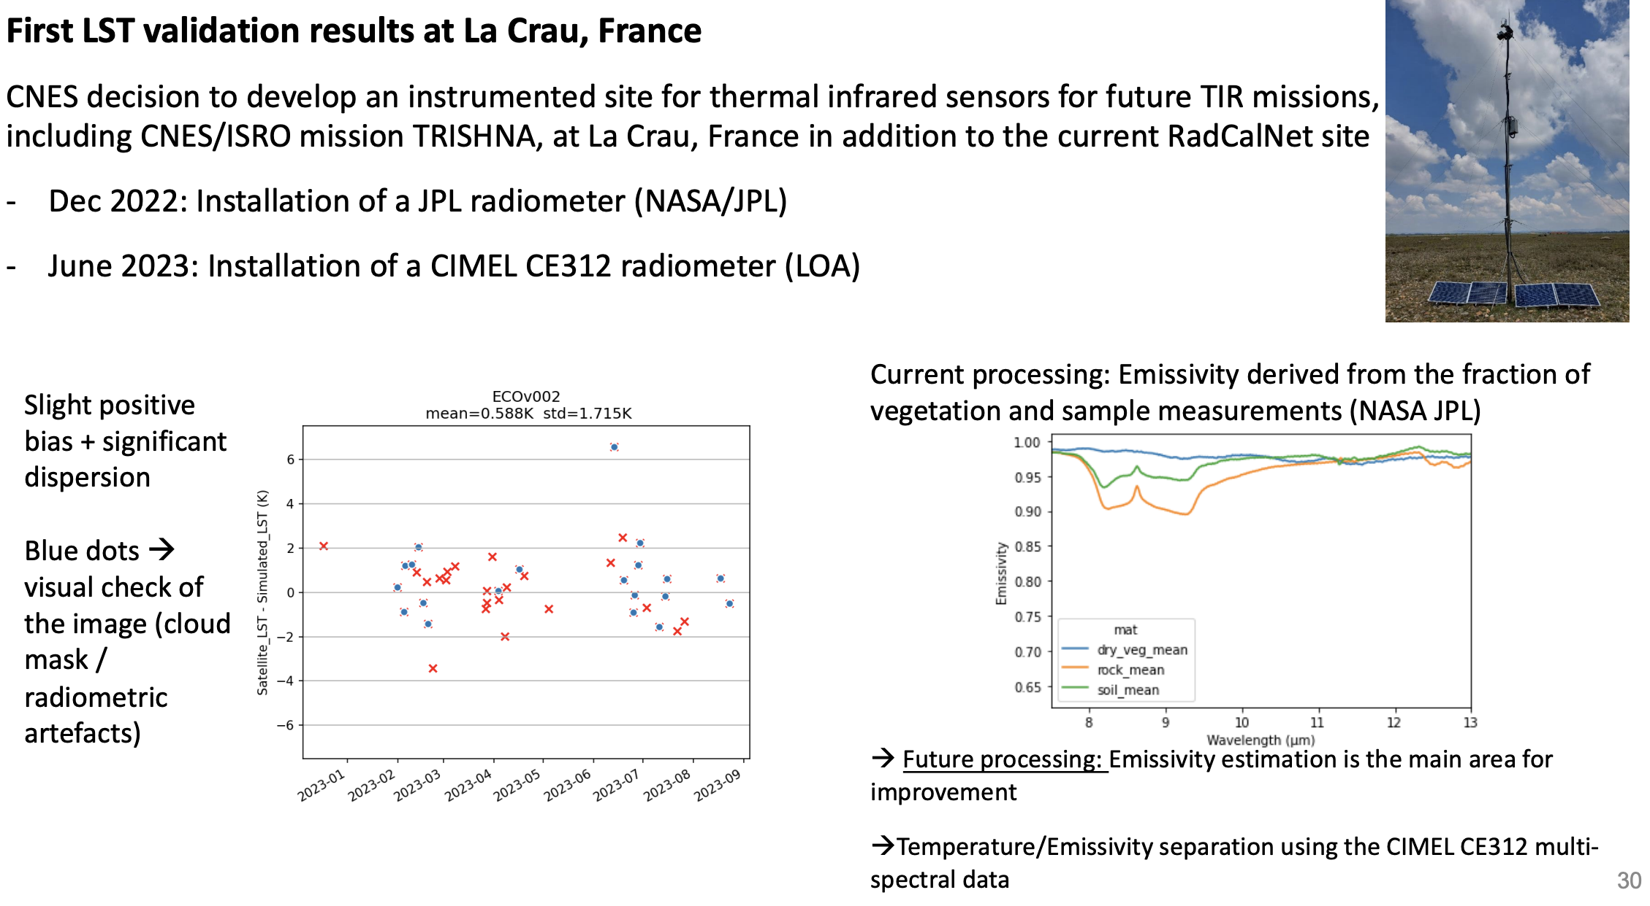
Land Product Validation
LST
Slide 18

Slide 19
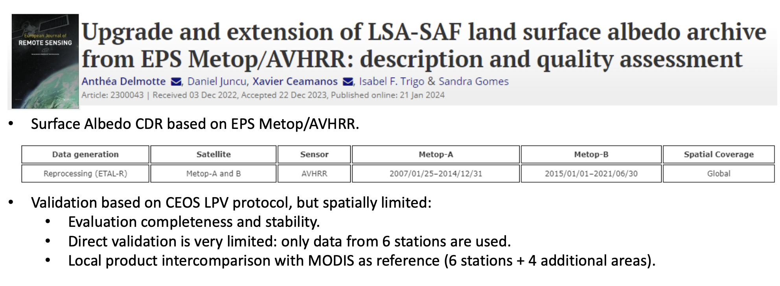
Land Product Validation
LST
Slide 19

Slide 20

Land Product Validation
LST
Slide 20

Slide 21
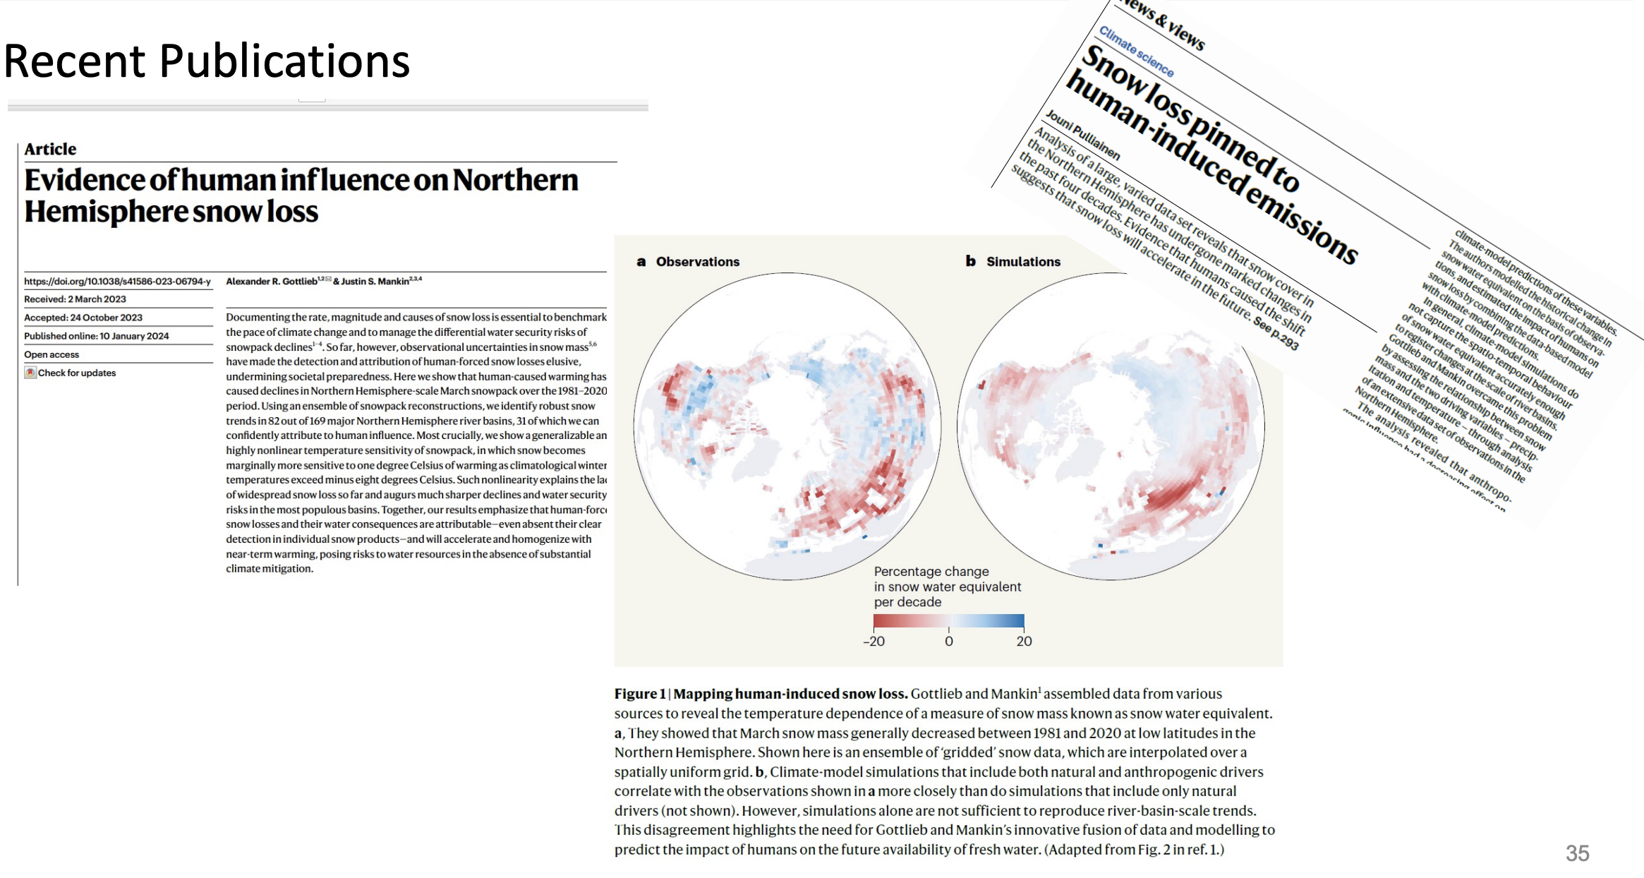
Land Product Validation
Snow
Slide 21

Slide 22

Land Product Validation
Snow
Slide 22

Slide 23
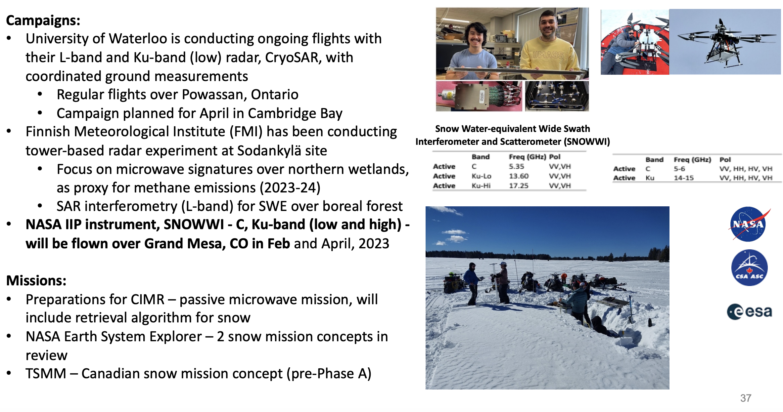
Land Product Validation
Snow
Slide 23

Slide 24
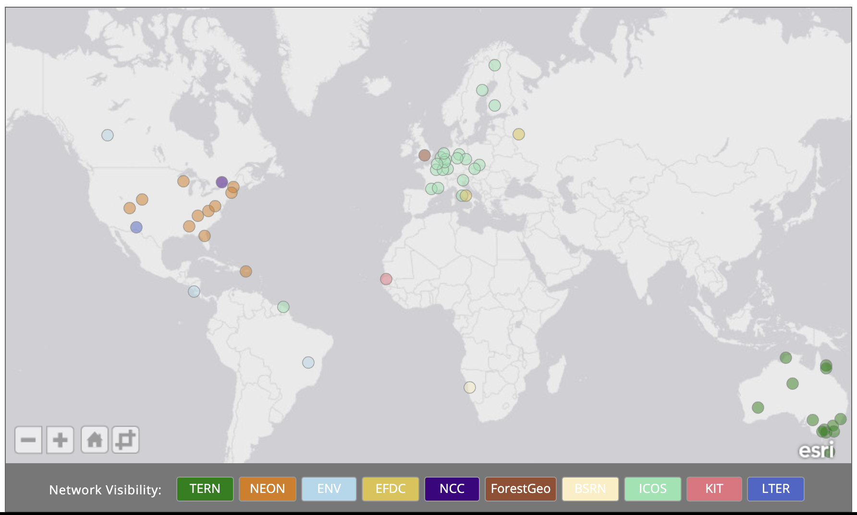
Land Product Validation
Review Supersites for LPV considering new focus areas and updated needs (outside of LPV)
Supersites
Slide 24

Slide 25
Land Product Validation
Slide 25

