Slide 1
WGCV-53
SI-Traceable Satellites (SITSats) task team report
Nigel Fox, UKSA/NPL
Yolanda Shea, NASA
Agenda Item 1.6
WGCV-53, Córdoba, Argentina
5th - 8th March 2024

Slide 2
Motivation 4 SITSats
Desire for ‘high quality’ ‘Reference/Fiducial’ data from which change can be unequivocally detected in relatively short time-scales and mitigate ‘data gaps’ (particularly for climate)
- Robust, transparent quantified evidence of traceability to a reference (ideally SI) - ‘QA4EO’
- Small comprehensively evaluated uncertainties at time and location of use
– allowing ‘stability’ criteria for climate to be robustly achieved tied to invariant reference (SI)
‘system of systems’ Integrated EO data, interoperable/harmonised
knowledge of/removal of biases
- ARD
- Robust SI-Traceability provides unambiguous trust, space agency agnostic, longevity
New space – Reliance on post-launch calibration anchor – no on-board Cal
- Reduced cost, complementary observations (temporal/spatial coverage)
- level playing field, maximal utilisation of investments and assets
CEOS/GSICS initiatives to establish international references/methods & SI-Traceability
- Coherent, comprehensive/flexible, reliable anchor to well-established methods (GSICS already
uses ref sensor philosophy!)
- mimics calibration methodologies of all terrestrial ‘industries’
- Provides a clear, distinguishing label of a specific property of a sensor but generic to ‘application’

Slide 3
Motivation for creating task group
Recognition, visibility of the new class of instrument to senior levels in space agencies & beyond
- noting at least 3 currently under-development and from different continents
In a similar manner to CEOS-VCs – coordinate, where appropriate, to facilitate commonality of purpose (shared vision) – below is generic VC inspired list
- maximal utilisation of resources,
- Continuity of ‘service’ (data) (coordination of launches)
- Internationally integrated ‘users’, data source agnostic tools
- Advocacy from an international ‘multi-agency’ perspective
- Lessons learnt – enabling of new missions/agencies
- Value > than sum of parts
Establish an agreed minimal set of definitions and principles (including operational) to distinguish SITSats and their utilisation
- Independent of application domain or technology
Seek to build a common user/customer base transcending individual missions
- Value/necessity to achieving a GEOSS fit for purpose to needs of climate & society

Slide 4
Definition:
A SITSat is a satellite-based sensor which can provide and verifiably- evidence, in a fully open and transparent manner, all significant contributions to the uncertainty of its measurements, metrologically traceable to the international system of units, SI, at the location and time from where they are made. In addition, this uncertainty must be at a level that is considered by the community to be of ‘Fiducial reference’ quality, i.e. that for a defined spectral domain/application it can be considered ‘state-of-the-art’ and able to unequivocally serve as a reference for similar measurements from other sensors. The uncertainty of a SITSat should be expected to reach or at least approach that required for key climate science objectives such as those identified in the “SI-Traceable Space-based Climate Observing System: a CEOS and GCICS Workshop” (https://doi.org/10.47120/npl.9319). When used as a reference a SITSat would be expected to have a measurement uncertainty of <0.5 compared to that of its non-SITSat peers.
Note:
1/ If used as a reference, the method used to compare with other sensors and its associated uncertainty to SI, should also be fully documented and evidenced.
2/ The nominal threshold uncertainty to be considered a SITSat for a particular type of measurement/application may increase or reduce over time commensurate with scientific consensus, currently this requires 2-10X improvement over current sensors. . Although desirable in the long-term, it is not essential to have a SITSat for all applications and sensor domains and thus the assignment of the classification to a sensor should only be made when the maturity and technology of a particular domain justifies it.
3/ A SITSat peer group would constitute ALL sensors making similar measurements (e.g. spatial and spectral range)

Slide 5
Task Group – Objectives (Draft from ToR)
Establish clear definitions of what constitutes a SITSat and minimal requirements needed to evidence this status.
Serve as a forum for agencies developing/planning SITSat missions to share experiences and knowledge.
Discuss collaboration opportunities, joint cal/val activities, campaigns, data sharing, etc.
Provide an opportunity for mission coordination, gap analyses, efficient tasking, acquisition planning, etc.
Facilitate coordination on technical topics, reporting of uncertainty and traceability information, interoperability, methods of dissemination, etc.
Aim for a systems-based approach, rather than having missions being developed and operated in isolation, along the lines of a CEOS Virtual Constellation.

Slide 6
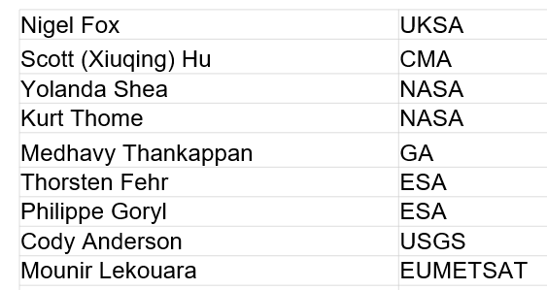
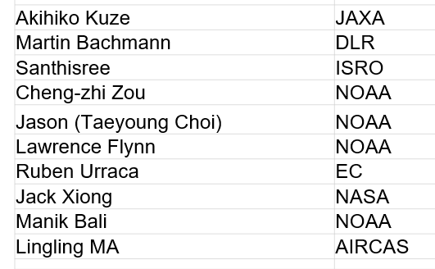
Current task team members
Co-Leads: Nigel Fox & Yolanda Shea

Slide 7
Priority Outputs/Deliverables
Establish clear definitions of what constitutes a SITSat and minimal requirements needed to evidence this status.
- How and what to present as uncertainty/SI-traceability evidence (standardized content and/or format)
Establish a vision/roadmap (whitepaper) of what a SITSat enabled observing system looks like
Data sharing, Systems based approach – Longevity beyond a single mission?
- Common (interoperable?) reporting/archive grid for climate? (Spectral/spatial)
- Common Grid for S2S calibration?
- Format – what info to report and how?
- Mirrored data stores/access?
- Minimal set of common ‘targets’ (comparison/gap filling etc)
4. Communications strategy Awareness raising / Key messages / Utility for observing system / Integrated multi-SITSat observing system

Slide 8
Communications: CEOS Cal/Val portal SITSat group page
Potential Content
Define SITSats and why they are important for global climate observing system
How to evidence it is a SITSat – Traceability & Uncertainty
How they can transfer calibrations – Link to full cal val architecture – expected performance improvement
Purpose of the SITSat group
What else? What would a non-SITSat person want to know?
SITSat group members & how to contact the group
Overview of SITSats in development/planned & expected operational timeframes
Future: Past and upcoming group activities (meetings, etc)
Future: Relevant Documentation (To be created by this group)

Slide 9
Other Communication Venues
Discuss potential venues (meetings, conferences, etc) for SITSat group members to educate community (Nigel, Yolanda)
AGU
EGU
EUMETSAT Meetings
AMS
GSICS Meetings
SITSat Member Organizations and space agencies (or equivalent)

Slide 10
What to communicate (initially)?
(If we have 2 minutes at the end of an existing/planned presentation)
Create a generic SITSat slide
Key messages
(If we have a few minutes in a meeting with an agency senior leader)
What SITSats are and why we need them.
Why the group was formed
Benefits of multi-national/agency collaboration in virtual constellation approach
Generalised poster?
??

Slide 11
Next steps
Approx 3 Virtual 0.5 day meetings a year + 1 in person (tied to other event if possible)
Establish CalVal portal page and wiki for common development by team
Membership (CEOS agencies or representatives of)
Recommendation for WGCV chair to provide a letter of encouragement to NASA recognising the importance of SITSats and CPF for as early a launch to the ISS as possible.
No critical urgency to deliver objectives but Communication strategy relatively high priority
- clarity on what a SITSat is! and what differentiates it from other satellites
- maximise short term opportunity to coordinate (CPF & TRUTHS in particular)
- Develop white paper on what a SITSat enabled observing system looks like

