Slide 1
WGCV-53
CONAE’s Welcome Presentation
Laura Frulla, CONAE
Agenda Item 1.2
WGCV-53, Córdoba, Argentina
5th - 8th March 2024

Slide 2
The Argentine National Space Plan
10 years strategic plan, periodically updated
It governs the activities and projects of CONAE since 1994 without interruption
Main objective: Go to space to observe the Earth
Make decision-making more efficient in the public and private sectors
Promote the development of the national industry, both in the upstream and downstream sectors
Promote and motivate national developments
Foster national and international cooperation

Slide 3
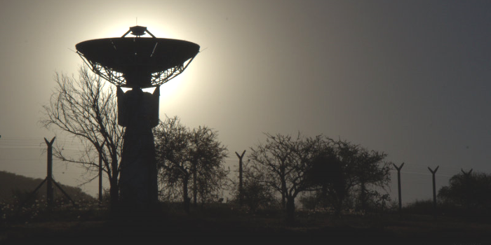
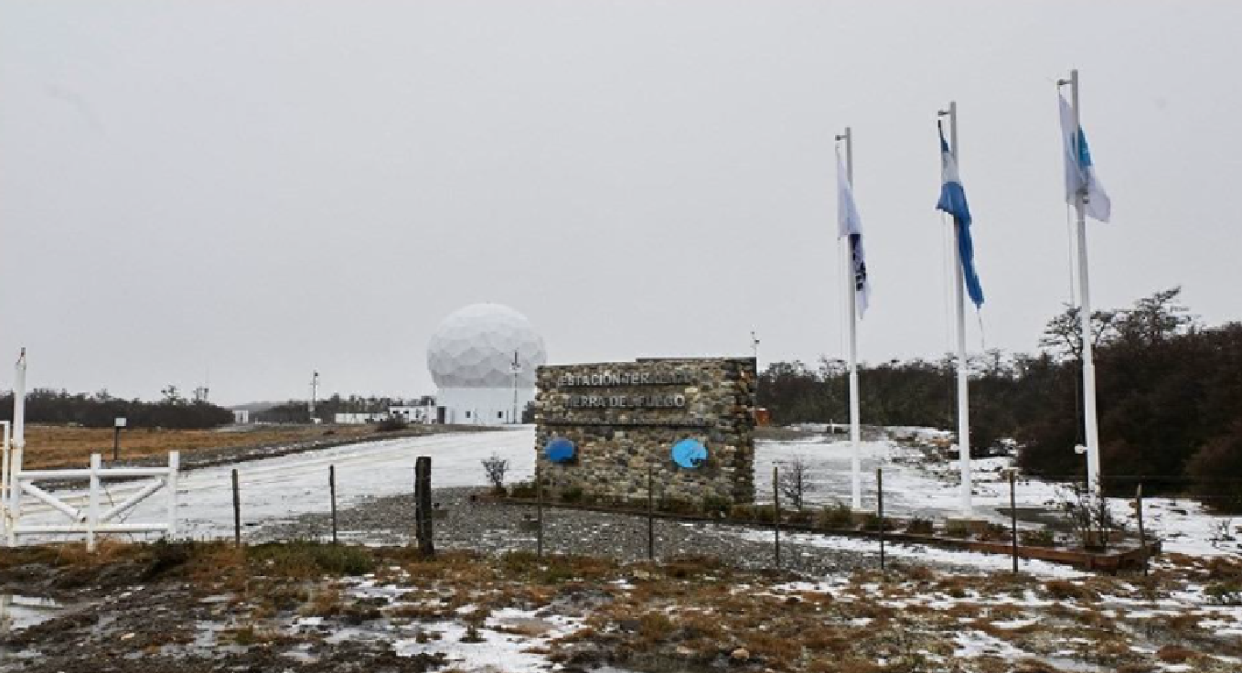
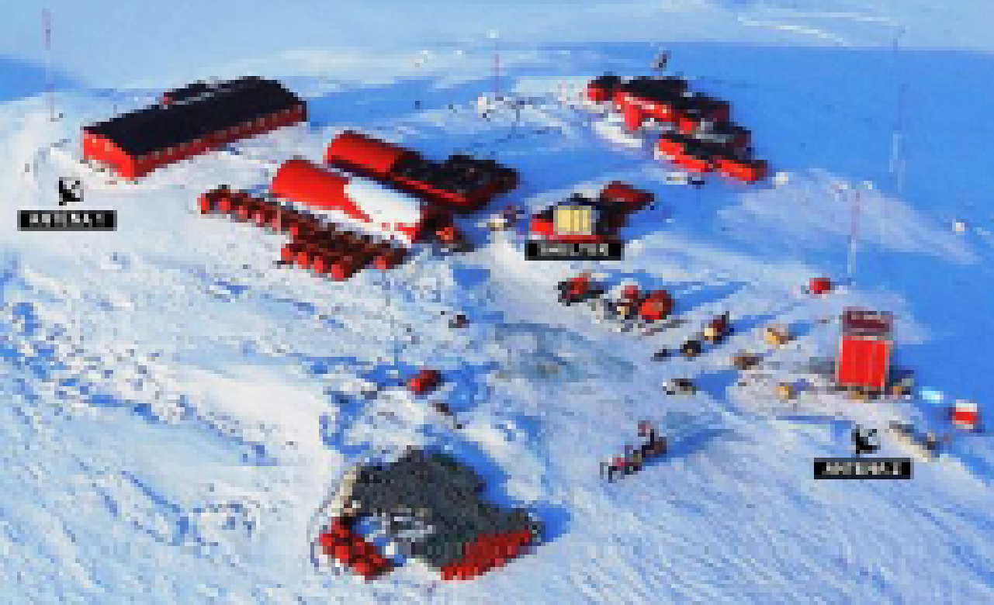
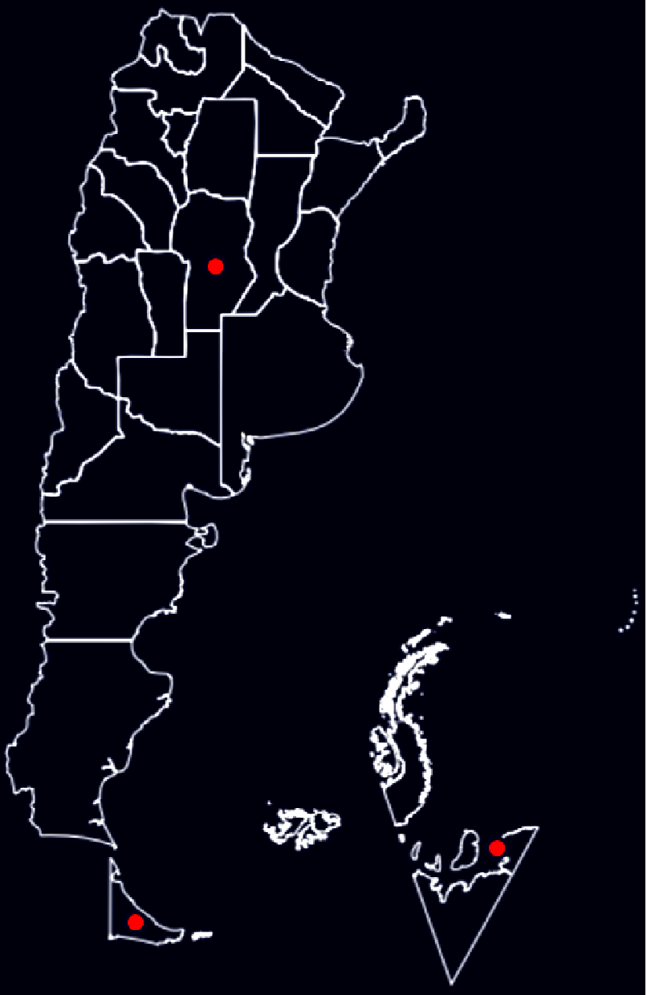
CONAE´s Main Activities
  Receiving stations operation
  Satelite monitoring and command
  Integration and test activities in dedicated laboratories
  Data reception and storage
  Data processing and EO products generation
  Data distribution
  Education, capacity building and user training (Gulich Institute)
  Satellite missions development
  Access to space
ETTdF
Ground Receiving Stations
Belgrano II
77° 52′ 25″ S
34° 37′ 39″ W

Slide 4
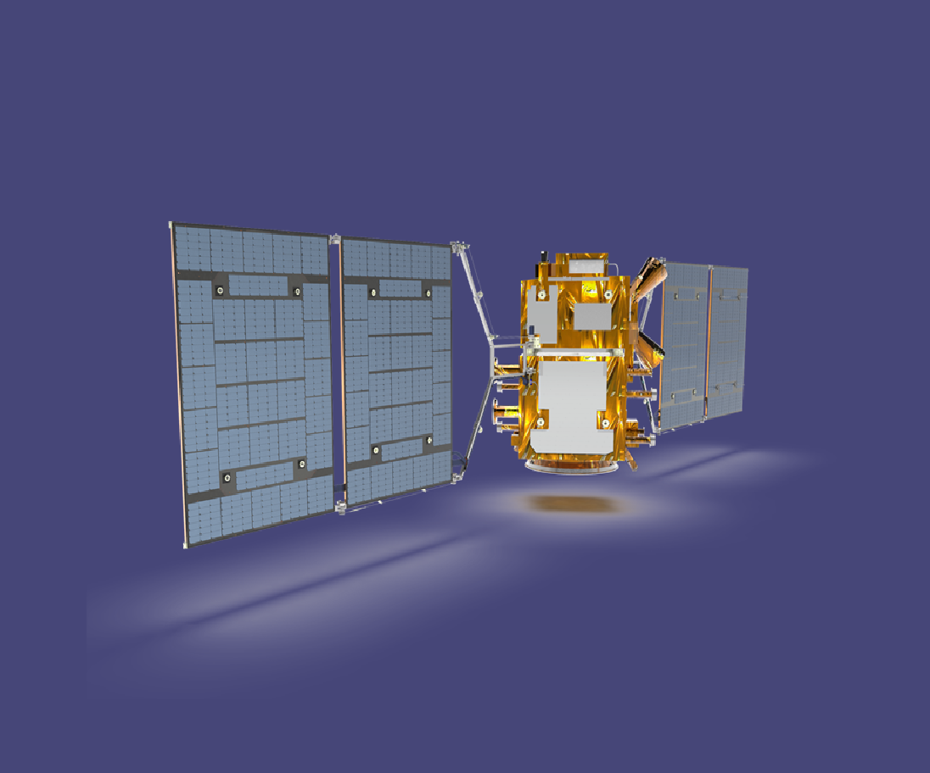
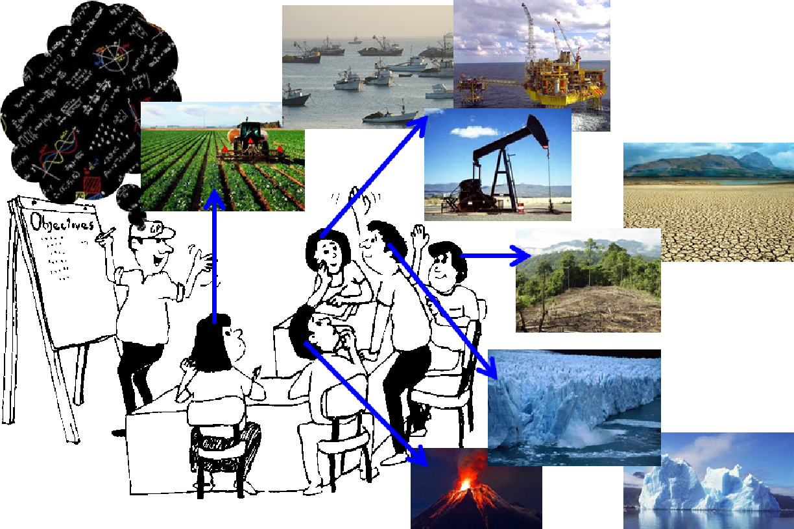
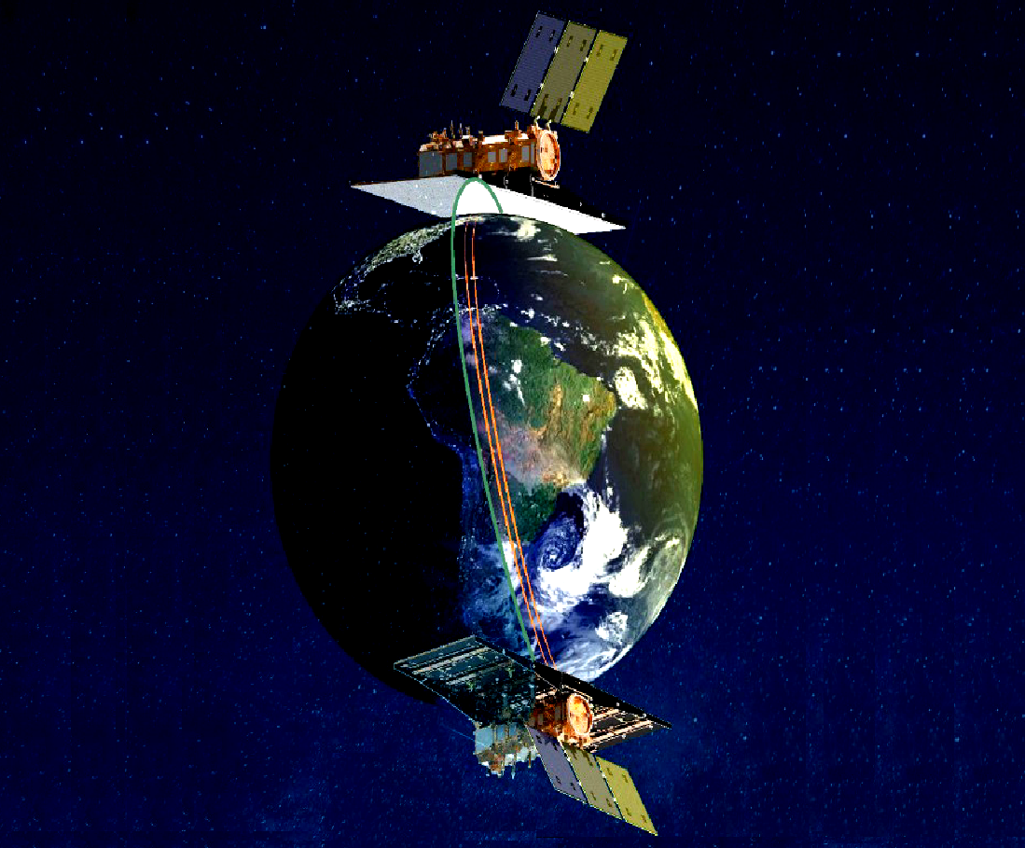
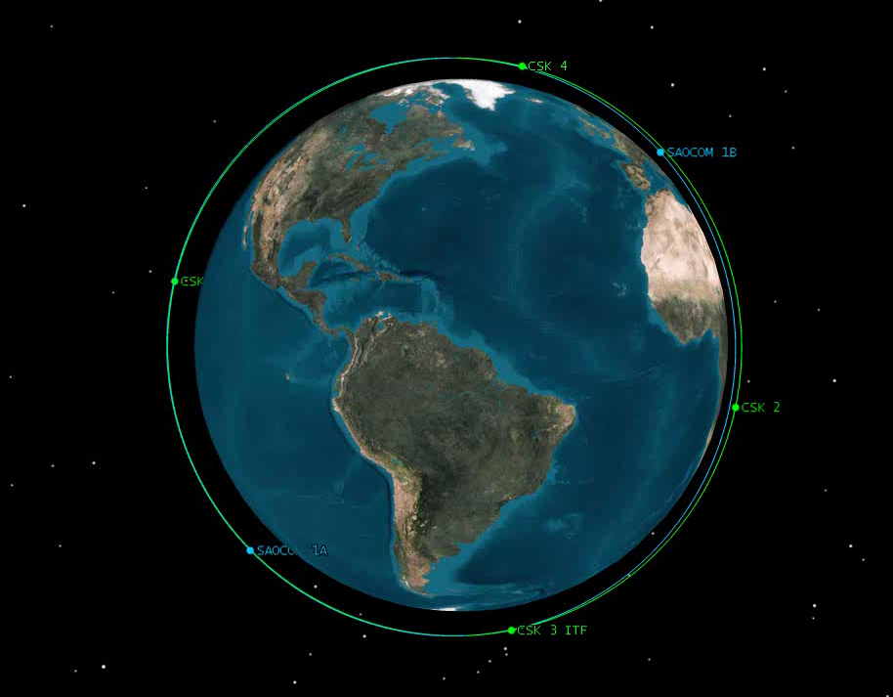
Operational Missions and Under Development
Q4 2024 / Q1 2025
SABIA-Mar Mission
SAOCOM 1A, 2018
SAOCOM 1B, 2020
user needs
SAOCOM-1 Constellation
SIASGE

Slide 5
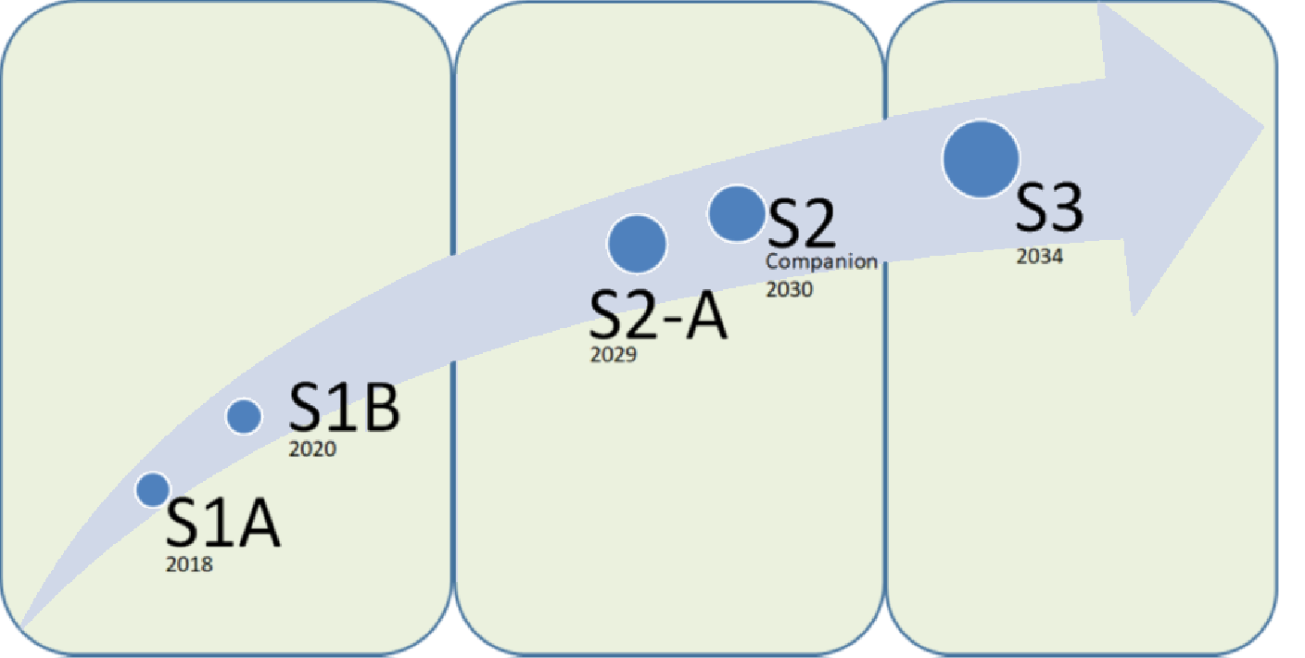
SAOCOM Continuity
  polar regions
  glaciers
  biomass
  change detection of height in snow, ice and glaciers
Main objective:
Supply SAR data continuity and to generate new and improved products
General objective :
Strengthen the interferometric capabilities
Intensify Antarctica monitoring

Slide 6
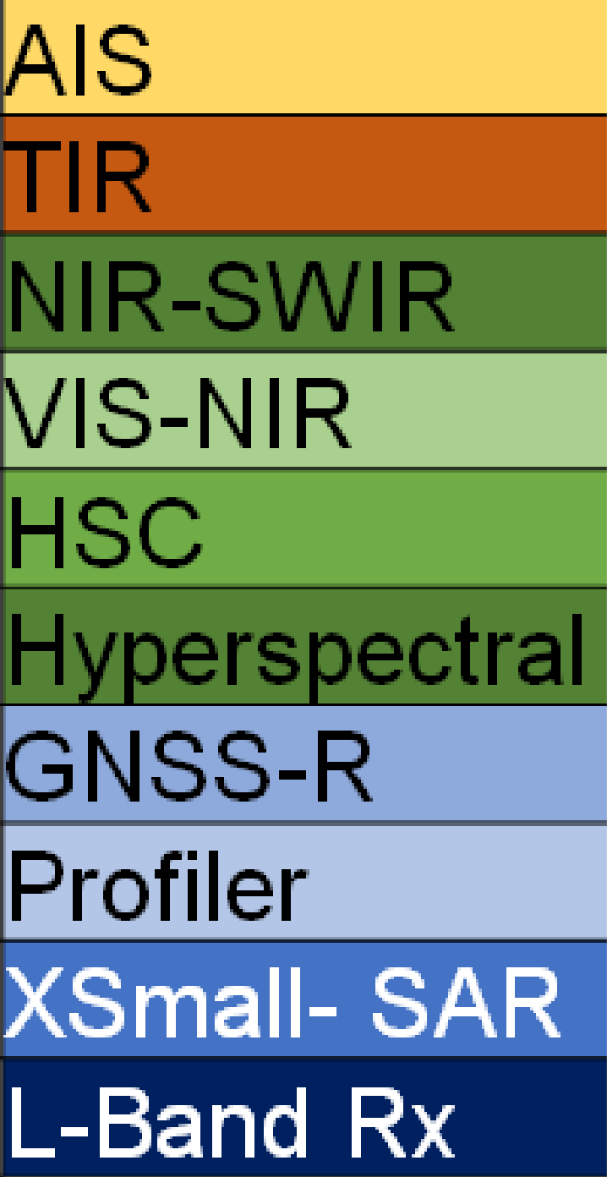
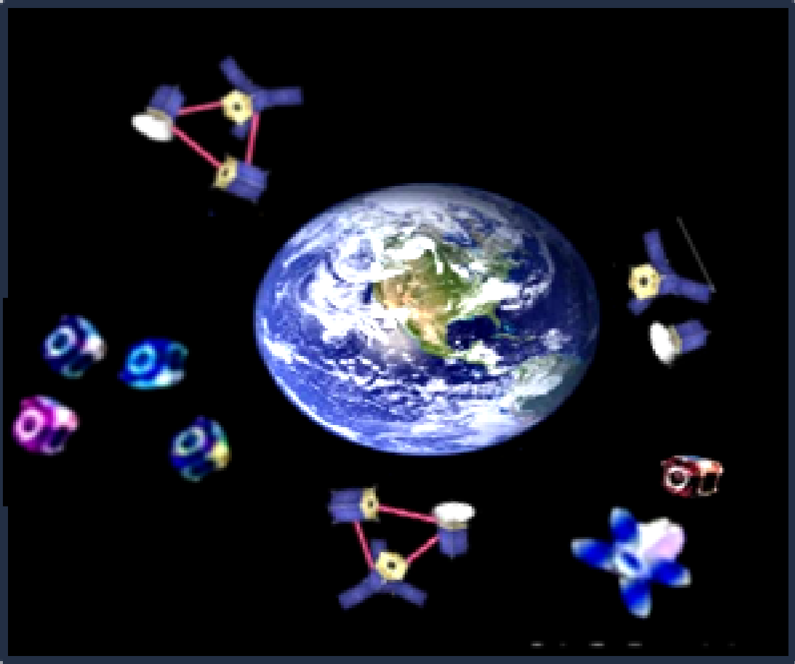
Planned Missions in Other Lines
Better geometric resolution
Operative TOPSAR interferometric products
Improved knowledge of the orbit
Better orbital tube/improve interferometric capabilities
Interferometric wide swath modes
Better duty cycle
Digital beam forming
SAOCOM 2
SAOCOM 3
SAOCOM 1A
SABIA-Mar
(ocean)
SAOCOM 2
SAOCOM 3
SAOCOM 1B
Companion
Patagonia Beta
(ship detection)
SARE II
(single pass interferometric acquisitions with SAO2)
Geostationary
SARE Beta
(environmental monitoring)
SARE I
(fishing monitoring)
SARE III
(climate laboratory)

Slide 7
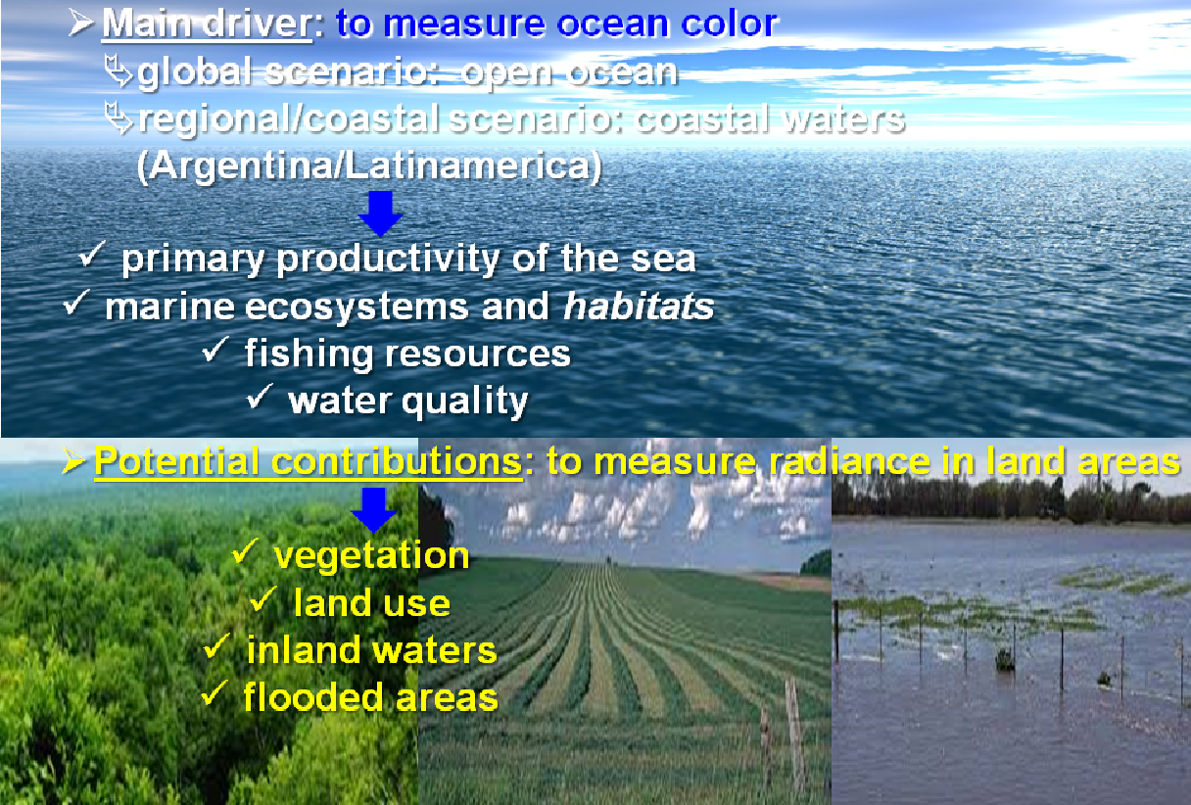
SABIA-Mar Mission
Normalized Water leaving radiance maps
Chlorophyll-a concentration Maps
(800 m)
(200 m/
400 atm.cor)
Diffuse Attenuation coefficient Kd (490)
Photosynthetic Available Radiation on a daily, weekly and monthly time scales
Turbidity

Slide 8
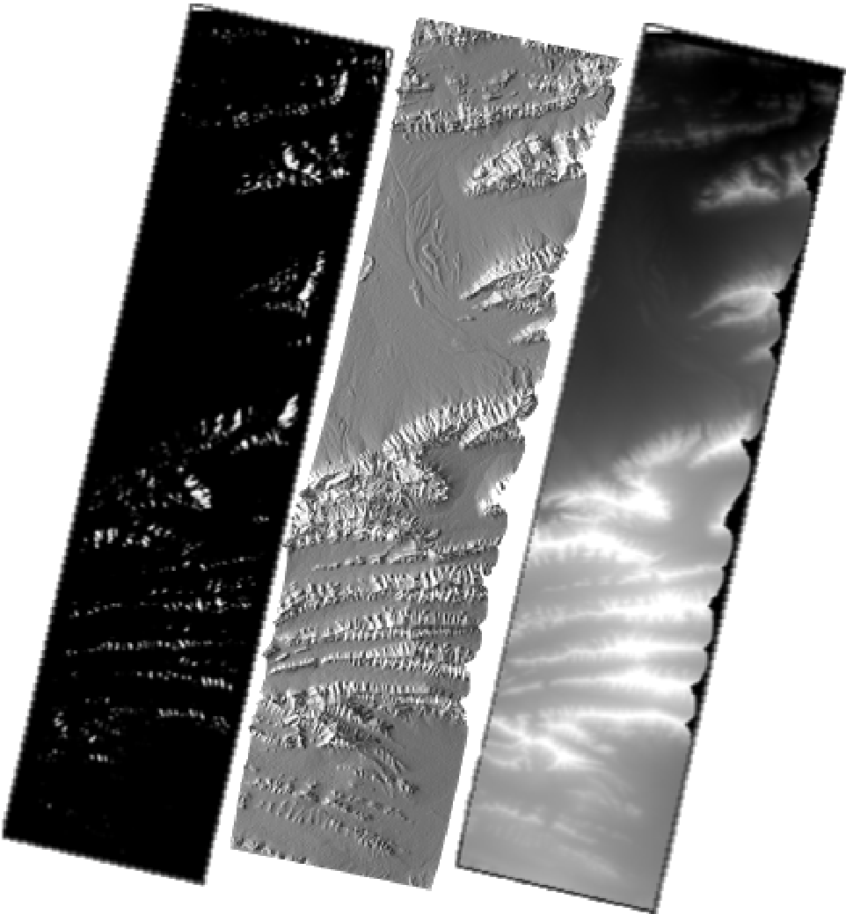
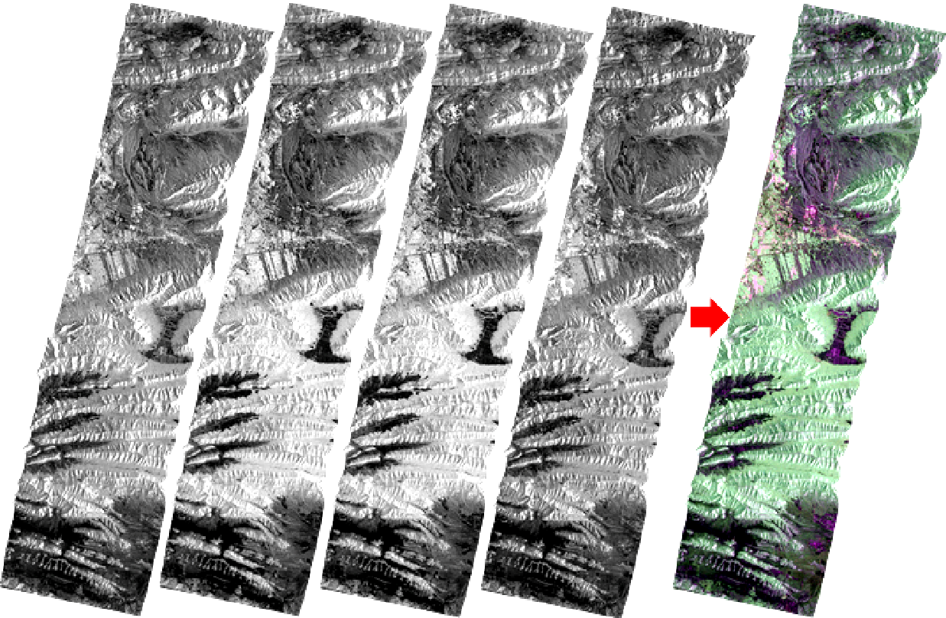
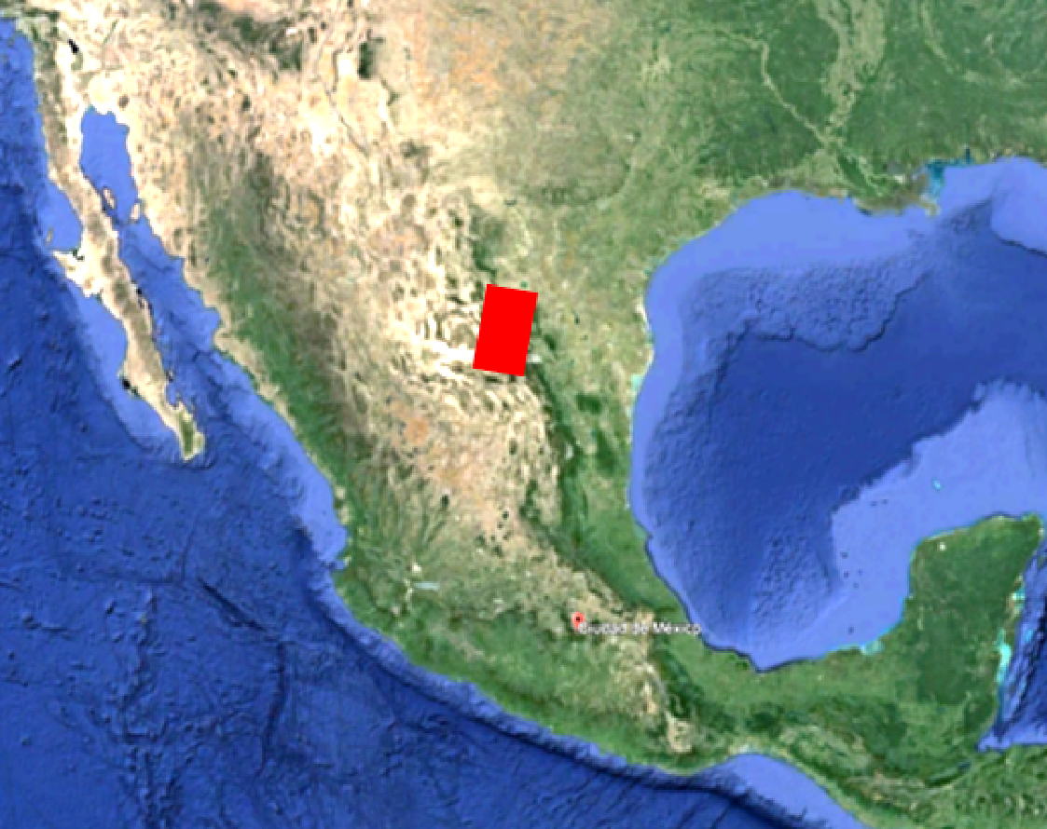
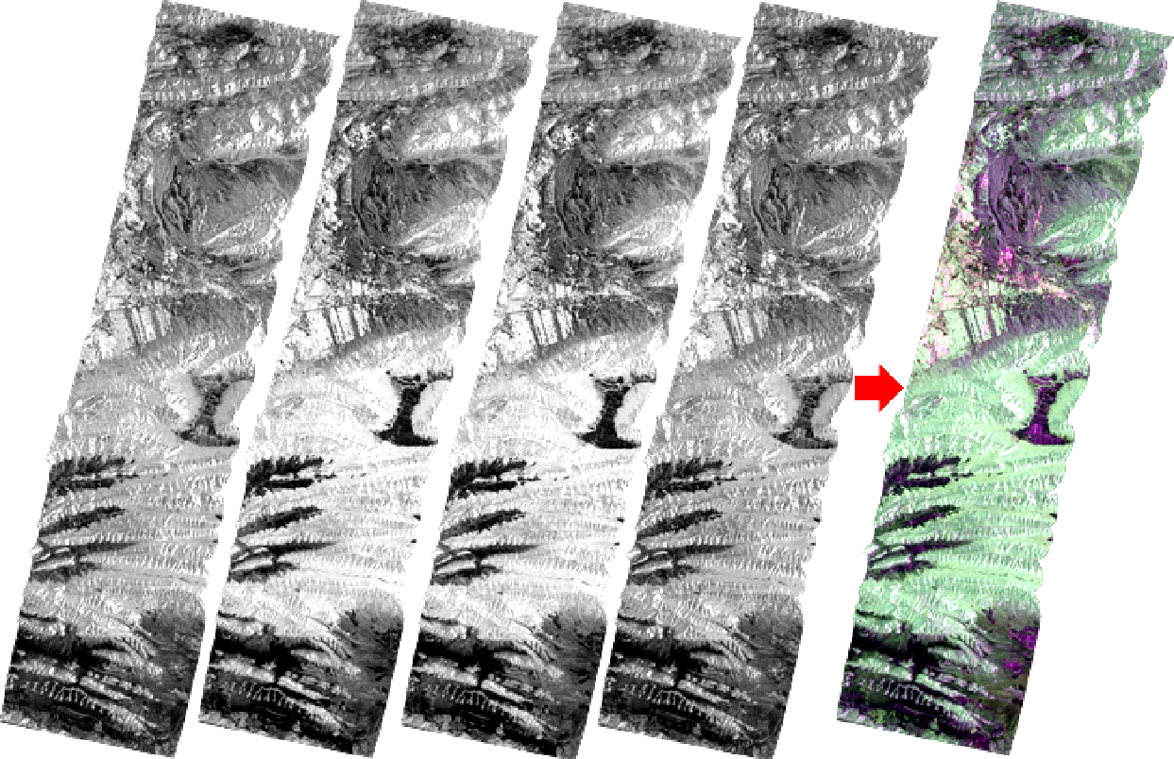
Level 1 Products
L1A, Single Look Complex-SLC, slant range
L1B, Detected Image-DI, ground range
L1C, Ground Ellipsoid Corrected-GEC, based on ellipsoid
L1D, Ground Terrain Corrected-GTC, based on DEM
L1A
STRIPMAP-SP/DP
R: HH
B: HV
G: VV
Auxiliary Data
HH
HV
VH
VV
SAOCOM 1A STRIPMAP-QP April 18, 2021
σ₀
Layover Shadow Mask
γ₀
Projected Local Incidence Map
DEM
HH
HV
VH
VV

Slide 9
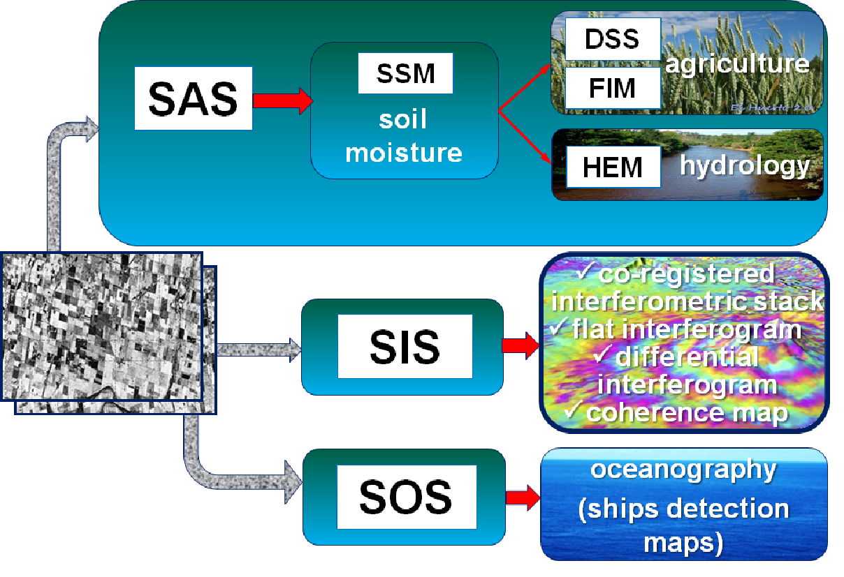

Level 2 and Higher Level Products
SAR images
(Level 1)
ships detection
oil spill maps
wind maps
ice floe monitoring

Slide 10
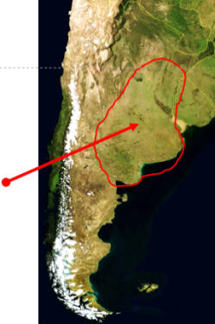
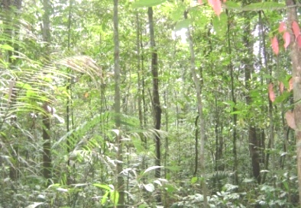
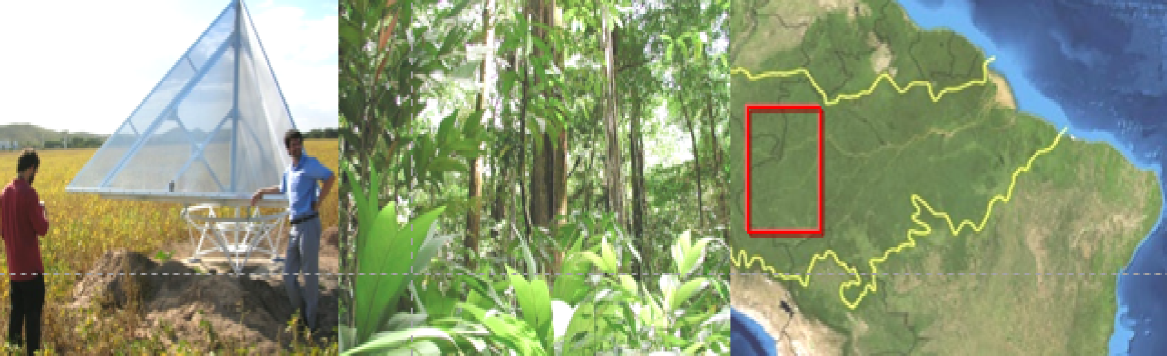
SAOCOM Mission Acquisition Strategy
Baseline Mission
  (fixed acquisitions)
Foreground Mission (variable acquisitions)
Background Mission (useful data base)
  soil moisture
  (Pampas)
  Argentina:
  emergencies
  maritime control
  biomass
  Los Andes (tectonic plates and glaciers movement)
  users
https://www.argentina.gob.ar/ciencia/conae/saocom-1-acquisition-plans-downloads-0
SAR calibration:
  rain forest
  specific point targets
  doldrums
  Latinamerica and the rest of the world:
  biomass
  polar zones

Slide 11
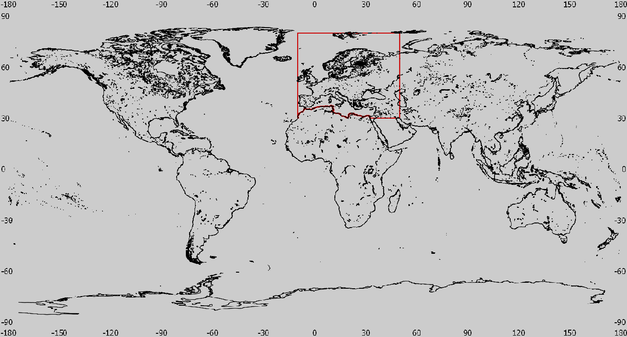
SAOCOM Data Access(1/2)
SAOCOM Catalogue can be navigated freely to identify already existing data. Upon registration, quicklooks can be seen:
  https://catalogos.conae.gov.ar/catalogo/catalogoSat.html
To access the data:
agreement
project
    u_inter@conae.gov.ar
    (outside ASI exclusivity area)
Licence of Use
one-click possibility

Slide 12
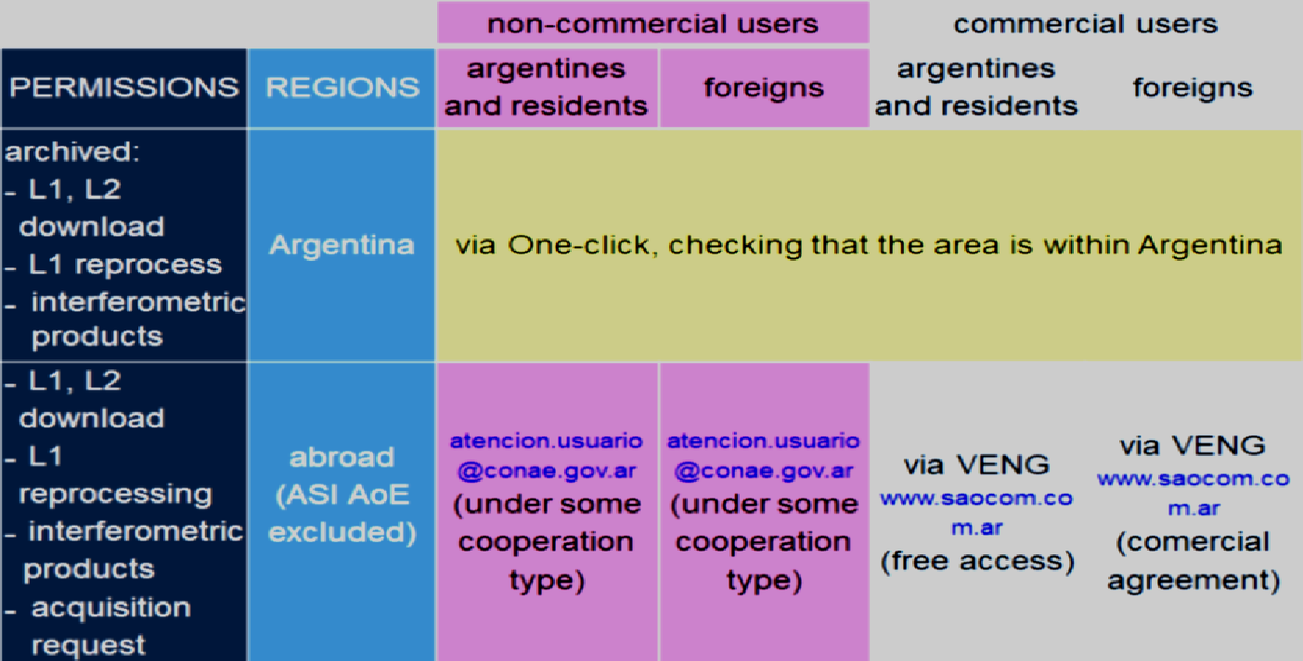
SAOCOM Data Access(2/2)
One click possibility
https://registro.conae.gov.ar/login/login/

Slide 13
Thank you

