Slide 1
WGCV-53
WGCV Contributions to the CEOS New Space Task Team
Cody Anderson, USGS
1.10
WGCV-53, Córdoba, Argentina
5th - 8th March 2024

Slide 2
JACIE/VH-RODA Cal Site Actions
Joint Agency Commercial Imagery Evaluation (JACIE)
Very high-resolution Radar and Optical Data Assessment (VH-RODA)
Common Cal/Val Evaluation Sites
Common data pool for commercial imagery over evaluation sites
Database of high-res Ground Control Points (GCPs) and Digital Elevation Models (DEMs)
GCPIX: a Proposal to Orchestrate GCP Collection
JACIE Partner Agencies
VH-RODA

Slide 3
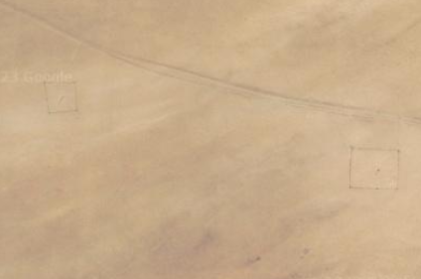
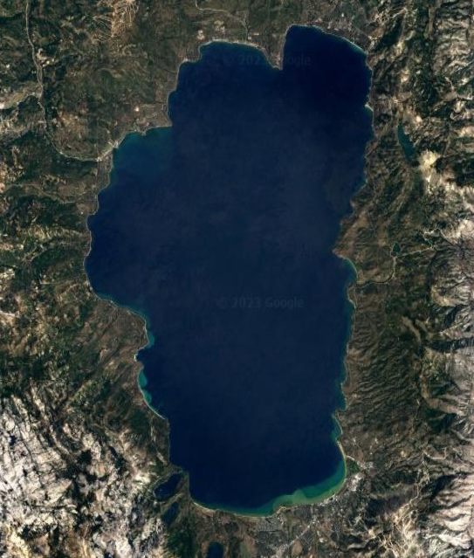
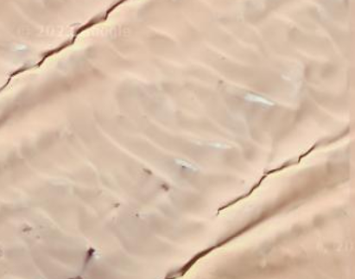
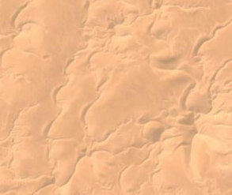
Radiometric Sites
Railroad Valley
Gobabeb
Lake Tahoe
Libya 4
Libya 1
Algeria 3

Slide 4
Radiometric Sites
Site Name | Center Latitude | Center Longitude
Instrumented Sites
Railroad Valley Playa | +38.50 | -115.69
Gobabeb, Namibia | -23.60 | +15.12
Lake Tahoe (Thermal) | +39.10 | -120.03
Pseudo-Invariant Calibration Sites (PICS)
Libya 4 | +28.55 | +23.39
Libya 1 | +24.42 | +13.35
Algeria 3 | +30.32 | +7.66

Slide 5
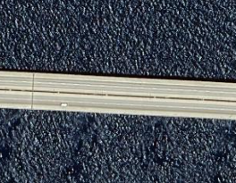
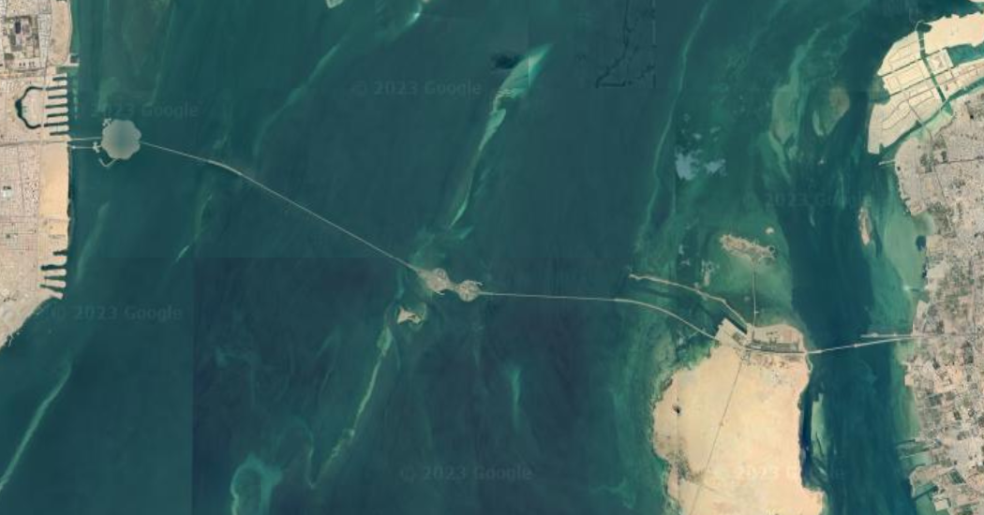
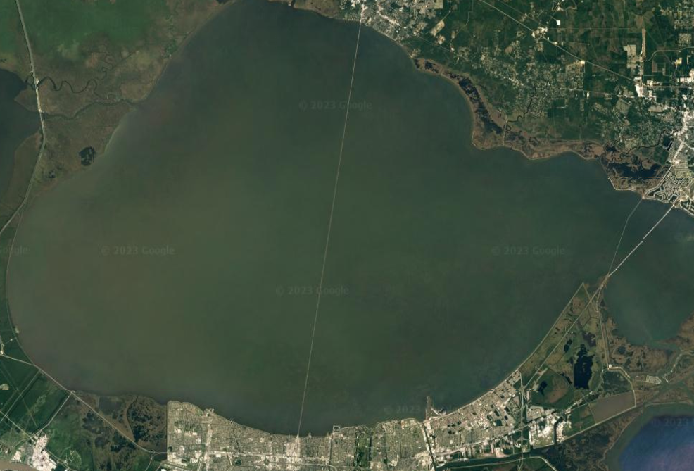
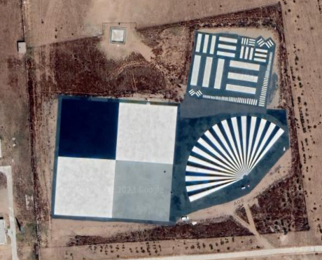
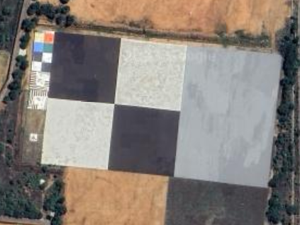
Spatial Sites
King Fahd Causeway
Lake Pontchartrain Causeway
Baotou Target
ISRO NRSC Target

Slide 6
Spatial Sites
Site Name | Center Latitude | Center Longitude
Medium Resolution Sensor
King Fahd Causeway | +26.20 | +50.34
Lake Pontchartrain Causeway | +30.21 | -90.12
High Resolution Sensor
Baotou Target, China | +40.85 | +109.63
ISRO NRSC India | +17.03 | +78.18

Slide 7
JACIE and Uncertainty Workshop
JACIE – March 11-14
Uncertainty Workshop
Focus on radiometric uncertainty of Top of Atmosphere (TOA)/Level 1, passive, reflective, optical imagery
Prelaunch Characterization (Lab Measurements)
Vicarious Calibration (RadCalNet)
Processing Chain (Raw-to-TOA Product)
Cross Calibration (Product-to-Product)
Format is intended to allow equal time for presentations and audience participated discussion

Slide 8
JACIE Viewpoint Survey
What is the role of your current primary employer:
Industry Accademia Government Contractor to the Government
Other _______
Are the currently available quality metrics/assessment results sufficient for your needs?
Yes No N/A
If not, what is missing or not mature enough __________________
Are all datatypes/modalities, currently, addressing data quality, adequately ?
Yes No N/A
If no, which datatypes/modalities need improvements ______
Is uncertainty a necessary input for your analysis?
Yes No N/A
Are uncertainty estimates available for your products?
Yes No N/A

Slide 9
JACIE Viewpoint Survey (Cont.)
Do you feel there are enough opportunities for Industry to collaborate with Government Agencies?
Yes No
Are Industry technical needs being adequately addressed by Government Agencies?
Yes No
If “No,” what recommendations could you provide ___________
Do you feel the “New Space” term is an adequate descriptor of the Commercial Sector?
Yes No N/A
If “No,” Is there a preferred term you would suggest: __________
Would your employer be amenable to providing free data over Cal/Val sites?
Yes No N/A

Slide 10
Summary/Actions
JACIE and Vh-RODA are key for engaging with New Space/Commercial Provider Cal/Val personnel
JACIE and VH-RODA approved Radiometric and Spatial Calibration Sites
Sites approved through IVOS
Recommended Action: WGCV to approve and publish list of Radiometric and Spatial Calibration Sites
Recommended Action: Explore location/access/management for Calibration Site Data Pool

