Slide 1
WGCV-53
New Space Calibration Monitoring System
N. Fox, S Hunt UKSA
Agenda Item 1.10
WGCV-53, Córdoba, Argentina
5th - 8th March 2024

Slide 2
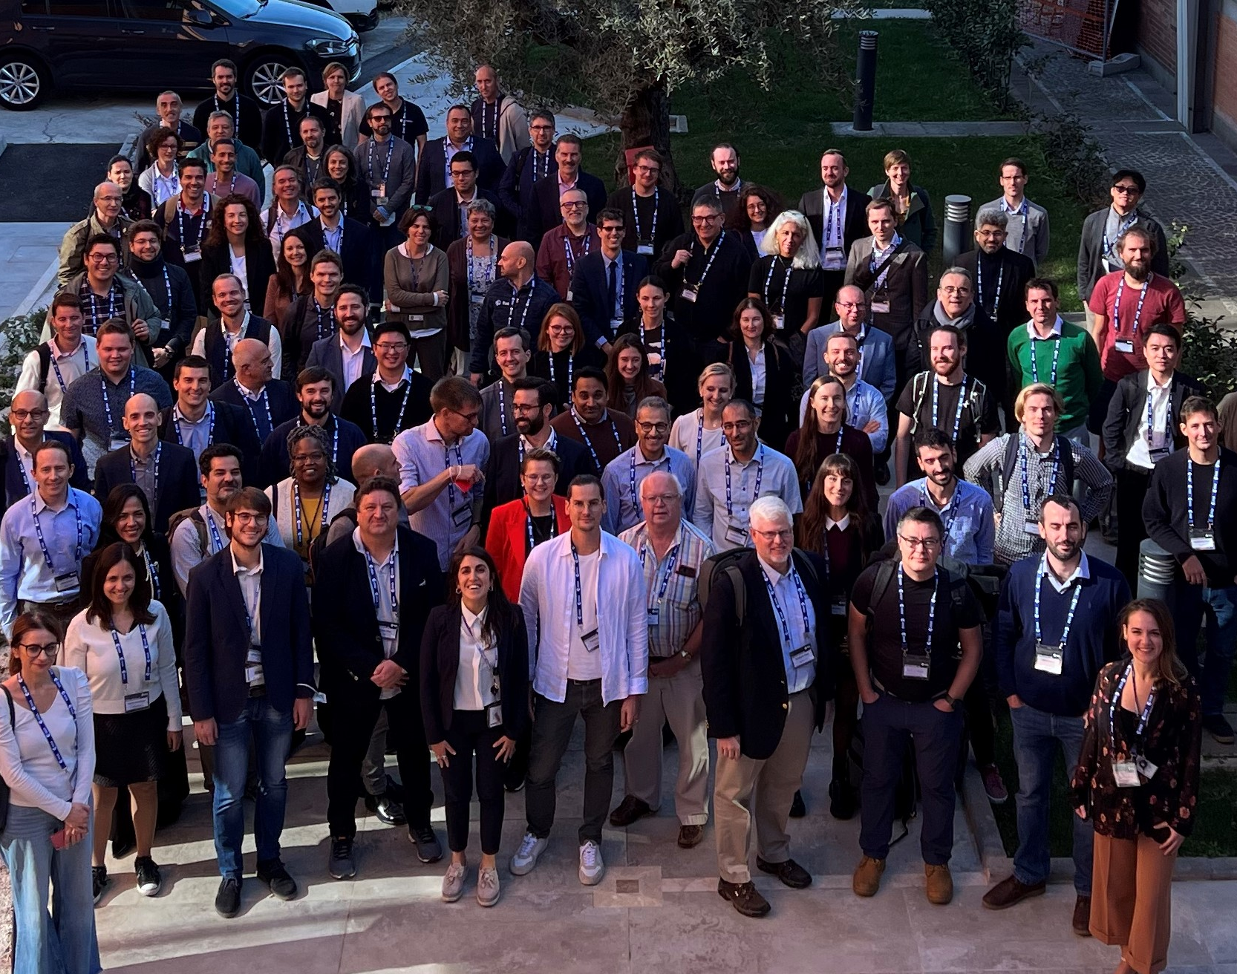
“New Space” Mission Data Quality
Users need to know the extent “new space” missions are fit for quantitative applications
  Activities such ESA EDAP & NASA CSDA
  Discussion fora such as JACIE & VH-RODA
Proposal at VH-RODA 22 (via I. Zuleta) to develop a community matchup comparison system to publish biases of missions wrt references
CEOS New space initiative – response to WGCV-52 ACT-18/19
VH-RODA 2022, ESRIN

Slide 3
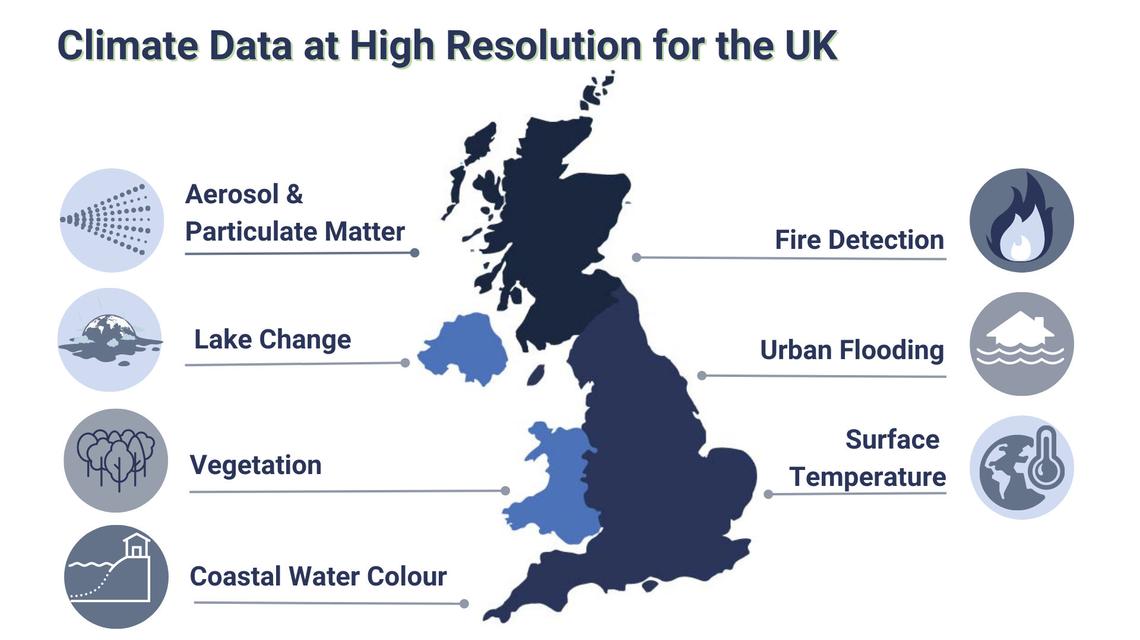


Supporting UK National Activity
Application
Application
Application
EO DataHub Platform
Processing
QA
Data Centre
Platform
Facility

Slide 4

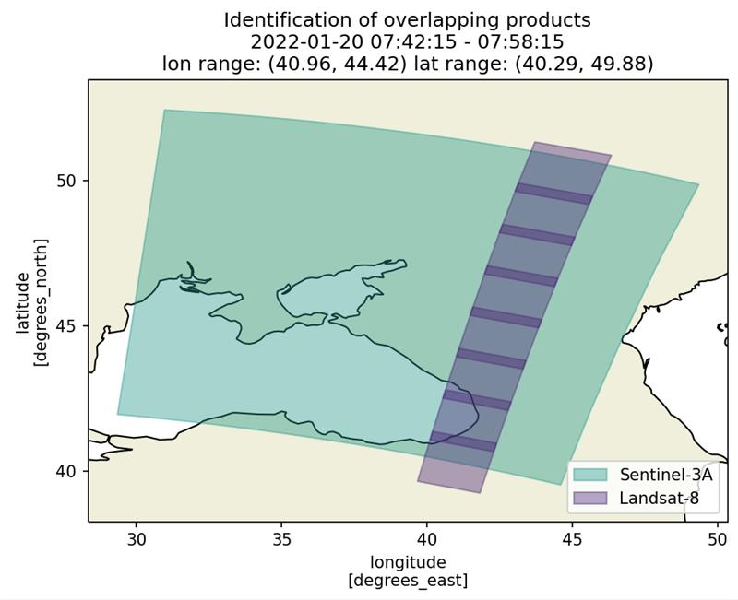
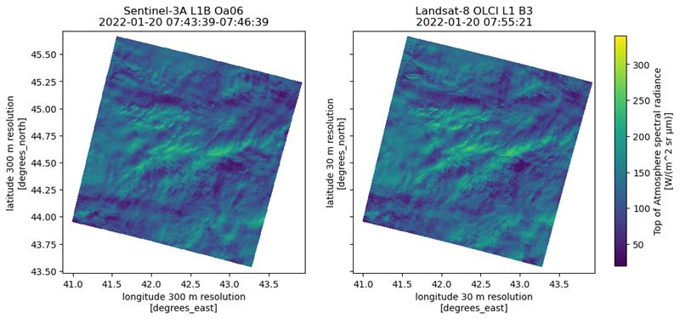
Match-up
“Data Cube”
Product Catalogue
Catalogue API Plugin
Data Reader Plugin
Identified Overpasses
Product Lookup
Match-up Products
Match-up Query
Match-up Dataset
Match-up Index

Slide 5
Cal/Val Pipeline
1
2
3
Evaluate comparison samples, compensating for observation differences
Optimises sensor model calibration parameters to best agree to reference
Validates performance though comparison to independent references
Sensor Model
Calibration
Harmonisation
Harmonisation Coefficients
To users
Matchup
Pre-processing
Comparison Samples
Match-up Datasets
Apply
Harmonisation
Harmonised Comparison Samples
Validation
Validation

Slide 6
Proposed Calibration Monitoring System
Build from NPL’s matchup database and cal/val pipeline to answer need from “new space” users – develop a CEOS calibration monitoring system
  Provide location for ”new space” missions to deliver set of products for defined cal/val sites
  Analyse and develop a web dashboard to share results
Started with an initial implementation:
  Sensors – Sentinel-2, Landsat-8, now looking for engagement with commercial providers
  CEOS References – RCN GONA, RCN RRV, Hypernets GONA, with PICS L4 coming later (setting up model will take a little longer)
    Potentially add to list but maintain a minimum core to constrain effort
    Look to have result from a combined comparison of sites

Slide 7
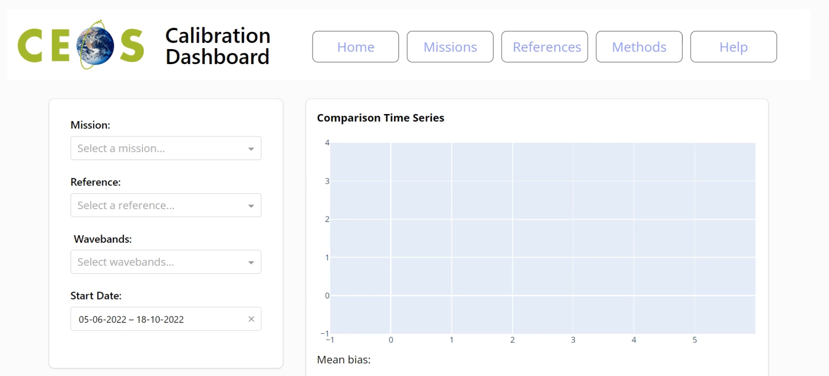

Slide 8
Considerations for Development
Code to be open sourced
  Gives transparency for users and vendors
  Enables community development
Missions able to join on a voluntary basis
  Software effort on the vendor side – e.g., reader/catalogue plugins
  Matchup products to be delivered to platform, but not intended to be redistributed
Deployment strategy
  Should be set up to run automatically to minimise on-going effort

Slide 9
Conclusions & Next Steps
Apply NPL’s cal/val pipeline to answer need from “new space” vendor/users – proposed as a CEOS calibration monitoring system
Seeking volunteer Beta test from Newspace to trial integration. Interest from vendors at VH-RODA
Looking to be in position to have live demo site this year

