Slide 1
WGCV-52
Infrared Visible and Optical Sensors (IVOS) subgroup: #34
Nigel Fox, NPL/UKSA
Agenda Item 5-2
WGCV-52, Frascati, Italy
5th - 9th June 2023

Slide 2
Terms of Reference
Promote international and national collaboration in the calibration and validation of all IVOS member sensors, Level 1.
Address all sensors (ground based, airborne, and satellite) for which there is a direct link to the calibration and validation of satellite sensors;
Identify and agree on calibration and validation requirements and standard specifications for IVOS members;
Identify test sites and encourage continuing observations and inter-comparison of data from these sites;
Encourage the preservation, unencumbered and timely release of data relating to calibration and validation activities including details of pre-launch and in flight parameters.
In the context of calibration and validation encourage the full consideration of “traceability” in all activities involved in the end-to-end development of an EO product including appropriate models and algorithms.

Slide 3
IVOS: Vision
To facilitate the provision of ‘fit for purpose’ information through enabling data interoperability and performance assessment through an ‘operational’ CEOS coordinated & internationally harmonised Cal/Val infrastructure consistent with QA4EO principles.
Pre-flight characterisation & calibration
Test – sites
Comparisons
Agreed methodologies
Community Good Practises
Interchangeable/readable formats
Results/metadata - databases
Shared learning
Recommendations as appropriate
Key Infrastructure to be established and maintained independent of sensor specific projects and/or agencies

Slide 4
Work plan
Structured into themes and led by ‘champions’ (Plus specific projects)
Land surface reflectance - Czapler Myers (U of Arizona USA)
Ocean colour (link to IOCCG, VC-OCR etc) - Murakami (JAXA JPN)
Surface Temperature (link to VC-SST, GHRSST) - Corlett (Eumetsat)
Geo spatial image quality - Helder (SDSU, USA) & Viallefont (ONERA F)
NEED TO REPLACE + hold meeting to define scope
PROJECTS
PICSCAR P Henry (CNES)
RadCalNet M Bouvet (ESA)
SST & OC Comparisons N Fox (NPL)
Vocabulary E Woolliams (NPL)
Sensor pre-flight workshop N Fox (NPL)
Uncertainty/traceability S Hunt (NPL)

Slide 5
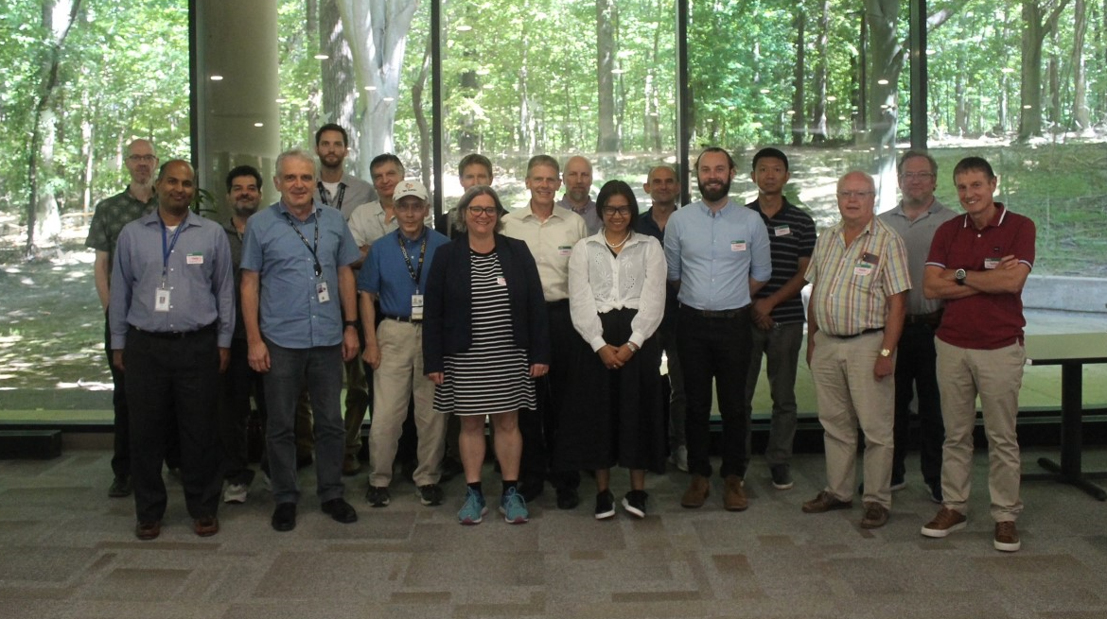
Summary of activities
IVOS 34 @ Reston, USA
hosted by USGS Aug/Sep 2022
(next meeting DLR Oberpfaffenhofen, Germany Sep 25-30 2023)
24 agency/orgs represented
34 attendees + 32 on-line +31 OC topic
Most themes and topics (work-plan
discussed or summarised)
Interim virtual discussions:
SITSCOS workshop Sep 2019)
Solar spec irradiance 2021
Calval portal 2021
ARD/Interoperability 2021
PISCAR virtual 2021
  mett
Special Projects:
RadCalNet team met Mar 2019/Aug 22
Various telecons since covid inc users workshop
Terminology task team established and active with WGCV
FRM4Veg Comparison (LPV) SRIX Jul 22
FRM4STS comparison Jun 22

Slide 6
IVOS 34 Topics
Vocabulary
Cal/Val methods
SITSats (SI traceable satellites)
Ocean Colour special session (Zibordi retirement)
PICS: Calibration and characterisation
Sensor performance assessment and status
Hyperspectral sensors
Uncertainty, Traceability, interoperability: what and how
CEOS WGCV projects/Actions:
- SST comparison, LST network, SITSCOS, Solar Irradiance

Slide 7
vocabulary
Updated IVOS on progress of CEOS wide initiative As per previous discussion)
Debated if some initial perceived priority words were in fact priorities:
Interoperability – do we actually think more helpful to keep definition relaxed to give more flexibility?
      Rather as a priority that we define what we need to do to enable it?
Same for ‘continuity’
Encouraged participation of interested parties to the CEOS task team

Slide 8
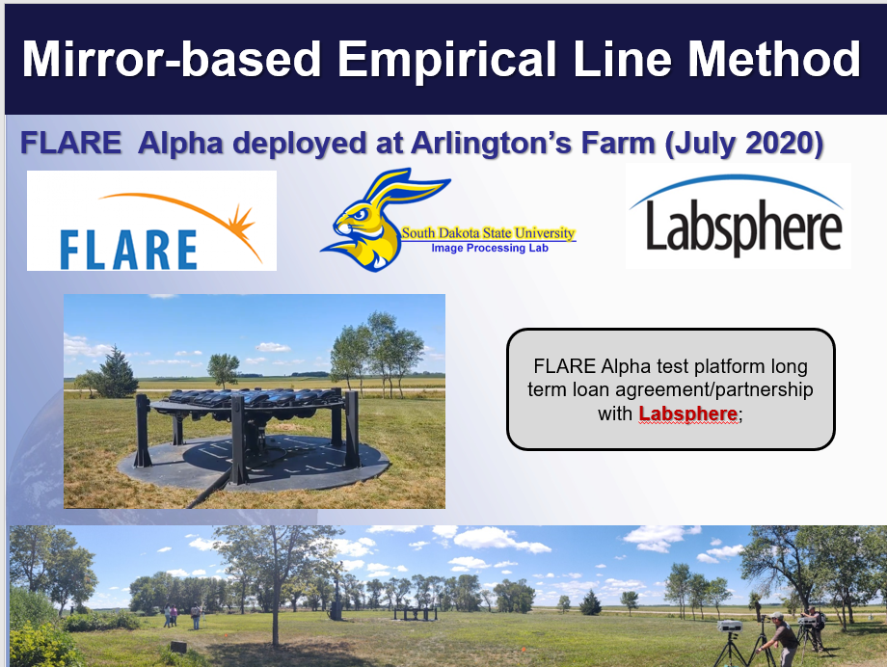
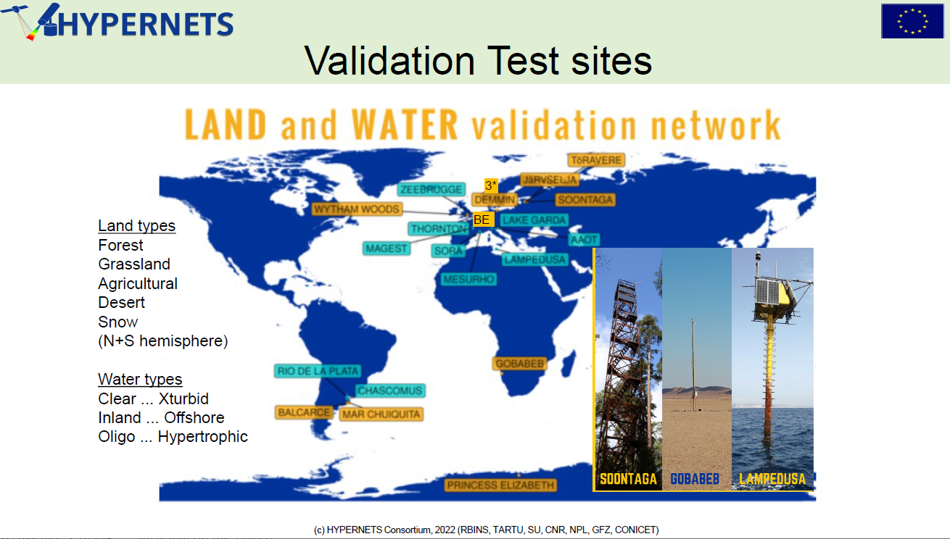
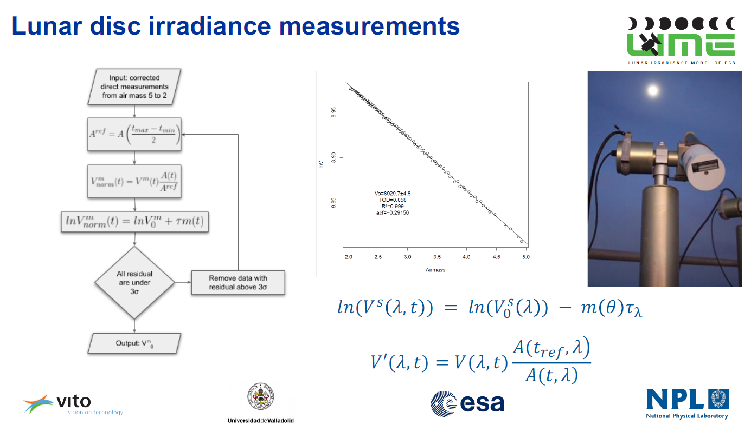
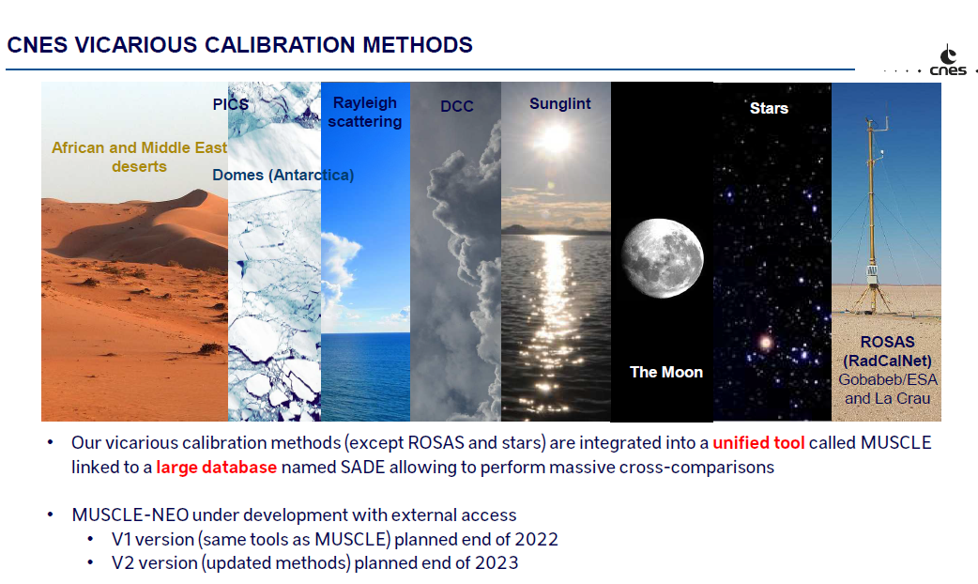
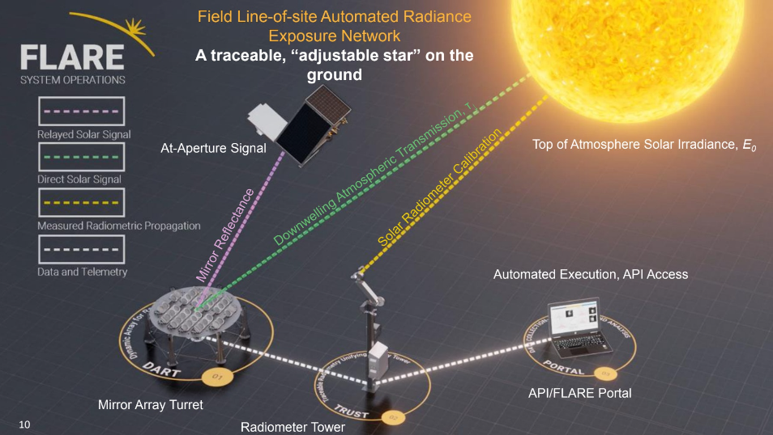
Cal/Val Methods: critical for L1 interoperability
PICS & RadCalNet independent sessions

Slide 9
CV 17-01
Establish means to achieve L1 radiometric interoperability – A community reference
Will create a template on Cal/Val portal (initially private) to record achievable uncertainties for different methods
IVOS team to populate template
Methods must be documented and be subject to peer review (IVOS team)
Evidence of results to specific sensors ideally to include Sensors such as S2, L8/9, S3, VIIRS
Any and all methods to be includable
Next step look to see how to combine results in most effective manner

Slide 10
Extension - interoperability
Establish database to collate and compare imagery/radiometry over set of CEOS sties to define a reference
Select sub-set of sites to constitute a reference (references) (in the absence of a SITSat assigned values may be from a ‘reference sensor’)
Provide guidance on use of imagery over sites to provide representative vales for comparison (allowing automation)
Encourage observations from sensor operators – particularly ‘New Space’ over sites and to provide ToA radiances/reflectances to database
Enable assessment of provided radiometry
Publish results/enable ‘harmonisation coefficients’ to be determined
    - Sensor owner may or may not apply them
CEOS endorsed ‘calibration’/ verification

Slide 11
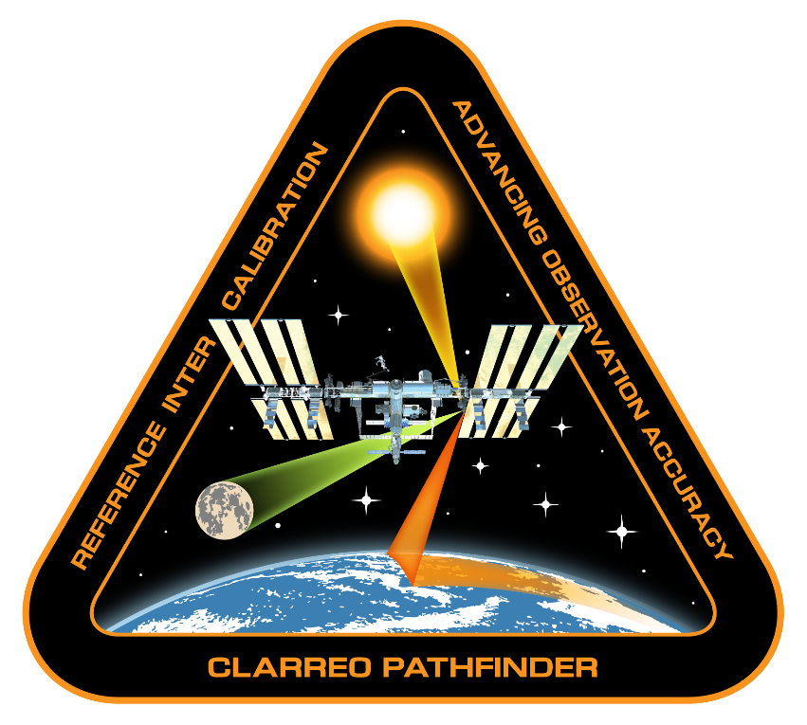
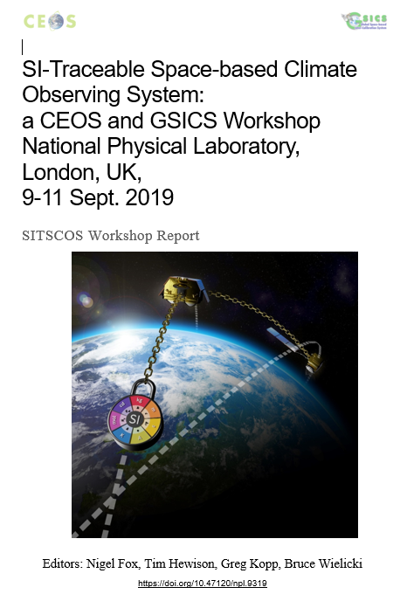
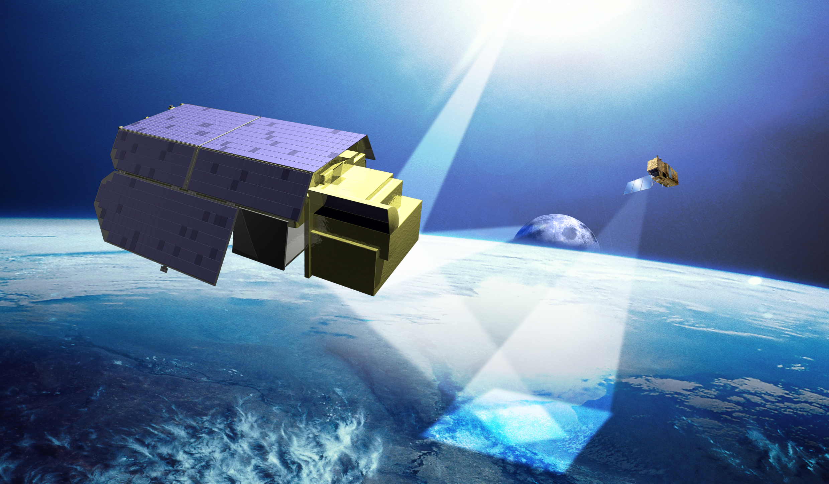
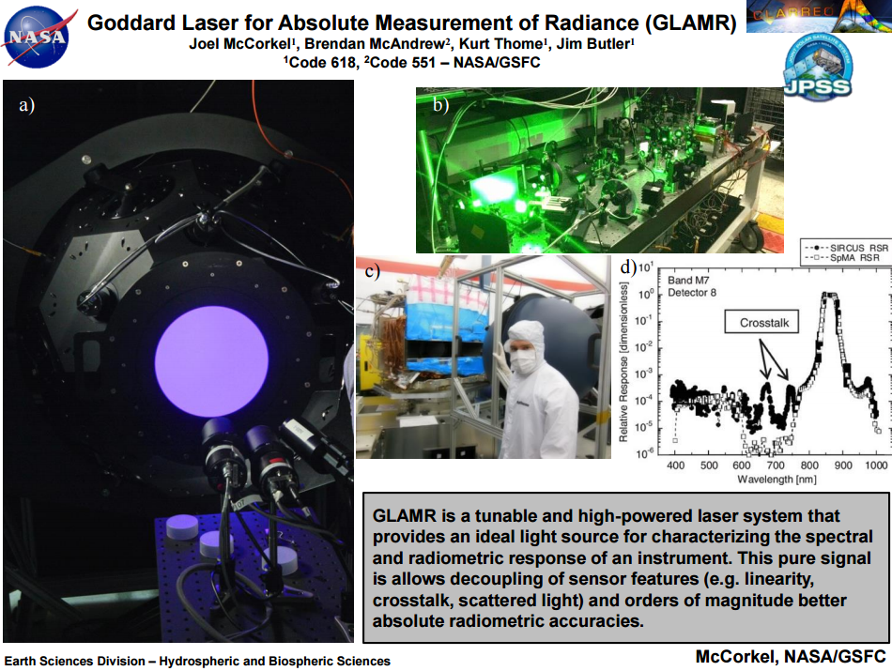
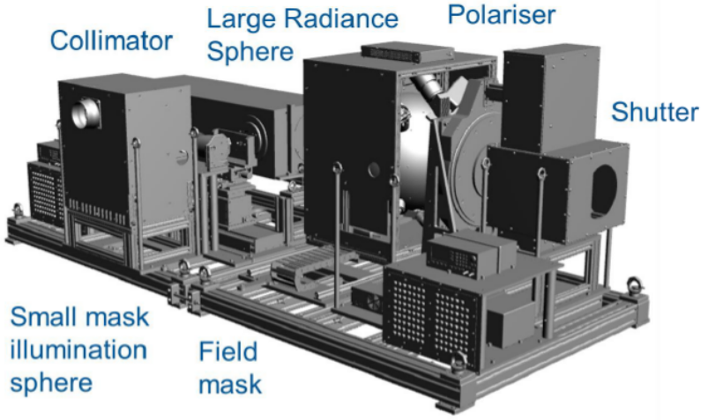

SITSats
TRUTHS
https://calvalportal.ceos.org/sitscos-ws
doi.org/10.47120/npl.9319
Report- Recommendations
How to get wider visibility?
NPL STAR-cc-OGSE
Cal-Val System

Slide 12
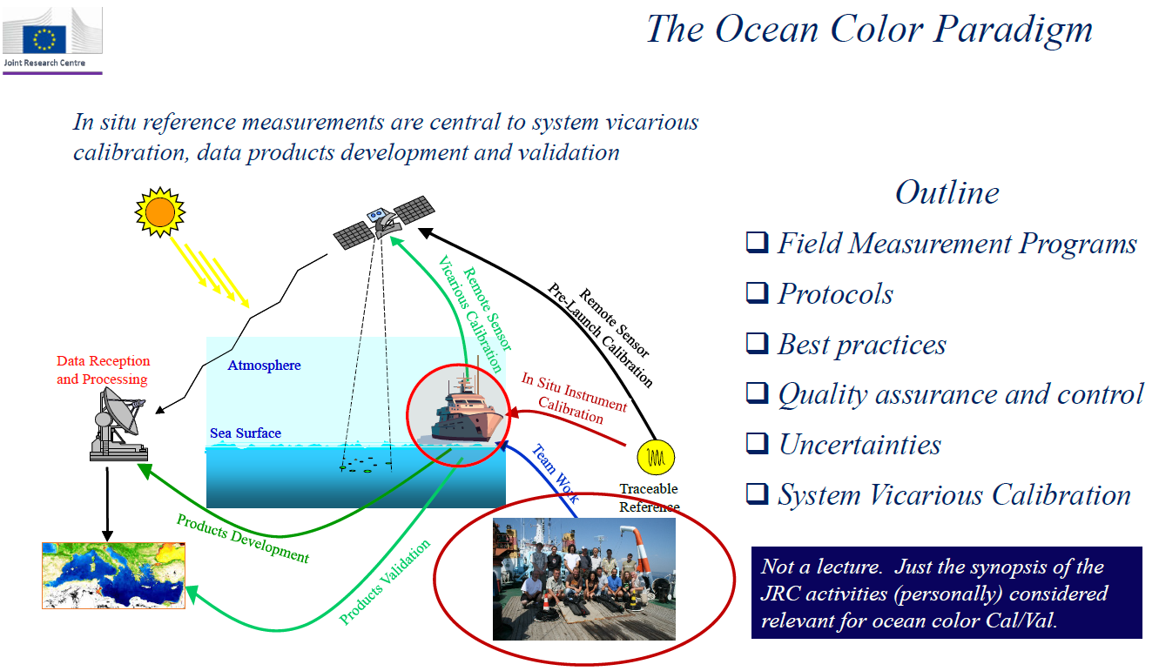
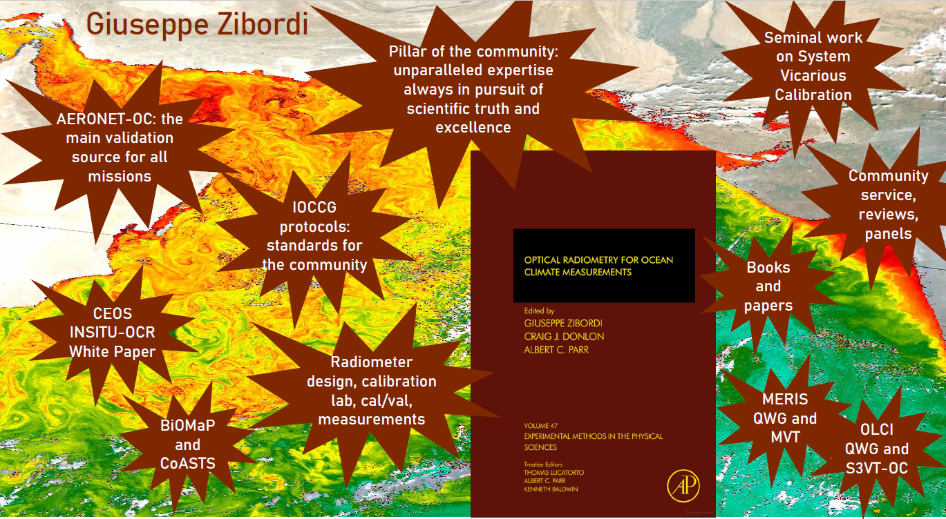


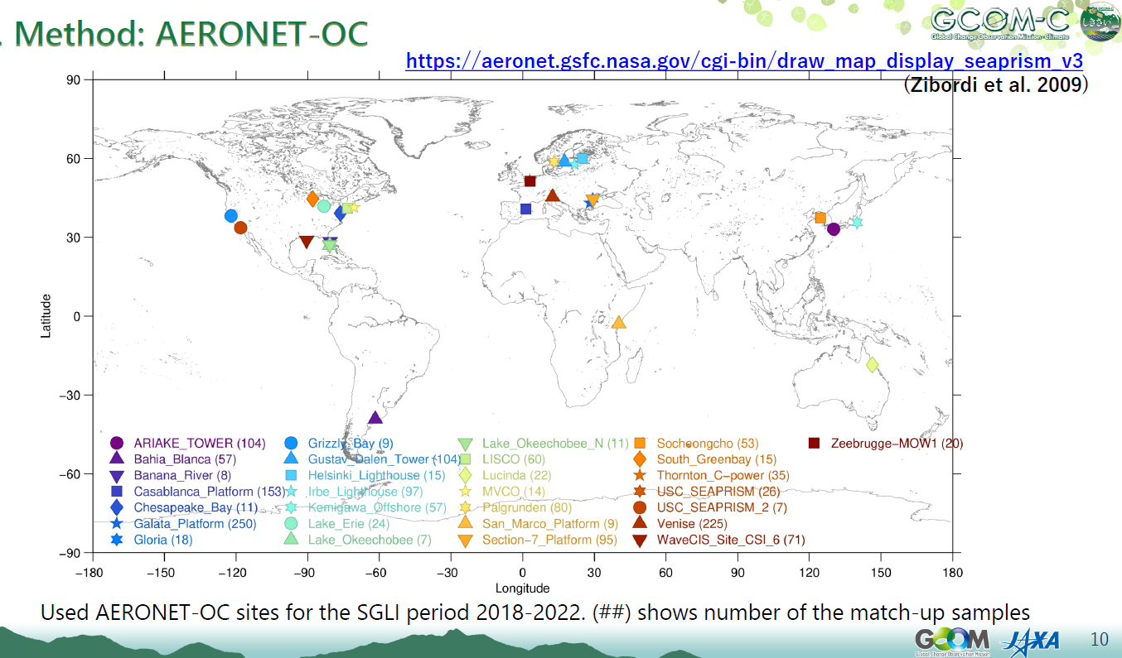
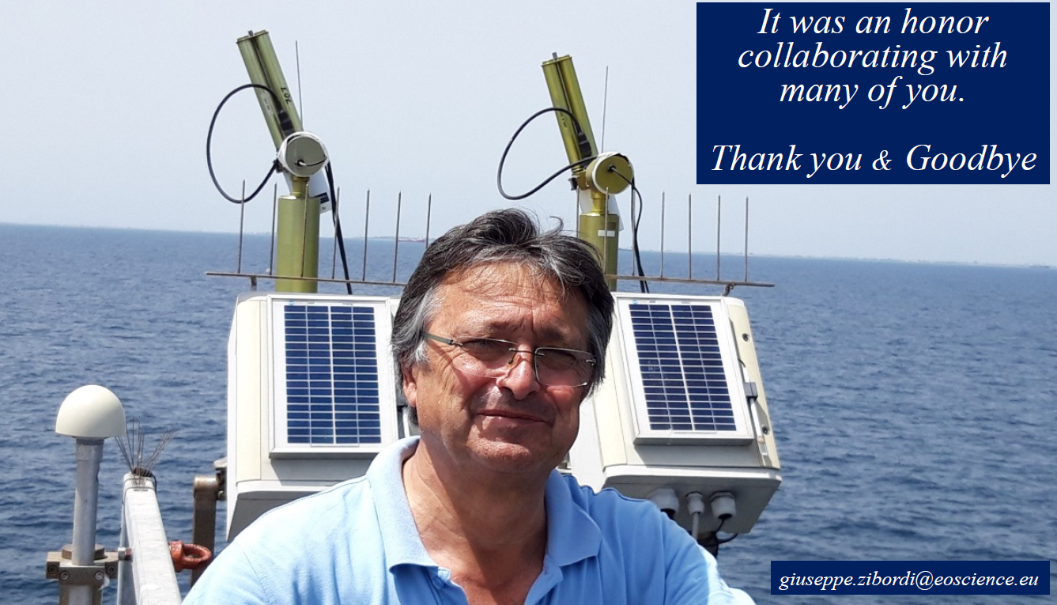
Ocean colour: progress over 25 yrs
Half day - 8 presentations
25 yrs of JRC, PACE, Use of A-OC by missions, FRMs, Moby future
Additional 30+ attendees

Slide 13


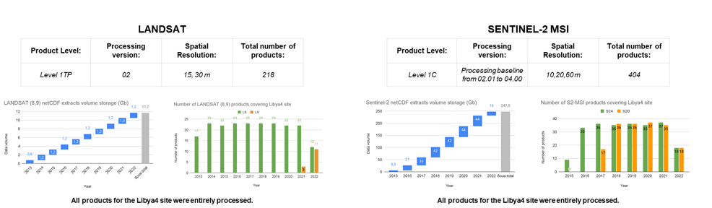
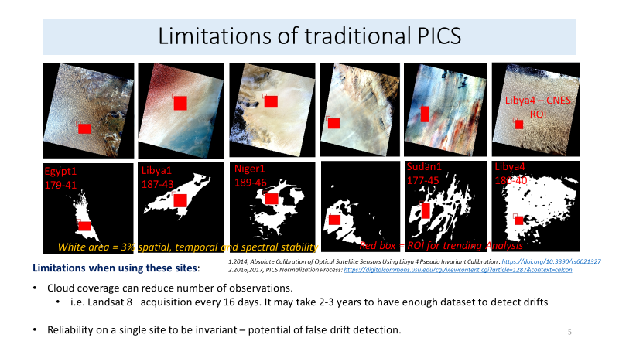
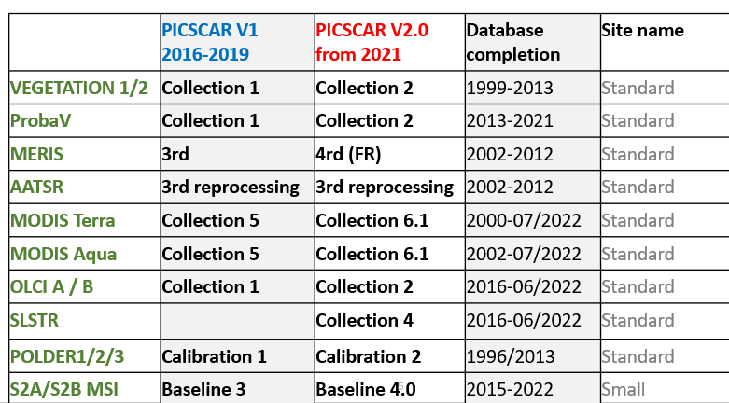
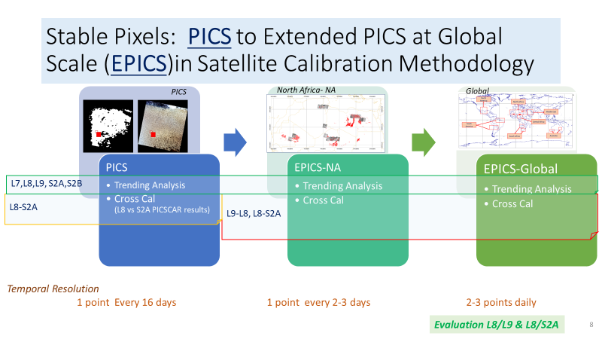
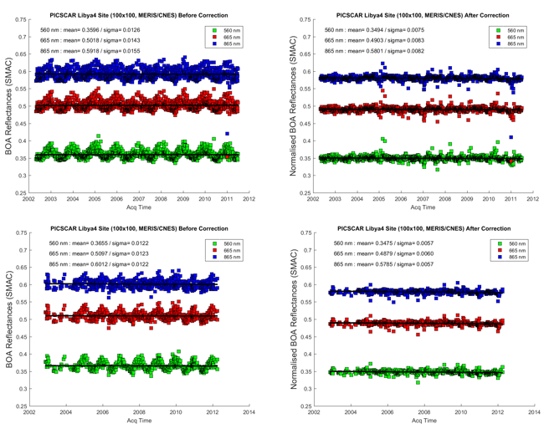
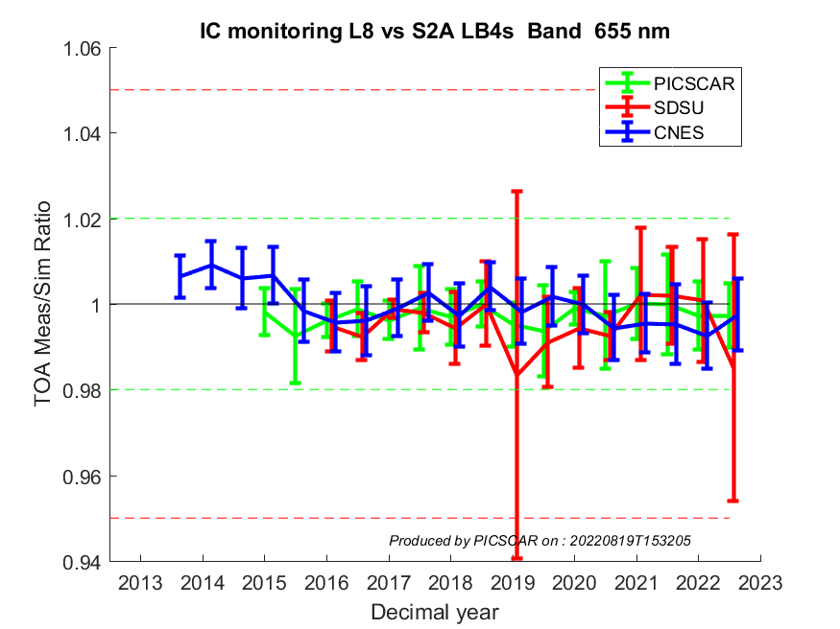
PICS: potential virtual meet before IVOS 35
Access through cal/val portal
Database update:
data sets
Quick looks
Analysis tools being added
Format to NetCDF
Ready to include other PICS
Add additional sensors VIIRS, MISR, +
L8 vs S2A
3 methods (655 nm)

Slide 14
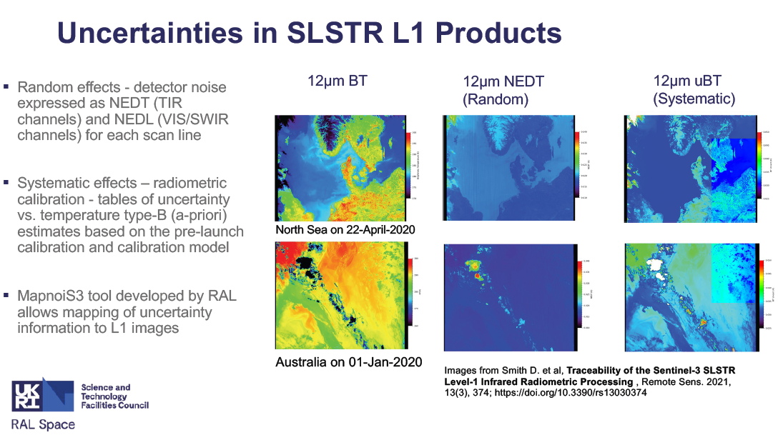
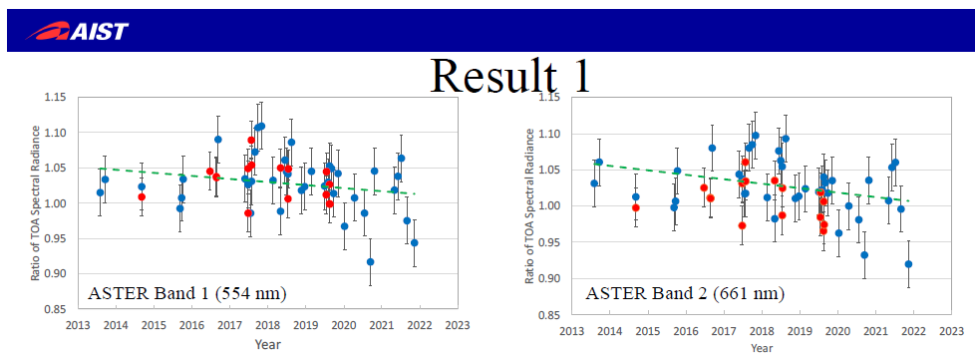
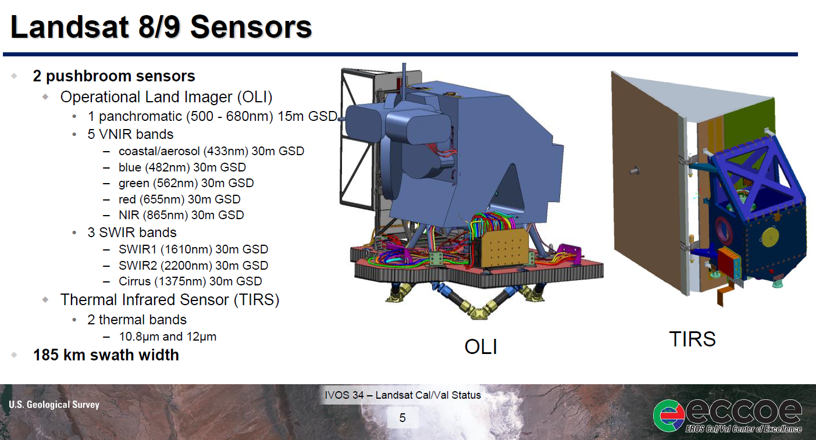
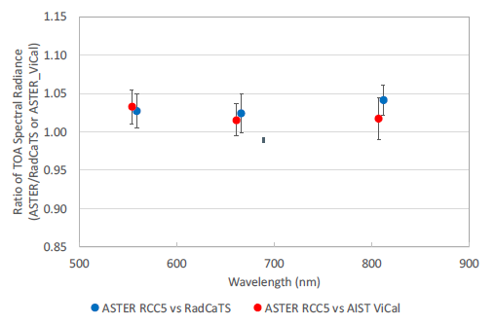
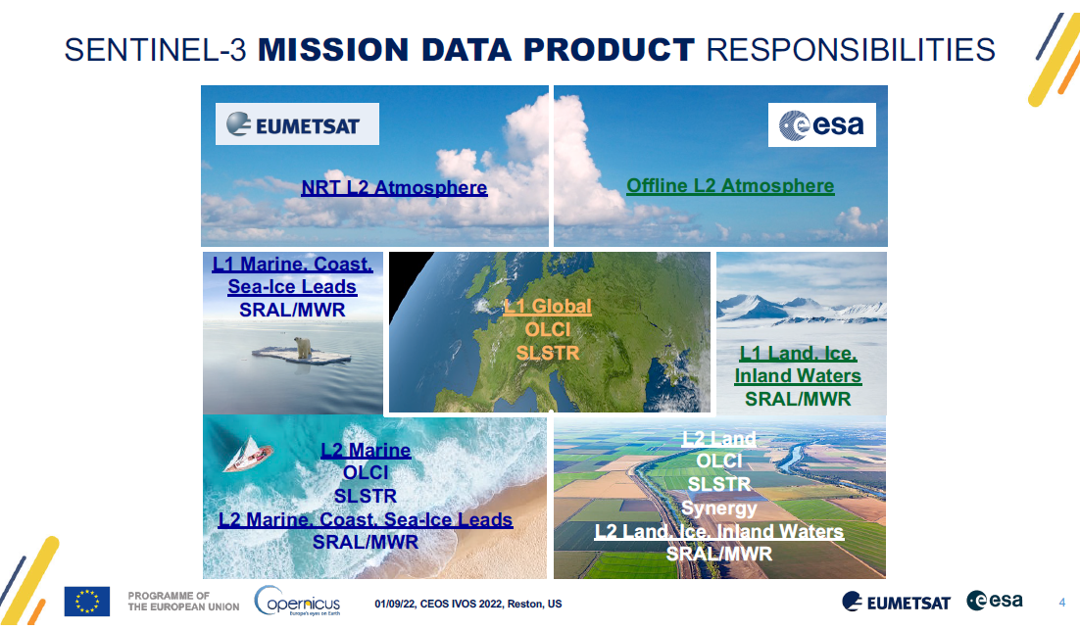
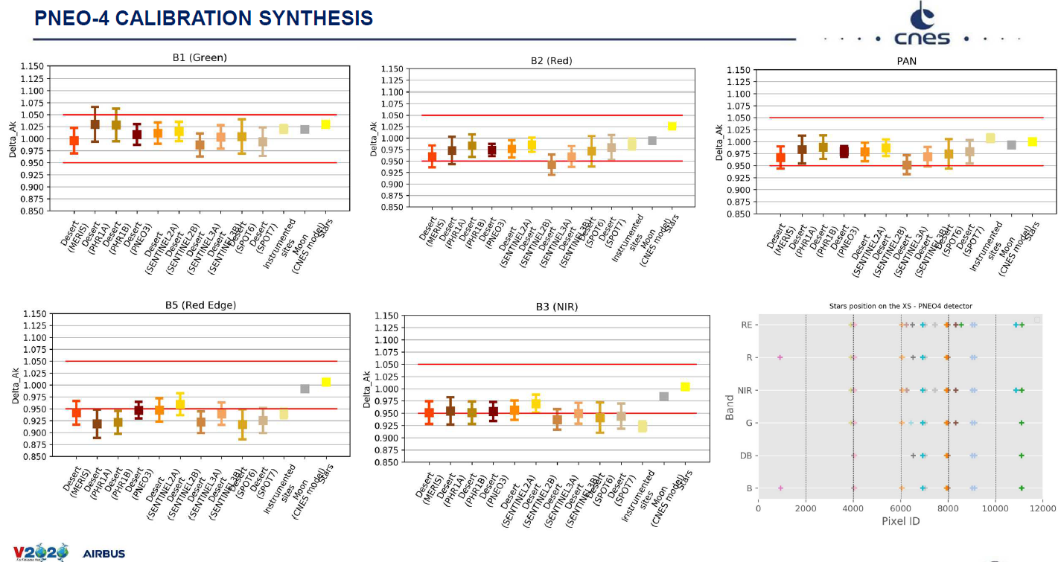
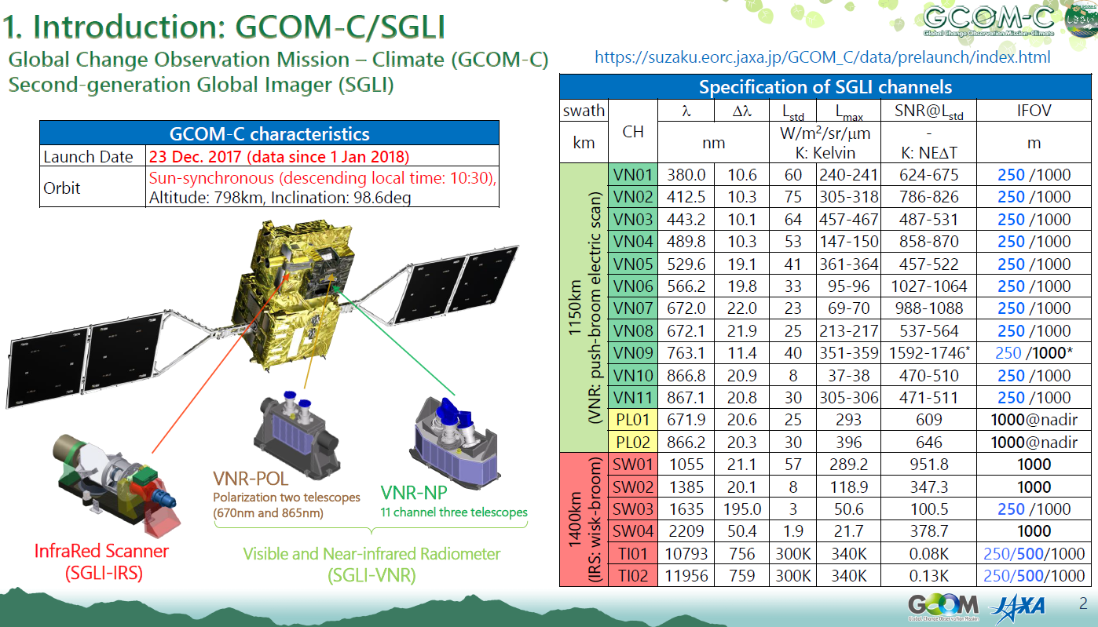
Sensor status and performance

Slide 15
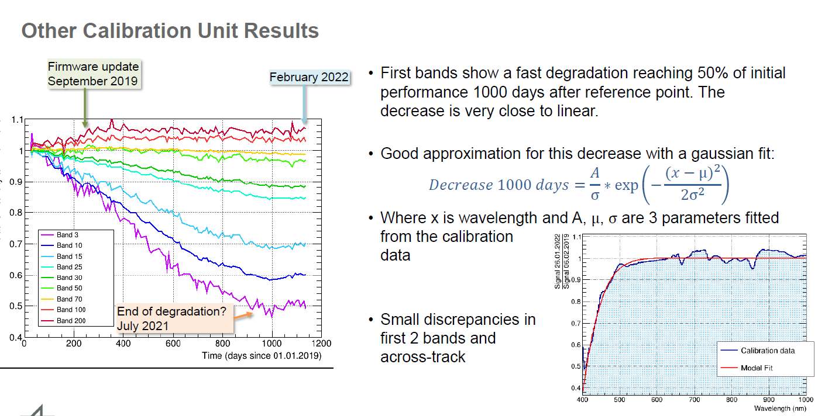
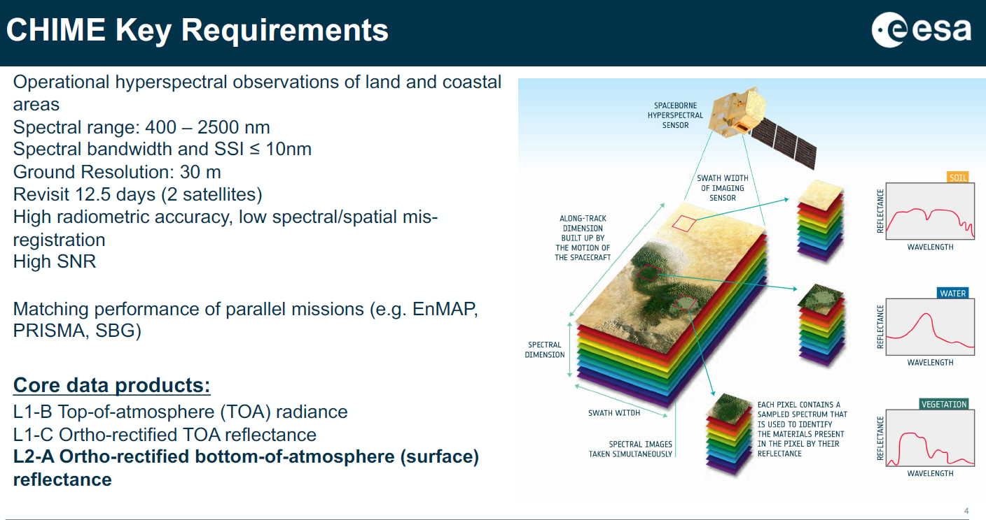

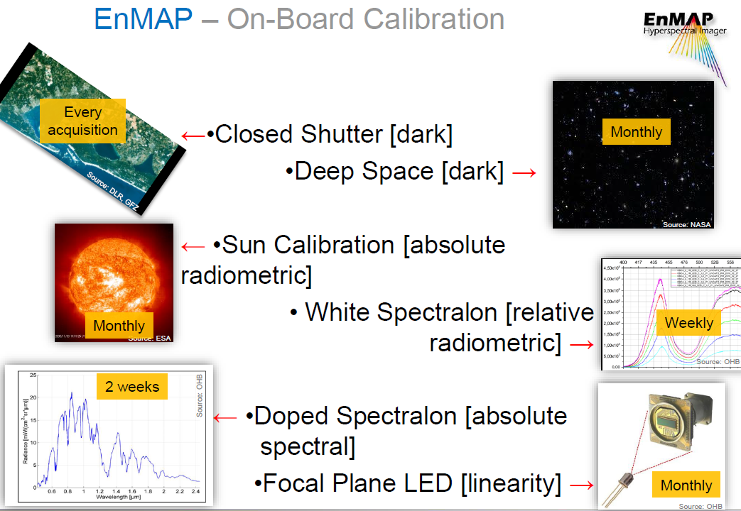
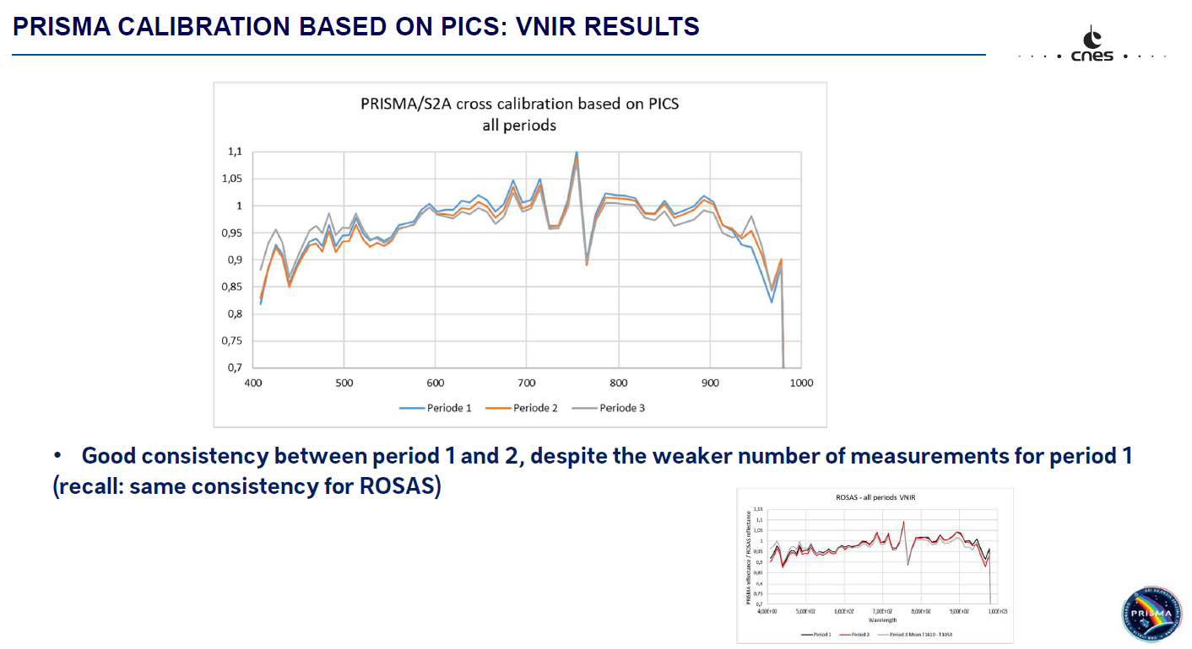
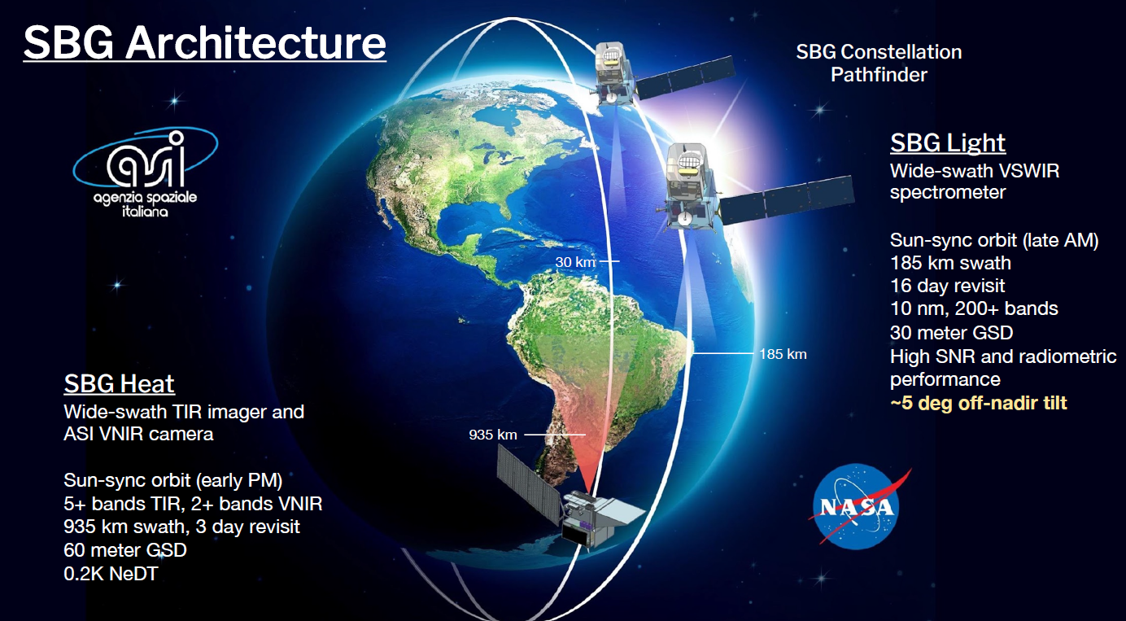
Hyperspectral
DESIS

Slide 16
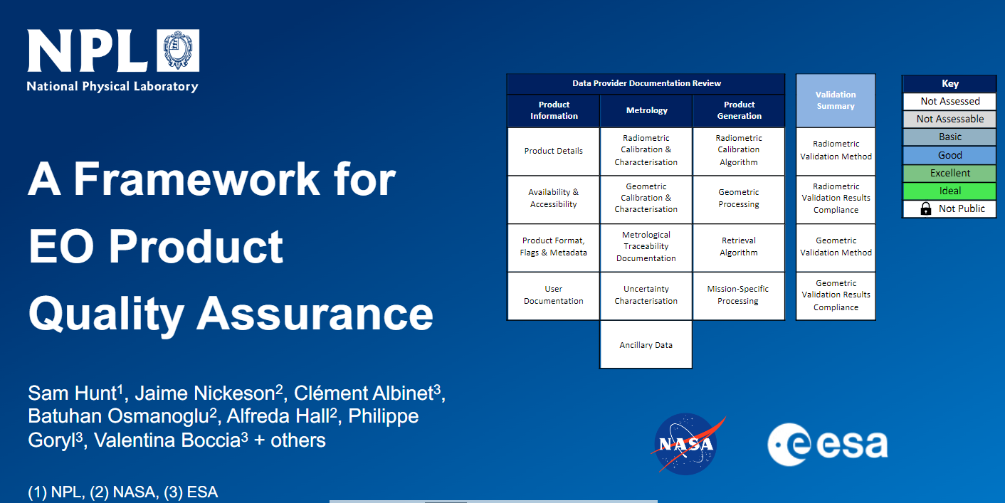
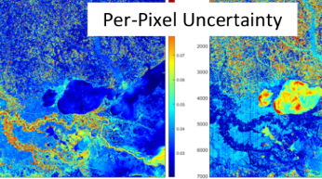
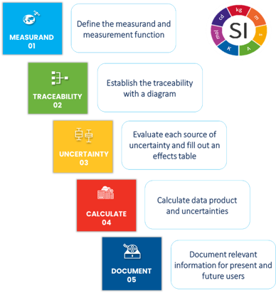
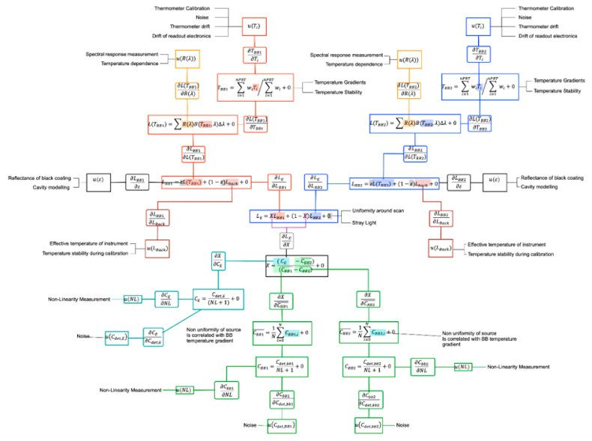
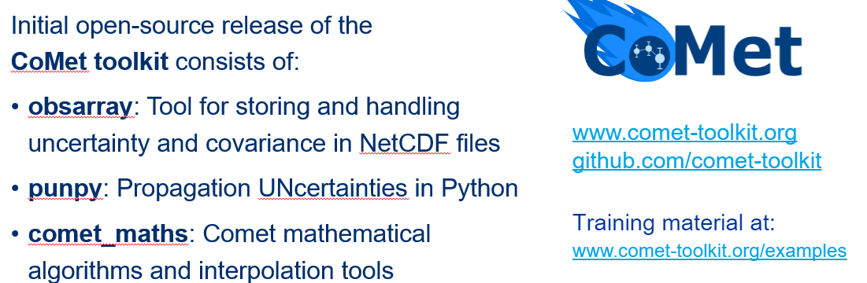
Uncertainty, Traceability and QA
Drivers: ARD, Per pixel Uc, Climate, New space -
What IS Traceability?
What do we have to evidence?
What is enough in terms of Uncertainty?
USGS/NASA initiative to derive per pixel Uc maps for Landsat 8 – comprehensive approach
Challenges – Next steps
Cannot quantify/assess all sources of uncertainty
Per pixel uncertainty is not easy
    – accounting for adjacent pixel interactions etc
Data volume increase can be dramatic
– How do we deal with this for user?
Level 1 – Level 2 etc
Follow-on workshop + interactions with WGISS on strategies for handling and reporting Uc
On CalVal portal
With new QA4EO

Slide 17
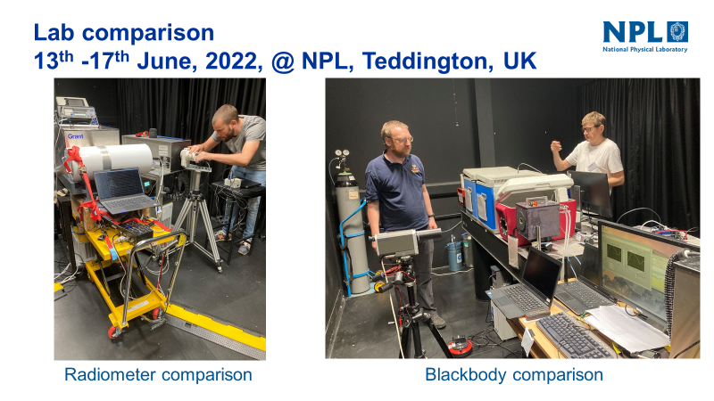
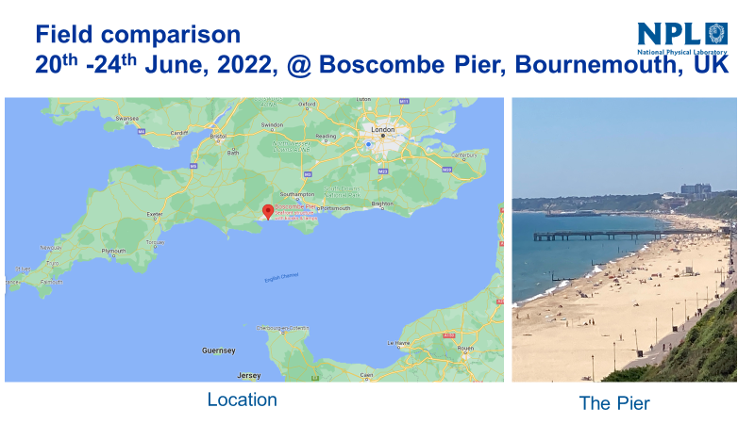
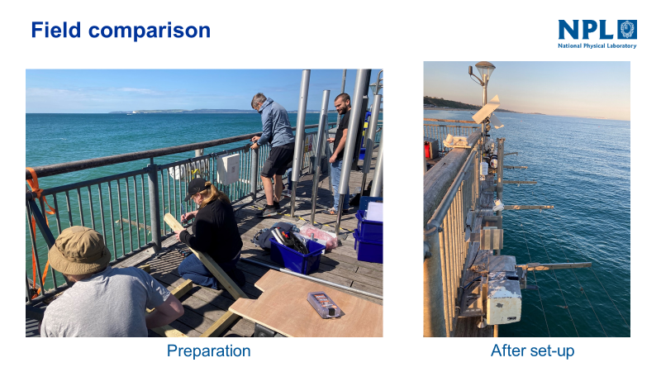
CEOS Projects
CEOS comparison (5) for Surface (water/land) brightness temperature
- 6 participants (water and land) (Covid limited)
- Results shortly
LST ToA brightness temperature (network) (TASK group started)
Discussion on requirements and strategy with LPV members
Agree on ToA brightness temperature per wavelength as a priority
Focus on higher resolution <100 m
Target of 0.5 K as ToA uncertainty (challenging! With land Water oK)
Project to start (see later)

Slide 18

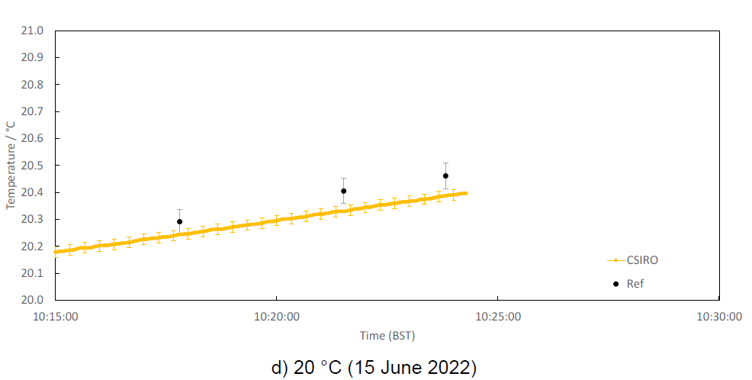
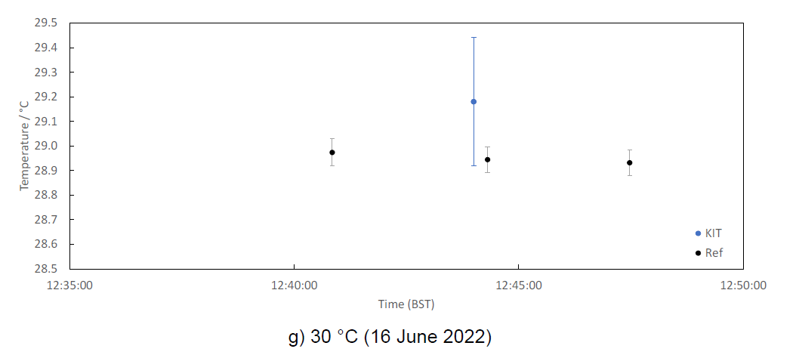
Comparison results: Reference BB 1 @ NPL
)
Specialised BBs
(CASOTS and CASOTS-II)
Commercial BBs
(Landcal P80P)
Temperature difference from reference value. Error bars denote k = 2 uncertainties

Slide 19
Comparison results 2
Lab radiometer comparison (@ NPL)
Stirred Liquid Bath BB
NH3 Heat-pipe BB
ISARs, SISTeR
(SST designed)
CIMEL, Heitronics
LST designed

Slide 20
Field radiometer comparison
(@ Boscombe Pier, Bournemouth)
Reported values
Averaged values over 20 min.
Error bars denotes k = 1 uncertainties
SST measured by participants

Slide 21
Comparison results 3-2
Difference of SST measured by participants from the reference
Reference value is the mean of all participants (excluding KIT after 22 June)
Error bar denotes k = 2 uncertainty

Slide 22
conclusions
Lab BB comparison
Landcal P80P BB uncertainties may be an overestimate.
Lab radiometer comparison
All radiometers underestimates uncertainties at and below 0 °C.
Possible systematic error in ISAR, increasing at lower temperature?
Field radiometer comparison
Two times larger temperature range of comparison,
two times improvement in agreement from 2016 comparison
(in terms of mean of the difference from reference value)
An abrupt shift in KIT measurement went unnoticed.
→ Internal reference BB (as in ISAR and SISTeR) is essential.

Slide 23
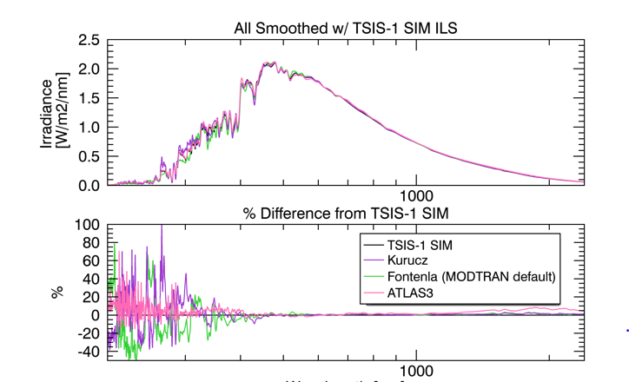
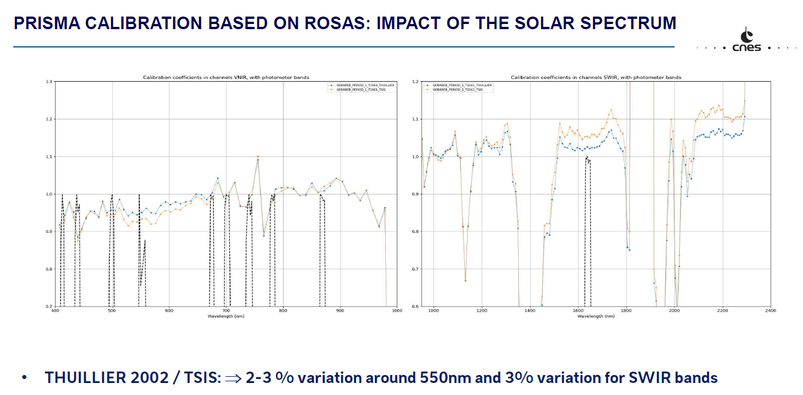
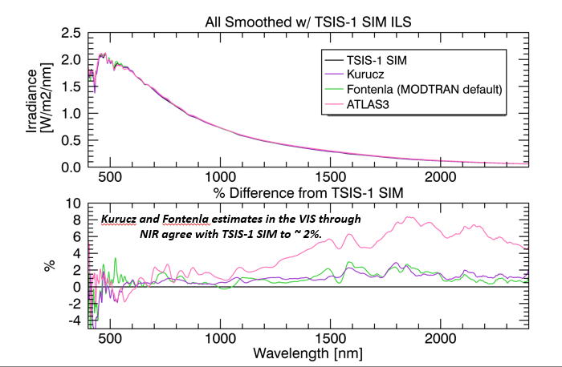
Solar spectral Irradiance
Make clear on Cal/val portal importance of stating reference
Make visible potential biases with using Modtran base values
      - Look to encourage Modtran team to include TSIS spectrum
Hold workshop to discuss impact on reporting sensor cal particularly updating operational sensors

Slide 24
CEOS Reference solar Irradiance Spectrum
CEOS Recommendation on use of a solar Irradiance spectrum for EO applications
CEOS recommends that wherever a reference solar irradiance spectrum is used in an Earth Observation application, the choice of that spectrum and a link to an accessible, processable version of that spectrum should be included with any documentation associated with its use, ideally integrated in the metadata. The methodology used to convolve the chosen solar irradiance spectrum with that of other EO data and the associated uncertainty should also be documented and made available.
For the purposes of harmonisation and interoperability, CEOS further recommends the use of its reference spectrum and where this is not done that a calculation indicating the difference of the chosen spectrum to that of the CEOS reference spectrum be made available.

Slide 25

Lunar workshop
https://www.eventsforce.net/lunarcalibrationws

Slide 26
Summary
Looking for a volunteer (s) to take leadership of ‘image quality/geometric’ focus group
      - Early meeting to define scope and priorities geolocation? Partnership with TM subgroup
Volunteers to add to Vocabulary group
Interoperability (radiometric) L1
– strategy to build a database for users to assess suitability for their application as first step
Uncertainties, Traceability – lot of interest further workshops include new space
      - Engage with WGISS on strategies for communicating / appending per pixel Uc
  LST ToA brightness temperature project to start with view to future operational network -STARTED
  Solar Irradiance Spectrum
    – large potential impact on changing to TSIS spectrum workshop discussion on how best to deal with it
    - Initial discussion to establish examples on impact to define strategy
    - follow-up with broader community e.g. operational services

