Slide 1
Geoscience Australia Cal / Val Update
Medhavy Thankappan
Geoscience Australia
Agenda Item # 4.9
WGCV 52 Plenary
Frascati, 5-9 June 2023

Slide 2





Satellite Cross calibration Radiometer
The Satellite Cross calibration Radiometer (SCR) will be a hyperspectral mission for effective transfer of radiometric calibration from Reference systems (e.g. Landsat, Sentinel) to Client systems
SCR Rationale:
Australia is reliant on international collaborators for enduring access to EO data
National programs need ongoing, sustainable access to EO data and meet multi-sensor use objectives
  Potential for combined use of multi-sensor EO data remains under utilised due to variable quality
Cross calibration enables consistent data quality for multi-source data to be used together
Space-based cross calibration opportunities are frequent and global in extent
Leverages capability that Australia is well regarded for, contribution to enhancing global data quality while growing sovereign space industry capability

Slide 3
SCR vs SITSat
SCR analogous to SITSats (e.g. CLARREO PF, TRUTHS, LIBRA)
SITSats - bottom-up design approach for high accuracy climate monitoring applications with SI traceable radiometric uncertainty typically < 1%
SCR - choice of COTS design meeting requirements for calibration transfer from a reference sensor (e.g. Landsat), will perform similar functions, but lack the high level accuracy of SITSat measurements
SCR will have spectral characteristics and GSD comparable to SITSats, but a high SNR not important
SCR relative spectral and radiometric calibrations need to be stable for Reference system transfer calibration to work effectively
SCR operated to maximise cross calibration opportunities with Reference / Client systems, to enable harmonious use of data from multiple optical satellite systems
SCR seen as a test bed for routine operation of space-based calibration missions and expected to complement the benefits from SITSats

Slide 4
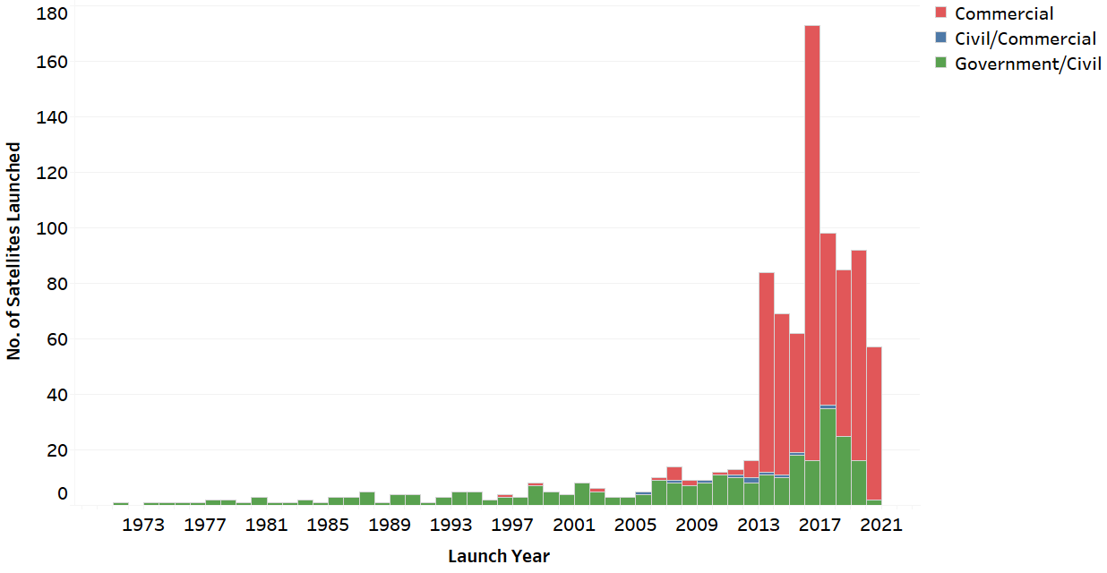
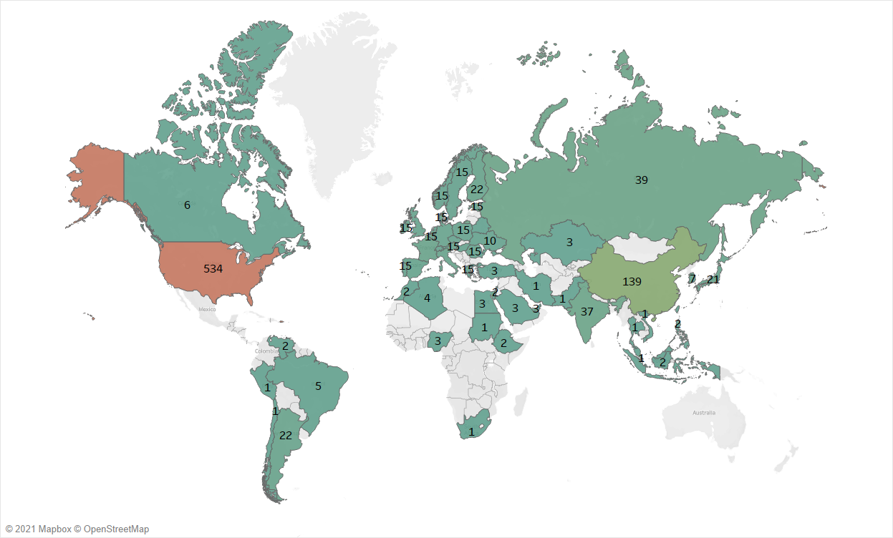
Data Rich, Information Poor
More satellites, greater
coverage
Better temporal, spatial, spectral resolution
Over 50 countries with EO satellites
Commercial is growing fast
Hyperspectral systems, 2021: 70; 2030: 1700+

Slide 5
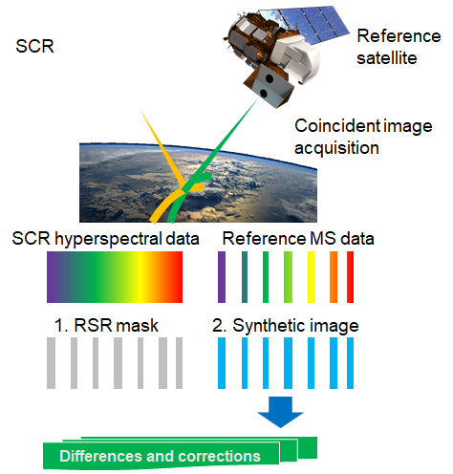
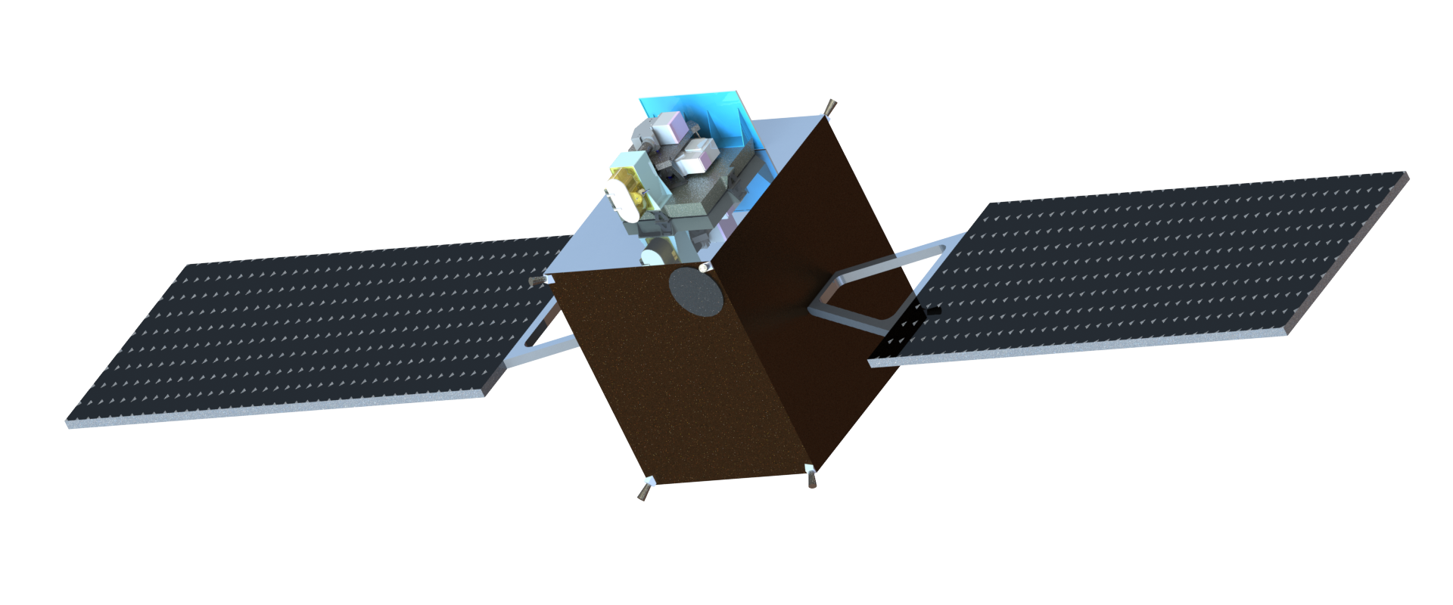
SCR Operations Concept
Simultaneous Nadir Overpasses of SCR and Reference or Client Systems
Use SCR data to match Reference or Client system
Create synthetic image
Compare synthetic image with Reference or Client system for cross-calibration
Generate spectral radiometric differences and corrections to update client system calibration

Slide 6
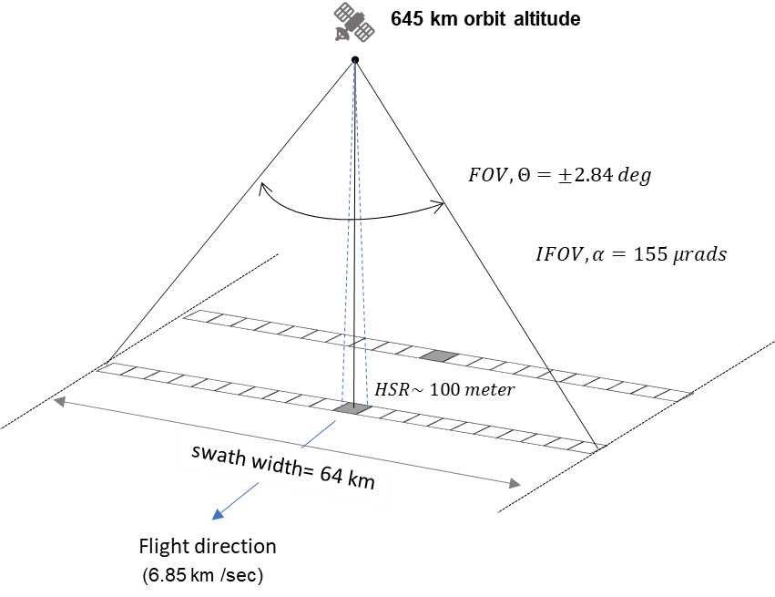
Nominal Requirements
Requirement | Value
Spectral Band Coverage | 400-2500 nm
Spectral Sampling | ≤ 5 nm VNIR ≤10 nm SWIR
Radiometric Accuracy | ≤ 3 % (Pre-Launch) ≤ 5 % (On Orbit)
Radiometric stability | ≤ 0.2 % (7 days)
Ground Sampling Distance | ≤ 100 meter
Swath Width | ≥ 64 Km
Signal to Noise Ratio (wavelength dependent) | > 50 to 150
Dynamic Range (adjustable integration time) | 1.15×L_{sat}
Polarisation Sensitivity | < 5%

Slide 7
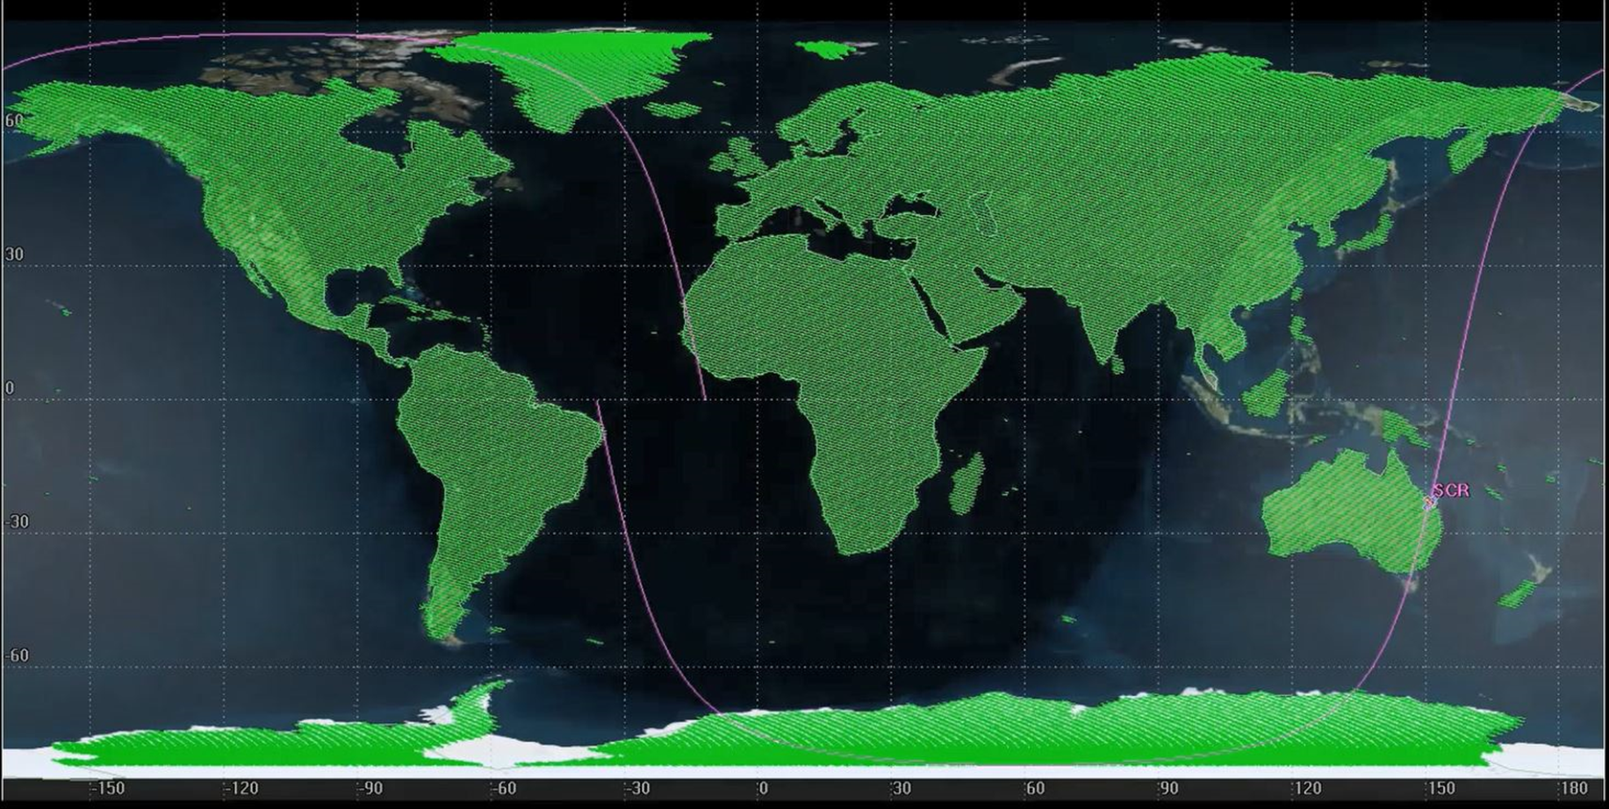
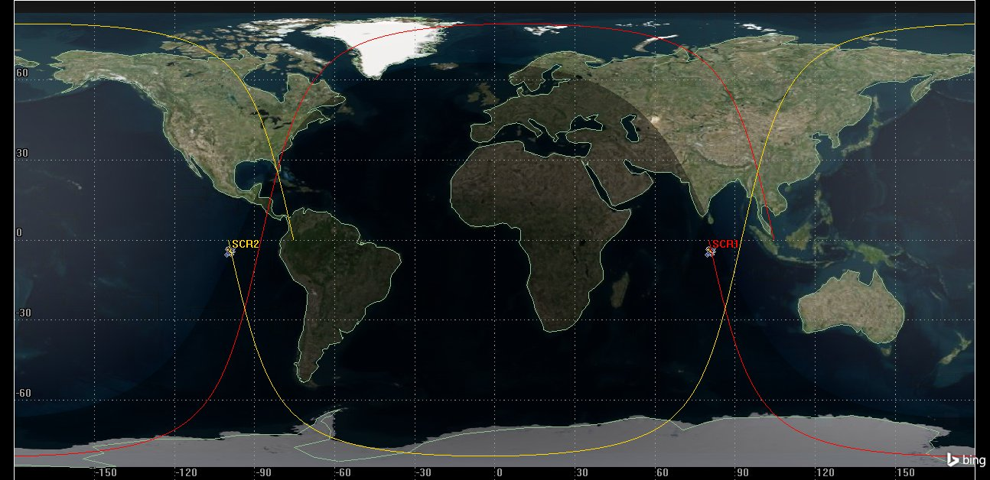
Orbit Selection
645 Km with Mean Local (equatorial crossing) Time (MLT) at 10:20 AM
Provides numerous daily cross-calibration opportunities while avoiding large mega-constellations (StarLink, OneWeb, Kuiper) and optimising viewing geometry

Slide 8
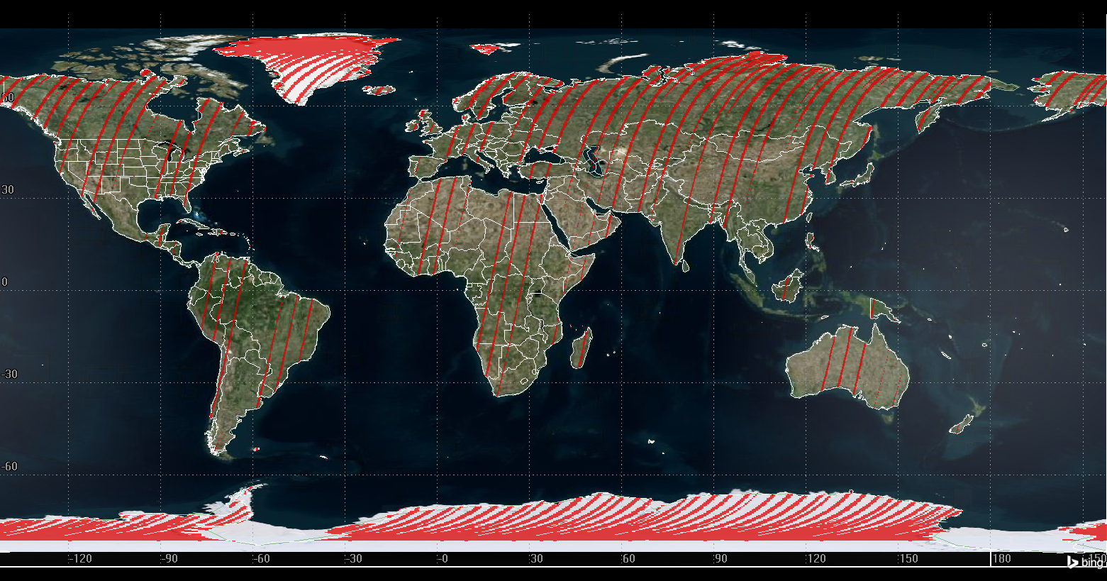
SCR Crossing Time selection
SCR intersections with one Landsat in single 48-day cycle
Results | 645 km (48-day repeat)
No. of SNO opportunities | 659
Total SNO area as % total land area | 10.07 (15 million sq. km)
Average SNO area per intersection | 22,761 sq. km
Max time gap between SNOs | 3 days 0 hrs 40 min 38 sec
No. of > 1-day gaps per cycle | 9
Sunlit only
Center ±3°of Landsat swath
Notes:
The satellites with crossing times within +/- 15 minutes of SCR will have higher intersections over entire landmass.
As the crossing time difference increases the intersections happen more towards the poles.

Slide 9

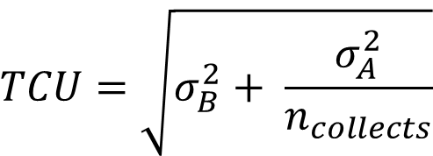

Transfer Calibration Uncertainty
Random (Type A) and systematic (Type B) uncertainties contribute to the TCU
Random (Single Collect) | Threshold Value | Systematic (Multiple Collects) | Threshold Value
Spatial BRDF Drift | 0.02 | Spectral Synthesis | 0.005
Atmospheric Drift | 0.01 | Spectral Straylight | 0.003
Linear Regression Model | 0.01 | Spatial Straylight | 0.003
Scene Polarisation Random | 0.005 | Flat Fielding | 0.003
 |  | Sensor Drift | 0.002
 |  | Scene Polarisation Bias | 0.005
Type A RSS | 0.025 | Type B RSS | 0.009
$$TCU=\sqrt{σ_{B}^{2}+ \frac{σ_{A}^{2}}{n_{collects}}}$$
$$σ_{A}$$
$$σ_{B}$$
Assumptions: Scenes and regions used in cross calibrations are selected to randomise and decorrelate various contributors so Type A uncertainties reduce with more collects

Slide 10
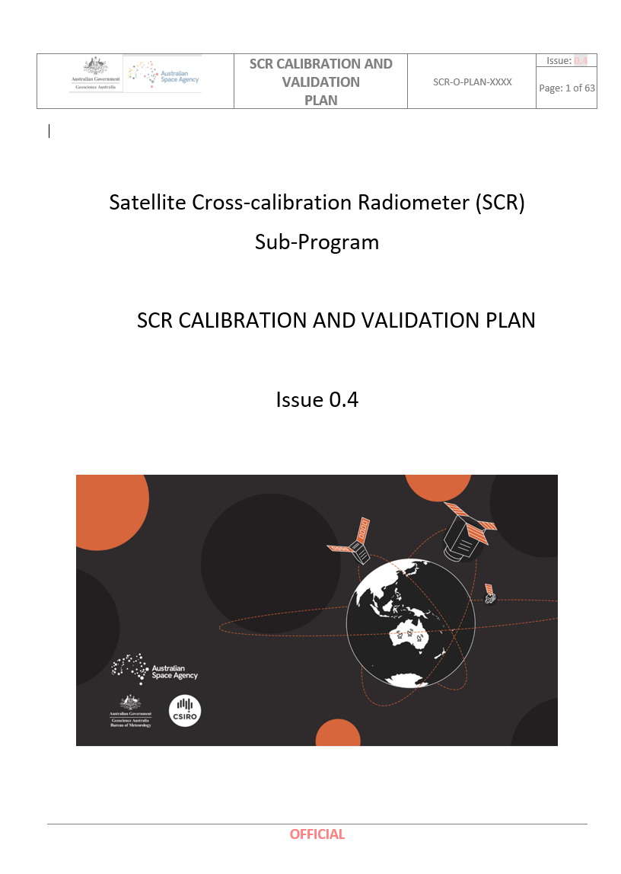
SCR Status Update
The SCR mission was announced in 2022
Mission Concept Review (MCR) 15-16 March 2022
Key Decision Point - A (KDP-A) 24 March 2022
Budget announcement in May 2023, indicated some changes to re-focus the Australian Space Agency (ASA) effort
Specific changes to the overall National Space Program for Earth Observation (NSP-EO) or the SCR mission were not flagged
GA is working closely with ASA the lead partner on the SCR mission to get priorities for SCR clarified
Planning for the SCR mission continues with our partners, including the development of a calibration and validation plan for SCR
DRAFT

Slide 11


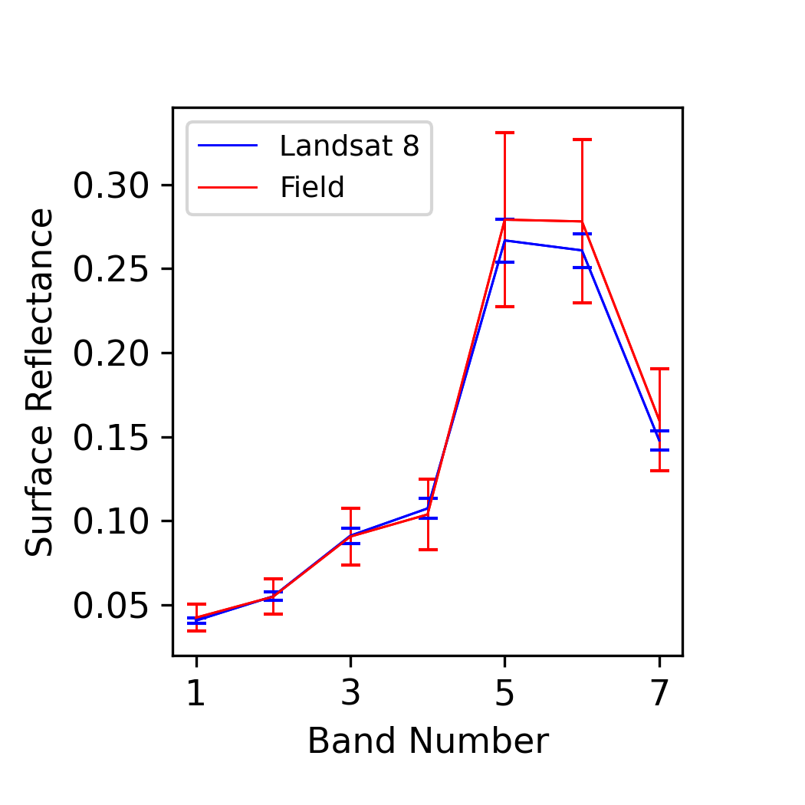
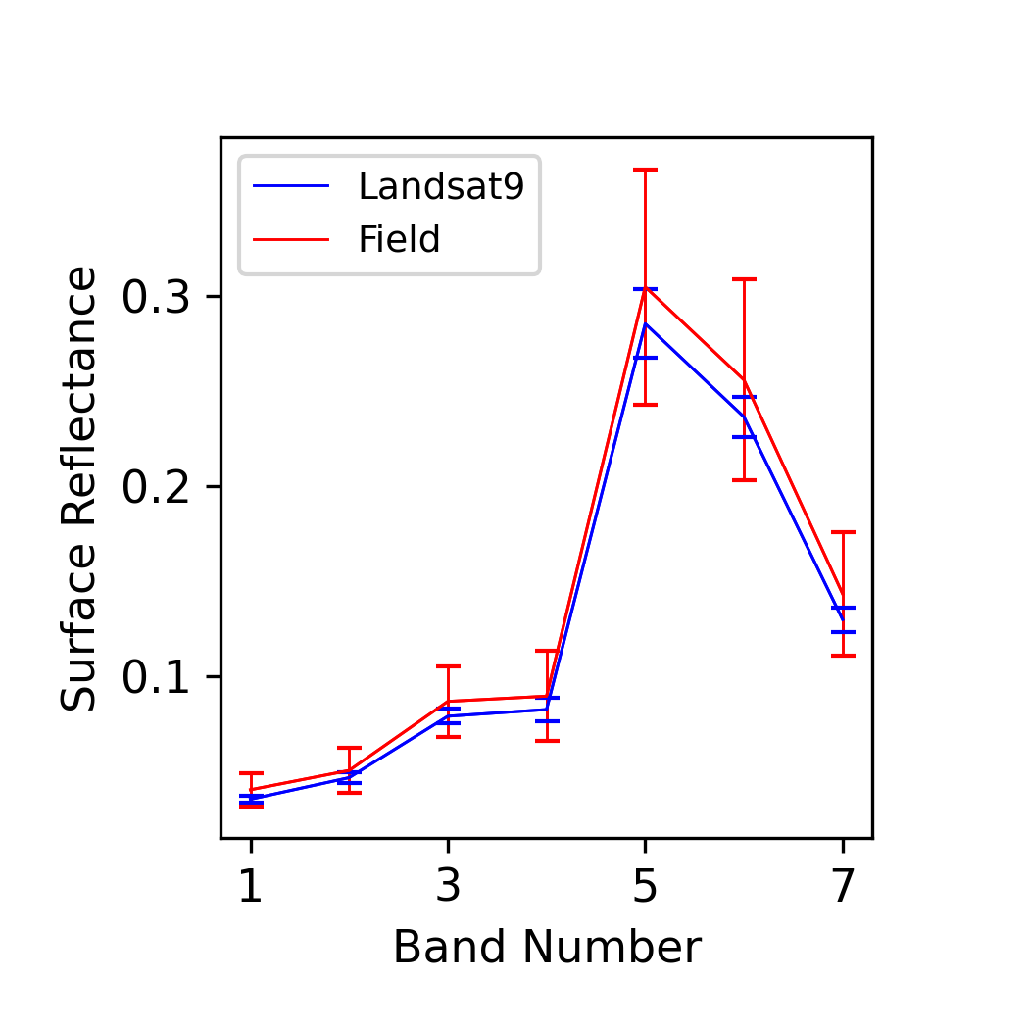
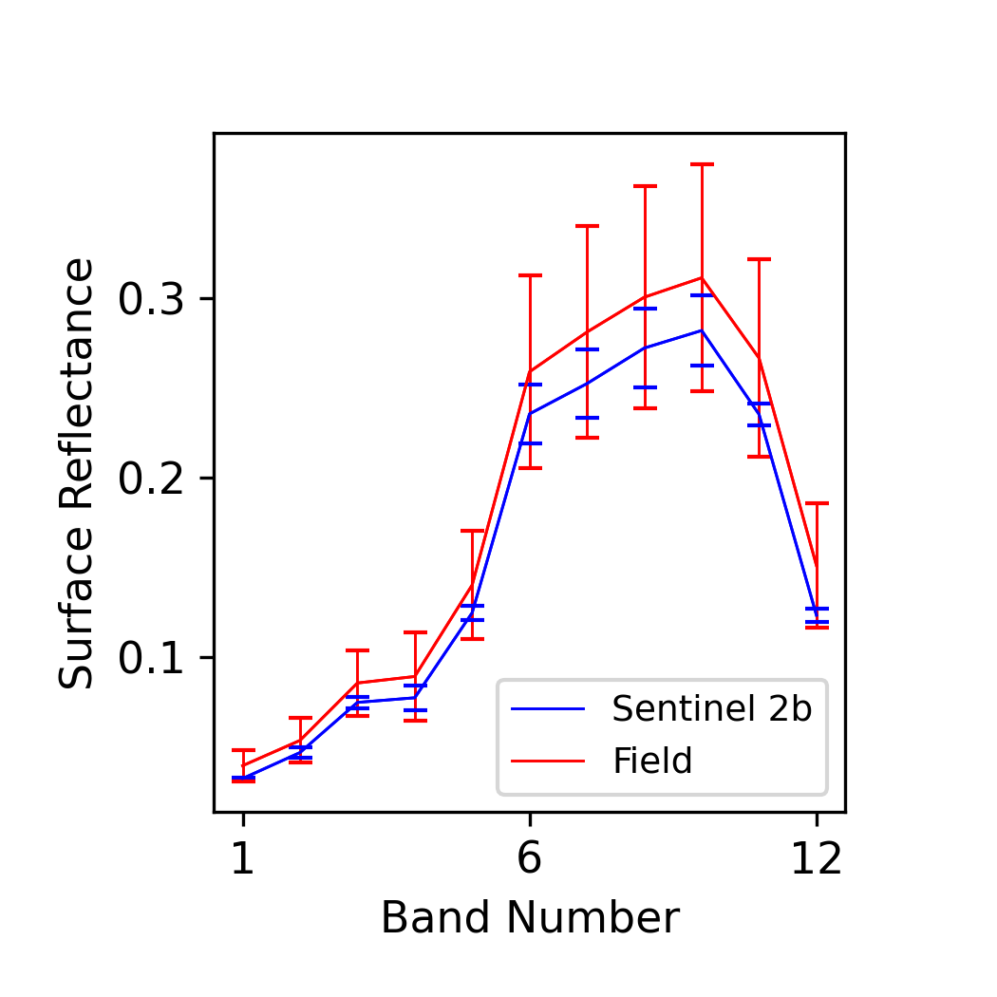
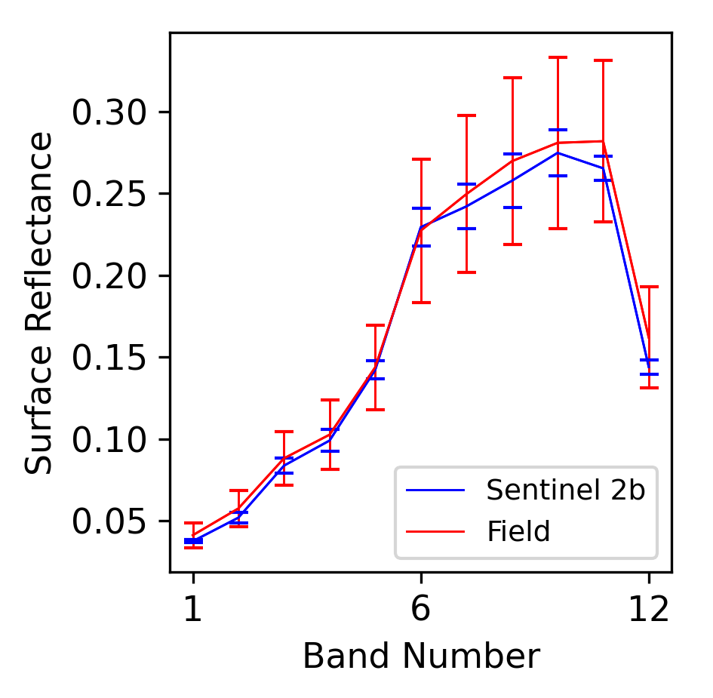
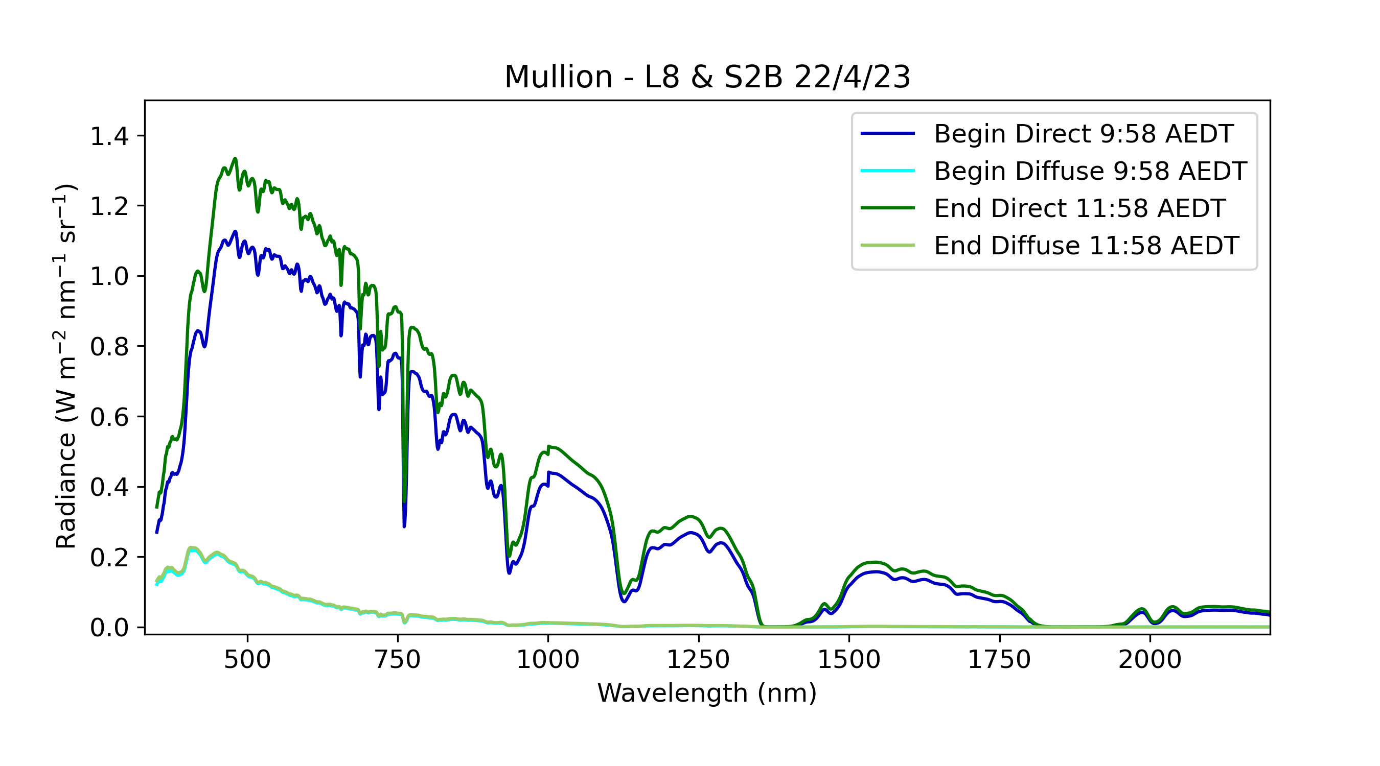
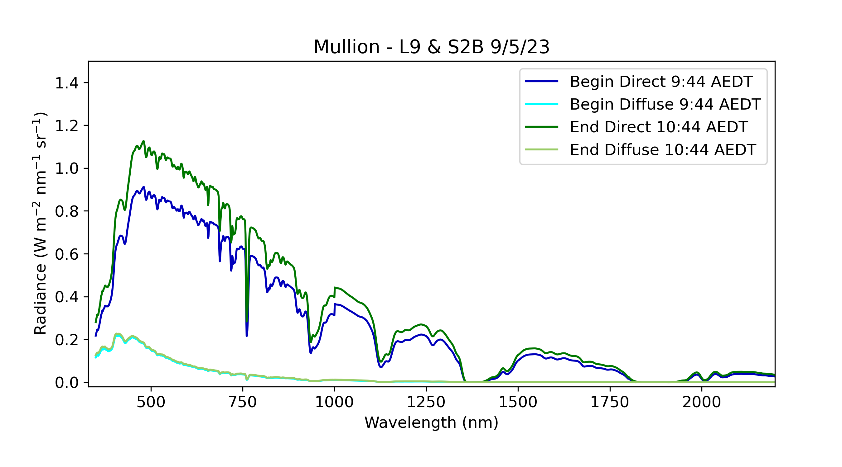
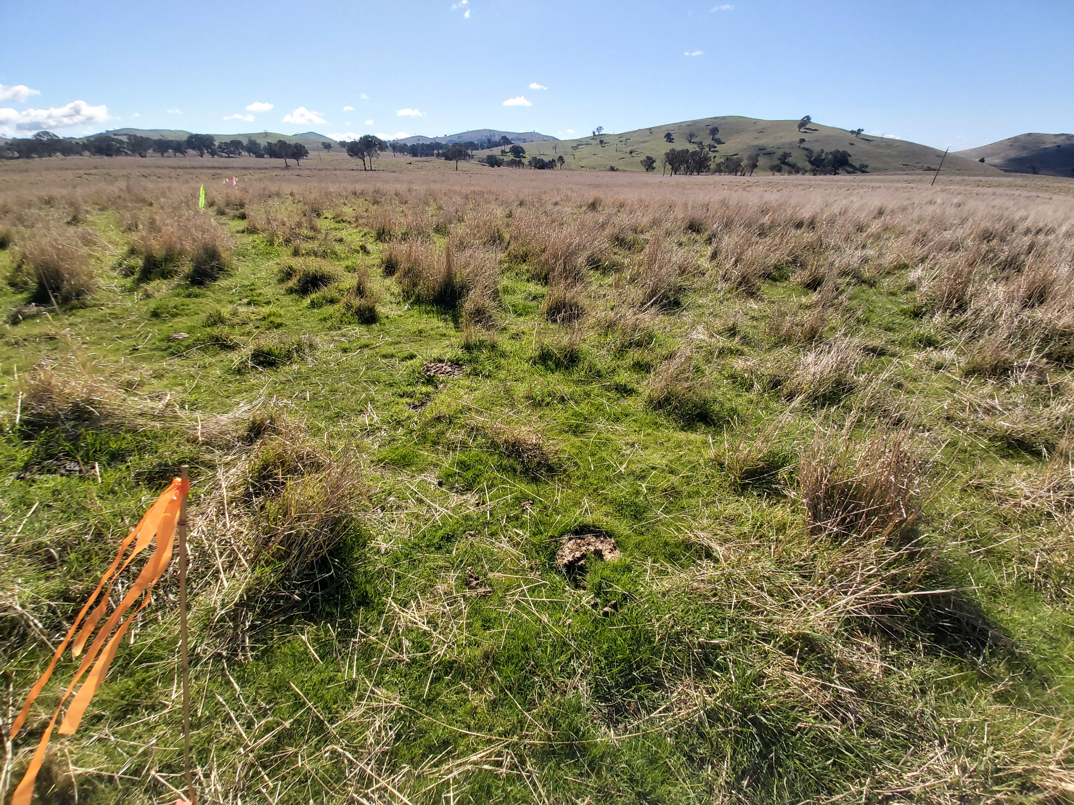
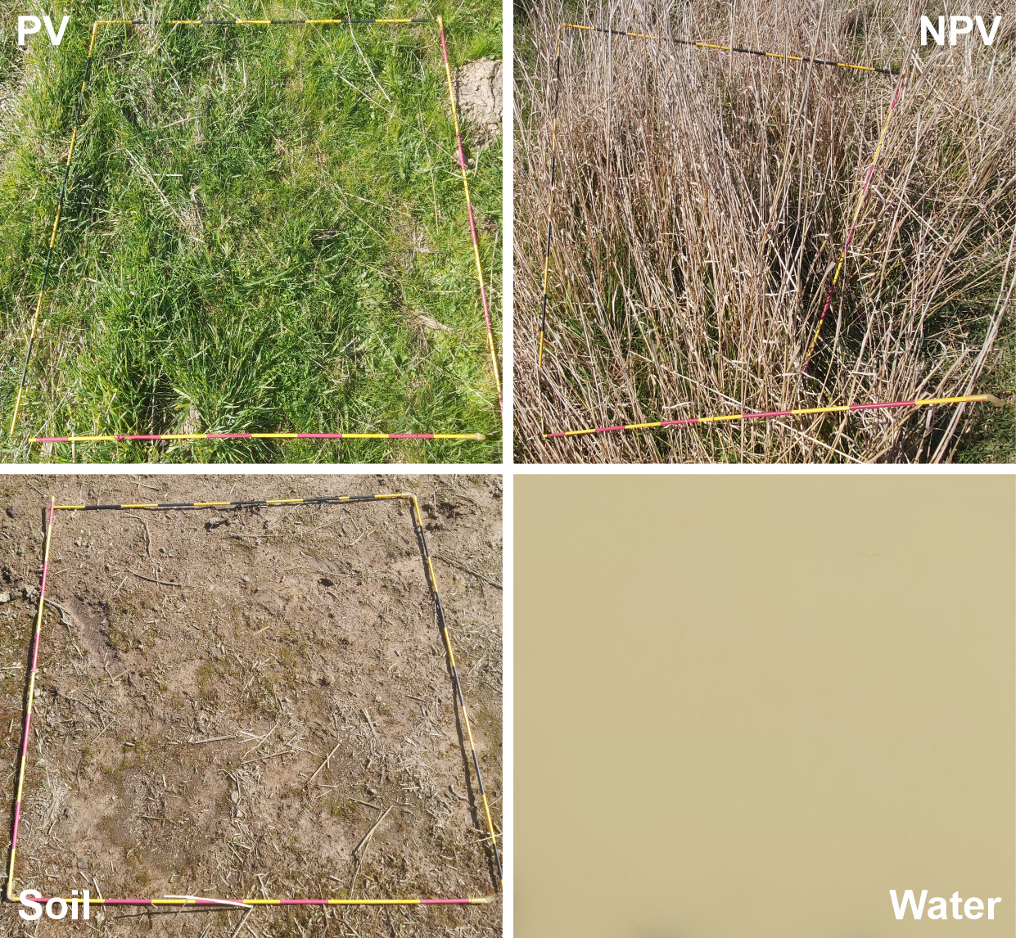
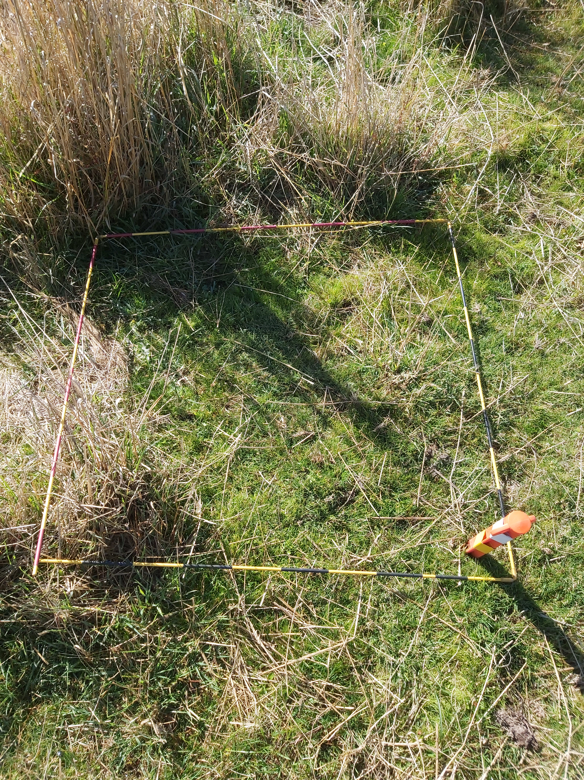
Surface Reflectance Validation Update
Ground based validation of satellite derived Surface Reflectance continues at GA
Mullion - L8 (15th April) & S2B 22nd April 2023
Mullion – L9 & S2B 9th May 2023
Atmosphere
Corner point
UAS RGB
Atmosphere
Site view
Cover end members

Slide 12
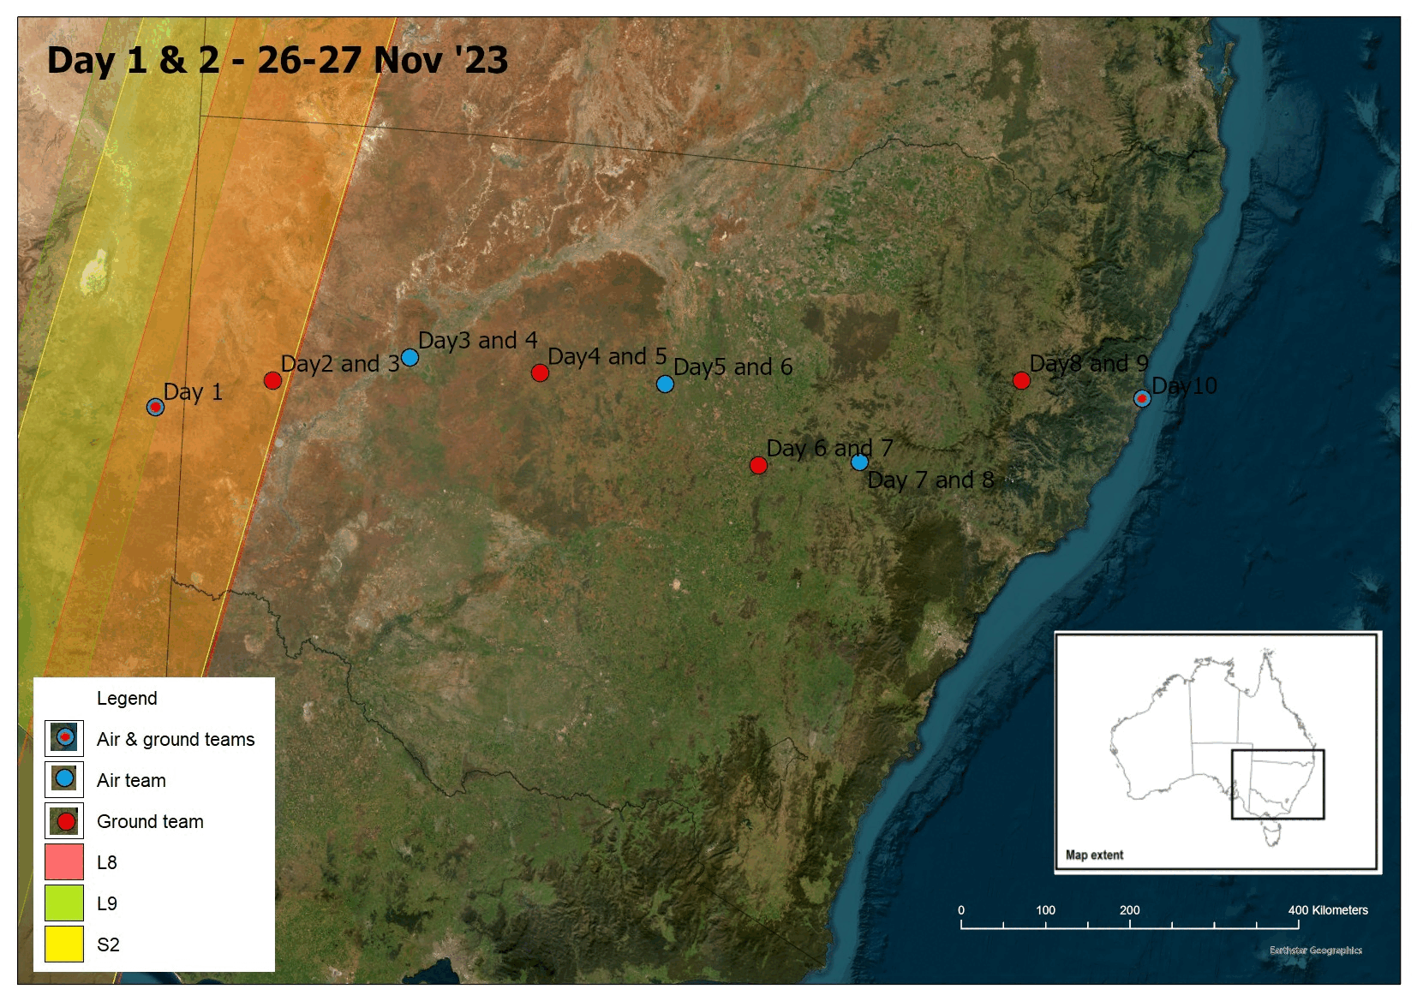
Proposed SR Validation Campaign
Targeted field validation campaign focussed on dual satellite overpasses being planned at GA (L8, L9, S2)
4 dual overpasses, on the 27 Nov. teams on either side of Landsat swath and the S2 swath on the day
All other dual overpasses will only have one team on site
24 ground-based match-ups to cover L8/L9/S2A/S2B

Slide 13
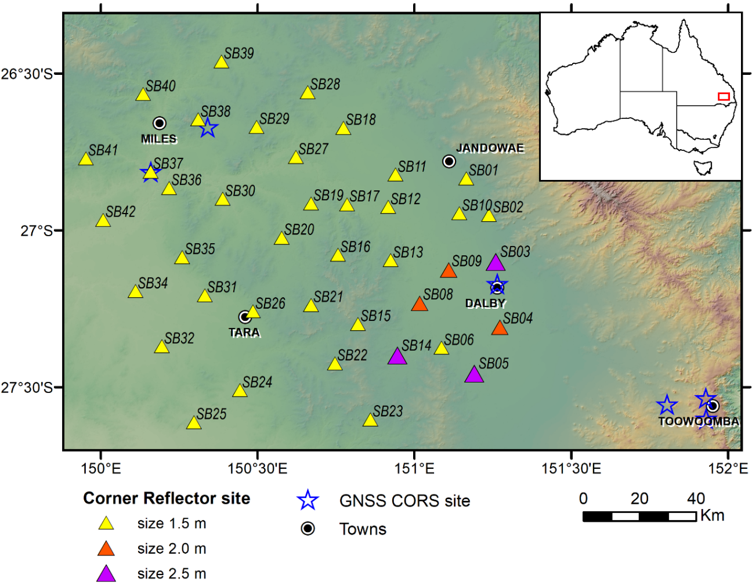
Queensland Corner Reflector Array
GA continues to maintain the QCRA of 40 CRs in Queensland
ESA leverages the QCRA for ongoing Sentinel-1 data quality assurance (https://sentinel.esa.int/web/sentinel/user-guides/sentinel-1-sar/document-library/-/asset_publisher/1dO7RF5fJMbd/content/id/4890957?_com_liferay_asset_publisher_web_portlet_AssetPublisherPortlet_INSTANCE_1dO7RF5fJMbd
AusCalVal (CSIRO) supported the maintenance of the QCRA site in May 2023 (completed before WGCV-52)

Slide 14
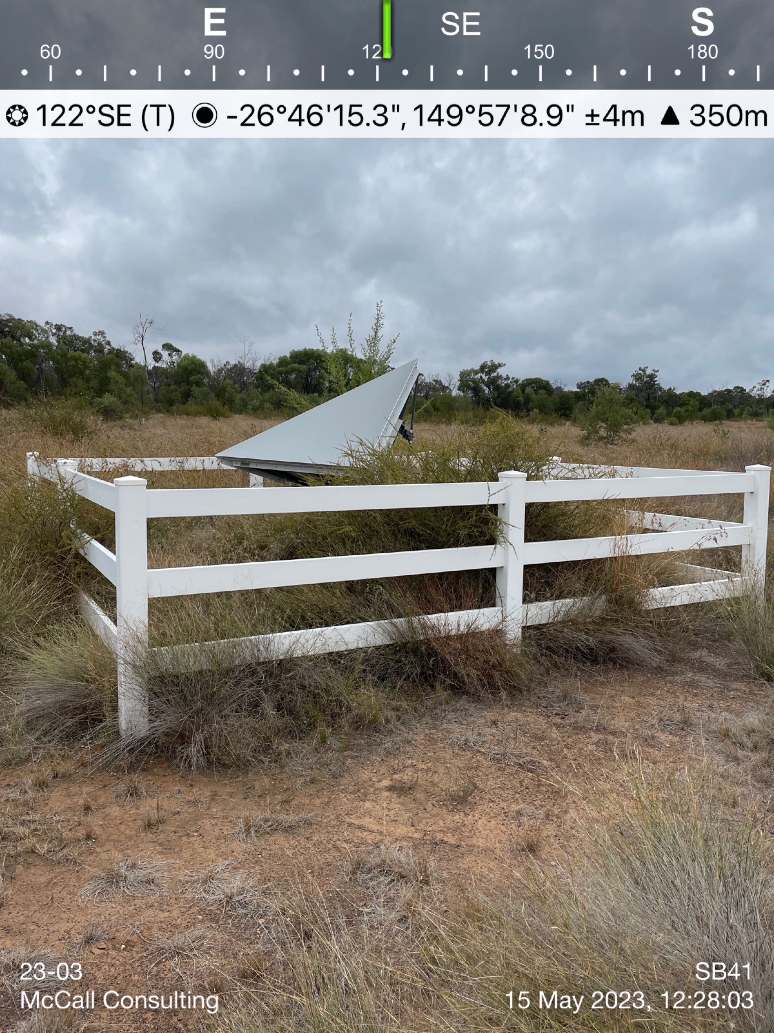
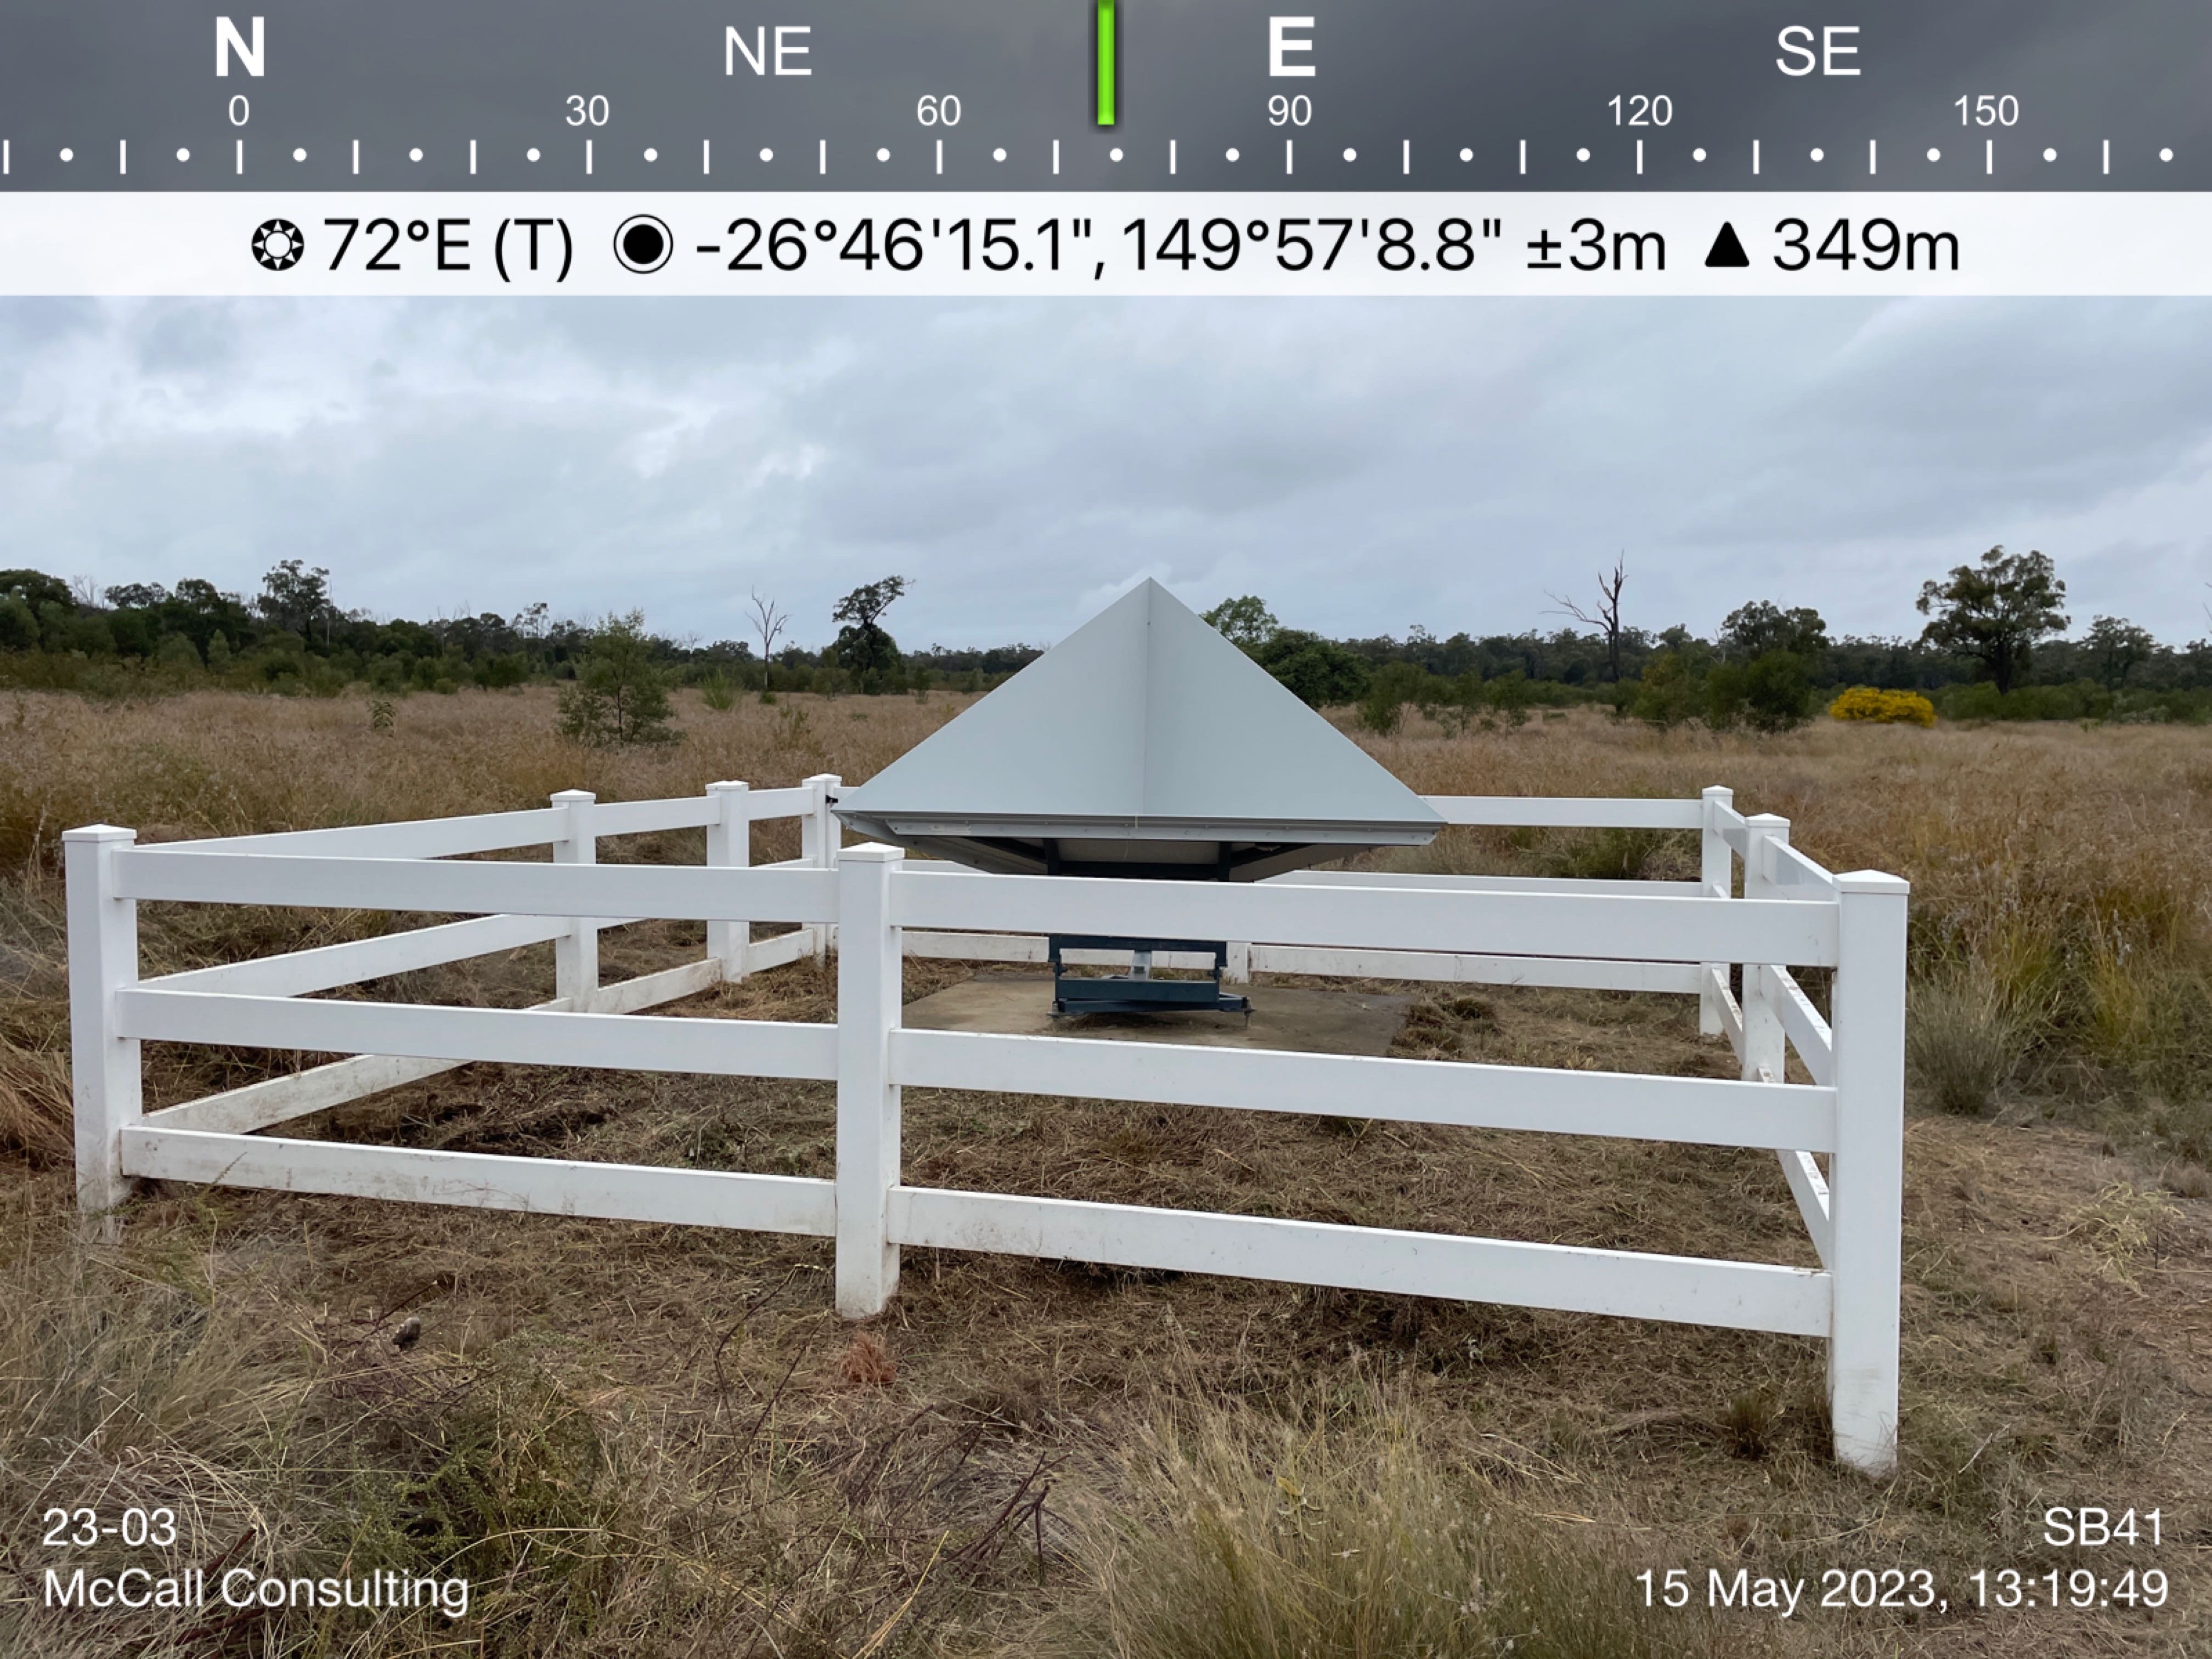
QCRA Maintenance
Before
After

Slide 15
Pandora Instrument
GA previously hosted two Pandoras on ESA’s behalf (at Canberra and Alice Springs)
Moving forward, only one Pandora instrument will be hosted by GA at Alice Springs, the second instrument may go to another location/host (TBD)
The Pandora instrument for Alice Springs is waiting to be shipped from Europe after re-calibration
Potential hosts and/or locations where additional Pandoras could be supported is being explored with AusCalVal

Slide 16
Thank you
medhavy.thankappan@ga.gov.au

