Slide 1

WGCV-52
The Radiometric Calibration Network: RadCalNet
M. Bouvet (ESA) on behalf of the RadCalNet WG (CEOS/WGCV/IVOS)
Agenda Item #4.7
WGCV-52, ESA/ESRIN, Italy
5th - 9th June 2023

Slide 2

What is RadCalNet?
Calibration
& QC
& Processing
Surface reflectance and atmosphere products
(RadCalNet specific)
Raw measurements
Site X
Hyperspectral TOA reflectance @ 30 mins interval for nadir view
RadCalNet portal
FTP
RadCalNet
Processing
&
QC
FTP
Calibration
& QC
& Processing
Surface reflectance and atmosphere products
(RadCalNet specific)
Raw measurements
Site Y

Slide 3
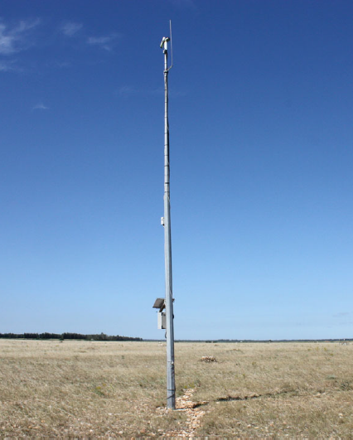
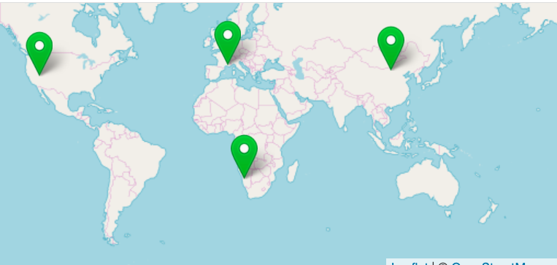
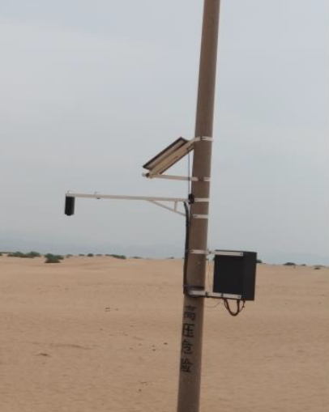
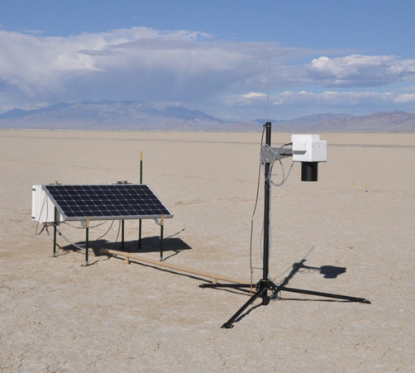
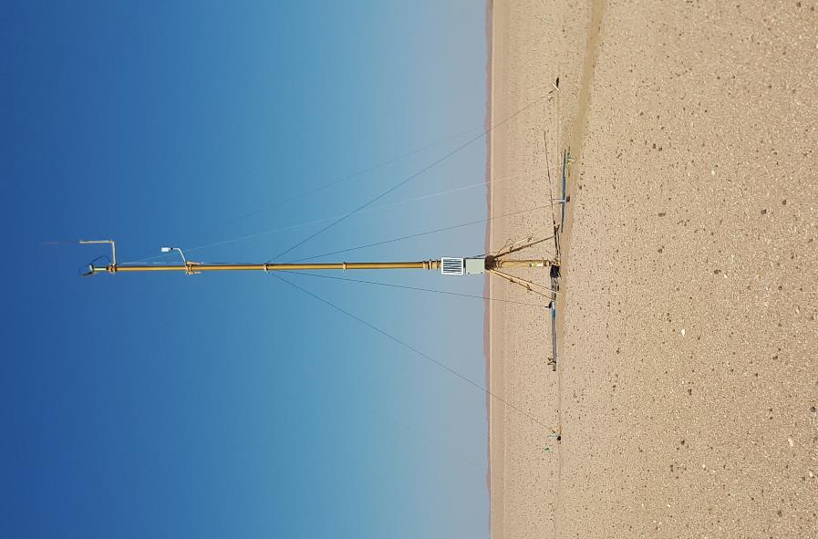
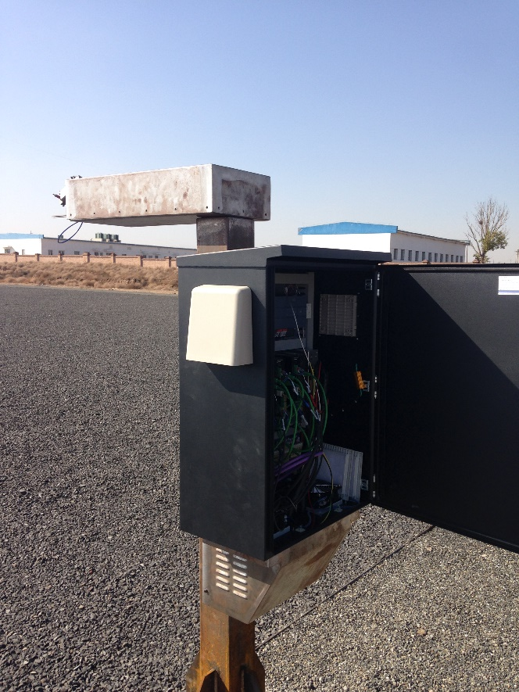
The RadCalNet sites
BTCN + BSCN
RVUS
LCFR
GONA
Today 5 sites (+ more in preparation)

Slide 4
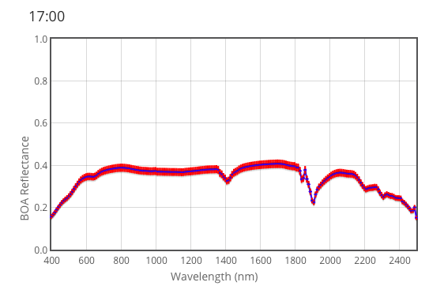
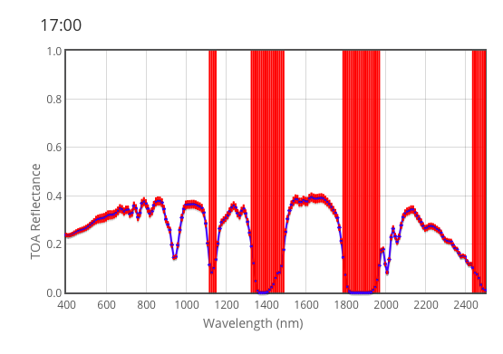
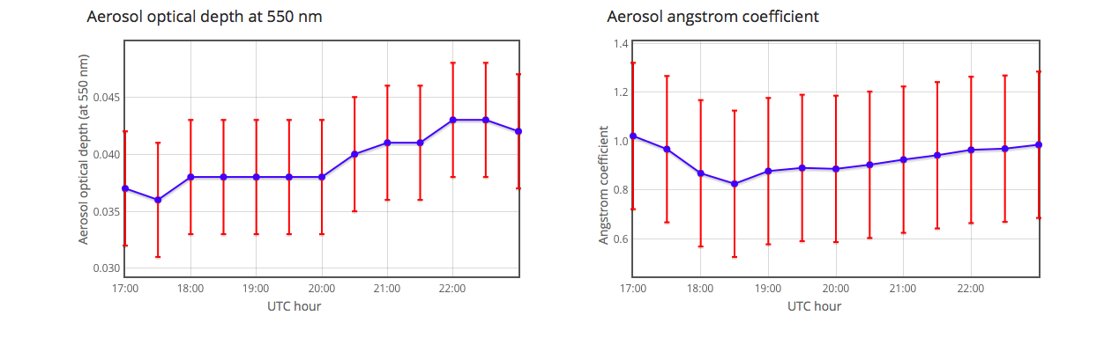
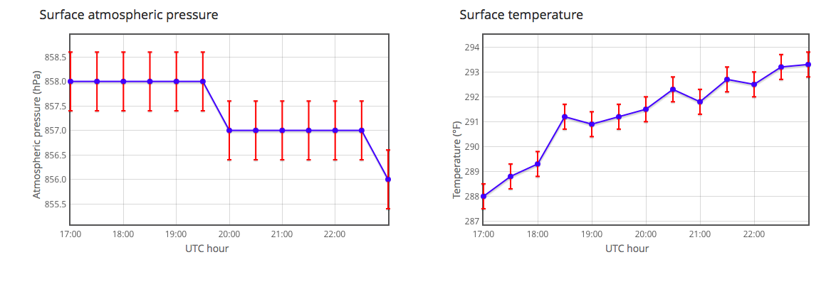
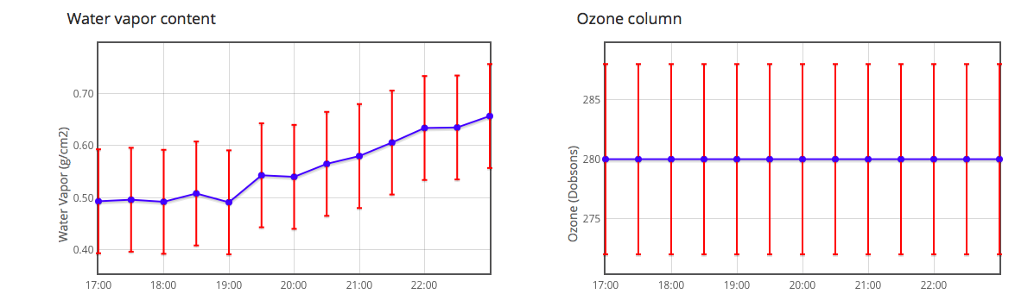
The RadCalNet processing
Propagation of surface/atmospheric measurements to top-of-atmosphere nadir reflectance via MODTRAN 6
Associated uncertainties results from propagation of the surface / atmosphere uncertainties via pre-computed Montecarlo runs of the radiative transfer
Surface reflectance
TOA reflectance
RadCalNet
Processing
Atmospheric measurements

Slide 5
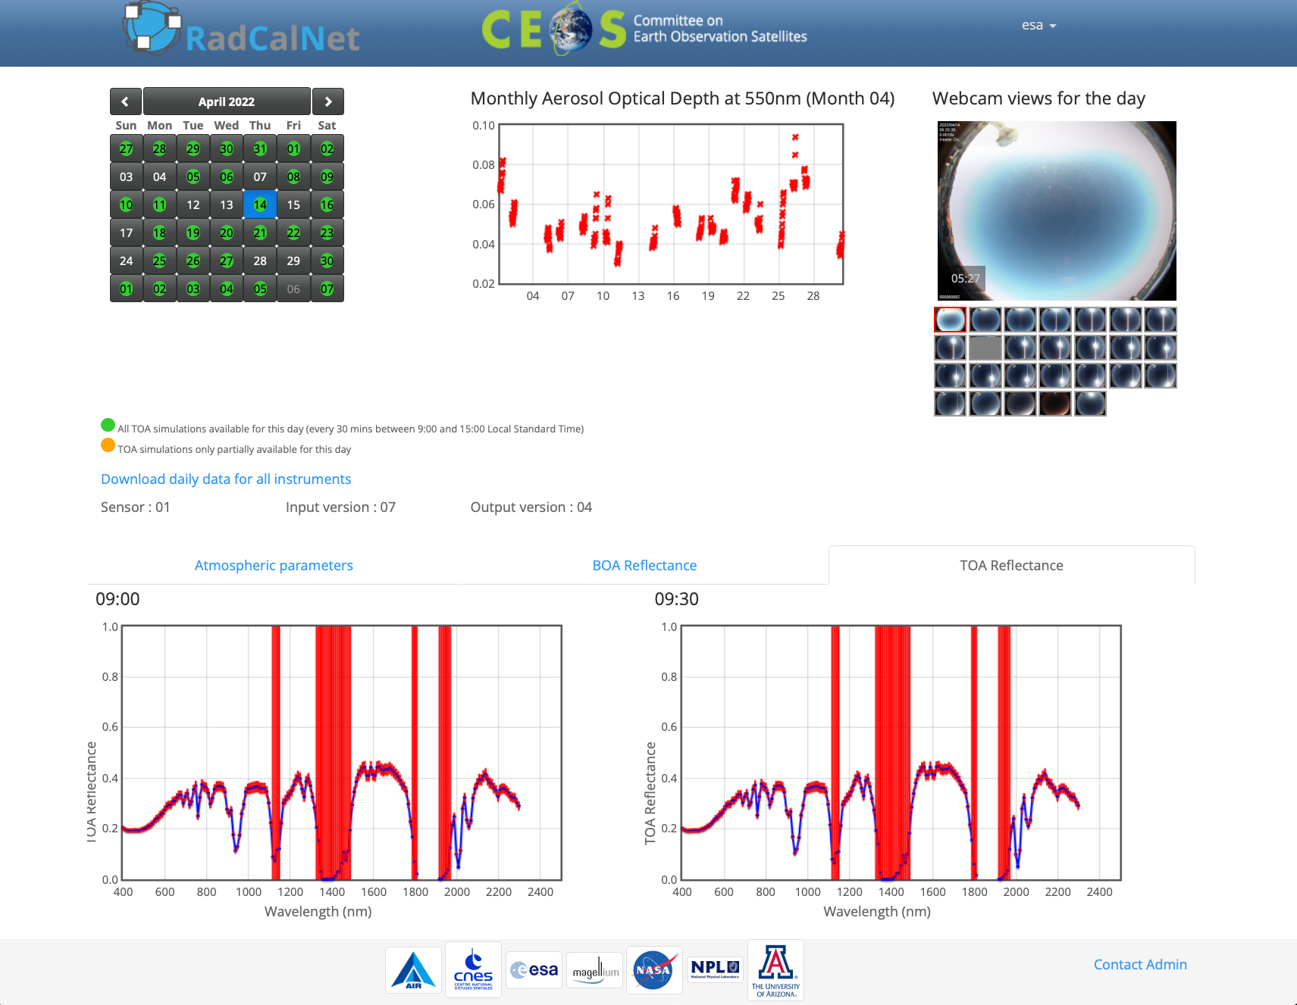
The portal

Slide 6
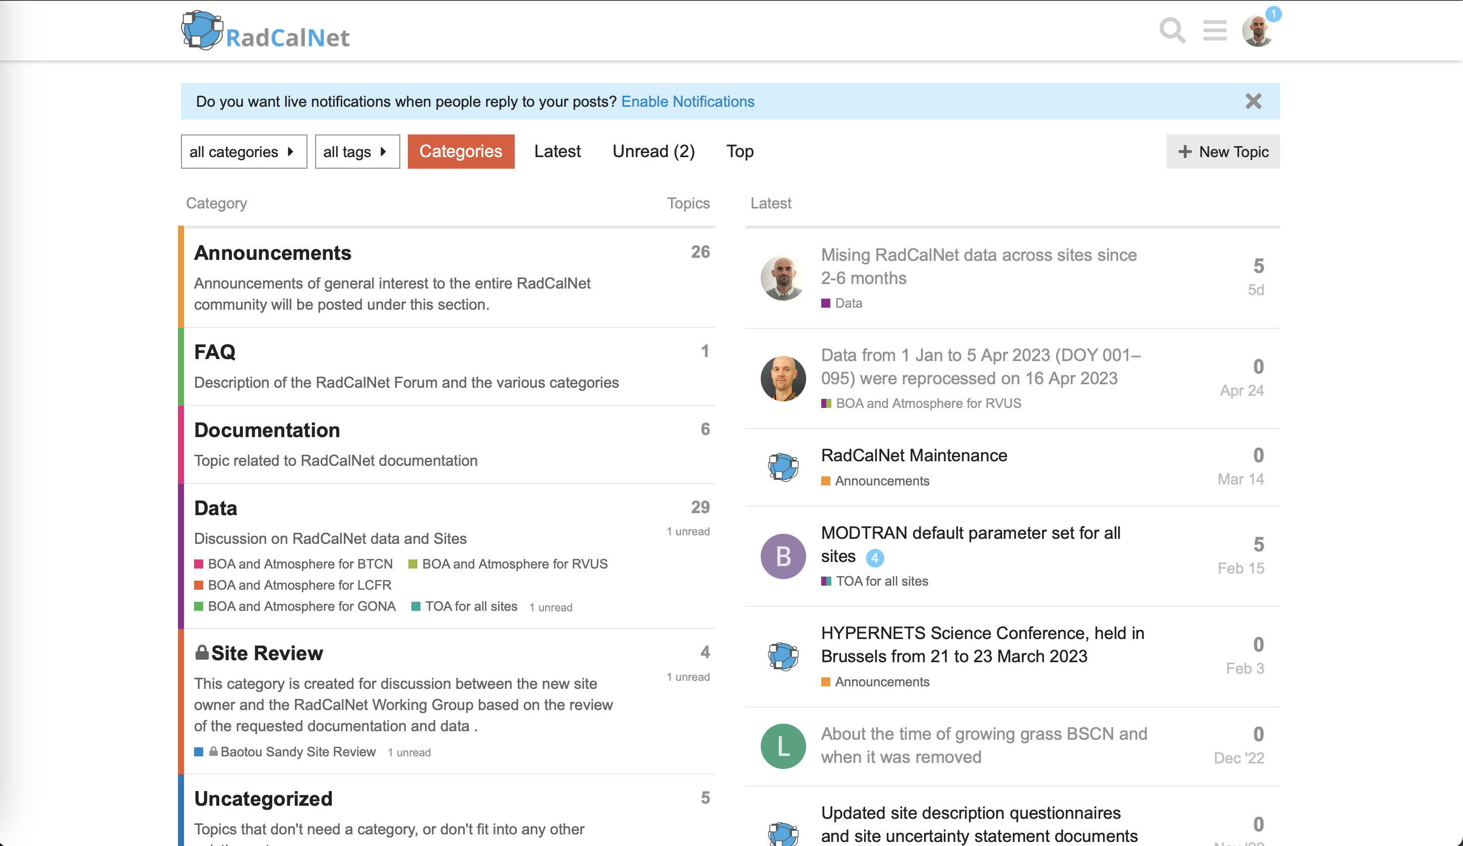
Forum

Slide 7
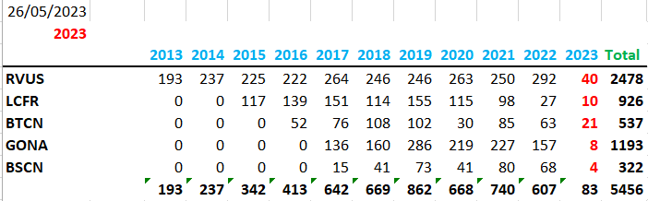
RadCalNet data overview
More than 5000 days worth of data available in the past 10 years
Limited data availability in 2023

Slide 8
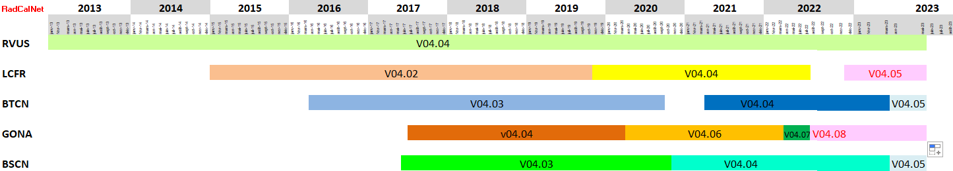
Overview of the processing versioning
Two full reprocessing of archive since RadCalNet portal opening in 2018:
  Collection 2020
  Collection 2022 released on 22 April 2022
Partial reprocessing planned this year: Collection 2023

Slide 9
2023 started not so well:
Limited amount of data due to poor weather condition in first quarter at Railroad Valley Playa and Baotou.
Several issues with the data processing and calibration were identified for the La Crau and Gobabeb sites and leading to a) an interruption of the processing since mid-March 2023 and b) a reduction of good data in 2022. Data are now reprocessed and will be made available with Collection 2023.
Minor data quality issues were also identified for historical Baotou data leading to reprocessing of the surface reflectance / atmospheric measurements and their associated uncertainties. These reprocessed data will be provided with Collection 2023.
Collection 2023 is expected to be released around summer and should be followed by normalization of the RadCalNet data throughput.

Slide 10
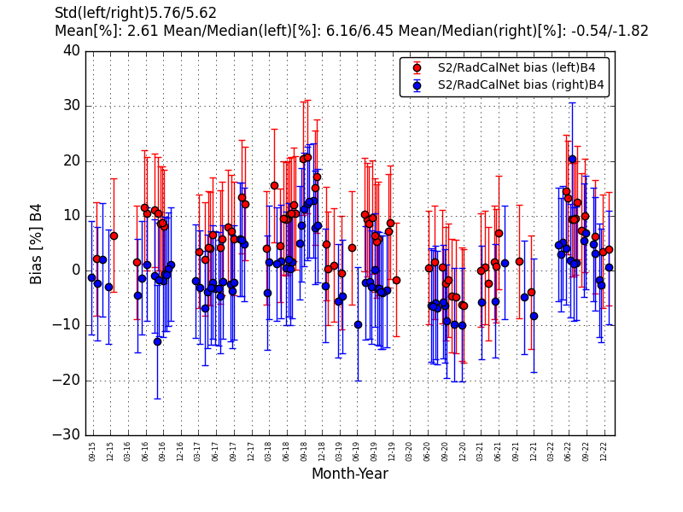
Comparison of Sentinel 2A to RadCalNet TOA at Railroad Valley Playa over the full archive
RadCalNet TOA reflectance available every 30 mins
Sampled at 10 nm spectral sampling interval
S2A geometry is not exactly nadir
BRDF effects not accounted for

Slide 11
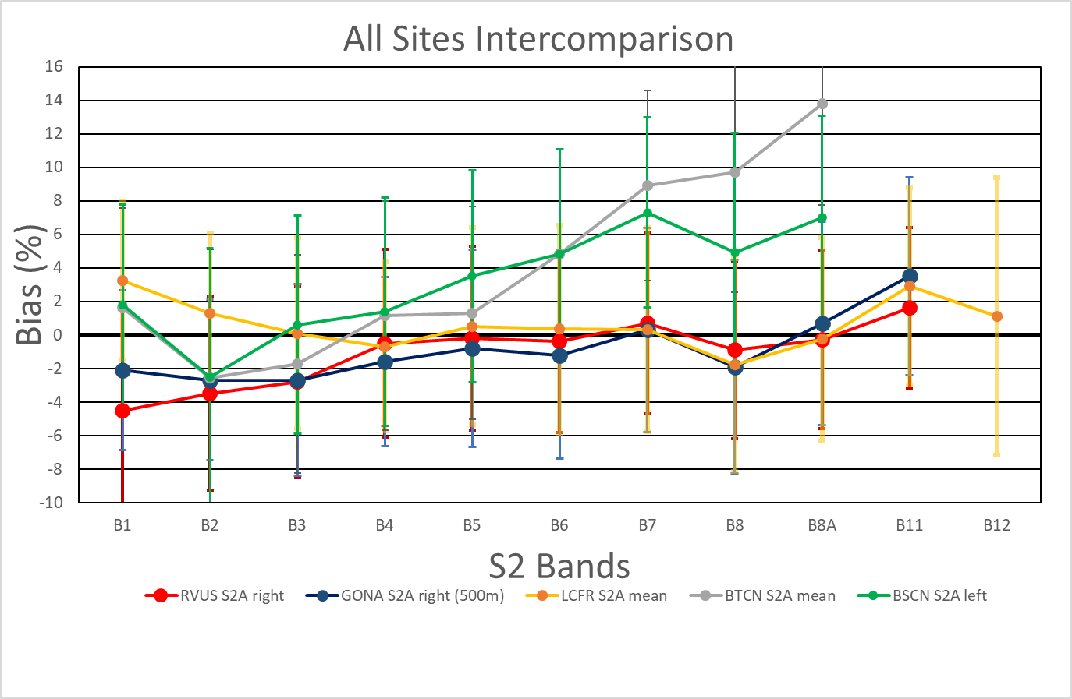
Site Intercomparison S2A – 5 sites spectral synthesis

Slide 12
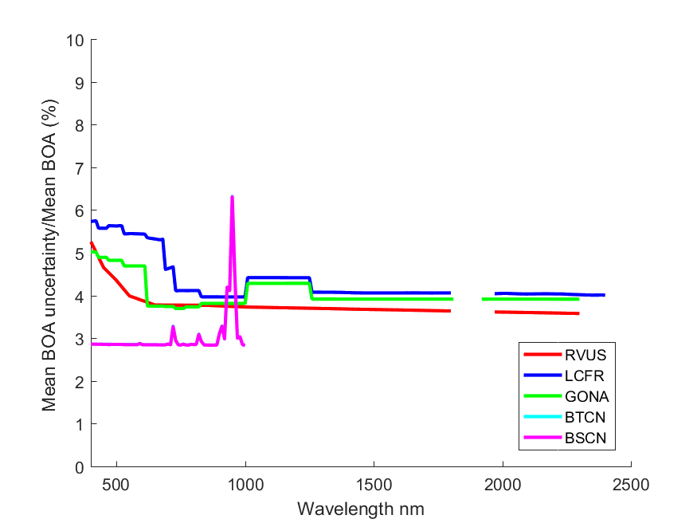
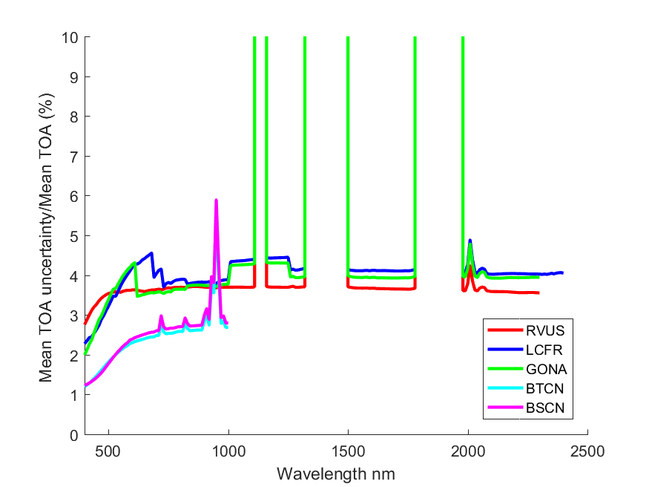
Mean relative uncertainties BOA/TOA at each sites average over full archive of data
Surface reflectance uncertainty documented in site owners uncertainty statements
TOA reflectance uncertainty derivation documented in B. N. Wenny and K. Thome Look-up table approach for uncertainty determination for operational vicarious calibration of Earth imaging sensors (https://doi.org/10.1364/AO.442170)

Slide 13
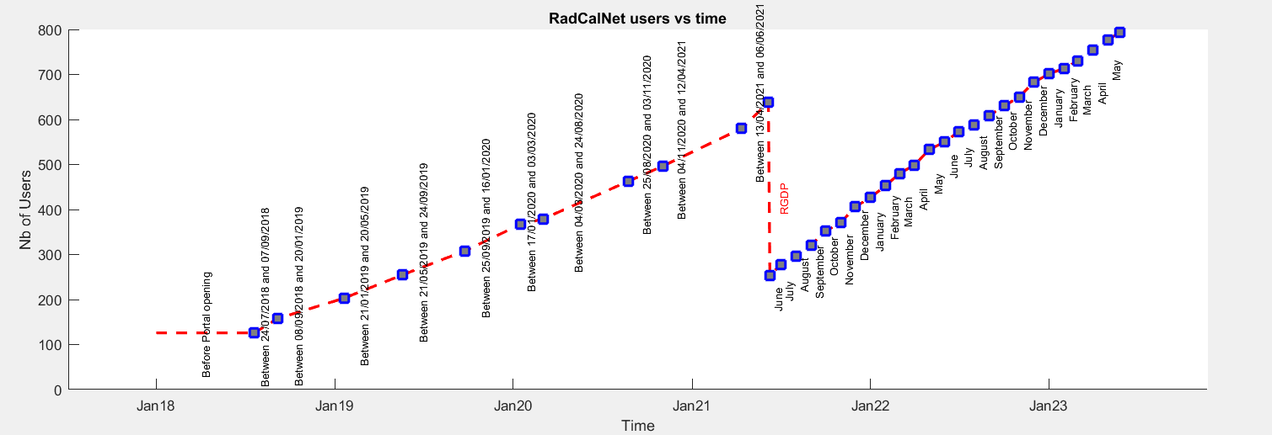
Users

Slide 14
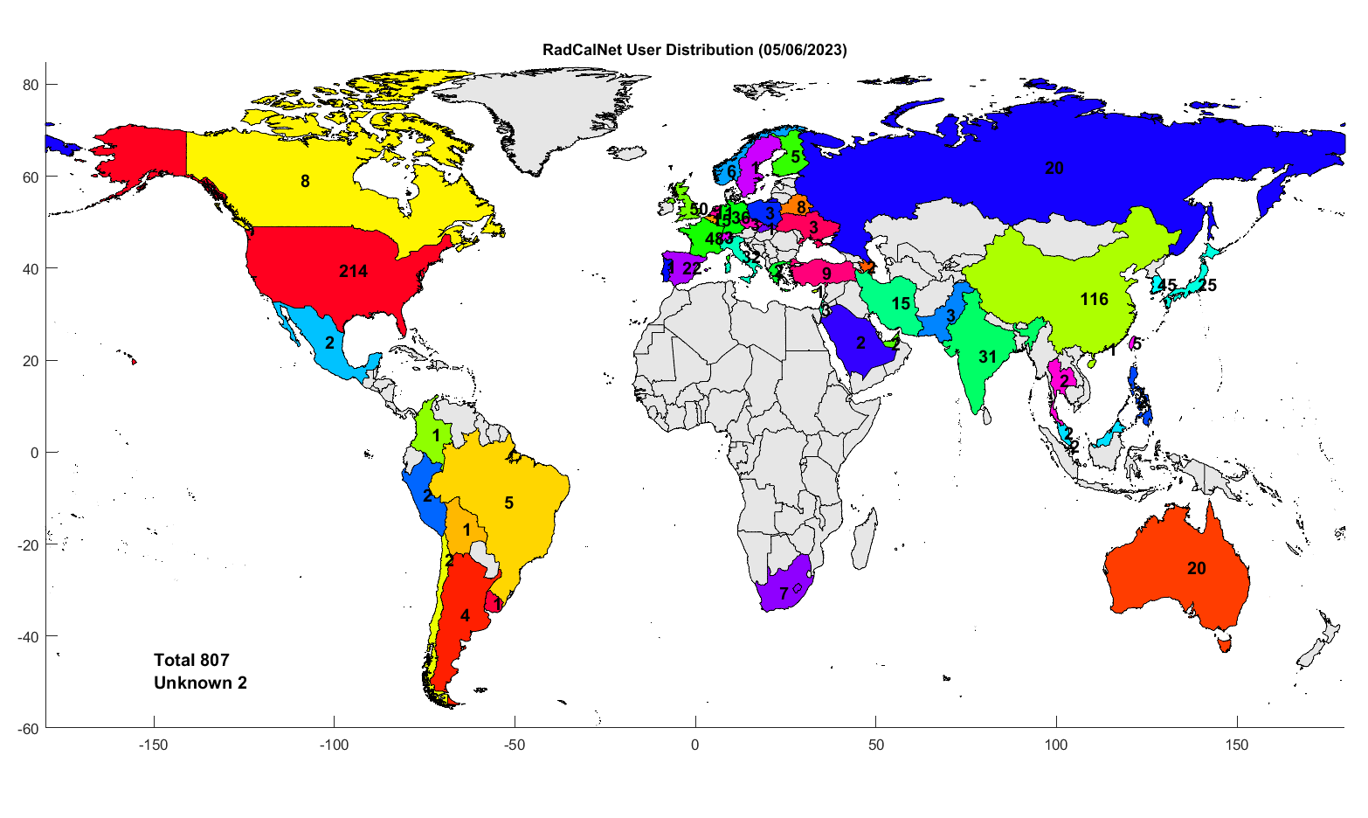
Users

Slide 15
First RadCalNet user workshop (9 – June 2021)
About 100 online participants
25 presenters
3 sessions:
  Multispectral instrument calibration/radiometric validation
  Hyperspectral instrument calibration/radiometric validation
  Exploitation of surface reflectance measurements

Slide 16
First RadCalNet user workshop (9 – June 2021)
Exploited for validation/calibration of L1 products from:
  New space missions: e.g, Maxar (Worldview, GeoEye), Planet (Skysat constellation), etc..
  National space agencies missions: e.g., ARGANS (Sentinel-2, Landsat-8), ISRO (AWiFS), AIST (ASTER), NASA (OCO, GOSAT), DLR (DESIS), etc…
Presentations and programme available on https://www.radcalnet.org

Slide 17
Acceptance process for new sites

Slide 18
Acceptance process for new sites
RadCalNet WG members contribute to the review
Process overseen by WGCV
Through an acceptance panel reporting to WGCV

Slide 19
New Sites Status
GHNA
AERONET- OC sites
KARI Site
Golmud site
USGS site
PIAU
Initial concept
Identify location
Set up instruments
Collect data
Prepare draft documents
Prepare submission
Submit application to RadCalNet
First Review
Second Review
Acceptance
Operation
DHCN
BTCN
GONA
RVUS
BSCN
LCFR

Slide 20
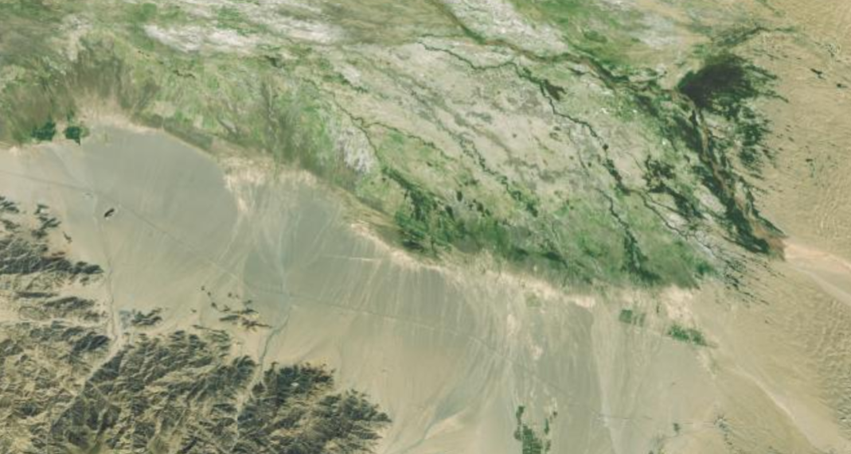
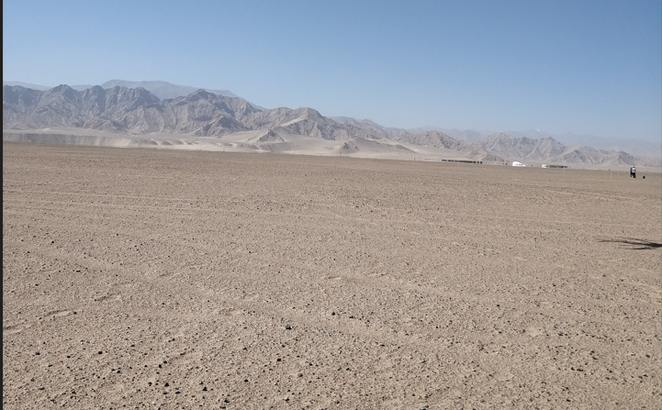
Golmud
Site name: Golmud site (36.435° N，94.225° E).
Located: The site locates in the central and western parts of Qinghai Province, is in the hinterland of Tibet plateau and near the northern margin of Qaidam Basin.
Climate: Typical plateau continental climate. The average annual temperature is 1.4°C, and the average annual precipitation is 83.5 mm.
Altitude: About 3000m.
Logistics: Near the G315 State Road.
Surface: Gobi.
Gobi area: ＞5km
Uniformity (CV): < 3%

Slide 21
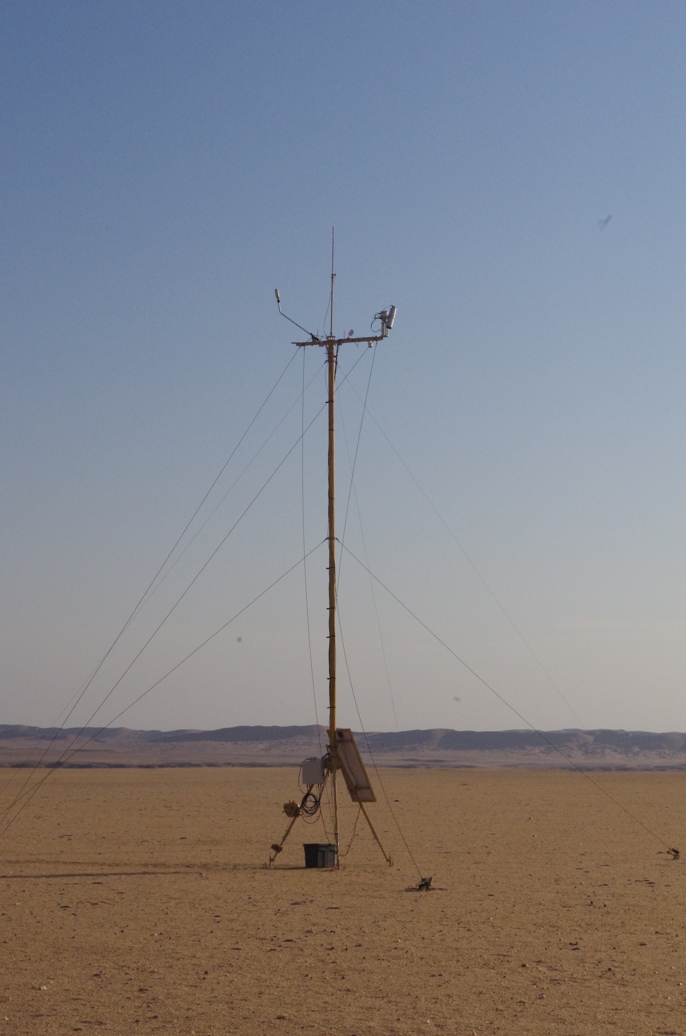
HYPERNETS Namibian site pre-operation
Nearly collocated (within 700 m) with existing site but different instrumentation.
86 days of data collected (at time of reporting) between May installation and 13th Oct 2022. Data transmission issue but more data should be coming in.
Work underway to automatically process LANDHYPERNET processed data to RadCalNet format in preparation for “GHNA” site application to RadCalNet
First draft of Site Questionnaire documents for GHNA complete
Next site visit potentially scheduled for mid-September 2023 for HYPSTAR-XR swap-out (v1 to v3)

Slide 22
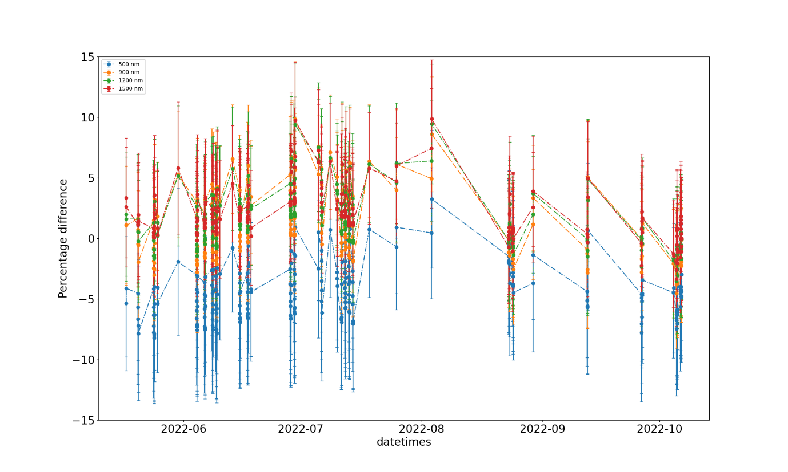
HYPERNETS Namibian site pre-operation
Percentage difference between surface reflectance from the RadCalNet site GONA and the HYPSTAR® XR plotted as a Timeseries from May to Oct 2022, for four selected wavelengths (500 nm, 900 nm, 1200 nm and 1500 nm)

Slide 23
Outlook
On going investigation activities:
Develop a (double difference) method to validate the RadCalNet TOA reflectance uncertainties using both Landsat-8 and Sentinel-2 observations over all sites
Feasibility of using AERONET-OC data for RadCalNet

Slide 24
Conclusion
Nearly 5 years of succesful RadCalNet operation
Collection 2023 under preparation
5 sites currently providing data and new sites expected to join the network
Continuous collaborative efforts to maintain instrumentation in operation, process and quality control data and communicate with users
Growing user base and data uptake.

Slide 25
Partners
L. Ma and N. Wang from Chinese Academy of Science
J. Czapla-Myers (UoA, US)
L. Landier and A. Meygret (CNES, FR)
A. Bialek, E. Woolliams, M. Sinclair, A. Ramsey, P. De Vis (NPL, UK)
B. Berthelot (Magellium, FR)
B. Wenny and K. Thome (NASA, US)
… and more working on the sites and the data

Slide 26

Thank you

