Slide 1
WGCV-52
TIRCALNet
Steffen Dransfeld, ESA
Aime Meygret, CNES
4.6
WGCV-52, ESA/ESRIN, Italy
5th - 9th June 2023

Slide 2
TIRCALNet Context
As per CNES WGCV presentation last year:
Several TIR missions operational: ECOSTRESS, ASTER, LANDSAT-8&9, MODIS, VIIRS, SLSTR, SEVIRI…
TIR future missions with higher resolution: TRISHNA, LSTM, SBG
More and more demanding LST accuracy requirements better than 0.1 K for climate studies
Importance of vicarious calibration for the validation of on-board calibration systems (black bodies) or direct calibration
L2 products (temperature & emissivity) validation need
In addition numerous new space TIR companies are about to be launched: ConstellR, Ororatech, Aistech,…

Slide 3
TIRCALNet Objectives
To collect surface temperature and emissivity, and atmospheric data necessary for the simulation of observations by TIR optical sensors and thus verify their radiometric calibration
To increase the number of matchups between in-situ measurements and space sensor observations and reduce the overall uncertainties, and reduce the efforts of individual agencies
To ensure traceability of the space sensor radiometry to the “Système International” (SI)
To support the establishment of the Global Earth Observation System of Systems by providing measurements to verify the radiometric consistency between EO space sensors
The success and experience return from RadCalNet network dedicated to VNIR-SWIR optical sensors cal/val

Slide 4
Current Limitations of LST Sites
Spatial representativeness of the in situ reference measurements
Directional effects
Lack of emissivity measurements
Data access
Data harmonization
Do not provide TOA radiances
Data quality assurance (error budget traceable to SI)
In situ instruments calibration quality and traceability
Needs for the development of denser ground-based reference Network

Slide 5
First activities for TIRCALNet
ESA and CNES defined after discussions with domain and agency (CNES, ESA & NASA) experts that TIRCALNet should be able to provide TOA Brightness Temperature signals propagated from BOA measurements of ~ 0.5K uncertainty and a set of tasks were identified :
Task 1 → Identification of uncertainty contributors to TOA-derived BT
Task 2 → Sensitivity analysis of uncertainties on TOA BT estimation
Task 3 → Definition of best site characteristics, optimal instrumentation and forward propagation scheme
Task 4 → Selection of potential candidate sites based on Task 3
Task 5 → Interaction with Working Groups and network roadmap

Slide 6
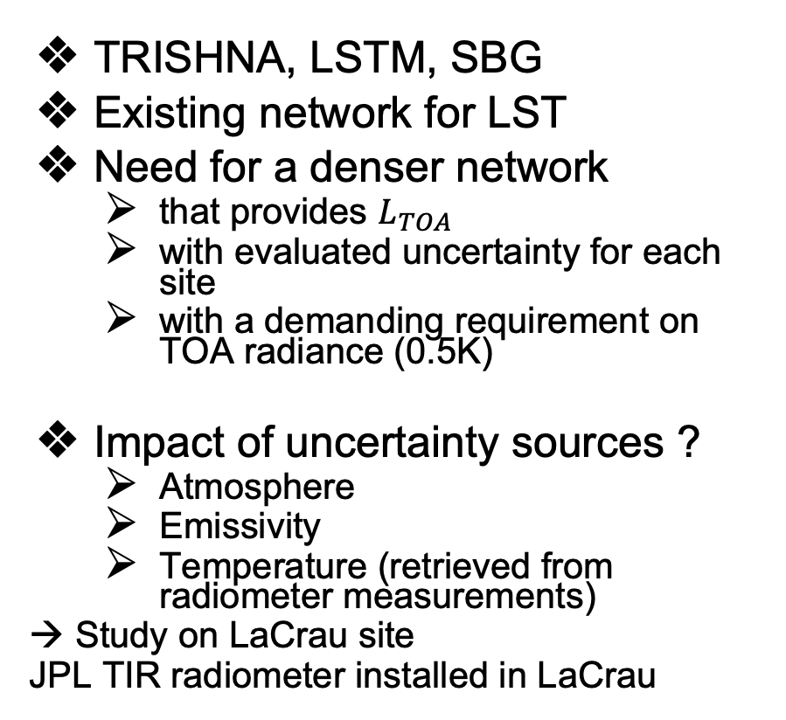
Site Study Objectives
TRISHNA, LSTM, SBG
Existing network for LST
Need for a denser network
  that provides $L_{TOA}$
  with evaluated uncertainty for each site
  with a demanding requirement on TOA radiance (0.5K)
Impact of uncertainty sources ?
  Atmosphere
  Emissivity
  Temperature (retrieved from radiometer measurements)
  → Study on LaCrau site
  JPL TIR radiometer installed in LaCrau
SURFRAD: Surface Radiation, NOAA GCU: Global Change Unit, University of Valencia
JPL network KIT (Karlsruhe Institute of Technology) stations
Location of ground observational networks currently used to validate standard LST products derived from US and European spaceborne instruments.
USCRN: US Climate Reference network
6

Slide 7





Preliminary CNES study at La Crau
CNES started tasks 1and 2, considering La Crau surface and atmosphere optical properties
Making some simplified assumptions (Lambertian Surface, Nadir viewing)
By using known quantities for atmospheric profiles (ECMWF data), surface emissivity DB from 1991 and simulated radiometer measurements L_{TOA} can be estimated and a sensitivity study by introducing uncertainty terms performed.
First test runs show that the main impact on TOA Brightness Temperature is the uncertainty on the ground emissivity. Uncertainties on the atmospheric profiles is an issue but of lesser impact.
Test runs were done for simulated data representing all months and uncertainty decreases significantly for ‘wet’ months
$$L_{TOA}\left(λ\right)$$
$$L_{atm}^{↑}\left(λ\right) \\ L_{atm}^{↓}\left(λ\right) \\ τ^{↑}\left(λ\right)$$
$$L_{radiometer}$$
$T_{s}$ , $ε\left(λ\right)$
7

Slide 8
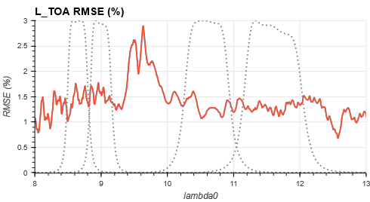
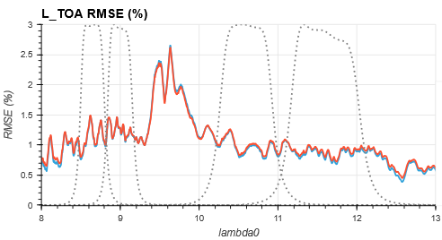
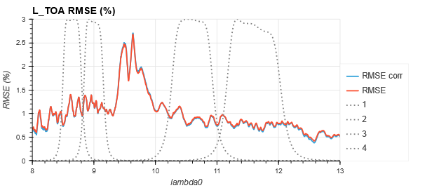
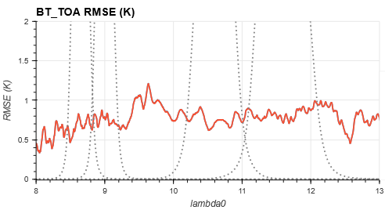
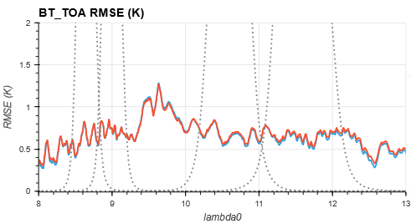
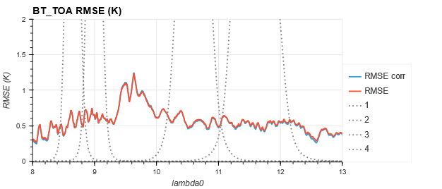
Typical Uncertainties
The RMSE (-> uncertainty) is ~1-1.5% of L_{TOA} translating to 0.5-1K of BT_{TOA}
January
July
October

Slide 9
Next steps of CNES study
More analysis needs to be done to assess for:
Spatial variations of emissivity and temperature vs the different FoVs of ground radiometer and TOA sensor
Directional effects of emissivity need to be understood and estimated better
Environmental effects specific to La Crau site need to be understood better
If better to have a multispectral or broad band TIR radiometer
Need to re-characterise the emissivity at La Crau since current DB dates from 91.

Slide 10
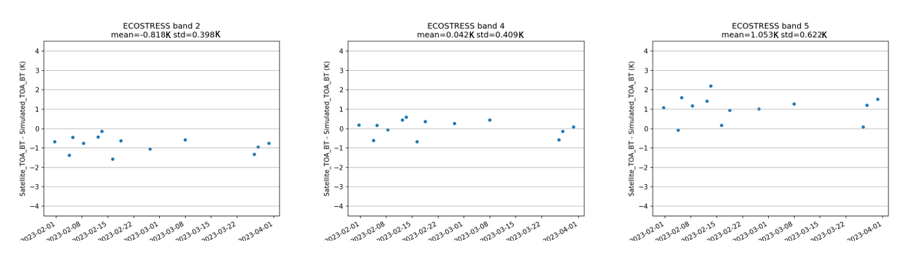
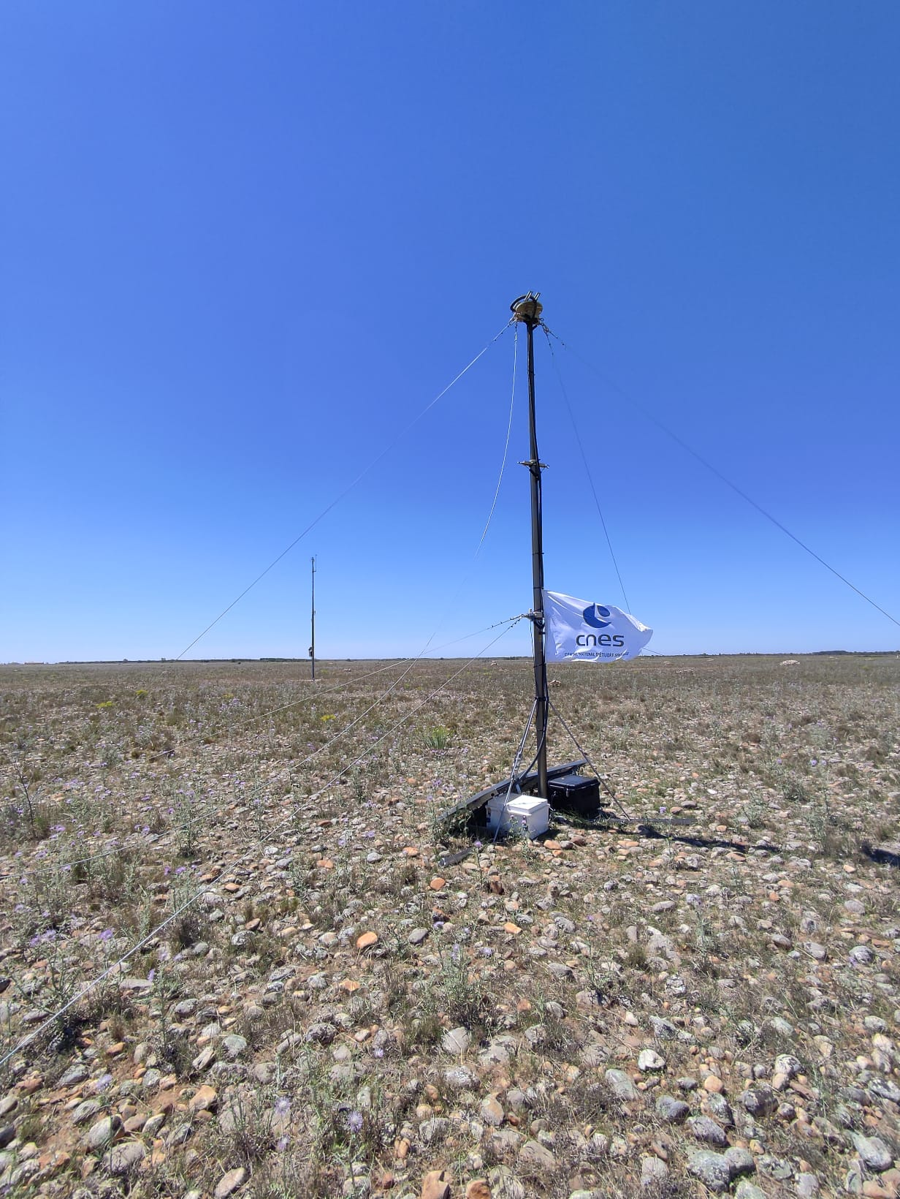
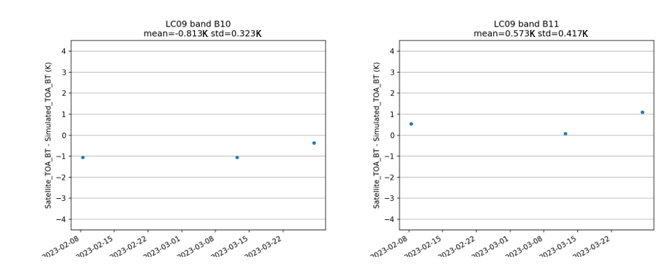
Preliminary CNES study at La Crau
CNES in collaboration with NASA/JPL have deployed a JPL field radiometer (1 large band 8-14µm) at La Crau site.
First evaluation of L1 products for ECOSTRESS or LANDSAT9 show very good consistency within 1 degree!
  To be confirmed with additional data
  Field/Airborne campaigns to perform in 2023/2024, in particular to characterize the emissivity
  Additional instrumentation to be installed
10

Slide 11
Next steps towards other sites
Transfer of CNES La Crau uncertainty budget template to other sites (e.g. from ESA LAW project) and perform similar simulations to gain an understanding how site environment may influence the uncertainty.
Development of a site measurement and forward propagation protocol to minimise uncertainties at TOA
Analysis of site characteristics (surface, cloud cover, etc.) to find possible candidate sites (e.g. Lake Tahoe, Acqua Alta platform, Russel Ranch
Develop a roadmap to equip and operate sites
Discussions with partnering agencies on how to collaborate and set up and operate networks (funding for instrumentation, site operation, data analysis, supporting studies, etc.)

