Slide 1
WGCV-52
Land Product Validation Subgroup
Michael Cosh
Agenda Item 4.5
WGCV-52, ESA/ESRIN, Italy
5th - 9th June 2023

Slide 2
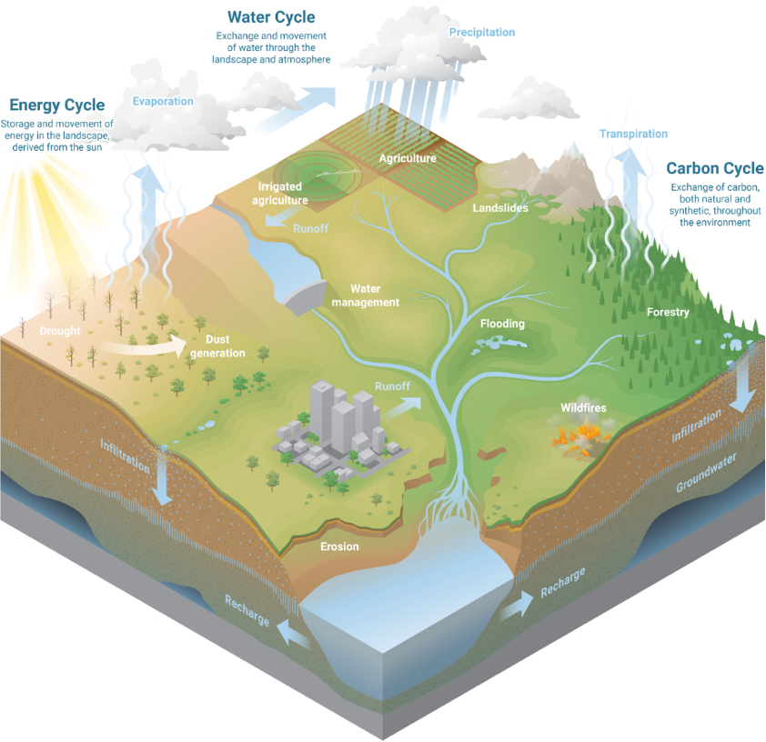
Focus Areas
Focus Area
Biophysical
Fire/Burn Area
Phenology
Vegetation Index
Land Cover
Snow Cover
Surface Radiation
Soil Moisture
LST and Emissivity
Aboveground Biomass
10
Slide ‹#›

Slide 3
Presenter Guidelines 2
 | First Name | Last Name | Institution | Location | End of Term
Main | Michael | Cosh | USDA | USA | Apr 2025 (final)
Main | Fabrizio | Niro | ESA | Italy | Apr 2025(promotion to Chair)
Main | Jaime | Nickeson | GSFC | USA | never
Land Cover | Alexandra | Tyukavina | University of Maryland | USA | March 2024 (1st term)
Land Cover | Sophie | Bontemps | Université Catholique de Louvain | Belgium | Oct 2023 (2nd term)
Biophysical | Marie | Weiss | INRA | France | Sep 2023 (2nd term)
Biophysical | Sylvain | Leblanc | Natural Resources Canada | Canada | Sept 2023 (2nd term)
Biophysical | Luke | Brown | Salford | UK | Jan 2026 (1st term)
Fire/Burn Area | Louis | Giglio | University of Maryland | USA | Sep 2023 (1st term)
Fire/Burn Area | Bernardo | Mota | National Physical Lab | UK | Jan 2026 (1st term)
Surface Rad | Angela | Erb | Umass Boston | USA | Jan 2026 (1st term)
Surface Rad | Jorge | Sanchez-Zapero | EOLab | Spain | Jan 2026 (1st term)
Soil Moisture | John | Bolten | NASA GSFC | USA | Apr 2026 (2nd term)
Soil Moisture | Carsten | Montzka | Jülich Research Centre | Germany | Sept 2023 (2nd term)
LST | Glynn | Hulley | NASA/JPL | USA | July 2024 (2nd term)
LST | Lluis | Perrez Planells | Karlsruhe Institute of Technology | Germany | June 2026 (1st term)
Phenology | Joshua | Gray | North Carolina State University | USA | Jan 2025 (2nd term)
Phenology | Victor | Rodríguez-Galiano | University of Seville | Spain | Aug 2025 (2nd term)
Snow Cover | Juha | Lemmetyinen | Finnish Meteorological Institute | Finland | June 2026 (1st term)
Snow Cover | Carrie | Vuyovich | NASA GSFC | USA | Jan 2026 (1st term)
Veg Index | Tomoaki | Miura | University of Hawai'i | USA | Dec 2022 (2nd term)
Veg Index | Else | Swinnen | VITO | Belgium | Apr 2023 (2nd term)
Biomass | Kim | Calders | Univ. Ghent | Belgium | April 2026 (1st term)
Biomass | Neha | Hunka | UMD | USA | April 2026 (1st term)
Slide ‹#›

Slide 4
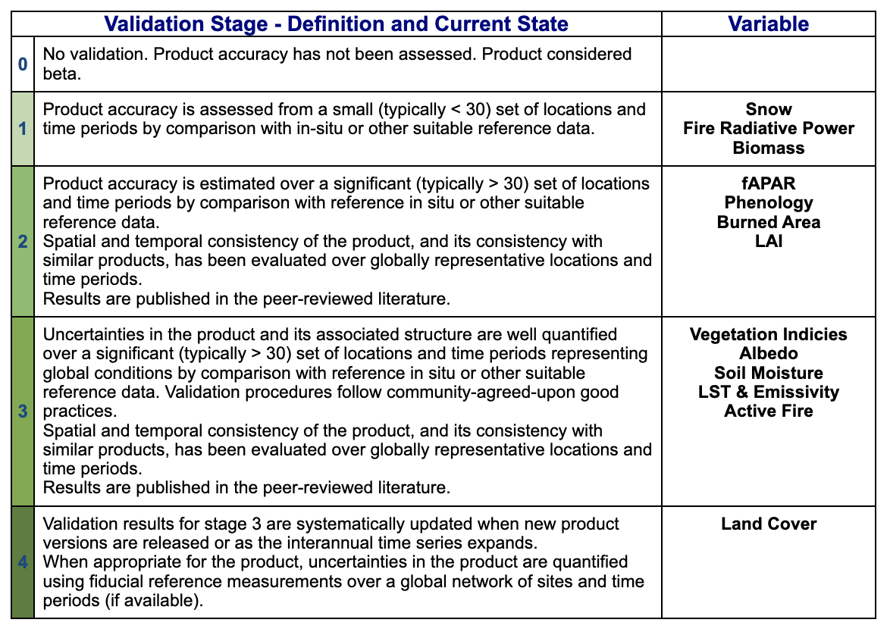
LPV Validation Stage Status
Slide ‹#›

Slide 5
Focus Area Protocols Update
Focus Area | Protocol
Biophysical | LAI(2014)
Fire/Burn Area | Burned Area Targeting summer 2023 Active Fire next
Phenology | Targeting summer 2023
Vegetation Index | Targeting summer 2023 (60%)
Land Cover | Targeting summer 2023 (60%)
Snow Cover
Surface Radiation | Albedo(2019) Global Downward Radiation Product Validation Best Practices (80%)
Soil Moisture | SM(2020)
LST and Emissivity | LST (2019)
Aboveground Biomass | AGWB(2021)
Slide ‹#›

Slide 6
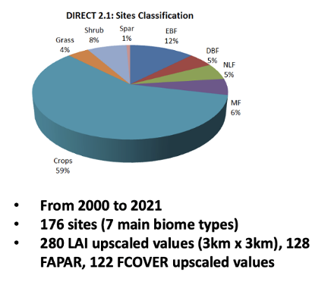
Biophysical
New campaigns and software development
FRM4VEG (LAI, FAPAR, CCC) in cropland (Barrax, Sp) and forest (Wytham Woods, UK), July 2021
P2S2 for the validation of S2 LAI/fAPAR (France & Belgium)
Vertical LAI measurement over DNF & MF (China), Apr, Jun, & Sep, 2021
ESA FRM4Veg: Validation of S3 OLCI IG-FAPAR 300m with FRM data
Validation and conformity testing was conducted using the FRM4veg dataset (2018, 2021), over Wytham (UK) and Barrax (Sp), with upscaled maps with uncertainties.
Updated CEOS DIRECT 2.1 database (new sites from Asia & FRM4VEG)
Biophysical reference datasets in NE China croplands available (https://doi.pangaea.de/10.1594/PANGAEA.939444)
China is considering several newly recommended National Standards for the Validation of Remote Sensing Products.

Slide 7
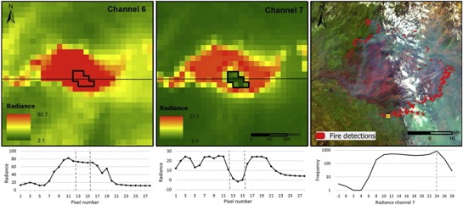
Fire/Burn Area
Fire Disturbance
Validation Protocol Status
Discussed at the GOFC Fire Implementation Team meeting (June 2022)
Solicited assistance with updating and writing the Burned Area and Active Fire protocols with participants from Canada (2), Europe (1), UK (2), and USA (7)
Planning a formalization of the incomplete Burned Area Validation protocol from 2010.
Active Fire
Validation accomplished by contemporaneous product inter-comparison (moderate and coarse resolution) or prescribed fire programs (few locations, small fires)
FRP Validation challenges
Limited availability of reference data
Field campaigns - Logistically challenging/limited sample size
Burned Area Validation
Product intercomparison – need to address issues around different approaches to reference data
Recommended – Burned Area Reference Database (BARD) for both validation and product development

Slide 8
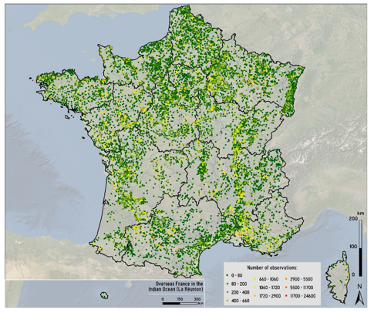
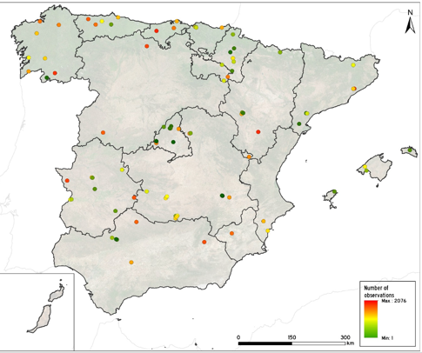
Phenology
Progress on CEOS LPV LSP Protocol
Most chapters now have leads, uneven but tangible progress across the chapters
“Phenometrics” usually lack an ecological definition, making it more challenging to conduct true validation
CEOS LPV protocol will document current best practices and definition and characterize self-consistency and errors resulting from choices in methodology
In situ Progress
“New” observational network in Spain managed by the Spanish Meteorological Agency (AEMET)
“New” observational network in France managed by INRAE

Slide 9
Vegetation Index
Vegetation Indices
Developed an outline for a Vegetation Indices Best Practice Protocol document. Recruited a small group of VI experts to review and finalize the outline.
Held a kick-off meeting with the expert group to review the procedure, expectation, and timeline. Followed up with another meeting to review the comments and suggestions. Revised the outline and incorporated comments.
Currently the leads are working on the first complete draft of the outline.

Slide 10
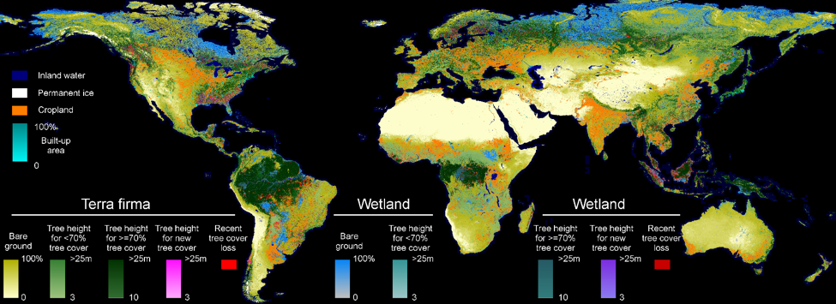
Land Cover
Updating the Land Cover Validation Good Practices protocol. This effort aims to update the 2006 Strahler, et al document and to also include Land Cover Change validation as well. First draft by summer 2023 followed by a technical workshop late 2023.
UMD GLAD Global Land Cover and Land Use, 2019 @30m
(https://glad.umd.edu/dataset/global-land-cover-land-use-v1)
Joint workshop between CEOS LPV and GEOGLAM on the validation of agricultural land cover products/essential agricultural variables planned for September 2023 at National Agricultural Library, Beltsville, MD.

Slide 11
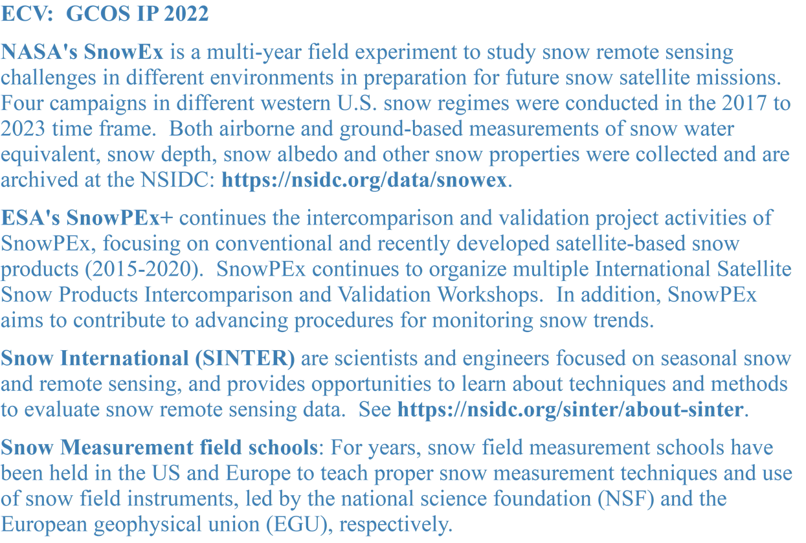
Snow Cover

Slide 12
Surface Radiation
The LPV Land Surface Albedo Best Practice Protocol (2019) is in place.
Working with the Baseline Surface Radiation Network (BSRN) albedo working group
Coordinating with scientists from China to share the in situ albedo measurements for albedo product evaluations.
Coordinate BSRN in situ measurements for satellite albedo and downward radiation products validation.
Surface Albedo Validation tool (SALVAL) published within the CEOS WGCV CAL/VAL portal (https://calvalportal.ceos.org/web/guest/salval)
Focus area is currently preparing a global downward radiation best practices protocol document.

Slide 13
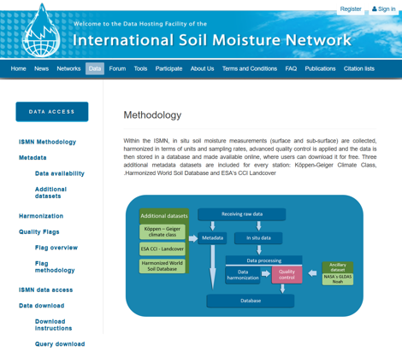
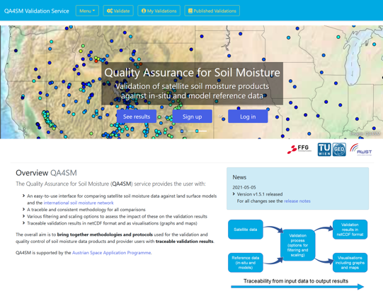
Soil Moisture
The LPV Soil Moisture Best Practice Protocol (2020) is in place.
ISMN has had challenges over the years, but now has a long-term maintenance commitment.
International Soil Moisture School – July 2022 UMass Amherst, NEON-Harvard Forest
Soil Moisture Field School, August 2023, USDA, Beltsville MD, USA

Slide 14
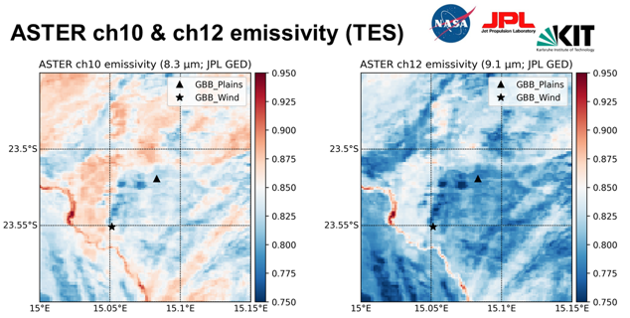
LST & Emissivity
The LPV Land Surface Albedo Best Practice Protocol (2019) is in place.
In situ LST from broadband hemispherical and narrowband directional radiances
Performed instrument intercomparisons. Concluded that use of broadband hemispherical TIR sensors for LST validation, even over flat, homogenous surfaces (e.g. Namibian gravel plains) should be avoided.
ECOSTRESS calibration update for collection 2 showing excellent results. Cold bias reduced from ~1K in collection 1 to near zero in collection 2.
Landsat 8 collection 2 LST validation – found that the L8 surface temperature product has a consistent accuracy and precision of ~1 K across various land cover types and water.
Participating in the Copernicus LST, Aerosol, and Water Vapor (LAW) project – product validation for Sentinel-3 LST products over KIT-Forest Site

Slide 15
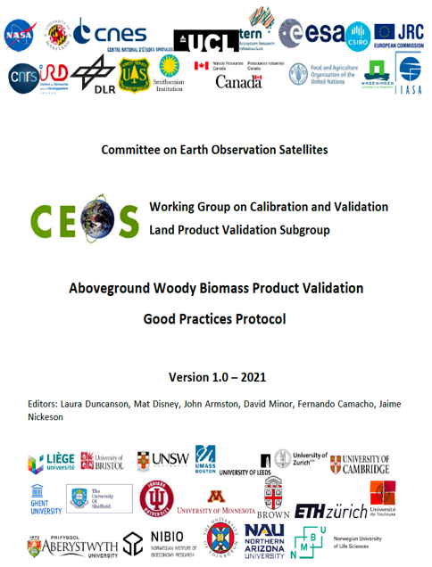
Above Ground Biomass
Providing guidance for:
Map producers, on how to estimate, propagate and report errors
Map users, on how to interpret errors
All, on how to collect reference data (field and airborne lidar), and use it to conduct independent product validation
How to quantify biomass change (in progress)
Summary of:
State of knowledge of biomass mapping
Community identified research and tool development priorities
Recommendations for protocol implementation
Biomass Product Harmonization Activity for the UNFCCC GST and
Second Biomass retrieval and intercomparison exercise (BRIX2)
Both activities are utilizing the Multi-Mission Algorithm and Analysis Platform (MAAP),
developed by ESA and NASA, as open science activities.
Following recommendations from CEOS LPV protocol
Results in open source jupyter notebooks for validation
Inform future development of missions / products

Slide 16
Past Actions
Review past actions/deliverables still open
Forest Biomass Reference Network (GEO-TREES) (CARB-21-03)
Production of harmonised biomass products from CEOS Agency missions (​​CARB-22-01)
Cal/Val and production of biomass products from CEOS Agency missions (CARB-17-05)
Forest Biomass measurements for GFOI countries (CARB-19-04)
Slide ‹#›

Slide 17
CARB-19-04
Forest Biomass measurements for GFOI countries (CARB-19-04)
Moved to LSI-VC Forests & Biomass Subgroup

Slide 18
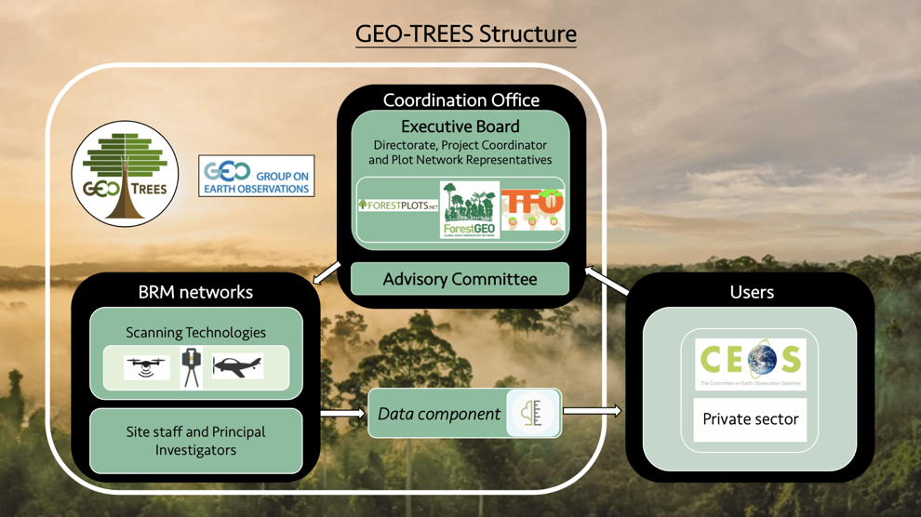
CARB-21-03
Forest Biomass Reference Network (GEO-TREES) (CARB-21-03)
In Progress…The project office is up and running via funding from the French government.
https://geo-trees.org and is actively soliciting funding, with various opportunities in the pipeline.
Nothing concrete as yet in terms of actual funding for data collection, but likely in the near future.

Slide 19
CARB-22-01
Production of harmonised biomass products from CEOS Agency missions (​​CARB-22-01)
Last update: For 2023 this activity will focus on intercomparison and validation of global biomass products from CEOS Agency missions.

Slide 20

CARB-17-05
Cal/Val and production of biomass products from CEOS Agency missions (CARB-17-05)
Plot scale data is being coordinated through GEO-Trees. More data needs to be collected.

Slide 21
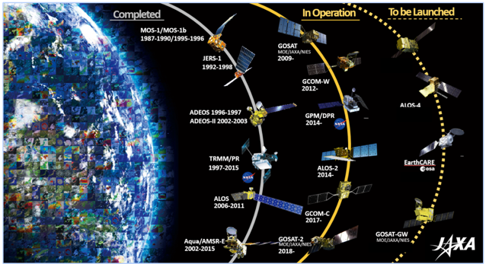
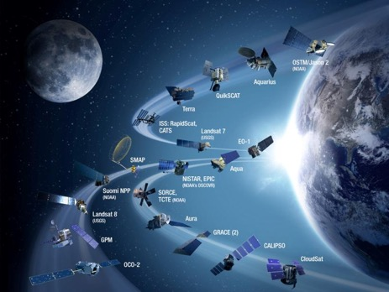
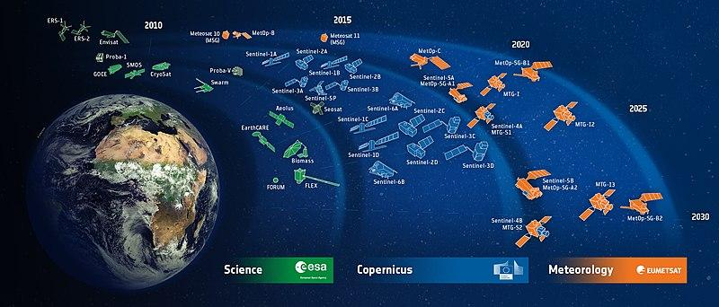
LPV Contributing Satellites Review
There is a need for a review on satellites which contribute to LPV development, not just in primary, but in ancillary datasets, both public and commercial
Challenges:
Moving Target: Aqua, Terra
Decommissioning cycles, GEDI, ECOSTRESS
Commercial transparency
Interdependencies of products on multiple satellites
Constellations

Slide 22
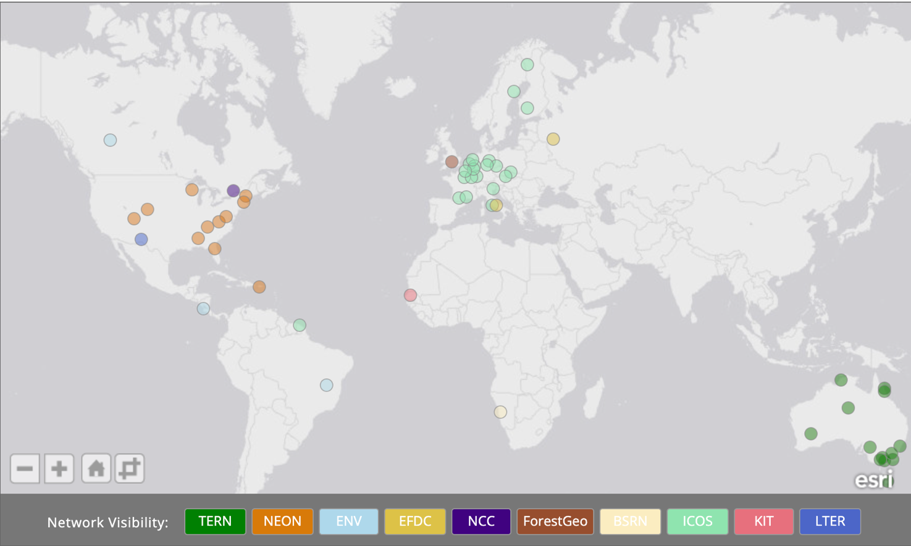
Interaction with IVOS on Supersites
Diversity of Sites
Landscapes of Interest
Multiparameter
Economics
Many Cooks

Slide 23
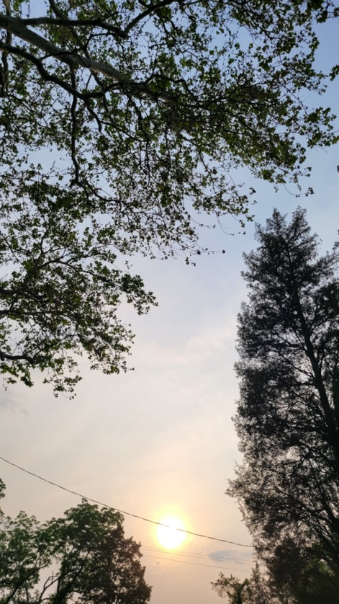
Discussion with IVOS on TOA cal LST
Top of Atmosphere
Small number of well understood sites
High Accuracy
Wide Diversity of Sites for greater confidence
Troublesome atmosphere globally
Land surface is heterogeneous
Interpretation
Land Surface Temperature

Slide 24





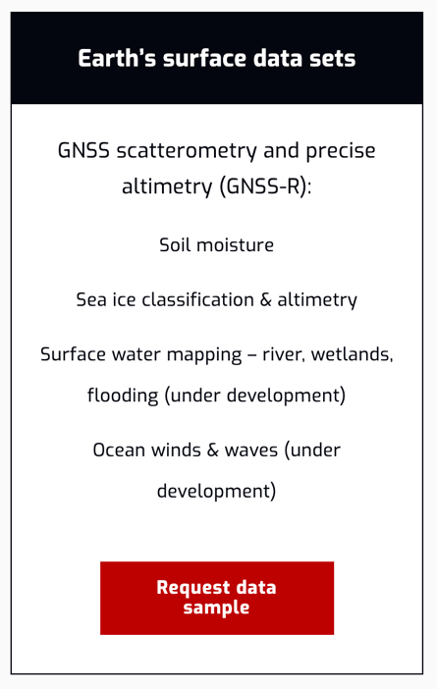
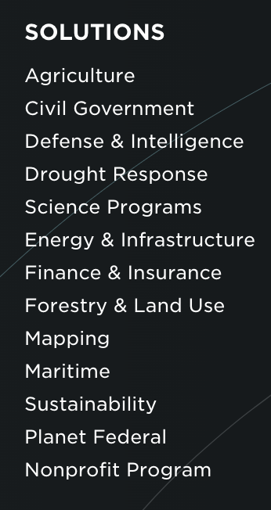
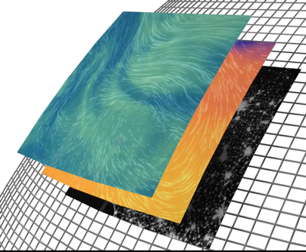
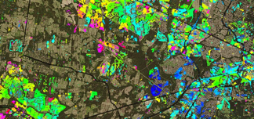
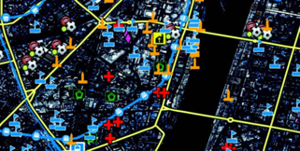
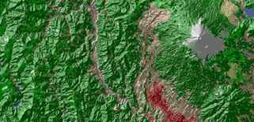
Commercial Satellite & Products

Slide 25
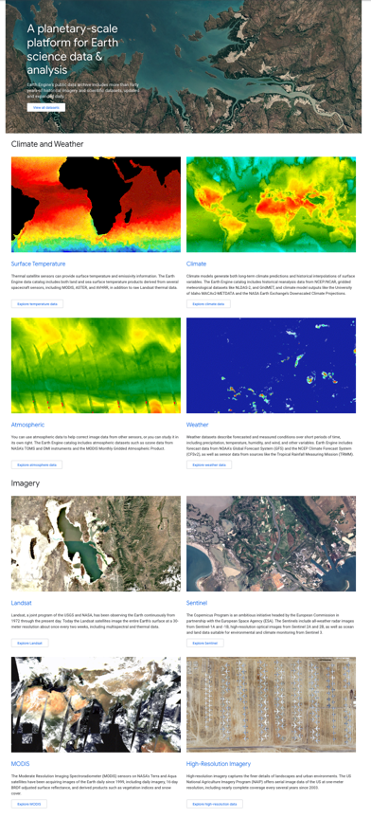
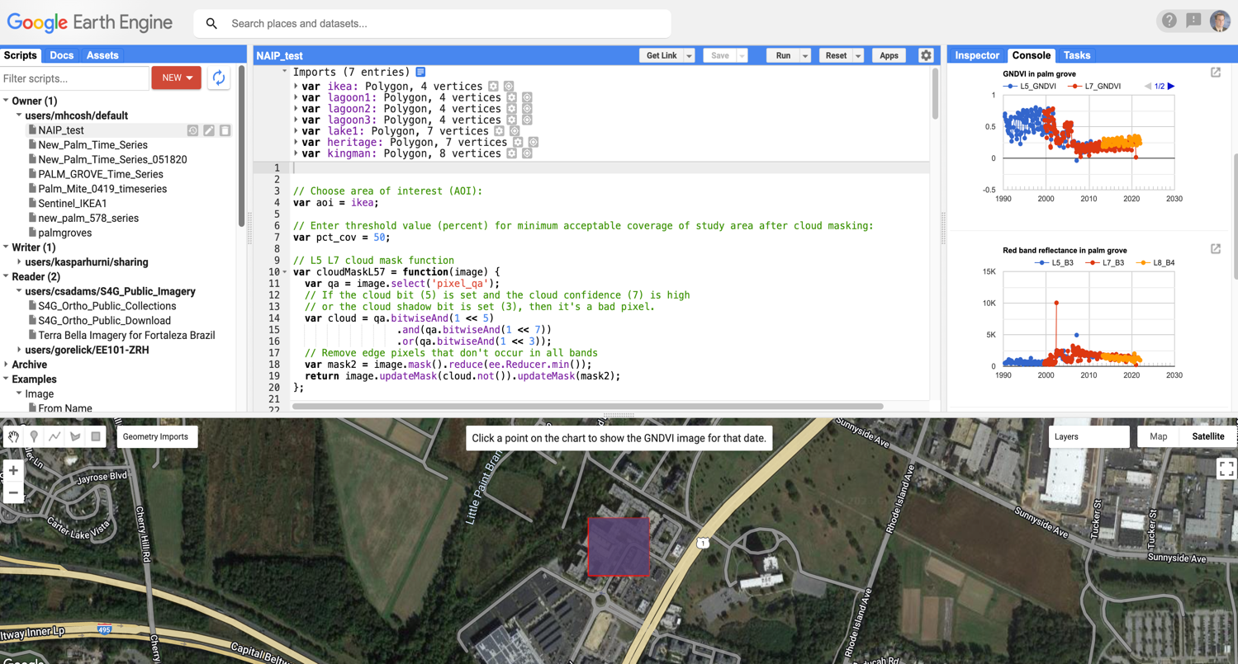
Google Earth Engine

Slide 26
Discussions
WGCV to consider potential for GPP/NPP land product Focus Area within LPV
WGCV to consider potential for Evapotranspiration land product Focus Area within LPV
Elevating Soil Moisture to Stage 4 with the release of FRM4SM
Slide ‹#›

Slide 27
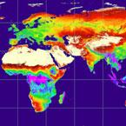
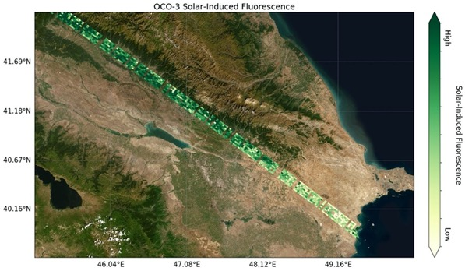
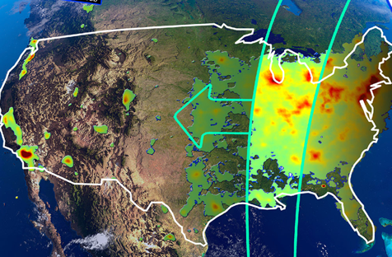
Potential for GPP/NP Focus Area
WGCV to consider potential for GPP/NPP land product Focus Area within LPV
Does GPP/NPP land product have a home in LPV currently.
MODIS GPP/NPP uses FPAR, Land Cover, modelled products (LST), etc.
Are new missions coming online which will produce products not with LPV, specifically SIF
MODIS GPP/NPP
OCO2 and OCO3
TEMPO
GPP/NPP - Gross Primary Production/Net Primary Production
Slide ‹#›

Slide 28
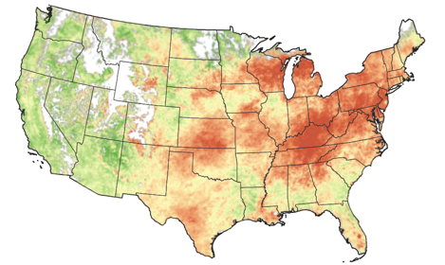
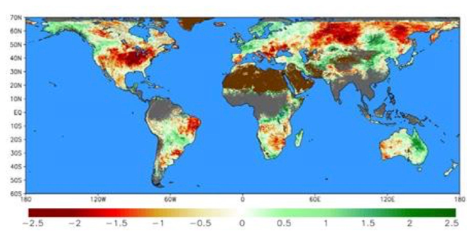
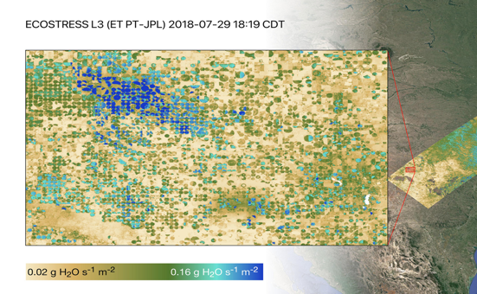
Potential for ET Focus Area
WGCV to consider potential for Evapotranspiration land product Focus Area within LPV
Evaporative Stress Index
SERVIR Global ESI
ECOSTRESS

Slide 29

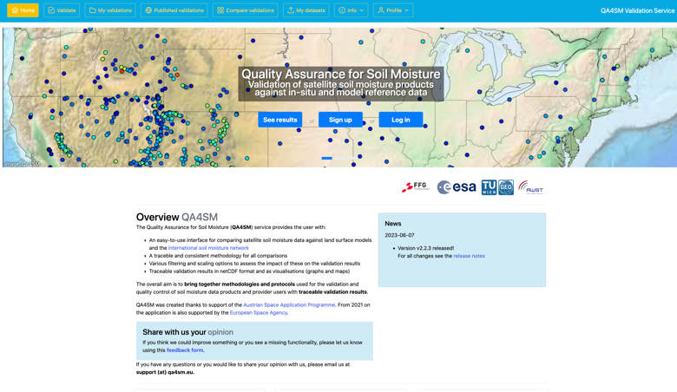




Elevating Soil Moisture to Stage 4
Elevating Soil Moisture to Stage 4 with the release of FRM4SM
International Soil Moisture Network
Quality Assurance for Soil Moisture
Fiducial Reference Measurements for Soil Moisture

