Slide 1
WGCV-52
Agency Report
Aerospace Information Research Institute (AIR),
Chinese Academy of Sciences (CAS)
Lingling Ma, AIR
Agenda Item 3.9#
WGCV-52, ESA/ESRIN, Italy
5th - 9th June 2023

Slide 2
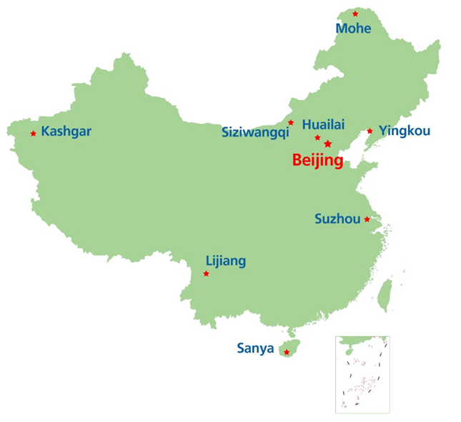
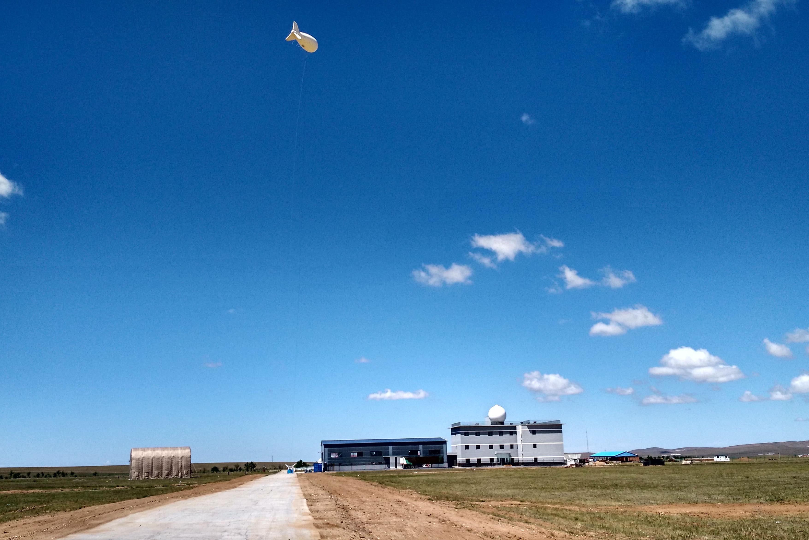
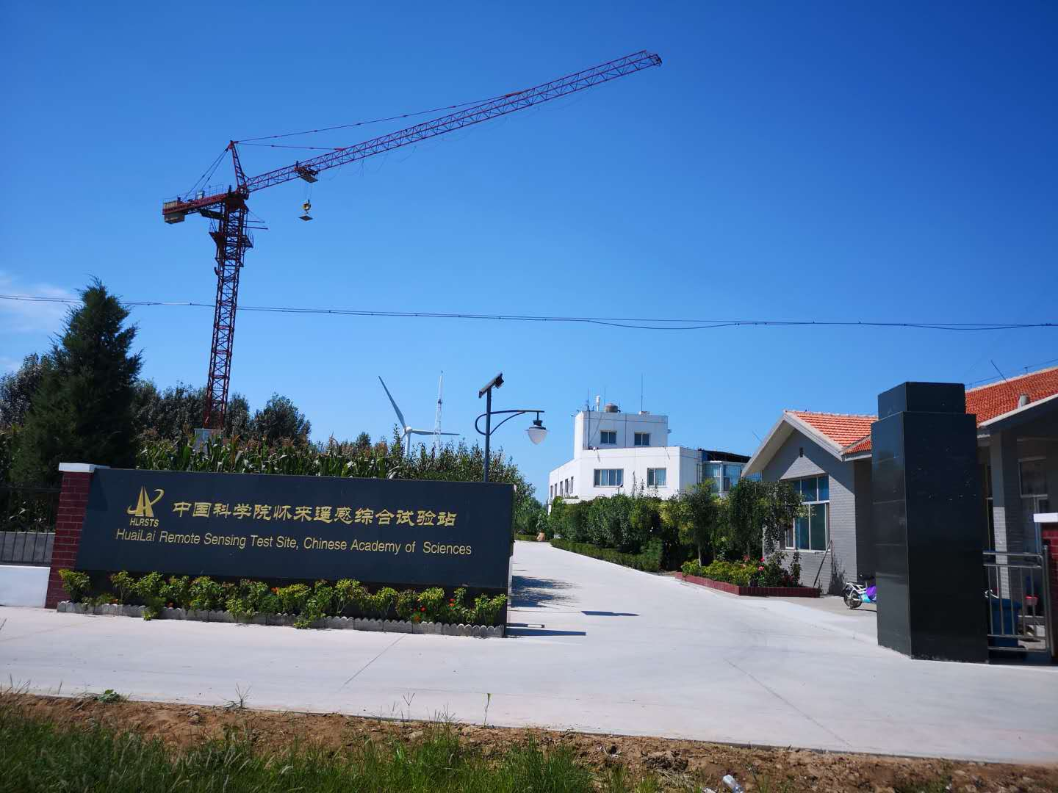
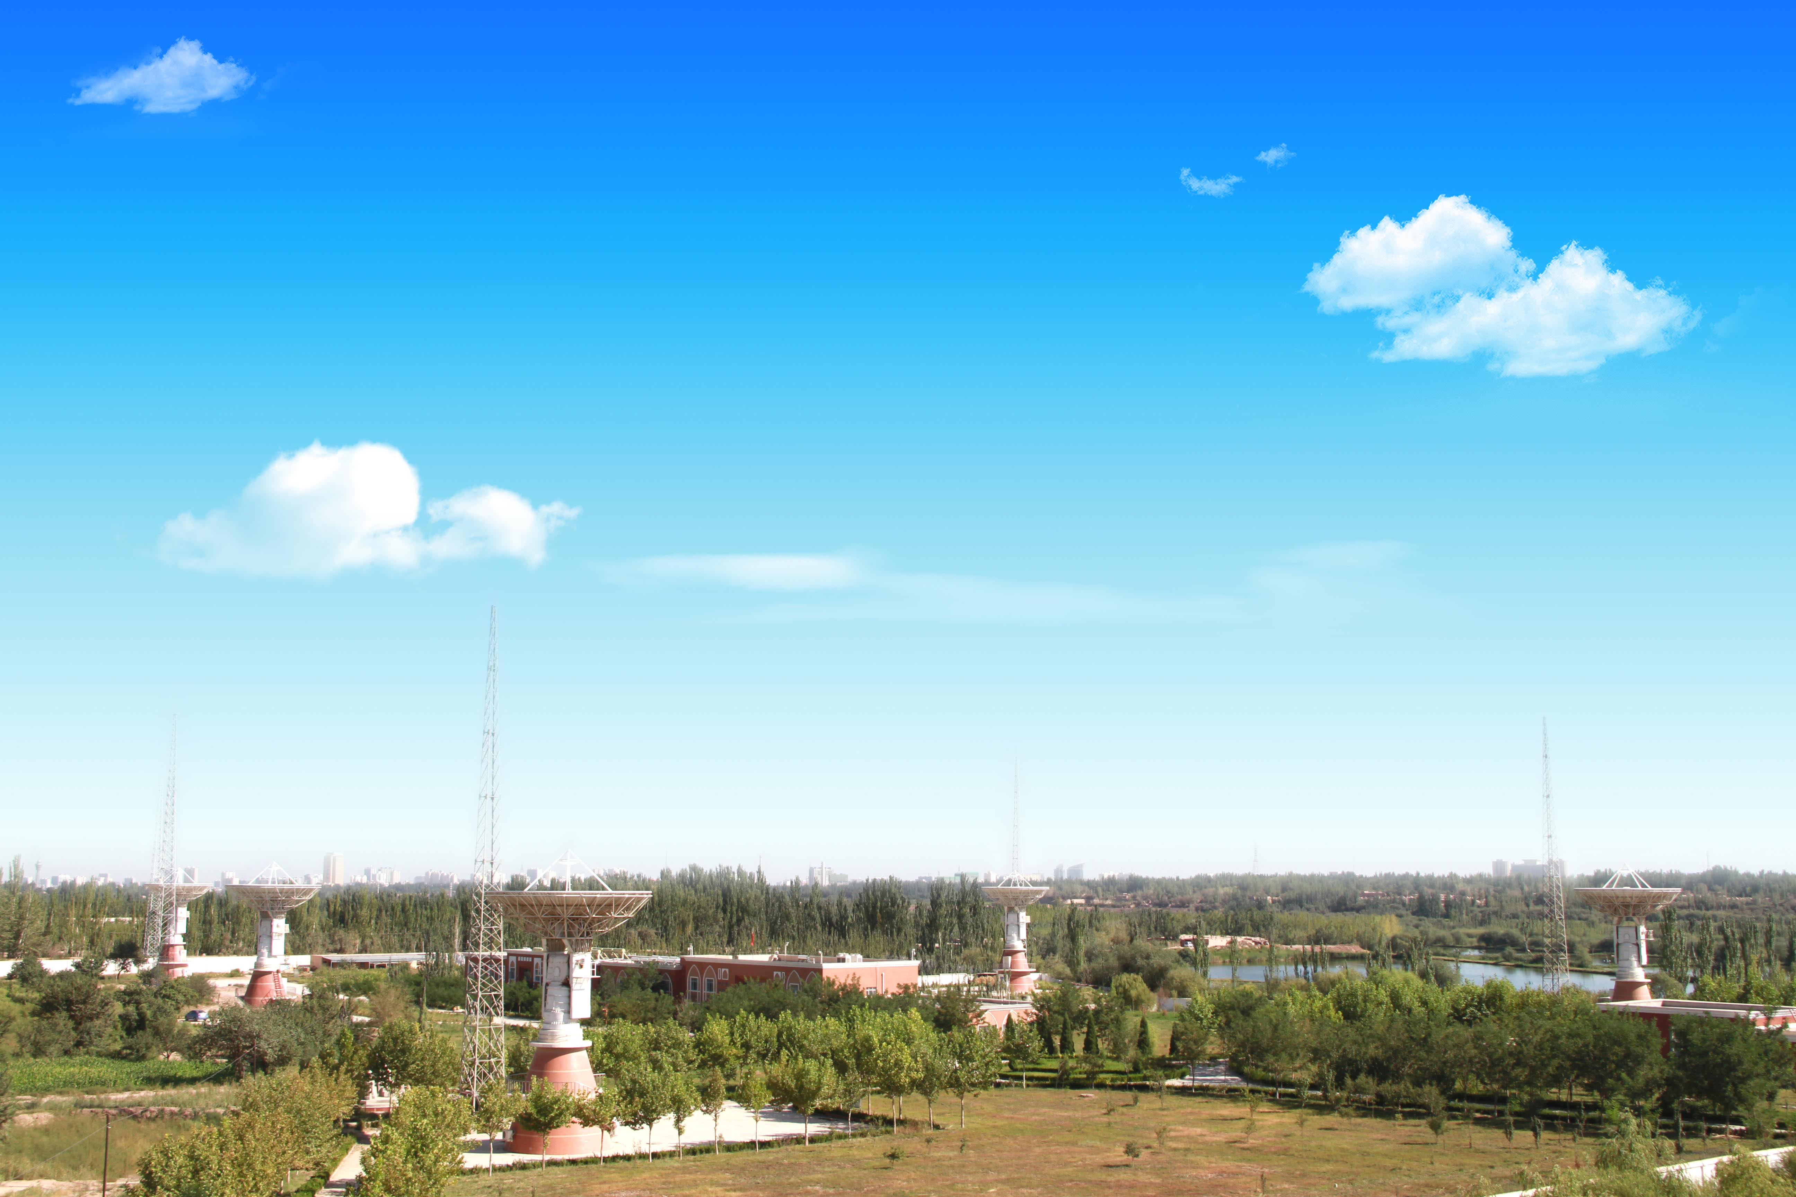
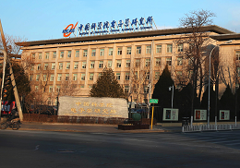
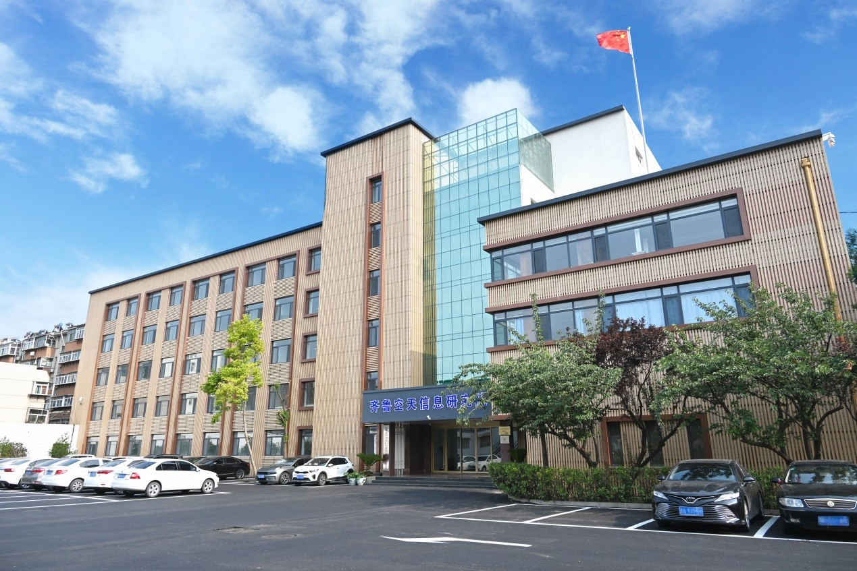
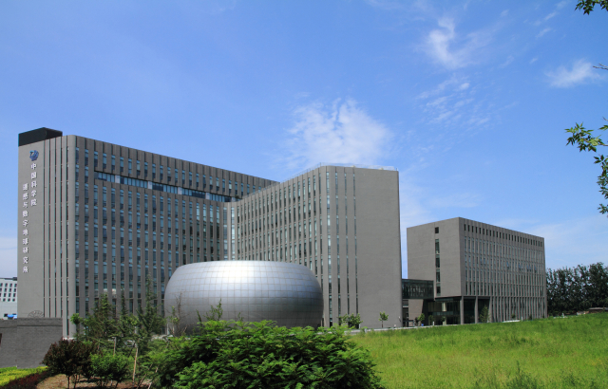
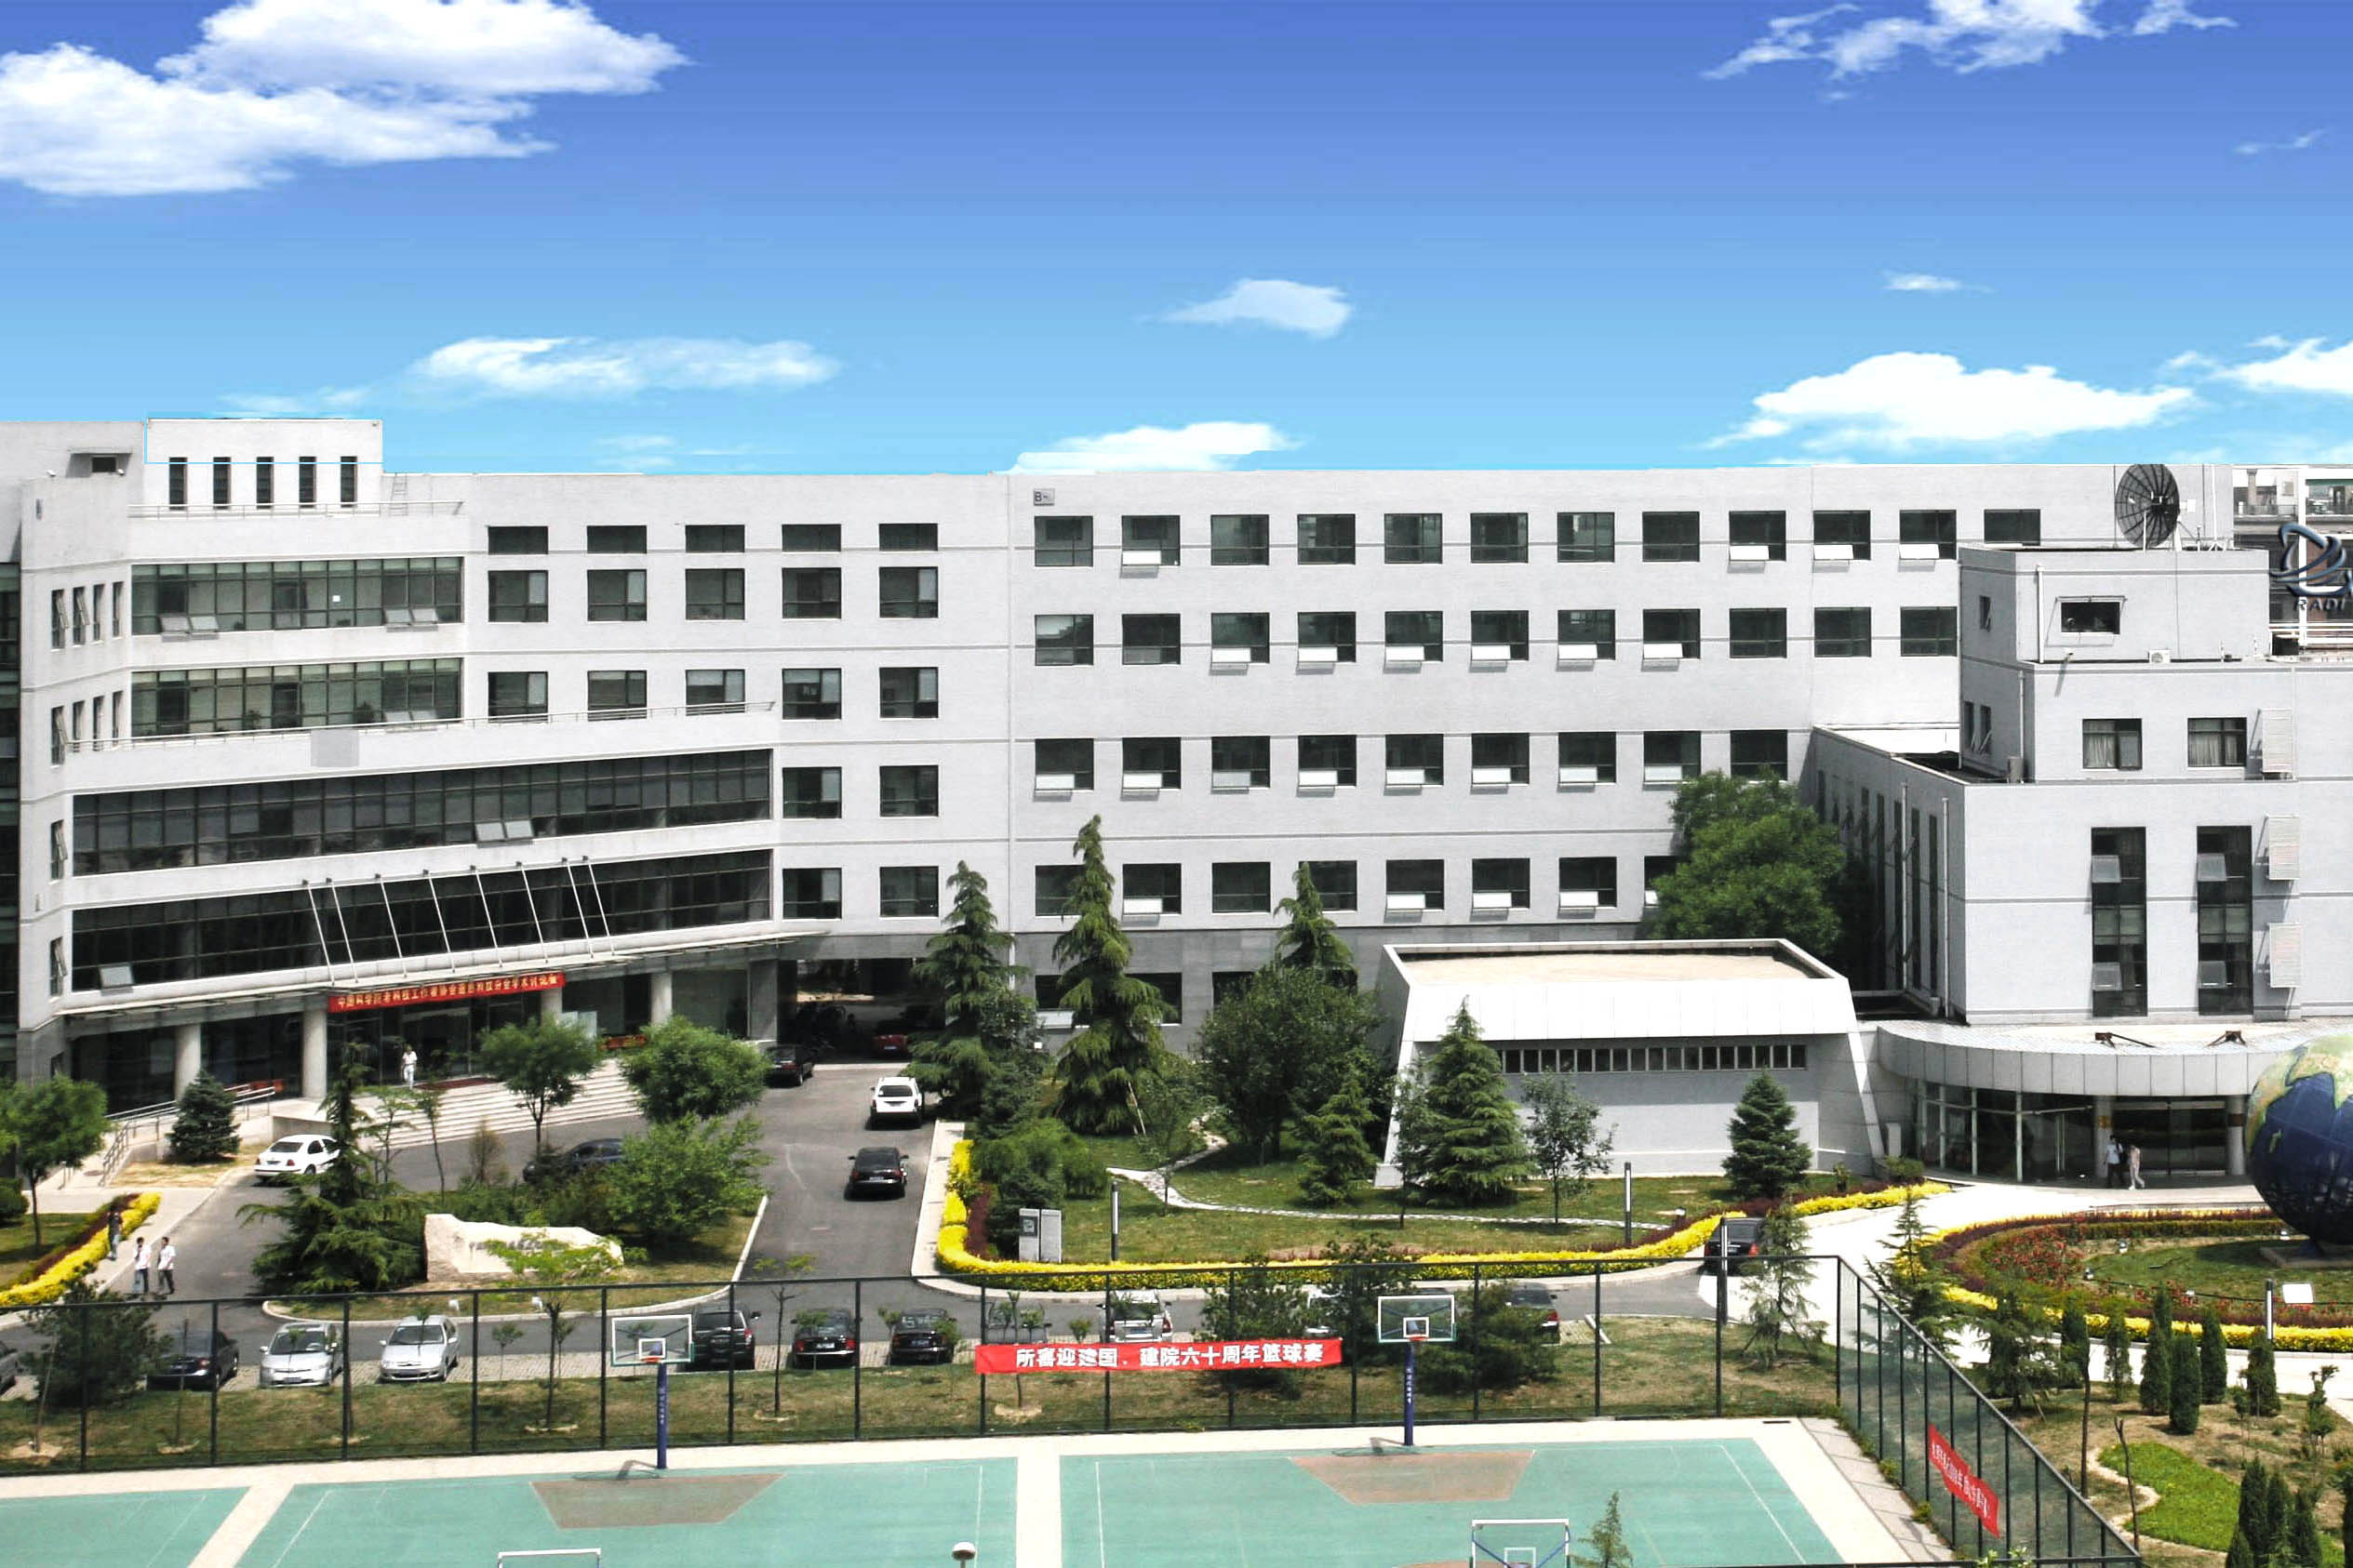
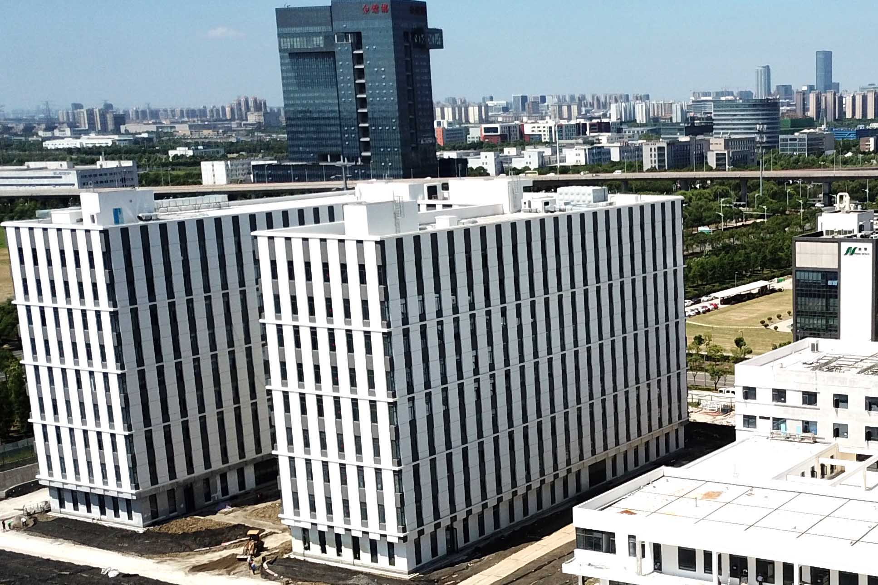
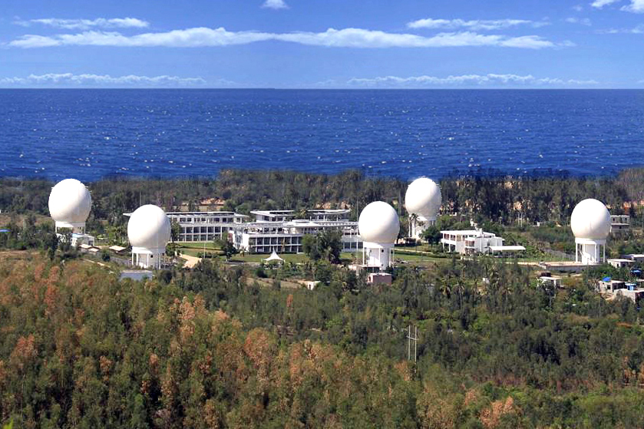
1. Brief introduction of AIR
The Aerospace Information Research Institute (AIR), Chinese Academy of Sciences (CAS), was established by incorporating three former CAS institutes:
The Academy of Opto-Electronics (AOE), Chinese Academy of Sciences;
Institute of Remote Sensing and Digital Earth (RADI), Chinese Academy of Sciences;
Institute of Electronics, Chinese Academy of Sciences (IECAS).
Over 3,984 employees by March 2023
        Five CAS academicians
        Over 300 full professors and professorate senior engineers
        Over 600 associate researchers and senior engineers
        AIR houses 21 national-level / CAS-level key laboratories, centers, and unincorporated units.
        AIR owns complete chains of RS payload developing, data receiving, processing and application.
12 campuses across China

Slide 3
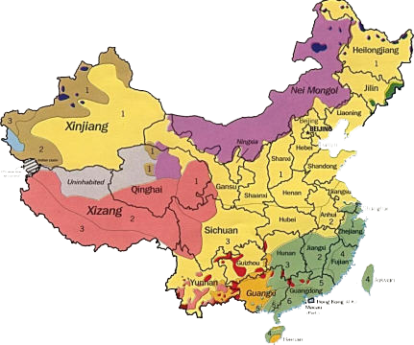
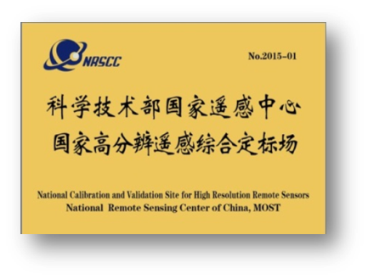
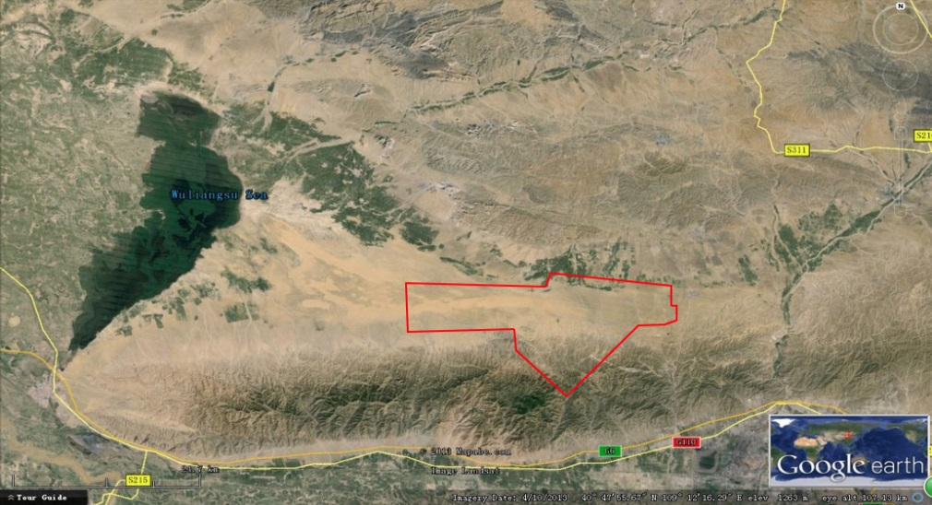
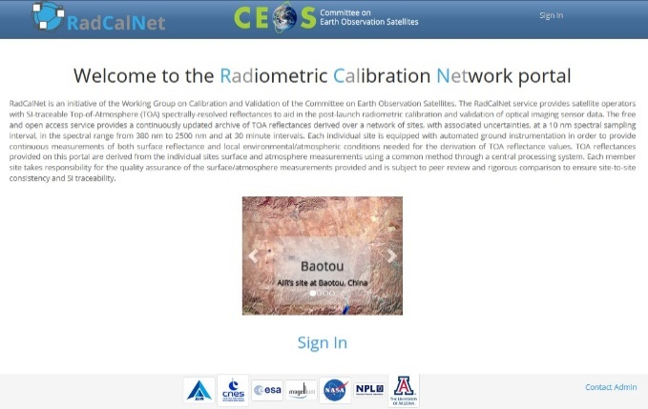
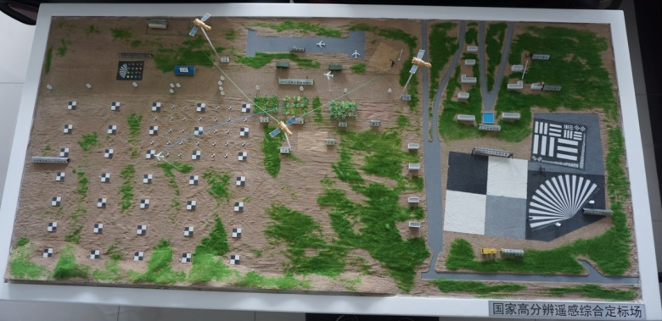
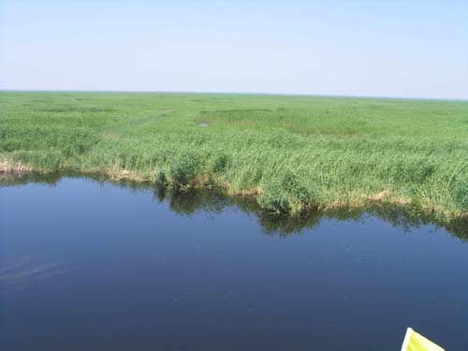
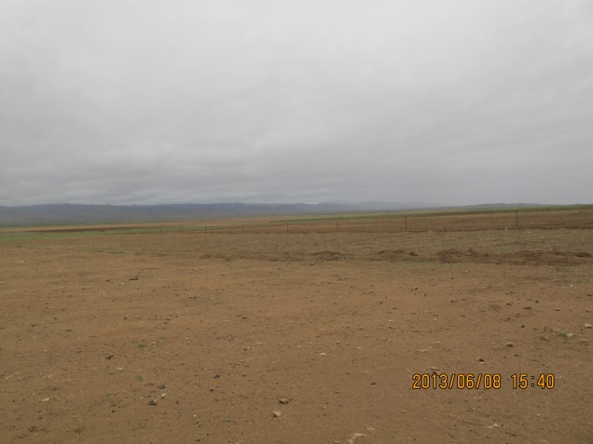
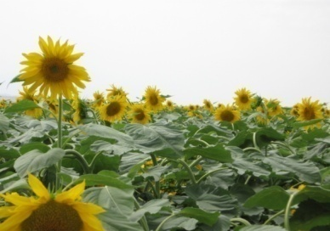
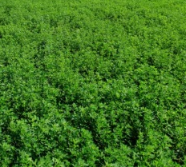
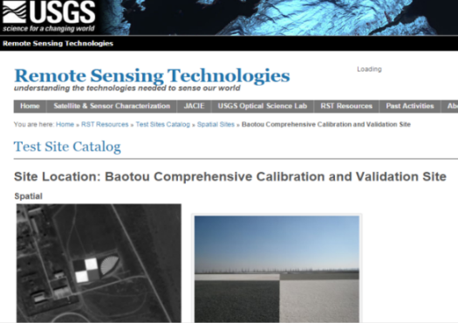
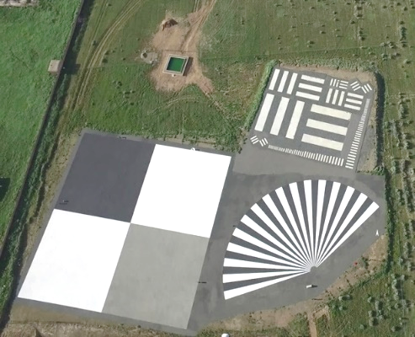


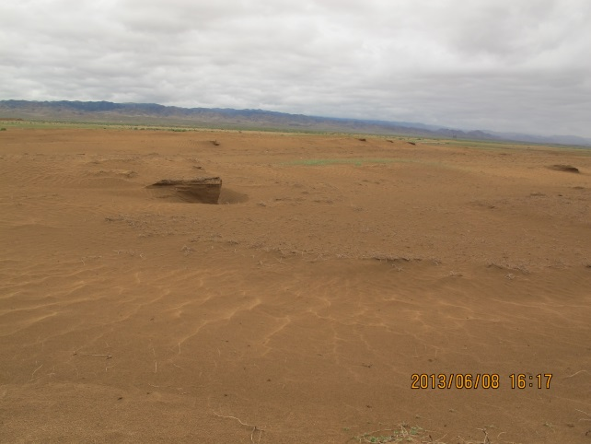
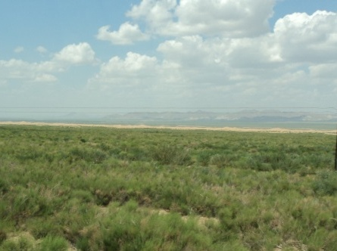
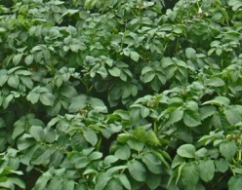
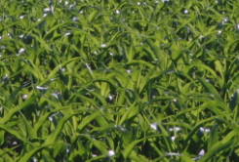
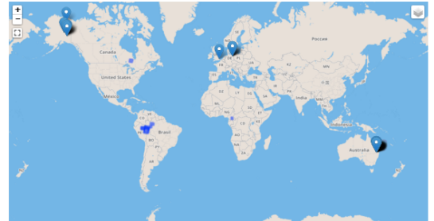
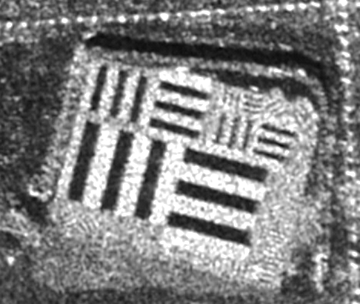
2.Status of Baotou Cal&Val Site and recent activities
Overall status
Located in Inner Mongolia, China. 50km away from the Baotou city.
Integrate multi-type typical natural scenes and permanent artificial for HR sensor calibration and evaluation.
It is designated as “National calibration and validation site for high resolution remote sensors” by NRSCC,MOST. It is also one of the demonstration sites of the RadCalNet, listed in the databases as permanent MTF target and SAR target.
乌梁素海
试验场区
Artificial GCPs
Ulansuhai lake
Bare soil
sunflower
lucern
Gravel targets
desert
Grassland
potato
maize
http://sarcv.ceos.org/targets/

Slide 4
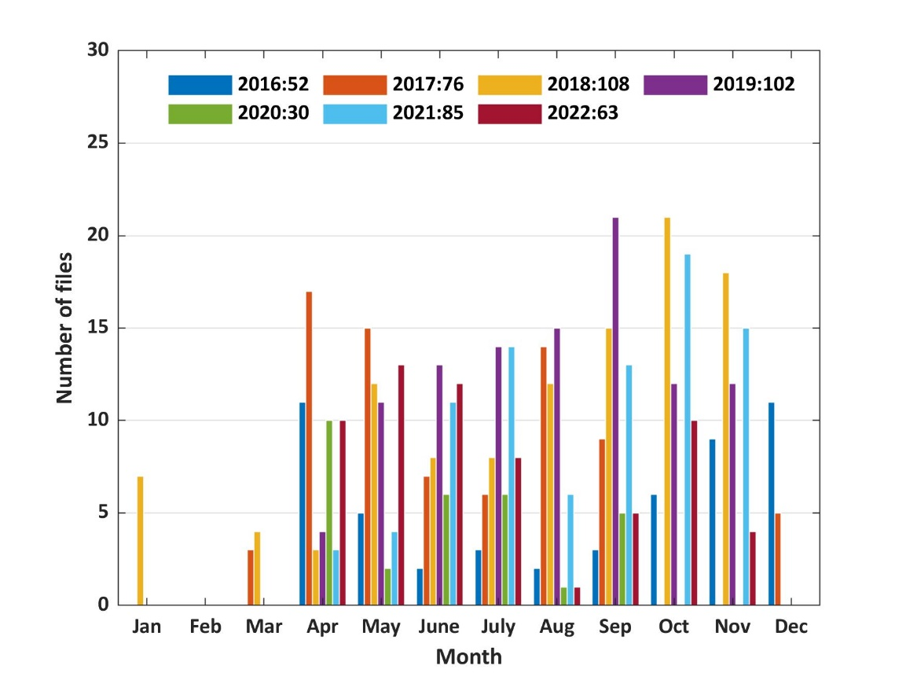
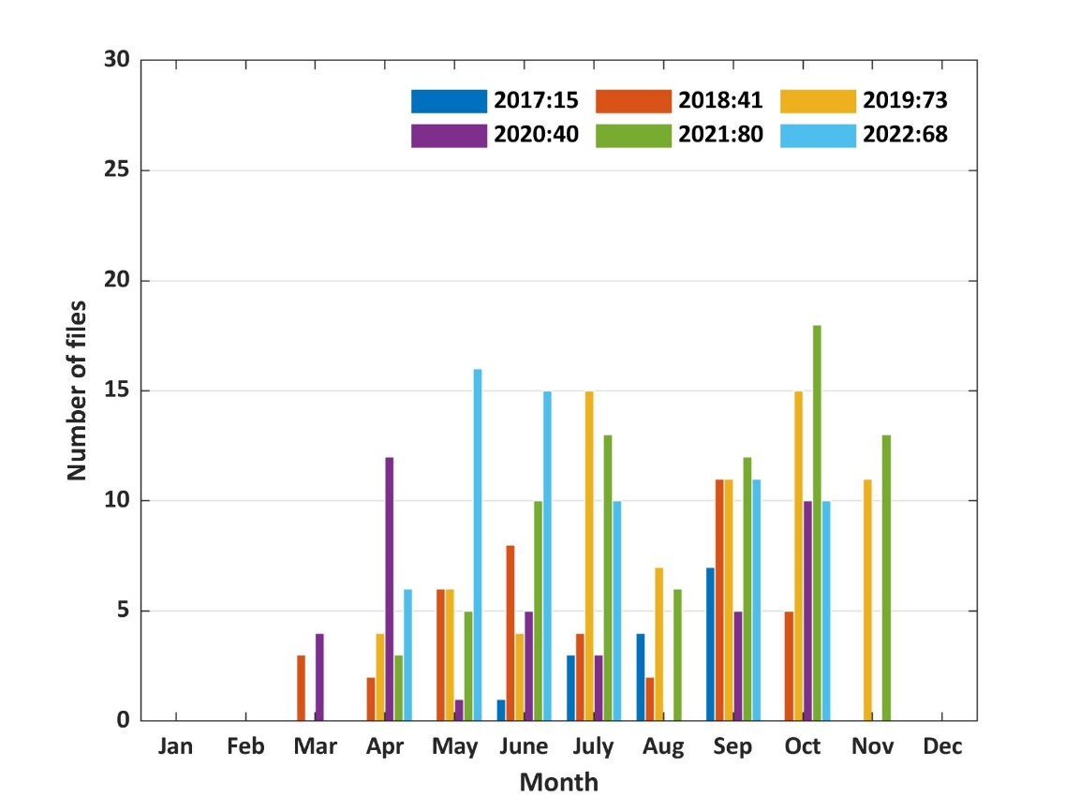
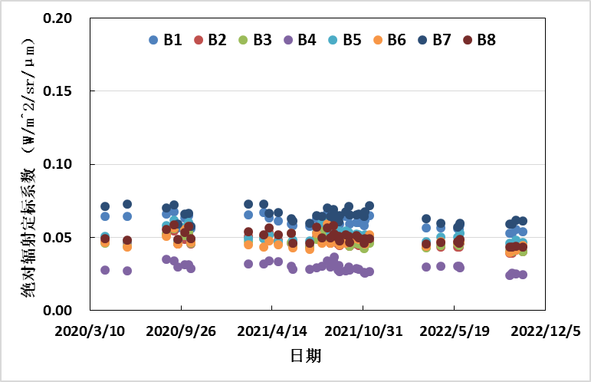
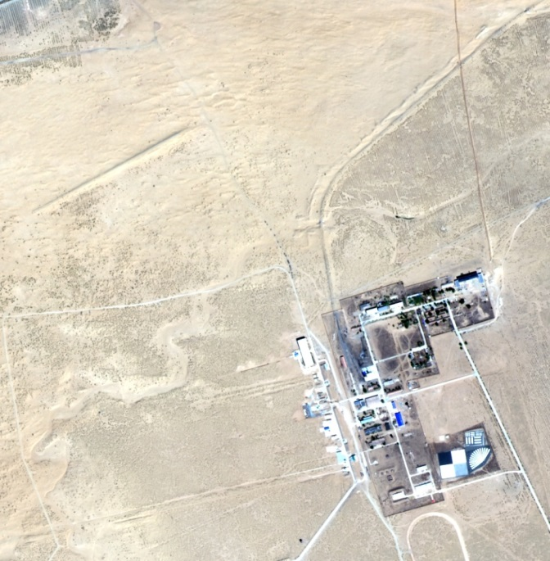
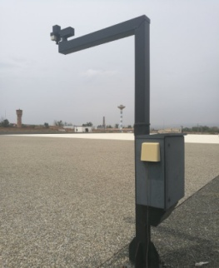
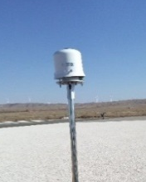
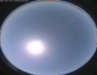
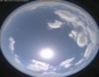
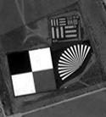
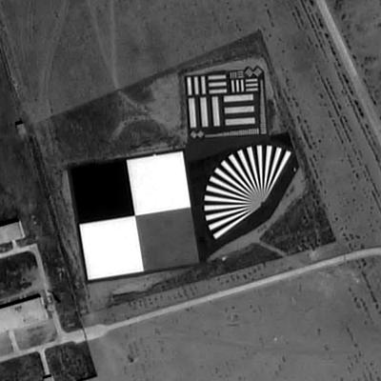
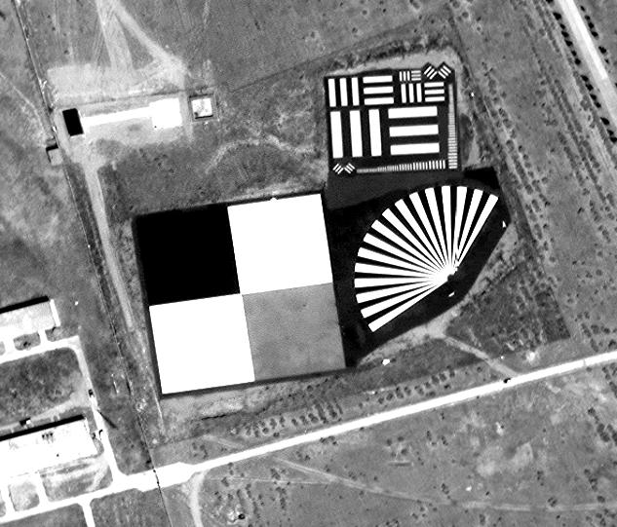
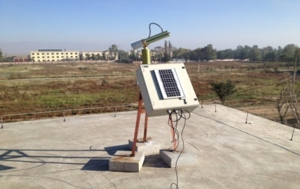
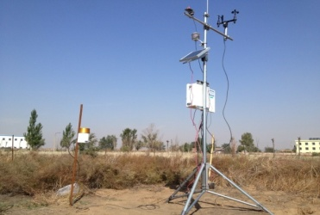
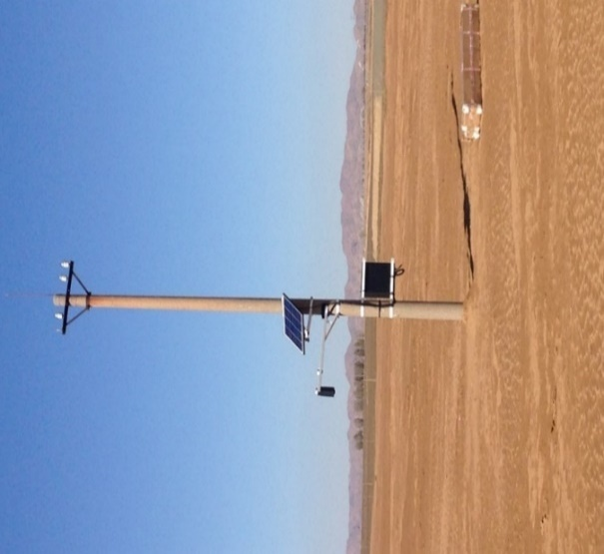
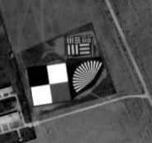
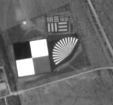

2.Status of Baotou Cal&Val Site and recent activities
Automatic calibration for optical satellites
RadCalNet BTCN
In the past years, Baotou site has provided automated radiometric calibration and performance assessment supports for a lot of Chinese HR optical satellites.
RadCalNet BSCN
GF-6
Desert
GF-1 Pan 2018/4/23
GF-2 Pan 2018/5/27
SV-1 Pan 2018/5/2
Complete instrument systems for surface spectral feature and atmospheric parameter automatic measurement
Permanent targets
SV-01 MUX
(2018/5/2 12:03:54)
SV-1 Pan 2018/5/2
ZY-3 Pan 2018/5/27
ZY-02C Pan 2017/4/13

Slide 5
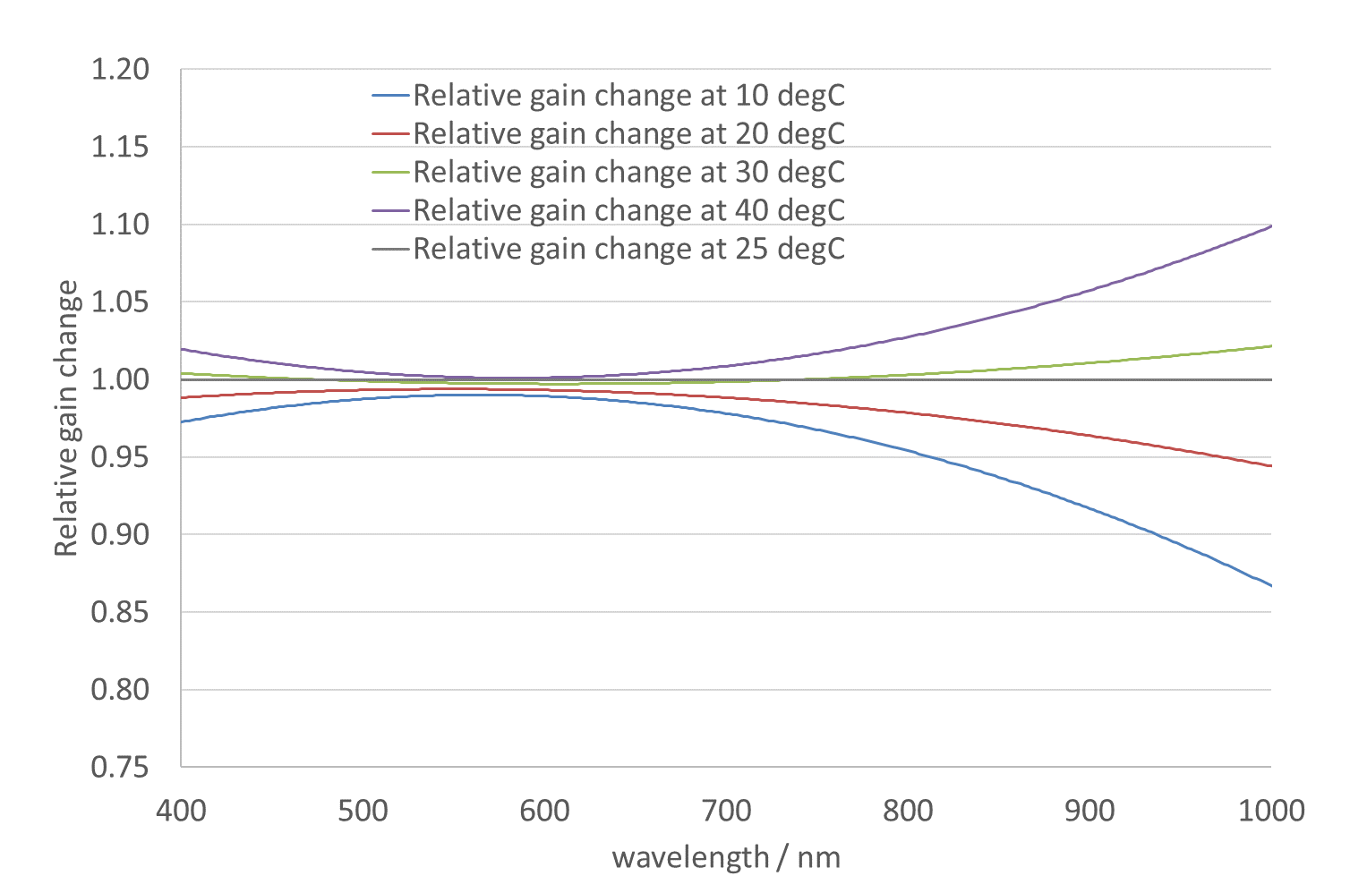
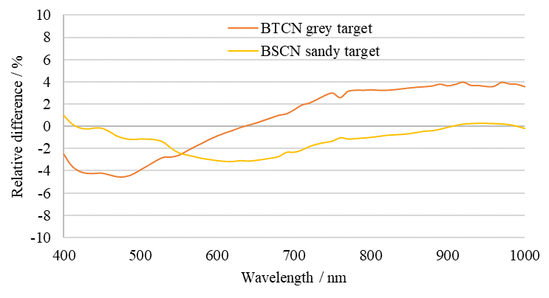
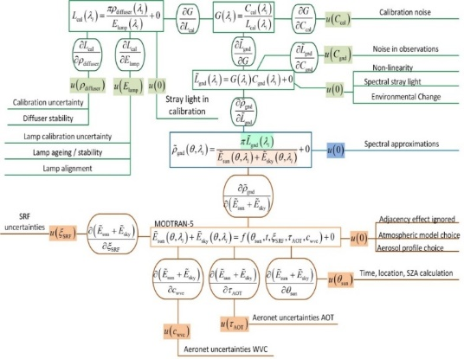
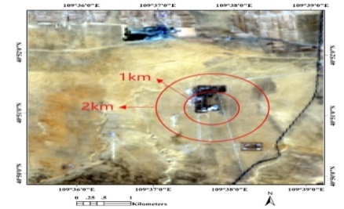
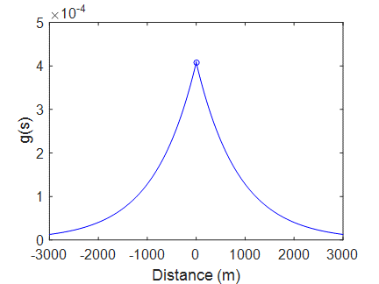
2.Status of Baotou Cal&Val Site and recent activities
Automatic calibration for optical satellites
Great efforts have been made to decrease the uncertainty of the simulation of TOA reflectance.
Empirically fitted model of temperature corrections for automatic surface spectrum measurement
Uncertainty of TOA reflectance
Atmospheric diffusion model for Baotou artificial target
Uncertainty tree diagram to describe the BOA reflectance
(Remote Sensing, 2020)
(IEEE TGRS，2021)

Slide 6
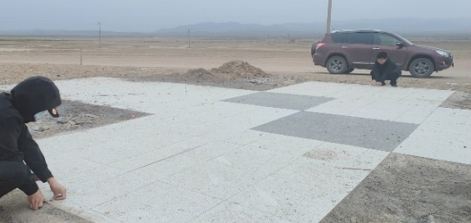
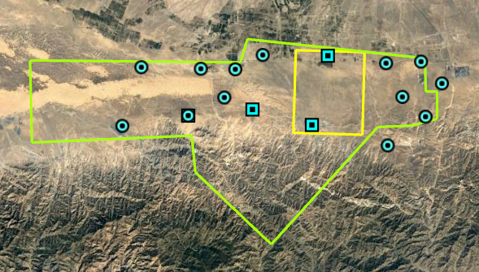












2.Status of Baotou Cal&Val Site and recent activities
Geometric Control Points for HR optical sensors
  75 small-scale permanent GCPs for geometric calibration of airborne sensors: within the range of 5km×6km, including 43 permanent targets (2m*2m) and 32 simple bases.
  16 large-scale permanent GCPs for geometric accuracy validation of HR satellite sensors: 4 targets were 13m×8m in size and 12 targets were 3m×3m in size.
permanent targets(13m×8m)
GCPs at the site
Google Earth image
(from Digital Global, 0.5m)
satellites image（SuperView-1，GSD 0.5m）
permanent targets(3m×3m)
simple bases
permanent targets(2m×2m)

Slide 7










2.Status of Baotou Cal&Val Site and recent activities
Cal&Val for SAR satellites
  A bar-pattern target based on roughness-difference was developed, offering a visual representation of image resolution.
Azimuth
The “image resolution” is better than 3m.
70m
60m
Nominal resolution:
Ground range instrument geometric resolution:1.21m
Azimuth instrument geometric resolution: 0.90m
KOMPSAT-5 SAR image on October 22, 2014(HH Polarization)
The resolution assessment results of the seven CRs are consist with each other except CR#7. The image of CR#7 is not a ideal point response image.
CR #1
CR #7
Corner reflector
SAR image
  For quickly deploying corner reflectors and avoiding repeated measurement of position information, 15 corner reflector bases were constructed and distributed across the site.

Slide 8






2.Status of Baotou Cal&Val Site and recent activities
Capability of atmospheric parameters observation
  Two sets of Automated Meteorological Observing System
  Sun Sky Multispectral Photometer (CE318): jointed in AERONET
  Microwave Radiometers (MP-3000A): the temperature and humidity profiles.
  Mini Micro Pulse LiDAR
Aerosol Extinction Coefficients from LiDAR
Temperature profile from MP-3000A

Slide 9



2.Status of Baotou Cal&Val Site and recent activities
Updating of Baotou site Infrastructure for flight campaign
2 km long airstrip and a test hangar in the field, which can easily support UAV flight tests.
Airstrip
Hangar
Satellite image over the Airstrip at Baotou site

Slide 10







2.Status of Baotou Cal&Val Site and recent activities
Flight campaign
The hyperspectral data was compared with Sentinel-2/MSI and in situ measurement. Airborne data shows much better agreement rather than that of in situ data.
An airborne flight campaign with 7.8km flight altitude.
Aircraft: Pilatus PC-12
Prototype of LIBRA’s EMIS (Earth-Moon Imaging Spectrometer, 0.38 – 2.35μm with spectral resolution of 10nm)
Sentinel-2/MSI (2021-10-23)

Slide 11
3. The validation site network for national civil space infrastructure
The National Civil Space Infrastructure project was proposed and began to construct in 2017.
It aims to provide common and basic services and support facilities for satellite remote sensing applications, and effectively serves different applications.
48 optical & microwave sites
The validation site network
Guarantee of basic information products and service quality
Authenticity inspection and optimization guarantee of information products
Guarantee of generic key technologies of satellite application
Provide resource sharing services for new technology research and development
Validation sites
6 electromagnetic test sites
Time-series high frequency multitype parameter automated measurement.
6 comprehensive fields
Comprehensive experimental field
Integrated field campaign instrument
provide a comprehensive site and capability for integrated field campaign
Instrument calibration lab.
Benchmark and comprehensive laboratories
Microwave simulation lab.
Optical simulation lab.
Towards the building of capacity of SI traceability

Slide 12

3. The validation site network for national civil space infrastructure
The validation network composed of 48 sites has been built nationwide, so as to validate six categories of products.
Achieved: DEM, DOM
Achieved: Land cover, Soil moisture, Snow cover, Soil salinity, Surface albedo, Interferometric deformation
Scheduled: Evapotranspiration, emissivity, snow cover …
Achieved: TOA radiance, Land Surface reflectance, Land Surface temperature, Brightness Temperature, Backscattering coef. …
Geometry products
Radiation products
Land products
Test site network
Vegetation products
Atmosphere products
12
Achieved: Vegetation index, Leaf area index, Vegetation phenology, vegetation height,…
Scheduled: SIF…
Water products
Achieved: AOD, Water vapor content,
Scheduled: Greenhouse gas, Pollution gas …
Achieved: Water surface reflectance, Water surface temperature, Water chlorophyll content, SSC…

Slide 13





4.1 Optical radiometric calibration based on PICS in Northwest China
TOA reflectance model suitable for several stable targets in Golmud area was constructed using Aqua/MODIS and ECMWF reanalysis data.
Constraint conditions for TOA reflectance model
SZA≤35°；AOD@550nm ≤0.4；WVC≤2.0g/cm²
Parameterized TOA reflectance model
$$ρ^{TOA}=\left(\frac{\cos{θ_{s}×}\left(a_{1}×\left(\cos{θ_{v}+a_{2}}\right)+a_{3}\right)+a_{4}×\left(\cos{θ_{v}+a_{5}}\right)}{a_{6}×\cos{Θ+a_{7}×\sin{Θ+a_{8}}}}+a_{9}\right)×\left(a_{10}×\sin\left(\frac{2π}{365}×DOY\right)+1\right)$$
DaZaoHuo East in Golmud
MODIS TOA reflectance time series
Scattering angle was introduced to characterize the multiple scattering contributions between the surface and atmosphere;
DOY was introduced to characterize seasonal changes
XiaoChaiDan Lake West in Golmud
Atmospheric parameters time series

Slide 14




4.1 Optical radiometric calibration based on PICS in Northwest China
The relative difference between the simulated TOA reflectance values and satellite observations is basically distributed within ± 5%.
The uncertainty / % associated with modelled TOA reflectance (Take GF6/WFV as an example)
Sentinel-2A/2B @ DaZaoHuo East
Landsat-8 @ DaZaoHuo East
 | B1 | B2 | B3 | B4
VZA | 0.07 | 0.07 | 0.04 | 0.01
VAA | 0.11 | 0.03 | 0.01 | 0.03
SZA | 0.11 | 0.01 | 0.01 | 0.03
SAA | 0.23 | 0.04 | 0.01 | 0.06
MODIS | 2.00 | 2.00 | 2.00 | 2.00
Model fitting | 2.26 | 2.22 | 2.05 | 1.93
Spectral Match factor | 2.01 | 2.29 | 2.15 | 2.01
Spectral expanding | 1.00 | 1.00 | 1.00 | 1.00
Total uncertainty | 3.77 | 3.90 | 3.72 | 3.57
Sentinel-2A/2B @ XiaoChaiDan Lake West
Landsat-8 @ XiaoChaiDan Lake West

Slide 15





4.1 Optical radiometric calibration based on PICS in Northwest China
A total of 91 cross calibrations (with an average of at least 2 per month) were performed on GF6/WFV data from 2019 to 2021 without relying on ground measurements.
Technical parameters of the WFV onboard GF-6
Orbit altitude | 505 km
Swath | PMS: 60 km; WFV:800km
GSD | PMS: 8 m
 | WFV: 8 16m
Maximum sidelooking angle | 35°
Spectral Response Function of GF-6/WFV
GF6/WFV time series calibration coefficient:（a）B1（b）B2（c）B3（d）B4

Slide 16



4.2 Infrared sensor radiometric calibration with reanalysis time-series data
In order to conduct recalibration of historical infrared data, the reanalysis time-series data (ERA 5) over the ocean area are used as the consistency calibration sources.
Though reanalysis data may have large uncertainty for individual record, the total calibration uncertainty can be reduced with massive samples.
Mean bias
Abs. bias
STD
RMSE
No. sample
the time-series trend is consistent
Temperature difference /K
Sample size
Sea skin temperature (SST_{skin}), atmospheric profiles of temperature and humidity derived from ERA5 are mainly used.
Latitude
ERA5 SST_{skin} V.S. Argo buoy observation
The standard deviation is 0.5K - 0.6K
The mean bias is around 0.2K
Ocean area: with good homogeneity in infrared image

Slide 17








4.2 Infrared sensor radiometric calibration with reanalysis time-series data
10 years’ historical HJ-1B (China’s environmental satellite) infrared data were recalibrated.
The recalibrated coefficients has been validated with MODIS observations in Tsinghai Lake and Dunhuang site.
Tsinghai Lake
Dunhuang Site
Spectral response function
Wave length / μm
HJ-1B IRS thermal band
Original RMSE: 0.69K
Recalibrated RMSE: 0.30K
Original RMSE: 2.84K
Recalibrated RMSE: 0.86K
BT(HJ-1B) /K
BT(HJ-1B) /K
Recalibrated results
Original observations
Recalibrated results
Original observations
BT(MODIS) /K
BT(MODIS) /K

Slide 18






4.3 Cross-calibration of HR optical satellite over RadCalNet sites
The project “Cross-calibration of high-resolution optical satellite with SI-traceable instruments over RadCalNet sites” was supported by ESA-MOST cooperative Dragon 5.
The objective is to build the benchmark transfer chain from well-calibrated satellites (future SI-traceable sensor) to RadCalNet TOA reflectance, so as to decrease the uncertainty of TOA reflectance product.
Cal&Val experts
Team composition
SI-traceable reference instruments
AIR-CAS
Chinese PI: Prof. Chuanrong Li
ESRIN-ESA
European PI: Prof. Philippe Goryl
SI
Focus on the satellite data processing, calibration
Sensor R&D experts
AIOFM-CAS, CIOMP-CAS and SITP-CAS
NPL and NIM
Metering experts
RadCalNet TOA reflectance
Calibrated instruments
CMA, CRESDA
RS data processing and application experts
The benchmark transfer chain

Slide 19







4.3 Cross-calibration of HR optical satellite over RadCalNet sites
Case study
Empirical Model over BSCN, RVUS and GONA were built using Landsat-8/OLI as reference sensor, and validated by comparing with Sentinel-2A/B observations.
LCFR is not yet analyzed as the site’s TOA reflectance for Red and NIR bands have shown variance in the summer, possibly due to vegetation growth in the area.
BSCN
RVUS
Modelling
ρ^{TOA} = f(X₁,X₂,X₃L)
For BSCN, the relative difference between TOA reflectance product and the observed TOA reflectance is reduced from 6% to less than 3%. The same relative difference for RVUS and GONA site has decreased as well.
S2：The correction factor between RadCalNet TOA reflectance product and modelled TOA reflectance was used to correct other TOA reflectance at the same day;
GONA
B2
S3: The corrected TOA reflectance was compared with Sentinel-2A/B observed TOA reflectance.
S1：The TOA reflectance model was firstly modelled, and the errors of TOA reflectance model were less than 4%;

Slide 20
Summary
Status of Baotou Cal&Val Site and recent activities
The validation site network for national civil space infrastructure
New technology explorations:
  Optical radiometric calibration based on PICS in Northwest China
  Infrared sensor radiometric calibration with reanalysis time-series data
  Cross-calibration of HR optical satellite over RadCalNet sites

Slide 21
Thanks!

