Slide 1
WGCV-52
SAR Subgroup Updates
Bruce Chapman, California Institute of Technology, Jet Propulsion Laboratory
SAR Subgroup Report
WGCV-52, ESA/ESRIN, Italy
5th - 9th June 2023

Slide 2
SAR Subgroup update
SAR subgroup Update
FALL 22 meeting
ARD workshop and CEOS ARD
Chair nominations
SARCALNET update
Documents
Implementation
Slide 2

Slide 3
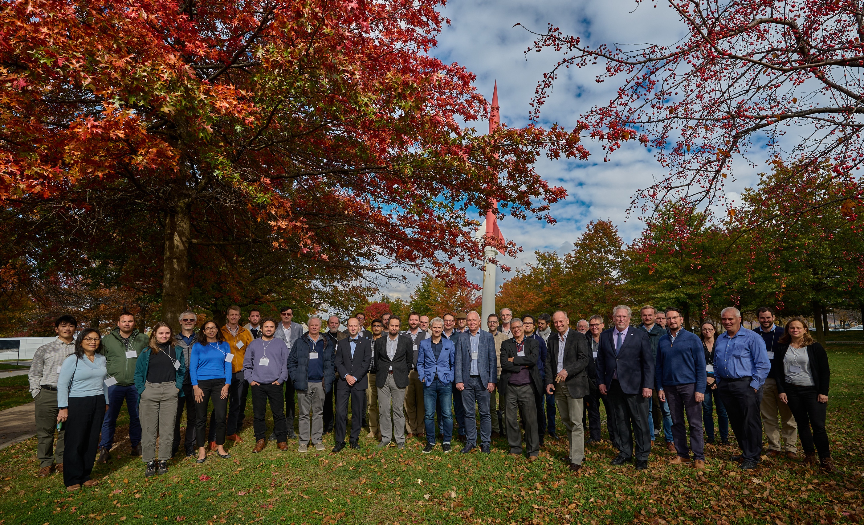
SAR Subgroup update
Fall 22 meeting
Hosted by Stephane Cote at CSA HQ, Montreal, Canada.
Mostly in person, but some remote participation
Approximately 40 participants
One day special session for S1 ARD workshop.
Sessions:
Calibration of ongoing missions
Calibration of future missions
Calibration targets
ARD format and systems
SARCalNet
Slide 3

Slide 4
SAR Subgroup update
ARD workshop
Focus was on the development of RTC products from Sentinel-1 data by ESA, NASA, and DLR.
CEOS ARD for SAR data
We discussed the addition of an ocean radar backscatter PFS and other topics
After this meeting, the CEOS ARD group continued the discussion
A harmonized SAR PFS is now being developed.

Slide 5
SAR Subgroup update
Chair Nominations
We have not yet had a meeting or group email exchange to discuss.
Next meeting to be hosted by Jens Reimann and Patrick Klenk at DLR in Oberpfaffenhofen, Oct 16-18, 2024.
Abstract submissions are open until July 15.
WGCV Deliverables
CV-23-02 – SARCalNet: Establishment of initial SARCalNet processes and network initiation
Projected completion in Q1 2024 is on track

Slide 6
SARCalNet
The SAR subgroup has a small group of about 20 volunteers working on the documents such as defining SARCalNet requirements.
Meet via Webex every 6-8 weeks to discuss progress
Documents on an ESA Sharepoint:
SARCalNet Handbook
SARCalNet website requirements
SARCalNet submission template
Requirements:
Requirements for artificial targets
Requirements for natural targets
Requirements for imager calibration analysis

Slide 7
SARCalNet
Handbook
Authors: Muriel Pinheiro, Antonio Valentino, Paolo Castracane
Describes general information on the SARCalNet initiative including a description of its organization and of relevant procedures.
We will have to formally create the SARCalNet working group
This document is mature but needs to be carefully reviewed prior to publication
To be undertaken this summer

Slide 8
SARCalNet
Submission templates
The document for artificial targets makes clear what information is required for a reflector array to be a part of SARCalNet, and to simplify the submission/approval process by making a common format.
Separate sections that describes the site, the corner reflectors that make up the array, and the results of each survey of the reflectors.
This document is mature but needs to be carefully reviewed and the data ingestion procedure tested.
Need to coordinate testing with the website team.
There is also a submission template for distributed targets, but this will likely be deferred until after artificial target submissions are fully tested and ready to go.

Slide 9
SARCalNet
Target requirements
Artificial targets
Main authors: Matt Garthwaite, Shweta Sharma, Jens Reimann
Describes the different calibration objectives for artificial targets, and the constraints on the targets based on those objectives.
This document is still being written. Need to add active targets and requires some editing.
Hope to complete before Fall 2023 meeting.
Natural targets
Main authors: Patrick Klenk
Needs further development, contains description of the different types of natural targets for various calibration objectives.
Hope to have a draft ready for review by Fall 2023 meeting.

Slide 10
SARCalNet
Image calibration analysis requirements
Main Author: Marc Thiebold
Describes calibration analyses for both natural and artificial targets and allow comparison between sensors
Analysis of the impulse response function
Polarimetric parameters
Antenna patterns
Noise levels
This is a mature document but must be thoroughly reviewed.
Targeting completion before fall meeting.

Slide 11
SARCalNet
Website requirements
Primary author: Paolo Castracane
This document describes the composition and functionalities of the proposed website such as
A specific webpage for each calibration site
information on adding/discontinuing sites
tools to ingest data
access rules
collecting stats
This document is mature, but needs a final review
Target reviews for this summer

Slide 12
SARCalNet
Implementation
Acceptance of the first draft of the requirements documents and other documents by the SAR subgroup membership.
Publish SARCalNet documentation on the subgroup website
Test webpage functionality
Test ingestion of multiple calibration sites
Form working group for SARCalNet
Duties of this group are described in the SARCalNet handbook
Invite community to submit calibration sites

Slide 13
SAR Subgroup update

