Slide 1
CEOS Analysis Ready Data (CEOS-ARD)

Slide 2
Presentation Overview
Recent updates (OGC ARD SWG, ISO, ARD23 Workshop)
Surface Reflectance ARD Equivalency – CEOS Interoperability Framework 'Pathfinder'
Discussion / Decision: Confirm alternate PoC for CEOS-ARD evaluations

Slide 3
Recent Updates
OGC ARD Standards Working Group was approved May 3.
ISO counterpart approved May 23.
OGC ARD SWG will have its next hybrid meeting at the 126th OGC member meeting in Huntsville, Alabama in the first week of June.
ISO has designated the ARD series of standards to be ISO 19176.
ISO 19176-1 is the first Part
CEOS contacts will follow the ISO 19176 development
Additional representation welcome
Getting Part I right will be critical.

Slide 4
Analysis Ready Data - OGC ARD SWG
Formal standard development processes of both ISO and OGC
Geospatial ARD standards
Using CEOS Analysis Ready Data as the basis
OGC ARD SWG
Initial release of the candidate Standard for review in the first quarter of 2024.
Approved by OGC – 1st official SWG meeting will occur at the June OGC Members Meeting in Huntsville
ISO has designed ARD series of standard to be ISO 19176
ISO 19176-1: Geographic information — Analysis Ready Data — Part 1: Framework and Fundamentals
Two-year development period
Expected to be published as an ISO and OGC standard in June 2025

Slide 5
Recent Updates
ARD23
CEOS-ARD OG and LSI members attended the ARD23 meeting May 16-18.
Industry organised ARD and related topic focused meeting. This is a critical engagement opportunity for CEOS-ARD and is a clear example of CEOS working team engagement with New Space.
In the margins of ARD23, CEOS-ARD OG and LSI members organised a meeting around the STAC specification, with the aim of better understanding this community specification and its implications for CEOS-ARD discoverability and accessibility and CEOS data in general.

Slide 6
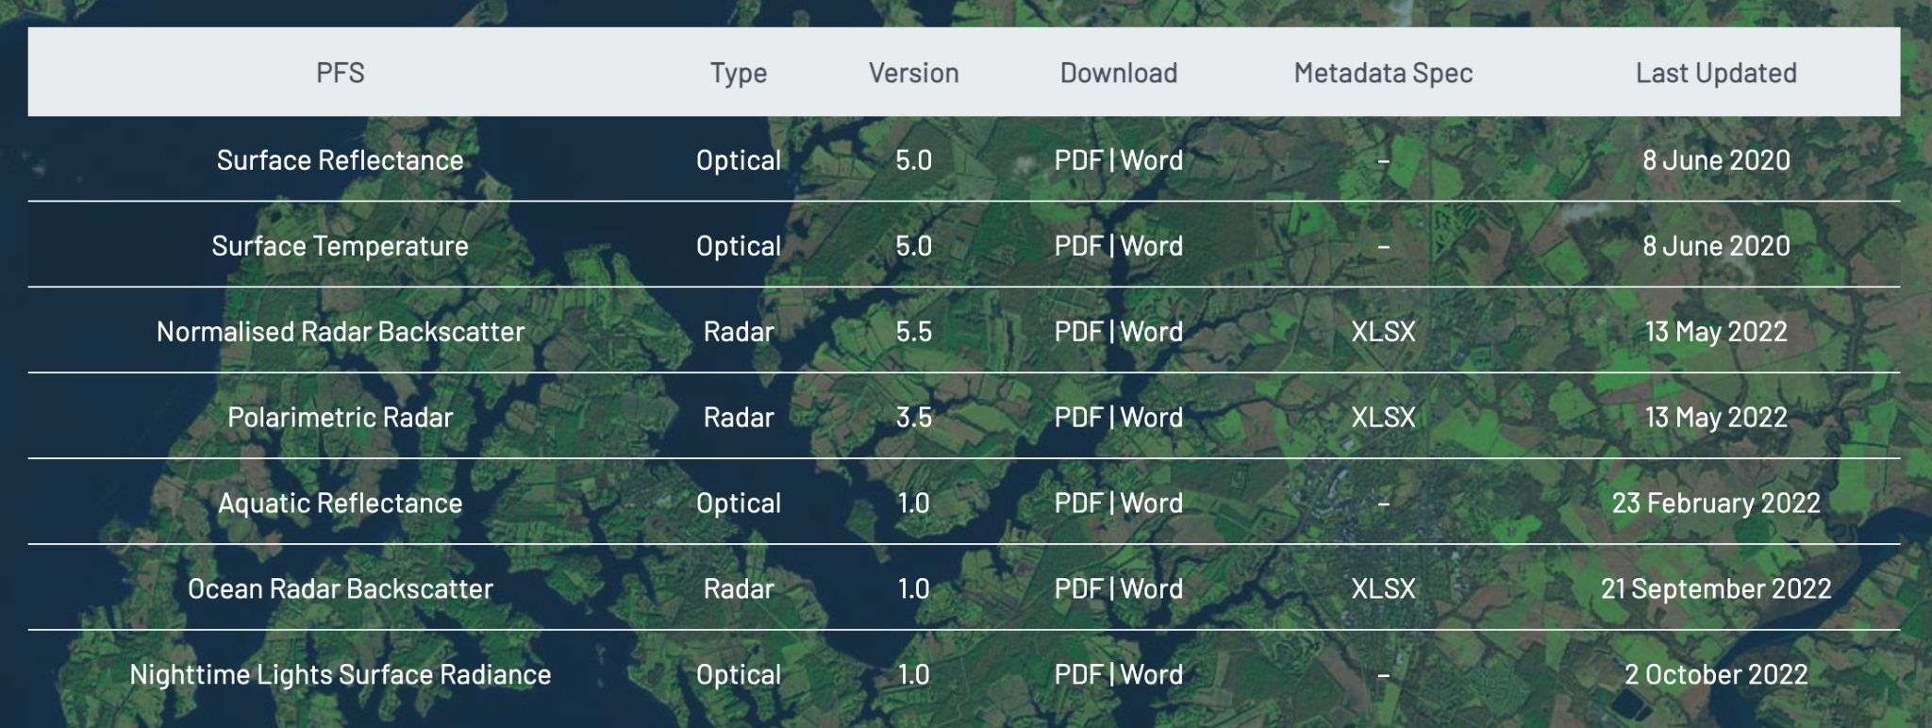
Current + In-development CEOS-ARD Specifications
Land
Inland and Coastal Waters
Oceans
Optical
Surface Reflectance
Surface Temperature
Nighttime Lights Surface Radiance
LiDAR Terrain and Canopy Top Height
Radar
Normalised Radar Backscatter
Polarimetric Radar
Geocoded Single-Look Complex (GSLC)
Interferometric Radar (INSAR)
Aquatic Reflectance
Ocean Radar Backscatter
http://ceos.org/ard/index.html#specs

Slide 7
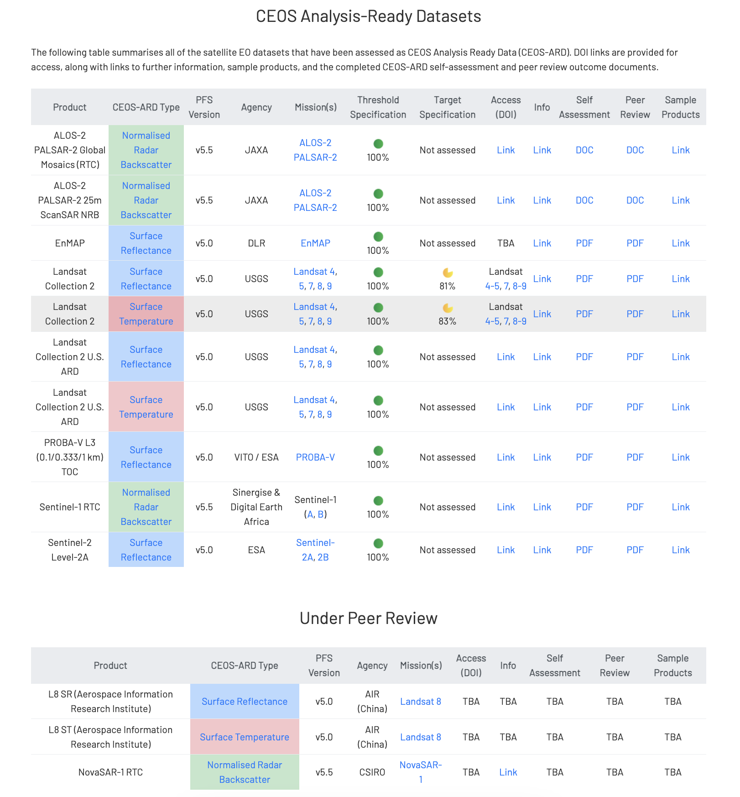

Slide 8
ISO ARD Roadmap
Defining overall structure of ARD series, the common structure and metadata, common preprocess/format/etc requirements
Allows other parts to plug in
Part 2 work will start when part 1 working draft is ready for review (expected one year after part-1 project starts-2024)
Other parts of the standards can start simultaneously if resources allow

Slide 9
Some open questions in LSI-VC / CEOS-ARD OG
Surface Reflectance ARD Equivalency – CEOS Interoperability Framework 'Pathfinder' ?
Versioning
Specification update cadence
CEOS-ARD inheritance
Derived datasets
Replicas
Discovery, Access and Promotion
STAC
Promoting datasets’ CEOS-ARD compliance on major data mirrors

Slide 10
Endorsement: Confirm alternate PoC for CEOS-ARD peer review evaluations
Clement Albinet of ESA has kindly offered to serve as alternate PoC for CEOS-ARD evaluations
Will form WGCV CEOS-ARD peer review team with Medhavy and Peter Harrison (GA)
Redundancy and additional support, acceleration of reviews
WGCV-52 Decision: Endorse Clement’s nomination
Thank you very much to Clement and ESA !

Slide 11
Thank you!

